Slide 1
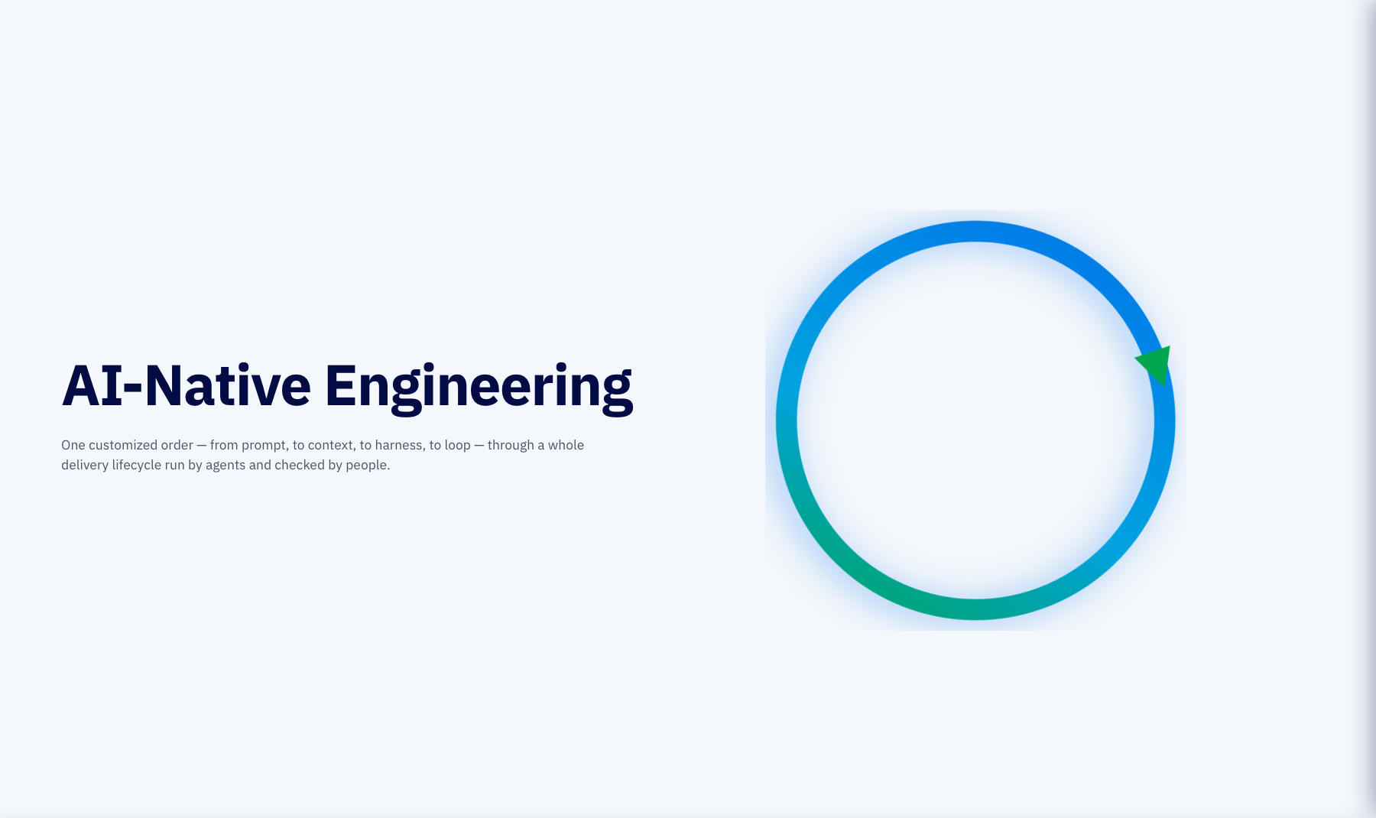
Notes:
Title (0 min)
Seventy-six minutes and one lens. Working with agents has moved outward four times: from the words you type, to the context the model sees, to the harness one run lives in, to the loop that repeats, checks, retries and stops that run without you on every turn. We start with one customer placing one customized order and never leave it. First the order becomes context: a spec. Then the smallest loop builds from it. Then every stage of a real delivery lifecycle is added, and at each one we name which of the four loop decisions it enforces and what the human signs. By the end the whole SDLC is one engineered loop on screen.

Slide 2
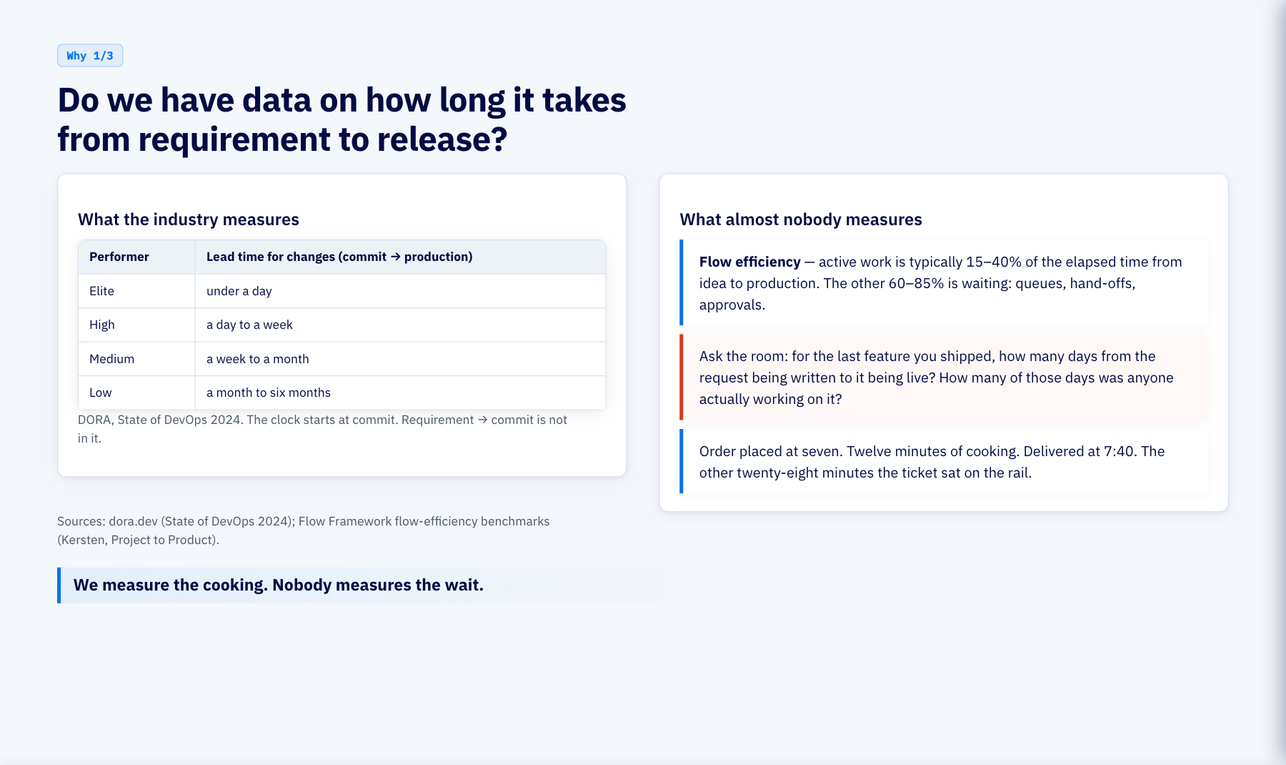
Notes:
Why · the clock (2 min)
Honest answer first: we do not have this number, and almost nobody does. DORA measures commit to production and puts elite teams under a day, low performers at one to six months; but that clock starts at commit, after the requirement has already been written, argued, re-written and scheduled. The flow-efficiency research says active work is fifteen to forty percent of elapsed time; the rest is waiting between hand-offs and approvals. Ask the room for their own number. Kitchen: twelve minutes of cooking, forty minutes to the door.

Slide 3
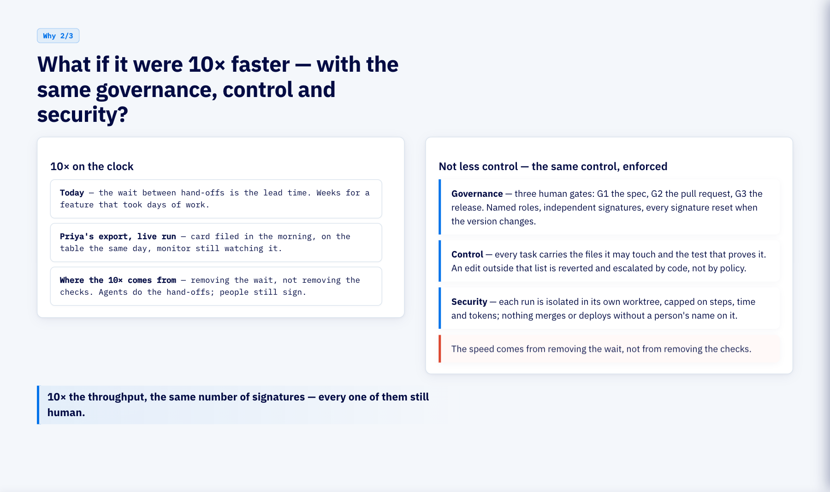
Notes:
Why · 10× with the same control (2 min)
The claim is not fewer checks. It is the same three gates, the same named roles, the same audit trail, with the waiting between them removed because agents do the hand-offs and code does the checking. In the live run Priya's export went from card to table in a day. Governance: three gates. Control: touch lists and tests per task, enforced by code. Security: isolated worktrees, hard caps, human sign-off before anything moves. Kitchen: the same head chef still reads every ticket; the ticket just stops sitting on the rail.

Slide 4
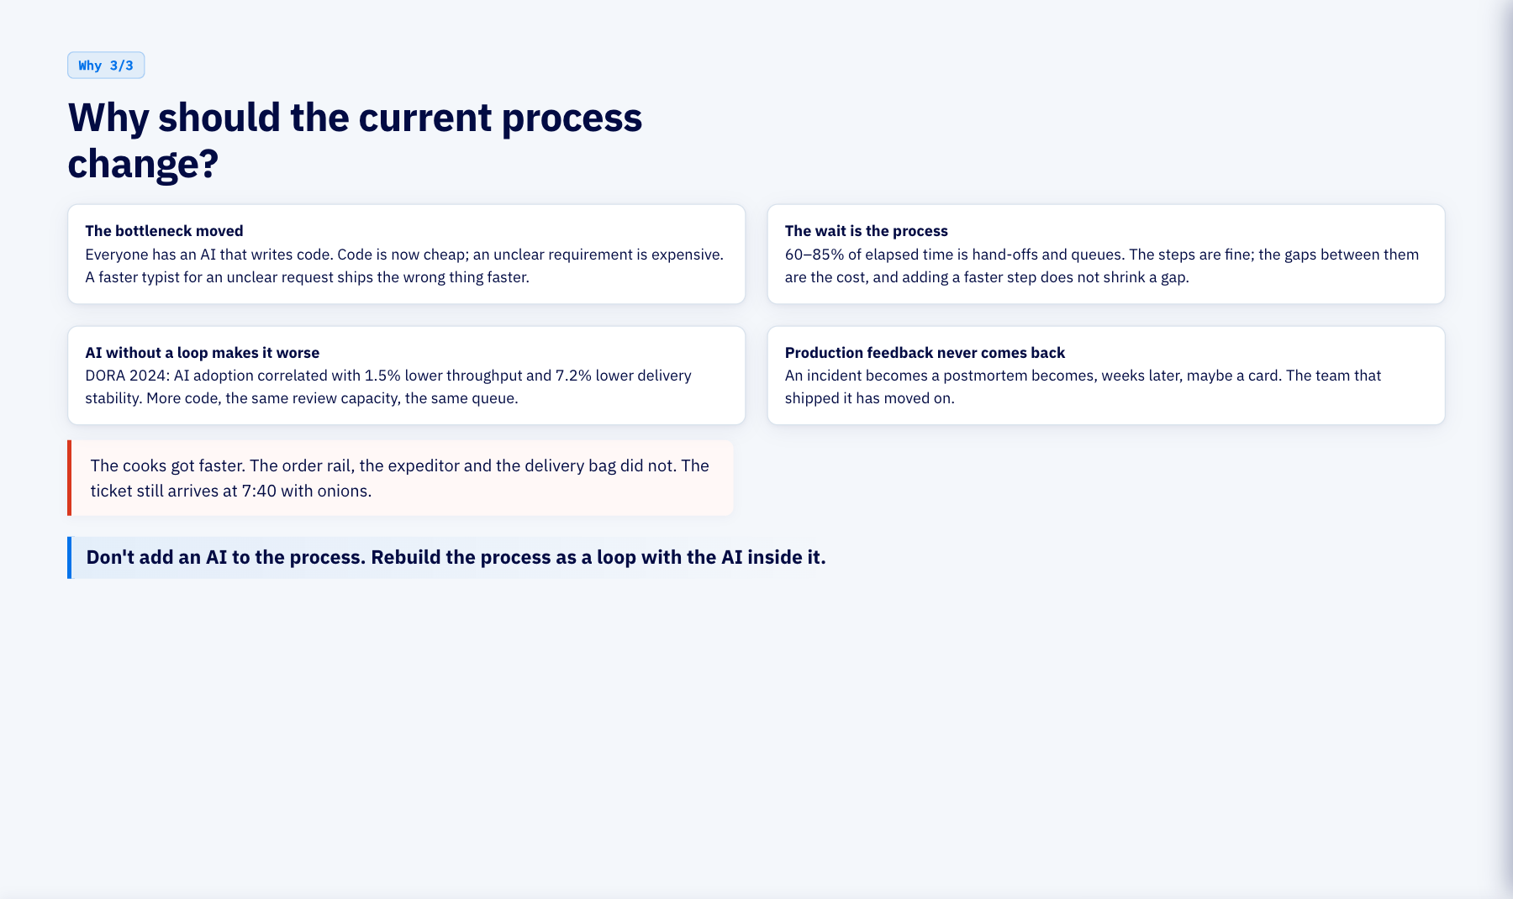
Notes:
Why · change the process (2 min)
Four reasons the process itself has to change, not just the tooling. The bottleneck moved from typing to understanding. The wait, not the work, is the lead time. Dropping AI into the old process makes the queue longer, and DORA measured that. And production never talks back to the backlog on its own. Every stage from Course 9 onward answers one of these four.

Slide 5
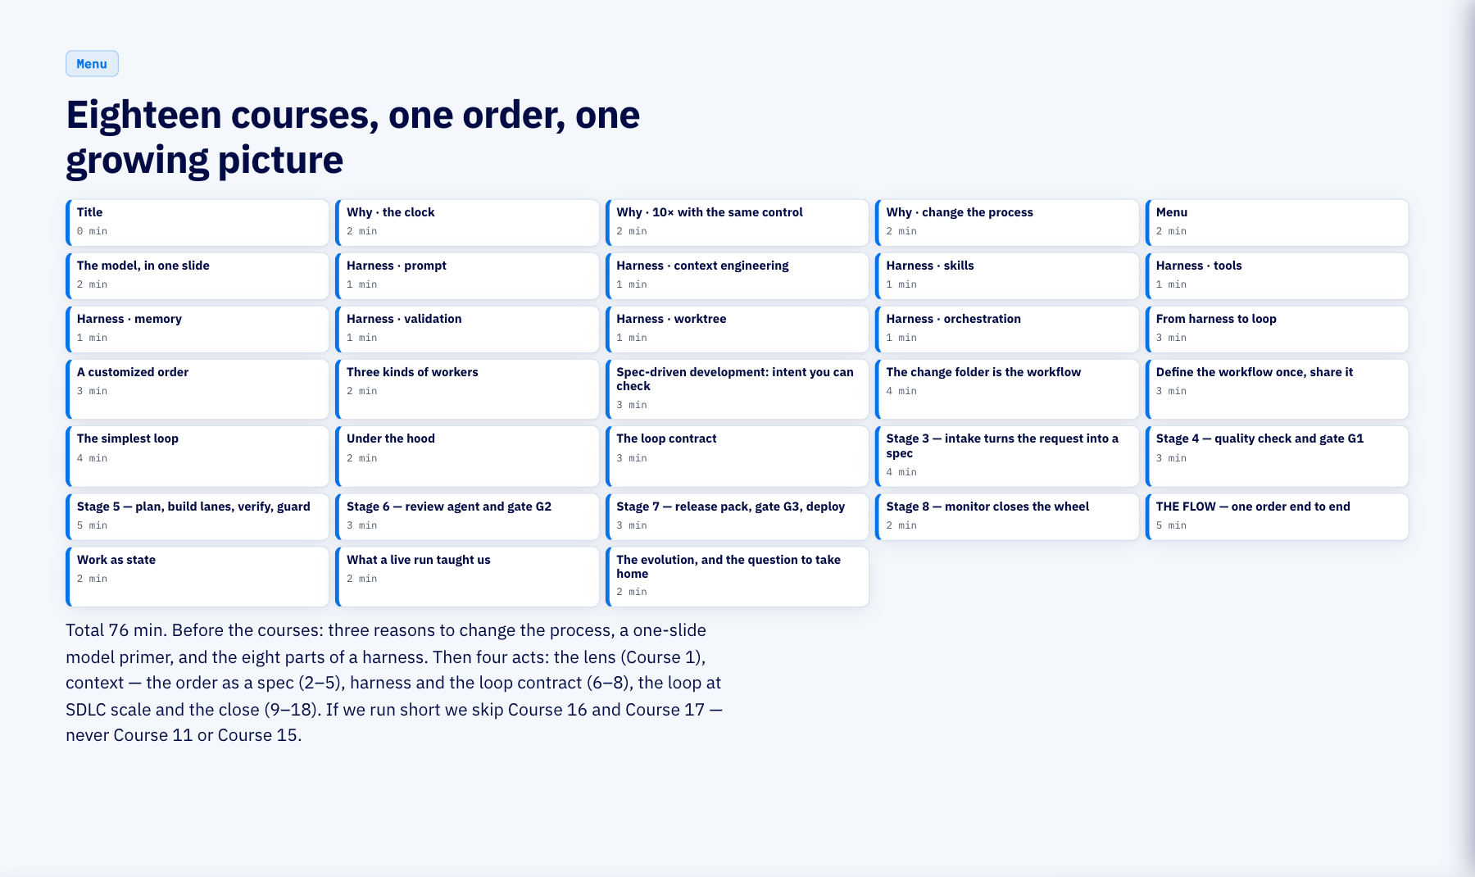
Notes:
Menu (2 min)
An opener, then four acts. First the lens: the four-layer map from prompt to loop. Second context: spec-driven development — intent you can check, the change folder as the workflow, and the workflow defined once in files and shared. Third harness: the smallest loop that works, the equipment under it, and the loop contract that names what every later stage enforces. Fourth the loop at lifecycle scale: every stage tagged with the decisions it enforces, one order all the way round, and the question to take home. Course 16 and Course 17 are the ones we drop if we are short.

Slide 6
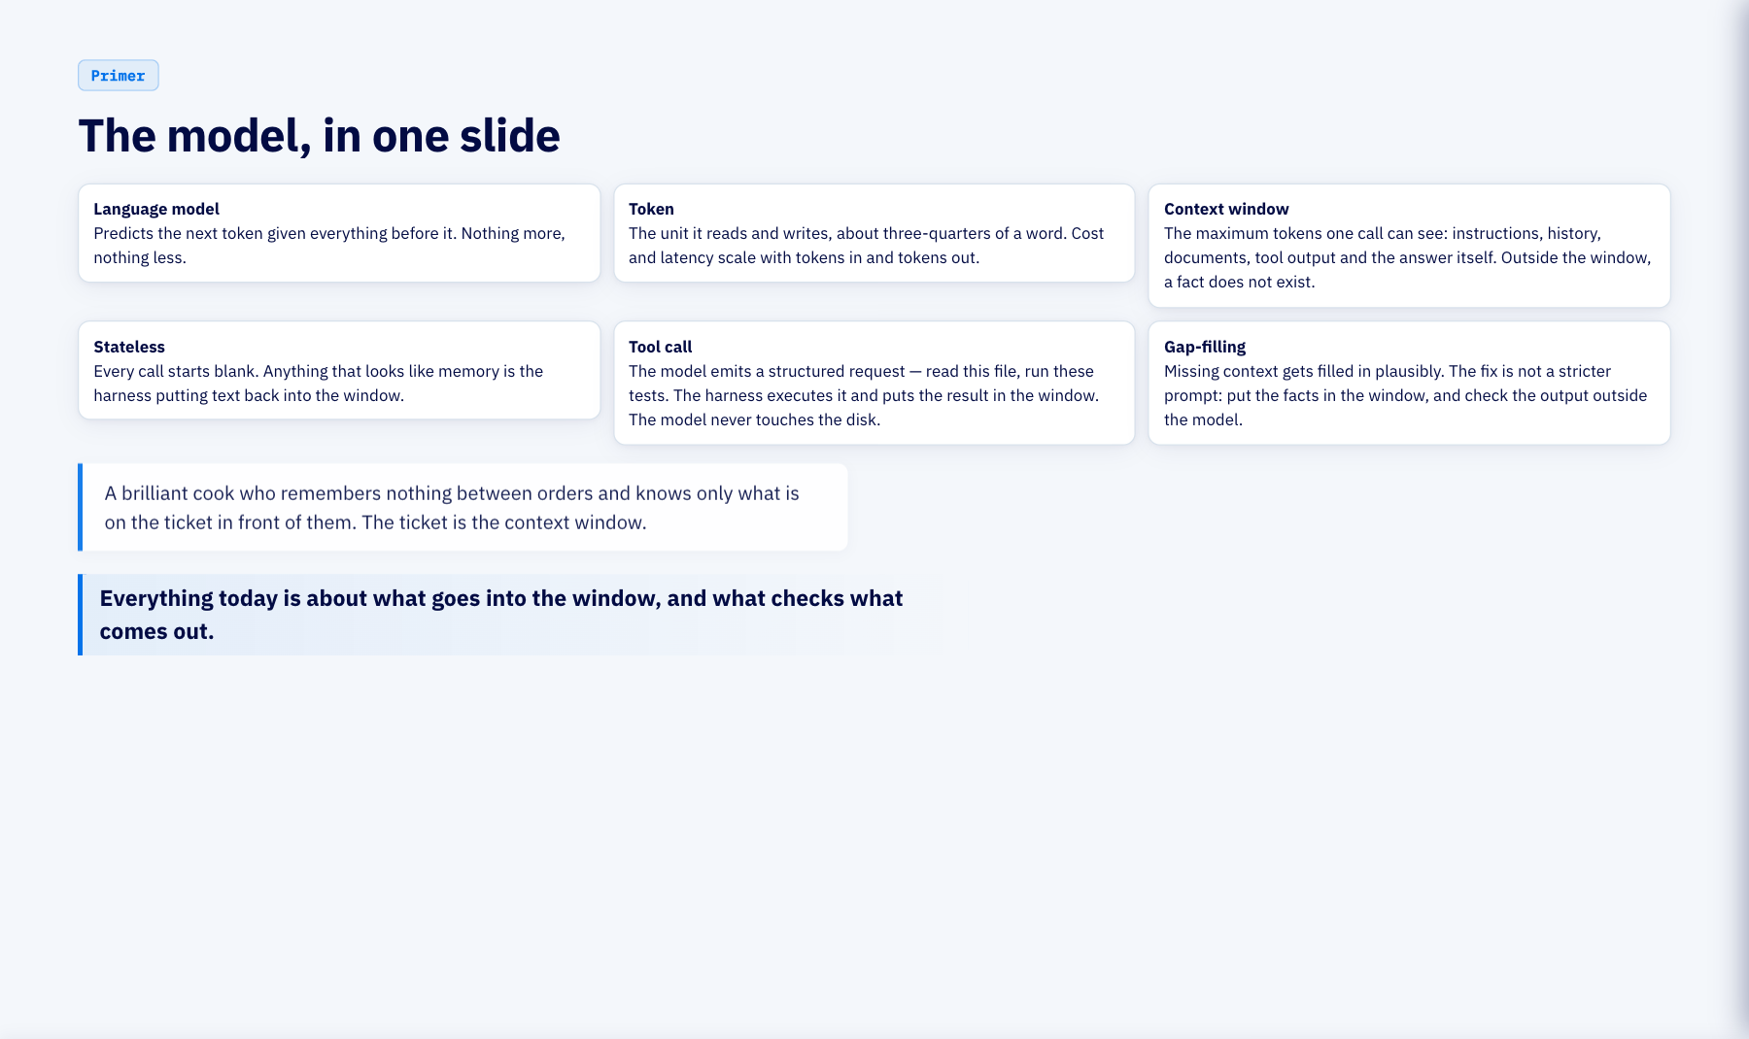
Notes:
The model, in one slide (2 min)
Six words, then we never define them again. A model predicts the next token. Tokens are what you pay for and wait for. The context window is everything it can see in one call; nothing outside it exists. Calls are stateless; memory is text the harness puts back. A tool call is a structured request the harness executes. And when context is missing the model fills the gap plausibly, which is why the answer is never a better prompt alone: it is putting the facts in the window and checking the output outside the model.

Slide 7
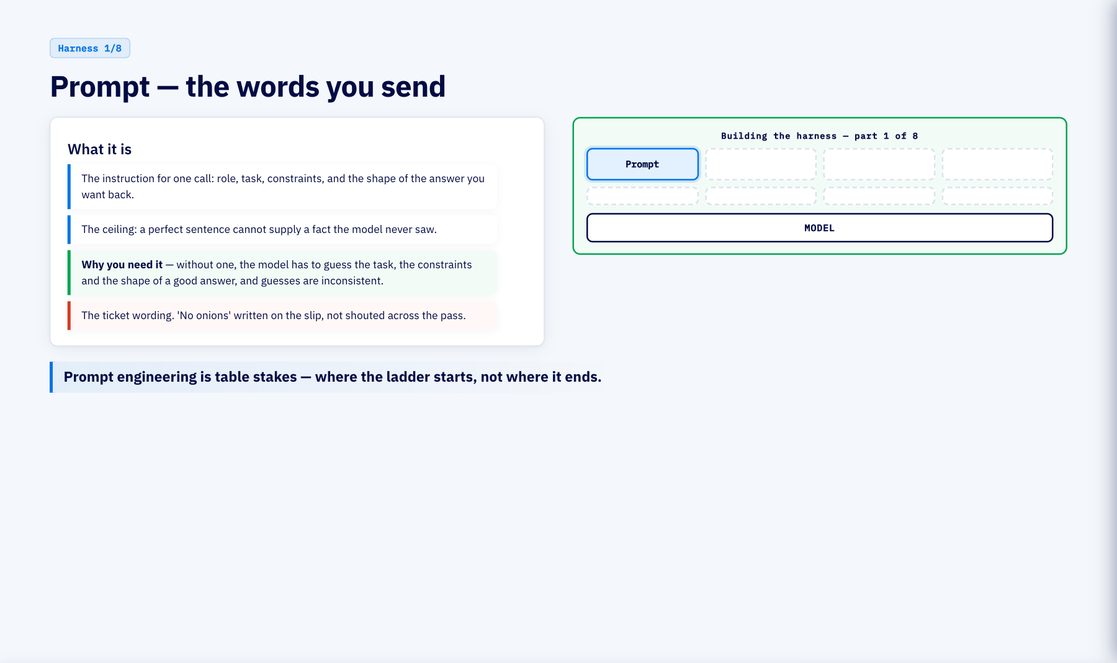
Notes:
Harness · prompt (1 min)
Layer one. A prompt is the instruction for one call. Its ceiling is hard: words cannot supply facts the model never saw. Without one, the model has to guess the task, the constraints and the shape of a good answer — and guesses are inconsistent.

Slide 8
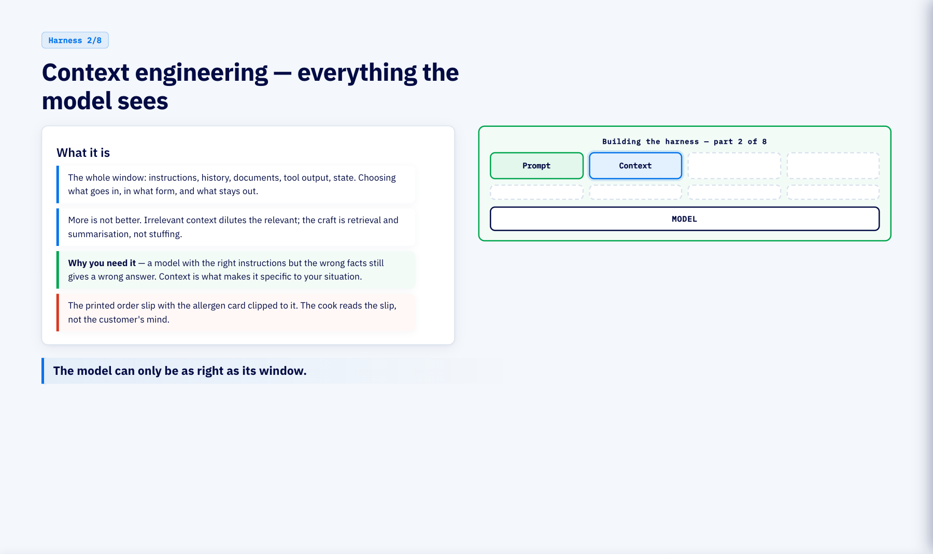
Notes:
Harness · context engineering (1 min)
Layer two. Context is everything in the window, and engineering it means choosing what goes in and in what form. A model with the right instructions but the wrong facts still gives a wrong answer; context is what makes an answer specific to your situation, not a generic one.

Slide 9
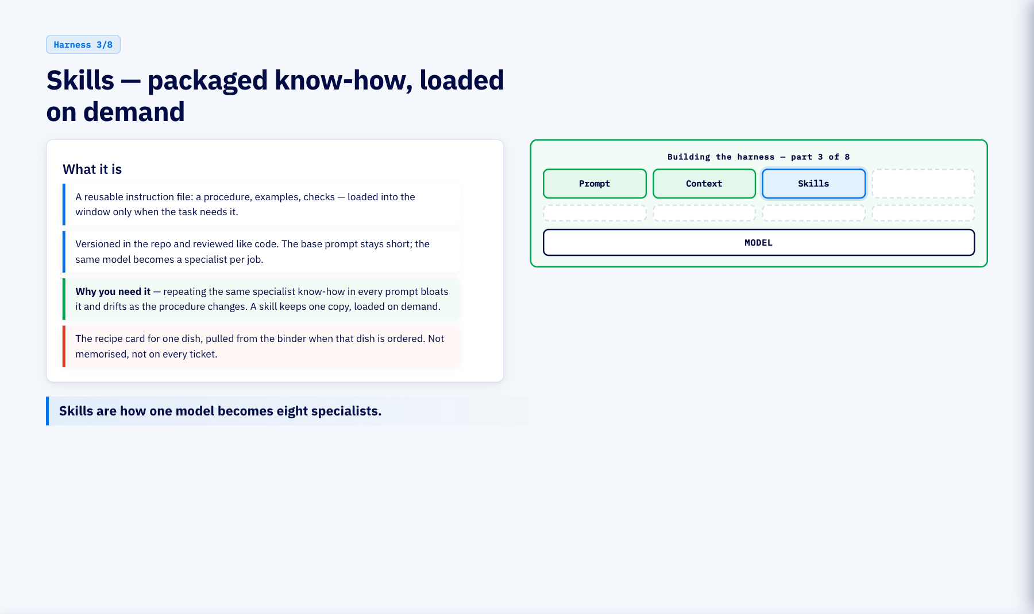
Notes:
Harness · skills (1 min)
Skills are packaged procedure: how this team does one kind of job, versioned and reviewed like code, loaded only when a task matches. Repeating the same specialist know-how in every prompt bloats it and drifts as the procedure changes; a skill keeps one copy, loaded on demand.

Slide 10
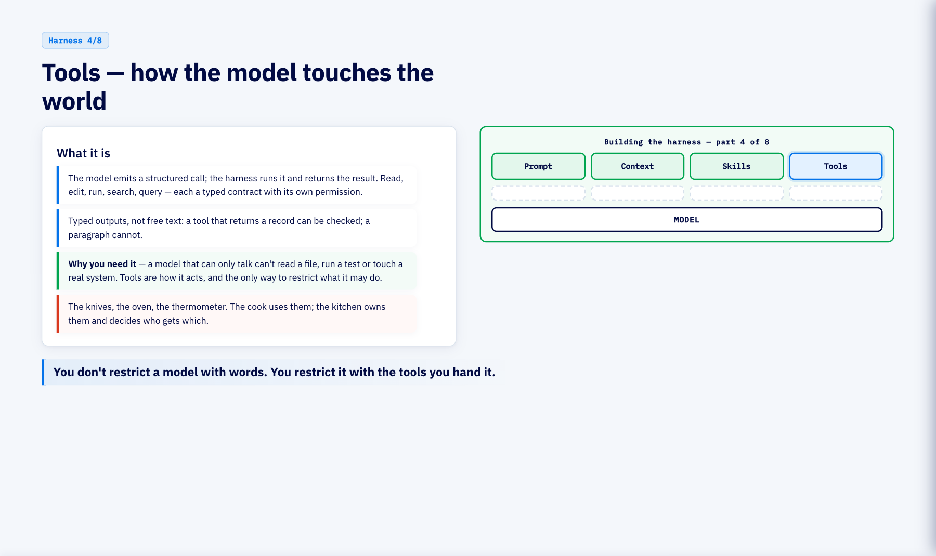
Notes:
Harness · tools (1 min)
Tools are how the model acts, and therefore where control lives. A model that can only talk can't read a file, run a test or touch a real system. The tool list is also the permission list — you restrict a model with the tools you hand it, not with words.

Slide 11
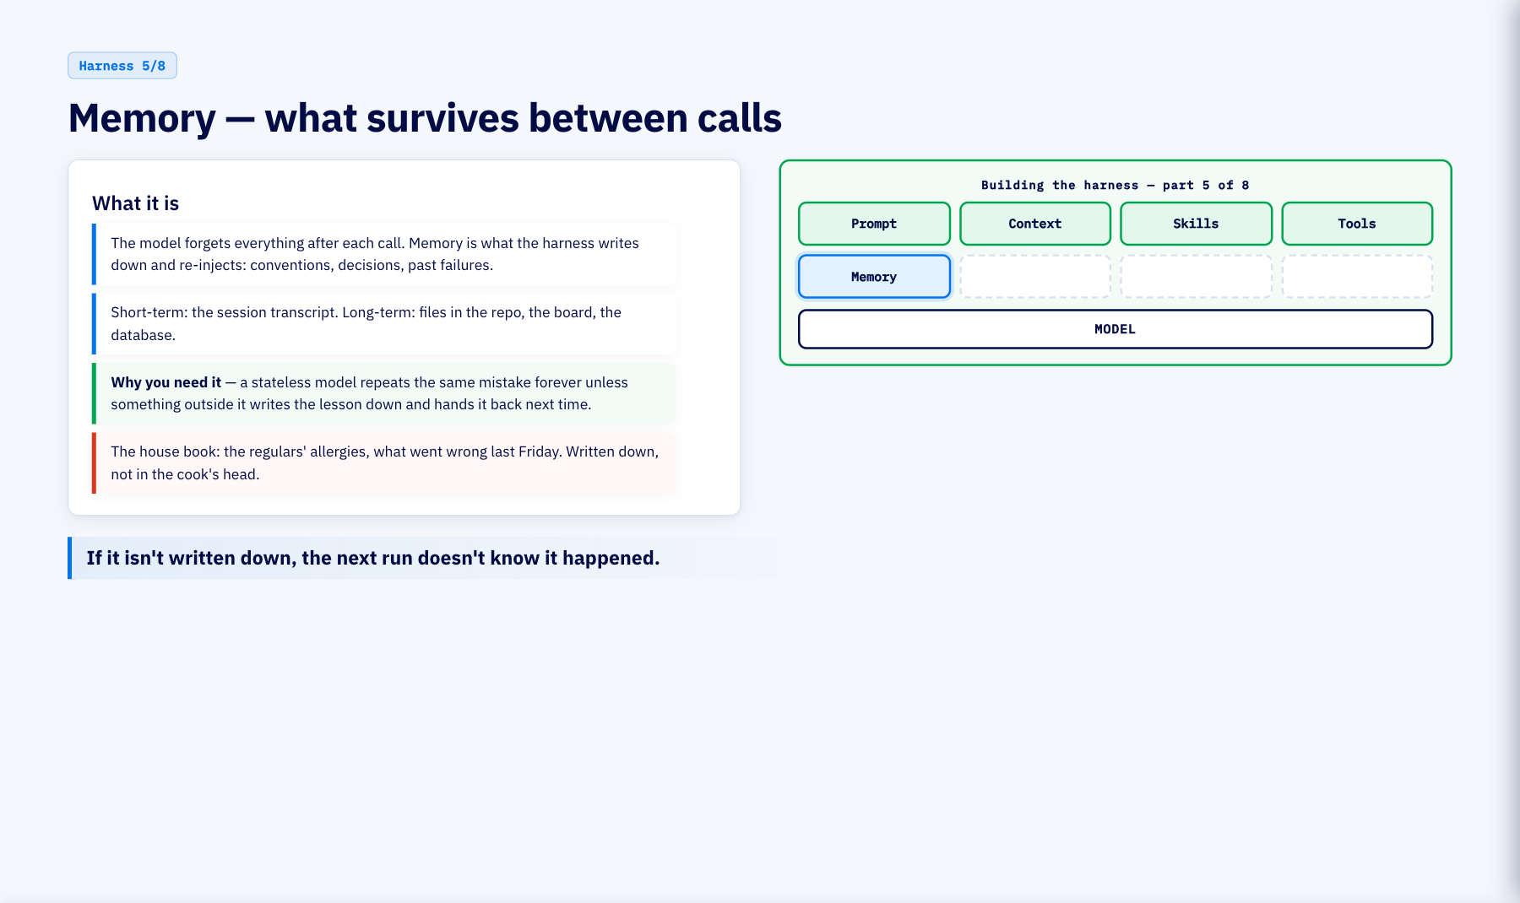
Notes:
Harness · memory (1 min)
Memory is not a model feature; it is a harness feature. A stateless model repeats the same mistake forever unless something outside it writes the lesson down and hands it back next time. Short-term is the transcript; long-term is files, the board, the database.

Slide 12
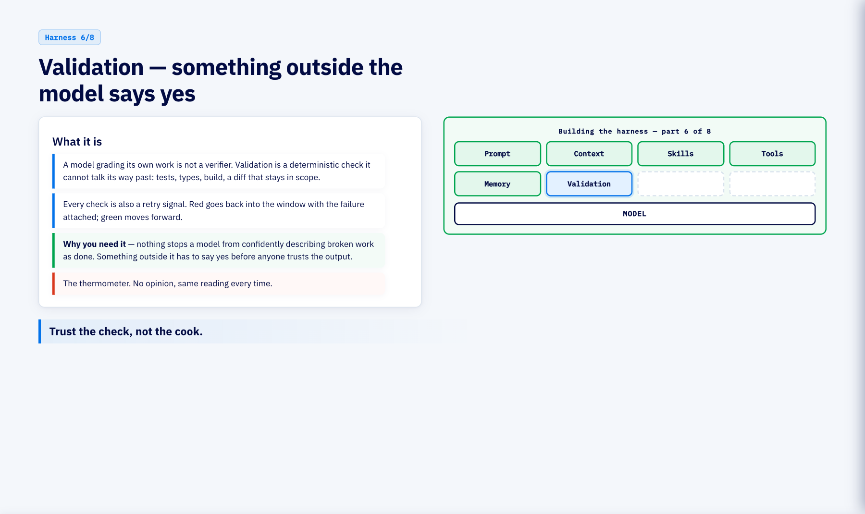
Notes:
Harness · validation (1 min)
Validation is the deterministic piece that makes every loop work. Nothing stops a model from confidently describing broken work as done; something outside it — tests, types, a diff that stays in scope — has to say yes before anyone trusts the output. Every check doubles as the retry signal.

Slide 13
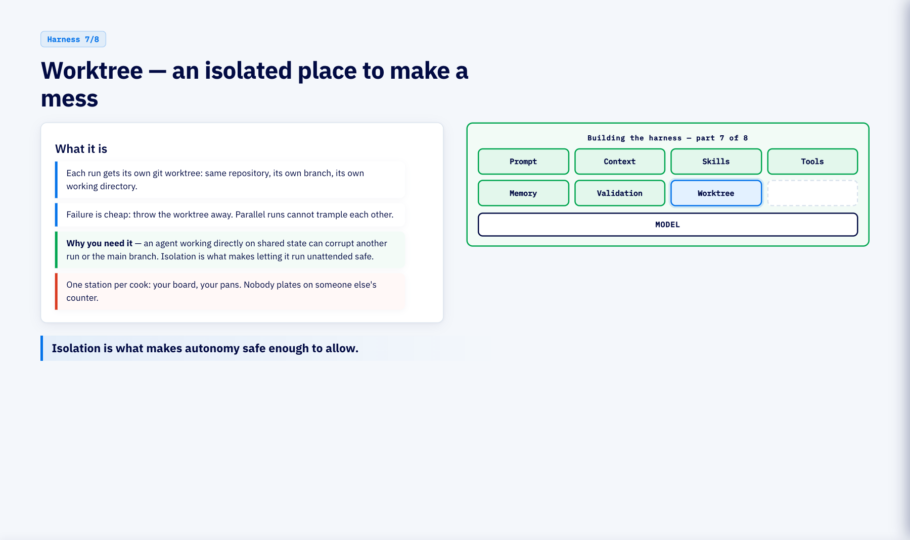
Notes:
Harness · worktree (1 min)
A worktree is the sandbox. An agent working directly on shared state can corrupt another run or the main branch; isolation is what makes letting it run unattended safe. Cheap to discard, invisible until pushed.

Slide 14
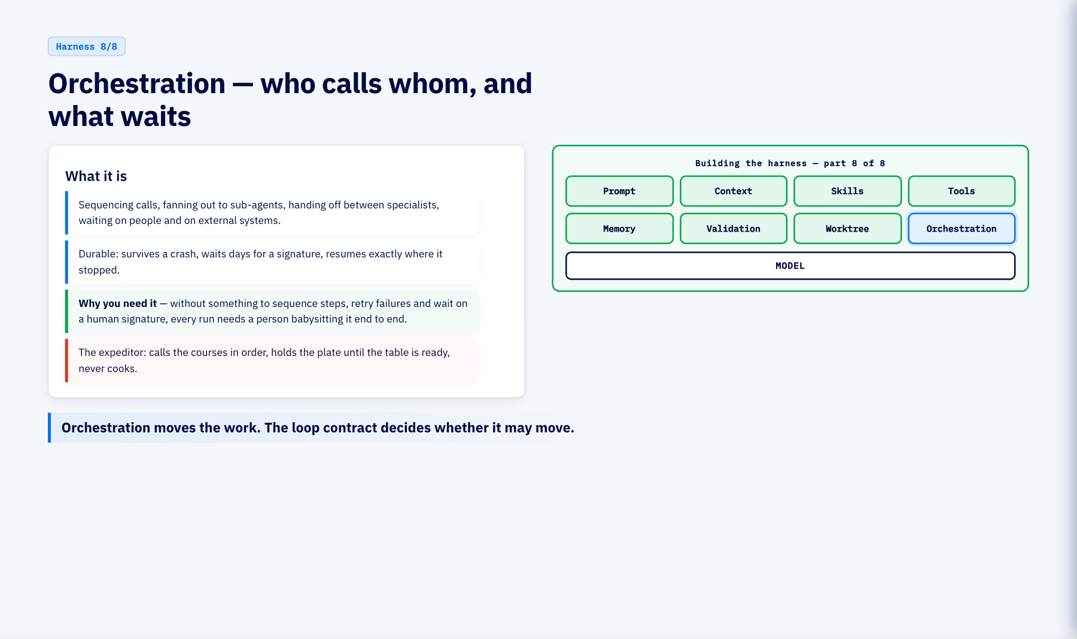
Notes:
Harness · orchestration (1 min)
Orchestration is who calls whom and what waits: sequencing, fan-out, hand-offs, durable waiting on humans. Without something to sequence steps, retry failures and wait on a human signature, every run needs a person babysitting it end to end. It is the visible half of a loop; the decisive half is the contract in Course 8.

Slide 15
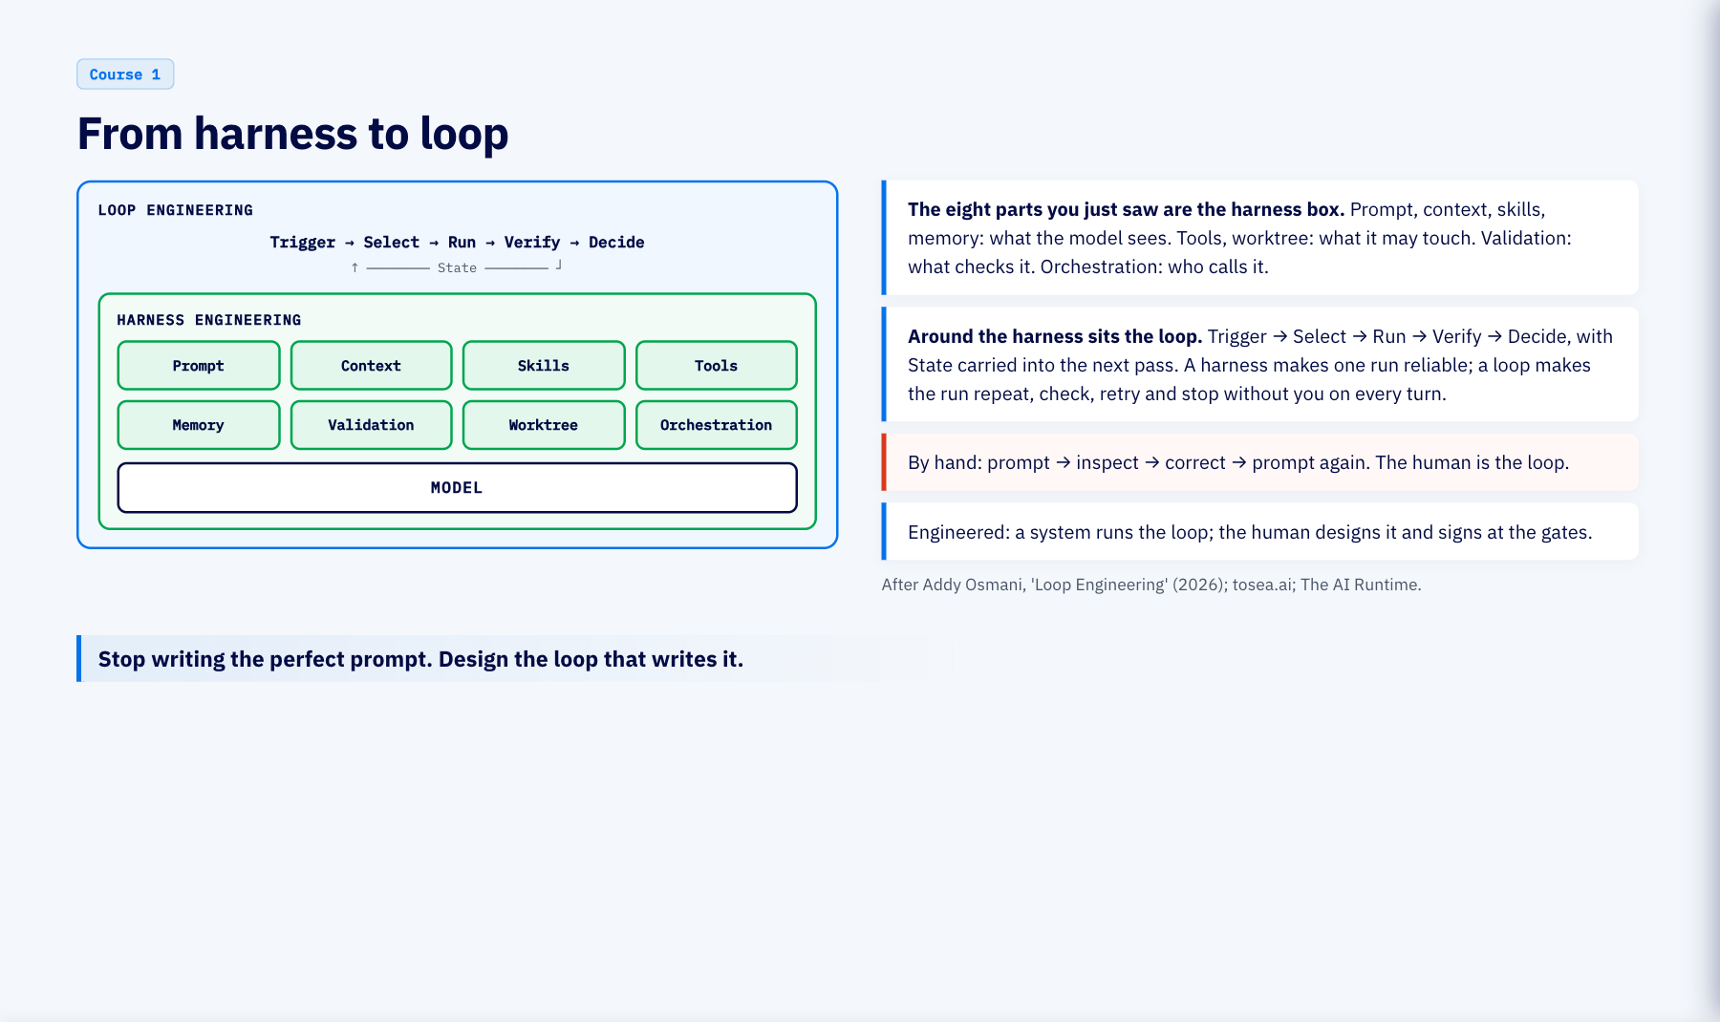
Notes:
From harness to loop (3 min)
The picture the rest of the hour builds on. Innermost, the model: it predicts tokens and nothing else. Around it the harness: the eight parts we just walked through, which make one run reliable. Around the harness the loop: trigger, select, run, verify, decide, with state carried between passes, which makes runs repeat, check, retry and stop without a human on every turn. By hand, the human is the loop. Engineered, a system runs the loop and the human designs it and signs at the gates. Course 6 shows the smallest one; Course 8 names its contract; from Course 9 every SDLC stage is one of these.

Slide 16
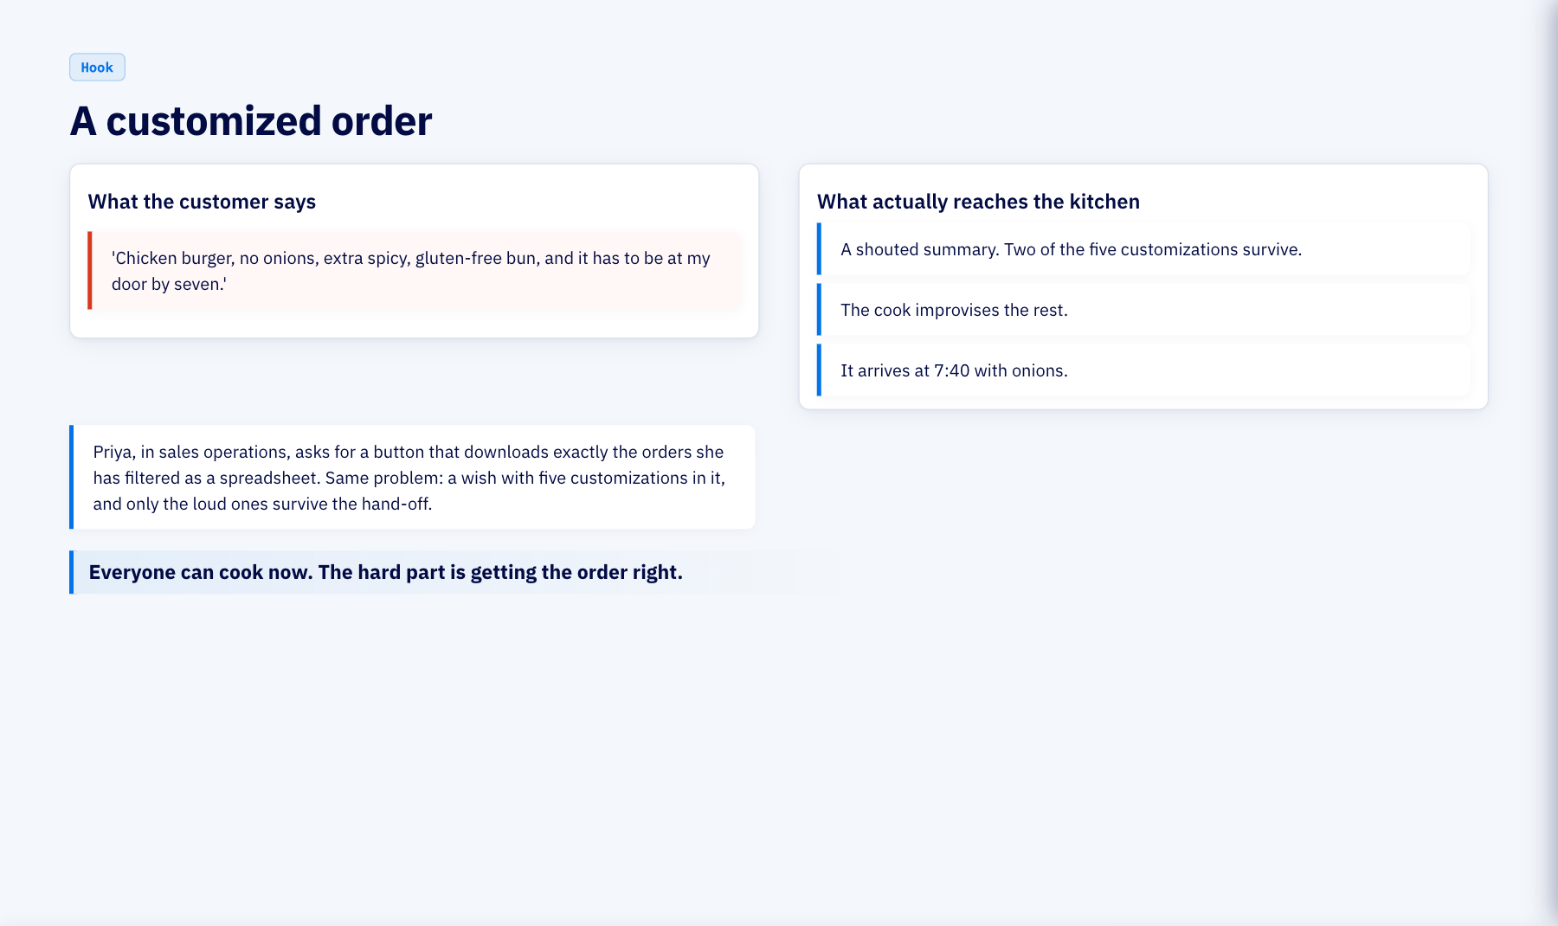
Notes:
A customized order (3 min)
A customized order is a perfect small example of a feature request: five constraints, all reasonable, none written down in a form anyone can check. Our real request for the next hour is Priya's: export the filtered orders view to CSV. It comes from a live run of this pipeline against a real repository. Everyone in this room has an AI that writes code. The order is still the bottleneck, and that is what we fix first.

Slide 17
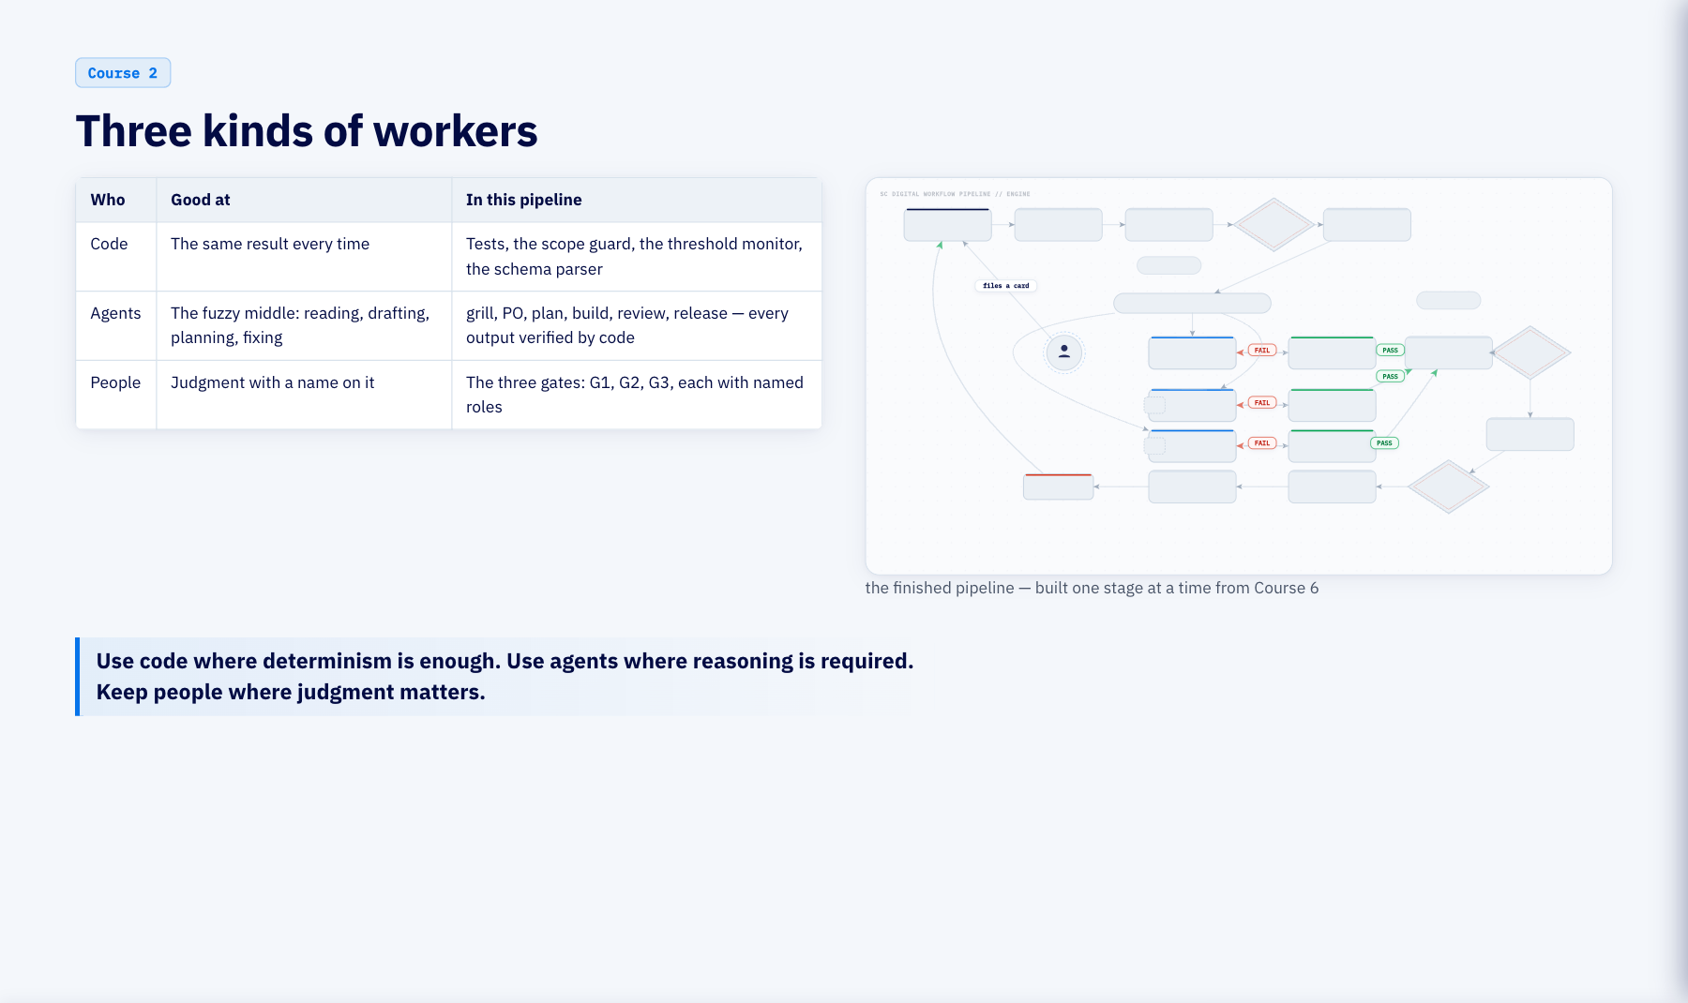
Notes:
Three kinds of workers (2 min)
Now the three kinds of workers behind everything you'll see today. Code is deterministic: the tests, the scope guard, the monitor threshold, the parser that reads the spec. Agents take the fuzzy middle: reading a request, drafting a story, planning tasks, building, reviewing. People own judgment: three gates, each with named roles. The gray picture is the finished pipeline. Do not read it yet.

Slide 18
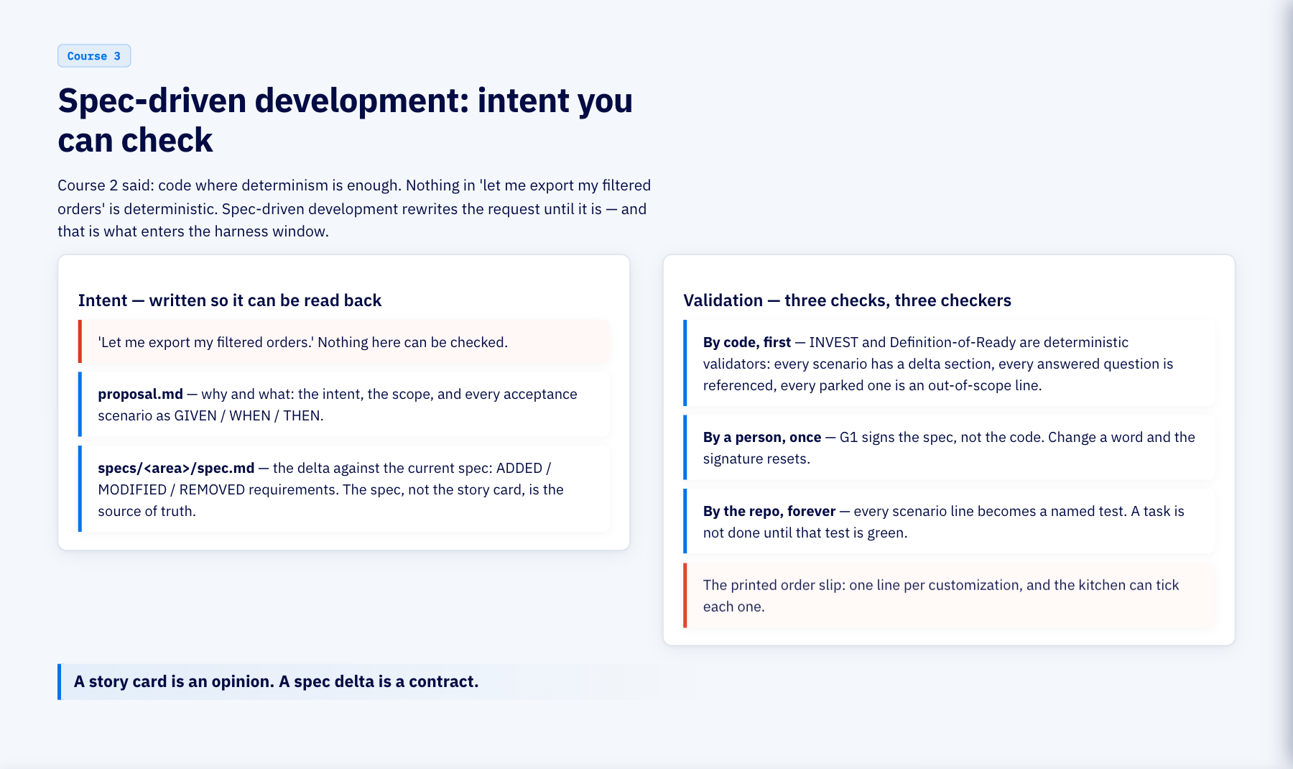
Notes:
Spec-driven development: intent you can check (3 min)
Bridge from Course 2: code where determinism is enough, and nothing in Priya's sentence is deterministic. Spec-driven development rewrites the request until it is, and that rewritten form is what enters the harness window. Two halves. Intent: the proposal says why and what; the delta says exactly what is added, modified or removed against the current spec, and the spec, not the card, is the source of truth. Validation: code checks the spec before a human reads it, because INVEST and Definition-of-Ready are deterministic validators; a person signs it once at G1; and the repo checks it forever, because every scenario line becomes a named test. Kitchen: the printed slip, one line per customization, and the kitchen can tick each one.

Slide 19
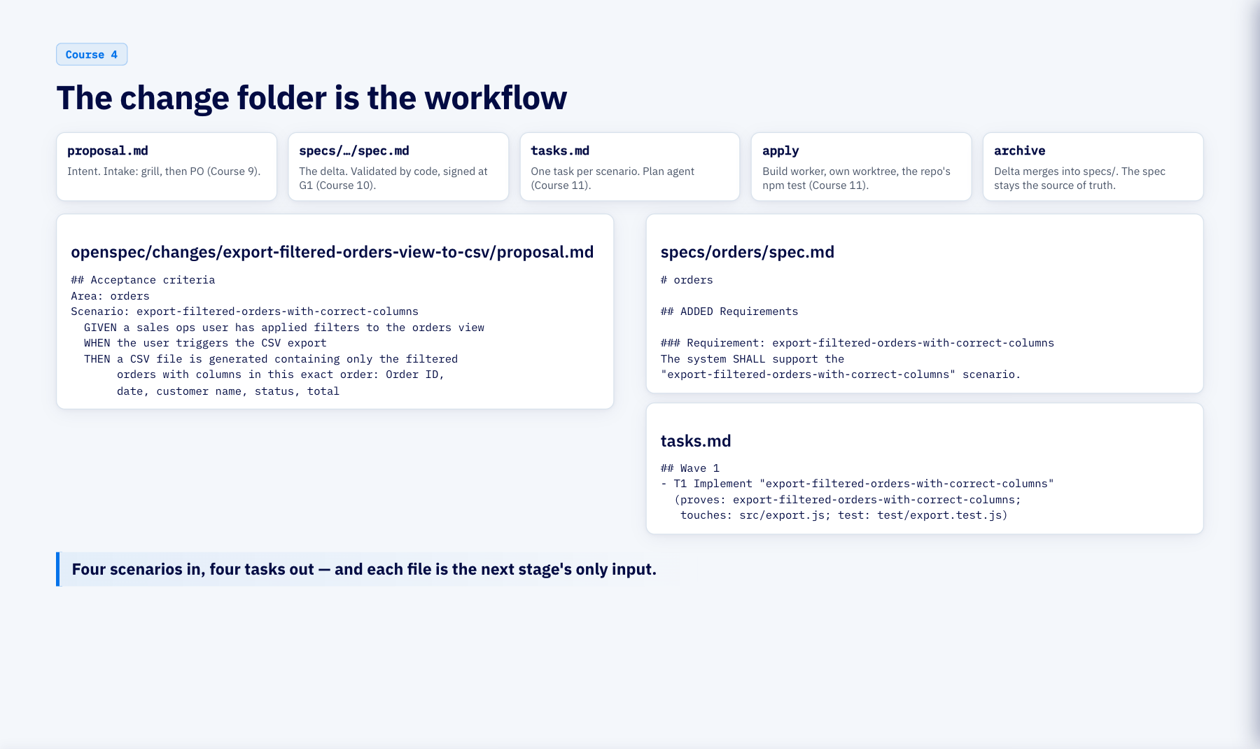
Notes:
The change folder is the workflow (4 min)
The OpenSpec change folder is not a document set, it is the workflow: each artifact is produced by one stage and is the next stage's required input, and a stage cannot start until the artifact it requires exists. Proposal from intake, delta from the PO agent and validated before G1, tasks from the plan agent, apply by the build worker in its own worktree, and when the change lands the delta merges into the main spec so the spec stays the source of truth. Below are the real files from the real run, unedited. Every task carries three facts: which scenario it proves, which files it may touch, which test proves it. Those three facts are the contract every later stage enforces.

Slide 20
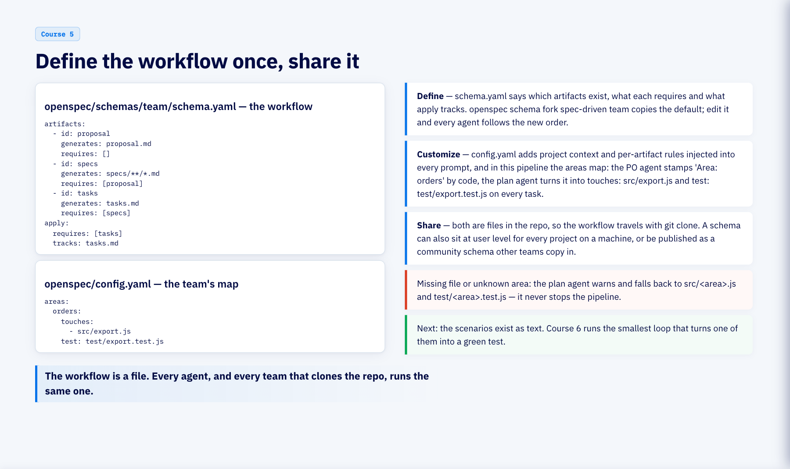
Notes:
Define the workflow once, share it (3 min)
Two files define the workflow, and both live in the repo. schema.yaml is OpenSpec's workflow definition: which artifacts exist, what each one requires, what apply tracks; fork the default and edit it, and every agent follows the new order. config.yaml is the team's customization on top: the default schema, project context and per-artifact rules injected into every agent prompt, and in this pipeline the areas map, which is how the area on a story becomes the files a task may touch and the test that proves it. The PO agent stamps the area deterministically; the plan agent resolves it through the map, and if the file or the area is missing it warns and falls back to a naming convention instead of stopping. Because both are files in git, sharing the workflow is git clone; a schema can also live at user level for every project on a machine, or be published as a community schema other teams copy in. Kitchen: the house recipe binder, written once, copied to every new kitchen the group opens. Bridge: the scenarios now exist as text; next course, the smallest loop turns one of them into a green test.

Slide 21
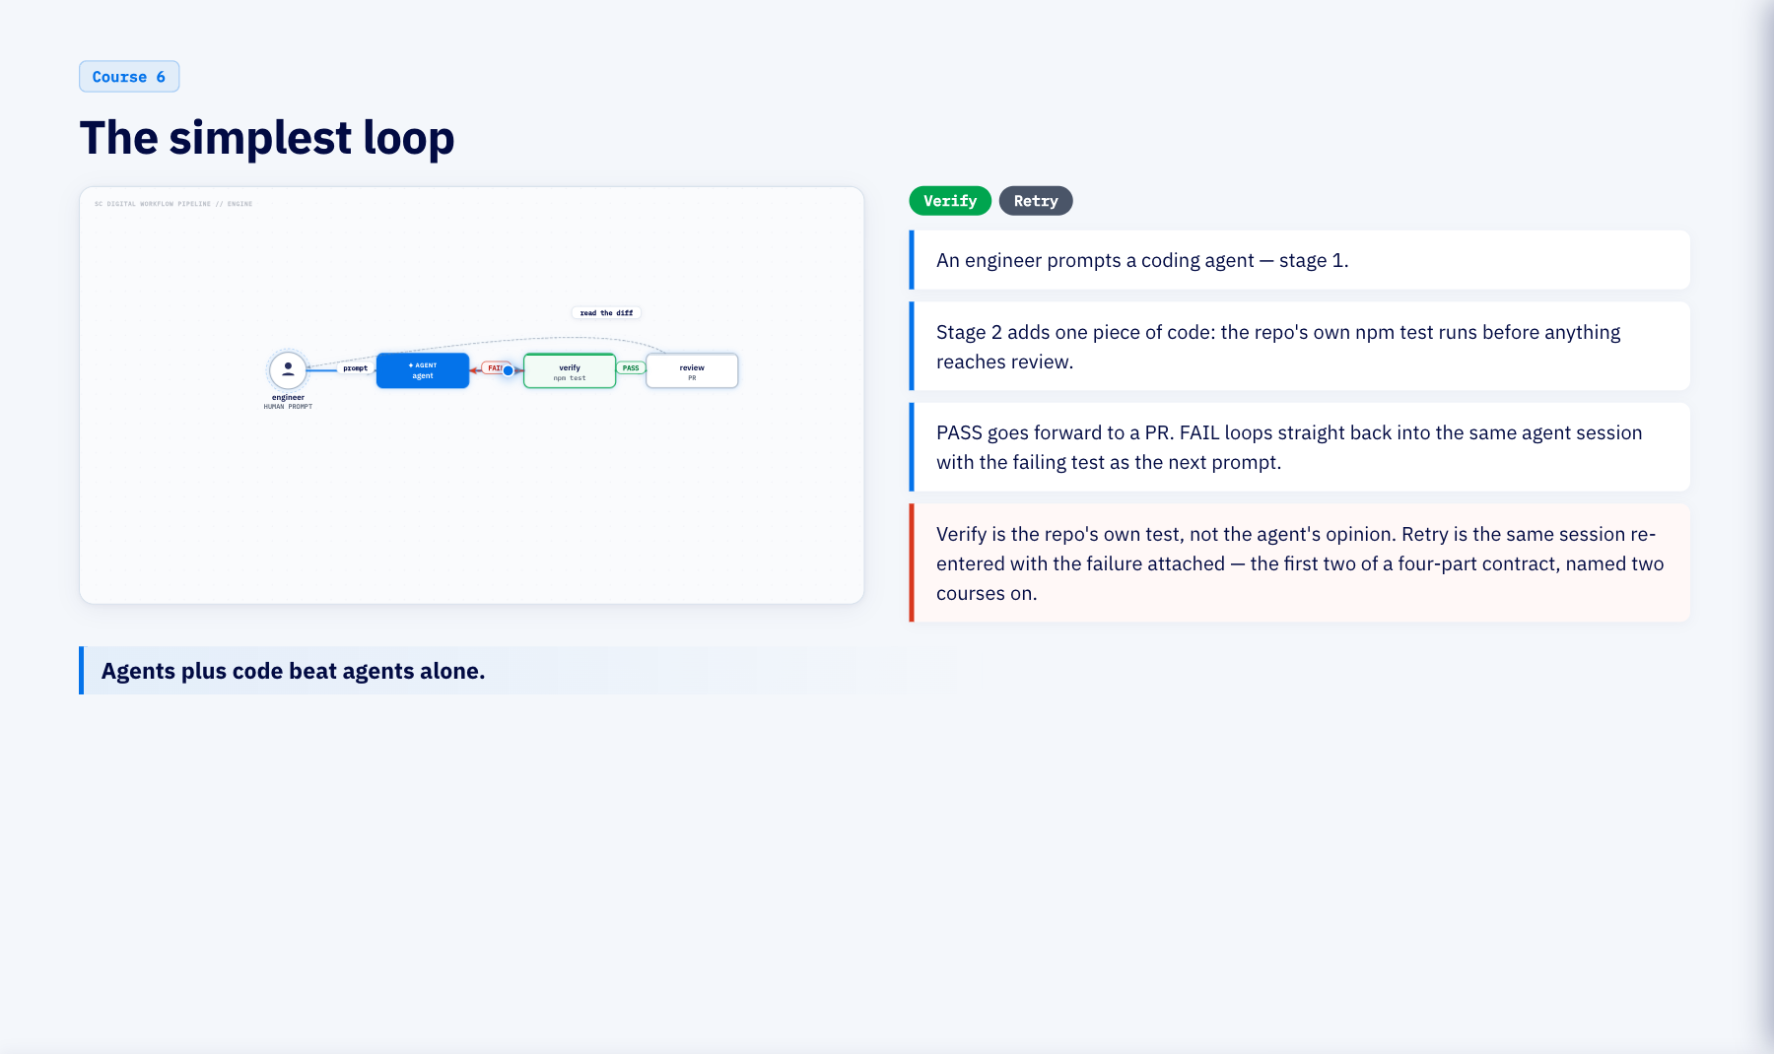
Notes:
The simplest loop (4 min)
This is the loop everyone talks about, and it works because of the one deterministic piece: the tests. The engineer prompts the agent. The agent edits. The tests run. Green goes to review; red goes back into the same session with the failure attached, and the agent retries against something true. Like a thermometer in the kitchen: no opinion, same reading every time. This is a first sighting of two loop-contract decisions — verify by code, retry into the same session — before we name all four formally, two courses from now.

Slide 22
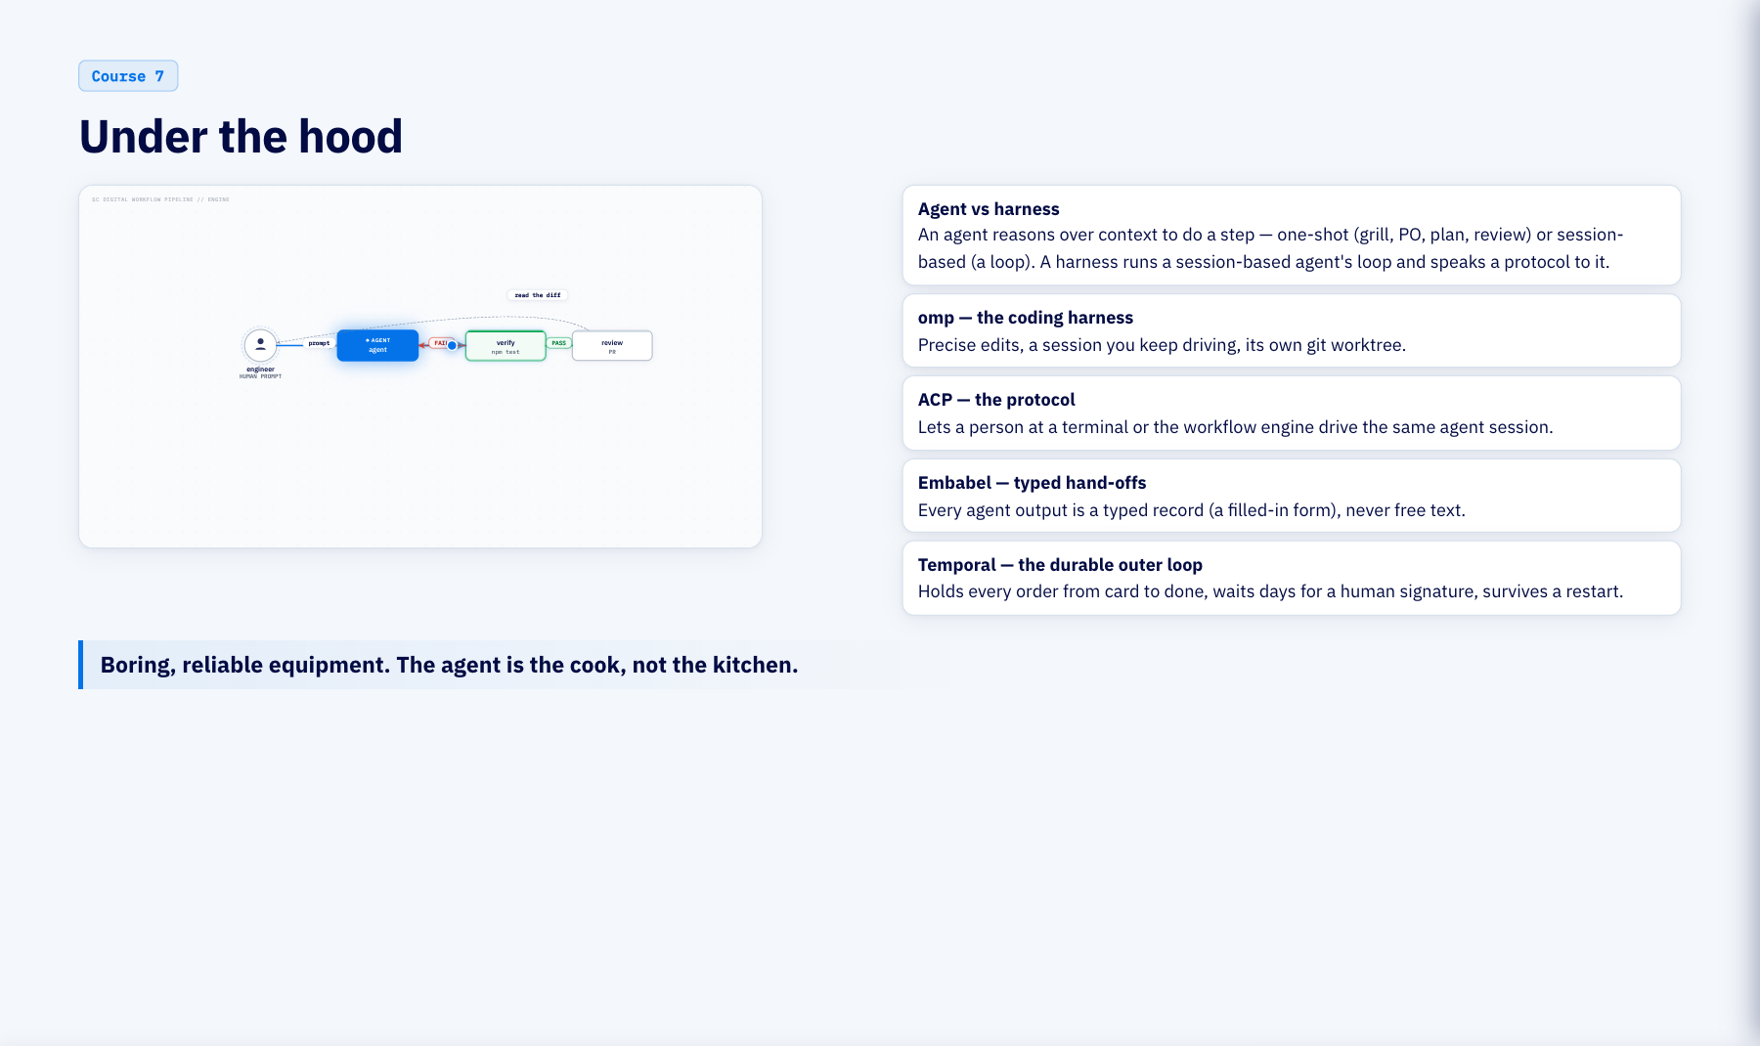
Notes:
Under the hood (2 min)
Two words, precisely, before the names. An agent reasons over context to do a step: one-shot, a single typed call, like grill or PO or plan or review; or session-based, a multi-turn reason-act-observe loop, like a build task. A harness is the product that runs a session-based agent's loop and speaks a protocol to it. omp is our coding harness. ACP is the protocol that lets a human or the workflow engine drive that same session. Embabel is not a harness; it makes every one-shot agent hand-off a typed record. Temporal is the durable outer loop that holds the whole order while it waits for people. None of this is the clever part.

Slide 23
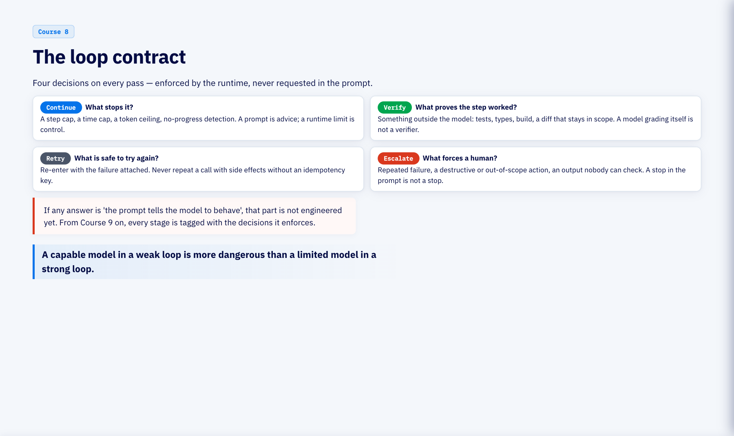
Notes:
The loop contract (3 min)
Orchestration is the visible half of a loop: automations, worktrees, sub-agents, connectors, memory. It says how work moves. The decisive half is the control structure: four decisions the loop makes on every pass. Continue: what stops it. A step cap, a time cap, a token ceiling and no-progress detection, enforced by the runtime, because a prompt is advice and a runtime limit is control. Verify: what proves the last step worked. Something outside the model: tests, types, build, a diff that stays in scope. A model grading its own work is not a verifier. Retry: what is safe to try again. Re-enter with the failure attached, and never repeat a call with side effects without an idempotency key. Escalate: what forces a human. Repeated failure, a destructive or out-of-scope action, an output nobody can check. A stop button in the prompt is not a stop button. If any answer is the prompt tells the model to behave, that part is not engineered yet. From Course 9 on, every stage carries the tags for the decisions it enforces.

Slide 24
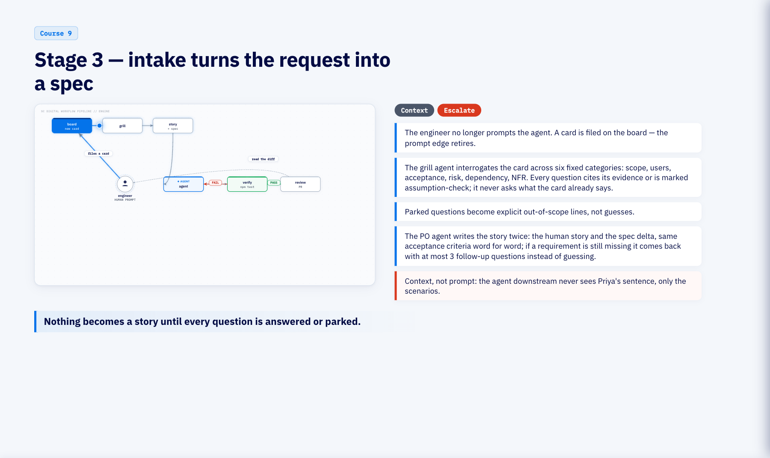
Notes:
Stage 3 — intake turns the request into a spec (4 min)
Here the pipeline takes control of the request. The engineer files a card and steps back. The grill agent asks six kinds of question and has to cite why it is asking. Priya answers or parks; parked becomes out of scope in writing. Then the PO agent writes the story and the spec delta from the same acceptance criteria, and if something is still missing it asks up to three follow-ups rather than inventing it. Like a waiter reading the customizations back before the ticket prints.

Slide 25
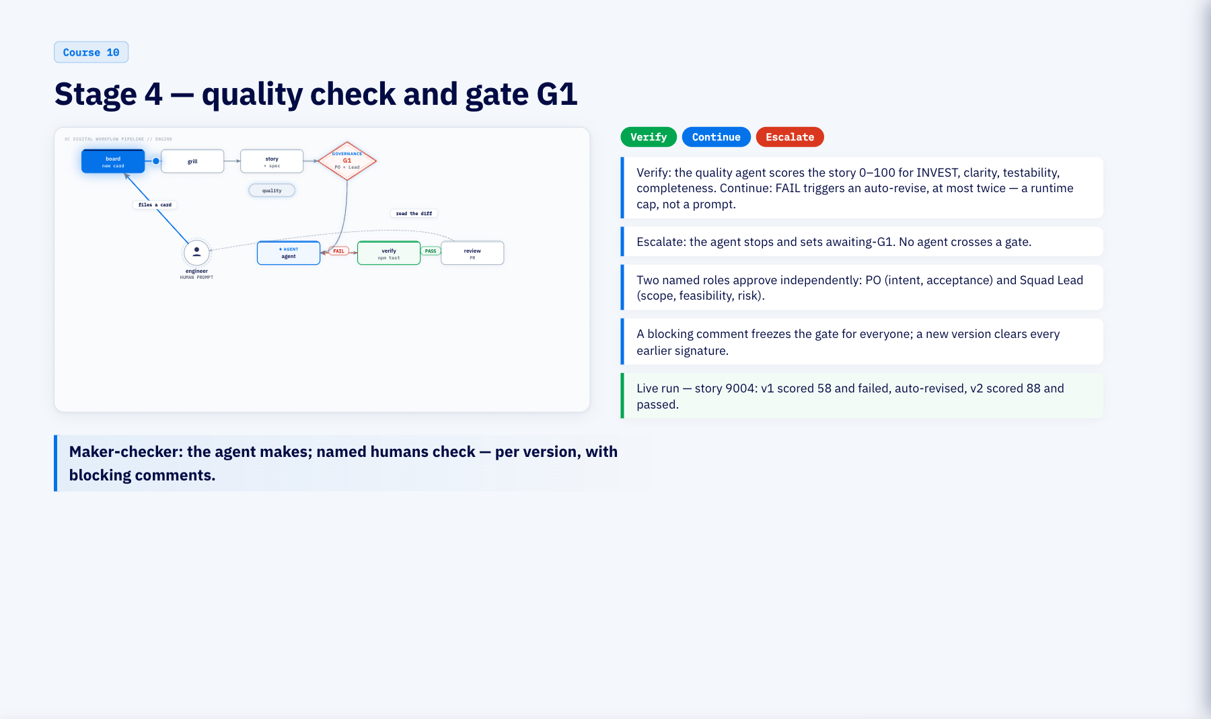
Notes:
Stage 4 — quality check and gate G1 (3 min)
The first gate has two locks. One is code: a quality score that must pass, with up to two automatic revisions. The other is people: two named roles approving the same version independently, with blocking comments that freeze the gate and versions that clear old signatures. In the live run the first draft scored 58 and failed; one revision later it scored 88. Like the head chef reading the ticket before it goes to the line.

Slide 26
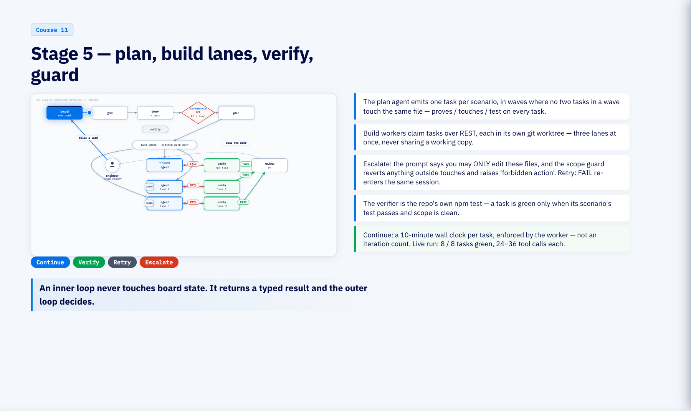
Notes:
Stage 5 — plan, build lanes, verify, guard (5 min)
Now the spec drives the build. One task per scenario, waves with no file conflicts, each task carrying its scenario, its touch list and its test from config.yaml. Workers claim tasks and build in isolated worktrees. The guard is code: edit outside your touch list and it is reverted and escalated. The verifier is code: the repo's own tests. In the live run all eight tasks went green. Like three stations each with their own thermometer, and nobody reaching into another station's pan.

Slide 27
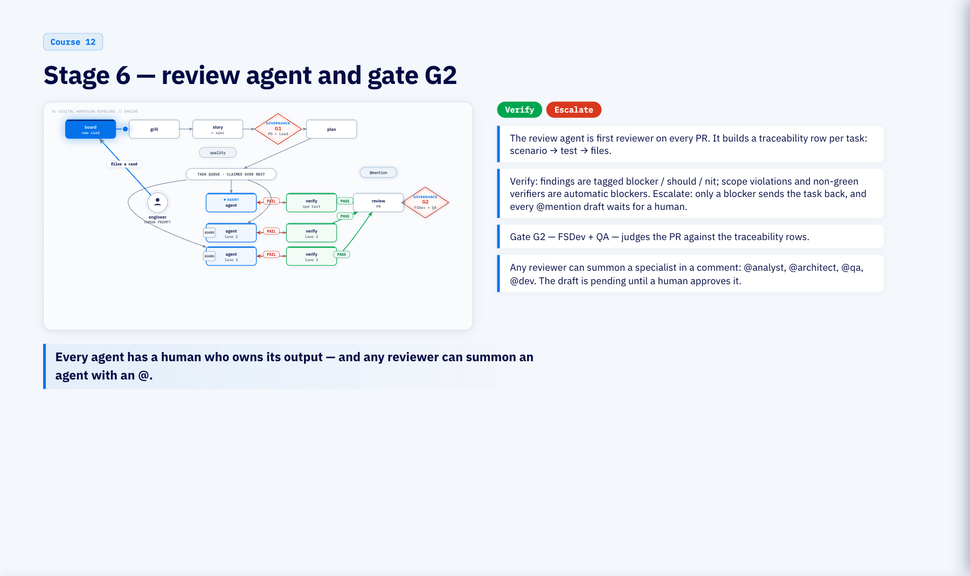
Notes:
Stage 6 — review agent and gate G2 (3 min)
Review is spec-controlled too. The review agent maps every task back to its scenario and its test, so the human gate reads traceability rows instead of raw diffs. Scope and verifier failures are blockers by construction. Then two named roles decide, and any of them can call a specialist agent into the thread, whose answer stays a draft until a person approves it. Like the expeditor checking the plate against the ticket before it leaves the pass.

Slide 28
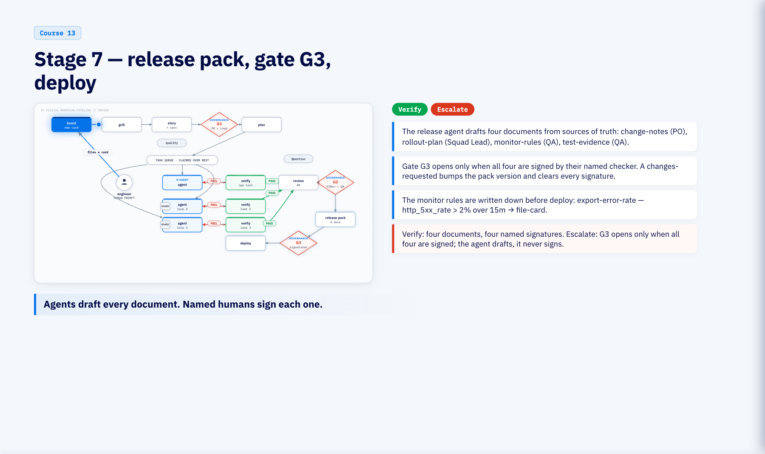
Notes:
Stage 7 — release pack, gate G3, deploy (3 min)
Release is the third gate and the first time the spec reaches operations. Four documents, four named checkers, one version number that resets every signature when anything changes. The monitor rule for this order is written here, before deploy, as a threshold code can evaluate. Like packing the delivery bag: receipt, allergen card, delivery slip, QC stamp, each signed by a different person.

Slide 29
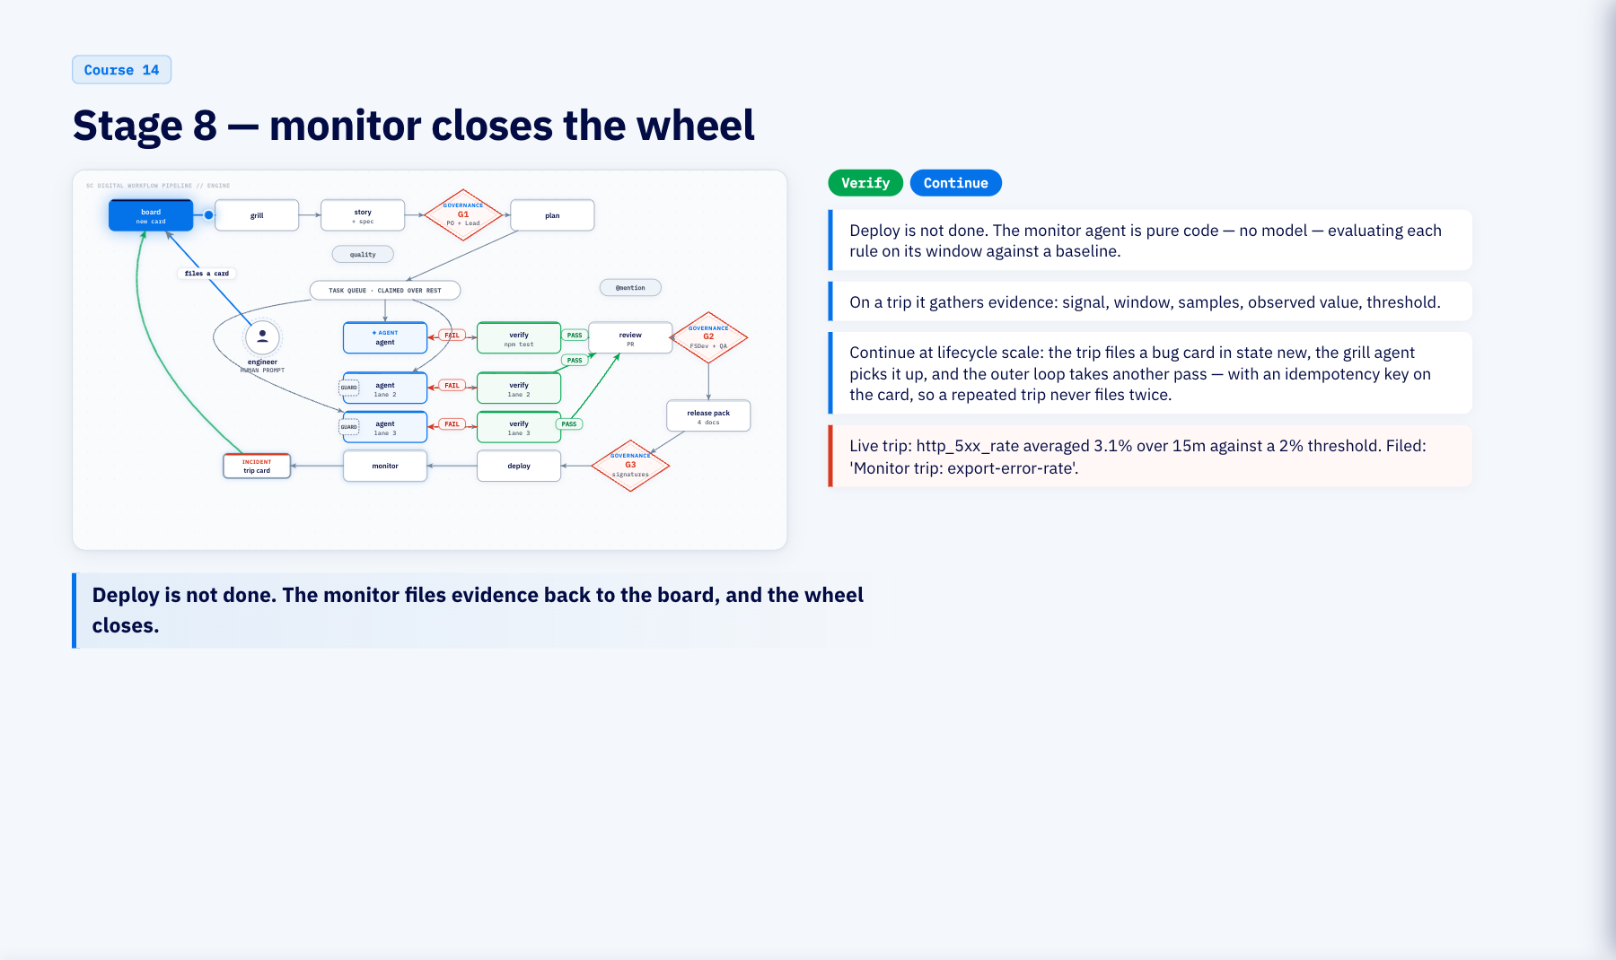
Notes:
Stage 8 — monitor closes the wheel (2 min)
The last stage is deterministic. The monitor reads the rule the release pack wrote, evaluates it on its window, and on a trip files a card with the numbers attached. That card is a new order, and the grill agent picks it up. In the live run the error rate averaged three point one percent against a two percent threshold and a card was filed. Like the customer's feedback going straight back onto the order board.

Slide 30
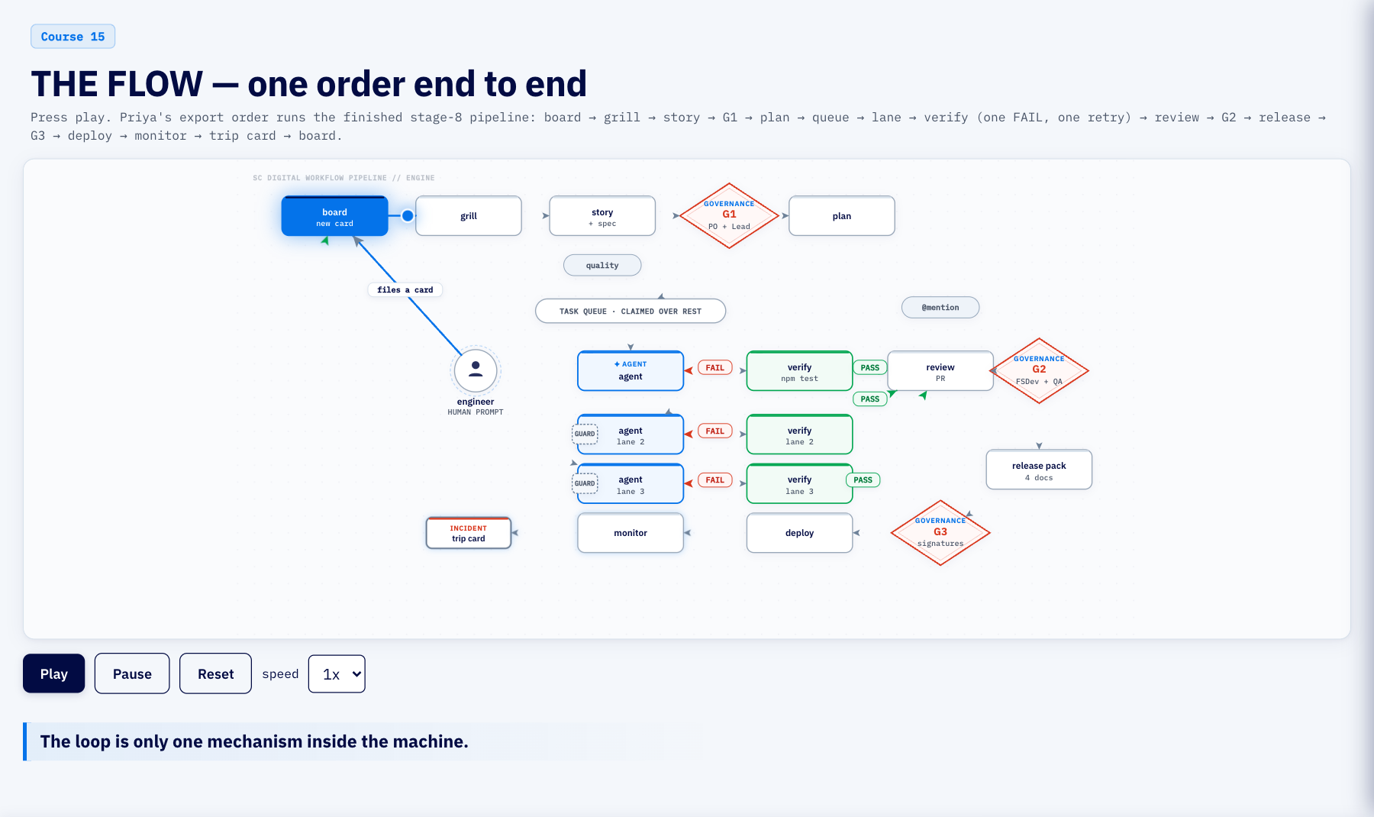
Notes:
THE FLOW — one order end to end (5 min)
This is the centrepiece. One order, the whole pipeline, one token. Watch it fail the verifier once and loop back into the same lane, then pass and go through review, the second gate, the release pack, the third gate, deploy, the monitor, and a trip card that lands back on the board. Pause and reset are there for you. The loop everyone talks about is one gear in this machine.

Slide 31
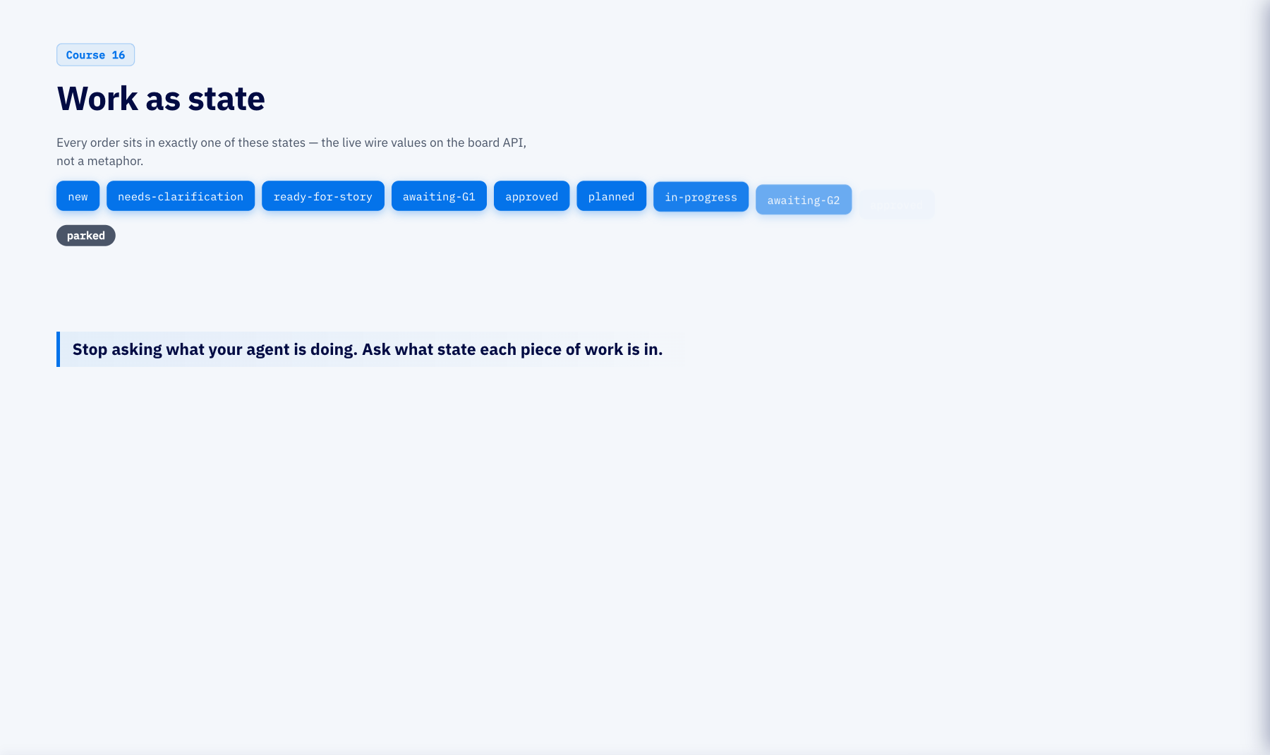
Notes:
Work as state (2 min)
Every piece of work is a card in exactly one state, and these are the real values the board reports. Light them in order and the whole lifecycle reads left to right through two approval gates, with queued and stale parked off the main line. When the verifier goes red the card goes back to in-progress and the lane tries again.

Slide 32
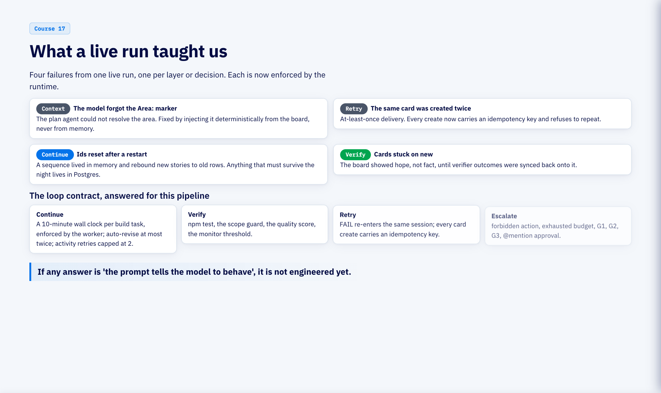
Notes:
What a live run taught us (2 min)
Four failures from one live run, one per layer or decision. The area marker was context the model had to remember, so it is now injected. The duplicate card was a retry without an idempotency key, so every create carries one. The reset ids were state that did not survive a restart, so it lives in Postgres. The stuck cards were a board that trusted the agent, so verifier outcomes are synced onto it. Then the contract answered for this pipeline: what stops it, what proves a step, what is safe to retry, what forces a human. None of those answers is a prompt.

Slide 33
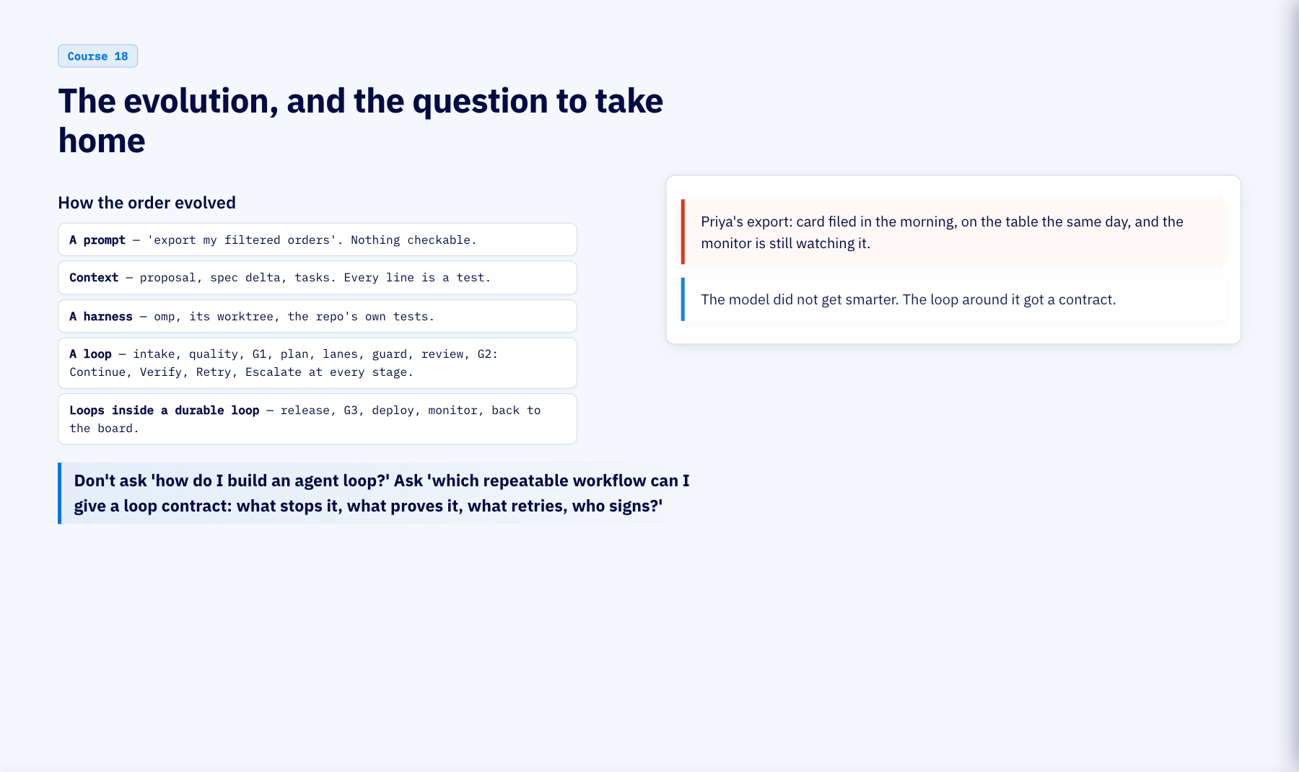
Notes:
The evolution, and the question to take home (2 min)
We started with a prompt, made it context, put a harness around one run, then a loop with a contract around the harness, then a durable outer loop around the whole lifecycle. The model never got smarter. The loop got a contract. So the question to take home is not how to build an agent loop; it is which repeatable workflow you already run that you could give these four answers.

