Slide 1





MENTAL HEALTH CARE SYSTEM
ABISHEK P
AJMAL AHAMED J
AKASH S
AKILAN K

Slide 2
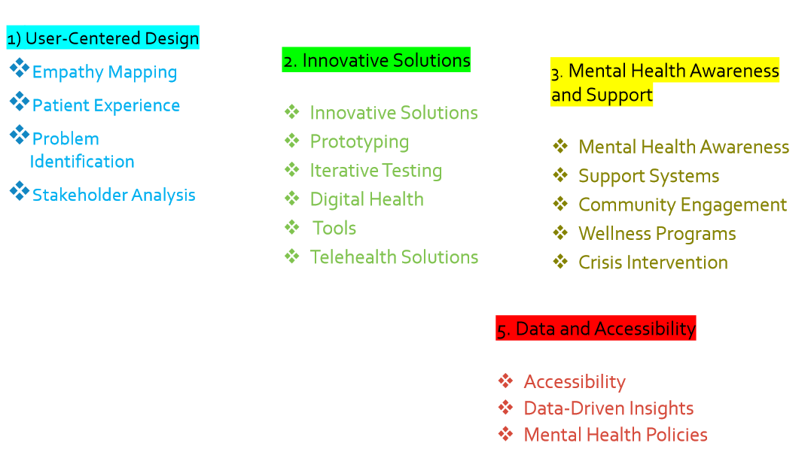
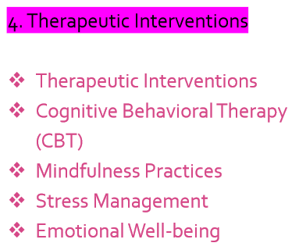








KEYWORDS BY SORTING &AFFINITY LINKS

Slide 3


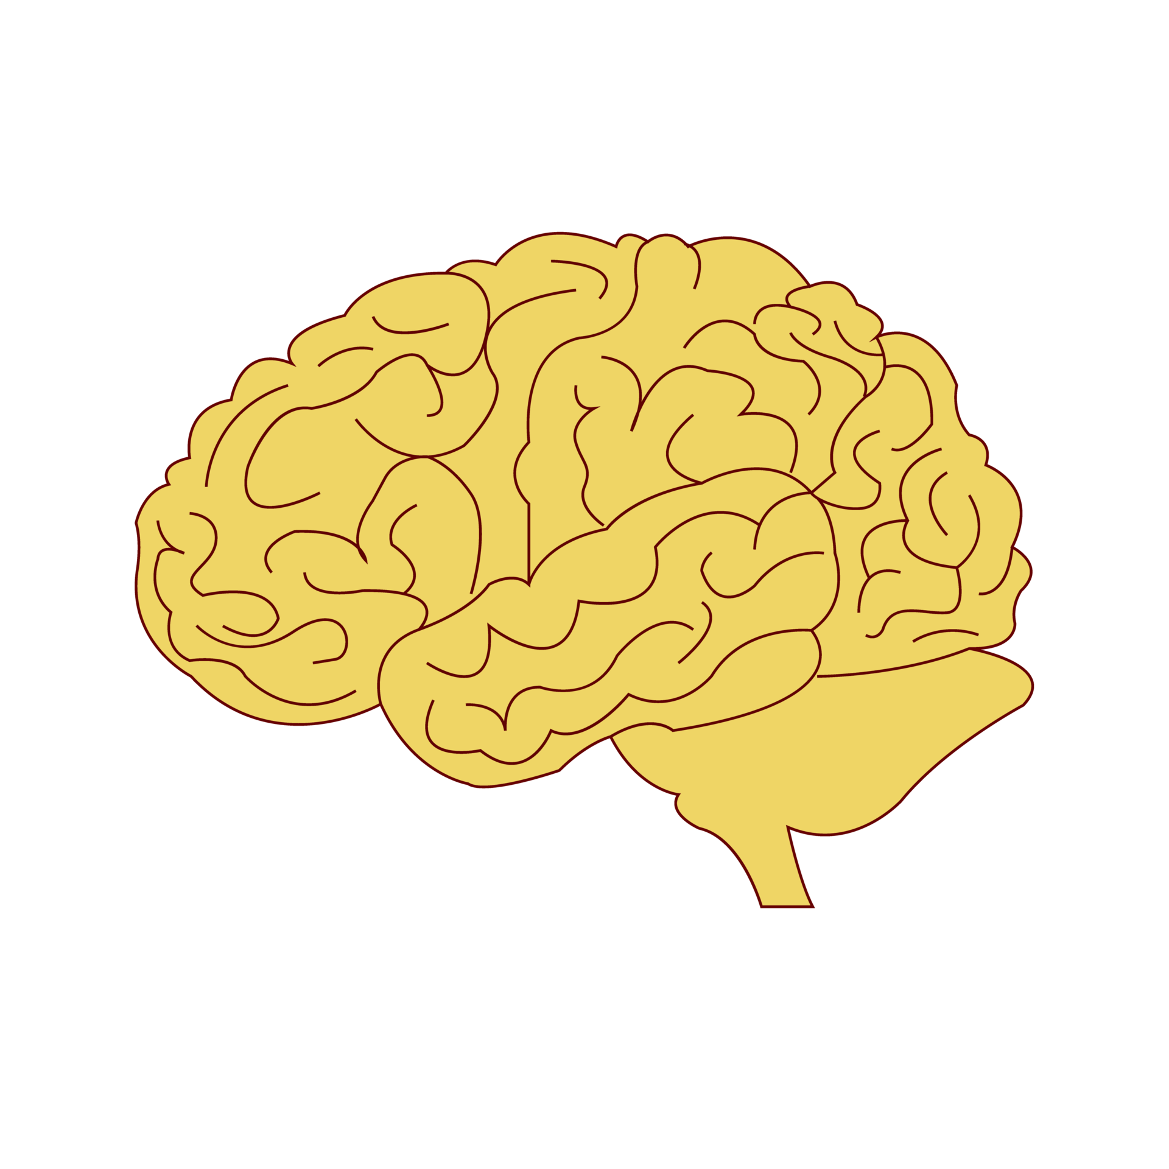


MIND MAPPING
Empathy Mapping
Patient Experience Problem
Identification
Prototyping
Iterative Testing
Digital Health
Support Systems
Community Engagement
Wellness Programs
Accessibility
Data-Driven Insights
Mental Health Policies
vjnfvjfdn

Slide 4
MATRIX TABLE
CATEGO-RIES | USER-CENTERED DESIGN | MENTAL HEALTH AWARENESS AND SUPPORT | INNOVATIVE SOLUTION | DATA AND ACCESSIBILITY
WHO | Who are the primary users of the mental health care system? | Who should be targeted in mental health awareness campaigns? | Who can benefit the most from innovative mental health solutions? | Who should have access to mental health data for research and improvement?
WHAT | What methods can be used to gather user feedback effectively? | What are the most effective ways to raise mental health awareness? | What challenges might arise when implementing innovative solutions? | What barriers exist to accessing mental health care services?
WHY | Why should stakeholders be involved in the design process? | Why is mental health awareness crucial for society? | Why is innovation important in the field of mental health care? | Why is data-driven insight important for mental health care?
WHEN | When should user feedback be collected during the design process? | When is it appropriate to seek support for mental health issues? | When should new innovative solutions be tested and evaluated? | When should data be collected and analyzed to improve mental health services?
WHERE | Where should user feedback sessions be conducted to ensure inclusivity? | Where can individuals find support for mental health concerns? | Where should prototyping and testing of new solutions take place? | Where can data be collected to gain insights into mental health trends?
HOW | How can user-centered design lead to better patient outcomes? | How can community engagement enhance mental health awareness? | How can innovative solutions improve the accessibility of mental health care? | How can data-driven insights lead to better mental health policies?

Slide 5
USER PARTICIPANT MAPPING
Advocacy groups
TERTIARY LEVEL
Health care Administrators
Health professionals
PRIMARY LEVEL
Patients
Policy makers
MENTAL HEALTH CARE SYSTEM
SECONDARY LEVEL
Family members
Community workers
QUATERNARY LEVEL
Researchers

Slide 6
CONTEXTUAL INQUARY

Slide 7

QUESTIONNAIRES AND CUE CARDS
User Feedback Questionnaire for Mental Health Care App
 | 1 Inadequate | 2 Fair | 3 Good | 4 Very Good | 5 Exceptional
1. How easy is it to navigate the app?
2. How helpful are the resources and tools provided in the app?
3. How satisfied are you with the virtual therapy session features?
CUE – CARDS
Therapeutic Alliance: How do you build a strong therapeutic alliance with your patients? Crisis Management: What strategies do you use for managing mental health crises? Patient Assessment: What are the key components of a comprehensive patient assessment? Treatment Plans: How do you develop and customize treatment plans for your patients? Dual Diagnosis: How do you approach treatment for patients with dual diagnoses (e.g., mental health and substance use disorders)?

Slide 8






ACTIVITY MAPPING
USER JOURNEY MAPPING
User action
Consideration
Decision
Retention
Feedback and support
Engagement
Onboarding

Slide 9

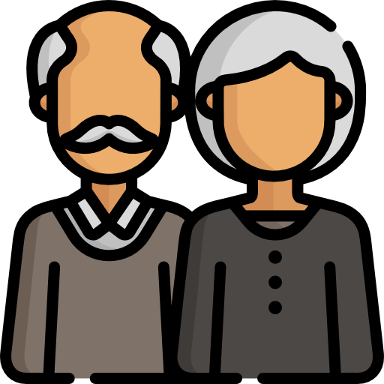
PORSONAS AND OIOR TABLE
Ananya (Teenage Daughter)
Usage: Ananya uses the app to cope with anxiety and peer pressure. She finds the community support groups helpful for sharing her experiences and getting advice from peers.
Suresh (Elderly Grandparent)
Usage: Suresh uses the app to combat loneliness and stay mentally active. He enjoys participating in guided meditations and reading about mental health to keep his mind engaged.
OIOR TABLE
Observation | Inference | Opportunity | Recommendation
Many individuals in rural areas have limited access to mental health care . | This lack of access leads to untreated mental health issues and worsens overall well-being. | Develop mobile mental health clinics and telehealth services to reach underserved communities.. | Design a mobile app-based platform that connects users with mental health professionals .
The cost of mental health care is prohibitively high for many individuals. | High costs prevent people from seeking necessary treatment, leading to untreated mental health conditions. | Create affordable mental health care plans and offer sliding scale payment options. | Design a subscription-based mental health app that offers affordable access to therapy sessions, and community support groups.
There is a significant stigma associated with seeking mental health care. | Stigma discourages individuals from seeking help, exacerbating mental health issues. | Promote mental health awareness and education to reduce stigma. | Design a campaign within the app that includes educational content, personal stories, and interactive activities to normalize mental health care

Slide 10

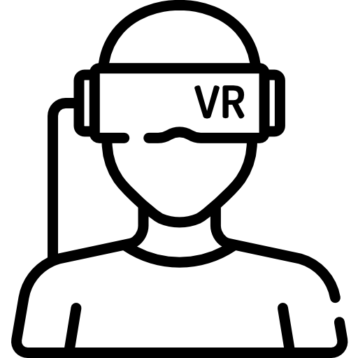

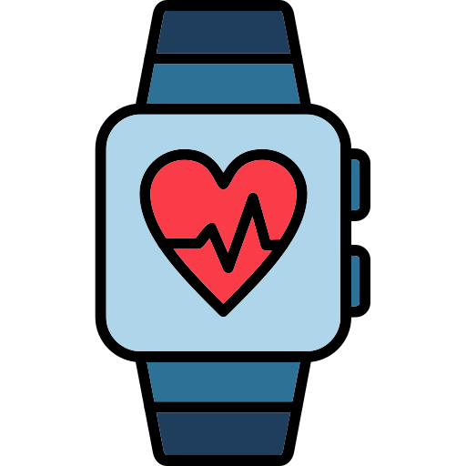

IDEATION PART - ONE
MENTAL HEALTH
CARE SYSTEM

Slide 11
CONTINUATION
SCAMPER for Mental Health Care System
Substitute: Replace in-person therapy with telehealth options or AI chatbots for 24/7 support.
Combine: Merge self-help tools (e.g., mood trackers) with professional therapy resources in one app.
Adapt: Adapt fitness tracking models to track mental wellness (e.g., daily mood and stress levels).
Modify: Modify app design to make it more user-friendly and less clinical, reducing stigma.
Put it to Another Use: Use peer support groups in virtual settings for broader community outreach.
Eliminate: Remove long wait times and complex insurance processes by offering immediate access to care.
Reverse: Shift from reactive care to proactive check-ins and mental wellness maintenance.
Lateral Thinking for Mental Health Care System
Reframe the Problem: Shift focus from treatment to preventative wellness (e.g., daily mental health check-ins).
Cross-Pollinate Ideas: Incorporate gamification from fitness apps to track and reward mental health milestones.
Break Assumptions: Challenge the need for long therapy sessions by offering micro-sessions or on-demand support.
Challenge the Status Quo: Create a system for instant access to care via chatbots or virtual therapy, bypassing traditional waiting times.

Slide 12
IDEATION PART - TWO
Synectics
Application in Mental Health App: Encourages thinking outside the box to design unique solutions for mental health challenges. For example, considering unexpected user interactions or combining unrelated mental health resources (e.g., combining mood tracking with mindfulness practices).
Analogical Thinking
Application in Mental Health App: Use analogies from other industries (e.g., fitness tracking apps) to create novel mental health tools, such as integrating gamification into mood tracking or creating a "mental health fitness tracker" to visualize emotional progress.
Concept Evaluation
Application in Mental Health App: Evaluate proposed app features (e.g., therapy chatbots, mood trackers) by testing user feedback and assessing how well they meet user needs, improve accessibility, and align with the goals of providing supportive mental health care.

Slide 13
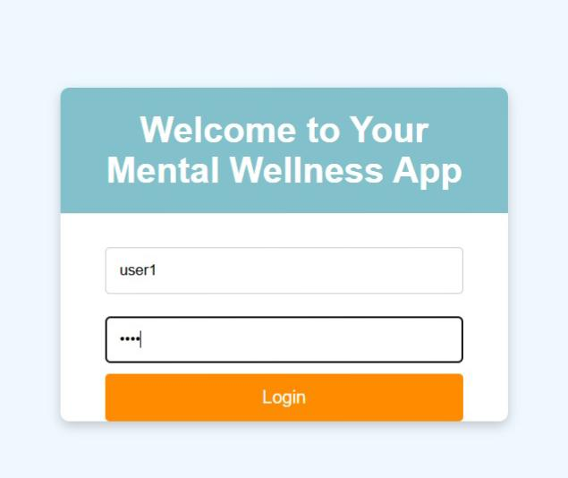
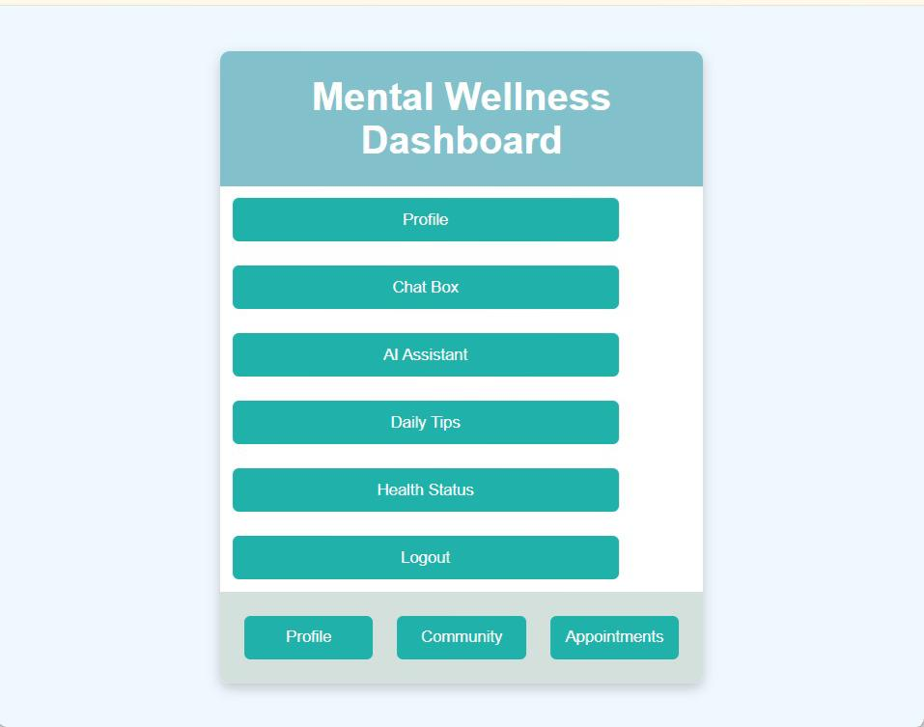
SOFT PROTOTYPE
LOGIN PAGE
DASHBOARD PAGE

Slide 14
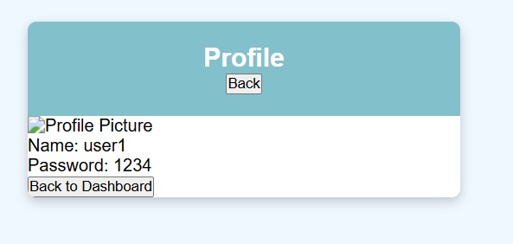
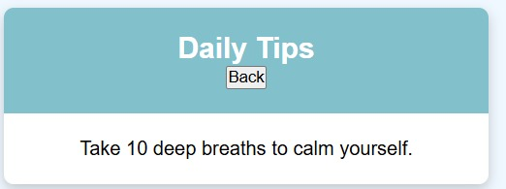
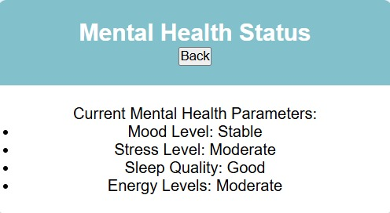
SOFT PROTOTYPE
Profile
Tips
STATUS

Slide 15
MEDIUM PROTOTYPE
MVP(Minimum Viable Product)
Definition: The most basic version of the app that includes only the essential features needed to solve the primary problem.
Key Features: Mood Tracker: Basic slider to track mood with optional notes.Daily Tips: Simple wellness reminders.
POC (Proof of Concept)
Definition: A prototype or demo built to validate that the core functionality works and the app’s concept is viable.
Purpose:
Test the feasibility of integrating real-time mood tracking and therapist interaction.
Validate the value of providing immediate access to crisis support.
Prove that users would benefit from easy-to-navigate features like therapy booking and self-help resources.
XD (Experience Design)
Definition: The overall feel of the app, ensuring it’s engaging, user-friendly, and accessible.
Key Aspects:
Usability: Simple, intuitive UI with clear calls to action (e.g., “Add Mood”, “Book Appointment”).
Emotional Engagement: Calming colors
IA (Information Architecture)
Definition: The structural design of the app’s content and information flow.
Components:
Navigation Structure: Clear, intuitive navigation with easy access to key sections (Dashboard, Mood Tracker, Crisis Support, Therapist Directory).

Slide 16







PROTOTYPE
MHC
Application
MHC
LOGIN
SETTINGS
AI ASSIST
HOME
HEALTH
LOGOUT
CHAT

Slide 17
USABILITY STUDIES, FEEDBACK
Usability Studies
Objective: Evaluate the ease of use and effectiveness of key app features (Mood Tracker, Therapy Booking, Crisis Support).
Method: User testing with 10-15 participants, performing tasks like logging moods, booking therapy, and accessing help
.
User Feedback
Positive:
Easy Mood Tracking: Users found the mood slider intuitive and simple.
Calming Design: The app’s minimalist, soothing interface was appreciated.
Emergency Access: The Crisis Support button was easy to find and reassuring.
Improvements:
Therapist Booking: Some users struggled with therapist search filters.
Personalization: Users wanted more control over mood triggers (e.g., "Work Stress").
Onboarding: A clearer introduction to app features was suggested.

Slide 18
CREATING BUSINESS MODEL
SWOT Analysis
Strengths | Weekenesses
Easy-to-use design | Limited initial user base
High demand for mental health services | Dependence on partnerships with therapists
Accessible emergency support | Need for user engagement over time
Opportunities | Threats
Increasing mental health awareness | Competition from other mental health apps
Integration with corporate wellness programs | Privacy and data security issues
Expansion into global markets | Regulatory challenges (e.g., HIPAA, GDPR)

Slide 19
SOAR -- ANALYSIS
Strengths | opportunities
Simple and effective features (mood tracking, therapy booking) | Growing demand for mental health solutions
Calming and user-friendly design | Potential for AI-based personalization
Aspirations | Result
Become a leading mental health app globally | Improve user well-being and engagement
Continuously evolve and offer new therapeutic tools | Increase user retention and satisfaction
Further Study and Research
Competitor Analysis: Study other mental health apps (e.g., Headspace, Calm) to see what works and where you can differentiate.
User Feedback: Regularly gather feedback from users to improve app features and usability.
Data Privacy: Research data security and privacy laws (GDPR, HIPAA) to ensure the app is fully compliant with regulations.

Slide 20
FULL REFERENCE AND ACKNOWLEDGEMENT
Name: Adler, D. A., Wang, F., Mohr, D. C., & Choudhury, T. (2022)
Available at :https://doi.org/10.1371/journal.pone.0266516
Name :B.G. Knight, L. Lee, in Encyclopedia of Gerontology (Second Edition), 2007
Page 41-49
Available at: https://doi.org/10.1016/B0-12-370870-2/00007-X
Acknowledgement:
1)Mrs.Murugavalli
KRCT - Samayapuram

