Slide 1
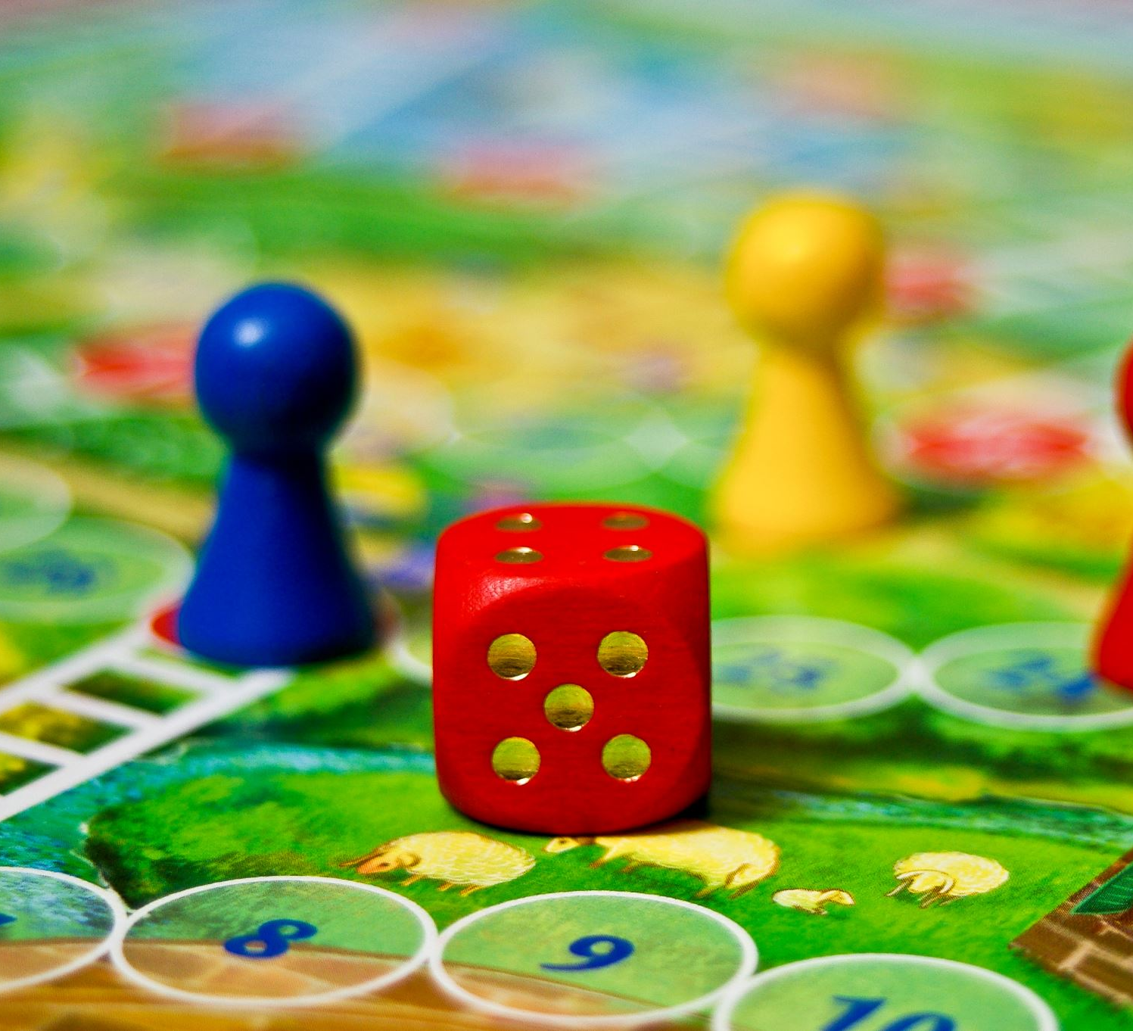
Connect four game
JOSEPH RUFUS PARTHIBAN MARIA DASAN – 201ADB077
AKIL ARAVINTH MALAYANDIPATTINAM VASUDEVAN – 201ADB095
KANDA GAMAGE PRABODA HASAN- 191ADB086
HARIDU CHATHURANGA ATHTHANAYAKE GEDARALAGE- 203AEB010

Slide 2
INTRDODUCTION to the game:
In the classic strategy game Connect 4, two players compete against one another to control the grid! Red or yellow discs are offered to the players. Starting in the center or at the edge, they drop the discs into the grid and stack their colored discs either vertically, horizontally, or diagonally.
PROGRAMMING LANGUAGE USED:
Python
LIBRARIES USED:
math
pygame
numpy
sys

Slide 3
REQUIRMENTS:
The game will involve two players, each with their own colour (i.e. red and yellow).
The game should contain a grid to drop the discs (21 yellow and reddiscs)
Clicking on the column will allow players to place their piece into the lowest open slot in the column.
The game will have alternate turns between the players.
When a player has four pieces in a row (horizontally, vertically, or diagonally), the game will recognize it and deem that player the winner.
the game is announced as a draw when the board is full.
The quit option will be available throughout the game.
After the game has concluded, a restart option will be available to restart the game.
Two players can compete against one another in the game on the same computer.

Slide 4
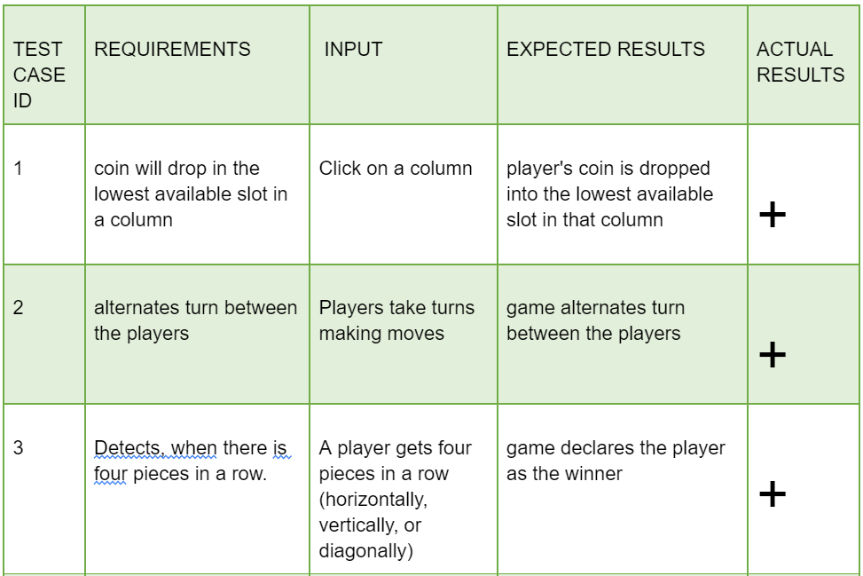
BLACK BOX TESTING:

Slide 5
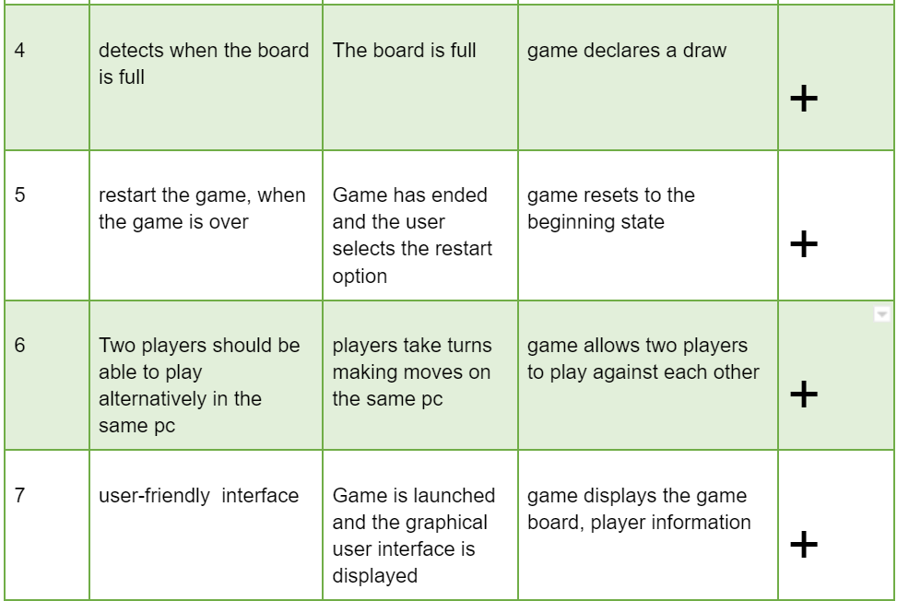
BLACK BOX TESTING:

Slide 6
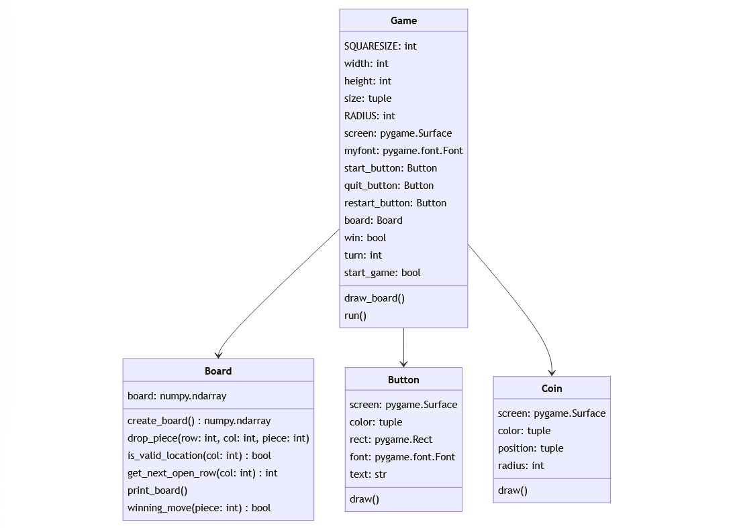
UML:

Slide 7
CLASSES:
Game
Board
Button
Coin
ATTRIBUTES OF GAME:
SQUARESIZE, width, height, size, RADIUS and screen.
ATTRIBUTES OF BOARD:
board
ATTRIBUTES OF BUTTON:
screen, color, rect, font and text:
ATTRIBUTES OF COIN:
screen, color, position and radius.

Slide 8
DEMONSTRATION OF THE GAME

