Slide 1
Instructions for completing pre-session assignment
Use this I-NDUCT deck template to submit your Pre-Class Assignment.
Download this template to your local folder and then start working on the local copy. Please do not start editing the slides online in the deck template present in the Shared Program Folder.
Save a local copy of the deck template using the naming convention: TeamNumber_TeamName_ DDMMYYYY
Update the footer on the slides with your team number and team name.
Do not delete any slides from this deck.
Please watch the videos indicated and completed the readings, before you work on this assignment.
Instructions for specific slides, if any, are in the SLIDE NOTES. Please read the Slide Notes before you start working on the slides.
Upload your completed assignment to the folder specified under the Shared Program Folder. Ensure that you upload the file using the naming convention as mentioned above.
Try and answer questions in the Appendix as well.

Slide 2
5- Exo-suit Institute name: Mahindra University
Exo-suit for upper-limb rehabilitation for stroke patients
20-Jan-2024
Presentation time available - 4 min.
Please read the Slide notes below carefully
Notes:
Add your team no. and team name.
Add a 1-line description of your product/solution. Some examples:
Holistic rehabilitation system for children with hearing impairment;
Process for producing an omega-3 fatty acid using a renewable, vegan source;
Technology for reclaiming used sand from foundries;
Closed loop recycling of construction and demolition waste;

Slide 3
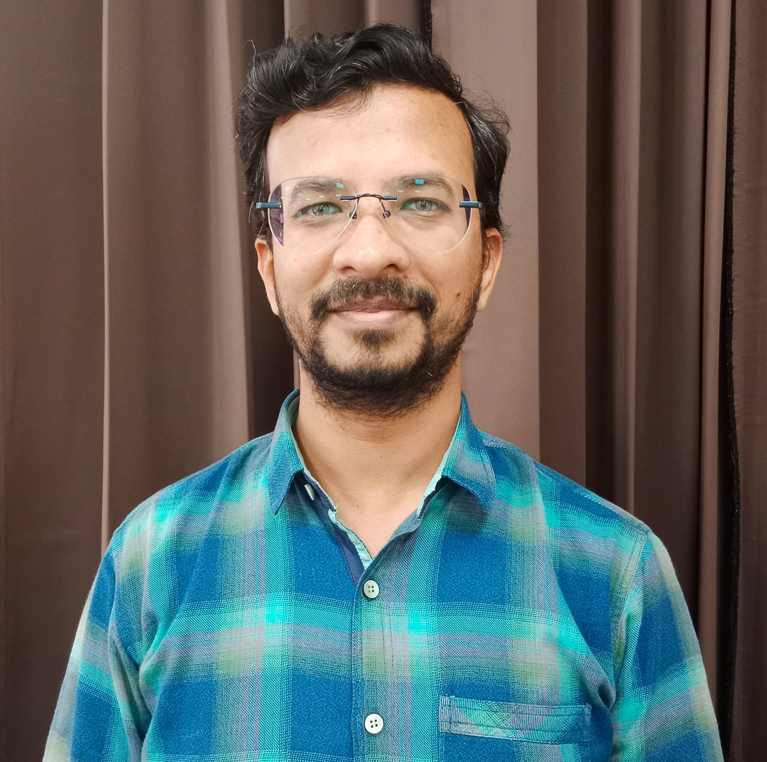
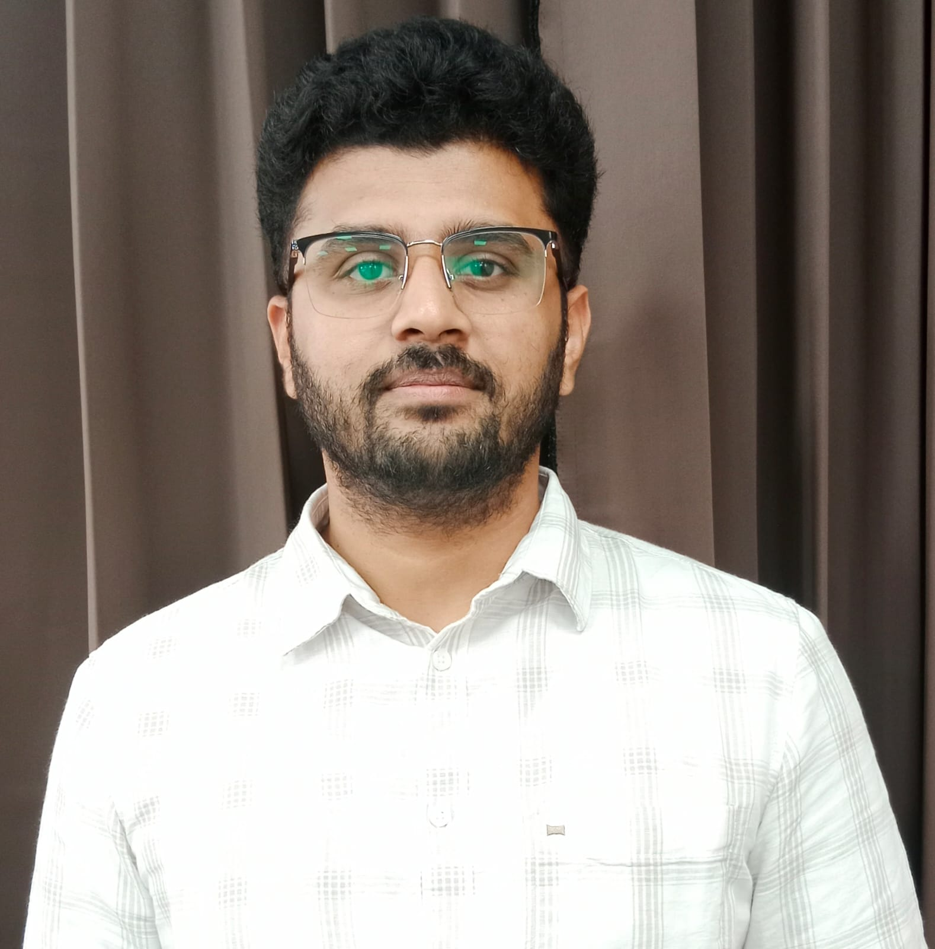
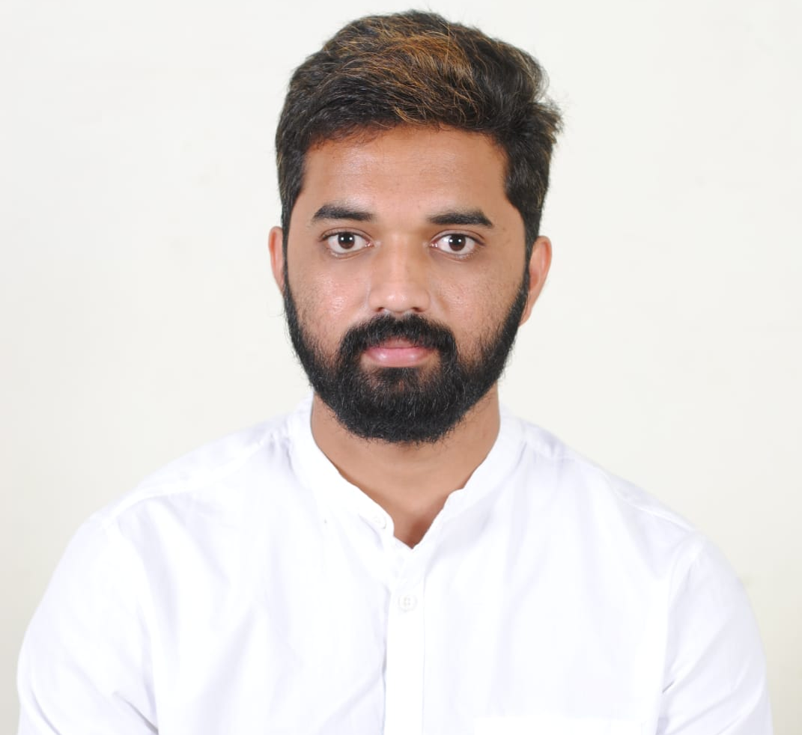
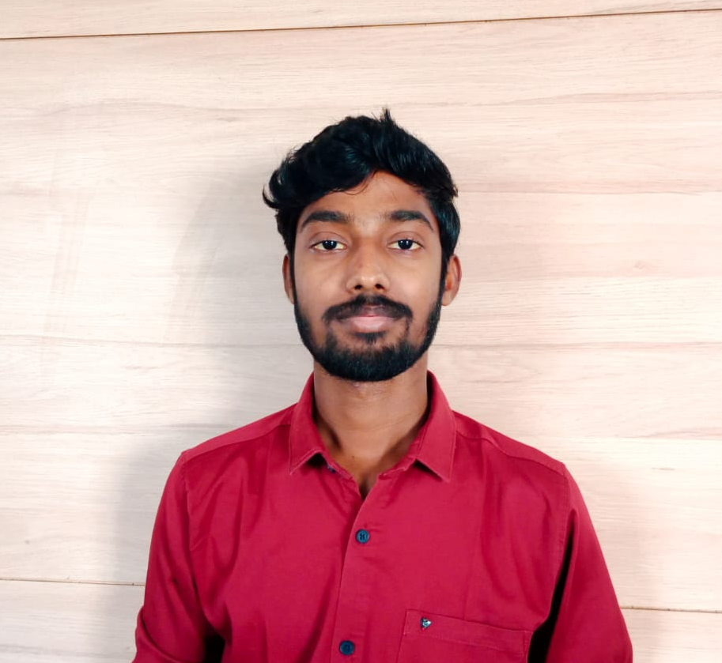
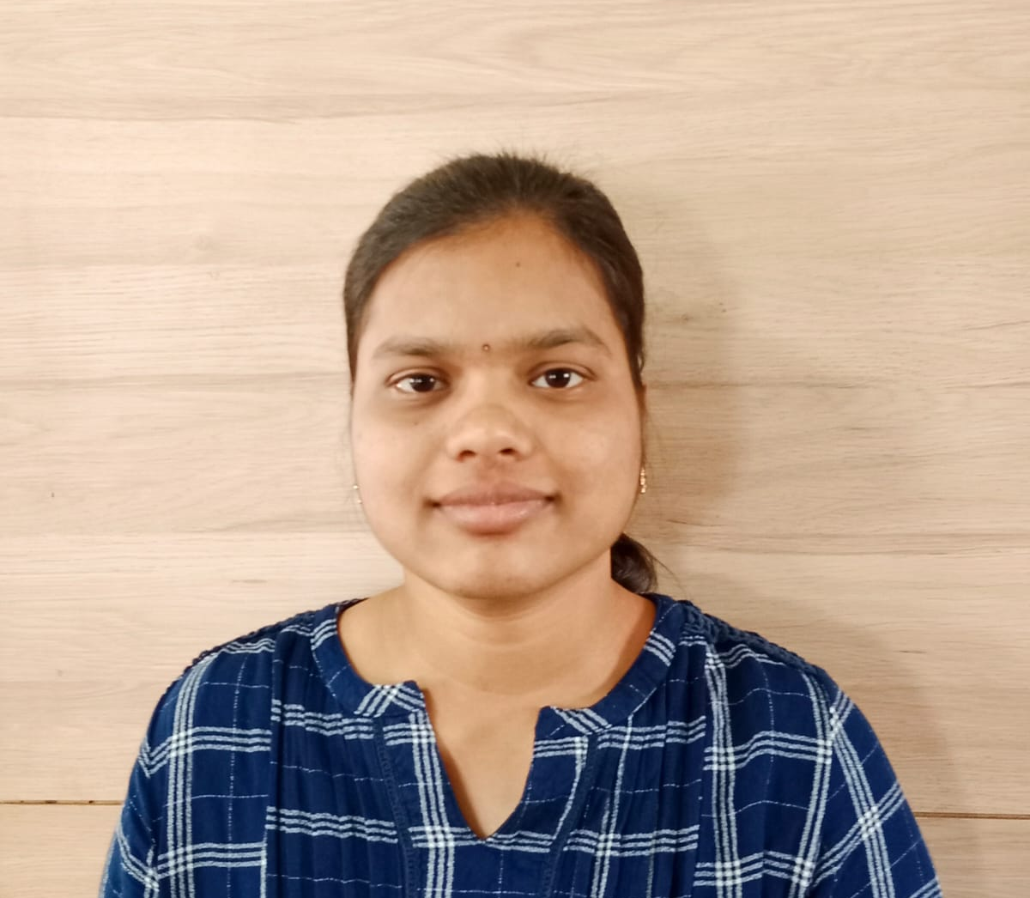
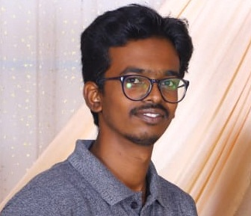
Our team
Deep Seth
Faculty Lead
Sanjeevi N
Faculty Lead
NAME
Business Mentor
Siddharth R Patil
EL 1
Srivatsa A
EL 2
Sanjana P
EL 3
Akhilan A
EL 4
Notes:
Please include the names and photos of:
Faculty Lead(s),
Entrepreneurial Lead(s),
Business Mentor
Please do not add more that 6 names on a slide. Make a copy of this slide in case you have more than 6 names. You can add/delete placeholders depending on the size of your team.

Slide 4
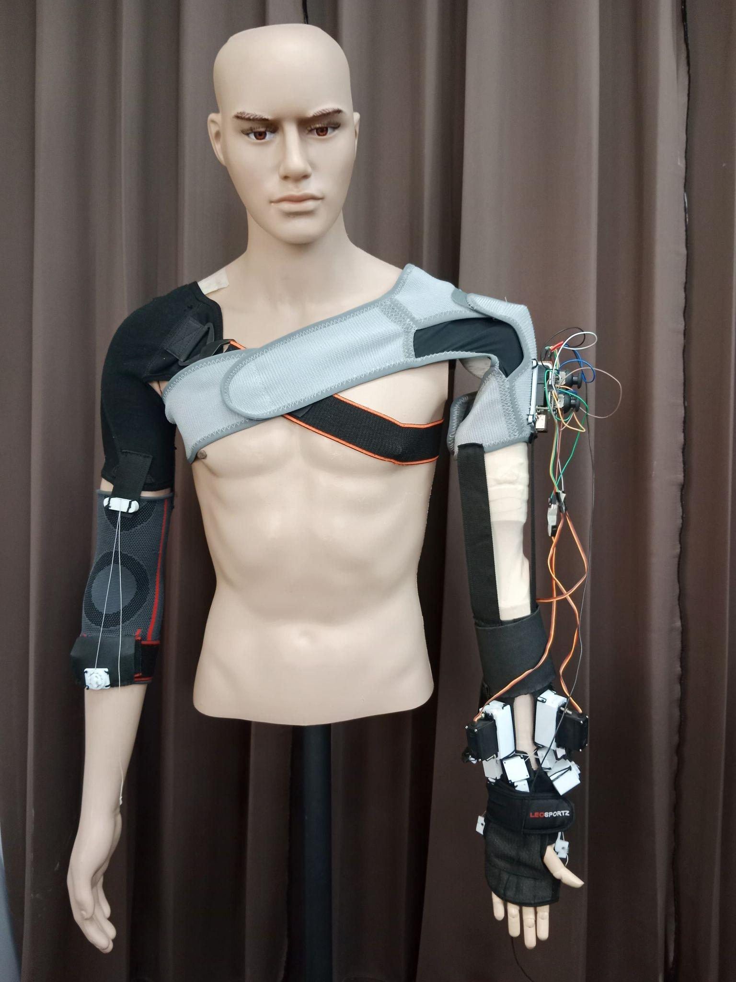
1. What is the core technology developed by the Faculty Lead and/or you? Describe its various applications.
Development of exosuit is focused on rehabilitation of Upper limb for stroke patients.
Using EMG sensors to detect Human intention.
A Robust Machine learning algorithm to classify/detect human arm movement/intent.
Exo-suit should apply forces according to the desired intent.
Fusion of Mechatronics, and human Bio-mechanics and Mechatronics to arrive at a flexible design
and development of exo-suit.
Ability to perform continuous and repetitive tasks, thus reducing the fatigue of physiotherapist.
Figure 1 : Exo-suit
Notes:
Besides the market you are targeting, where else can your basic technology or solution be used?

Slide 5
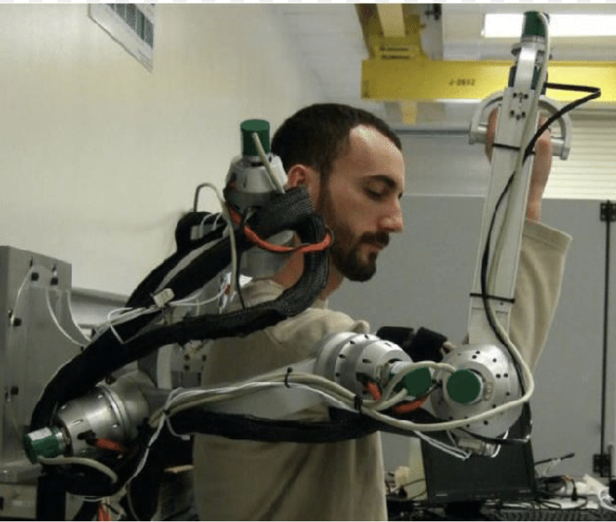
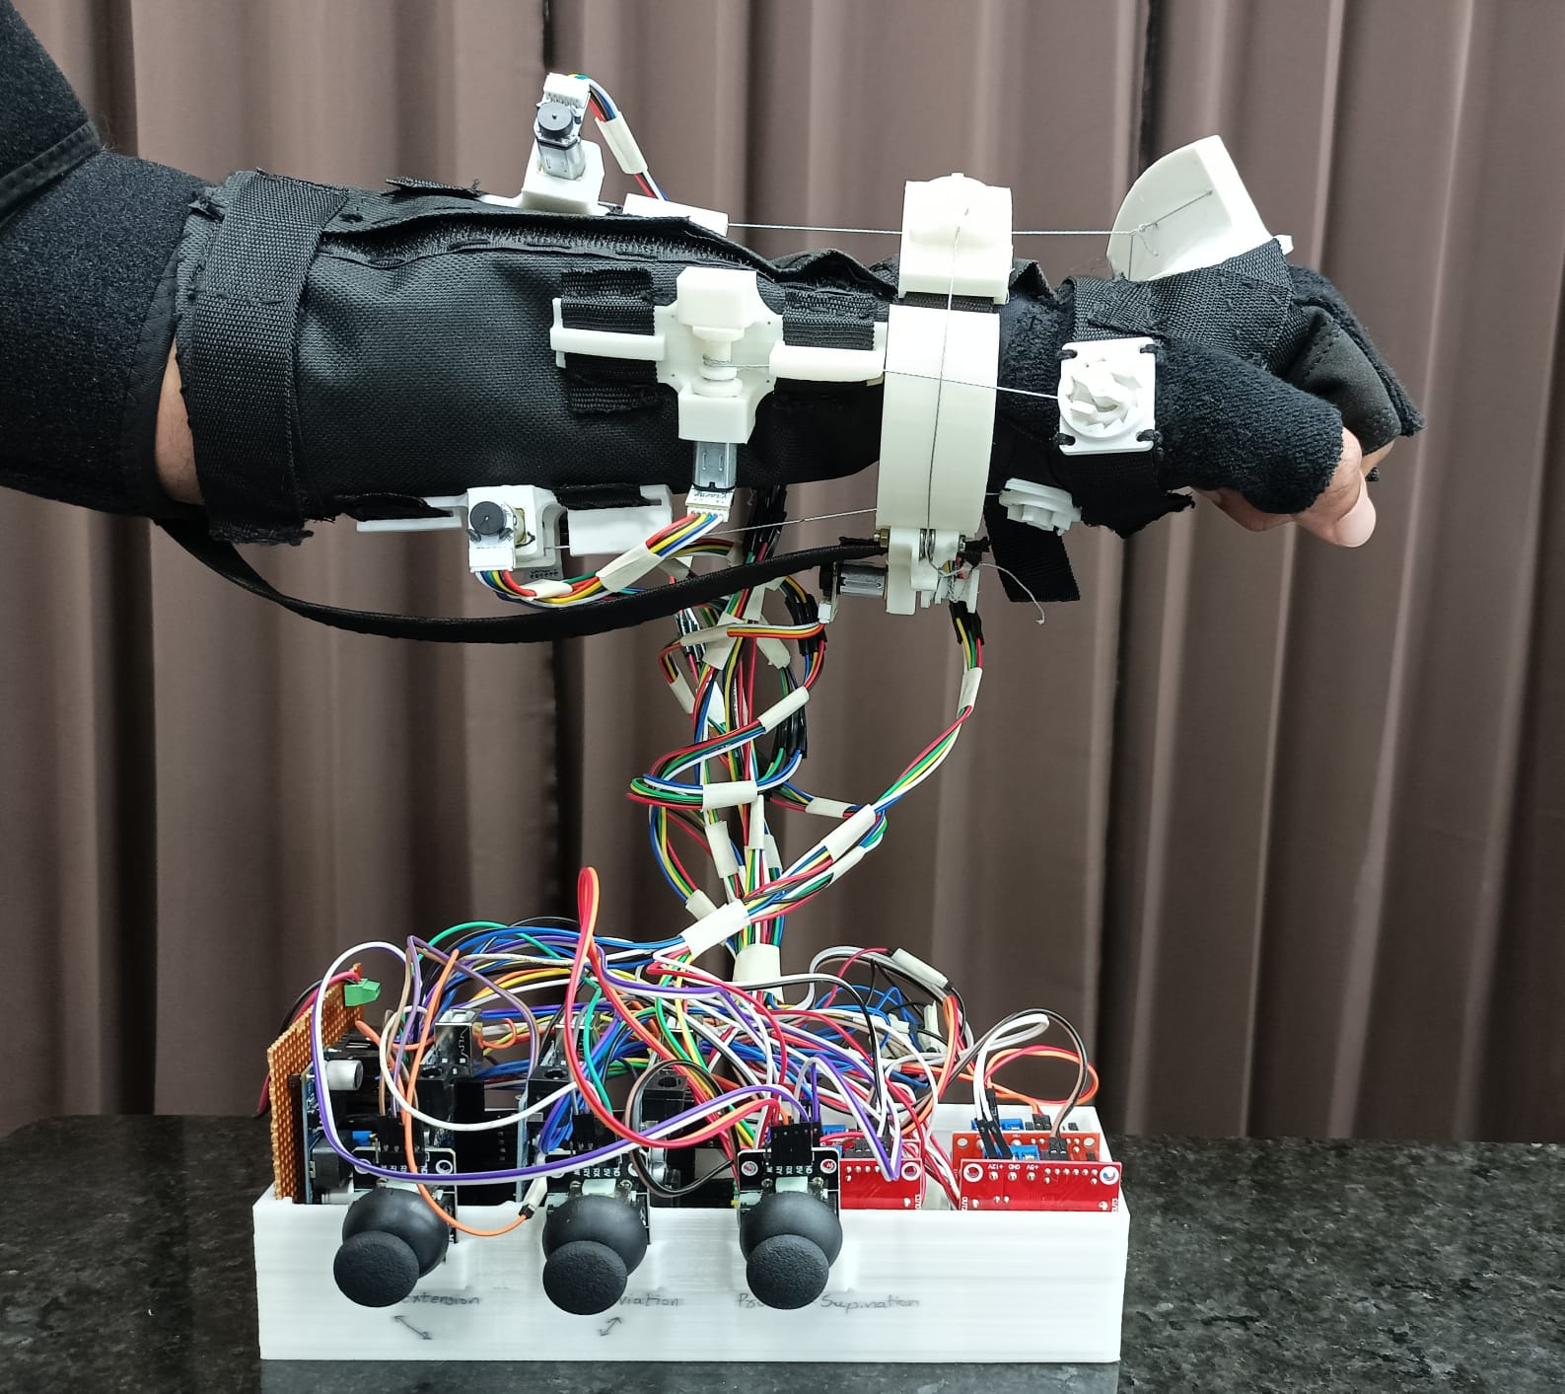
2. Innovation / Solution : - Describe your innovation and how it works (Within one slide ONLY)
Problem 1: The weight of the design and flexibility
The exosuit mechanism is purely cable driven, thus making it flexible and light-weight.
Problem 2: Timely actuation of forces is very critical aspect.
Actuation or Control of the exosuit is dependant on the muscle intent of the impaired patient.
Using Machine learning algorithms to classify what movement is intended to done by the arm.
Problem 3: Physiotherapist fatigue and non-availability of quantitative feedback.
This reduces the fatigue of physiotherapist for manual training.
Continuous and repetitive exercise of the impaired patient for longer duration constant intensity.
We can readily observe and monitor the development of impaired patients.
Figure 2 :Rigid exo-suit
Figure 3: Soft Exo-suit
Notes:
1. Write in full sentences rather than telegraphic headlines to describe what ‘Product’ or ‘Solution’ you have created.

Slide 6
3. Business Idea: - Describe your ‘Business’ Idea in one or two sentences - What problem/s are you solving OR What needs are you fulfilling? For whom?
Context
Problems
Customers
Desired outcome
Notes:
Please note there are 3 parts to be covered in this slide (a) Your business idea (b) What problem are you solving? © For whom are you solving the problem? i.e. who is your principal customer?
Please share your ‘BUSINESS” idea and not your ‘Product’ idea.

Slide 7
4. Business Potential: - How big do you think your startup can become in five years? (Annual Revenue) - What is the basis of your answer?
At present, out of every 1 crore population, 12 to 15 thousand people have stroke or paralysis.
Every year there has been 50% increase in the number of stroke or paralysis patients.
So, we can predict a high demand for our exosuit for rehabilitation application.
Our major customers would be either physiotherapists or hospitals that helps stroke patients to regain their ability.

Slide 8
5. Genesis & History of your startup/team : - Who amongst the team came up with the idea? How, when? - How did you come together as a Team? - At what stage of evolution is your startup? (e.g. Product status, Business status)
Our faculty leads has already been a part of the research related to Exo-suits and exoskeletons necessary for rehabilitation applications.
Our team comprises of Ph.D. and Masters students, with mere interest in Bio-mimetics and healthcare robotics.
We, all together are highly motivated to make our product and commercialize it.
We are still working on the research and development area of our product.
Notes:
Share the story of how your startup and your team came about.

Slide 9
5. Personal motivation to be an Entrepreneur: Why do each one of you in your team think that this is an opportunity worth committing your time and energy for you to pursue?
EL 1: We are a team, highly motivated to help for the betterment of the society and make a product that is easily accessible and easy to use. We wish to commercialize our product and make a foundation for more research and development in the related field.
EL 2: We are highly motivated to develop solution for the existing issues and commercialize it and present it to the market where we can create our own place in the business world.
EL 3: I am highly motivated to help society through our startup product. And seeing customers solve their pain points by using our product is a reward to us.
Notes:
Please give responses for each Team member.
EL1 means the first Entrepreneur in the team, EL2 is the second Entrepreneur and so on…

Slide 10
Thank you

