Slide 1

PyCon Italia

Slide 2
Building Conversational Chatbots using Python and Facebook Messenger API
Akilesh Lakshminarayanan
BITS-Pilani University, Goa, India, Batch of 2018
B.E. Computer Science
M. Sc. Economics

Slide 3
Introduction
What are chatbots?
Where are they used?
Virtual assistants
Cortana, Alexa, Siri
Customer Service
Starbucks, Lyft, PizzaHut
Medicine
Woebot

Slide 4
Architecture
Query Classifier
Entity Recognizer
User Query
User
Response Generator
Context Manager
Response

Slide 5
Query Classification
User Query
Query Classifier
Entity Recognizer
User
Response Generator
Context Manager
Response
Keyword based classifier
Few query classes
Limited vocabulary
Trained classification model
Labelled historical queries
Machine learns over time
Store model in pickle object
Tools
NLTK
scikit-learn
Examples:
Book me a ticket from London to New York on 15th March, 2018. (New Booking)
Can you please web check me in to my flight to New York today? (Web check in)
Please cancel my booking to Milan tomorrow. (Cancellation)

Slide 6
Entity Recognition
User Query
Query Classifier
Entity Recognizer
User
Response Generator
Context Manager
Response
Traditional Parsers
Cannot capture all variations in NL
spaCy
Language models
Pre-trained LSTM Neural Network
Custom Entity Training
Entity Recognition
Location, org, date, numbers
POS tagging
Nouns, verbs, pronouns etc
After query classification
Extract relevant entities based on class
Examples.
Book me a ticket from London to New York on 3rd May 2018, on Lufthansa.
Can you web check me into my flight to London? My PNR is 30223422.

Slide 7
Context Management
User Query
Query Classifier
Entity Recognizer
User
Response Generator
Context Manager
Response
Consider the following user queries:
I want to book a ticket
Class: New Booking
Entities: None
I want to book a ticket from London to Berlin.
Class: New Booking
Entities: Origin, Destination
I want to book a ticket
I want to book a ticket from London to New York
State 1.
Origin: F
Destination: F
Date: F
State 2.
Origin: T
Destination: F
Date: F
State 3.
Origin: T
Destination: T
Date: F
How?
Stateful transition diagram
Incrementally obtain entities from user
Implementation
State 4. Get origin
State 5. Get destination
Get other details
State 6. Get date

Slide 8
Response Generation
User Query
Query Classifier
Entity Recognizer
User
Response Generator
Context Manager
Response
Closely linked to context manager
Generate response based on state
Example
State 4: Please specify the city of origin?
State 6: Please specify the date of travel?
I want to book a ticket
I want to book a ticket from London to New York
State 1.
Origin: F
Destination: F
Date: F
State 2.
Origin: T
Destination: F
Date: F
State 3.
Origin: T
Destination: T
Date: F
Next?
Response sent to user
UI?
Facebook Messenger
State 4. Get origin
State 5. Get destination
Get other details
State 6. Get date

Slide 9
User Interface
Workflow
Facebook Messenger Platform
Bot development toolbox
Messenger API
Features
CI elements: Quick replies, images, location, payments
Customer Chat plugin for websites
Bot must be deployed on the cloud
Heroku
Messenger bot application
Web framework : Flask
Methods in flask application
GET: Authentication
POST: Receive messages
Webhook triggered
User sends query message
Message received by flask server
Server POST method called
Wait for user response
Message Processing
Facebook SEND API call with response
User receives bot response
Message processed and response generated

Slide 10
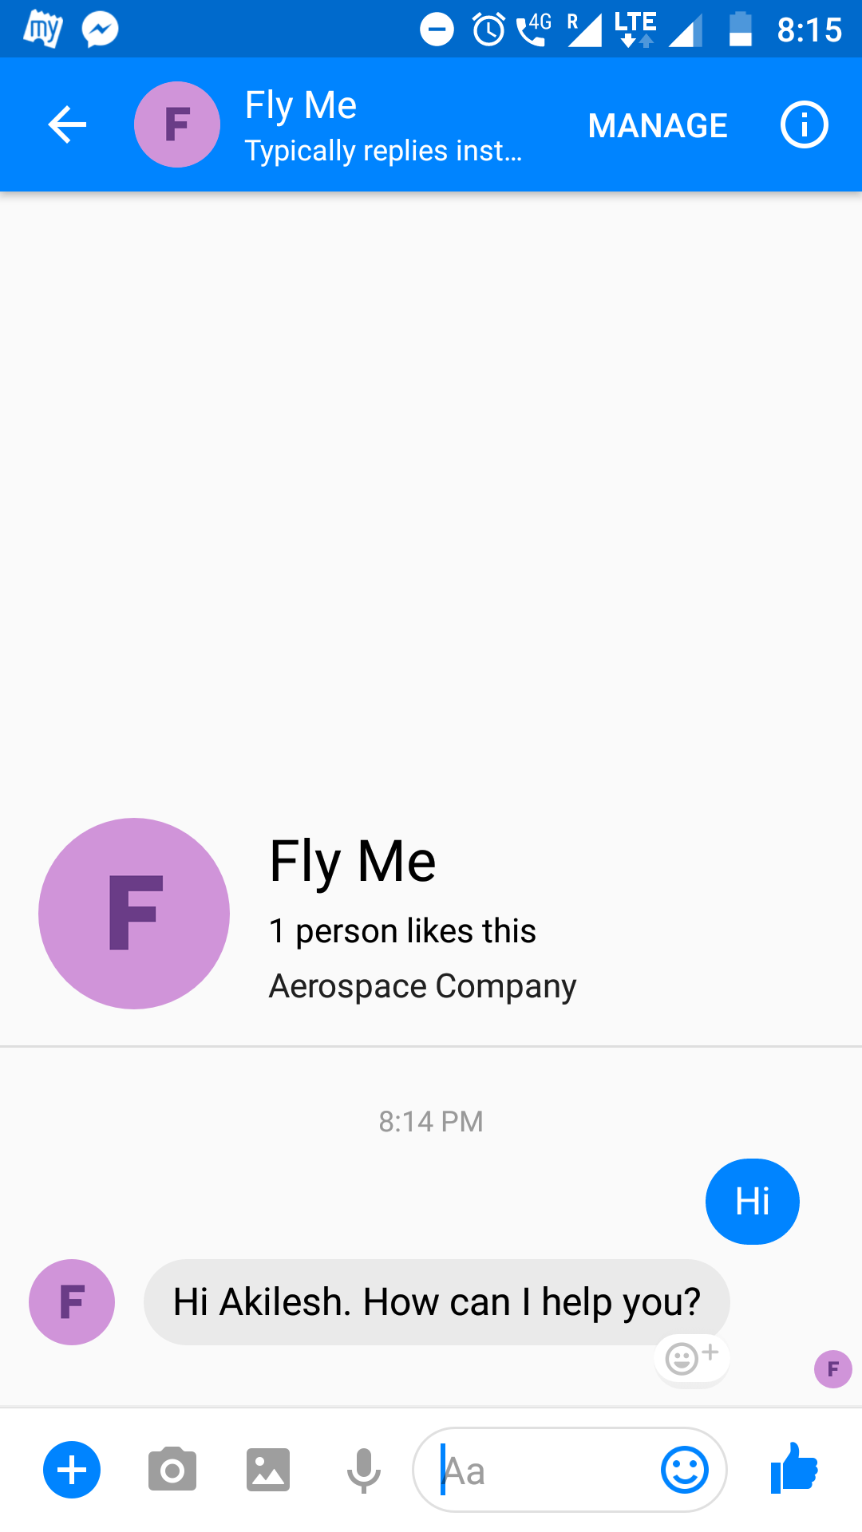
Deploy your Application on the Cloud: Heroku
Heroku setup
Comprehensive Tutorial: Setup Messenger bot using Python and Flask
Key steps
Setup requirements.txt
Setup Procfile for heroku
Create a facebook page associated with bot
Authentication
PAT - Page Access Token
New App on Facebook Developers website
Specify the callback url for webhook events as the heroku app url
Bot is ready to go!

Slide 11
Questions?

Slide 12
Thank you for bearing with me!
Happy to hear your feedback on my talk (positives and negatives)
Email: akilesh1995@gmail.com
Twitter: leshtalks

