Slide 1
Automated Sanction Checker using Chatbot
Developed and Designed by :Akilesh Balaji
Supervised by: Prof.Bilal Yousuf

Slide 2
Problem Statement
During the course of the recent pandemic crisis, independent and small businesses have found it difficult to make ends meet.
This happened due to fact that the government outsourced the offer relief funds through private independent banks, thus causing a bias in distribution of the money.
Many forms of malicious money laundering are being committed in the banking industry.
Thus the only solution for this problem is to use machine learning for automation of screening of customers

Slide 3
Objectives:
To build a chatbot that provides an interactive experience for the user
To develop a prominent Optical Character Recognition tool that scans the identification documents.
To formulate an Algorithm that provides High Level Screening of Customer based on KYC data and finds its similarity with the sanction checker.
To model various Machine Learning Algorithms that evaluates the efficiency of the application.

Slide 4
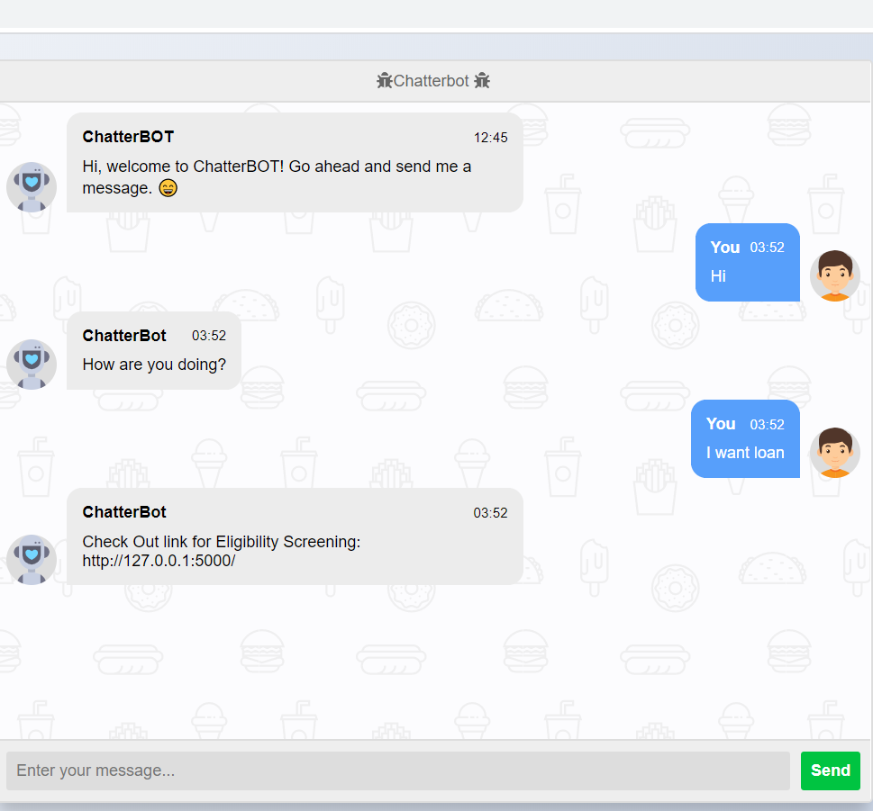
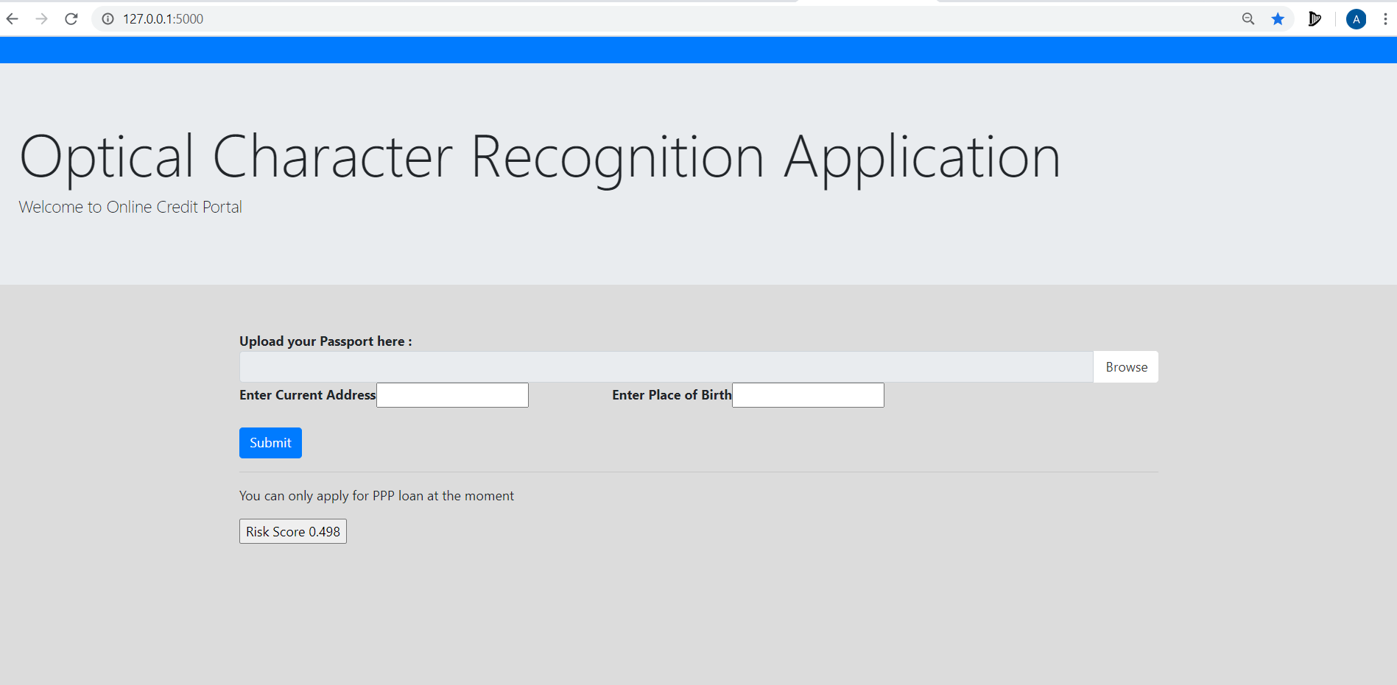
User Interface:
Usecase:
Consider, Mr.Steve the independent barber lose his business because of the pandemic. He can apply for loan based on the KYC data, he will be eligible to apply for loan from either banks or private

Slide 5
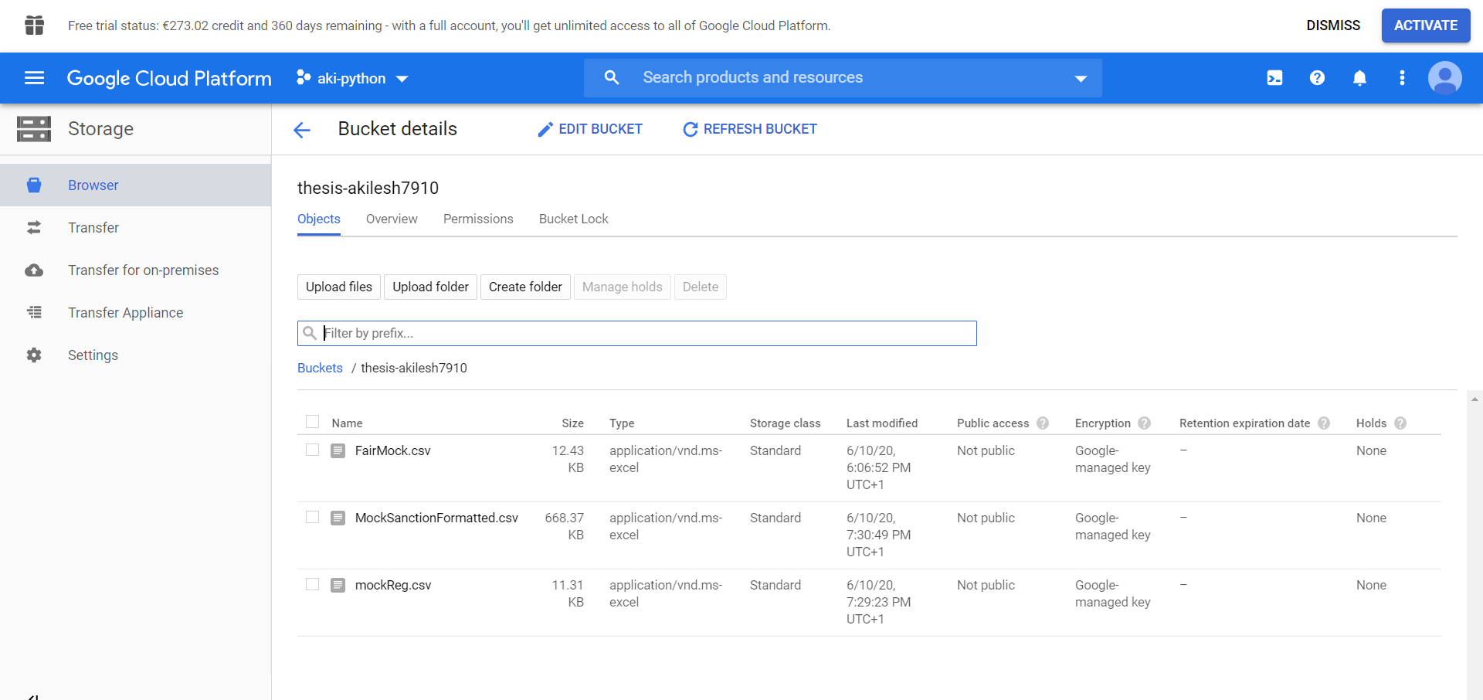
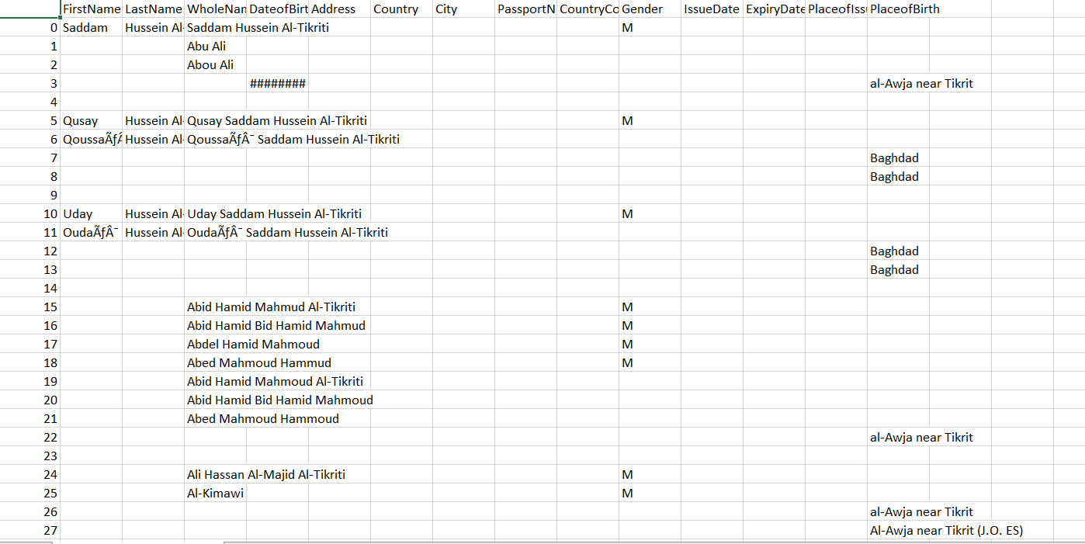
Pre-Processing: Sanction List
The pre-processed sanction list is stored in the Google Cloud Platform.

Slide 6
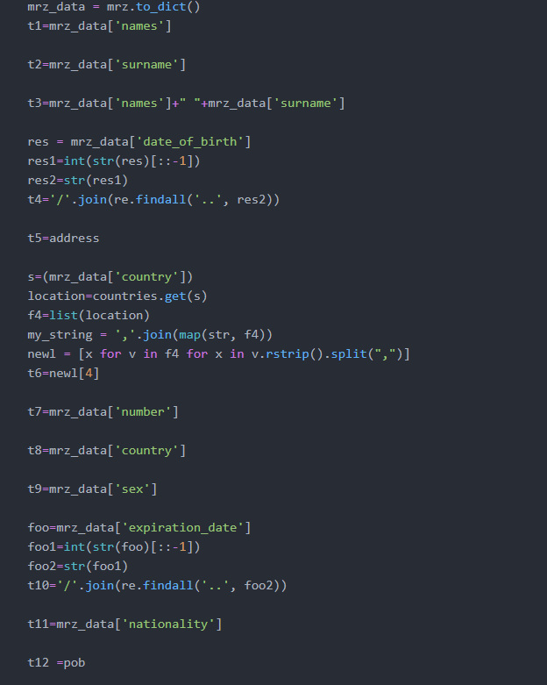
Optical Character Recognition
Library passporteye-Tesseract
Dependent Attributes:['FirstName','LastName','WholeName','DateofBirth','Address','Country','PassportNumber','CountryCode','Gender','ExpiryDate','PlaceofIssue','PlaceofBirth']

Slide 7
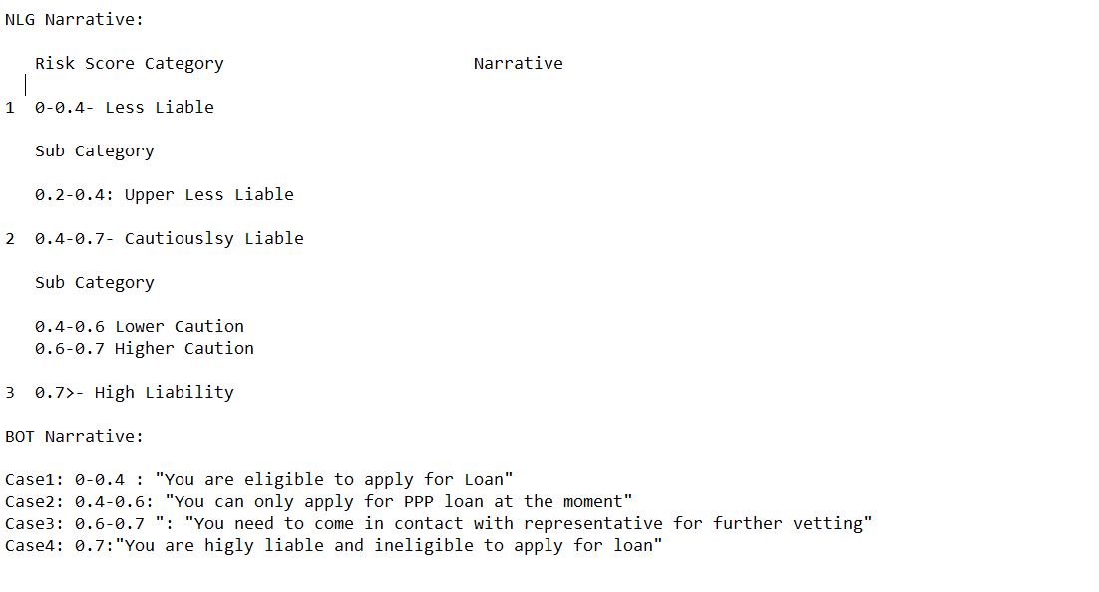
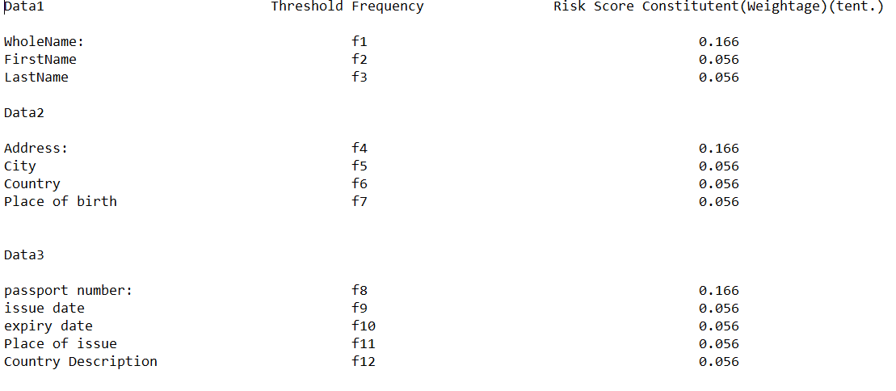
Algorithm:
N=Risk Score
At n=0,If n>f1,f2…fi, then n++.
For each n score the NLG narrative is generated.

Slide 8
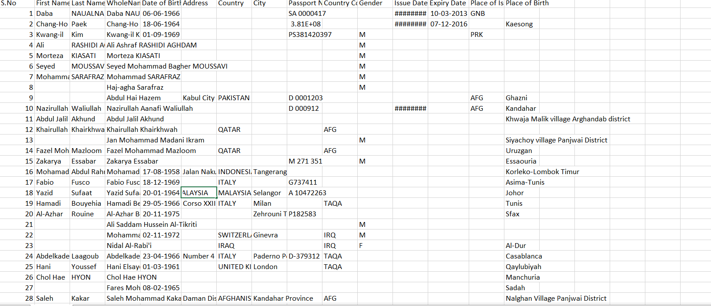
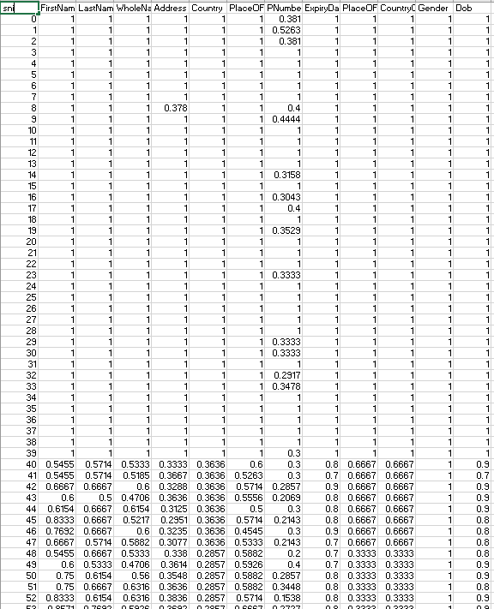
Mock Data: Generation
100 Mock Data- 40 data from sanction list- 60 randomly generated data.
Similarity checked using Levenshtein Algorithm.

Slide 9
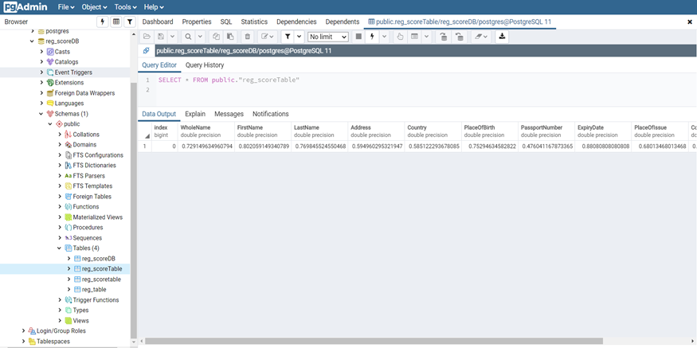
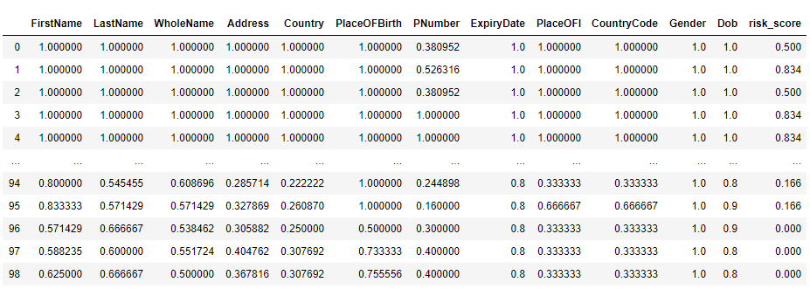
Mock Data Training
Threshold Frequency stored in PostgresSQL.
Risk Score for each data is stored in cloud

Slide 10
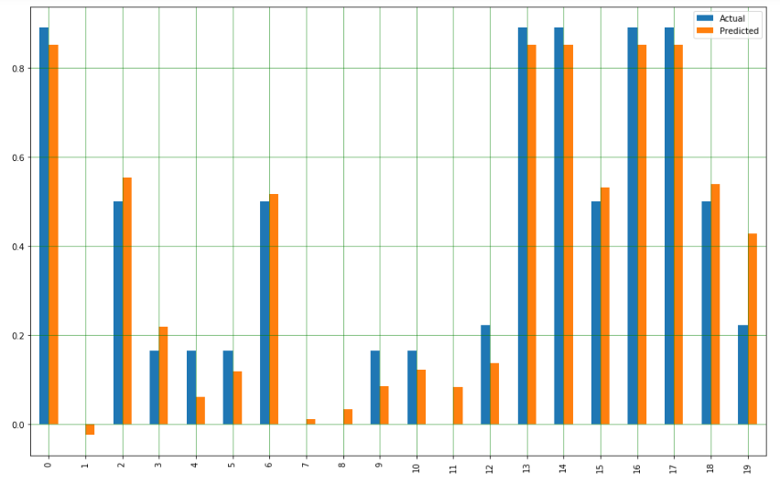
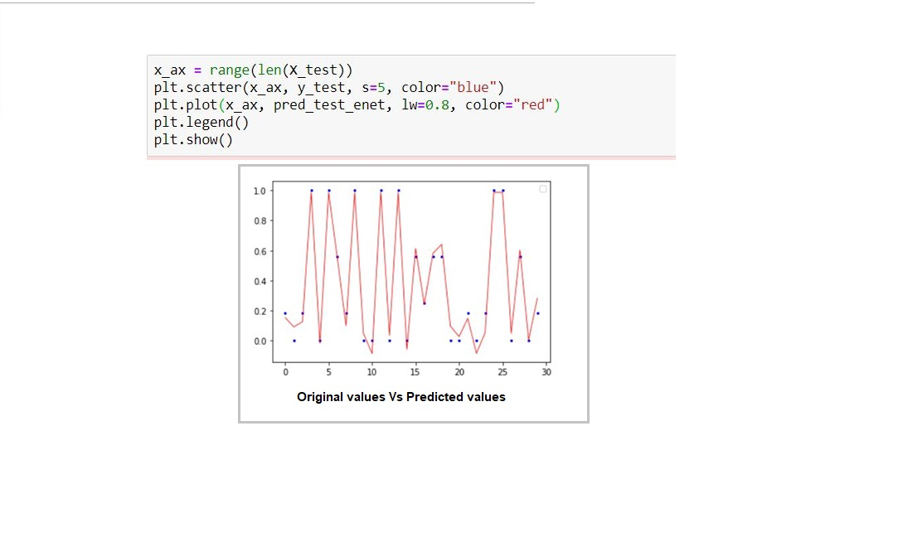
Model Evaluation-Machine Learning
Model Type | Multiple Linear | Ridge | Lasso | ElasticNet
RMSE Value | 0.00732 | 0.005 | 0.0918 | 0.0563
R^2 Value | 0.93 | 0.96 | 0.94 | 0.96

Slide 11
Findings and Future Works:
Model Accuracy : Solid
Future Works: Extension of the application stream different types of loan using Streaming service.
Make the Chat bot experience more interactive.
The only way to evolve in the field of AML is to adopt Automated AML algorithms which is on the same page with the AML regulation law.

