Slide 1
Complaint Tracker using Natural Language Processing
-Akilesh Balaji

Slide 2
Objective : To design an AI for tracking customer complaints registered through calls and websites. Solution : Topic Modelling is done by executing Natural Language Processing on the registered complaints. USP: As Italian complaints are considered, translation of text is done. The Tracking is made available for both online complaints and complaints made through phone call.

Slide 3
AI Training and Storage
Data
Scrape data from web using Python.
Storage
Store data in database.
Import data to csv file.
Output
Translate data to English in MS-Excel.
Run NLP program.
Produce Sentiment Analysis and Topic modelling.
In case of call complaints, the data is entered directly into the database.

Slide 4
Software Architecture
Database(Postgres SQL)
Python(NLTK)
Sentiment Analysis(VADER)
Topic Modelling
googletrans-lib/MS-Excel
Translation

Slide 5
Overview
Database(Postgres SQL)
Python(NLTK)
Sentiment Analysis(VADER)
Topic Modelling
googletrans-lib/MS-Excel
Translation
Scrape Data: The data is scraped from the website using Python.
Database: Postgres SQL is used to store the data.
Translation: The Italian complaints are translated using MS excel, as it is found to be more precise.
Topic Modelling: It is the process of segregating the complaints based on their topics and providing AI trained solutions. It is done by Python using Natural Processing NLTK library.
Natural Language Processing: Python library Natural Language Tool Kit is used to do this process. In this case, using the keyword taxonomy concept we segregate complaints and then produce the apt solution for the complaint.
Sentiment Analysis: Sentiment analysis is done using the VADER(Valence Aware Dictionary for Sentiment Reasoning) classification of the NLTK library.

Slide 6
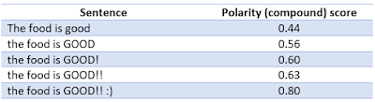
Natural Language Processing
Import data for mapping
Identify taxonomy words
Remove Punctuations
Drop empty rows if any and export data to it
Split sentences and append for topic categorization
Sentiment Classification
(VADER)

Slide 7
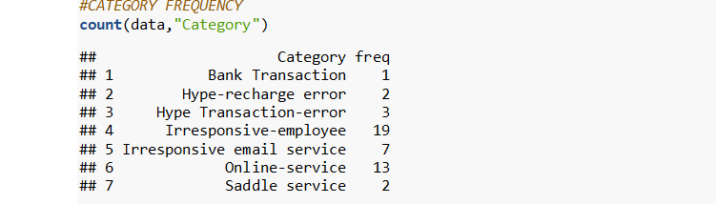
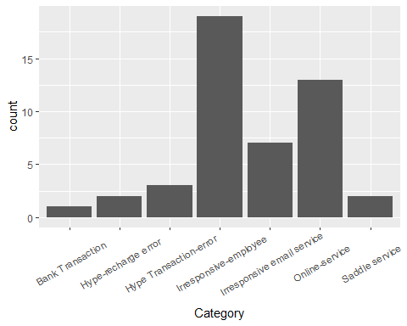
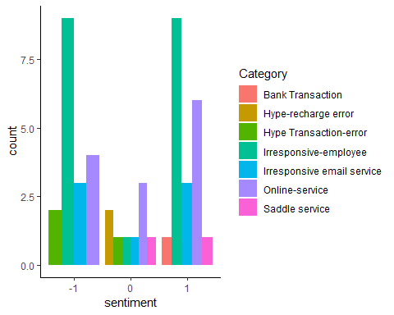
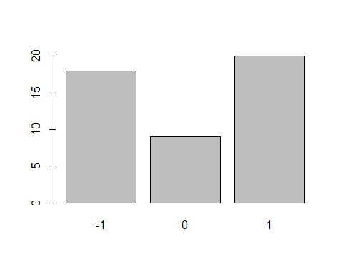
R-Chart Interpretation
Category Frequency
Category Chart
Sentiment-Category Relation
Sentiment Chart

