Slide 1
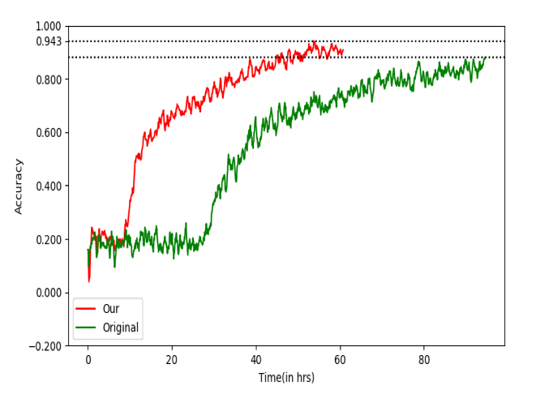
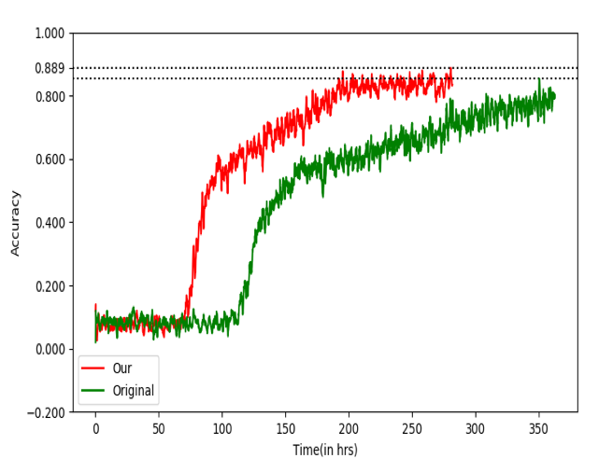

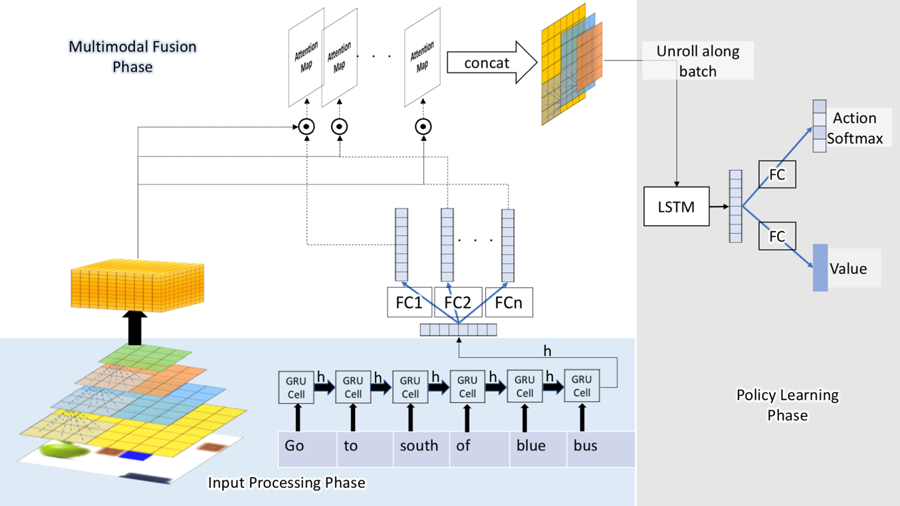



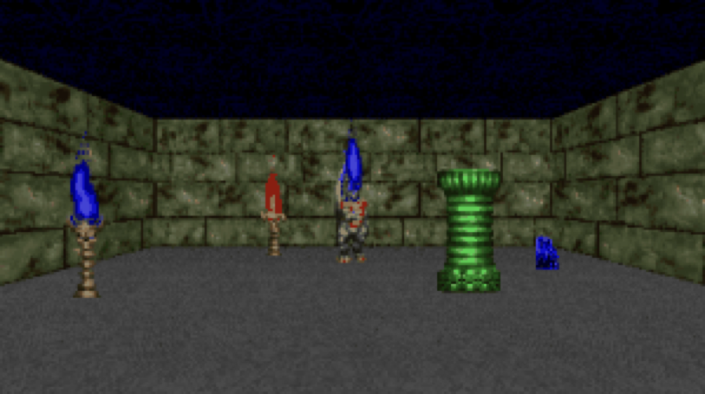
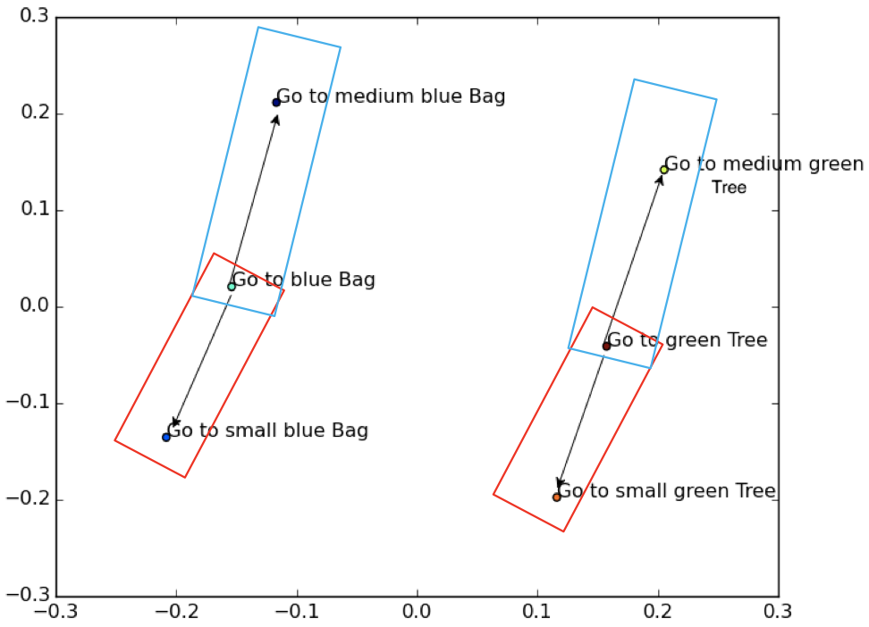
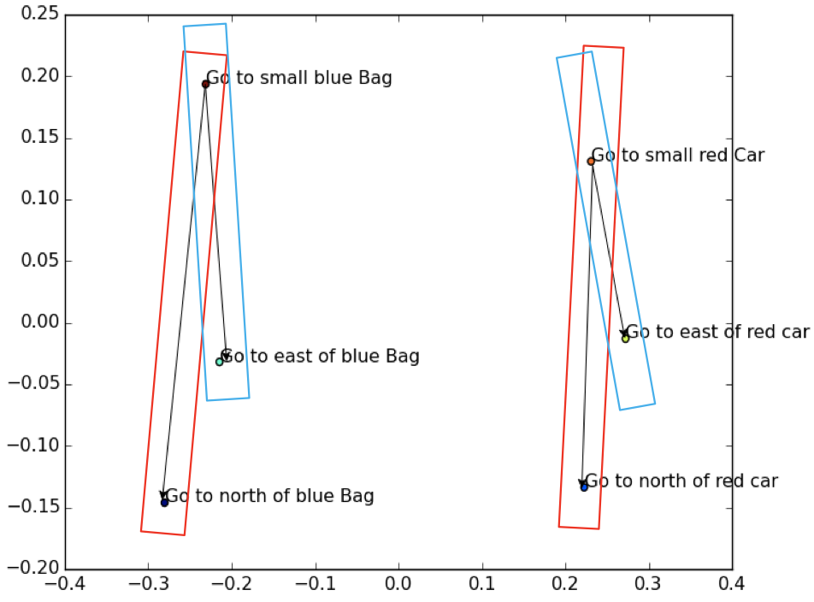
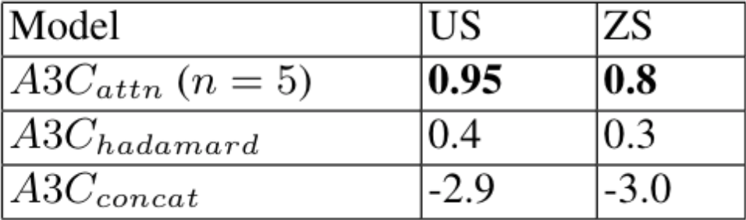
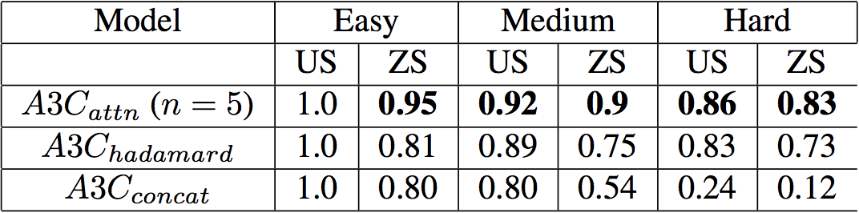
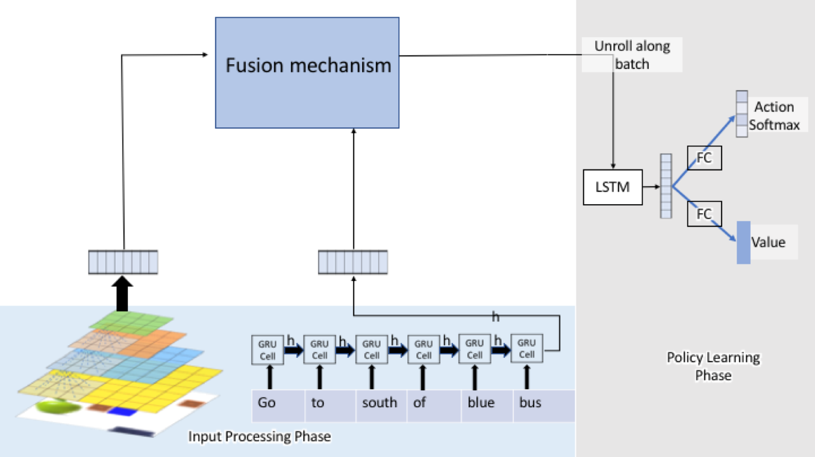
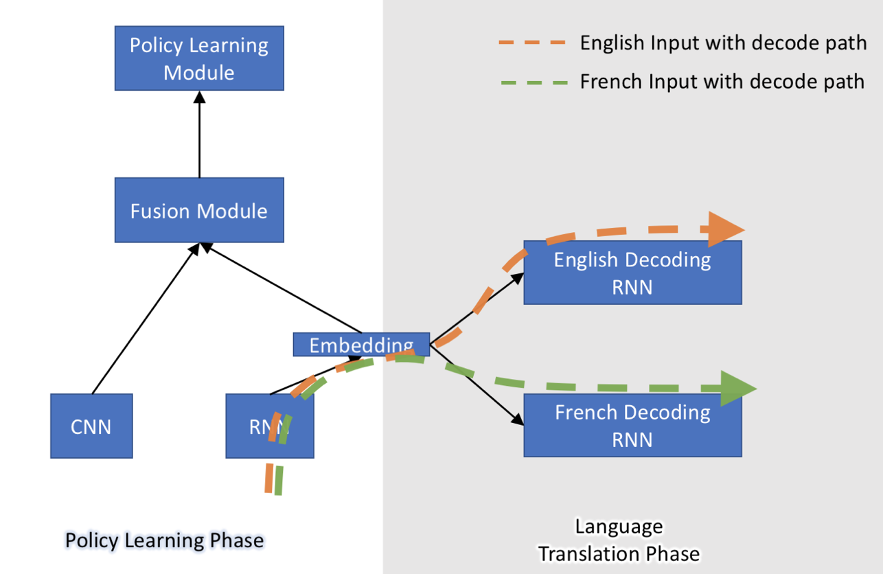
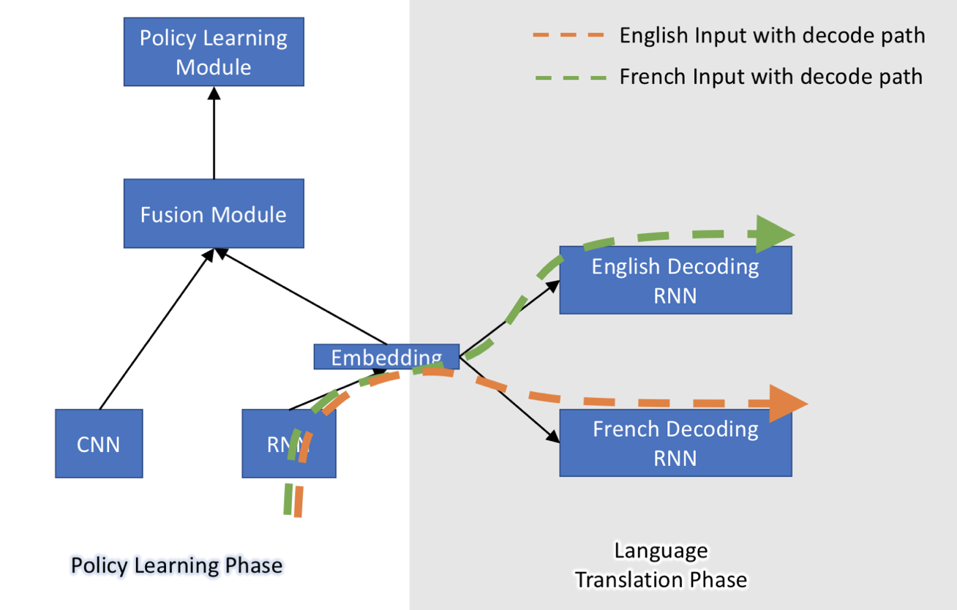
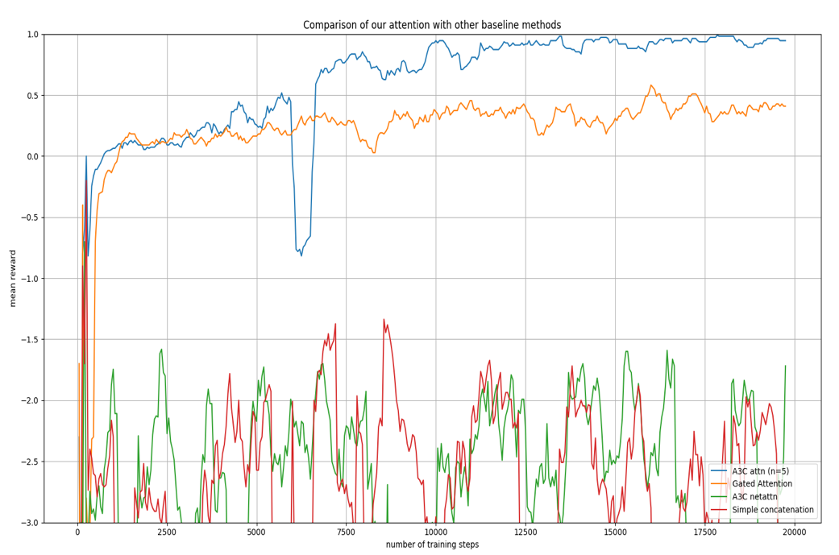
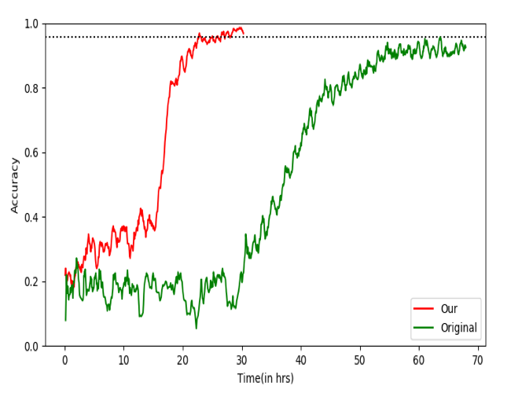
Attention Based Natural Language Grounding By Navigating Virtual Environment
Abhishek Sinha^{*1,} Akilesh B^{*1,} Mausoom Sarkar¹, Balaji Krishnamurthy¹
1. Adobe Systems, Noida
Introduction:
Language is grounded in context.
How do we teach agents the essence of words?
One possible way out is to train an agent to perform a navigation task aided by language.
Virtual Environments
Methodology:
Prior art
The two existing fusion mechanisms are –
1. Concatenation
2. Hadamard Product
Our Approach:
Results:
The main steps are :-
Compute image feature vector and the text feature vector.
Fuse the two feature vectors to get a combined representation.
Obtain the policy and the value from the representation.
Train using reinforcement learning (A3C algorithm).
63 different objects.
Each object has multiple colors and sizes.
Sample instructions –
If small red flower is present then go to small blue sofa else go to medium black bear.
There is a small yellow banana and a medium blue bus. Go to later.
3D (medium)
3D (hard)
Attention Maps:
Vector arithmetic:
VizDoom based 3D environment
70 different instructions.
3 different difficulty levels.
Sample instructions –
Go to the red tall torch.
Go to the largest green object.
Language translation:
Train Phase
Test Phase
2D
3D (easy)

