Slide 1
QE

Slide 2
Quiet
Exceptional

Slide 3

Quiet Exceptional
Lost
Your Phone?
Find a Misplaced Phone.
Even in Silent Mode.

Slide 4

Quiet Exceptional
Minimalistic
Ring after
MissedCalls
Missed Call Alerts.
Does not disturb babies.

Slide 5
Quiet Exceptional
EASY
Interface +
No Ads
No Complicated options.
Just Tap to start.
Let the App handle the rest.

Slide 6
Q
Temporary DND
Meeting
So you dont have to worry about switching back to a ringer mode.
Quiet Exceptional

Slide 7
Quiet Exceptional
Maximum
Privacy
No Data User Data leaves the Device without active user action.
No Internet Required.

Slide 8
Quiet Exceptional
Reach
A Friend
With SMS Alarm
!
Quiet Exceptional Alarm
Message App
Tap to stop ringing
Q
Quiet Exceptional

Slide 9
Quiet Exceptional
Alert if
Notification contains
„Custom Text“
For example „Bank“
!
Your Bank Account has ..
Message App

Slide 10
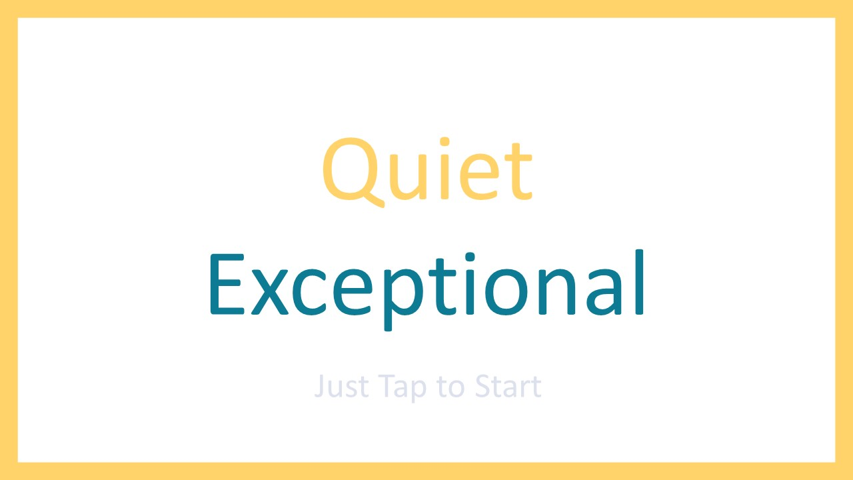

Slide 11


