Slide 1
Security Threats in Microservices
Akil Karthikeyen
Nandakishor

Slide 2
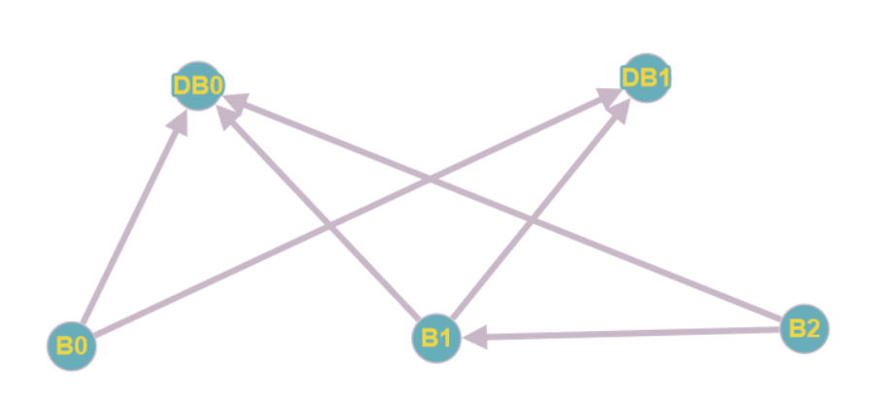

Building a graph
DB0, DB1 are database nodes
B0, B1, B2 are normal nodes
7001, 7002, 8001, 8002 and 8003 are port numbers of DB0, DB1, B0, B1 and B2 respectively.
Database nodes generate data, which is then passed over to normal nodes
Our aim was to build a script file that takes in a graph, along with port numbers as the input and creates database nodes(APIs) and normal nodes as per the graph and host them on the ports specified.
On the left is the graph we gave as the input

Slide 3
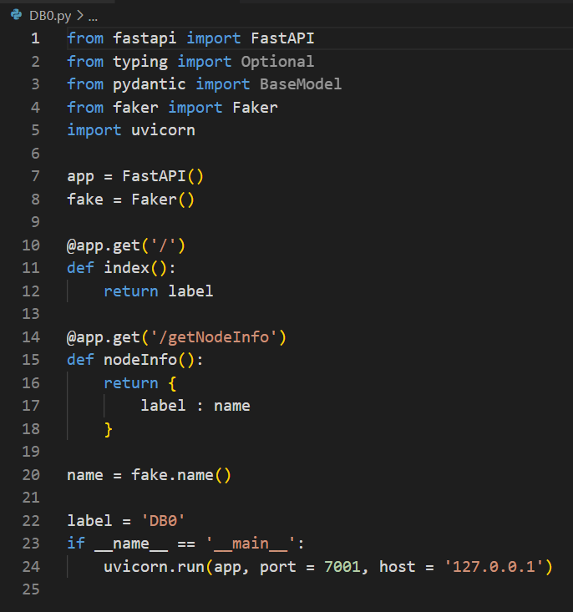
Database node’s skeleton
Has 2 ‘Get’ methods ‘/’ and ‘/getNodeInfo’
‘/getNodeInfo’ when invoked returns a JSON object of the form:
{ ‘NodeName’ : data }
The figure on the left is ‘DB0’, which is the NodeName
We use the library ‘faker’, to generate data randomly
All database nodes have this same structure. The only things that change are the NodeName, data generated and the port where it is hosted

Slide 4
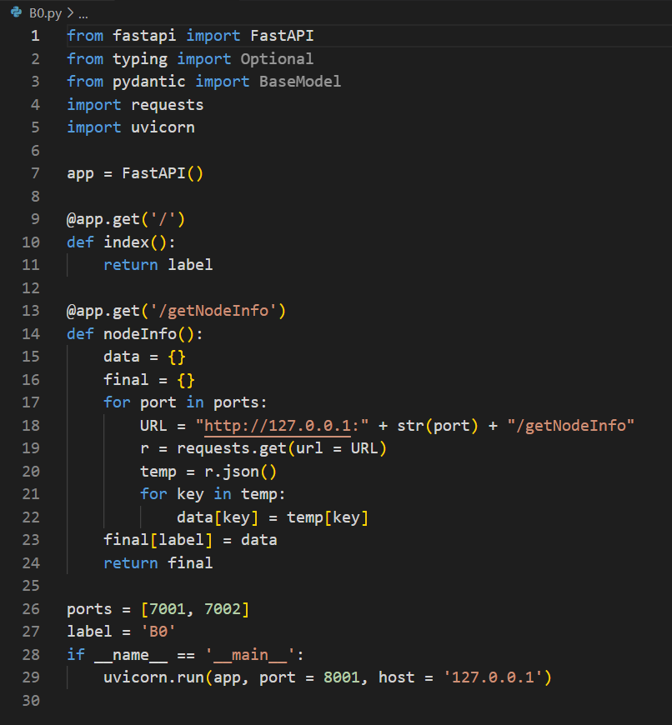
Node’s skeleton
Each node(B0, B1 and B2) has a list called ‘ports’ which has the port numbers of its parents, created according to the input graph
A get request is made to each of the parents and the data supplied is put together in form of a JSON object
{
‘NodeName’ : {
‘Parent1Name’ : Data1,
‘Parent2Name’ : Data2,
}
}
All non - database nodes have this same structure(the one shown on the left is ‘B0’)
The only things that change are the NodeName, list of parent ports and the port where this is hosted

Slide 5
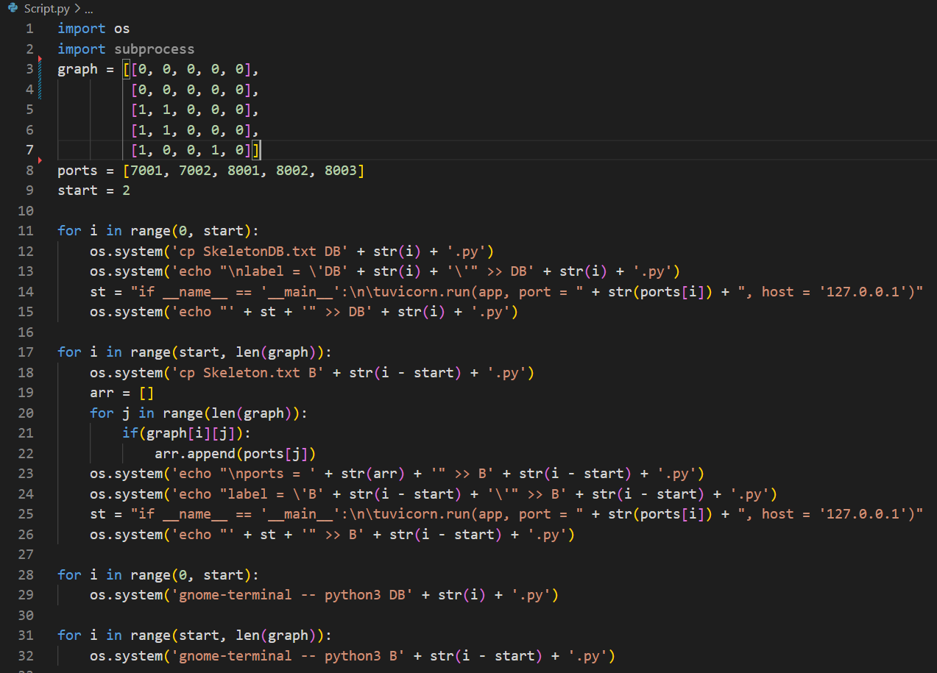
Script File - for automation

Slide 6
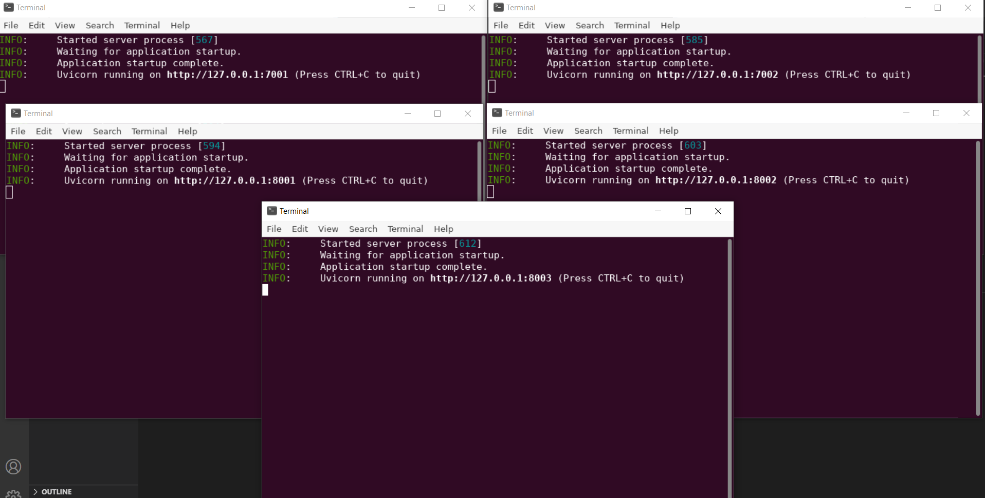
Screenshots

Slide 7
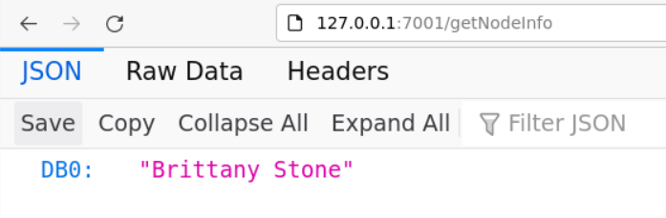
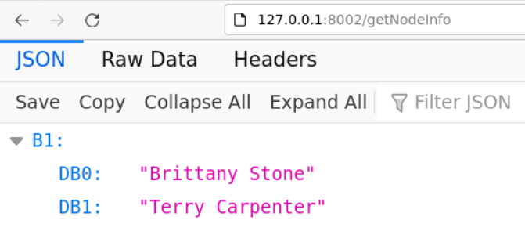
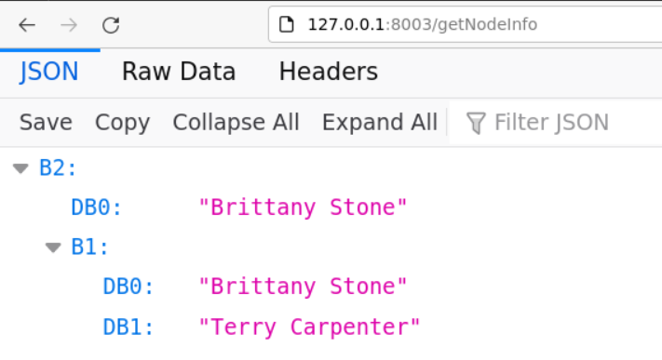
DBO
B1
B2

Slide 8
What has to be done next?
Things to be done before next meeting
Node features have to be introduced(anything that will show up as a dependabot alert)
Edge features have to be introduced(not clear how to introduce edge features yet)
The entire application has to be classified as being secure/insecure(not clear how to do this yet)
Learn about GNNs and how to work with them
To train a GNN, multiple graphs have to be created and each graph has to be classified as being secure/insecure(not clear how to generate such a big dataset and label them as secure/insecure)
Use node features and edge features to build the GNN
Explore Stellargraph
What is Stellargraph?
How it works?
Give a graph as input and observe what you get
Explore Graph Attention Networks(GAT)
Read the research paper
Understand the math behind it
See how it can be used in our project
Explore Call counts
What is call counts?
Tools for call counting

Slide 9
Codes available at Our Github repository
https://github.com/akilkarthikeyan/system-security/tree/master

