Slide 1
System Security Project
Akil and Nandakishor

Slide 2
Problem Statement
Analyzing the structure of microservice based-based applications and the dependencies between individual application components, to identify faults and security vulnerabilities in a static manner.

Slide 3
Roadmap
Build multiple instances of multiple microservices
Identify paths of flow of data for each API call
Build a graph to represent flow of data where nodes are APIs and edges are the calls made between them
Identify which nodes/APIs are secure/insecure
Identify which flows/calls are secure/insecure
Classify the entire graph/application as being secure/insecure
Build a graph neural network that takes the whole graph along with security findings of nodes and edges as features, to classify the entire application as being secure/insecure

Slide 4
Tools involved
FastAPI/OpenAPI
OpenTelemetry/OpenTracing/Jaeger
Weaver
Kong
GitHub Dependabot
TensorFlow

Slide 5
Log
Static analysis tools
Ran dependabot on eShopOnContainers
Also ran codeQL on the same
Ran codeQL on Hostel-Management
FastAPI and OpenAPI
Watched FastAPI tutorials
Created simple APIs and simulated multiple API calls

Slide 6
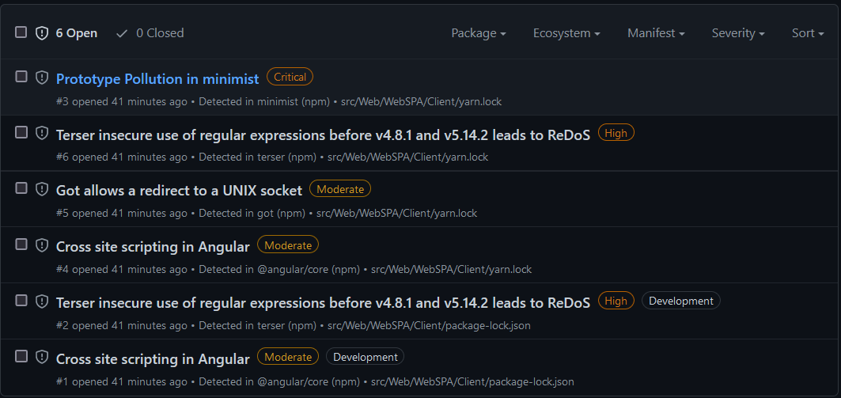

Slide 7
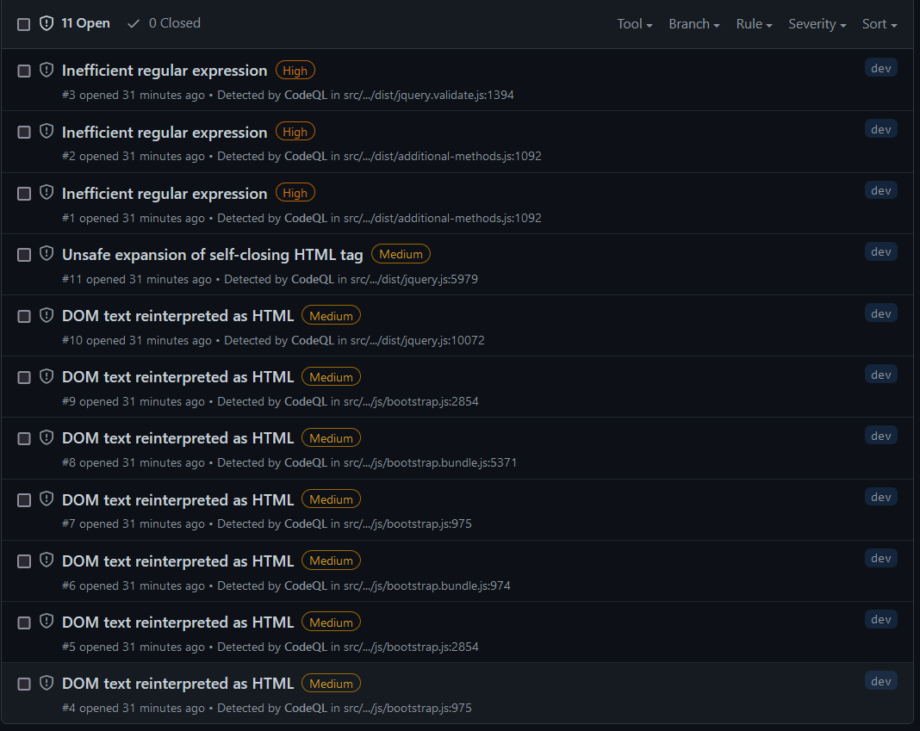

Slide 8
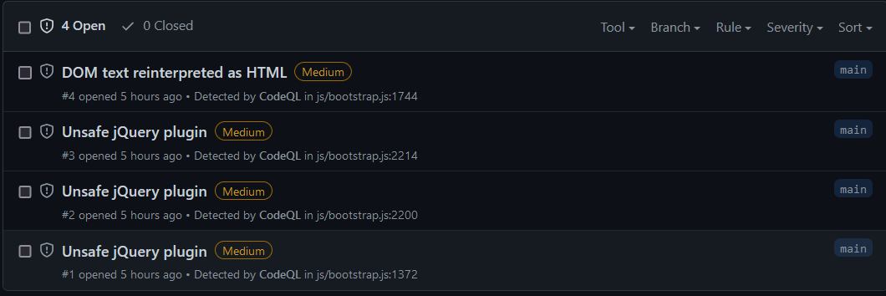

Slide 9
Log
OpenTelemetry
Went through OpenTelemetry Documentation for Flask and FastAPI
Ran Automatic Instrumentation for both Flask and FastAPI
Went through Manual Instrumentation (was a little complicated)
Also went through Light Step - a tool to visualize OpenTelemetry data
Conclusion
OpenTelemetry only showed information pertaining to the API on which it was being used
Did not have information about which API was calling which
Cannot use OpenTelemetry to build dependency graph between APIs

Slide 10
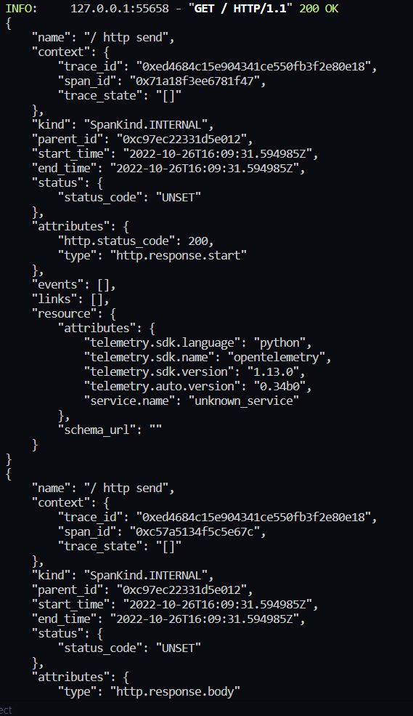
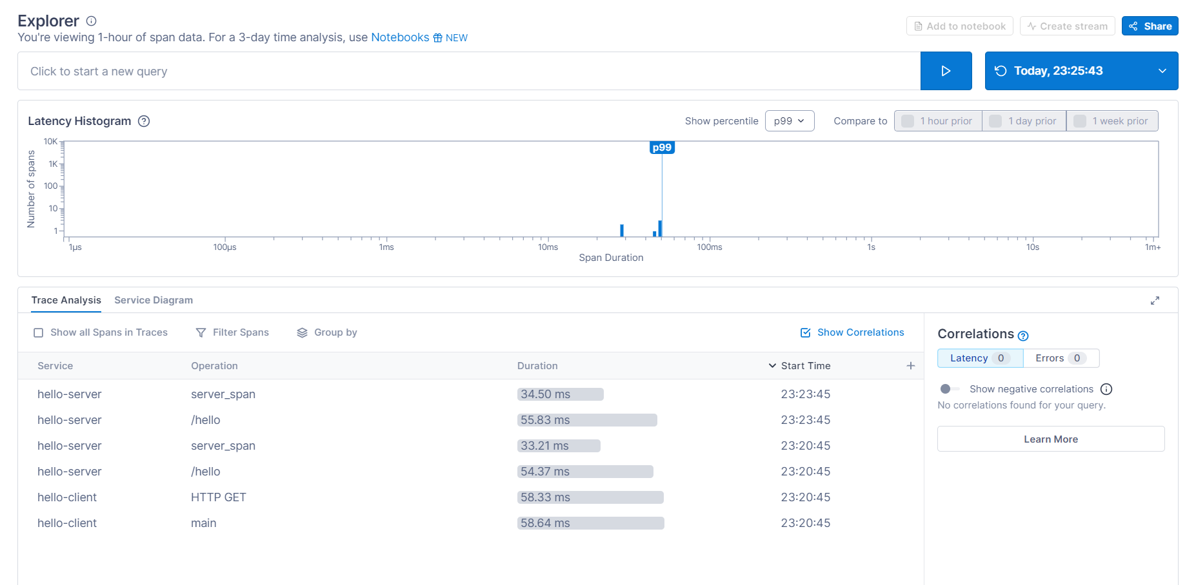

Slide 11
Log
Jaeger and OpenTracing
Very similar to OpenTelemetry
Not used much, and OpenTelemetry preferred over both
Conclusion
Since we were unable to build a dependency graph using OpenTelemetry, our other option was to build APIs and model API calls based on some graph. That way, we know which API is calling which and keep track of everything

Slide 12
Log
Modeling APIs and calls based on a graph
Started by designing a simple skeleton for APIs
Two types of API/nodes:
Database/root APIs that generate information
Other APIs that pass generated information to the leaf APIs that make initial calls
Cannot build each API individually, so we decided to automate the process
Our aim was to design a script file, whose input will be a graph
The script file should create the entire application(all APIs) and run it
Used a module called ‘faker’ to generate random data in the database nodes
Each API encapsulates data it receives and adds a header with its name(to verify later if the flow was correct)

Slide 13
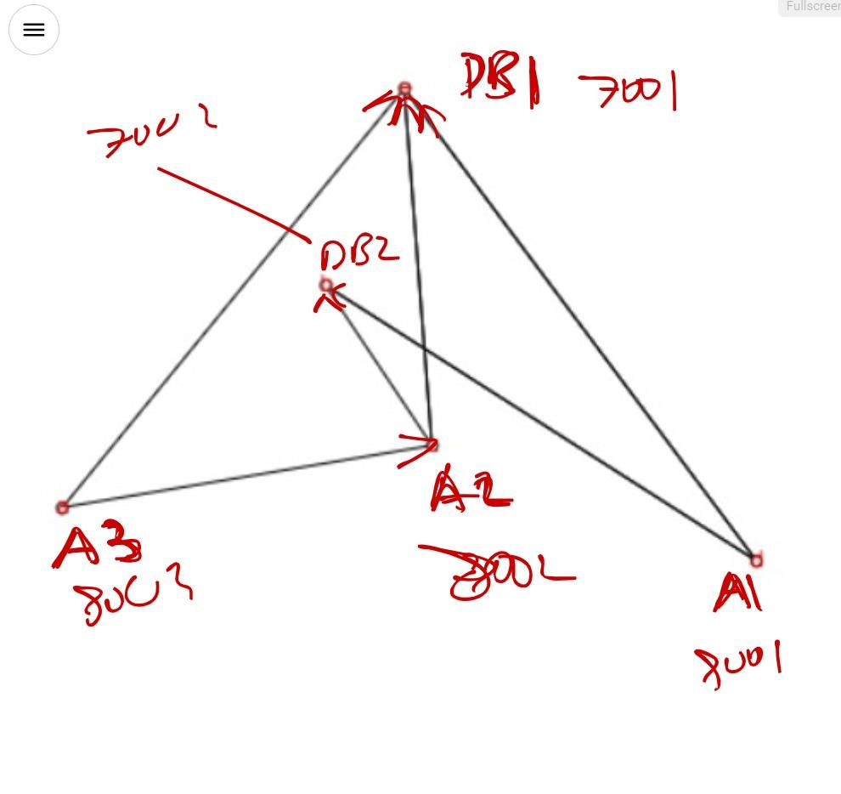

Slide 14
What has to be done next?
Node features have to be introduced(anything that will show up as a dependabot alert)
Edge features have to be introduced(not clear how to introduce edge features yet)
The entire application has to be classified as being secure/insecure(not clear how to do this yet)
Learn about GNNs and how to work with them
To train a GNN, multiple graphs have to be created and each graph has to be classified as being secure/insecure(not clear how to generate such a big dataset and label them as secure/insecure)
Use node features and edge features to build the GNN

