Slide 1
AI-Based Vulnerability Prioritization Engine using SBOM Context
REVA Academy for Corporate Excellence (RACE)
Name: Akil Kumar M N
Program: M.Tech in Cyber Security
Batch: CS10
SRN: R22MTC51
Date: 10th October 2026
Capstone 1/2: 2
race.reva.edu.in

Slide 2
Agenda
01
Introduction
Background | Why this study
06
Data & Model
Sources | Features | Table 1
02
Literature Review
Seminal works | Research gap
07
Backtest & Ablation
Tables 2 and 3
03
Problem Statement
Why CVSS alone fails
08
Live Demo & MLOps
Dashboard | Nightly retrain | API
04
Project Objectives
What Cap-2 had to prove
09
Limitations & Future Work
What the numbers do not show
05
Architecture & Methodology
Pipeline | Risk formula
10
References
Papers | Data sources

Slide 3
Background Information
Background
Traditional vulnerability management relies heavily on static CVSS scores, which fail to reflect the real-world risk, causing inefficiencies in risk prioritization and exposing systems to cyber attacks
Why This Study
This study proposes a risk-based prioritization framework integrating CVSS scores and SBOM data with threat intelligence and asset criticality to offer a proactive solution with business context-aware prioritization to generate context aware risk scores aiming to reduce risk exposure.

Slide 4
Literature Review
No. | Title | Author and Year | Journal | Description | Insights | Research Gaps/Comments
1 | A Statistical Approach to Severity Aware Vulnerability Prioritization | Year: 2024 Authors: Miguel Bicudo, Cainã Pereira, Lucas Miranda, and many more | IEEE | The study integrates historical weaponization data with CVSS scores to predict vulnerability severity, aiding better patch management. | Prioritizes vulnerabilities based on real-world risk. Balances timely patching with system stability. Enhances patch management efficiency. | The project introduces a risk-scoring engine that integrates not only CVSS and EPSS but also real-time TI feeds.
2 | User Vulnerabilities in AI-Driven Systems: Current Cybersecurity Threat Dynamics and Malicious Exploits in Supply Chain Management and Project Management | Year: 2024 Authors : Joseph Squillace, Justice Cappella, Andrew Sepp | IEEE | The study explores the cybersecurity vulnerabilities of AI and ML in critical infrastructure, with a focus on supply chain and project management. It highlights how AI and ML improve operations but also pose new risks, identifying threats and misuse cases through case studies. | AI and ML introduce both operational benefits and exploitable risks. Case studies reveal potential flaws and automation of cyberattacks Emphasizes the need for improved security practices in critical infrastructure | The paper focuses on AI and ML's role in securing PII and organizational policies but overlooks their application in vulnerability management, particularly in integrating real-time threat intelligence, asset criticality, and business impact for effective patch prioritization.
3. | ERS0: Enhancing Military Cybersecurity with AI-Driven SBOM for Firmware Vulnerability Detection and Asset Management | Year:2024 Max Beninger; Philippe Charland; Steven H. H. Ding; Benjamin C.M. Fung | IEEE | This paper outlines improving firmware security by generating SBOMs from firmware using string matching and code clone detection inside firmware binaries to provide asset visibility and vulnerability detection for analysis and component identification | The methodology is tailored for military contexts with hierarchical structures. Focuses on procedural clarity and continuous vulnerability management. Highlights the need for comprehensive defense mechanisms against cyber risks. | The gap is that the abstract focuses on military vulnerability management procedures but doesn’t include real-time threat data or context aware vulnerability prioritization.
4. | Supply Chain Risk Analysis Via SBOM Data Enrichment | Year: 2023 Authors:Antoine Lemay; Neeraj Katiyar | IEEE | The proposed approach enhances SBOM data with additional metadata such as vulnerability databases, dependency relationships, and supplier information. This enriched data is then used to perform risk analysis on software components and identify potential security issues within the supply chain. | Emphasized risk based on SBOM data for software analysis Identifying Supply chain security issues | The framework enriches SBOM data but mainly relies on static analysis or rule-based risk evaluation and Context-Aware Vulnerability Prioritization
Seminal works | Summary | Research Gap

Slide 5
Problem Statement
Problem Statement:
Vulnerability management processes depend on static CVSS scores, which do not account for real-time exploitability.
Asset criticality and business impact are often overlooked in prioritizing vulnerabilities.
Security teams struggle to choose which critical vulnerabilities to patch first when many share the same CVSS score.
Delayed remediation of high-risk vulnerabilities increases exposure to cyberattacks.
There is a need for a dynamic risk-based model that incorporates EPSS, SBOM component data, asset exposure to generate context aware risk scores

Slide 6
Project Objectives
Cap-1 proposed a context-aware score; Cap-2 had to make the "AI" real, measure it against CVSS and deploy it.
1
Learned exploitation likelihood
2
Context-aware ranking
3
Evidence and deployment
Gradient-boosted classifier trained on NVD CVEs with CISA KEV as the label.
Time split: train 2019–2023, validate 2024, test 2025.
Compared with CVSS-only and EPSS-only baselines (Table 1).
Five signals: model probability, EPSS, KEV, SBOM fan-in with asset criticality, CVSS scope.
Three rankings side by side: CVSS-only, Cap-1 formula, Formula + ML.
Business context from an optional asset-context file.
Time-frozen backtest: patch effort to cover 90% of later-exploited CVEs (Tables 2–3).
Nightly retrain with a regression gate, public dashboard, REST API.

Slide 7
Architecture and Methodology
Public sources
Nightly pipeline (GitHub Actions)
Dashboard (GitHub Pages) / API
NVD CVE feed (fkie-cad mirror)
Feature builder
CVSS vector, CWE, vendor KEV rate, references, keywords, PoC ≤30 days
Inputs (stay in the browser)
CycloneDX SBOM · Trivy / Nessus / CSV · asset-context.json
CISA KEV catalogue
KEV classifier
LightGBM, time split, Platt-calibrated
SBOM enrichment
correlation by bom-ref / purl; dependency depth and fan-in
FIRST EPSS (current + 2025-01-01)
Export + backtest
per-CVE probability + top-3 reasons; Tables 1–3; AUC gate > 0.80
Live intel
EPSS and KEV fetched live, cached 24 h, dated snapshot fallback
PoC-in-GitHub + Exploit-DB
Formula + ML risk score
Risk = 100 × (0.5·P_model + 0.3·EPSS + 0.2·KEV) × (0.5·CVSS impact/6 + 0.5·fan-in/max fan-in) × Crit_asset × Scope
Crit_asset = 1.5 / 1.25 / 1.0 for tier 1 / 2 / 3, ×1.2 if internet-facing · Scope = 1.15 if CVSS scope changed · SBOM depth and fan-in are not reachability
Live system: https://akilkumarmn.github.io/sbom-risk-engine/

Slide 8
Dataset, Features and Split
Source | Used for
NVD CVE feed (fkie-cad mirror) | CVSS vector, CWE, CPE vendor, references, dates
CISA KEV catalogue | label; dateAdded rebuilds KEV at any past date
FIRST EPSS | baseline, model variant, backtest input
PoC-in-GitHub, Exploit-DB | first public-PoC dates
Time-based split (NVD published date)
Train 2019–2023
108,024 CVEs · 784 KEV
Validate 2024
39,944 CVEs · 160 KEV
Test 2025
47,969 CVEs · 197 KEV
195,937
CVEs in the split
1,141
in CISA KEV
0.6%
positive rate
Features (knowable at publication)
CVSS base + one-hot vector · top-30 CWE · vendor/product KEV rate (target-encoded on training years, out-of-fold) · reference counts and exploit-site domains · description keywords (RCE, unauthenticated, deserialization, SSRF, auth bypass) · public PoC within 30 days of publication
Leakage guards: KEV-derived NVD fields and KEV-catalogue links are ignored; tested with planted traps.
Why not a random split?
A random split lets 2025 CVEs learn from their own vendors' later history. Splitting by date mimics deployment: the model only ever scores CVEs newer than everything it trained on.

Slide 9
Model Results — Table 1
2025 test year: n = 47,969 CVEs, k = 197 in KEV (0.4%)
Ranker | AUC-ROC | PR-AUC | P@100 | P@500 | R@1000 | Effort 90%
CVSS base score | 0.765 | 0.017 | 0.086 | 0.038 | 0.125 | 60.0%
EPSS (FIRST)* | 0.972 | 0.464 | 0.690 | 0.230 | 0.665 | 5.0%
Our model, without EPSS | 0.915 | 0.200 | 0.380 | 0.148 | 0.467 | 25.6%
Our model, with EPSS* | 0.983 | 0.548 | 0.720 | 0.286 | 0.807 | 3.8%
Logistic regression | 0.920 | 0.128 | 0.260 | 0.094 | 0.442 | 20.7%
Learner: lightgbm · Platt-calibrated on 2024 · metrics are expected values under random tie-breaking (CVSS ties thousands of CVEs).
* EPSS rows use today's EPSS file, which already reflects post-publication exploitation: an optimistic upper bound. The time-frozen comparison is the backtest.
Highlighted row = the project's own contribution, independent of EPSS.

Slide 10
Backtest - Table 2
19.3k vs 42.1k
mean rank of the later-exploited CVEs, Formula + ML vs CVSS-only (population case, N = 150,296, lower is better)
Effort to cover 90% of later-exploited CVEs
population: Formula + ML 36.7% · Formula 48.4% · CVSS 53.1% · EPSS 72.8%
Removing the ML probability costs +19.2 pp of patch effort (ablation).
50% / 75% coverage: ours 4% / 15% · CVSS 24% / 44% · EPSS 12% / 43%
SBOM case below: constructed validation fixture, not an application. The population case carries the claim.
kev-app (fixture): N=150, M=4 | Mean rank | P@10 open | Effort 90%
CVSS-only | 30.6 | 0.200 | 47.7%
Formula | 4.2 | 0.400 | 5.3%
Formula + ML | 6.2 | 0.300 | 10.0%
EPSS-only (ref.) | 5.0 | 0.300 | 8.7%

Slide 11
Ablation — Table 3
Signal removed | kev-app: effort 90% | change | population: effort 90% | change
None (full Formula + ML) | 10.0% | +0.0 pp | 36.7% | +0.0 pp
ML probability | 8.7% | -1.3 pp | 55.9% | +19.2 pp
EPSS | 38.0% | +28.0 pp | 46.4% | +9.7 pp
KEV flag | 10.0% | +0.0 pp | 36.6% | -0.0 pp
Blast radius (fan-in) | 14.7% | +4.7 pp | n/a | —
Scope multiplier | 10.7% | +0.7 pp | 36.3% | -0.3 pp
Asset criticality | 10.7% | +0.7 pp | n/a | —
Reading the table
ML probability: helps (+19.2 pp on population)
EPSS: helps (+9.7 pp on population)
KEV flag: no measurable effect (-0.0 pp on population)
Blast radius (fan-in): helps (+4.7 pp on kev-app)
Scope multiplier: no measurable effect (-0.3 pp on population)
Asset criticality: helps (+0.7 pp on kev-app)
Positive change = removing the signal made the ranking worse. A signal that hurts is reported, not hidden.
Only the Likelihood weights (0.5 / 0.3 / 0.2) are hand-set; this table is the evidence for keeping or dropping each term. Fan-in and asset criticality only exist in the SBOM case.

Slide 12
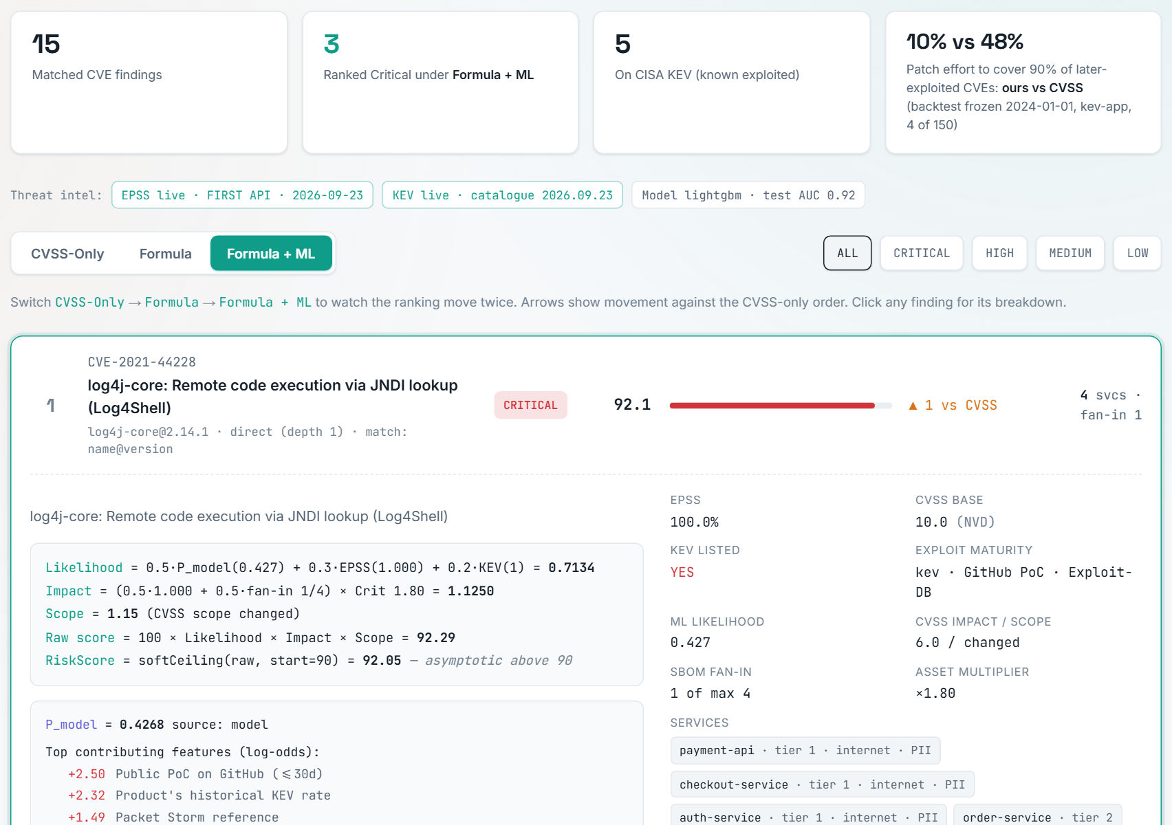
Live Demo — Dashboard
Three-way toggle
CVSS-only → Formula → Formula + ML: the ranking moves twice.
ML signal card
Test AUC read from model_meta.json, never typed by hand.
Per-finding breakdown
P_model and its top-3 feature contributions, formula terms, services.
Live threat intel
EPSS and KEV fetched live with a dated snapshot fallback; only CVE IDs leave the browser.
Asset context upload
Tier and exposure multiply Impact.
https://akilkumarmn.github.io/sbom-risk-engine/

Slide 13
MLOps — Nightly Retrain and API
Fetch feeds
Build features
Train + Table 1
Export shards
Backtest
Tests + gate
Commit + deploy
retrain.yml · cron 30 21 * * * (03:00 IST) · the Pages deploy is called directly after the commit
✓
Regression gate
=
One formula, two engines
{}
REST API (FastAPI + Docker)
The nightly model is published only if test AUC > 0.80 on real data, the backtest exists and the Python/JavaScript parity tests pass.
A failed gate keeps yesterday's model online.
engine/scoring.py (backtest, API) and site/engine.js (browser) are checked for identical scores on every push (tests.yml).
Leakage traps and the backtest answer key are tested too.
POST /score: SBOM + scan (+ asset context) → ranked list with all three scores and top features.
docker run -p 8080:8080 sbom-risk-engine → Swagger UI at /docs

Slide 14
Outcomes against the Cap-1 Expectations
Cap-1 expected result | What Cap-2 measured | Evidence
Smarter identification of prioritized vulnerabilities | Model without EPSS: test AUC 0.915 vs CVSS 0.765 | Table 1
Reduction in patch workload | Mean rank of later-exploited CVEs 19.3k (ours) vs 42.1k (CVSS); effort to cover 90%: 36.7% vs 53.1% | Table 2
Reduction in MTTR | Not measurable without remediation timestamps — dropped as a claim | Limitations
Improved risk visibility | Per-finding breakdown, top features, live intel badges, three-way toggle | Dashboard
Rule used for this deck: every claim points at a number in Tables 1–3 or at the running system.
Numbers are read from site/model_meta.json and site/backtest.json by scripts/build_deck.py · results snapshot v1.0-cap2 · generated 2026-09-24

Slide 15
Limitations and Future Work
Limitations
– KEV is an incomplete, US-federal-biased label; "not in KEV" is not "never exploited".
– Low prevalence limits precision; PR-AUC and precision@k are the honest metrics.
– EPSS already encodes much of the signal; the model without EPSS is the independent contribution.
– Backtest CVSS is today's NVD value; one SBOM yields few later-exploited CVEs (population case added).
– The generated backtest fixture is a constructed validation set, not an application: its packages carry the answer-key CVEs and its dependency tree is one level deep.
– SBOM depth and fan-in are not reachability; asset context is user-supplied, not discovered.
– Nessus findings without a CPE are skipped (counted in the log).
Future work
– Call-graph reachability analysis for Java dependencies.
– VEX ingestion to suppress not-affected findings.
– Learn the Likelihood weights end to end from backtest outcomes.
– Relabel with organisation-specific incident data.

Slide 16
References
1. A Statistical Approach to Severity Aware Vulnerability Prioritization, IEEE, 2024. https://ieeexplore-ieee-org-reva.knimbus.com/document/10815757
2. User Vulnerabilities in AI-Driven Systems: Current Cybersecurity Threat Dynamics and Malicious Exploits in Supply Chain Management and Project Management, IEEE, 2024. https://ieeexplore-ieee-org-reva.knimbus.com/document/10459480
3. ERS0: Enhancing Military Cybersecurity with AI-Driven SBOM for Firmware Vulnerability Detection and Asset Management, IEEE, 2024. https://ieeexplore-ieee-org-reva.knimbus.com/document/10685598
4. Supply Chain Risk Analysis Via SBOM Data Enrichment, IEEE, 2023. https://ieeexplore-ieee-org-reva.knimbus.com/document/11014830
5. J. Jacobs, S. Romanosky, B. Edwards, I. Adjerid, M. Roytman, "Exploit Prediction Scoring System (EPSS)", Digital Threats: Research and Practice, 2(3), 2021. https://www.first.org/epss/
6. G. Ke et al., "LightGBM: A Highly Efficient Gradient Boosting Decision Tree", NeurIPS, 2017.
7. CISA, Known Exploited Vulnerabilities Catalog. https://www.cisa.gov/known-exploited-vulnerabilities-catalog
8. OWASP CycloneDX Bill of Materials Standard. https://cyclonedx.org/specification/overview/

Slide 17


