Slide 1

Digital Marketing
Essentials

Slide 2
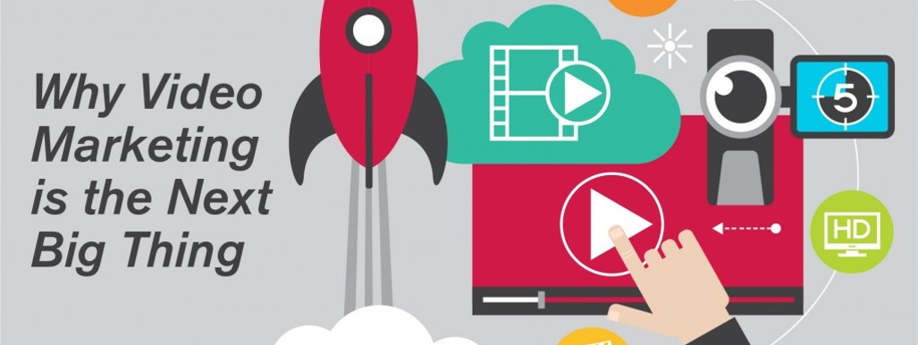
Video is still the king
Video allows users to watch and listen to the ad without having to devote large portion of their concentration to reading copy

Slide 3

Interactive emails
Interactive emails allow customers to add items to their carts, choose between colors and styles and even play games right in the inbox.

Slide 4
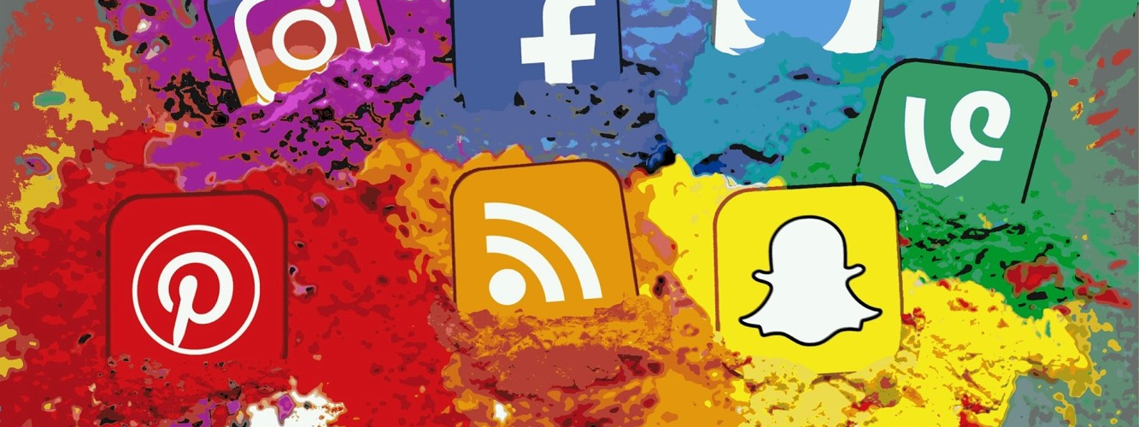
Social video will explode in popularity
Video uploads on just Facebook alone have grown by 75% over last year. Auto play videos, Live videos adds a lot of features

Slide 5

Mobile is making bigger inroads
Google is beginning to demote sites that do not have adequate mobile optimization

Slide 6

Linking Machine learning and marketing automation
Google Rank Brain
Boomtrain

Slide 7
Countdown timer emails
Countdown timers help convince would-be customers that the proverbial window is closing and that they must take action now.

