Slide 1
Decision Trees

Slide 2
Enriching training and learning session…
Training Checklist
Sitting arrangement F2F
Quality over Quantity
Everyone to have their own machines for
hands-on practice
Illuminated and happy glowing training
room (no candle light dinner ambience)
Anyone wanting to step-out, feel free
Feel free to ask for breaks
Feel free to ask same question again till you understand
Let me know if you want me to skip Practice Exercises in between the session
Brief side-talks are okay
I don’t speak to walls, respect each
other
Involvement
Enriching Training
Content
Duration

Slide 3
Classification Tree
CART

Slide 4
Learning Objectives
What is Classification Technique?
CHAID, CART, C4.5 Intro
Gini Gain Computation
Why are Classification Tree algorithms Recursive?
What is pre-pruning and post-pruning in Classification Tree?
What is Loss?
What is Validation? What is Cross-Validation?
Why you should avoid over-fitting?
Performance Measure

Slide 5
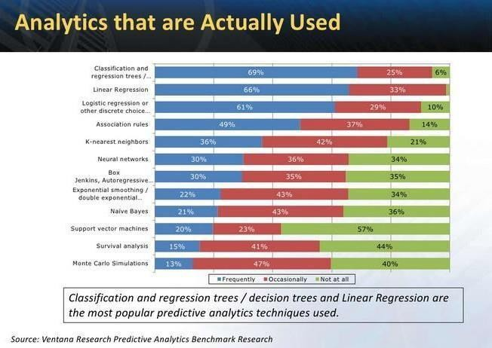

Analytics that are actually used
5

Slide 6
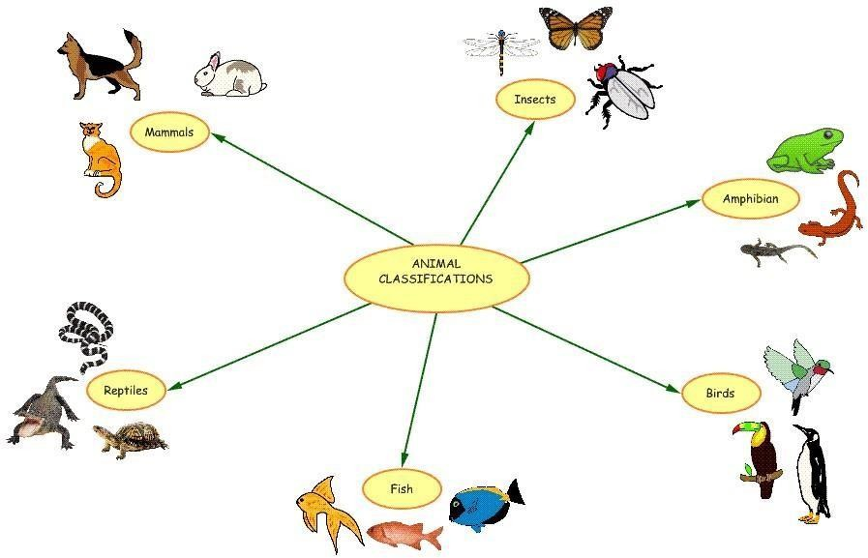
What is Classification?
The action or process of classifying something according to shared qualities or characteristics.

Slide 7
Defining Characteristics of each animal classification
Mammals – Mammals are vertebrates (backboned animals). Mammals are warm-blooded and have hair. Mammals are able to move around using limbs
Birds – Birds are warm-blooded vertebrates, having a body covered with feathers, forelimbs modified into wings, scaly legs, a beak, and no teeth, and bearing young ones in a hard-shelled egg
Insects – any of small invertebrate animals which typically have a well defined head, thorax, and abdomen, only three pairs of legs, and typically one or two pair of wings
Amphibian - any cold-blooded vertebrate that live on land but breed in water
Reptiles - class of cold-blooded air-breathing vertebrates with completely ossified skeleton and a body usually covered with scales or horny plates
Fish - A limbless cold-blooded vertebrate animal with gills and fins and living wholly in water

Slide 8
To Explain (Profile)
Why Classify?
Explaining in the classification world is called Profiling
or
To Predict (Classify)
Predicting the class of new records is called Classifying

Slide 9
Win Back Campaign Classification Analysis
Parent Node
Total
Dud | 10,000 | 100%
W.B. | 3,500 | 100%
W.B.% | 35.0%
Dud | Dud Accounts (Inactivefor long period)
W.B. | Win Back
Child Node
 | Ina ct | ive <6 | Mths |  | Inactive 6 - 12Mths
 |  |  | 40%
 | Dud | 4,000 |  |  | Dud | 2574 | 26%
 | W.B. | 2,100 | 60% |  | W.B. | 921 | 26%
W.B.% |  | 52.5% |  |  | W.B.% | 35.8%
Inactive > 12Mths
Dud | 3,426 | 34%
W.B. | 479 | 14%
W.B.% | 14.0%
InRteorontaNlNodoede
Lien Chrg > 5K |  |  |  | Lien Chrg 1Kto 5K |  |  |  | Lien Chrg < 1K |  |  |  | Acc Balance<1000 |  |  |  | Acc Balance >=1000
Dud | 1,550 | 16% |  | Dud | 1,250 | 13% |  | Dud | 1,200 | 12% |  | Dud | 1,234 | 12% |  | Dud | 1,340 | 13%
W.B. | 421 | 12% |  | W.B. | 601 | 17% |  | W.B. | 1,078 | 31% |  | W.B. | 152 | 4% |  | W.B. | 769 | 22%
W.B.% | 27.2% |  |  | W.B.% | 48.1% |  |  | W.B.% | 89.8% |  |  | W.B.% | 12.3% |  |  | W.B.% | 57.4%
AccTy | pe SAL= | TRUE | Acc Type SAL=FALSE |  |  |  | Gender =Female |  |  |  | Gender =Male |  |  |  | Cnt Txns Last Active Mth <10 |  |  |  | Cnt Txns Last Active Mth >=10
Dud | 275 | 3% |  | Dud | 1,275 | 13% | Dud | 450 | 5% |  | Dud | 800 | 8% |  | Dud | 311 | 3% |  | Dud | 1,029 | 10%
W.B. | 70 | 2% |  | W.B. | 351 | 10% | W.B. | 129 | 4% |  | W.B. | 472 | 13% |  | W.B. | 85 | 2% |  | W.B. | 684 | 20%
W.B.% | 25.5% |  |  | W.B.% | 27.5% |  | W.B.% | 28.7% |  |  | W.B.% | 59.0% |  |  | W.B.% | 27.3% |  |  | W.B.% | 66.5%
Gender =Male |  |  |  | Gender = Female |  |  |  | t Txns Last Active Mth<
Dud | 540 | 5% |  | Dud | 735 | 7% |  | Dud | 250 | 3%
W.B. | 300 | 9% |  | W.B. | 51 | 1% |  | W.B. | 35 | 1%
W.B.% | 55.6% |  |  | W.B.% | 6.9% |  |  | W.B.% | 14.0%
Cnt Txns Last Active Mth >=10
Dud | 550 | 6%
W.B. | 437 | 12%
W.B.% | 79.5%
Leaf Node Leaf/Node Terminal Node
Terminal Node

Slide 10
Main issues of classification tree learning
Choosing the splitting criterion
Impurity based criteria
Information gain
Statistical measures ofassociation
Binary or multiway splits
Multiway split
Binary split
Finding the right sized tree
Pre-pruning
Post-pruning

Slide 11
Popular Classification Techniques
CHAID - CHi-squared Automatic Interaction Detector. The “Chi- squared” part of the name arises because the technique essentially involves automatically constructing many cross-tabs, and working out statistical significance of the proportions. The most significant relationships are used to control the structure of a tree diagram
CHAID is a non-binary decision tree; Recursive Partitioning Algorithm
Continuous variables must be grouped into a finite number of bins to
create categories.
CLASSIFICATION AND REGRESSION TREES (CART) are binary
decision trees, which split a single variable at each node.
The CART algorithm recursively goes though an exhaustive search ofall
variables and split values to find the optimal splitting rule for each node.
C4.5 builds decision trees from a set of training data using the concept of information entropy

Slide 12
CART

Slide 13


CART | Splitting Criteria
CART uses the Gini Index as measure of impurity
Gini of a Node
(NOTE: p( j | t) is the relative frequency of class j at node t).
Gini of Split Node is computed as Weighted Avg Gini of each Node
at Split Node level
n_{i} = number of records at child i,
n = Total number of records in parent node
Gini Gain = Gini(t) – Gini(split)

Slide 14


Gini calculations
Cust_ID | Gender | Occupation | Age | Target
1 | M | Sal | 22 | 1
2 | M | Sal | 22 | 0
3 | M | Self-Emp | 23 | 1
4 | M | Self-Emp | 23 | 0
5 | M | Self-Emp | 24 | 1
6 | M | Self-Emp | 24 | 0
7 | F | Sal | 25 | 1
8 | F | Sal | 25 | 0
9 | F | Sal | 26 | 0
10 | F | Self-Emp | 26 | 0
Root Node
N:10; T:4
Gender
M
N: 6; T: 3
F
N: 4; T: 1
Node | Gini Computation Formula | Gini Index
Overall | = 1 - ( (4/10)^2 + (6/10)^2 ) | 0.48
Gender = M | = 1 - ( (3/6)^2 + (3/6)^2) | 0.50
Gender = F | = 1 - ( (1/4)^2 + (3/4)^2) | 0.375
Gender | = (6/10) * 0.5 + (4/10) * 0.375 | 0.45
Gini Gain | = Gini (Overall) – Gini (Gender) | 0.03

Slide 15

Gini calculations
Root Node
N:10; T:4
Node | Gini Computation Formula | Gini Index
Overall | = 1 - ( (4/10)^2 + (6/10)^2 ) | 0.48
Occ = Sal | = 1 - ( (2/5)^2 + (3/5)^2) | 0.48
Occ = Self- Emp | = 1 - ( (2/5)^2 + (3/5)^2) | 0.48
Occupation | = (5/10) * 0.48 + (5/10) * 0.48 | 0.48
Gini Gain | = Gini (Overall) – Gini (Occupation) | 0.0
Occupation
Sal
N: 5; T: 2
Self-Emp
N: 5; T: 2
Age | <=22 | <=23 | <=24 | <=25
Gini (Left) | 0.5 | 0.5 | 0.5 | 0.5
Gini (Right) | 0.47 | 0.44 | 0.38 | 0
Gini Split | 0.48 | 0.47 | 0.45 | 0.40
Gini Gain | 0.0 | 0.01 | 0.03 | 0.08

Slide 16


Exercise… Compute Gini Gain
Root Node
N:100; T:40
Y
N
Visits > 3
M
N: 25; T: 10
F
N: 75; T: 30

Slide 17
Sampling…
## Creating Development and Validation Sample
##dummy_df = pd.read_csv(‘path/filename.csv’)
##x_train, x_test, y_train, y_test = train_test_split(x,y,test_size =0.5)
Sampling Code
Separate Dev & Val samples are providedas such we will directly import them rather than use sampling code
CTDF.dev <- pd.read_csv("datafile/DEV_SAMPLE.csv", sep = ",", header = T)
CTDF.holdout <- pd.read_csv ("datafile/HOLDOUT_SAMPLE.csv", sep = ",", header = T)

Slide 18
Decision Tree code to build CART Tree
## installing rpart package for CART
# from sklearn.model_selection import train_test_split
# from sklearn.tree import DecisionTreeClassifier
# import matplotlib.pyplot as plt from sklearn.externals.six # # import StringIO from IPython.display import Image
# from sklearn.tree import export_graphviz
# import pydotplus
\
## calling the Decision Tree function to build the tree
model_dt = DecisionTreeClassifier(max_depth = 8, criterion =“gini“, min_samples_split = 100, min_sample_leaf = 10 )

Slide 19
Decision Tree control arguments
Min_samples_split: the minimum number of observations that must exist in
a nodein order for a split to be attempted.
Min_samples_leaf: the minimum number of observations in any terminal leaf node. If only one of min_samples_leaf or min_samples_split is specified, the code either sets min_samples_split to min_samples_leaf*3 or min_samples_leaf to min_samples_split/3,as appropriate.
max_depth: The maximum depth of the tree.if NONE then nodes are expanded until all leaves are pure or until all leaves contains less than min_samples_split samples.
Criterion: The function to measure the quality of the split. It can be “gini” for
the gini impurity and “entropy” for the information gain.

Slide 20
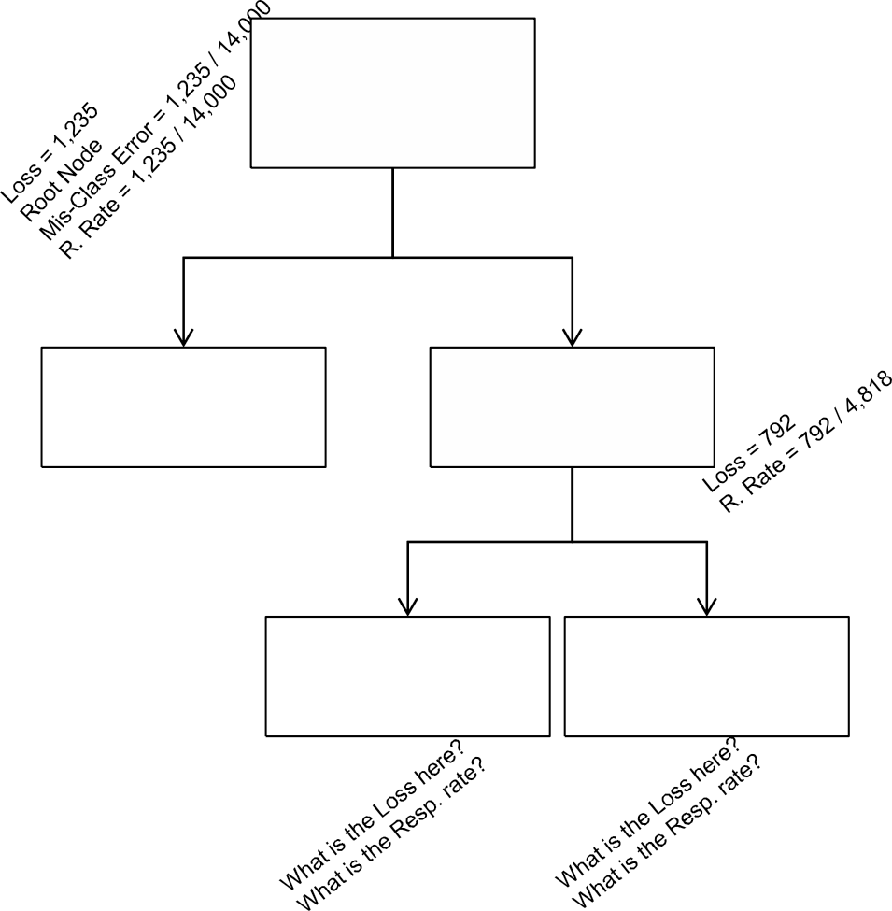
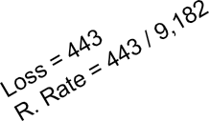
Loss, Mis-Classification Error and Response Rate
Root Node
# Obs : 14,000
# Target =1 : 1,235
# Target = 0 : 12,765
N
Holding Period >= 10
Loss is the number of cases mis-
classified in a given node
Mis-Classification Error is the ratio of total number of cases mis- classified to total number of cases
– We are interested in mis- classification error for the full tree
Y
# Obs : 9,182
# Target =1 : 443
# Target = 0 : 8,739
# Obs : 4,818
# Target =1 : 792
# Target = 0 : 4,026
ABC > X
Response Rate is the ratio of
number of responders (Target =
to the total number of cases
– We are interested in finding nodes where the response rate is very high
# Obs : 600
# Target =1 : 400
# Target = 0 : 200
# Obs : 4,218
# Target =1 : 392
# Target = 0 : 3,826
What is the mis-classification error for the above tree?

Slide 21
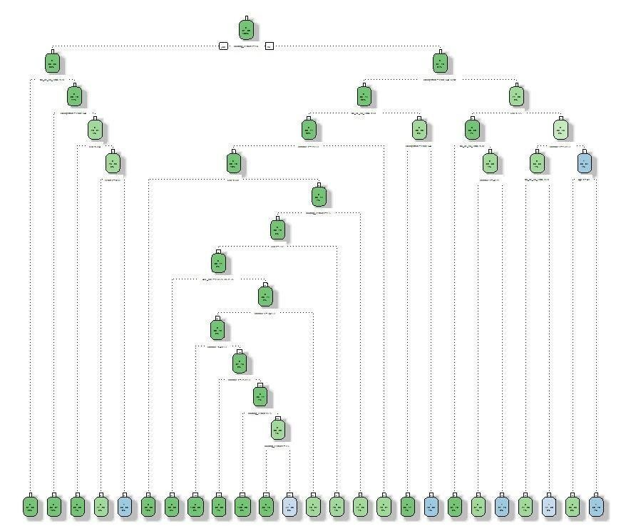
Plotting the Classification Tree
)
l
Let us export the output to PDF format to have a clear view ofthe tree

Slide 22
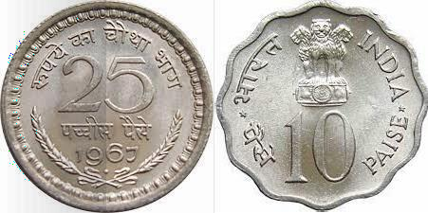
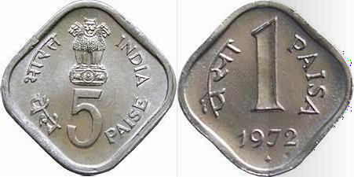
Concepts | Greedy Algorithm
Make 31 Paise using any combination of above coins Optimal solution with few coins : 25 + 5 + 1
What if the 5 paise coin is not there? Optimal solution with few coins : 10 * 3 + 1
Greedy Algorithm solution: 25 + 1 * 6

Slide 23
Concepts | Cross Validation
K FoldCV | P1 | P2 | P3 | P4 | P5 | P6 | P7 | P8 | P9 | P10
Fold 1 | Train | Train | Train | Train | Train | Train | Train | Train | Train | Test
Fold 2 | Train | Train | Train | Train | Train | Train | Train | Train | Test | Train
Fold 3 | Train | Train | Train | Train | Train | Train | Train | Test | Train | Train
Fold 4 | Train | Train | Train | Train | Train | Train | Test | Train | Train | Train
Fold 5 | Train | Train | Train | Train | Train | Test | Train | Train | Train | Train
Fold 6 | Train | Train | Train | Train | Test | Train | Train | Train | Train | Train
Fold 7 | Train | Train | Train | Test | Train | Train | Train | Train | Train | Train
Fold 8 | Train | Train | Test | Train | Train | Train | Train | Train | Train | Train
Fold 9 | Train | Test | Train | Train | Train | Train | Train | Train | Train | Train
Fold 10 | Test | Train | Train | Train | Train | Train | Train | Train | Train | Train
Cross Validation is part of the CART algorithm
Method to see how well the model performs to unseen data
Typically xval parameter for cross- validation is set to 10

Slide 24
Concepts | Over-fitting
If you grow the tree too long you will run the risk of over-fitting
100%
90%
80%
70%
60%
50%
40%
30%
20%
10%
0%
Training Data Test Data
Accuracy
0
10 20 30 40 50 60 70 80 90 100
Tree Size (No. of Nodes)
Classification model may not work well on unseen data
How do we avoid Over-fitting?
Stopping Rule: don’t expand a node if the impurity reductionof the best
split is below some threshold
Pruning: grow a very large tree and merge backnodes

Slide 25
Concepts | Parsimony Principle & Re-substitution Error
Parsimony principle is basic to all science and tells us to choose the simplest scientific explanation that fits the evidence.
Resubstitution Error: It measures what fraction of the cases in a node is classified incorrectly if we assign every case to the majority class in that node; It always favours large tree
To counter balance the resubstitution error we need a penalty component that favours smaller tree
Sub-tree Node
530 ; 113; 0
Y N
SCR < 334
Node 14
122; 10; 0
Node 15
408; 103; 0
Gender: M,O
Node 30
388; 90; 0
Node 31
20; 7; 1
Re (prunded) = 113 / 530
Re (leaves) = 107 / 530

Slide 26
Cost Component Pruning
“cost-complexity” – a measure of avg. error reduced per leaf
Calculate number of errors for each node if collapsed to leaf
Compare to errors in leaves, taking into account more nodes used
Sub-tree Node
530 ; 113; 0
Re (prunded) + 1 α
= Re (leaves) + 3
α
Y N
113 / 530 + 1 α = 107 / 530 + 3
α
SCR < 334
Node 14
122; 10; 0
Node 15
408; 103; 0
α =
0.0056
Gender: M,O
Node 30
388; 90; 0
Node 31
20; 7; 1

Slide 27
Pruning
Pruning is Basically the average cost complexity reduced per leaf
in a Decision Tree.
Generally It’s a hit & try method to get the accuracy improved over the depth of tree getting reduced or average number of nodes reduced without over fitting.
Practically, We creates a Tree structure which is getting refined on certain pre-assumptions for improving the performance and accuracy of a Decision Tree classifier
http://stats.stackexchange.com/questions/92547/r-rpart-cross-validation-and-1-se-rule-why-is-the-column-in-cptable-called-xst https://stats.stackexchange.com/questions/13471/how-to-choose-the-number-of-splits-in-rpart

Slide 28
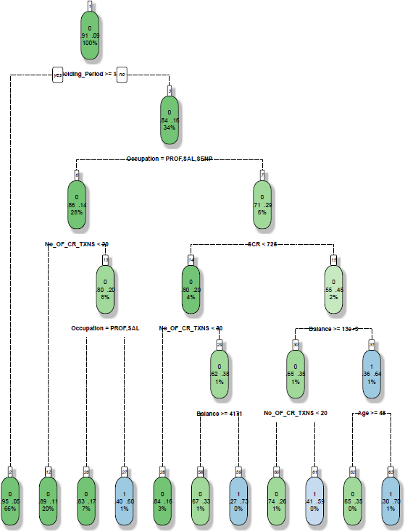
Pruned Classification Tree

Slide 29
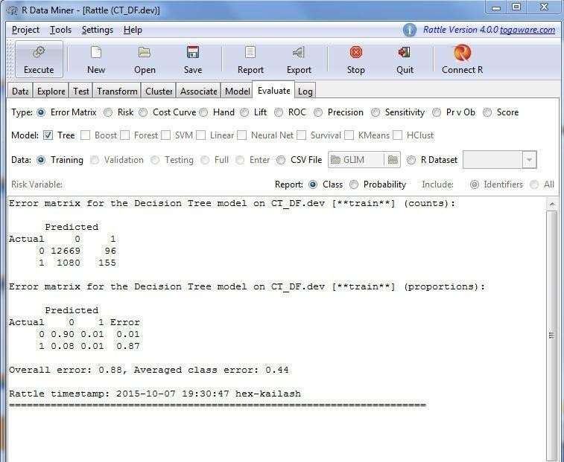
Model Evaluation
Various measures to see the model performance
Error Matrix
Gini Coefficient
AUC
KS
Lift Chart
Demo of Rattle interface to build model and generate various model evaluation measures
https://www.youtube.com/watch?v=OAl6eAyP-yo

Slide 30
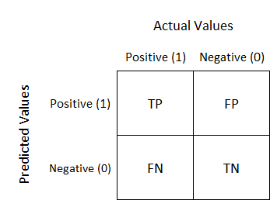
Confusion Matrix… ☺☺☺

Slide 31
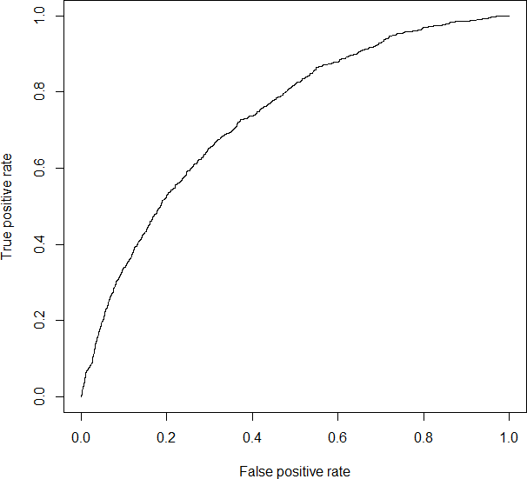
Area Under Curve
Classification Matrix |  | Predicted
 |  | Y | N
Actual | Y | a | b
 | N | c | d
Sensitivity = True Positive Rate
= True Positive / Total Positive
= a / (a + b)
Specificity = True Negative / Total Negative
= d / (c + d)
False Positive Rate = 1 - Specificity

