Slide 1
LOGISTIC REGRESSION
PROJECT
Presented BY Akim and Nirina - ML Course

Slide 2
INTRODUCTION
We are working with a microchip quality control dataset.
Each microchip goes through two lab tests before being accepted or rejected.
Our job is to build a model that can automatically predict the outcome.
The main challenge: the two classes cannot be separated by a straight line.

Slide 3
THE DATASET
Input features (X):
Test 1 score
Test 2 score
Label (y):
1 → Chip passes quality control
0 → Chip fails quality control
Split into training set (X_train, y_train) for model learning.

Slide 4
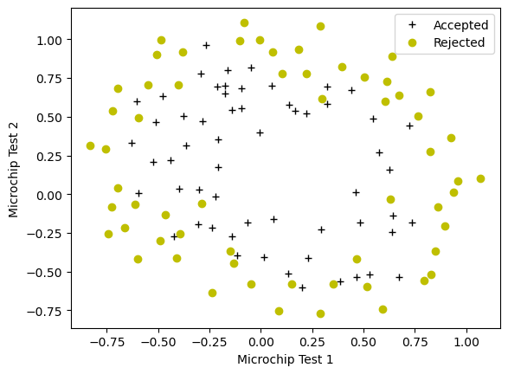
LOOKING AT THE DATA
Plotting the two classes shows they are mixed together — a straight line won't work.

Slide 5
OUR APPROACH
Sigmoid function to convert outputs into probabilities (0 to 1).
Feature Mapping: we turn 2 inputs into 27 polynomial features so the model can learn curved patterns.
Log Loss to measure how far off our predictions are.
L2 Regularization (λ = 0.01) to keep the model simple and avoid overfitting.
Gradient Descent: we optimize the model over 10,000 steps with α = 0.01.

Slide 6
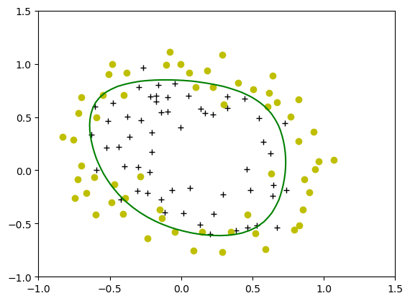
TRAINING RESULTS
Final training accuracy: 82.20%
The cost function went from 0.72 down to around 0.45 over 10,000 iterations.
The model found a curved boundary that correctly separates most chips.
Decision boundary after training

Slide 7
WEB APPLICATION
We deployed the model as a Streamlit web app.
The user enters two test scores and clicks a button to get a prediction.
The app computes σ(w·x + b) and displays the probability as a progress bar.
Result: Admitted if probability ≥ 40%, Refused otherwise.

Slide 8
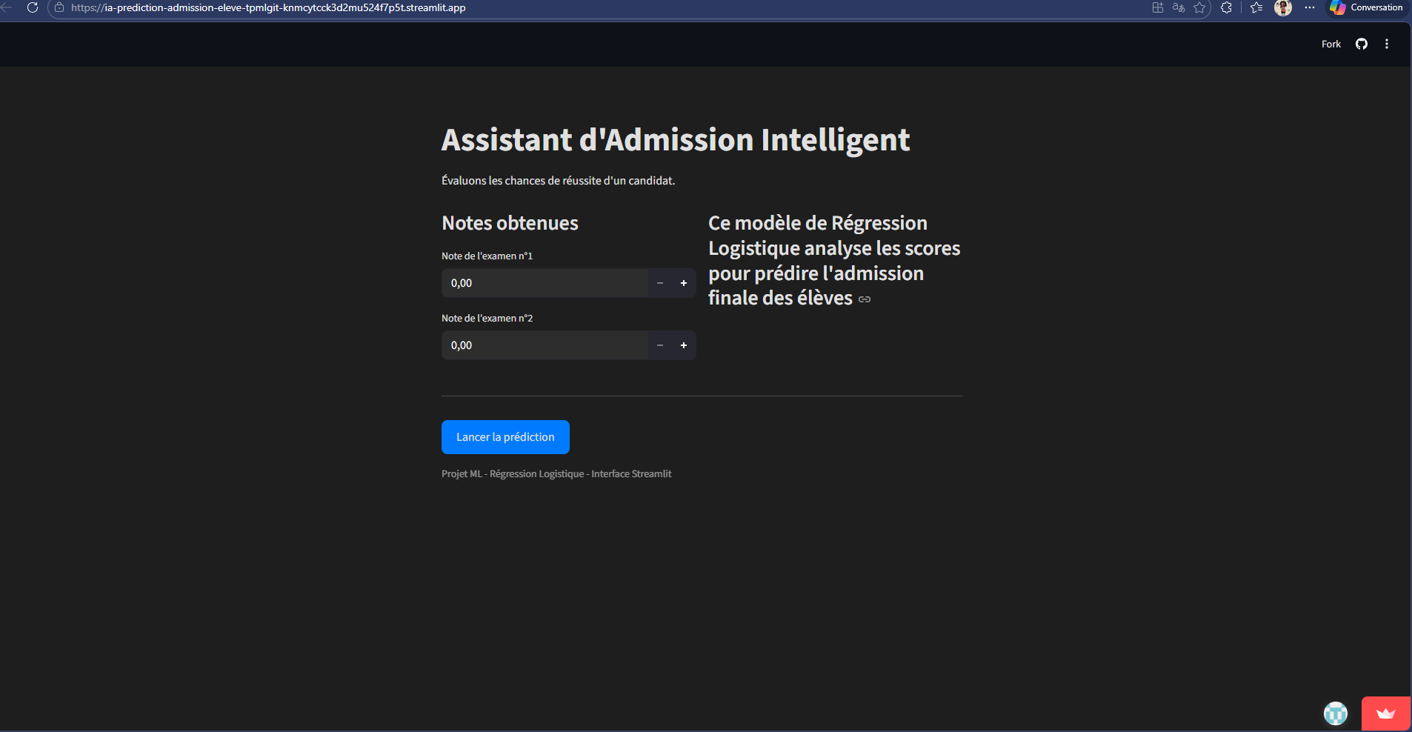
STREAMLIT

Slide 9
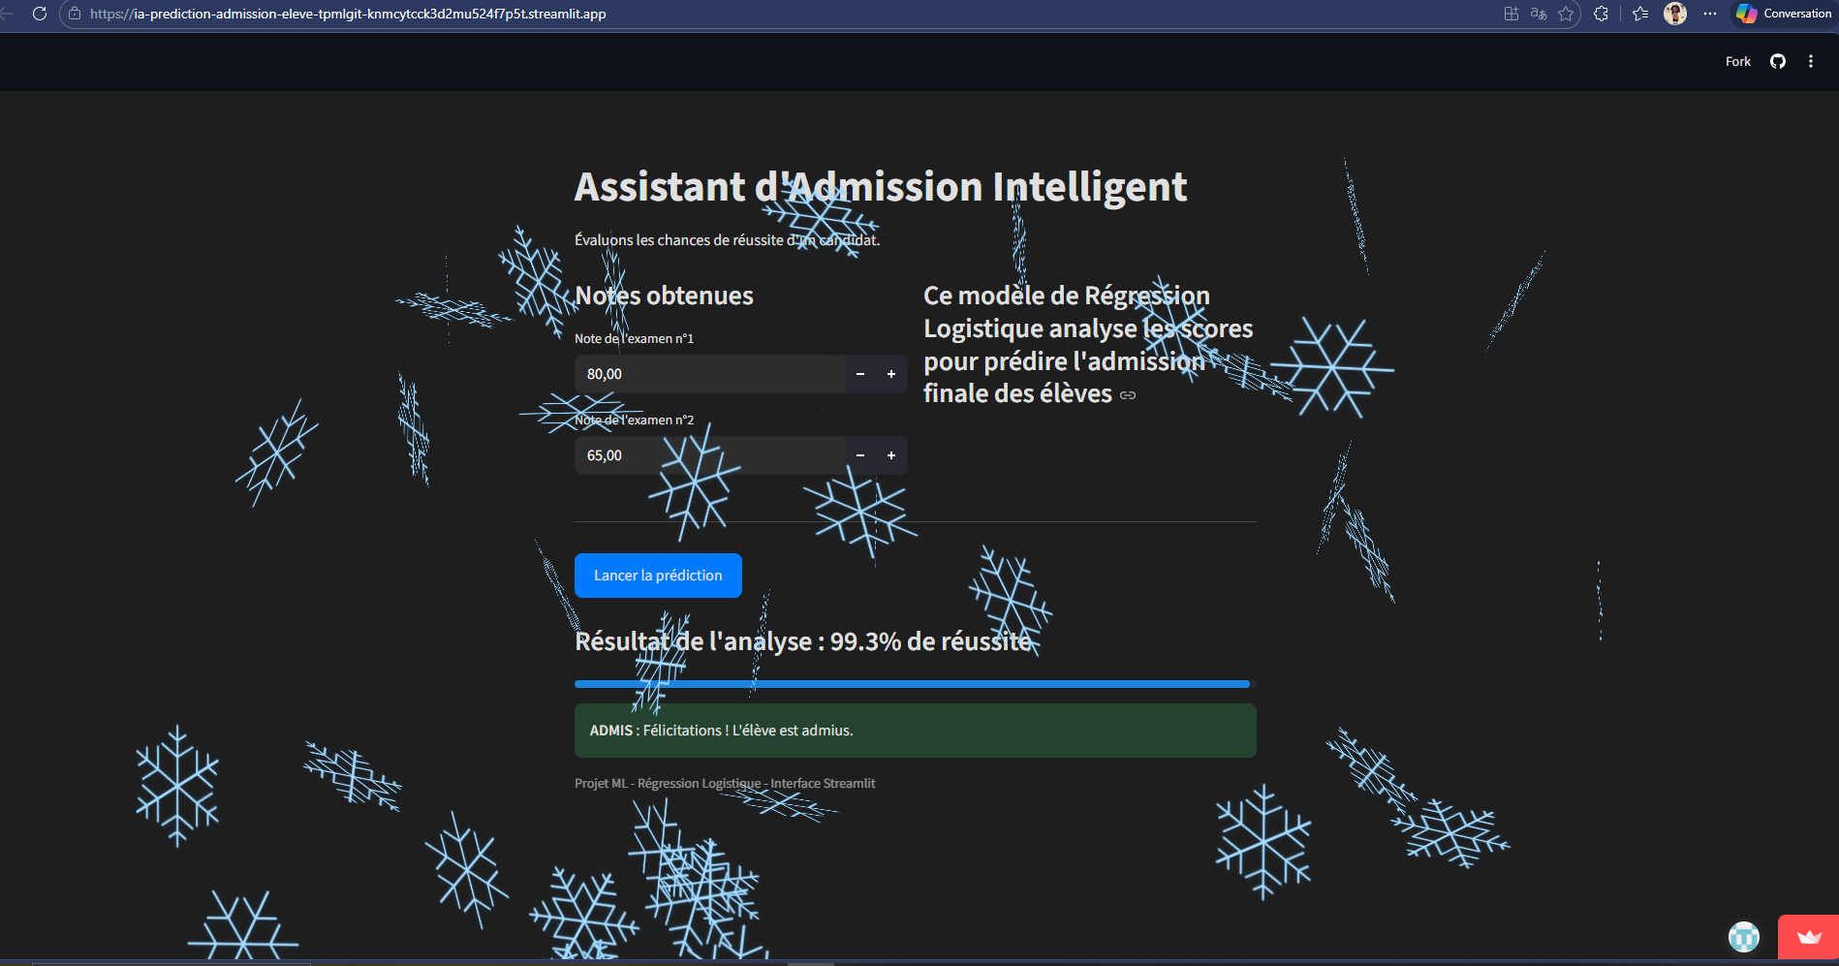

Slide 10
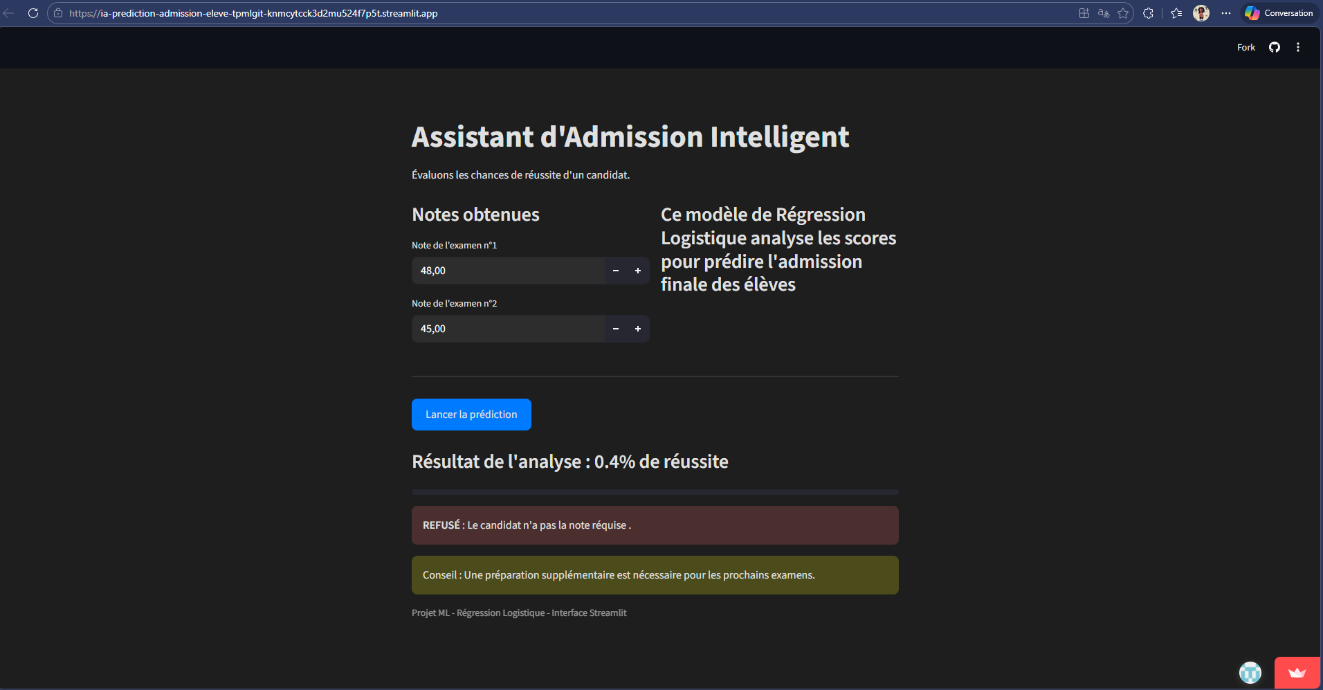

Slide 11
CONCLUSION
Logistic regression is a powerful yet simple tool for binary classification.
When the data is not linearly separable, feature mapping is the right solution.
Regularization is essential to get a model that works on new data.
We successfully went from a notebook to a working web app.
THANKS !

