Slide 1
R-CNN
Rich Feature Hierarchies for Accurate Object Detection and Semantic Segmentation
Notes:
Regions with Convolutional Neural Nets

Slide 2
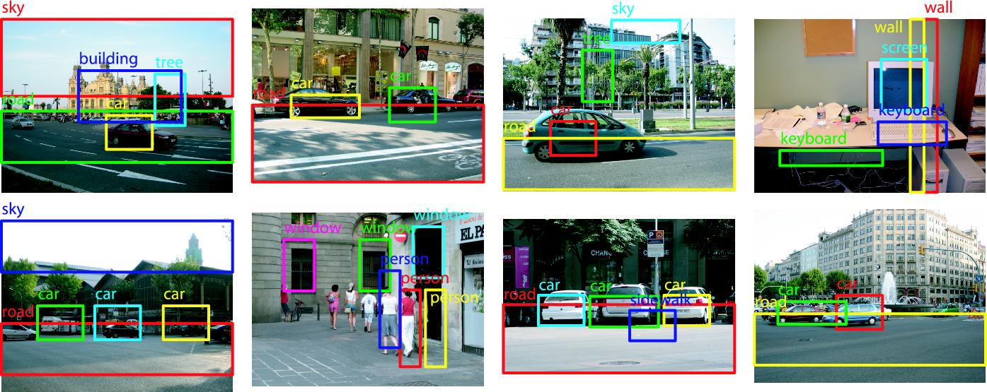
Object Detection, Why?
How do we detect multiple objects in a scene?
Notes:
Most of us have experience witnessing object detection when our phone cameras detect multiple faces on the screen

Slide 3
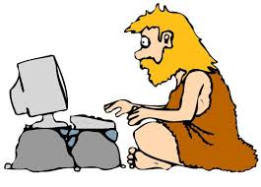
History
Fukushima’s Neocognitron
Support Vector Machine (SVM)
Scale Invariant Feature Transform (SIFT)
Histogram of Oriented Gradients (HOG)
Convolutional Neural Nets
Notes:
Before we talk about how it works, it is important to understand some of the history behind object detection
We will discuss Fukushima’s Neocognitron, Support Vector Machine, Scale Invariant Feature Transform, Histogram of Oriented Gradients, and Convolutional Neural Nets
All of these have slowly lead into the research that we have today

Slide 4
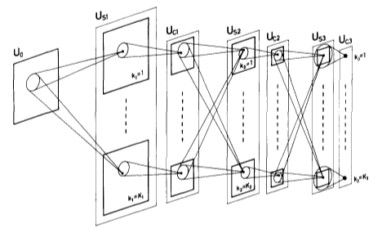
Neocognitron
Inspired by cells in the primary visual cortex.
Lacks a supervised training algorithm
Notes:
Kuihiko Fukushima, Japanese research scientist proposed the idea of the “neocognitron”, an artificial neural network, to study pattern recognition in human brain
It has been used for handwritten character recognition and other forms of pattern recognition
It heavily influenced and gave inspiration for convolutional neural networks
Picture above is the architecture of the network, where the lowest stage is the input layer and it corresponds to photoreceptors of the eye’s retina
Can be trained to recognize patterns through learning
Ultimately not ideal as it lacks a supervised training algorithm

Slide 5
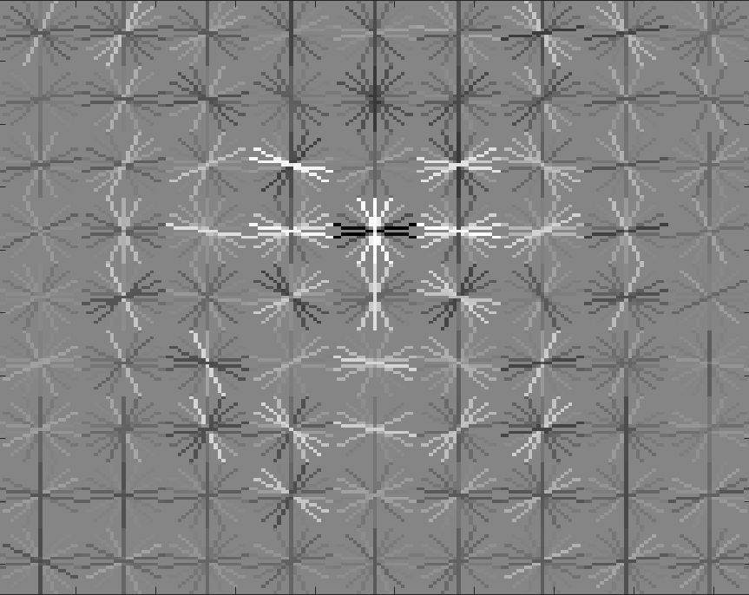
SIFT and HOG
Scale Invariant Feature Transform (SIFT)
Histogram of Oriented Gradients (HOG)
Notes:
SIFT is an algorithm used in computer vision to detect and describe local features in images
It does this by finding interesting points on any object in an image and then extracting them to provide a “feature description”, which is a description of the visual features of said object, while throwing away excess information.
After the description is extracted from the training image, it can then be used to identify the object by seeing if the local regions that have been extracted match what is in the image
HOG is a feature descriptor that is also used in computer vision for object detection and is similar to SIFT, with the difference being in the way that it is computed.
Instead of having a local region to match, HOG uses a sliding window method to check if the window that it has selected matches the trained portion

Slide 6
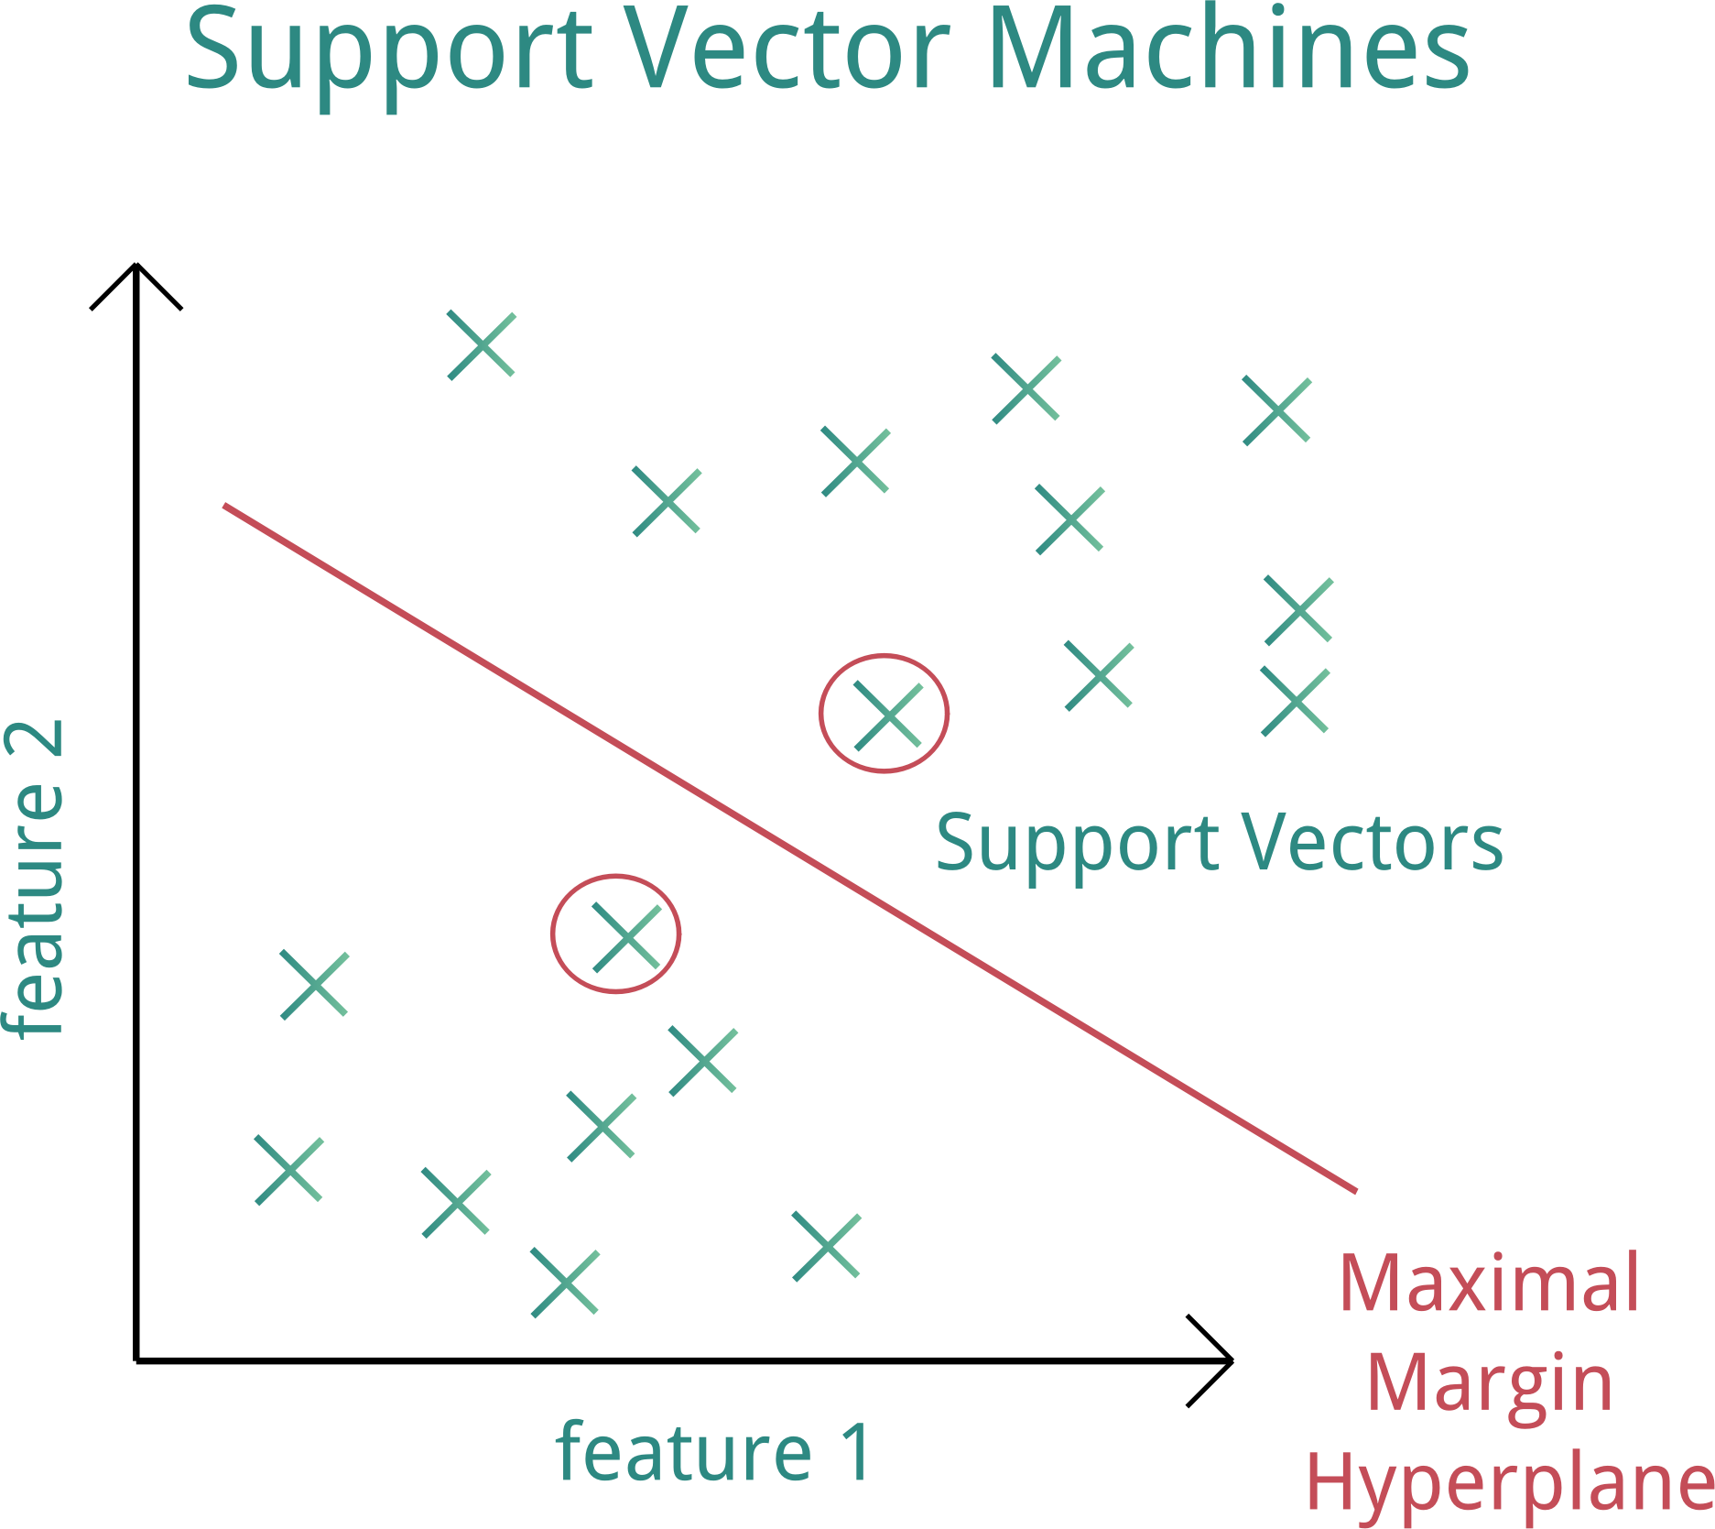
Support Vector Machines
Supervised learning algorithm used commonly in classification
Pushed CNNs out of fashion
Notes:
Support Vector Machines divides a dataset into 2 classes by finding the relevant hyperplane
Intuitively, the further from the hyperplane the data points lie, the more confident we are that they have been correctly classified, so we want points to be as far as possible
SVMs are accurate, work well on smaller/cleaner datasets, but are less effective with larger and noisier datasets with overlapping classes
Pushed CNNs to the side for a while, and we will discuss CNNs shortly

Slide 7
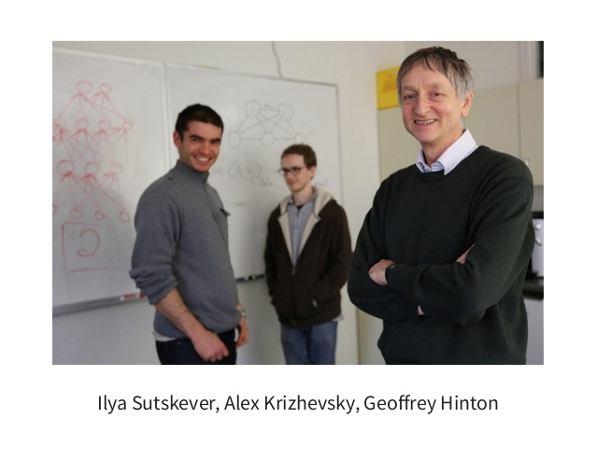
Rise of CNNs
Alex Krizhevsky, Geoffrey Hinton, and Ilya Sutskever brought life back into CNNs
New CNN dubbed AlexNet
Blew competition away in ImageNet challenge
Notes:
It provided substantially higher image classification accuracy on the ImageNet challenge.
The ImageNet challenge is like the Olympics of Computer Vision.
In 2012, AlexNet won the challenge, blowing away the competition.
Named after Alex Krizhevsky.
That’s him, the shy guy in the middle hiding from the camera.
The most important thing about AlexNet, in terms of this paper, is that it got people interested in CNNs again, and it was time to start creating CNNs with higher levels of object detection accuracy

Slide 8
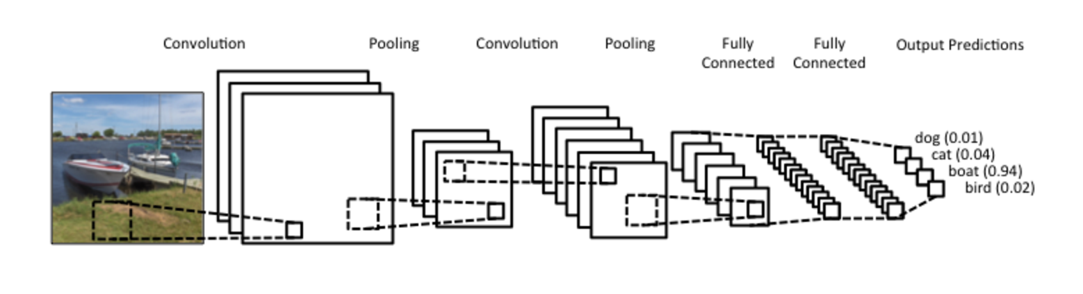
Convolutional Neural Nets

Slide 9
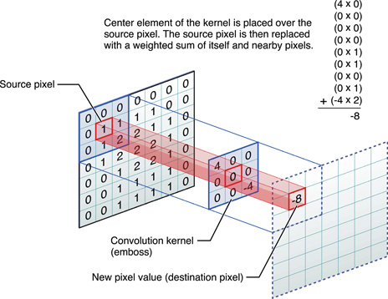
Convolution
Notes:
Left: receptive field, Center: filter/kernel, Right: activation map/feature map
Convolution: Process of moving the filter over the image to produce the map.
During convolution the filter (or kernel) is moved across the width and height of the input image.
The dot product of the receptive field and the filter is computed at each step and the result is stored in an activation map.
We will have many features and many activation maps.

Slide 10
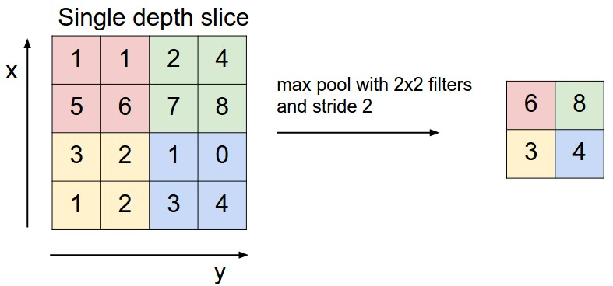
Pooling
Notes:
Max-Pooling: Output from the convolutional layer is sliced up into sections, The maximum value is taken from each section to produce a new map.
The exact location of a feature is less important than its rough location relative to other features.
Useful Because: Reduces the dimension of the feature maps, Reduces the amount of computational work
Note: It is common to place pooling layers in between successive convolutional layers.
Note that typically several layers of convolution and pooling will be arranged, one feeding into the other.

Slide 11
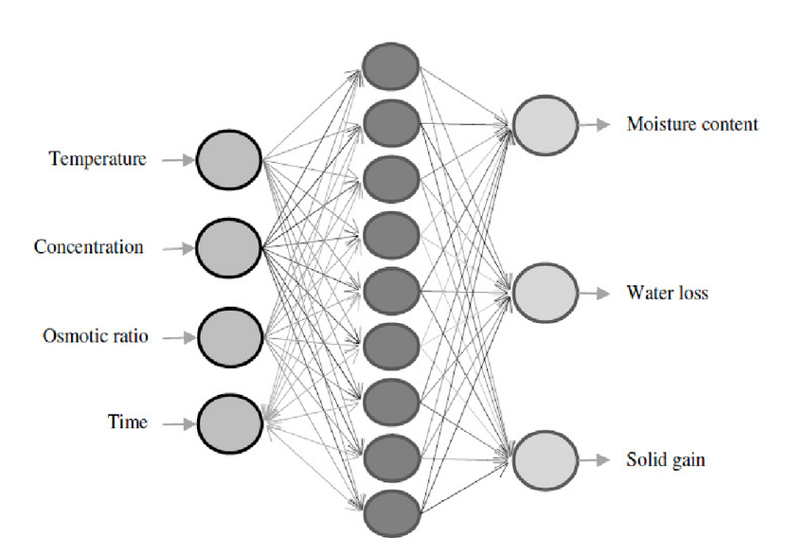
Fully Connected Layer
Notes:
Each element of the final set of feature maps will be an input into this layer (an MLP), hence the name fully connected layer.
Purpose: classify the input image
FCL gives non-linear combinations of the the features.
Features found by prior convolutional layers may be useful for classification, but combinations are better.
Other classifiers can be used in place of a fully connected MLP, such as SVMs, but today fully connected MLPs are the way to go.

Slide 12
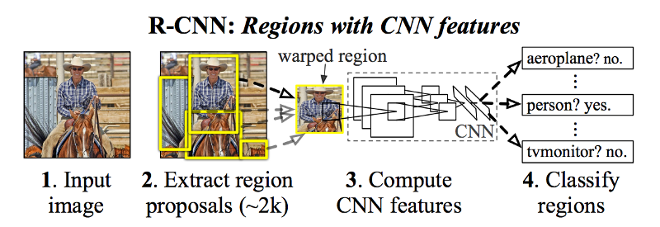
R-CNN
Notes:
Region-Based Convolutional Neural Network
3 Modules
Region Proposal
Can be any standard region proposal algorithm
Simplest is Selective Search
Generate many “proposed” regions and test to see which are likely to be a good fit
Search image for differences in pixel intensities (large difference implies possible boundary for object)
Convolutional Layers
Performs feature detection on images
Standard Classifier to assign class labels to obnjects.
Could be any type of classifier (SVM, FFNN, etc)

Slide 13
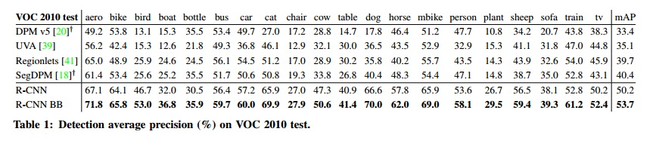
PASCAL VOC 2010-12
R-CNN demolished all competition in the field
Notes:
R-CNN absolutely DESTROYS all previous work
Nearly 10% increase in mean-average precision (mAP
Implementing Bounding Boxes on region proposals achieves even greater accuracy

Slide 14
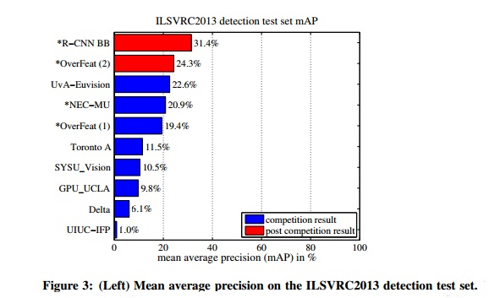
ILSVRC2013 detection
Notes:
8% jump over the next best algorithm

Slide 15
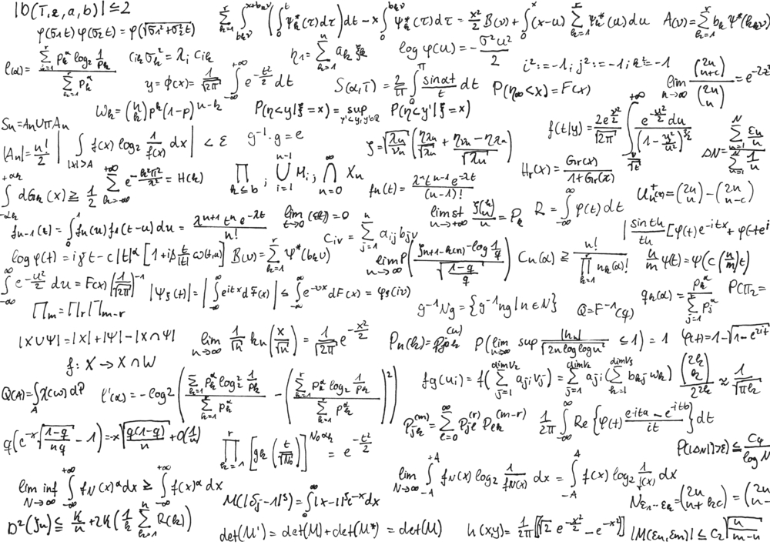
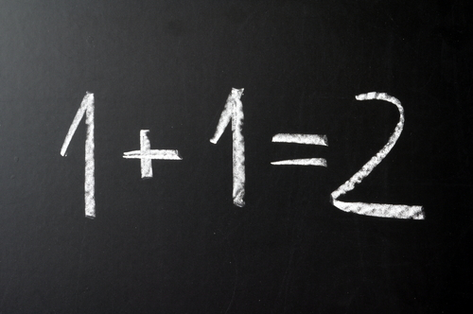
In short…
Simpler approach yields better results!
Notes:
Data driven approach provides much higher accuracy
Algorithms are also conceptually simple
Much higher generality

Slide 16

What now?
R-CNN unified many aspects from computer vision and deep learning!
Notes:
Computer vision and deep learning go hand-in-hand as tools from both were used.

