Slide 1
Predicting Failure to Appear (FTA) in court cases
Olatunji Akinbule, Ping Tu, Zhijie Ren

Slide 2
Overview
Charges of failure to appear (FTA) are common across both court and arrest records. FTA was the top felony arrest charge from FY 2015 and FY 2017, making up nearly 20% of felony arrests, and was the fifth most common offense in court records between 2010 and 2016.
Focus groups and interviews with Public Defender Service (PDS) and Pretrial Services Agency (PSA) staff suggest that lack of transportation is a significant factor in failures to appear. Defendants may be indigent or they may prioritize other needs like food or rent above transportation.
PDS clients already receive metro cards from their attorney, and the attorney has described the effect on attendance as positive.
Notes:
REN

Slide 3
Project Question
We seek to assist The Lab with an assessment of the probability that a defendant will miss a court appointment over the course of a case using data available at the outset of the case.
Given that transportation is widely reported barrier to court appearances, will the distribution of prepaid metro-transit cards increase court appearance rates among defendants?
Notes:
REN

Slide 4
Project objective
We want to build a model that will allow us to assess the likelihood that a defendant will fail to appear using only the data that is available at the outset of a case. This will allow for greater precision in assessing the treatment effects associated with receiving a free MetroCard at the time of their release.
Notes:
REN

Slide 5
Why does this matter?
Missed court appointments tax government agencies with otherwise avoidable costs.
Staff at the DC Superior Court (DCSC), DC Public Defender Service (PDS), DC Pretrial Services Agency (PSA), Office of the Attorney General (OAG), and United States Attorney's Office (USAO), Metropolitan Police Department (MPD), and Department of Corrections (DOC) are burdened by efforts to:
locate defendants, reschedule hearings, initiate warrants, execute warrants, adjudicate additional FTA charges, and manage the additional penalties imposed.
Notes:
REN

Slide 6
Term Definitions
Case: Represents each unique legal case
Party: The defendant or consumer who is the subject of a court case
Court Docket: A record of the proceedings of a court case usually containing information about the parties such as the judge, defendants and case events.
Receipt: Payment records that may detail fines and fees paid by defendants (parties) to the DC superior courts for bench warrant bonds or to the Crime Victims Compensation Program that provides financial assistance and reimbursement to victims of crime.
Attorney: Member of the judicial profession who represents a client in court when pleading or defending a case.
Bench Warrant: Warrant issued by a judge for the arrest of a person who has violated court rules and is in contempt of court. The warrant gives police the powers to apprehend the defendant and bring them before the court to answer contempt charges.
Failure to Appear (FTA): When a defendant obligated to show up in court fails to appear and also has no representation.
Notes:
TJ

Slide 7
Potential reasons for FTA
Mental Health Challenges
Hospitalization
Other concerns including missing work
Ignorance about the severity of missing court appointments
Indigent defendants who might be unable to afford the cost of transportation
Confusion (defendants with multiple cases)
Notes:
TJ

Slide 8
Data
Our data source is the District of Columbia Superior Court online case search eAccess portal
The DC courts maintain and publish the data on administrative processing of each defendant’s case.
Developed API to scrape court data from 2006 - 2019
Notes:
Ping

Slide 9
Data Source & Population
Theoretical Population: All defendants over the course of the existence of the DCSC including defendants with published and unpublished court records. Some court records are not published because they might involve juveniles, are unavailable at the point of our data scraping, sealed or expunged
Accessible Population: All case information published to the DC Superior Court website.
Sampling Frame: The sampling frame for our project is the entire set of scraped misdemeanor court case information from 2006 through 2019.
Notes:
Ping

Slide 10

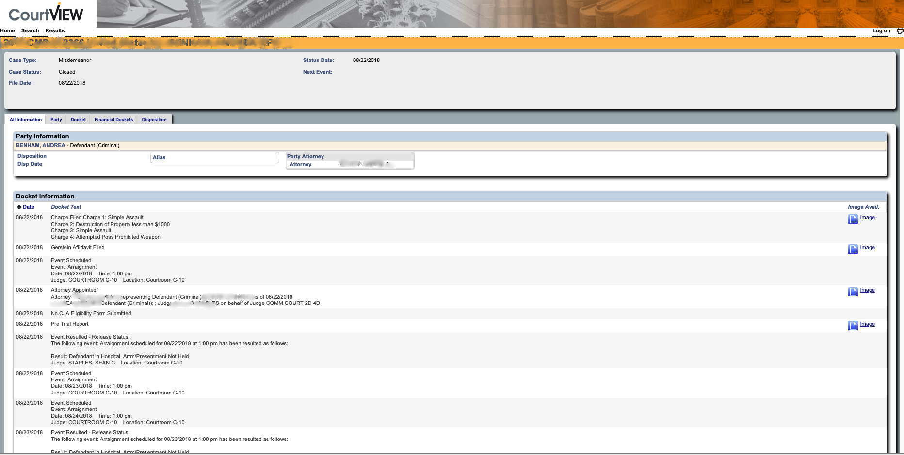
DATA SCRAPING
cv.case_number_search(
case_number = '2019 CF2 000510'
)
cv.name_search(
last_name = 'Woods',
first_name='Oliver,
dob_begin='01/01/1961',
dob_end='01/01/1962',
)
Notes:
Ping

Slide 11
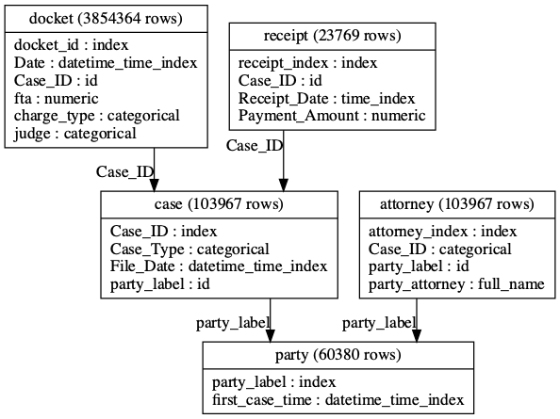
Data Model
We have 29268 Felony Crime cases, including CF2 and CF3, and 103967 Misdemeanor cases, 31.04% of which are labeled FTA (32273). For now, we only focus on Misdemeanor cases, because we have more data for them. Below is the data model we generated using Featuretools. (Numbers could change and they are controlled by one parameter called num_party, number of parties/consumers/defendants)
Notes:
PING

Slide 12
Features
Feature | Description
previous_fta | The number of ftas of the current defendant
previous_receipt | The total number of receipts of the current defendant
party.TIME_SINCE_LAST(case.File_Date) | How long has passed since the last time this current defendant having a case
party.TIME_SINCE_FIRST(case.File_Date) | How long has passed since the first time this current defendant having a case
party.COUNT(case) | The number of cases of this current defendant
party.NUM_UNIQUE(attorney.Case_ID) | The number of cases that the attorney of current case had
Notes:
PING

Slide 13
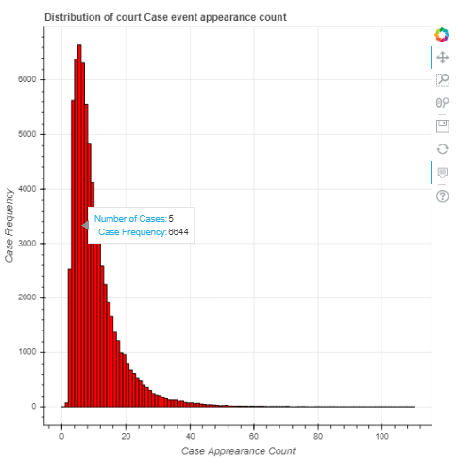
Distribution of unique court event days over case duration
Number of days a defendant or their attorney should be showing up for a case event.
Mode: 5 court appearances
Maximum: 301 appearances
Cases with greater than 5 events are extremely high burden and usually indicative of conditions such as mental health and hospitalization
Notes:
TJ

Slide 14
Case Walk through - 301 appearances
August 2018
Dec 2018
Jan 2019
Sep 2019
Charge Filed
Defendant in Hospital
Event Rescheduled 75 times
Defendant Hospitalized
Event Rescheduled 50 times
Defendant Hospitalized
Event Rescheduled
96 times
Event Rescheduled 80 times
Defendant in Hospital
Charge Disposed
Notes:
TJ

Slide 15
Case Walk through B - 5 FTAs
June 2016
July 2016
July 2016
Sep 2016
Nov 2016
April 2019
Charge Filed
FTA
Bench Warrant Issued
Detained
Released
FTA
Bench Warrant
Status Hearing
FTA
FTA
Bench Warrant
Makes Wrong Court Appearance
Bench Warrant Quashed
FTA
Bench Warrant
Released
Bench Warrant Return Hearing
Status Hearing
Detained
Hearing Held
Prisoner Return
Released on Bond
Charge Disposed
Notes:
TJ

Slide 16
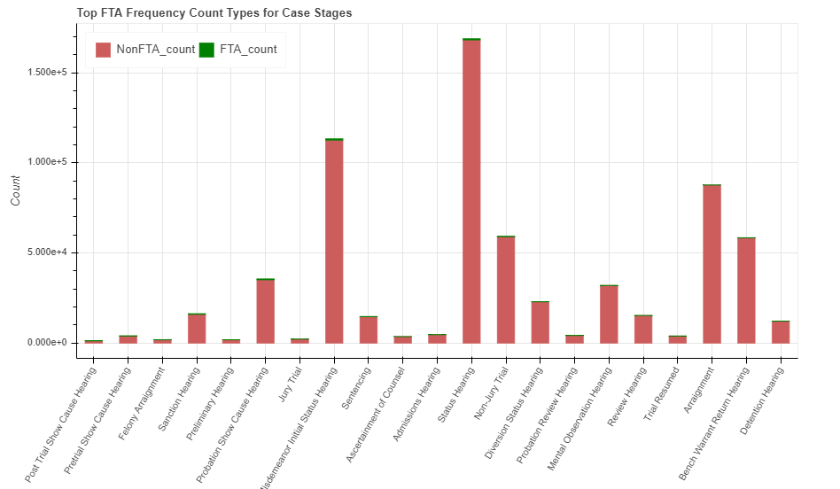
Notes:
TJ

Slide 17
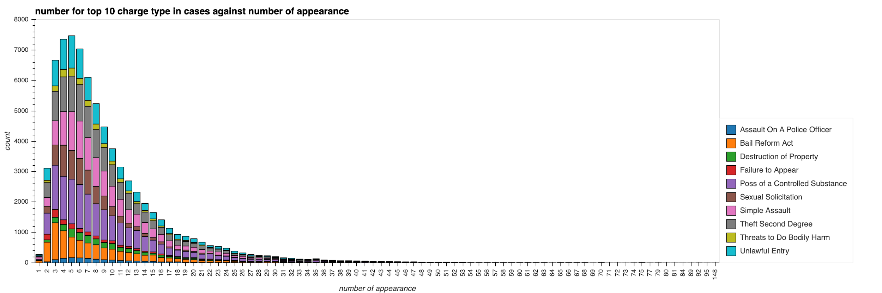
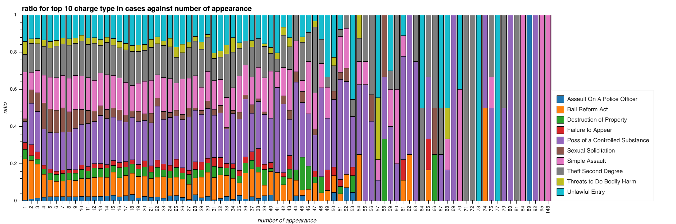
The proportion of possession of controlled substance increases over time.
Notes:
PING

Slide 18
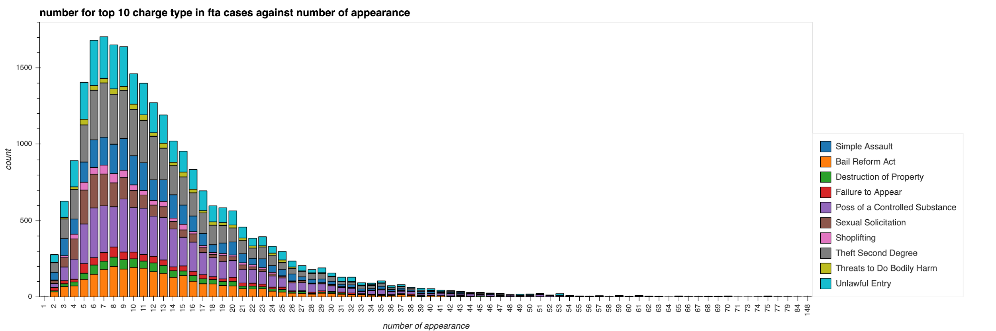
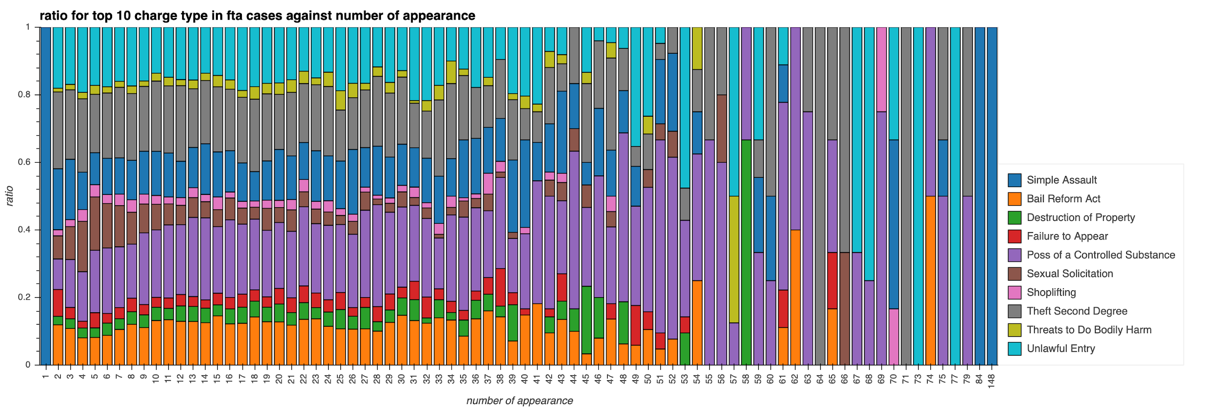
The count of top 10 charge types decreased by 80% in fta cases
Notes:
PING

Slide 19
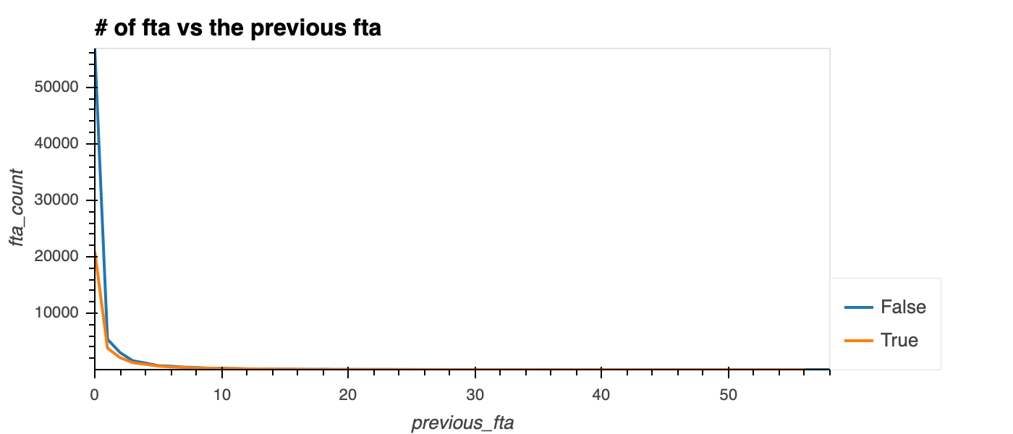

Slide 20
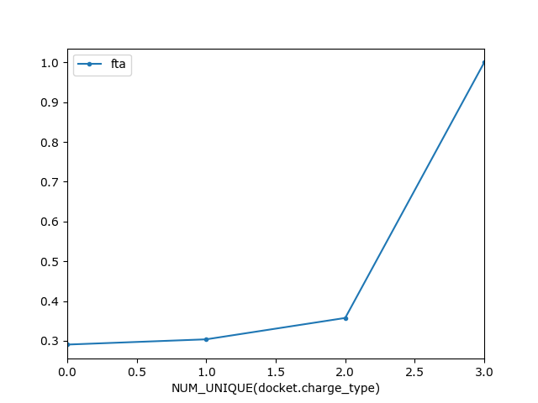
fta rate
Notes:
TJ

Slide 21
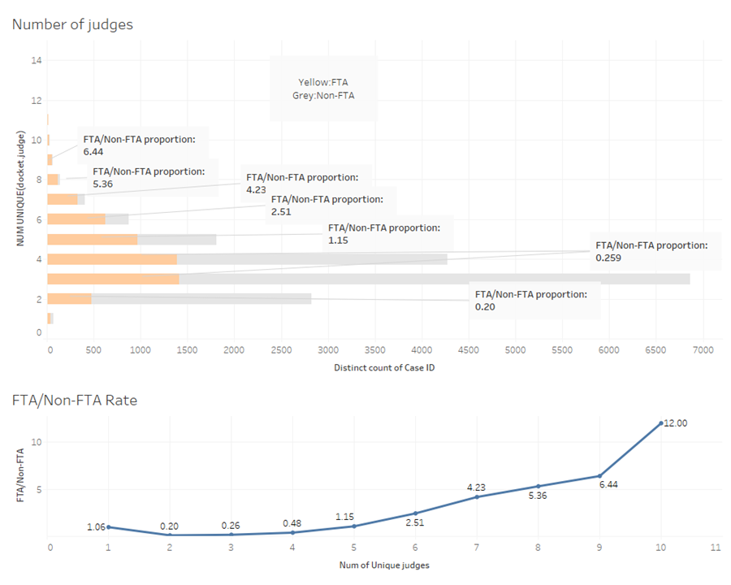
Number of Judges & FTAs
Notes:
REN

Slide 22
Confounding Variables/ Limitations
Other potential confounds that could account for an FTA which we cannot control for given the limited variables available from court data include:
Mental & Physical health
Social economic factors e.g Education, Employment, Income, Housing
Pretrial services Intervention - Recommendation from PSA to Judges to detain high risk defendants (felonies) forced to show up
Personal Information: Age, Drug Use Patterns
However we believe that the rate of missed court appearances will potentially serve as a proxy for some of these highlighted confounds. From exploring the data, the highest number of missed court appearances was synonymous with drug usage and or mental health challenges.
Notes:
TJ

Slide 23
Ruling out Confounds - Stratified Randomized Control Trial Design
The design will involve assigning defendants to a treatment or control condition based on a stratified random sample design. The assignment could be stratified by case type, age, etc. but the ideal form of stratification -- for which all of these other strata would be proxies -- is risk of failure to appear itself.
Defendants are blocked by their FTA likelihood are randomly assigned into treatment (receiving prepaid metro cards) and control groups with no intervention to avoid the selection bias
Notes:
REN

Slide 24
Design – Randomized Control Trial
Block
High Risk FTA | R High FTA Risk Defendants | X Metro Card Intervention | O 1,2
 | R High FTA Risk Defendants |  | O 1,2
Low Risk FTA | R Low FTA Risk Defendants | X Metro Card Intervention | O 1,2
 | R Low FTA Risk Defendants |  | O 1,2
R – Randomized Allocation blocked by FTA Risk
X – Intervention
O - Observation
Notes:
REN

Slide 25
Ensuring Predictive Results
01
Cleaning up the data to exclude any redundancy or ambiguous space in the dataset
Implementing multiple machine learning models (each with its unrelated methodologies, strengths and weaknesses) and making a comparative assessment of the results across the best performant models using accuracy metrics such as the Recall & Precision at K-scores on a hold out set (2019).
02
03
Applying K-fold cross validation to assess our model performance across different test sets (sampling methods: stratified random sampling, cluster random sampling based on week)
Notes:
REN

Slide 26
Model Predictive Features
1. COUNT(docket) 12. SUM(receipts.CUM_COUNT(Case_ID))
2. SUM(receipts.Payment_Amount) 13. Party.NUM_UNIQUE(case.YEAR(File_Date))
3. Unique charge type for each case 14. Party.NUM_UNIQUE(docket.case.Case_Type)
4. Unique number of judge for each case 15. COUNT(receipts)
5. Party.NUM_UNIQUE(attorney.Case_ID) 16. Party.COUNT(receipts)
6. Party.SUM(receipts.Payment_Amount) 17. Party.COUNT(docket)
7. Party.SUM(case.TIME_SINCE_LAST(docket.Date)) 18. Party.COUNT(attorney)
8. YEAR(File_Date) 19. CUM_COUNT(party_label)
9. Party.SUM(receipts.CUM_COUNT(Case_ID)) 20. Party.TIME_SINCE_LAST(case.File_Date)
10. Party.COUNT(case) 21. Party.TIME_SINCE_FIRST(receipts.case.File_Date)
11. NUM_UNIQUE(receipts.Receipt_Number) 22. NUM_UNIQUE(docket.YEAR(Date))

Slide 27
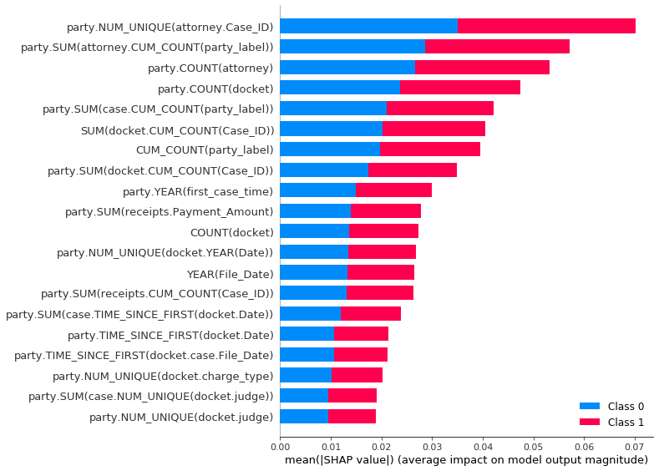
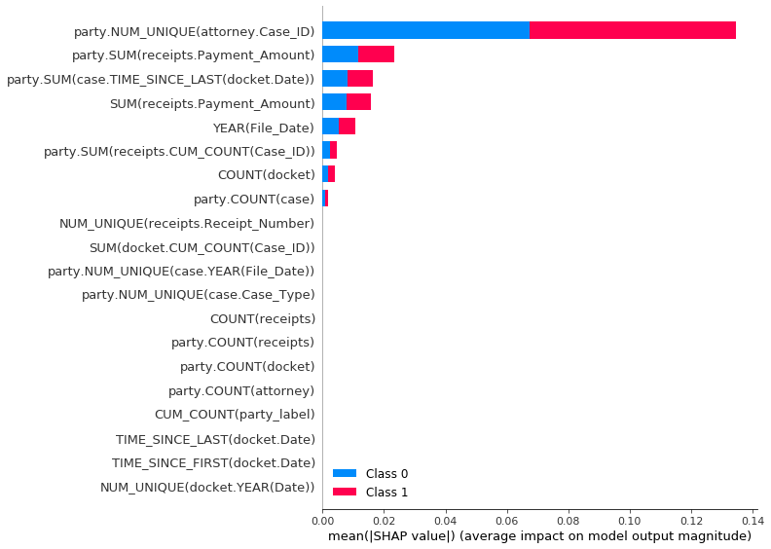
Feature Importance
LightGBM
RandomForest
party.NUM_UNIQUE(attorney.Case_ID) represents the total number of cases of current attorney in charge of the particular case.
Assumption : Normally attorney can show up for defendant, which doesn’t count as FTA. But if the defendant’s attorney has several cases at the same time, it is impossible to take care of all defendants.

Slide 28
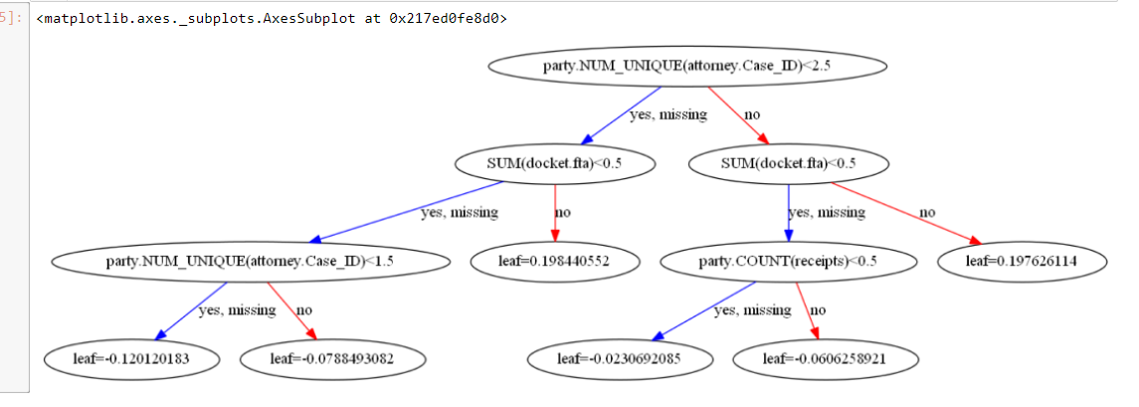
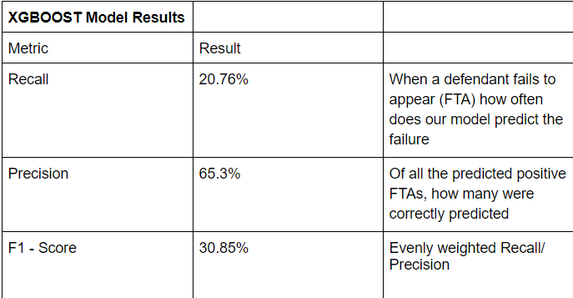
Preliminary Results
Notes:
REN

Slide 29
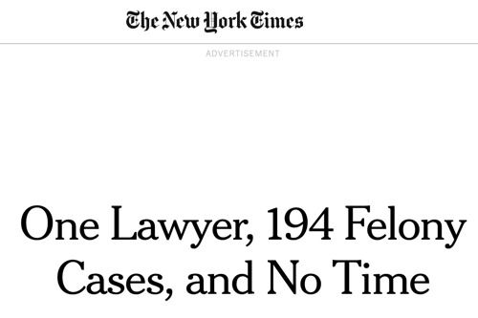
Preliminary Results
The party.NUM_UNIQUE(attorney.Case_ID)
which represents the number of unique cases the
attorney has been previously assigned. From our research
we found out that the court appointed public
defender attorneys are usually overburdened with
more cases than they can possibly give time to as
indigent defenders are assigned to them. There is no
guarantee that the public defenders would have
enough time to make a representation for them
especially when they do not show up.
Given that all 3 models rank the party.NUM_UNIQUE as the most predictive feature for an FTA a conclusion validity is established and the DC Mayor’s office will take a closer look into this trend.

