Slide 1
KAFKA

Slide 2
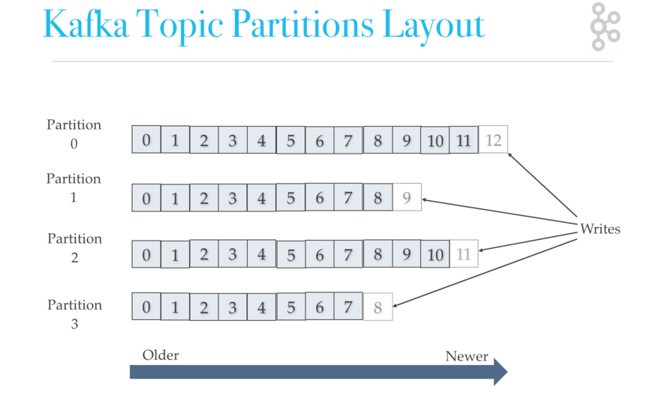
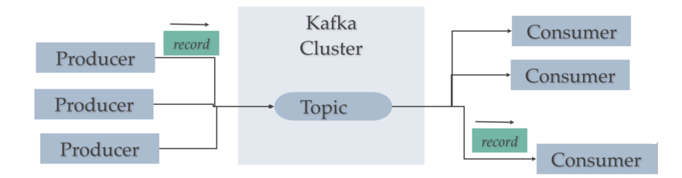
KAFKA
Kafka is a distributed streaming platform
Publish and subscribe to streams of records, similar to a message queue.
The Kafka cluster stores streams of records in categories called topics.
Each record consists of a key, a value, and a timestamp
Topic is feed name to which records are published. A topic can have zero, one, or many consumers
For each topic, Kafka maintains a partitioned log that looks like this:
Offset that uniquely identifies each record within the partition
Persists all published records (consumed or not) for a configure period
Storing data for a long time is not a problem
Consumer can reset to an older offset or skip to start consuming from "now".

Slide 3
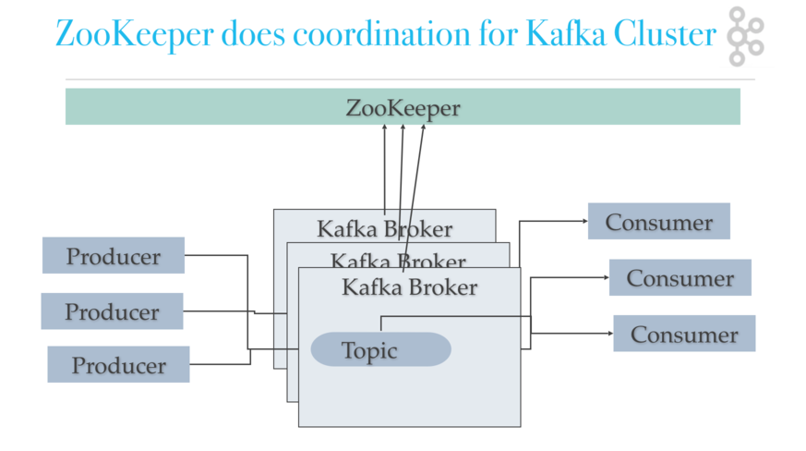
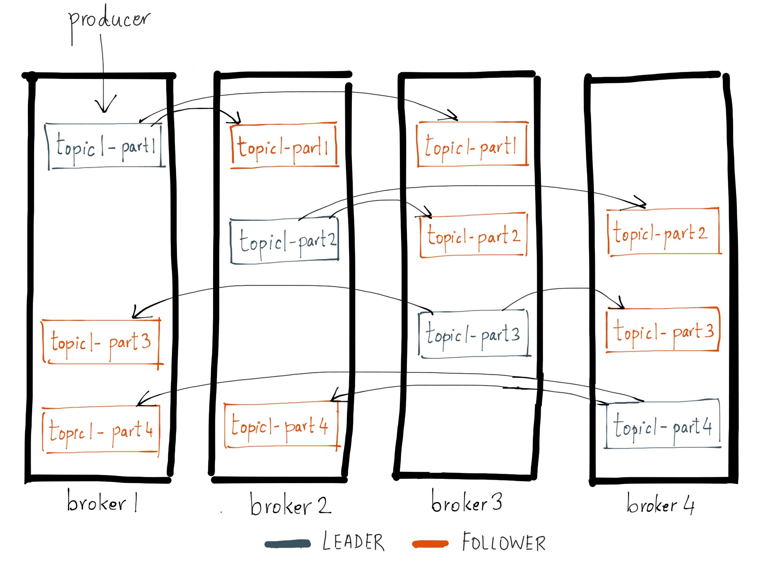
DISTRIBUTION
The partitions of the log are distributed over the servers.
Each partition is replicated across a configurable number of servers for fault tolerance.
Each partition has one server which acts as the "leader" and zero or more servers which act as "followers".
The leader handles all read and write requests for the partition while the followers passively replicate the leader.
If the leader fails, one of the followers will automatically become the new leader.
Each server acts as a leader for some of its partitions and a follower for others so load is well balanced within the cluster.

Slide 4
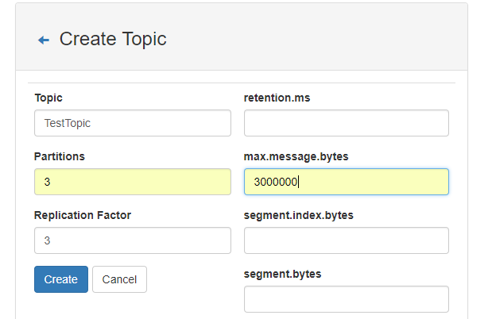
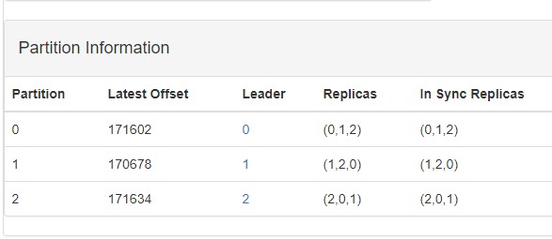
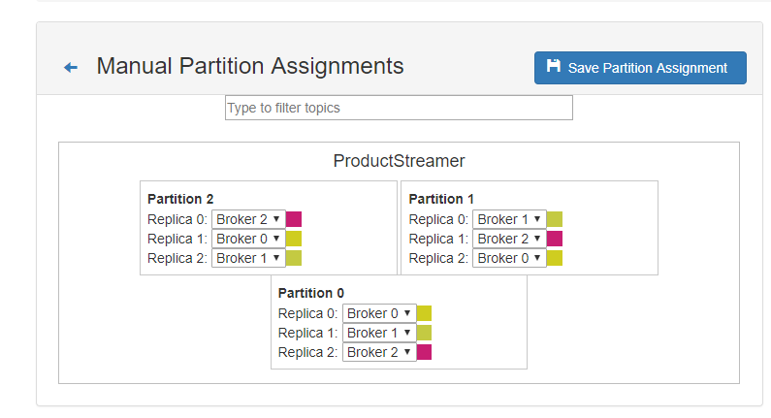
REPLICA

Slide 5
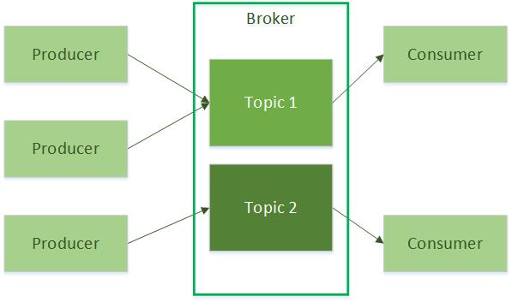
PRODUCERS
Producers publish data to the topics of their choice.
The producer is responsible for choosing which record to assign to which partition within the topic. This can be done in a round-robin fashion simply to balance load
or it can be done according to some semantic partition function (say based on some key in the record)

Slide 6
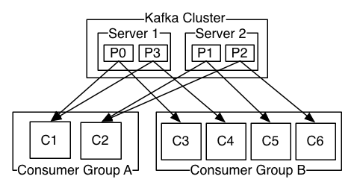
CONSUMERS
Consumers named with consumer group name, each record published to a topic is delivered to one consumer instance within each subscribing consumer group.
Consumer instances can be in separate processes or on separate machines.
If all the consumer instances have the same consumer group, then the records will be load balanced over the consumer instances.
If all the consumer instances have different consumer groups, then each record will be broadcast to all the consumer processes
Each group is composed of many consumer instances for scalability and fault tolerance.
Each instance is the exclusive consumer of partitions at any point in time.
This process is handled by the Kafka protocol dynamically. (__consumer_offsets)
Kafka only provides a total order over records within a partition, not between different partitions in a topic.
For a total order over records a topic that has only one partition and only one consumer process per consumer group.

Slide 7
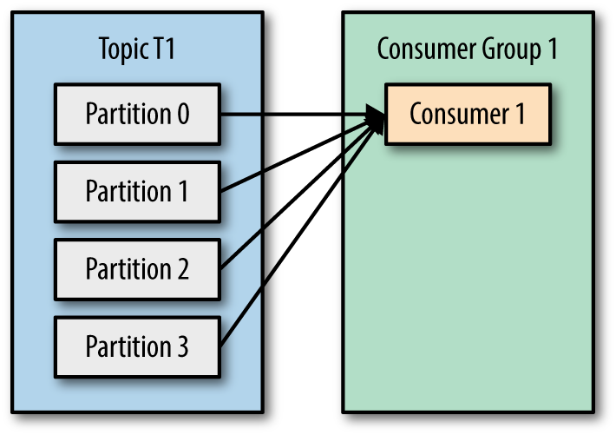
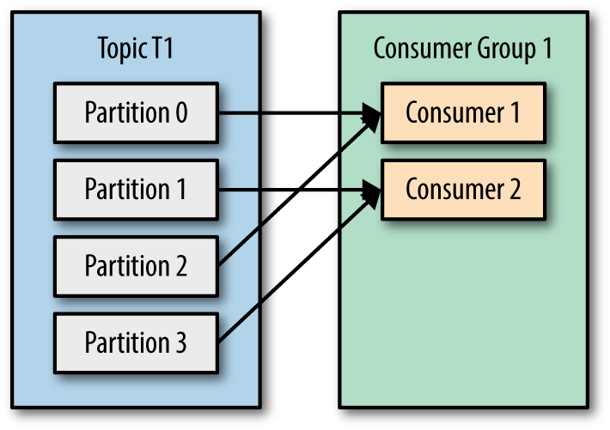
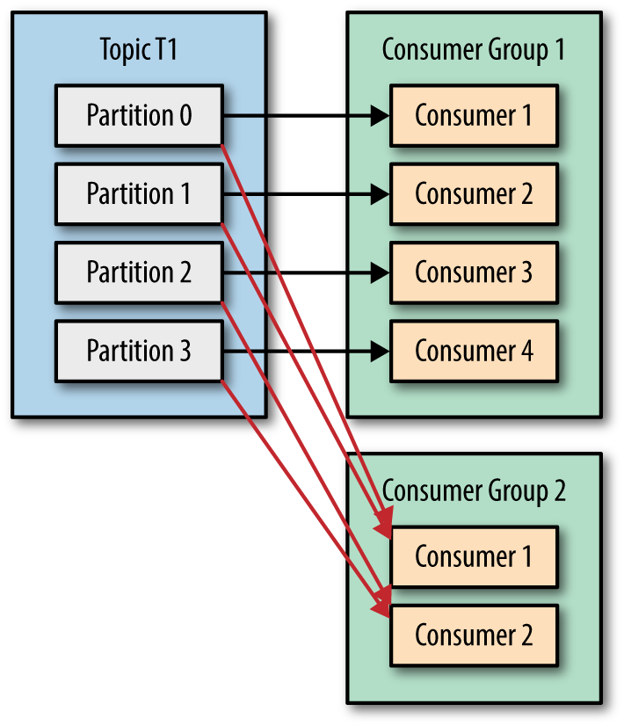
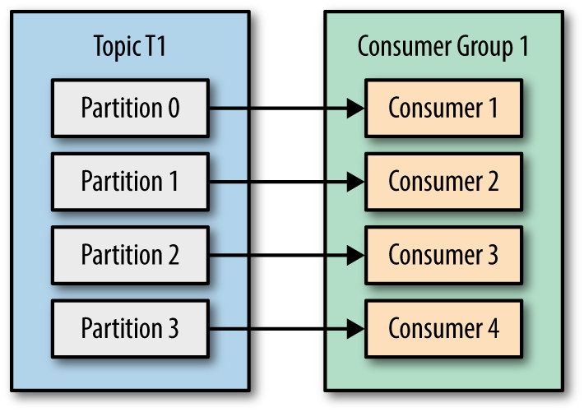
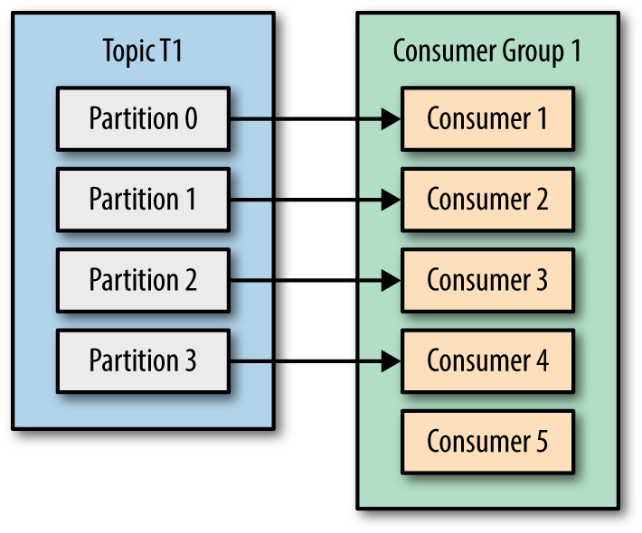
CONSUMERS

Slide 8
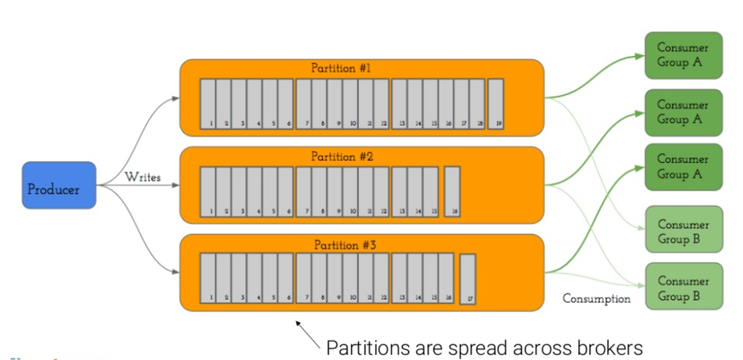
CONSUMERS

Slide 9
CODE

Slide 10
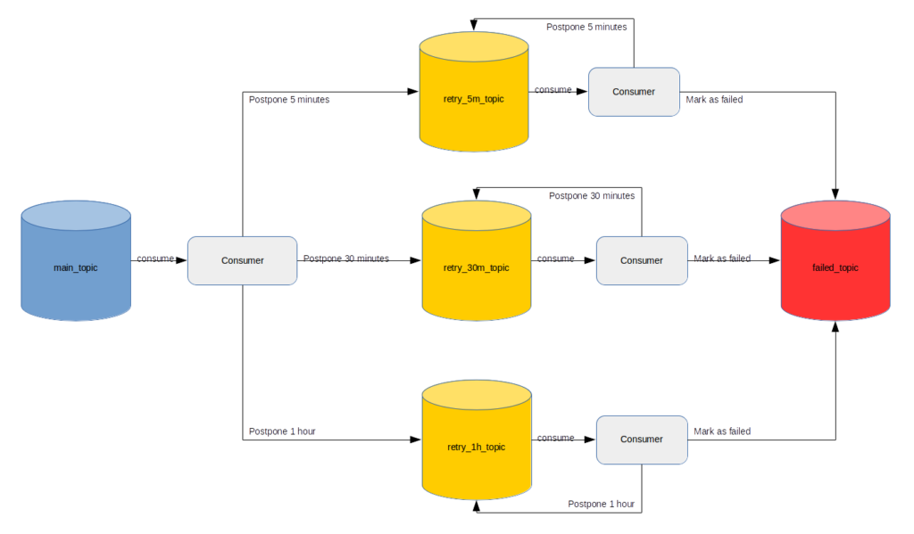
RETRY
Messages can be consumed from topic partitions in sequential order only
You cannot skip messages and come back to them later
If you want to postpone processing of some messages you can republish them to separate topics, one for each delay value
Processing failed messages can be achieved by cloning the message and republishing it to one of retry topics with updated information about attempt number and next retry timestamp
Consumers of retry topics should block the thread unless it is time to process the message
Messages in retry topics are naturally organized in the chronological order, sorted by the ‘retry_timestamp’ field
https://blog.pragmatists.com/retrying-consumer-architecture-in-the-apache-kafka-939ac4cb851a

Slide 11
ZOOKEPER
Kafka needs ZooKeeper
Kafka uses Zookeeper to do leadership election of Brokers and Topic Partition pairs.
Zookeeper sends changes of the topology to Kafka, so each node in the cluster knows;
when a new broker joined, a broker died, a topic was removed or a topic was added

Slide 12
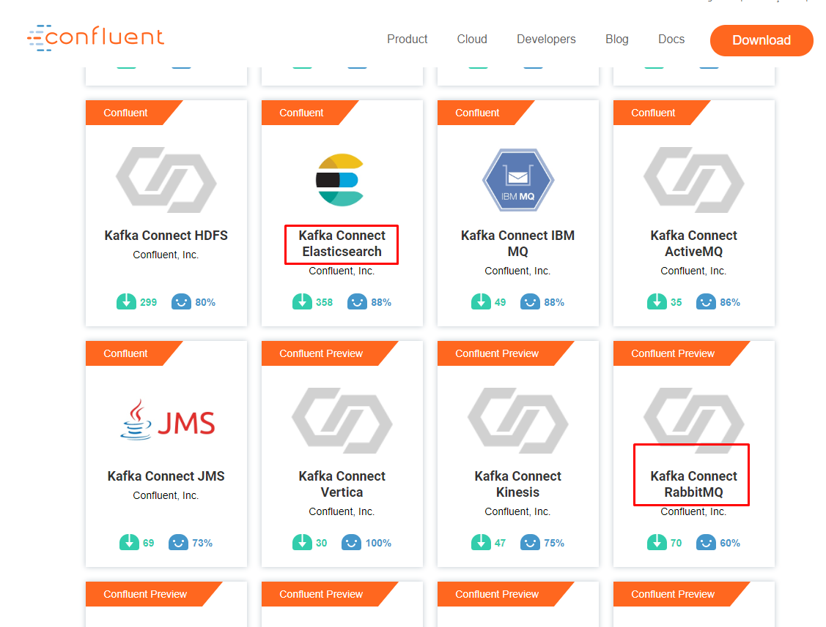
CONNECTORS

Slide 13
DEV ENV W/ DOCKER
docker run -d --name zookeeper -p 2181:2181 jplock/zookeeper
docker run -d --name kafka -p 7203:7203 -p 9092:9092 -e KAFKA_ADVERTISED_HOST_NAME=172.31.162.65 -e KAFKA_MESSAGE_MAX_BYTES=3000000 -e KAFKA_REPLICA_FETCH_MAX_BYTES=3100000 -e ZOOKEEPER_IP=172.31.162.65 ches/kafka
docker run --rm ches/kafka kafka-topics.sh --create --topic tags --replication-factor 1 --partitions 1 --zookeeper 172.31.162.65:2181
docker run --rm ches/kafka kafka-topics.sh --list --zookeeper 172.31.162.65:2181
docker run --rm --interactive ches/kafka kafka-console-producer.sh --topic tags --broker-list 172.31.162.65:9092
docker run --rm ches/kafka kafka-console-consumer.sh --topic tags --from-beginning --zookeeper 172.31.162.65:2181
docker run --rm --interactive ches/kafka kafka-consumer-groups.sh --new-consumer --describe --group group1 --bootstrap-server 172.31.162.65:9092
https://github.com/ches/docker-kafka

Slide 14
BUILD-IN SCRIPTS
docker run --rm ches/kafka kafka-topics.sh --create --topic tagsPart3 --replication-factor 1 --partitions 3 --zookeeper 172.31.162.65:2181
docker run --rm ches/kafka kafka-consumer-groups.sh --new-consumer --describe --group group1 --bootstrap-server 172.31.162.65:9092

Slide 15
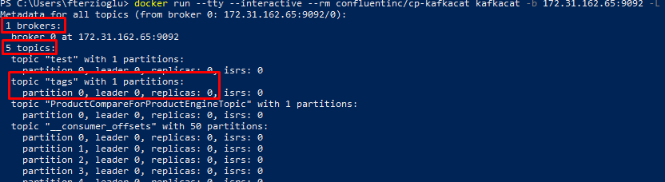
kafkacat
https://github.com/edenhill/kafkacat
docker run --tty --interactive --rm confluentinc/cp-kafkacat kafkacat -b 172.31.162.65:9092 -L
Creatiion New Tag;
docker run --interactive --rm confluentinc/cp-kafkacat kafkacat -b 192.168.20.180:9092 -t tags -K: -P

Slide 16
https://kafka.apache.org/intro
http://cloudurable.com/blog/kafka-architecture/index.html
http://cloudurable.com/blog/kafka-architecture-topics/index.html
https://blog.newrelic.com/engineering/kafka-best-practices/
https://www.oreilly.com/library/view/kafka-the-definitive/9781491936153/ch04.html
https://kafka.apache.org/documentation/#impl_offsettracking
https://stackoverflow.com/questions/50207715/where-to-set-maximum-message-size-in-apache-kafka
https://blog.newrelic.com/engineering/new-relic-kafkapocalypse/
https://www.oreilly.com/library/view/kafka-the-definitive/9781491936153/ch04.html
https://www.confluent.io/hub/

