Slide 1

Project Defense A WEB-BASED EDUCATION PORTAL APPLICATION FOR CRAWFORD UNIVERSITY USING CODEIGNITER FRAMEWORK by AKINLONU ENIOLA O. – 150502043 Computer Science

Slide 2
PRESENTATION OUTLINE
Introduction
Literature review
Problem statement
Aim and objectives
Scope and limitation
Research methodology
System implementation interface
Result discussion
Conclusion

Slide 3
INTRODUCTION

Slide 4
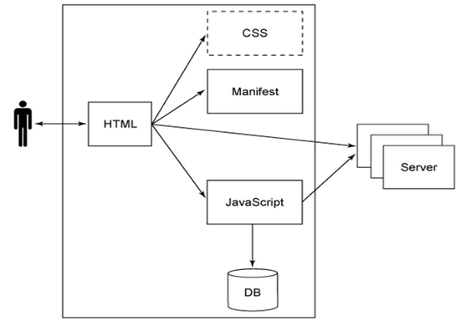
WHAT IS A WEB APPLICATION?
A web application or web-based application or web app is a computer program that utilizes web browsers and web technology to perform tasks over the Internet.

Slide 5
WHAT IS A PORTAL?
A Portal is a private location on the internet, accessible with a unique URL (web address) and unique username and password unlike a website that is publicly accessible.
It has the following features
Personal login is required
Only portal members can see the contents
Content is unique to user based on linked account information and group member settings/permissions
Secure access point for personalized information
Communication features with other portal members or group
Dynamic content changes more frequently than typical websites
Interactive functionalities for portal site members

Slide 6

CODEIGNITER FRAMEWORK
According to its documentation at https://www.codeigniter.com/
“CodeIgniter is a powerful PHP framework with a very small footprint, built for developers who need a simple and elegant toolkit to create full-featured web applications.”
Features
Small footprint
Exceptional performance
Nearly zero configuration
Clear documentation
Very high security
Simple solutions over complexity

Slide 7
LITERATURE REVIEW

Slide 8
TOPIC | AUTHOR | SOURCE AND YEAR | CONTRIBUTION | LIMITATION OBSERVED
AOCOED portal | Flex Systems | Flex systems tutor. (2011) | AOCOED portal – FlexSchool Login | Not smart Not responsive
SAFSMS | Flexisaf | https://flexisaf.com.solutions/#schools (2014) | An all encompassing school school management software supporting from playgroups to post primary schools | Not simple enough, not intuitive, only opportuned and vastly versed computer users can use it well.
SRMS | Flexisaf | https://flexisaf.com.solutions/#schools (2014) | School Registration portal | UX is poor

Slide 9
PROBLEM STATEMENT

Slide 10
Inefficiency: Slow page load and response time
Under implemented
Persistent and offensive dialog on page load that threatens satisfactory user interaction
broken links, duplicate and redundant links
unimplemented functionality
use of anachronistic technologies and defective user interface and poor user experience, no online help.
User has to go to the Edu-portal office to manually set a new password for his/her account.
Unreliable and insecure as server breaks down and students are unable to access the portal and it has no active SSL (Secure Sockets Layer) certificate i.e. it doesn’t use Https (Hypertext Transfer Protocol Secure) protocol.

Slide 11
AIM AND OBJECTIVES

Slide 12
To create an embedded online course portal which provides a pre-assessment module that allow courses verification to the students when login on the website and result checking by students. In addition, the course portal can also automatically evaluate and showcase the report of courses of the students.
Course allocation, approval, course grading and result processing by lecturers.
Position-based user restriction, bursary approval and dispensation of clearance to qualified users, mailing, admission list management, user data management.
To improve the privacy, user-friendliness and to enable convenient access to the different kinds of information and services mounted on the web by users, it would be desirable to set up a portal for channeling the vast information resources to the different users in an efficient and effective manner.

Slide 13
SCOPE AND LIMITATION

Slide 14
The application of this software may not be limited to Crawford University alone but can be used equally by other universities, even secondary schools and colleges. This paper only covers all that is required to design and implement the education portal program and nothing more.
However, my LIMITATION FACTORS
TIME
FINANCIAL
SINGLE / TOO FEW DEVELOPERS

Slide 15
RESEARCH METHODOLOGY

Slide 16
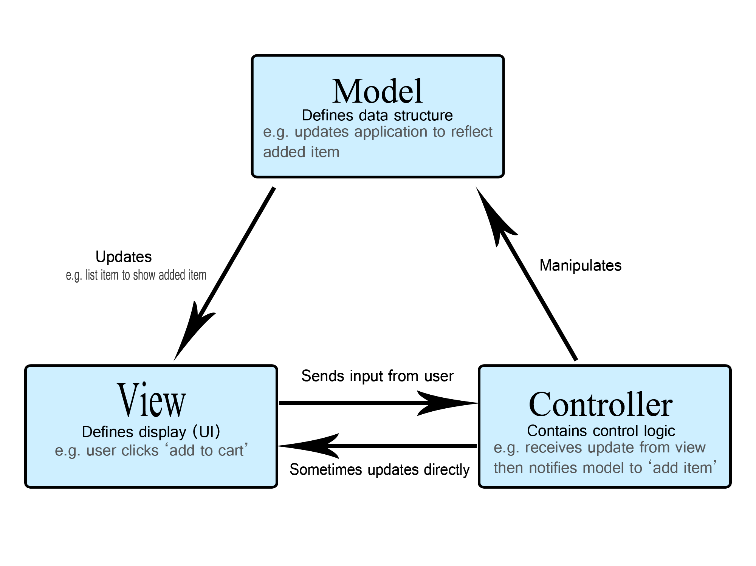
DESIGN PATTERN – MVC (Model View Controller)

Slide 17




PROGRAMMING TOOLS

Slide 18
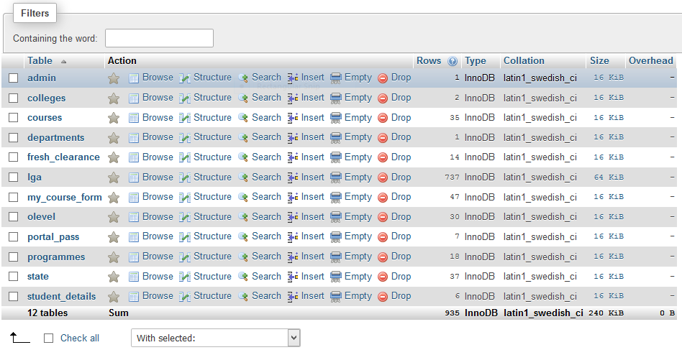
DATABASE STRUCTURE

Slide 19
SYSTEM IMPLEMENTATION INTERFACE

Slide 20
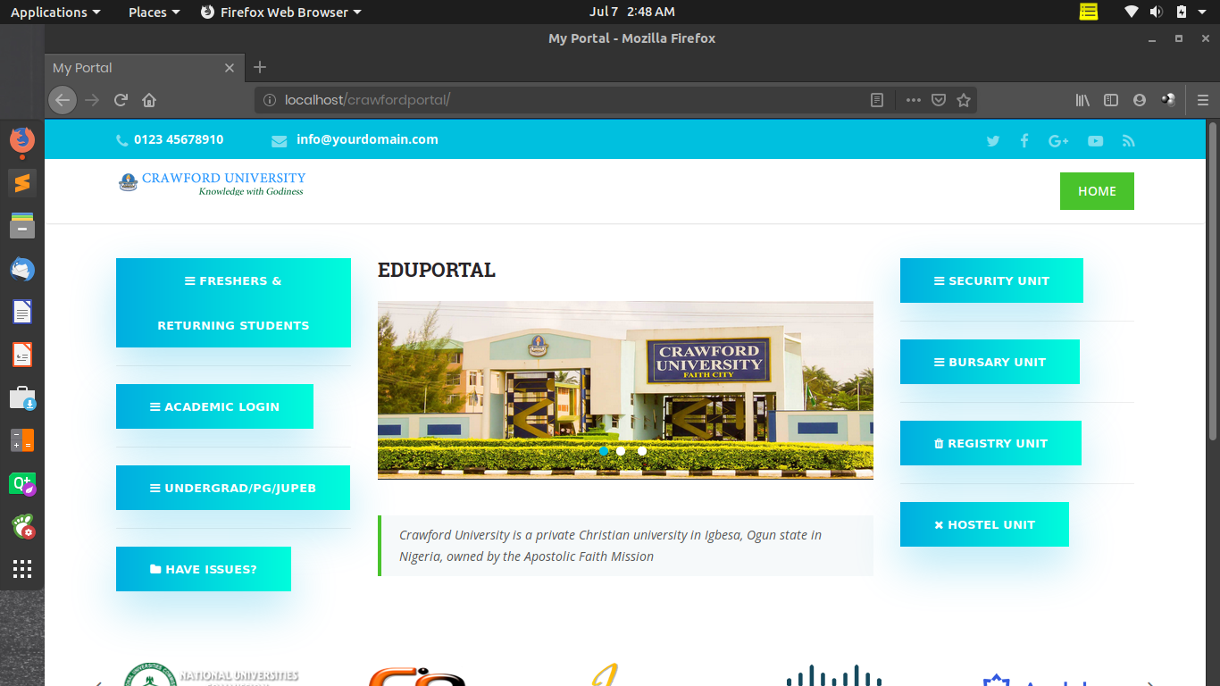

Slide 21
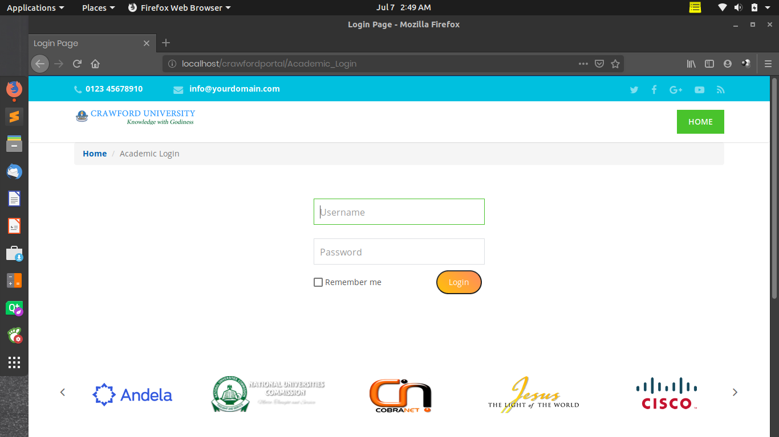

Slide 22
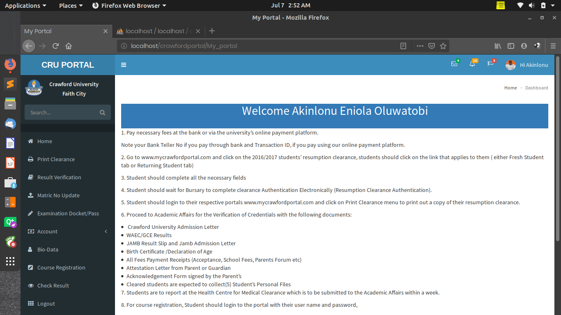

Slide 23
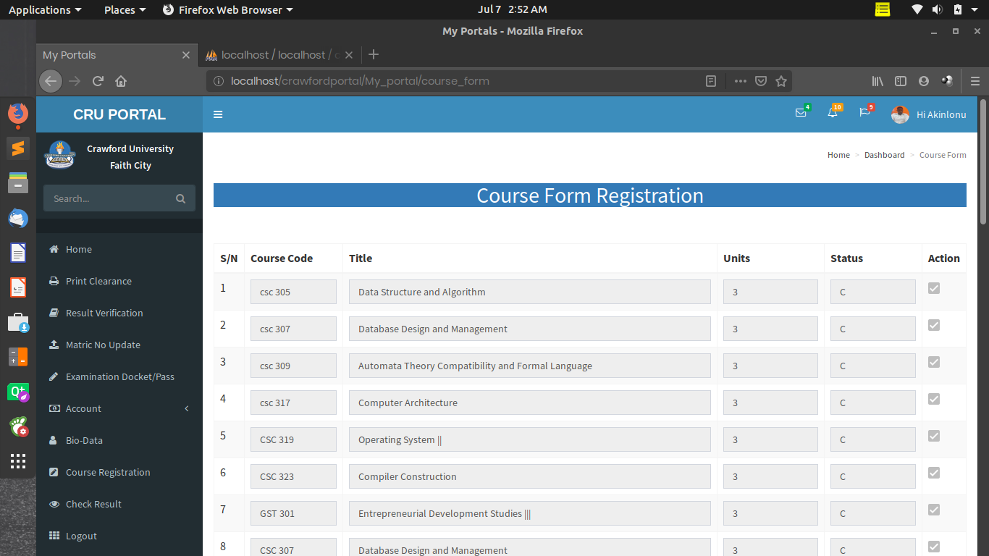

Slide 24
RESULT DISCUSSION

Slide 25
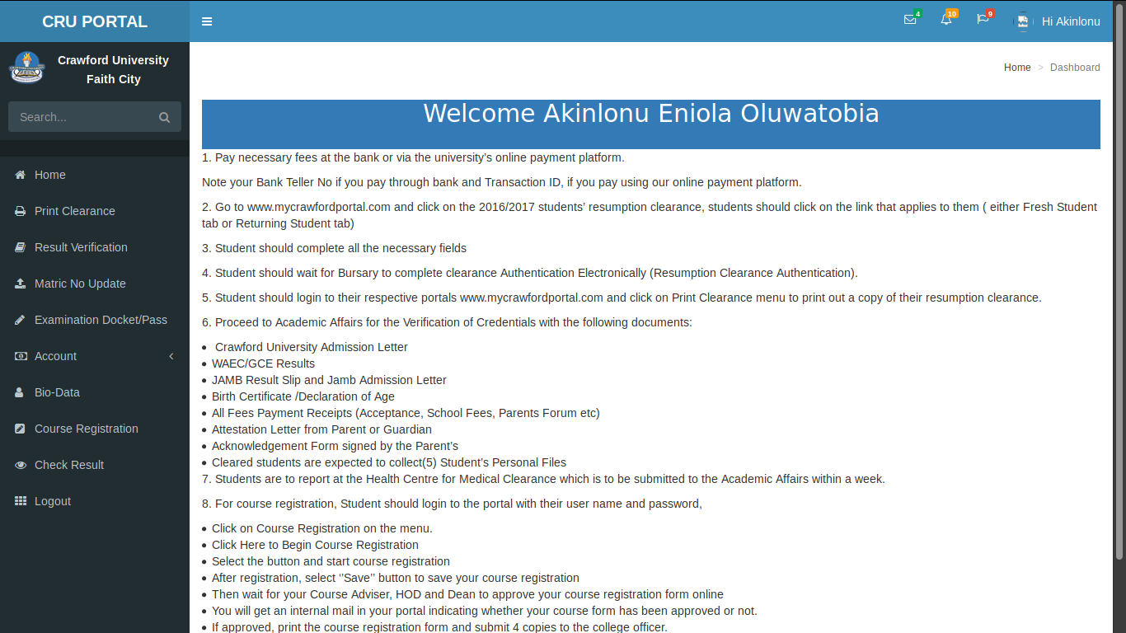

Slide 26
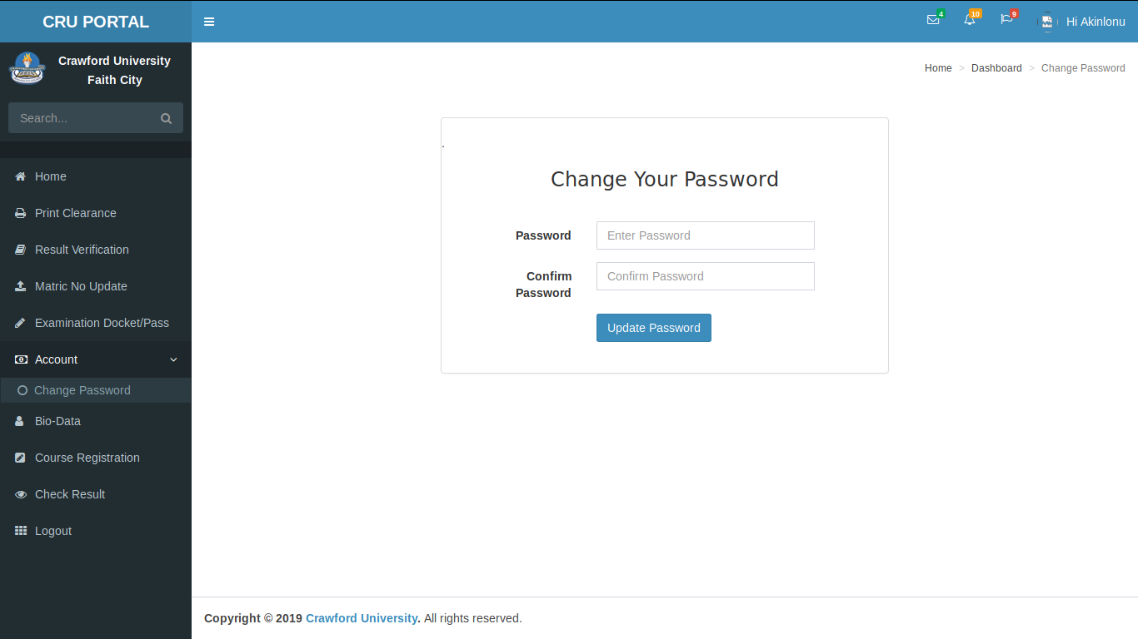

Slide 27
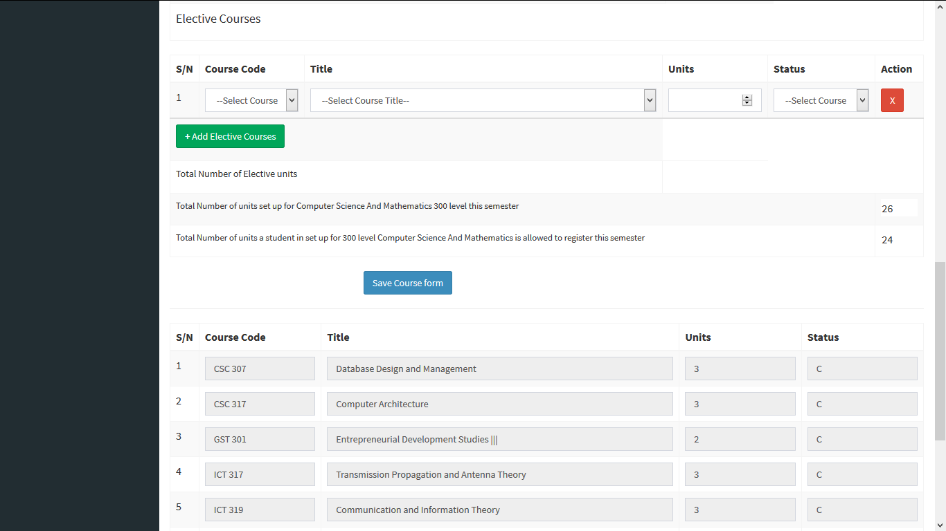

Slide 28
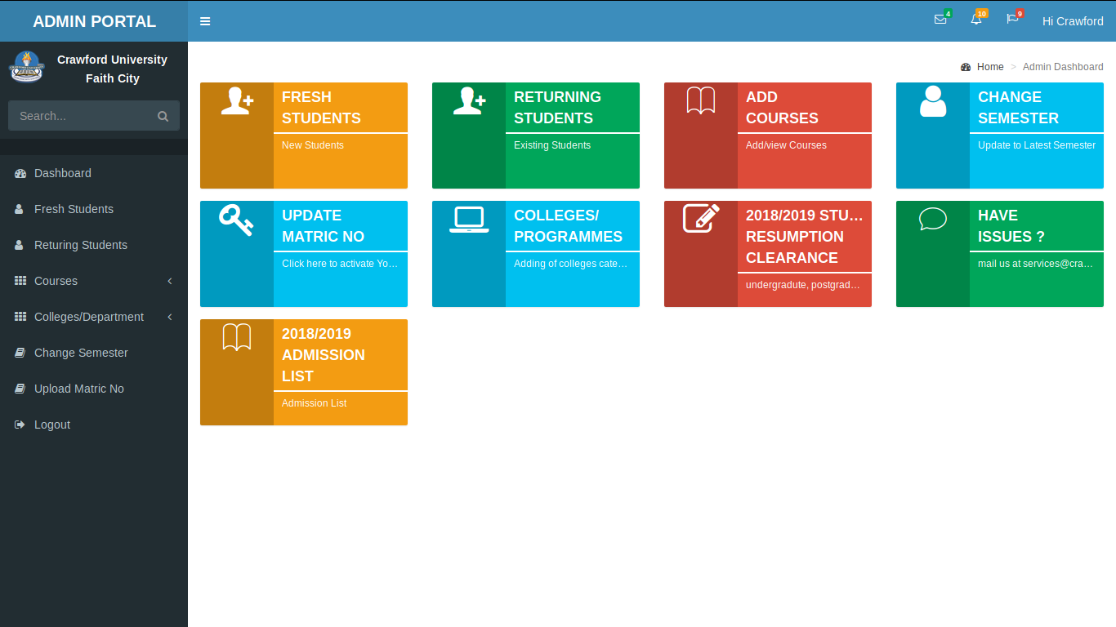

Slide 29
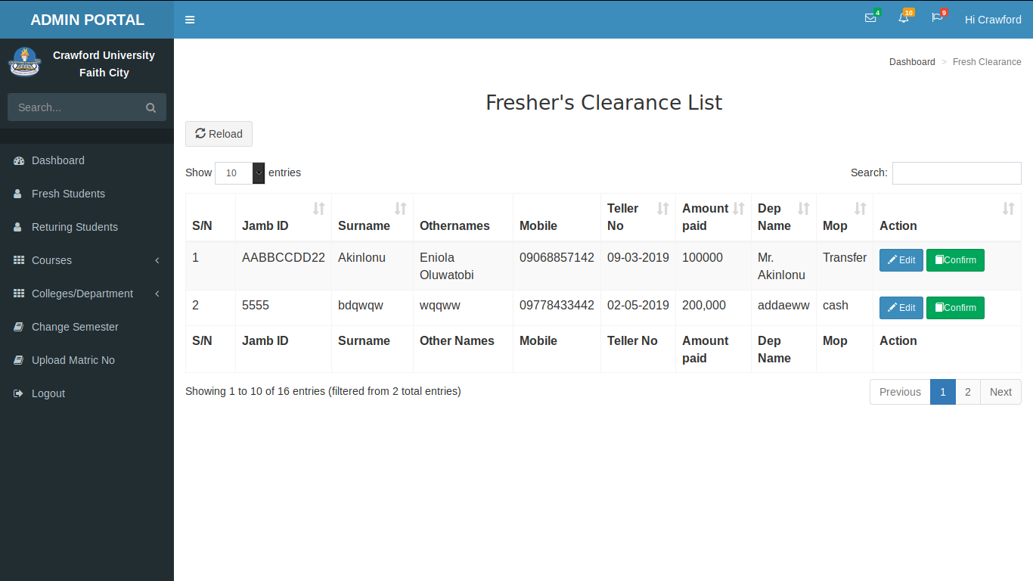

Slide 30
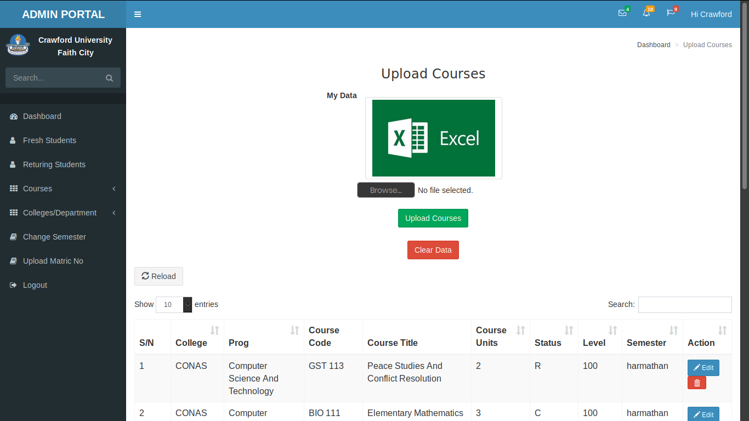

Slide 31
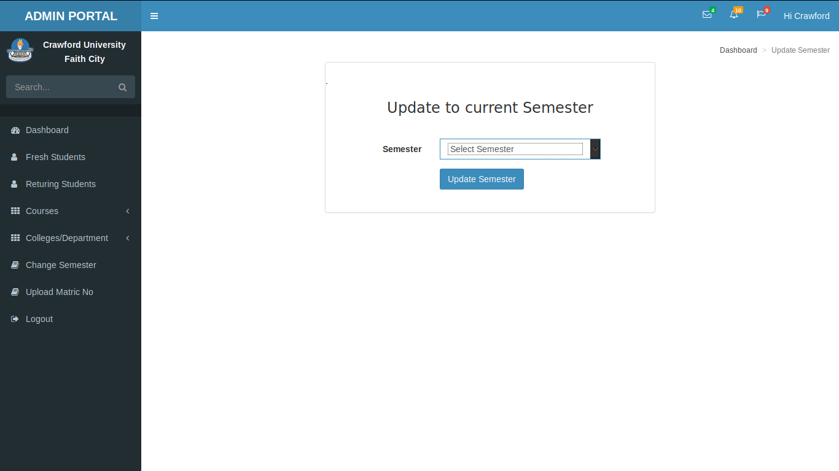

Slide 32
CONCLUSION

Slide 33
It is said that “You know by doing”, Even as an experienced developer, I still got to master new and crucial skill sets and ideas such as using the codeigniter framework, git, and SQL functions.
Also important lessons learnt:
PRG – post/Redirect/Get
How to place a submit button outside a <form> tag
How to insert multiple rows into database with one insert using mysql syntax
Set initial AUTO_INCREMENT value for SQL column
How to use bootstrap
and many more. . .
Also my problem solving skills and search engine approach has been augmented.
I RECOMMEND this application to be an SPA – Single Page Application

Slide 34


