Slide 1

Lexical & Distributional Semantics
AdvNLP/E Lecture 1
Dr Julie Weeds, Spring 2026

Slide 2
Lecture 1 Overview
Part 1
Part 2
Lexical semantics
word senses
semantic relationships
WordNet
semantic similarity measures based on WordNet
evaluation
Distributional Semantics
bootstrapping semantics from context
cosine similarity
(positive) pointwise mutual information
evaluation
word ambiguity
semantic relationships
sparsity
This might be revision if you have done Applied NLP!

Slide 3
Lexical Semantics
Lecture 1, part 1
Dr Julie Weeds, Spring 2026

Slide 4
Word senses
Words are often ambiguous
Words can have multiple senses (i.e., meanings)
I placed the book on the counter.
vs
I placed my counter on the gameboard.
How many more senses of counter can you think of?

Slide 5
Dictionaries
Lexicographers produce dictionaries which:
enumerate the senses of all of the words in a language
provide definitions of different sense
provide examples of usage of different senses
WordNet online search:
http://wordnetweb.princeton.edu/perl/webwn
Oxford English Dictionary online search:
https://en.oxforddictionaries.com/?utm_source=od-panel&utm_campaign=en

Slide 6
How many different senses do words have?
WordNet | Oxford
Noun:4, Verb:6 | N:6, V:11
Noun:4, adJ:1 | N:4, V:1, J: 1
Noun: 11, Verb:4 | N:14,V:9
Noun:1, Verb: 2 | N:2
Noun: 9, Verb:2, adJ:1, adveRb: 1 | N:13, V: 3, J: 1, R: 1
plant
chicken
book
twig
counter
Dictionaries do not always agree on this! Why is it so difficult?

Slide 7
Sense distinctions
Homonymy
polysemy
Broad distinctions
fine-grained distinctions
plant
book
A written or printed work
A living organism, typically growing in a permanent site
A bound set of blank sheets for writing in
A place where an industrial process happens
A set of accounts
A bookmaker’s record of bets
The notebook used by a referee

Slide 8
Lexical semantic relationships
synonymy
antonymy
hyponymy / hypernymy
meronymy / holonymy
topical relatedness

Slide 9
Synonymy
==
fast
quickly
Words which mean the same thing
Two words are synonymous if they can be substituted in all possible contexts without changing the meaning of the utterance.
True synonyms are very rare
Choice of synonym usually gives us some extra information about the situation or speaker e.g., car vs automobile
It is often defined as a relationship between word senses rather than between words. e.g., plant == spy ?

Slide 10
Antonymy
≠
hot
cold
Words which are opposite in meaning
Substituting one for the other would often cause a contradiction:
The food is hot.
The food is cold.
Antonyms are actually very similar in meaning
hot and cold both describe the temperature of an object
rise and fall both describe an object which is moving in the vertical plane
Most antonym pairs are adjectives, verbs or adverbs

Slide 11
Hyponymy and Hypernymy
ISA
dog
animal
hyponym
hypernym
Linguistic terms which capture the idea of class inclusion
A dog is a type of animal so:
dog is a hyponym of animal
animal is a hypernym of dog
It’s a transitive relationship so
If dog is a hyponym of animal
And poodle is a hyponym of dog
Poodle is also a hyponym of animal
animal
ISA
dog
ISA
poodle

Slide 12
Hyponym Hierarchies
The hyponymy relationship links together large numbers of concepts in a tree or hierarchy
Most general superclass at the top
Most specific types at the leaves
animal
dog
cat
poodle
terrier
Words which share a common hypernym are called co-hyponyms

Slide 13
WordNet
More than an electronic dictionary!
See http://wordnet.princeton.edu for more general information
Or see: Christiane Fellbaum (1998, ed.) WordNet: An Electronic Lexical Database. MIT Press.

Slide 14
WordNet
A linguistic network organized around synonymy and hyponymy
Core unit is the synset
a set of synonymous word senses
a set may contain a single word
synset items may be bigrams (e.g., “plant life”) as well as unigrams
each synset is also associated with a single definition
Polysemous words appear in multiple synsets
One for each sense
Synsets are then connected via hyponymy…..
{plant, flora, plant life} = a living organism lacking the power of locomotion
{plant} = something planted secretly for discovery by another
{plant, works, industrial plant} = buildings for carrying on industrial labour

Slide 15
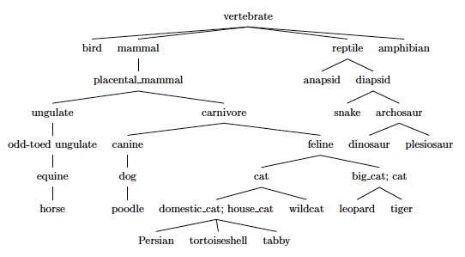
Extract from the WordNet noun hierarchy

Slide 16
Semantic similarity based on WordNet
Intuition: More similar concepts are closer together in the hierarchy.

Slide 17
Path length: shorter path -> greater similarity

Slide 18
Potential problems with pathlength
Pathlength does not differentiate between different types of path e.g., canine → … → vertebrate vs dog → … ← cat
Intuitively, concepts (separated by same path length) are more dissimilar higher up the tree; but this is not captured by path length similarity measure
Some parts of tree may be densely populated with rare terminology

Slide 19
Lowest common subsumer: similarity based on what two concepts share
What is the LCS of:
tabby and tiger?
poodle and carnivore?
poodle and tiger?

Slide 20
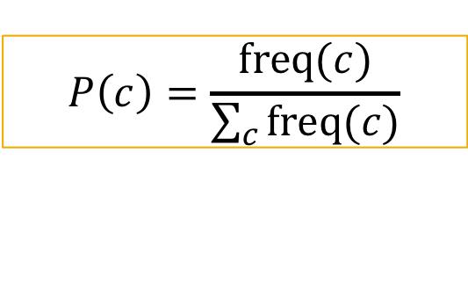
Information content
Intuition: concepts which have the LCS carnivore are more similar than concepts which have the LCS vertebrate
We gain more information when we are told two objects are both carnivores than when we are told they are both vertebrates.
We capture this probabilistically via the information content (IC) of a concept
Annotate the hierarchy with the frequency of occurrence of each concept in some corpus
Remember that the occurrence of a concept implies the occurrence of all of its hypernyms (if something is a dog, it is also a canine and so on)
$$P\left(c\right)=\frac{\text{freq}(c)}{\sum_{c}{\text{freq}(c)}}$$

Slide 21
Question
How do we count the number of times a concept has occurred in a corpus?

Slide 22
WordNet similarity measures based on information content (IC)
Information content in a concept
Information content in what the concepts share (their lowest common subsumer)
See Resnik, 1995
Ratio of shared information content to total information content
See Lin 1998b

Slide 23
Word similarity
Can you write python code to implement this function?

Slide 24
Evaluation
How do we evaluate semantic similarity measures?
What is the right answer?

Slide 25
Human synonymy judgements
Rubenstein & Goodenough 1965 (65 pairs)
Miller and Charles 1991 (30 pairs)
WordSim-353 2002 (353 pairs)
MEN dataset 2012 (3000 pairs)
 | M&C | WN
car-automobile | 3.92 | 1.0
magician-wizard | 3.5 | 1.00
journey-car | 1.16 | 0.0
coast-forest | 0.42 | 0.15
noon-string | 0.08 | 0.0

Slide 26
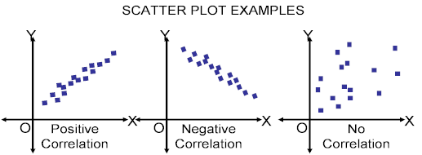


Correlation
Pearson’s product-moment correlation coefficient
Spearman’s rank correlation coefficient

Slide 27
Distributional Semantics
Lecture 1, Part 2
Dr Julie Weeds, Spring 2025

Slide 28
Distributional Semantics
“You shall know a word by the company it keeps.”
Firth (1957)
The Distributional Hypothesis: “Words that occur in the same contexts tend to have similar meanings.”
Harris (1954)

Slide 29
What does tezguino mean?
A bottle of tezguino is on the table.
Everyone likes tezguino.
Tezguino makes you drunk.
We make tezguino out of corn.
(Lin, 1998)

Slide 30
Bootstrapping the semantics of unknown words
The contexts in which tezguino is used suggest that tezguino may be:
A kind of alcoholic beverage made from corn mash
Similarity plays an important role in word acquisition (Gentner, 1982)
Can we use corpora to infer similarity between words i.e., infer that tezguino is similar to beer, wine, vodka etc?

Slide 31
Applications of distributional semantics
Automatic thesaurus construction
For any language, genre, domain … where we have a corpus
Overcoming data sparseness in models which require labelled training data

Slide 32
Distributional semantics in document classification
Imagine we have built a Naïve Bayes document relevancy classifier using a relatively small training sample (e.g., 500 documents)
A test document contains the word tezguino which has not been seen in the training sample
so it cannot contribute to the relevancy classification
But by applying distributional semantics to a very large unlabeled corpus (e.g., the web), we know that tezguino is very similar to beer
beer has been seen in the training sample
Assume P(tezguino|class) ≈ P(beer|class)

Slide 33
Facets of meaning
Tigers eat meat.
The monkey ate a banana.
X17 likes to eat falafel.
My son does not eat courgettes.
The machine ate my credit card.
What can be eaten?
What eats things?
Meat, banana, falafel, courgettes and credit card all share 1 facet of meaning – that they can be eaten
Tigers, monkey, X17, son and machine all share 1 facet of meaning – that they eat things
From these examples we can learn:

Slide 34
Features to capture facets of meaning
Dependency relationships between words:
“is subject of eat”
“is object of eat”
Proximity between words
“occurs within a window of +- m words either side of the word eat”
Feature values can be Boolean but are usually real-valued
strength of association
Dependency parsing is difficult
Windows are easy to construct
Window size can be varied to capture different types of semantic relationships

Slide 35
Context windows
window size around target word = +-1
Features added per target word
The | machine | ate | my | credit | card
The | machine | ate | my | credit | card
The | machine | ate | my | credit | card
The | machine | ate | my | credit | card
The | machine | ate | my | credit | card
The | machine | ate | my | credit | card
the: {machine: 1}
machine: {the: 1, ate: 1}
ate: {machine: 1, my: 1}
What features will be added for my, credit and card?

Slide 36
Context windows
window size around target word = +-2
Features added per target word
The | machine | ate | my | credit | card
The | machine | ate | my | credit | card
The | machine | ate | my | credit | card
The | machine | ate | my | credit | card
The | machine | ate | my | credit | card
The | machine | ate | my | credit | card
the: {machine: 1, ate: 1}
machine: {the: 1, ate: 1, my: 1}
ate: {the: 1, machine: 1, my: 1, credit: 1}
What features will be added for my, credit and card?

Slide 37
Distributional Representations
feature | banana | meat | credit | Total
yellow | 10 | 2 | 3 | 15
red | 2 | 14 | 19 | 35
eat | 20 | 9 | 1 | 30
spend | 1 | 2 | 27 | 30
card | 3 | 2 | 50 | 55
the | 25 | 25 | 50 | 100
is | 20 | 20 | 40 | 80
tiger | 3 | 17 | 0 | 20
man | 6 | 9 | 10 | 25
monkey | 10 | 0 | 0 | 10
Total | 100 | 100 | 200 | 400
Use windowing to extract and count features for all words in a large corpus i.e., distributional representations or vectors

Slide 38

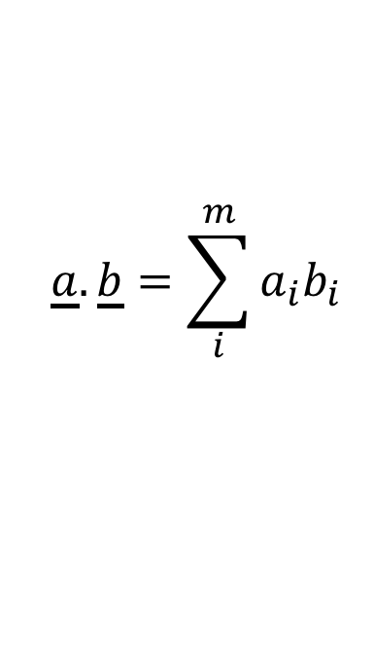
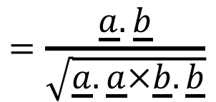
Cosine similarity
The more similar two words are, the smaller the angle θ between their vectors will be.
So:
w₁
$$sim\left(w_{1},w_{2}\right)=cos⁡(θ)$$
score(w “yellow”)
a
dot product
$$=\frac{\underline{a}.\underline{b}}{\sqrt{\underline{a}.\underline{a}×\underline{b}.\underline{b}}}$$
b
w₂
θ
Where:
m=number of dimensions
score(w, “eat”)
$$\underline{a}.\underline{b}=\sum_{i}^{m}{a_{i}b_{i}}$$

Slide 39
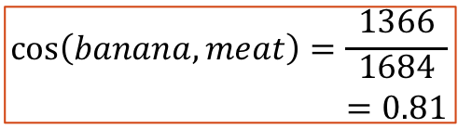
Calculating cosine
feature | banana | meat | a.b | a.a | b.b
yellow | 10 | 2 | 20 | 100 | 4
red | 2 | 14 | 28 | 4 | 196
eat | 20 | 9 | 180 | 400 | 81
spend | 1 | 2 | 2 | 1 | 4
card | 3 | 2 | 6 | 9 | 4
the | 25 | 25 | 625 | 625 | 625
is | 20 | 20 | 400 | 400 | 400
tiger | 3 | 17 | 51 | 9 | 289
man | 6 | 9 | 54 | 36 | 81
monkey | 10 | 0 | 0 | 100 | 0
Total | 100 | 100 | 1366 | 1684 | 1684
$$\text{c}\text{os}\left(banana,meat\right)=\frac{1366}{\begin{aligned}1684 \\ =0.81\end{aligned}}$$

Slide 40
Pointwise Mutual information (PMI)
Frequency and/or simple conditional probability do not capture the intuition that some features are more informative than others
the and is appear relatively frequently with all of the words
so their contribution to similarity should be smaller
PMI measures the amount of information gained by seeing a word and a feature together
A feature which co-occurs with a target word more than we would expect (if words and features occurred independently) has more weight in the similarity calculation

Slide 41
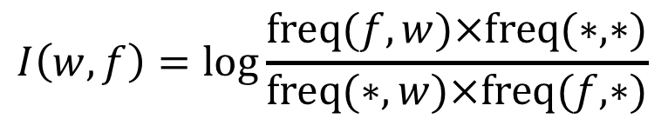
calculating PMI
$$I\left(w,f\right)=\log{\frac{\text{freq}(f,w)×\text{freq}(∗,∗)}{\text{freq}(∗, w)×\text{freq}(f, ∗)}}$$
grand total
row total
column total

Slide 42
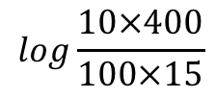
Representations based on PMI
feature | banana | meat | credit | Total
yellow | 10 | 2 | 3 | 15
red | 2 | 14 | 19 | 35
eat | 20 | 9 | 1 | 30
spend | 1 | 2 | 27 | 30
card | 3 | 2 | 50 | 55
the | 25 | 25 | 50 | 100
is | 20 | 20 | 40 | 80
tiger | 3 | 17 | 0 | 20
man | 6 | 9 | 10 | 25
monkey | 10 | 0 | 0 | 10
Total | 100 | 100 | 200 | 400
feature | banana | meat | credit
yellow | 1.42
red
eat
spend
card
the
is
tiger
man
monkey
$$log\frac{10×400}{100×15}$$

Slide 43
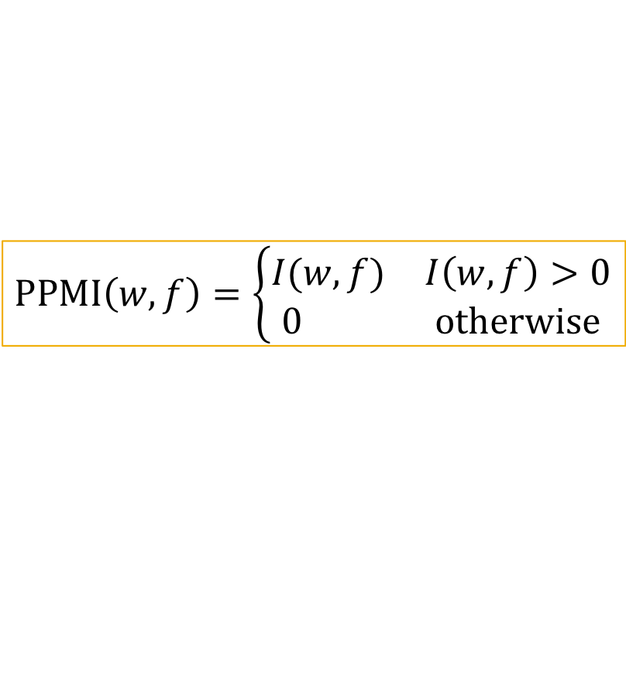
Positive PMI (PPMI)
What happens when frequency of co-occurrence is 0?
PMI = negative infinity!!!
positive PMI avoids this problem
similarity is then also based on shared features rather than the sharing of absent features
$$\text{PPMI}\left(w,f\right)=\left\{\begin{aligned}\begin{matrix}I(w,f) & I\left(w,f\right)>0\end{matrix} \\ \begin{matrix}0 & \text{otherwise}\end{matrix}\end{aligned}\right.$$

Slide 44
Representations based on PPMI
feature | banana | meat | credit | Total
yellow | 10 | 2 | 3 | 15
red | 2 | 14 | 19 | 35
eat | 20 | 9 | 1 | 30
spend | 1 | 2 | 27 | 30
card | 3 | 2 | 50 | 55
the | 25 | 25 | 50 | 100
is | 20 | 20 | 40 | 80
tiger | 3 | 17 | 0 | 20
man | 6 | 9 | 10 | 25
monkey | 10 | 0 | 0 | 10
Total | 100 | 100 | 200 | 400
feature | banana | meat | credit
yellow | 1.42 | 0 | 0
red | 0 | 0.68 | 0.12
eat | 1.42 | 0.26 | 0
spend
card
the
is
tiger |  |  | 0
man
monkey |  | 0 | 0
$$log\frac{10×400}{100×15}$$

Slide 45
Automatic thesaurus generation
Extract feature representations based on corpus co-occurrence frequencies
Convert representations to PPMI
Calculate cosine similarities for all pairs of words
computationally very expensive
may want to reduce the number of words considered in vocab
e.g., top 10,000 words
Find nearest neighbours of each word

Slide 46
Evaluation
Difficult – why?
Intrinsic evaluation
human synonymy judgements
manually compiled thesauruses
Extrinsic evaluation
performance gain in an application

Slide 47
Word ambiguity
Here is the distributional thesaurus entry for the noun bow (derived using nltk.lin_thesaurus)
bow
ribbon | 0.09
machete | 0.07
spear | 0.07
hull | 0.07
sword | 0.07
knife | 0.07
arrow | 0.06
scarf | 0.06
rope | 0.06
streamer | 0.06
What different senses of the word bow do you think are captured by the thesaurus entry?
Are the neighbours distributed evenly between the senses or do some senses have more neighbours than others?
Why do you think this is?

Slide 48
Senses in Distributional Semantics
Distributional representations are of words not senses
mixture of senses in distributional neighbourhoods
this can be a problem in some applications. ….?
possible solutions: carry out WSD
before finding distributional neighbours
after finding distributional neighbours
Distributional neighbours tend to reflect predominant sense of word
how could this be useful?
Notes:
Remove reference to WSD?

Slide 49
Semantic relationships
Similar words are not necessarily synonyms
Neighbourhoods typically contain:
synonyms, antonyms, hypernyms, hyponyms, co-hyponyms, meronyms, topically related words ….
journey
The nearest neighbour of a word is often an antonym (or co-hyponym). Why might this be a problem?
automobile
car
bus
mini
ferrari
wheel
drive
vehicle

Slide 50
Sparsity
Zipf’s Law: “The product of the frequency of a word and its rank is approximately constant.”
Rank | 1/Rank | Freq
1 | 8 | 8
2 | 4 | 4
3 | 2.667 | 3
4 | 2 | 2
5 | 1.6 | 2
6 | 1.333 | 1
7 | 1.143 | 1
8 | 1 | 1
9 | 0.889 | 1
10 | 0.8 | 1
 | 23.43 | 24
Hapax Legomena : words which only occur once. However large
the corpus, these make up approximate half the vocabulary.

Slide 51
Consequences of Zipf’s Law
100k dimensional co-occurrence vectors will be very sparse (lots of zeros)
difficult to compare vectors because of all of this unseen stuff
What can we do?

Slide 52
Coming up
Solutions to this problem (week 4):
Smoothing
Dimensionality reduction
Language models with fixed dimensionality e.g., recurrent neural network language models (RNNLMs)
Probabilistic language models (week 2)
n-gram modelling
evaluation and perplexity
generalization and smoothing

Slide 53
Reading
Week 1 seminar:
Pedersen (2010): Information Content Measures of Semantic Similarity Perform Better without Sense Tagged Text

Slide 54
References
Christiane Fellbaum (1998, ed.) WordNet: An Electronic Lexical Database. Cambridge, MA: MIT Press.
Lin, D. (1998a) Automatic retrieval and clustering of similar words. In Proceedings of COLING/ACL.
Lin, D (1998b) An information-theoretic definition of similarity. In ICML 1998, San Francisco, pp 296-304
Mikolov, Yih and Zweig 2013 – Linguistic Regularities in Continuous Space Word Representations, (NAACL-HCT 2013)
Pedersen, T. (2010). Information Content Measures of Semantic Similarity Perform Better without Sense Tagged Text
Resnik, P (1995) Using information content to evaluate semantic similarity in a taxonomy. In IJCAI-95, pp. 448-424
Zweig, G. and Burges, A. 2011. The Microsoft Research Sentence Completion Challenge. Microsoft Technical Report

