Slide 1
Reflective Injection Detection – RID.py
Or How I slapped together some python c-types in a week to do what defensive vendors aren't incorporating into main-line products
Or Bringing the Sexy Back - A defensive tool that doesn't fail quite as hard as it could

Slide 2
Pre-talk notes
I don't own any of the artwork. It's all from google-images without copyright notices.
I think fault lies on both sides of the fence.
My statements here don't reflect my past, present, or future employer's point of view. Some thinks were inserted merely for humor.

Slide 3
Who Am I?
This page intentionally left blank

Slide 4
Who Am I?
On a more serious note:
You can check out my CV here on linkedin:
pub/andrew-king/23/432/679
Just a note, defense is first offense is last

Slide 5
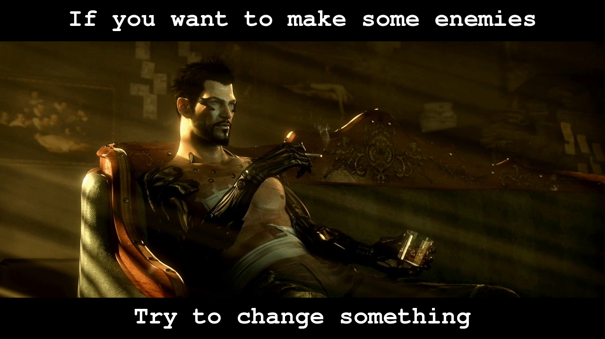
Why would I do a talk that's going to make people angry?

Slide 6
Reflective Injection?
Load DLL from memory
VirtualAlloc or Ex
No heap(might fragment)

Slide 7
Defense
Programmers are lazy
  Not just defensive programmers
So there's probably very little 'request specific and check' going on
Memory address allocations tend to be pretty predictable
Possible optimization for scanning

Slide 8
Offense
So what if they start looking for our PE mapping code?
Just do the expansion on disk with some utility and now all that relocation code isn't needed.
Vendors would rather search for reflect inject stager code I think...
See some AV detects my obfuscation tutorial as malicious even though it prints hello...

Slide 9
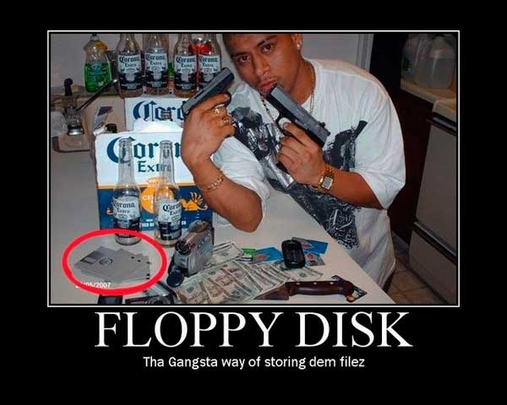
Fail

Slide 10
Why does it still work?
Can we detect it at runtime?
Only if we monitor VirtualAllocEx which seems really doubtful since all memory allocations eventually wind up there.
Why it's not implemented in my opinion.
Can we scan memory for it?
Sure, that's easy.

Slide 11

Defense side of things

Slide 12
Finding reflect injected DLLs
What does a DLL structurally have that raw data doesn't?
PE header
COFF headers
Section tables
Permissions
Predictable layout

Slide 13
So first build a white-list
Get all processes
Get modules for all processes
Build an exclusion map for yourself
  You need a count and can't immediately auto-kill for one offense.
  Timing issue.

Slide 14
VirtualQueryEx
Find all allocated memory pages and save all the data about them.
You never know, you might need it later

Slide 15
Process of elimination
Eliminate all known legitimate pages
Eliminate Thread areas
There are more criteria I use to eliminate...
Memory allocations tend to be predictable

Slide 16
ReadProcessMemory
Find the data in the relevant sections...
Check for suspicious structures
Check for fishy permissions
Could check only probable allocation space...we're talking about shellcode here

Slide 17
So now that we found it
What to do about it?
Just flip access permissions so threads die when they try and execute there
Suspend threads found to be operating in that area
Dump the DLL
Try to reverse the relocations
Add it to the process's list of DLLs
  load and empty one and raw edit the location
Give it to your trusty old AV

Slide 18

Okay so that was easy, and not altogether new
Home user products aren't doing it, but you never know...

Slide 19

Offense side of things

Slide 20
Offense side of things
So how could we beat this?
Load a large-ish DLL into memory that the process probably isn't going to use
Carve it out and do some reflective injection into a targeted area.
Change permissions on the page with the header.

Slide 21
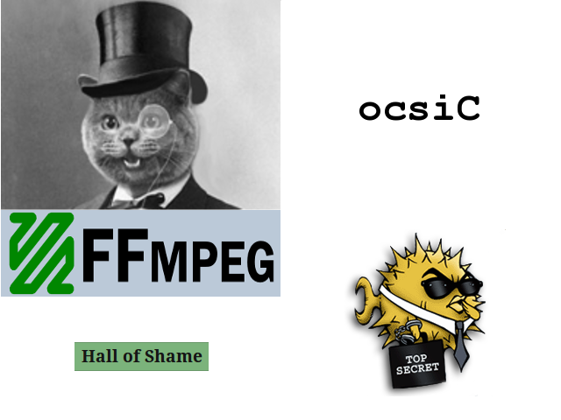
Why don't more developers open source?
Because people like this don't donate:

Slide 22
Demo

Slide 23
But then...
Yes then A/V vendors would see your code.
SO, you might want to think about run-time obfuscation

Slide 24
Conclusion
Both sides of the fence on this one.
Can it be halted/slowed down?
  Sure
Why isn't it?
  It's kind of processor intensive to catch quickly.
  Releasing some code.
  You'll want to shim in the nice-ing up the processor bit

Slide 25
It's not pretty, but it works.
Only tested on x86
Doesn't have many features
Yes, it's python with Ctypes
  I have a C port. It's much easier on memory, but much slower...I used lists instead of C++ maps.

Slide 26
The other code
I stripped out all the lists of possible structures and put in a basic regex for metasploit shellcode instead of section offsets
I couldn't really in good conscience put a fully weaponized thing out there

Slide 27
What else am I working on?
Interesting things with python obfuscation
Shout outs
Thanks

Slide 28
Questions?
Yes, I'll be around

