Slide 1
AirBnB_Full_Project
File created on: 07-02-2022 11:43:46

Slide 2
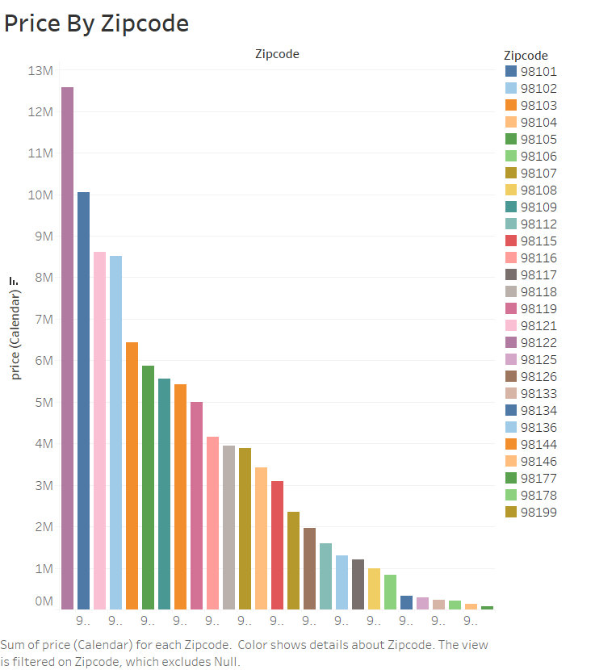

Slide 3
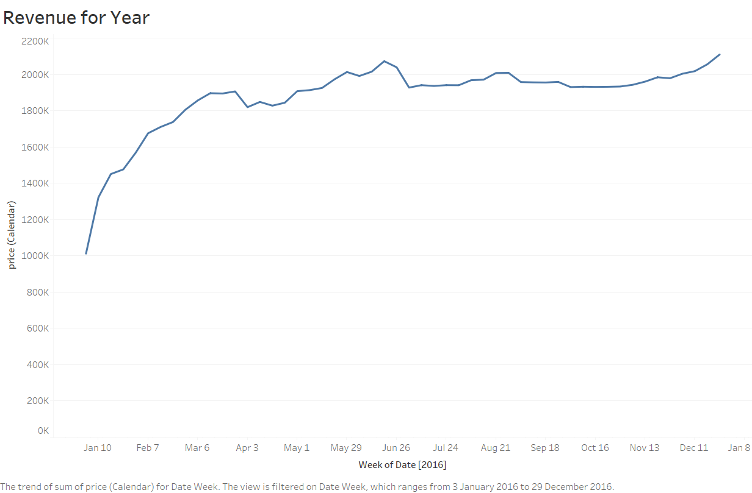

Slide 4
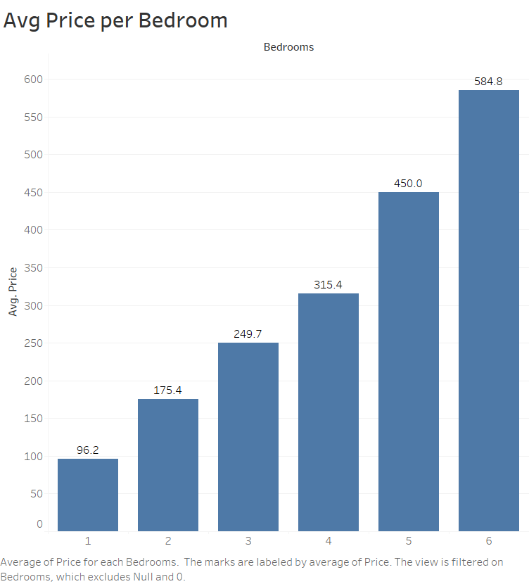

Slide 5


Slide 6
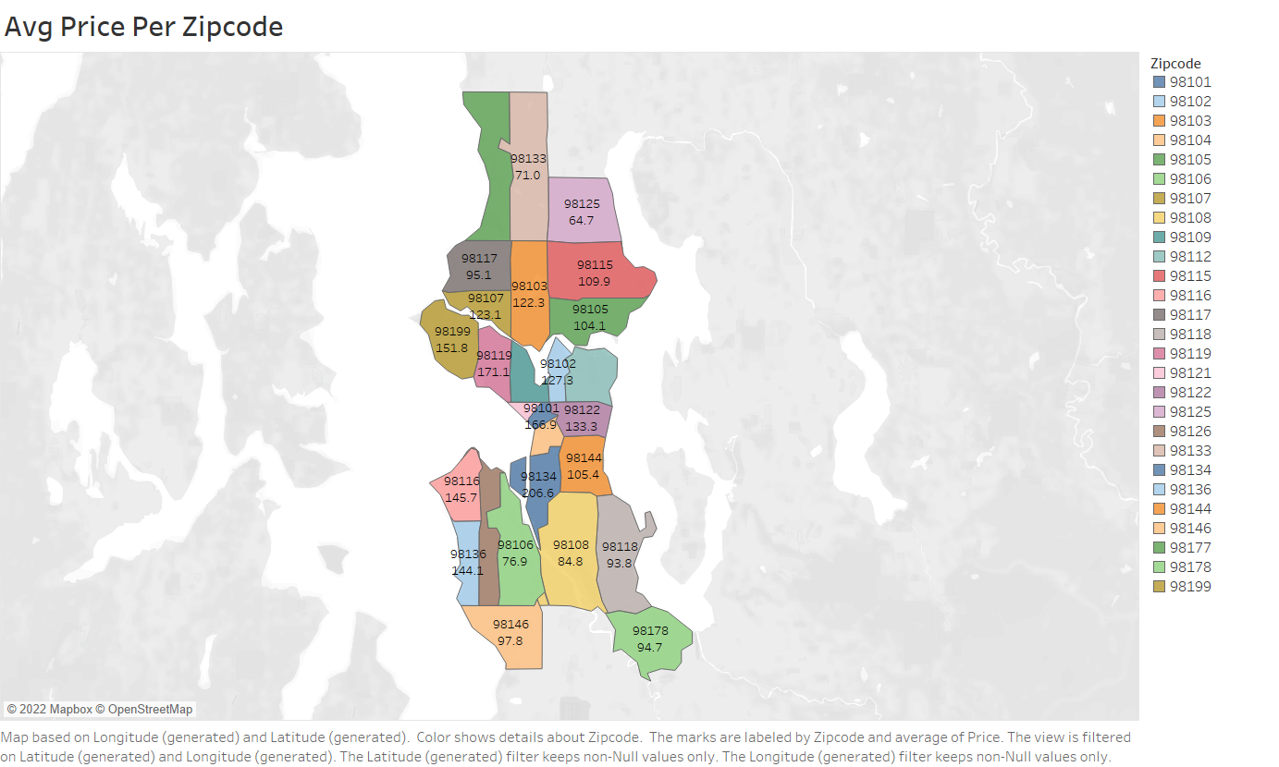

Slide 7
