Slide 1

Homework03
Java Operators - Scanner

Slide 2

Before you start!!!
Create
Please make sure that you have a package called as “homeworks”
Create
Please create a class called as “Homework03” inside the homework package
Do
Do all tasks in the same class
Follow
Please follow the instructions carefully and understand requirements before starting coding
Let
Let TechGlobal Team if any of requirement is not clear or you have any questions related to given tasks below

Slide 3
Task-1
Requirement:
-Write a Java program that asks user to enter 2 numbers as input and print the average of the numbers.
Test Data: 7
11
Expected Output:
The average of the given 2 numbers is: 9

Slide 4
Task-2
Requirement:
-Write a Java program that asks user to enter 2 numbers as input and print the product of the numbers.
Test Data: 3
5
Expected Output:
The product of the given 2 numbers is: 15

Slide 5
Task-3
Requirement:
-Write a Java program that asks user to enter 3 numbers as input and print the square of each number entered by user.
NOTE: Square of number means number multiplied with itself
Test Data: 5
6
10
Expected Output:
The 5 multiplied with 5 is = 25
The 6 multiplied with 6 is = 36
The 10 multiplied with 10 is = 100

Slide 6
Task-4
Requirement:
-Write a Java program that asks user to enter 2 numbers and print the remainder of first number by second number
Test Data:
First number = 25
Second number = 8
Expected Output: The remainder of 25 % 8 = 1

Slide 7
Task-5
Requirement:
-Write a Java program that asks user to enter 5 numbers as input and print the average of numbers.
Test Data: 6
10
12
15
17
Expected Output:
The average of given 5 numbers is: 12

Slide 8
Task-6
Requirement:
-Write a Java program that asks user to enter a number as input and print its multiplication table up to 10.
Test Data: 7
Expected Output: 7 * 1 = 7
7 * 2 = 14
7 * 3 = 21
7 * 4 = 28
7 * 5 = 35
7 * 6 = 42
7 * 7 = 49
7 * 8 = 56
7 * 9 = 63
7 * 10 = 70

Slide 9
Task-7
Requirement:
-Write a Java program that asks user to enter the side of a square as input and print square’s perimeter and area
NOTE: area of a square = side * side
perimeter of a square = 4 * side
Test Data: 7
Expected Output:
Perimeter of the square = 28 Area of the square = 49

Slide 10
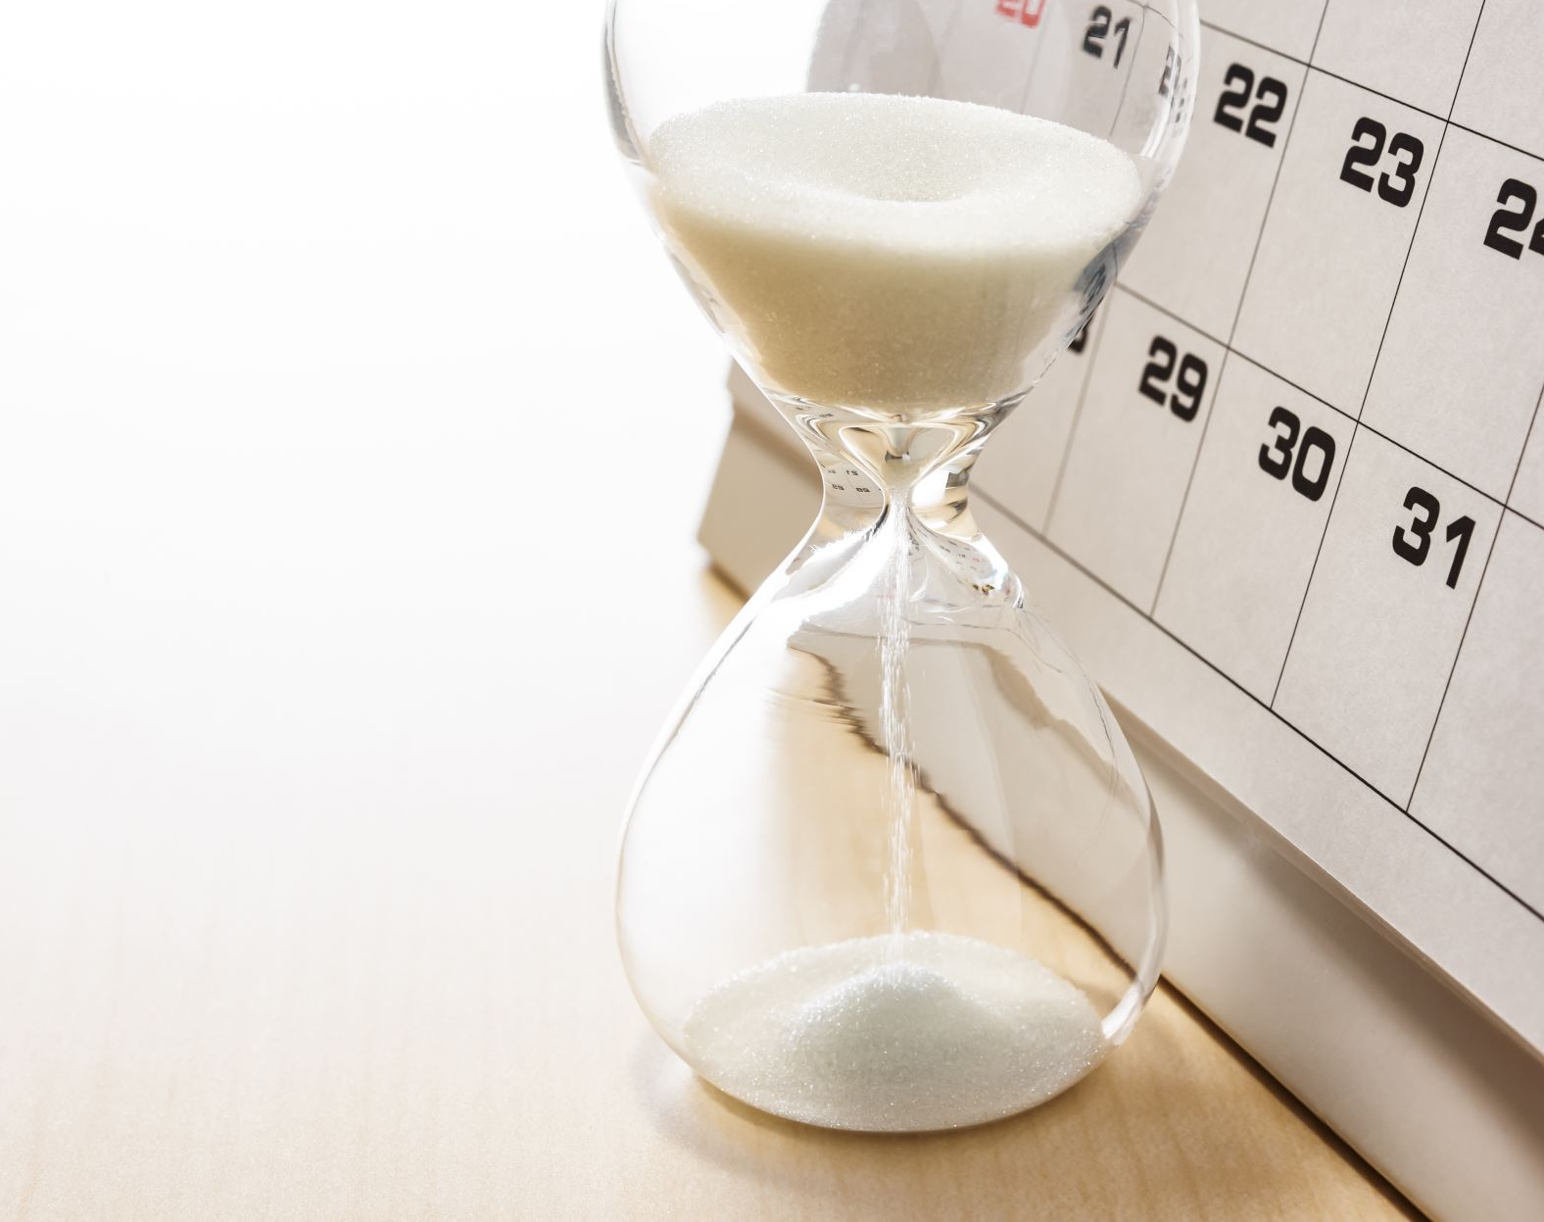
DUE DATE

