Slide 1

Java Homework09
Loops

Slide 2
Before you start!!!
Make sure that you have package called “homework”
Please create a new class called as “Homework09” inside the homework package
Do all tasks in the same classes
Please follow the instructions carefully and understand requirements before starting coding
Let TechGlobal Team if any of requirement is not clear or you have any questions related to given tasks below

Slide 3

Task-1
Requirement:
Write a program that prints all the numbers that are dividable by 7 starting from 1 to 100 (1 and 100 are included)
NOTE: Result must be in one line with space and dash separators
Expected Output: 7 – 14 – 21 - 28 . . . 77 - 84 - 91 - 98

Slide 4
Task-2
Requirement:
Write a program that prints all the numbers that are dividable by both 2 and 3 starting from 1 to 50 (1 and 50 are included)
NOTE: Result must be in one line with space and dash separators
Expected Output: 6 – 12 – 18 . . . 36 – 42 - 48

Slide 5
Task-3
Requirement:
Write a program that prints all the numbers that are dividable by 5 starting from 100 to 50 (100 and 50 are included)
NOTE: Result must be in one line with space and dash separators
Expected Output: 100 – 95 – 90 . . . - 60 - 55 - 50

Slide 6
Task-4
Requirement:
Write a program that prints the squares of all numbers starting from 0 to 7 (0 and 7 are included)
NOTE: Use loop!!!
Expected Output:
The square of 0 is = 0
The square of 1 is = 1
The square of 2 is = 4
The square of 3 is = 9
The square of 4 is = 16
The square of 5 is = 25
The square of 6 is = 36
The square of 7 is = 49

Slide 7
Task-5
Requirement:
Write a program that finds sum of the numbers starting from 1 to 10
Calculation => 1+2+3+4+5+6+7+8+9+10
NOTE: Use loop!!!
Expected Output:
55

Slide 8
Task-6
Requirement:
Write a program that asks user to enter a positive number
And find the factorial of the number
0! = 1
1! = 1
2! = 1*2 = 2
3! = 1*2*3 = 6
Test Data 1: 5
Expected Output 1:
120
NOTE:
5! = 1*2*3*4*5 = 120
Test Data 2: 7
Expected Output 2:
5040
NOTE:
5! = 1*2*3*4*5*6*7 = 5040

Slide 9
Task-7
Requirement:
Write a program that asks user to enter their first and last name
And count how many vowel letters they have in their first and last name
Vowel letters = a, e, i, o, u
Example program1:
Program: Please enter your full name
User : Chris Thompson
Program: There are 3 vowel letters in this full name
Example program2:
Program: Please enter your full name
User : Alexander George
Program: There are 7 vowel letters in this full name

Slide 10
Task-8
Requirement:
Write a program that asks user to enter a number
If number is less than 100, then ask user to enter another number and find sum of entered 2 numbers.
Keep asking user to enter numbers until the sum of all entered numbers is at least 100.
If first number entered by user more than or equal to 100, print message “This number is already more than 100” and do not ask user to enter any other numbers
NOTE: Use do while loop!!!
Example program1:
Program: Please enter a number
User : 120
Program: This number is already more than 100
Example program2:
Program: Please enter a number
User : 50
Program: Please enter a number
User : 75
Program: Sum of the entered numbers is at least 100

Slide 11
Task-9
Assume that you are given a number and you are asked to find series of Fibonacci numbers
What is Fibonacci numbers: a series of numbers in which each number ( Fibonacci number ) is the sum of the two preceding numbers
It always starts with 0 and 1
EX: 0, 1, 1, 2, 3, 5, 8, 13, 21
NOTE: Write a program that handles any n series of numbers
Test data 1:
5
Expected output 1:
0 – 1 – 1 – 2 – 3
Test data 2:
7
Expected output 2:
0 – 1 – 1 – 2 – 3 – 5 - 8

Slide 12
Task-10
Requirement:
Write a program that asks user to enter a name
If name starts with j or J, then finish the program
But, if the name does not start with j or J, then keep asking until user gives a name that starts with j or J.
Example program1:
Program: Please enter a name
User : Jessie
Program: End of the program
Example program2:
Program: Please enter a name
User : Alexander
Program: Please enter a name
User : Chris
Program: Please enter a name
User : Jordan
Program: End of the program

Slide 13
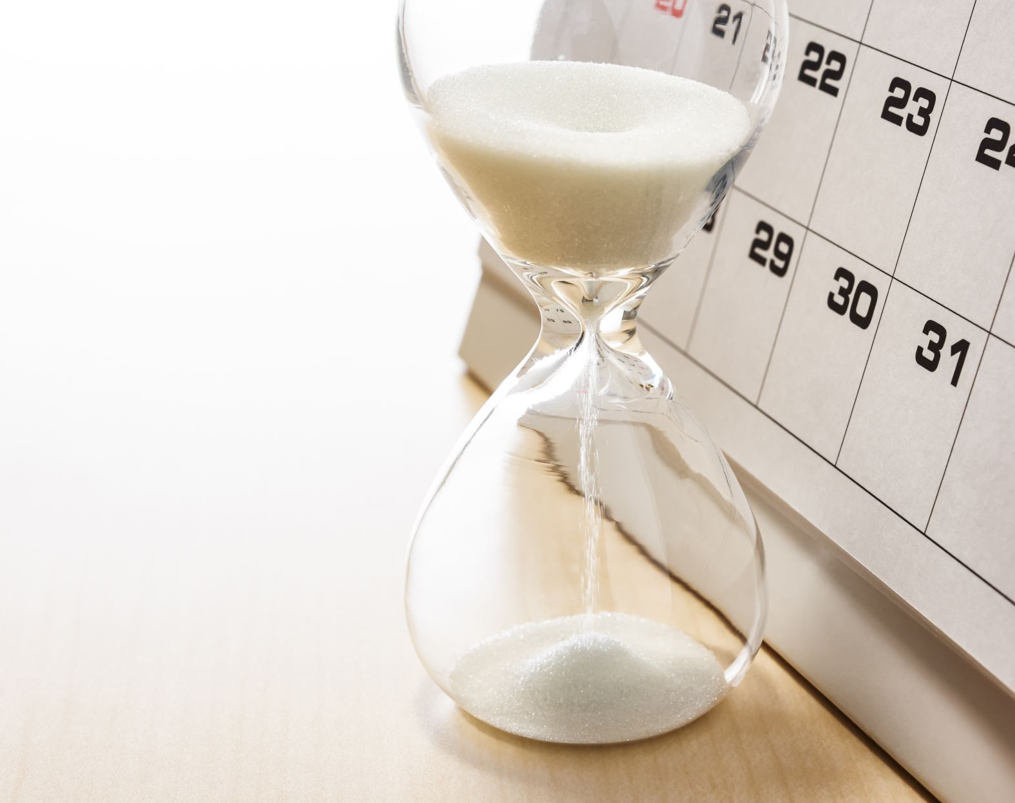

DUE DATE

