Slide 1

Performance Comparison of Deep Learning Techniques in Naira Classification.
AKINOLA, Lanre Olusegun
12349031

Slide 2

PROBLEM STATEMENT
There has been issue of the following in Nigeria:
automated cash handling system
naira sorting systems
assisted technology for visually impaired

Slide 3
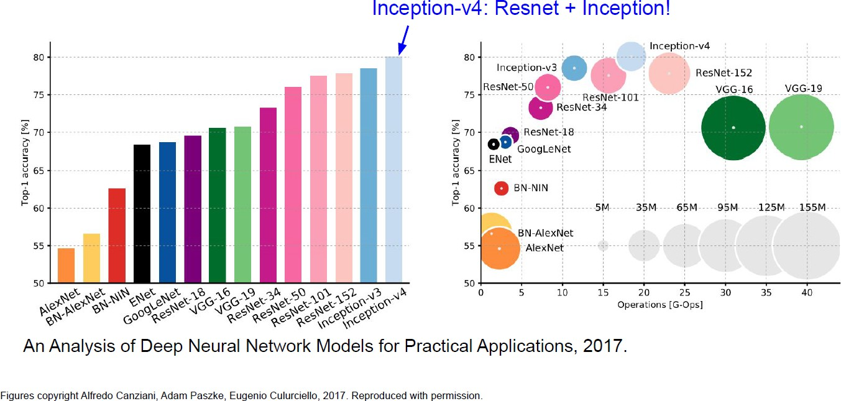
PROPOSED SOLUTION
Build a basic CNN model and three different pre-trained models to train images of different categories of naira notes for image classification and compare the results for performance.
Basic CNN model
VGG19
ResNet50
InceptionV3

Slide 4
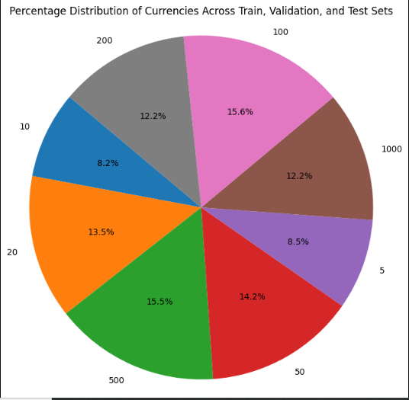
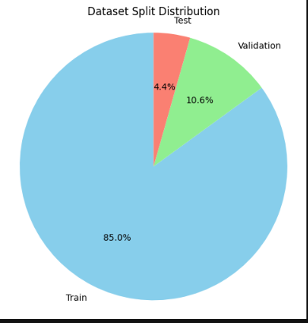
DATASET/SURVEY ANALYSIS
Dataset from Kaggle
(https://www.kaggle.com/datasets/ismailismailtijjani/naira-nigerian-currency-dataset)
Denominations include #5, #10, #20, #50, #100, #200, #500 and #1000

Slide 5
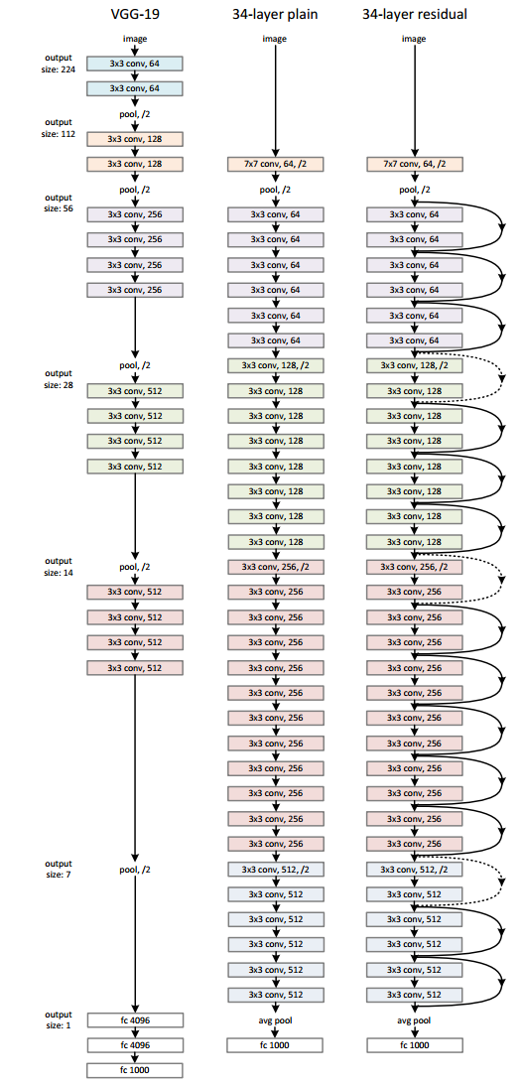
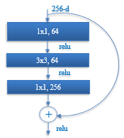
IMPLEMENTATION PLAN
Winner of ILSVRC 2015 challenge
3.57% top-5 error rate
Residual learning: G(x) = F(x) + x
Learning concept & input
Allows for deeper
models
34, 50, 101, 152 layer deep CNNs
Heavy use of batch normalization
ResNet-50 Architecture
[He, K., Zhang, X., Ren, S. and Sun, J., 2016. Deep residual learning for image recognition. In Proceedings of the IEEE conference on computer vision and pattern recognition (pp. 770-778).
.

Slide 6
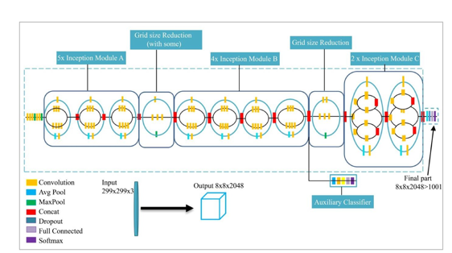
IMPLEMENTATION PLAN
Inception-V3 Architecture
Iparraguirre-Villanueva, O., Guevara-Ponce, V., Roque Paredes, O., Sierra-Liñan, F., Zapata-Paulini, J. and Cabanillas-Carbonell, M., 2022. Convolutional neural networks with transfer learning for pneumonia detection.
.

Slide 7
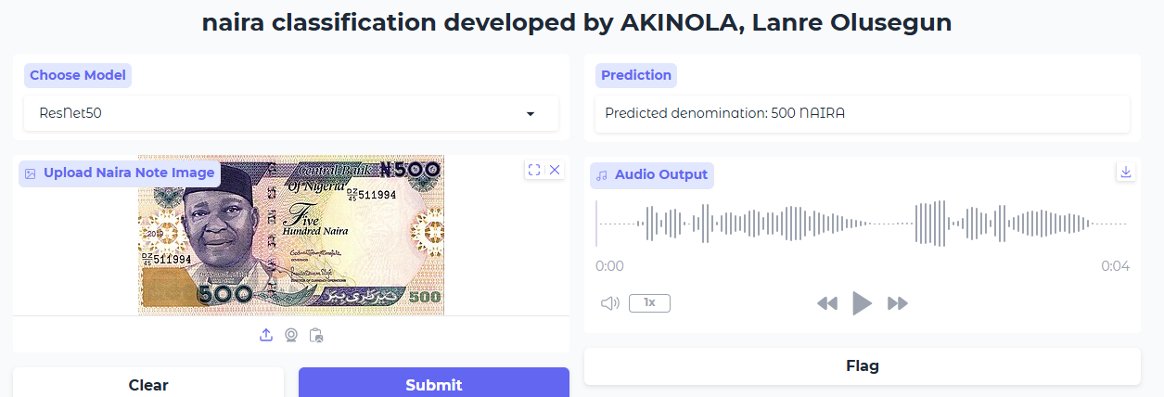
MODEL DEPLOYMENT
The model’s architecture are pre-trained.
Task: Multi-Class classification
Input: images of different naira currencies
Models: CNN, VGG19, ResNet50, inceprtionV3, Interface: Gradio for quick demo
Outputs: 8 results (Probability of each).
Gradio web interface

Slide 8
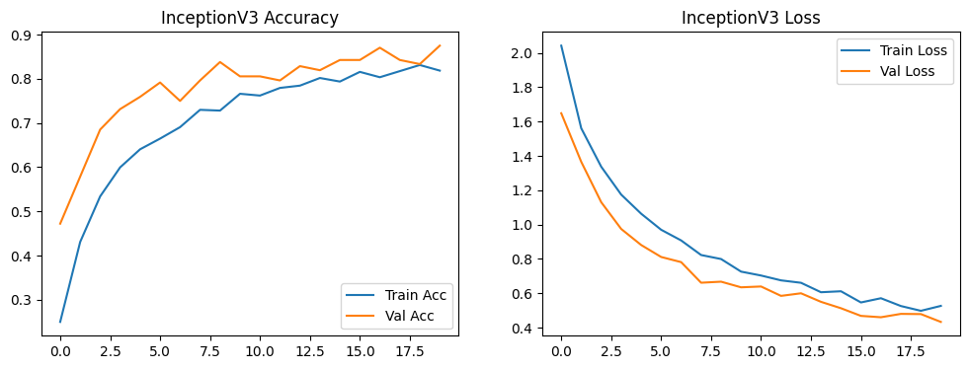
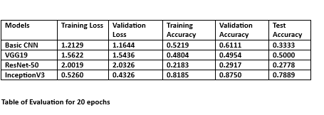
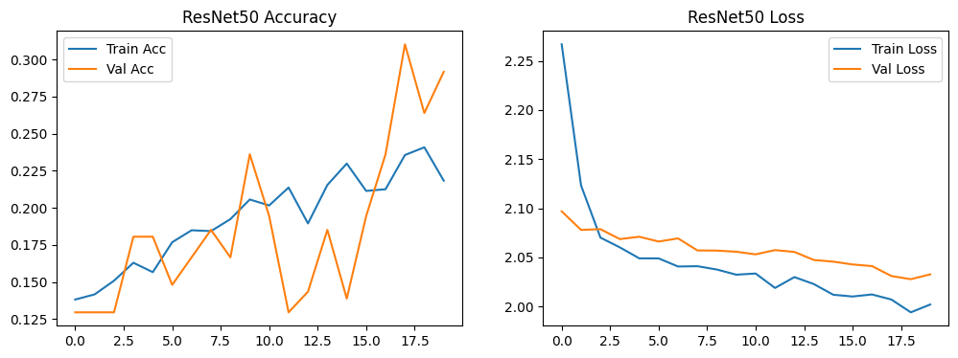
Model Evaluation
Graph of Training and Validation Accuracy
Graph of Training and Validation loss

Slide 9
Model Evaluation
In classification tasks various evaluation methods and metrics are used to assess the performance of a model.
The model developed was evaluated using a Confusion Matrix.
Confusion Matrix shows:
True positives.
False positives.
True negatives.
False negatives.

Slide 10
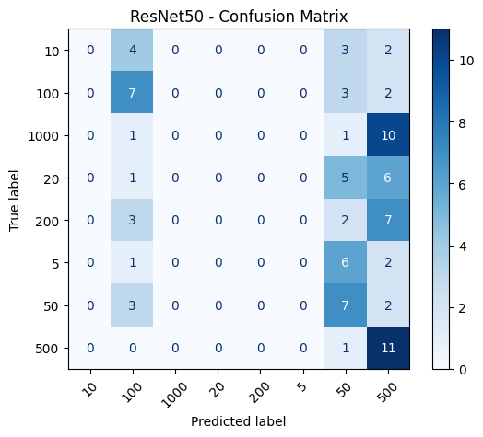
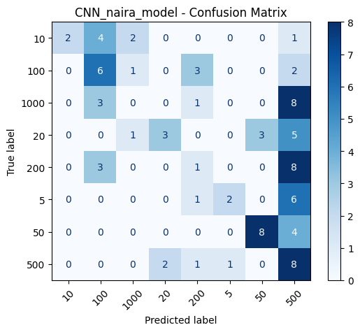
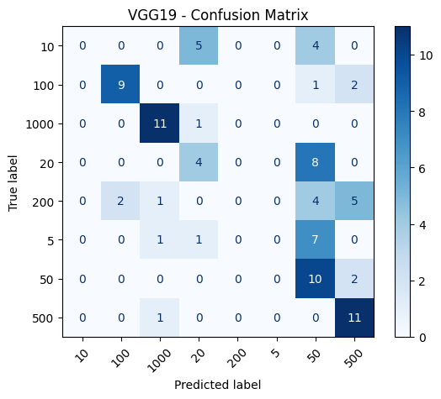
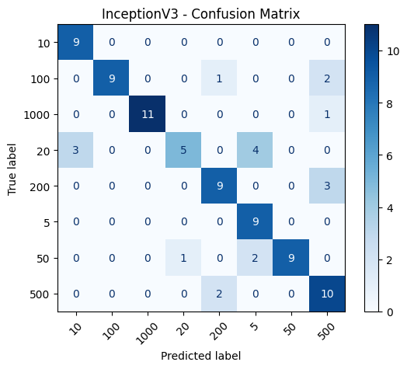
Model Evaluation

Slide 11
A LOOK INTO THE FUTURE
Different approaches to improve the performance of this project.
Train the model with more training data.
Train with more epochs.
Change different hyperparameters like the optimizers, loss activation function.
Use different CNN classification models.
Add more layers to the fully connected layers
Train the models also with fake naira notes to detect fake naira

Slide 12
BIBLIOGRAPHY
Tijjani, Ismail & Mustapha, Ahmad & Idris, Isma'Il. (2024). Performance Comparison of Deep Learning Techniques in Naira Classification. 10.48550/arXiv.2412.02072.
Jyothi, Ch & SundaraKrishna, Y. & SrinivasaRao, V.. (2016). Paper currency recognition for color images based on Artificial Neural Network. 3402-3406. 10.1109/ICEEOT.2016.7755335.
Bahrani, Suyash. (2020). DEEP LEARNING APPROACH FOR INDIAN CURRENCY CLASSIFICATION. International Journal of Engineering Applied Sciences and Technology. 5. 335-340. 10.33564/IJEAST.2020.v05i06.049.

Slide 13

Thank you for listening
Any question ?

