Slide 1
Lending Club Case Study
Aditya Kintali
Nikhil Bansal

Slide 2
AGENDA
Problem Statement
01
Key Objective
02
Data Sourcing & Understanding
03
Data Cleaning
04
Data Analysis
05
Conclusions and Final Comments
06

Slide 3
PROBLEM STATEMENT
Underwriting risk analysis for a consumer finance company
The company has below 2 types of risks are associated with a loan application:
If the applicant is likely to repay the loan, then not approving the loan results in a loss of business to the company
If the applicant is not likely to repay the loan, then approving the loan may lead to a financial loss for the company

Slide 4
KEY OBJECTIVE
Help the business in better decision making
FIND DRIVING FACTORS BEHIND A LOAN DEFAULT
These factors will be used for taking actions such as denying the loan, reducing the amount of loan, lending (to risky applicants) at a higher interest rate, etc.

Slide 5
Data Sourcing & Understanding
The data given is all the loans issued through the time period 2007 to 2011
The initial data set has 39717rows and 111 columns with mixed data types.
The understanding started with analyzing the columns in the given data set:
54 columns have complete null values
Further 4 columns have mostly null values
Further 7 columns was found to have just one value
Identified 4 columns that do not add any value to analysis

Slide 6
Data Cleaning
The 69 columns (54+4+7+4) mentioned in the previous slide were dropped.
The null values in “emp_length” column were replaced with “0” and removed the extra character “+” at the end.
Removed extra “%” character from “int_rate” and “revol_util” columns.
“Unknown” values in “title” and “pub_rec_bankruptcies” columns were handled.
Further converted relevant columns to numeric data type.
Dropped the rows having just null values
It finally leaves us with (39598 rows and 42 columns) for analysis.

Slide 7
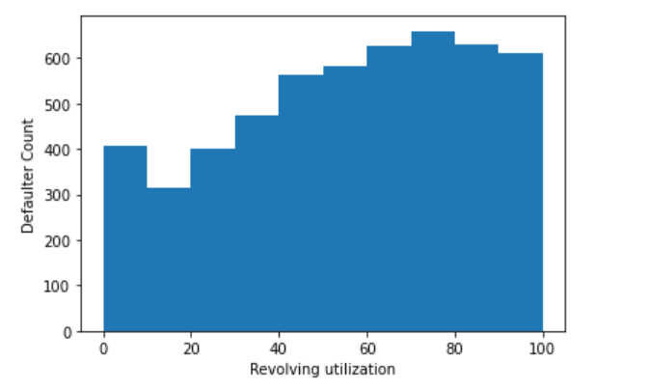
Conclusion - 1
Customers who are revolving their credit more are more likely to default.

Slide 8
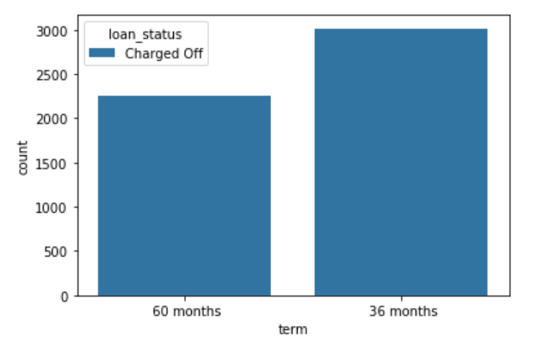
Conclusion - 2
The shorter the tenure of the loan, more is the likelihood of default.

Slide 9
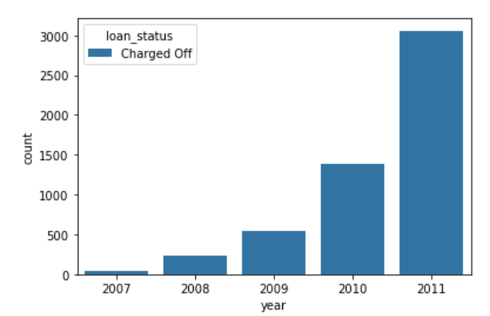
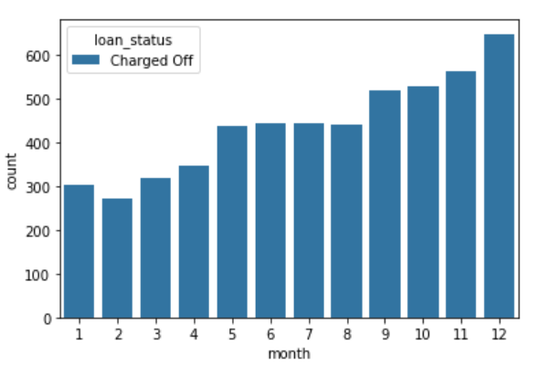
Conclusion - 3
Number of customers defaulting loan is almost increasing by double every year, which states the need to bring in better loan approval mechanism.
Maximum numbers of loans are approved towards the end of year.

Slide 10
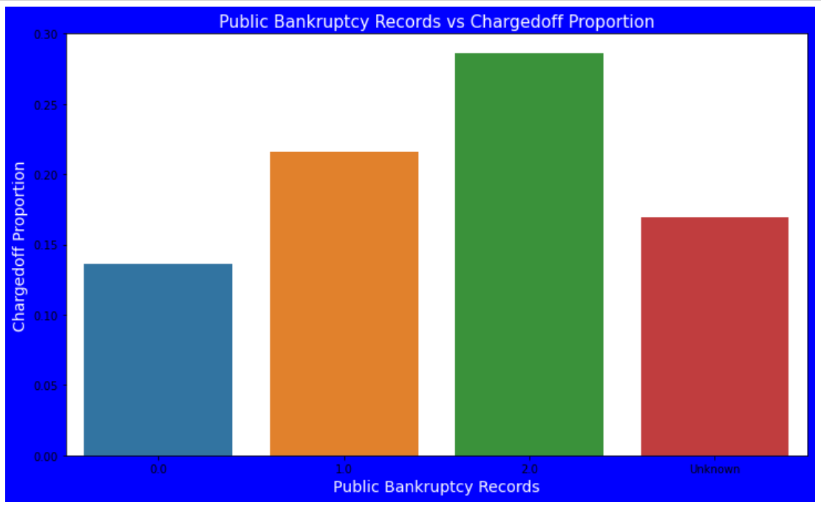
Conclusion - 4
Customers with previous bankruptcy records are more likely to default

Slide 11
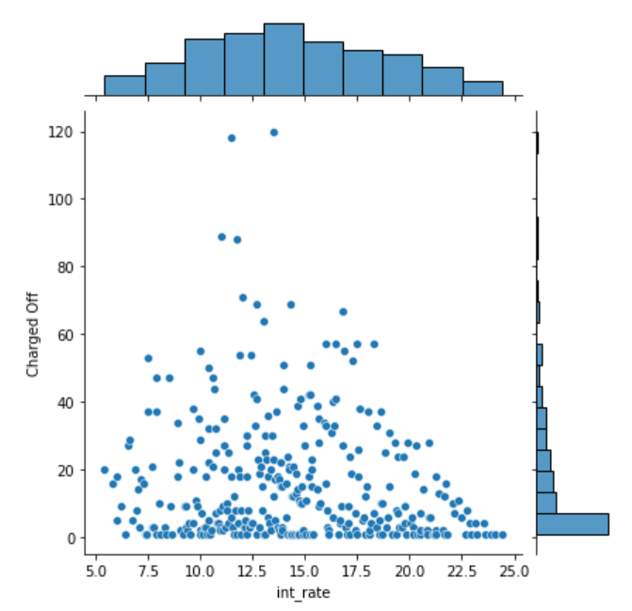
Conclusion - 5
The defaulters are more for interest rate of around 15%

Slide 12
Final Comments

Slide 13
THANK
YOU

