Slide 1


Reducing inference times
Akin Wilson

Slide 2

Value proposition
Currently rely on TF serving framework to deploy models
- Advantage
Ease of use
- Disadvantage
Not a inference-optimized framework.
Currently required to prop up second serving node to handle volume for just UK verification service. Likely be the same for all other territories

Slide 3
Proposed system
Training enviroment
Deployment enviroment

Slide 4


What is Onnx and the Onnx runtime?
Onnx stands for Open Neural Network Exchange
Founded by Microsoft and Facebook in 2017, the goal was to establish a open standard to save ML and DL models.
The initiative is now supported by IBM, Huawei, Intel, AMD, Arm and Qualcomm.
Onnx today provides post-training quantisation and a suit of other deployment optimization tools
Due to being the standard the industry is converging to, it also allows you, for example, to convert a model to the Tflite format.
Onnx runtime is a part of the Onnx ecosystem.
It provides a means for a model exported via onnx to be deployed and queried
Alleviates the need for framework dependencies. No TF or PT dependencies required
Allows for deployment in low-resource environments, i.e. microcontrollers. The runtime itself is light-weight.
Can use a variety of execution providers for the runtime to use.

Slide 5
What is an execution provider?
An execution provider is the hardware and software combination use to compute the network’s outputs given an input.
For example, currently we use the execution provider of Cuda (the software) to compute the matrix multiplications that make up our models. Cuda makes use of the GPU to do so (the hardware).
When using the CPU for executions (the hardware) the underlying software library being used to perform calculations is called MLAS (the software).

Slide 6
Introducing execution provider TensorRT
TensorRT is an execution provider.
Built by those who build the GPUs themselves, it is an SDK for high-performance deep learning inference, includes a deep learning inference optimizer and runtime that delivers low latency and high throughput for inference applications
How can I combine these?

Slide 7
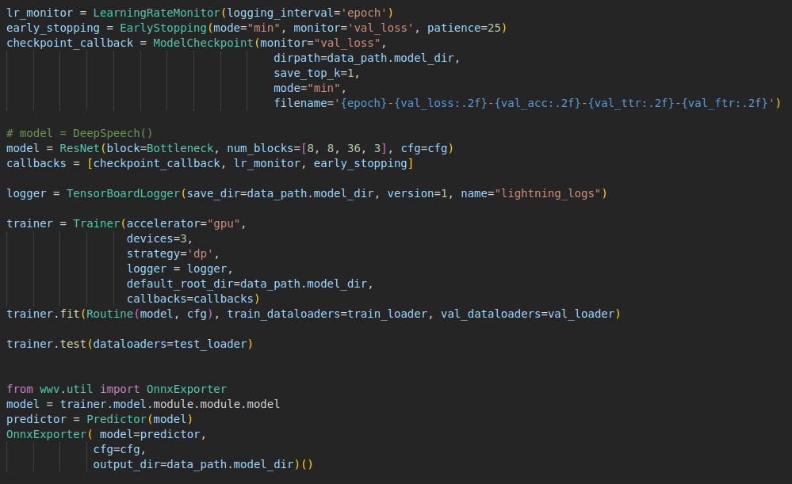
The nitty gritty: The training pipeline

Slide 8
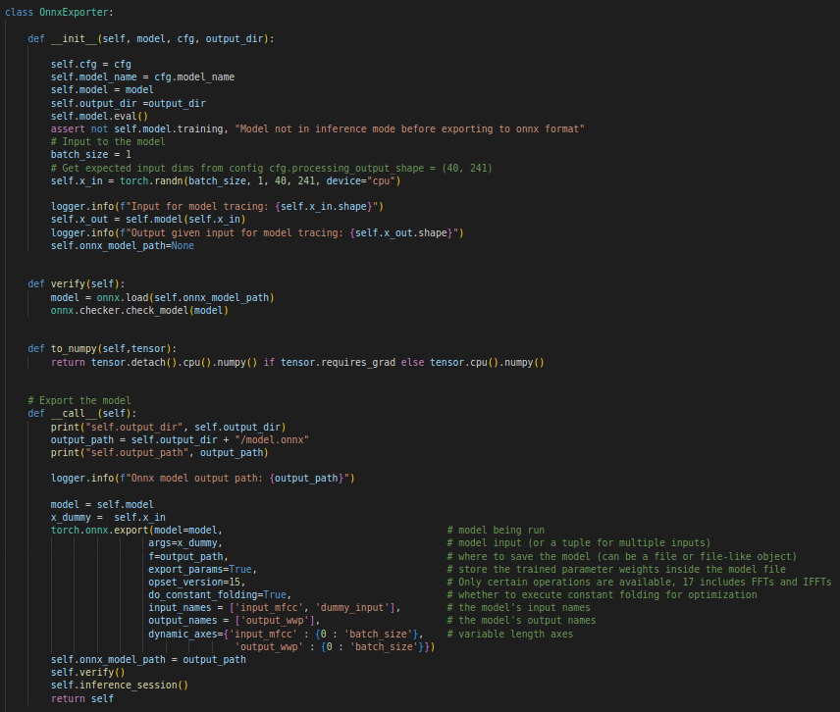
The nitty gritty: Exporting to onnx
Creating dummy inputs for tracing and scripting.
Export to onnx using scripting and tracing functionaltiy of torch
Verify the exported model.

Slide 9
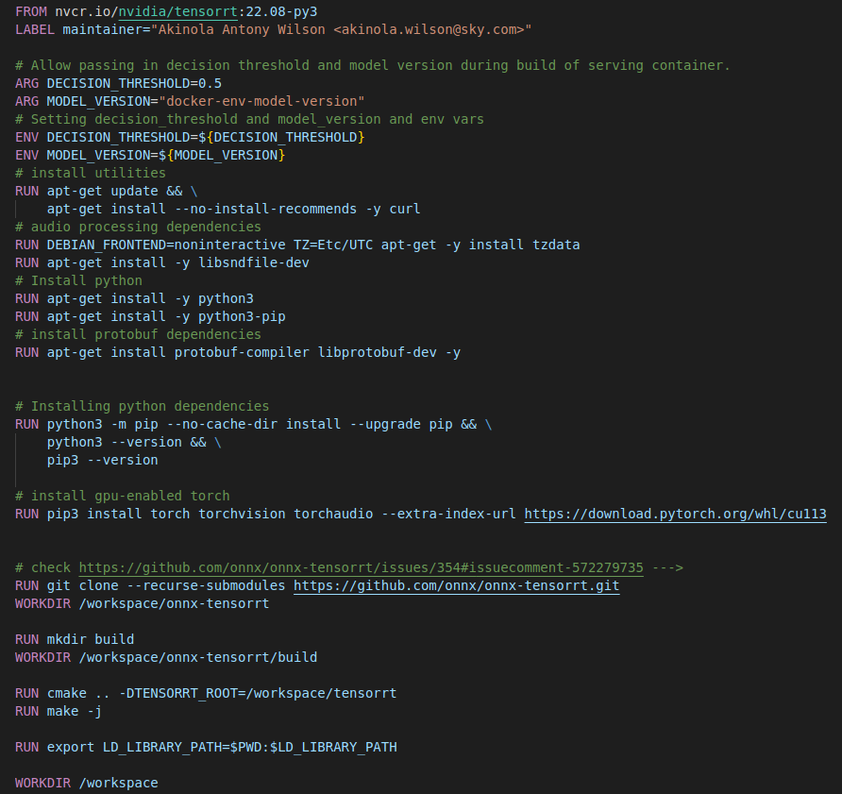
The nitty gritty: The deployment environment
Get base image: TensorRT using an ubuntu OS
Install onnx-TensorRT dependencies
Clone the onnx-tensorrt repository, build and configure to use TensorRT

Slide 10
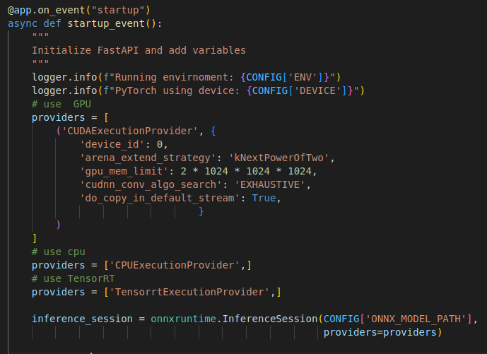
The nitty gritty: Providing the executioner
Possible choices of executioners: CPU, GPU or TensorRT
Can add additional inference parameters, like with Cuda executioner version.

Slide 11
The results: Comparing the execution providers under load
The load test pushes the endpoint to its limits, increasing the load and thereby queries per second, until we receive a timeout response.

