Slide 1


Representation Learning
Akin Wilson

Slide 2

Introduction
Representation learning has many applications in the domain of DL. For example, a pracitioner if needed could used a overcomplete sparse autoencoder to find a memory efficient represenation of data. Another application is as a means of feature extraction upstream before being passed to a memory-constraint classifier.

Slide 3
Weights, states and the ML model
A machine learning model is built using a dataset, an architecture and an optimizer

Slide 4
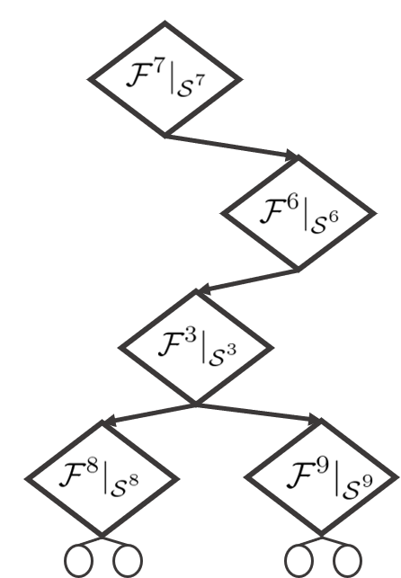
Weights, states and the ML model
A machine learning model is built using a dataset, an architecture and an optimizer
Architecture: Light gradient boosting ensemble

Slide 5
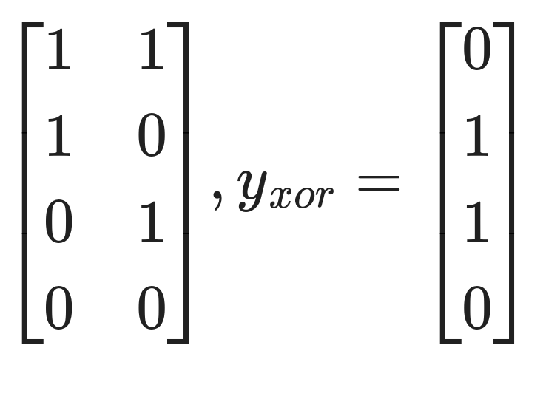
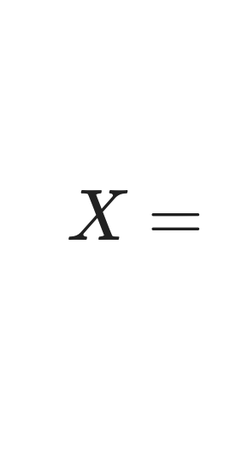
Weights, states and the ML model
A machine learning model is built using a dataset, an architecture and an optimizer
Architecture: Light gradient boosting ensemble
Dataset: The XOR gate relations

Slide 6


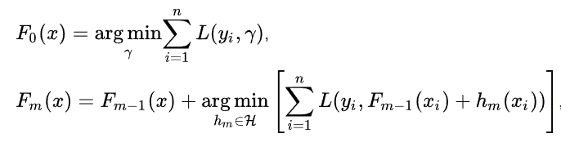

Weights, states and the ML model
A machine learning model is built using a dataset, an architecture and an optimizer
Architecture: Light gradient boosting ensemble
Dataset: The XOR gate relations
Optimizer: Gradient boosting

Slide 7
Weights, states and the ML model
A machine learning model is built using a dataset, an architecture and an optimizer
Architecture: Light gradient boosting ensemble
Dataset: The XOR gate relations
Optimizer: Gradient boosting

Slide 8
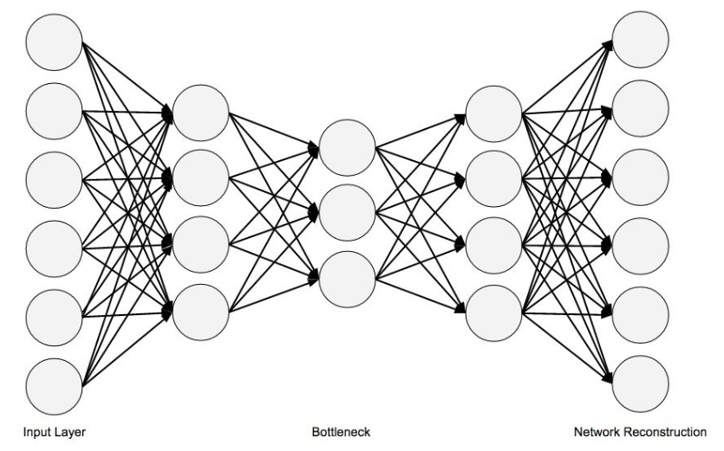
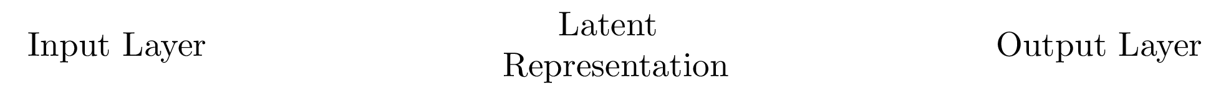
The Autoencoder

Slide 9
Its variants …
Sparse, under and overcomplete, generative

Slide 10
Its variants …

Slide 11
Applications

Slide 12
Applications

Slide 13
Applications

Slide 14
From discrimantive to generative

Slide 15
Synthesis

Slide 16
Synthesis

Slide 17
Synethically augmented fitting results

Slide 18
Synethically augmented fitting results

