Slide 1

Pre-Optimized
Compatible Triangulations of Simple Polygons
吴亮 3001141083
akira_cn@msn.com

Slide 2
Important Techniques！
Graphics Deformation
Texture Warping
As-Rigid-As-Possible Shape Interpolation!
(SIGGRAPH 2000)

Slide 3

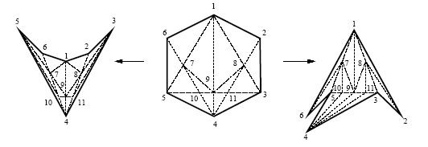
A Simple Construction [1]
Additional O(n²) Steiner Points

Slide 4
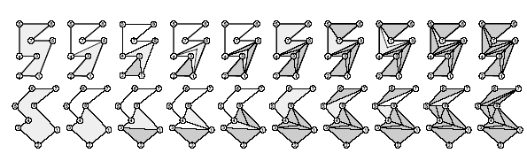
High Quality Com. Triangulations[2]
Calculate minimum-link
Create link-paths (Costly act!)

Slide 5
The Problems
Can this be fast? (Real-time perform?)
How to get better result?
(Regular triangles and better shape)

Slide 6
Our Algorithm
1) Create Compatible Polygons
(Force Target Sub-Polygons to be Convex)
2) Triangulate Source Sub-Polygons
3) Pre – Optimize!
4) Smooth Surface Fitting
5) Combine the Pieces of Meshes

Slide 7
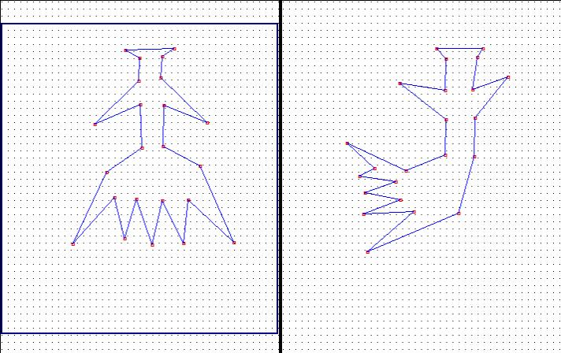
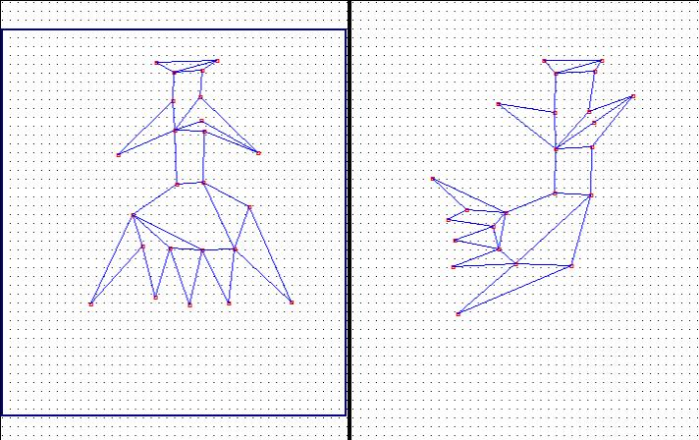
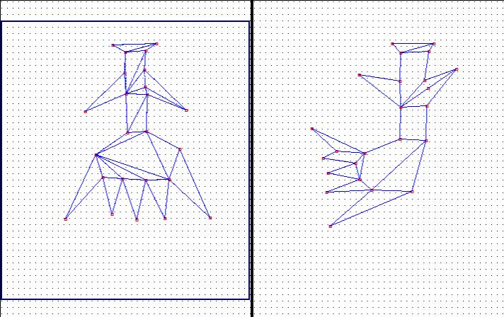
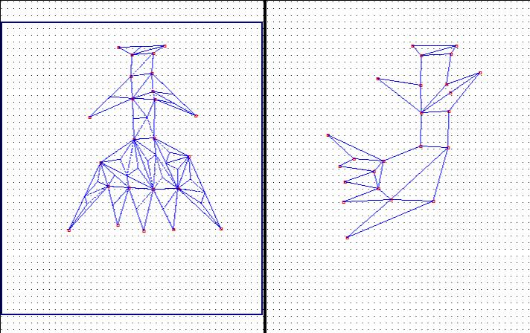
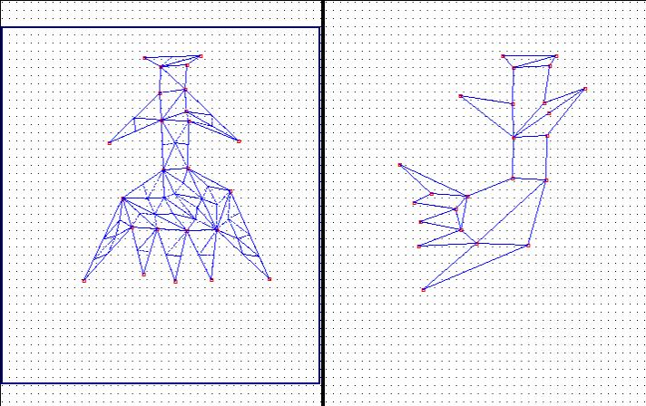

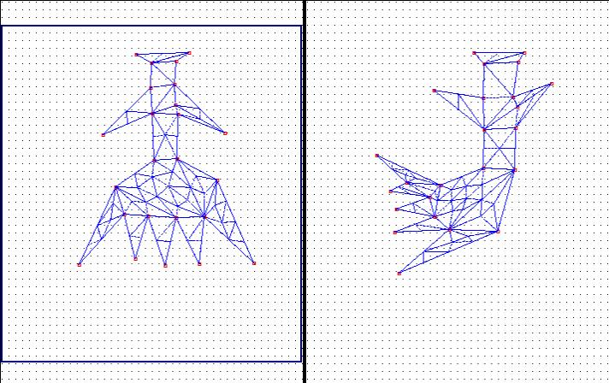
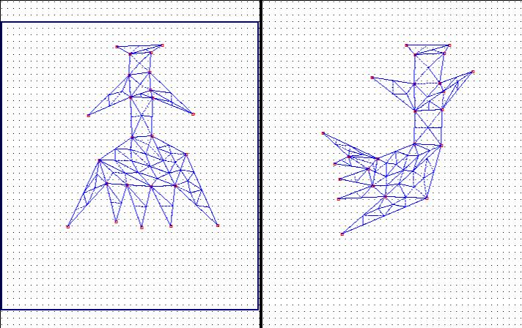
Performance —— Our Algorithm

Slide 8
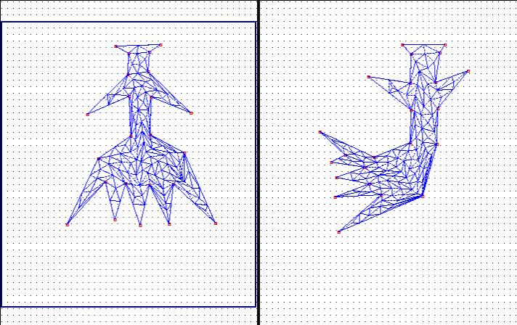
Performance [1]

Slide 9
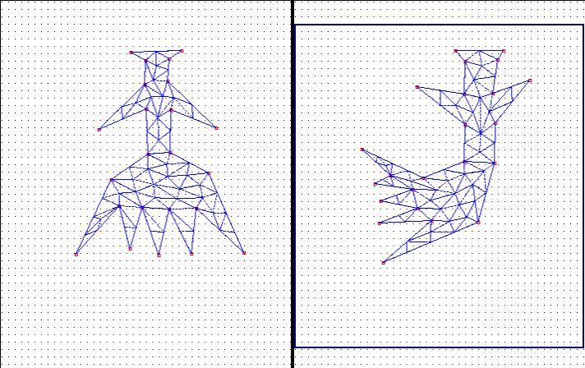
Performance [2]

Slide 10
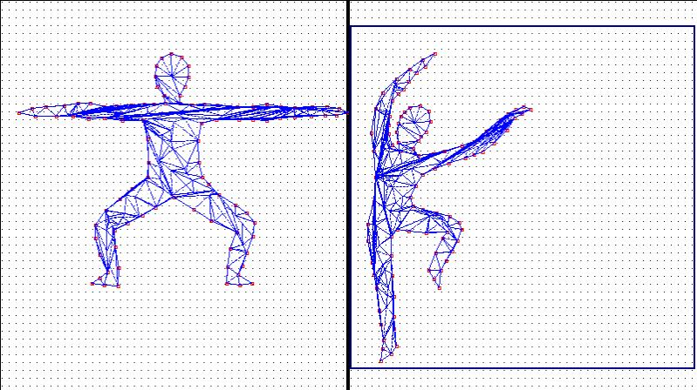
Performance [1]

Slide 11
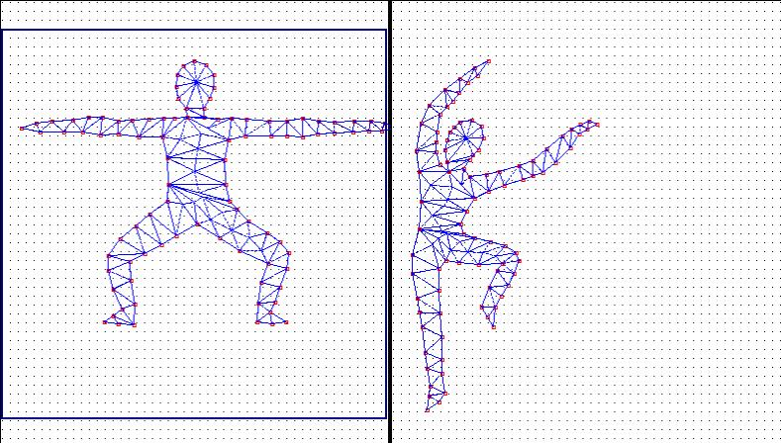
Performance —— Our Algorithm

Slide 12
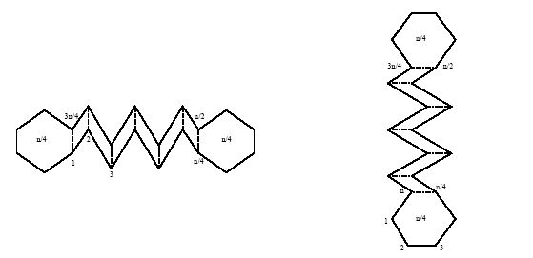
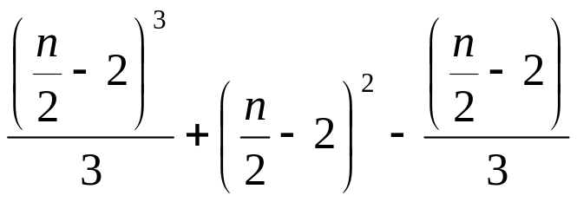
A Lower Bound

Slide 13
Contrasts
 | Const. Speed | Opt. Speed | Extra Points | Mesh Quality
SCT [1] | — | × | × | ×
HQCT[2] | × | — | ○ | —
POCT | ○ | ○ | — | ○

Slide 14
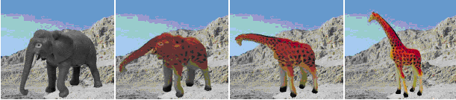
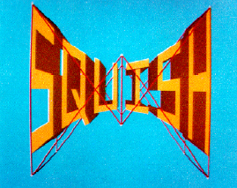
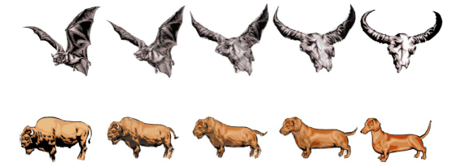
The Future!

Slide 15
References
[1] Boris Aronov, Raimund Seidel, Diane Souvaine. On Compatible Triangulations of Simple Polygons. Computational Ceometry: Theory and Application, 3:27-35, 1993.
[2] Vitaly Surazhsky, Craig Gotsman. High Quality Compatible Triangulations. 11th International Meshing Roundtable, Ithaca, NY, September 2002, pages 183-192.
[3] Michael S. Floater. Parametrization and smooth approximation of surface triangulations. Elsevier Science B. V. 1997.
[4] Vitaly Surazhsky, Craig Gotsman. Morphing Stick Figures Using Optimized Compatible Triangulations. Pacific Graphics 2001.
[5] Craig Gotsman, Vitaly Surazhsky. Guaranteed intersection-free polygon morphing. Computers & Graphics 2001.

Slide 16
Thank you！

