Slide 1
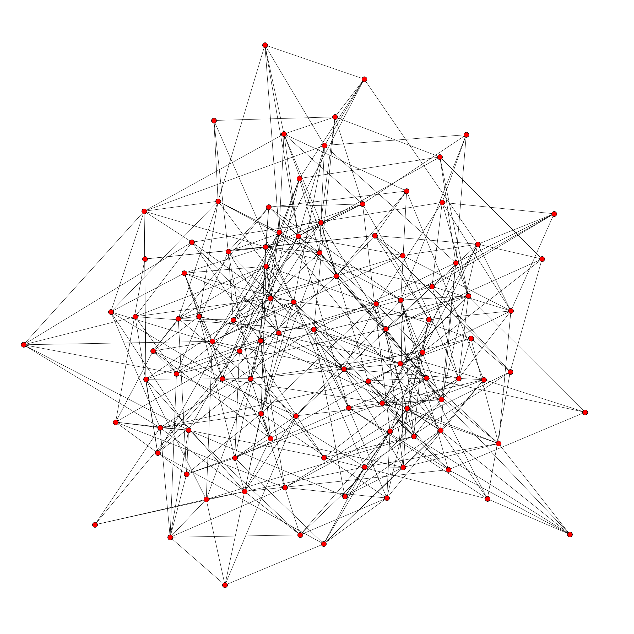
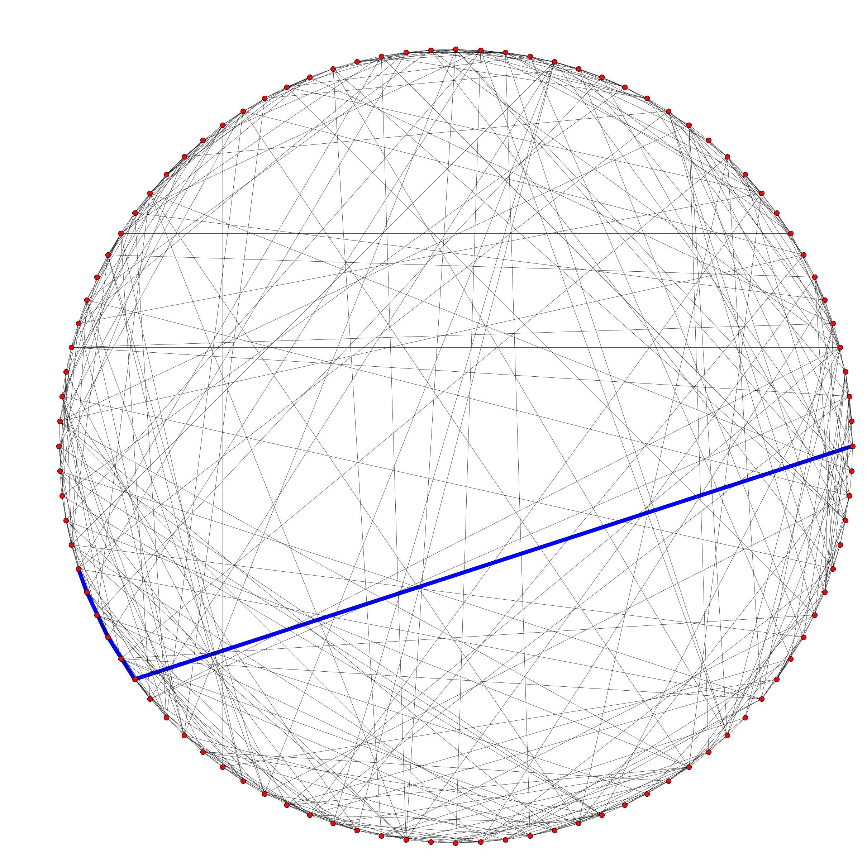
Generate an embedding into a navigable base graph (e.g. Kleinberg(2000))
with Metropolis-Hastings Algorithm
Real-world F2F network
Decentralized routing in a base graph

