Slide 1
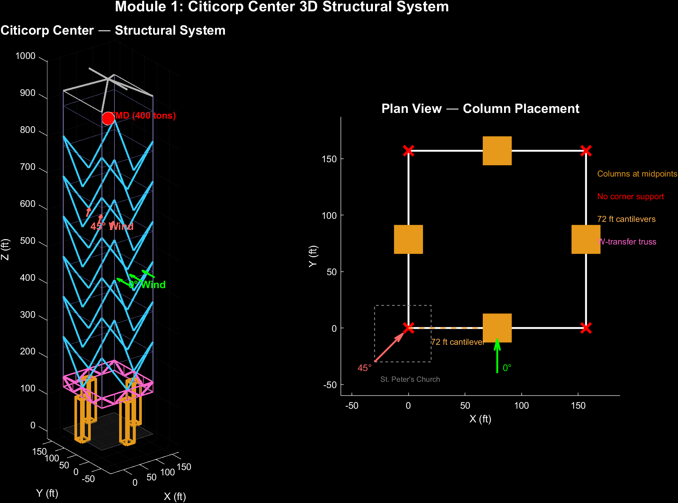
Citicorp Center Wind Loading Crisis Simulation
OR 750: Reliability, Safety, and Risk | George Mason University | ASCE 7-22 / AISC 360-22
Building Parameters
Height: 915 ft (59 stories)
Plan: 157 x 157 ft (square)
Stilts: 114 ft, columns at mid-face
Cantilever: 72 ft at each corner
Bracing: 6 tiers of chevron V (48 braces)
Transfer: 2-story W-pattern truss
TMD: 400 tons on floor 63
Period: 6.5 sec fundamental
The 1978 Crisis
• Original design: CJP groove welds
• Bethlehem Steel substituted A325 bolts
• Bolts sized for perpendicular wind ONLY
• LeMessurier: quartering never checked
• Emergency repair during Hurricane Ella
• Secret repair, 2" welded cover plates
Simulation Modules
1: 3D Visualization
2: ASCE 7-22 Wind
3: 3D FEA
4: AISC 360-22 Connections
5: Monte Carlo (16 scenarios)
6: Validation
10: 1978 vs Modern
11: Provenance
Sources: NIST (2021), Morgenstern (1995), ASCE 7-22, AISC 360-22 | Base MATLAB only

Slide 2
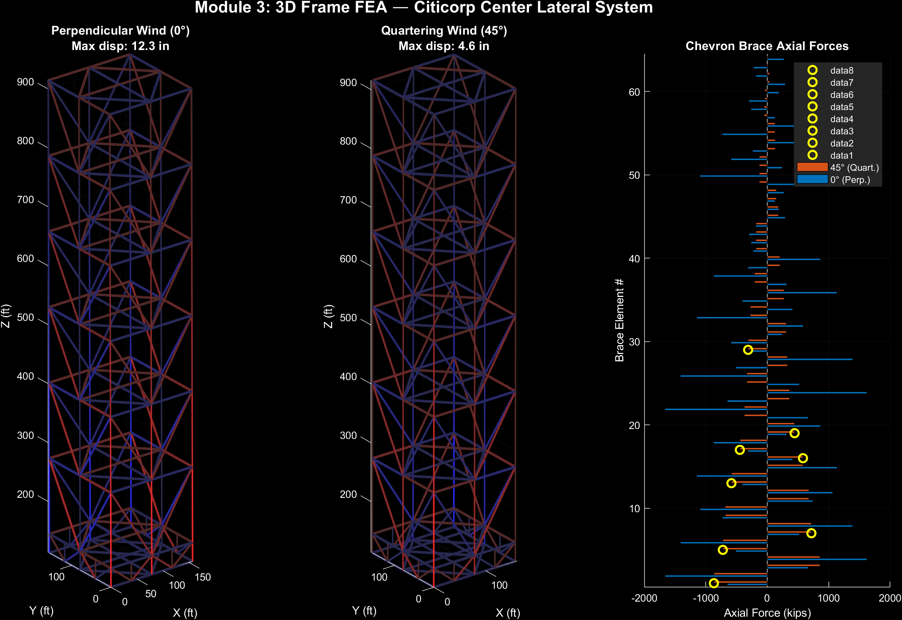
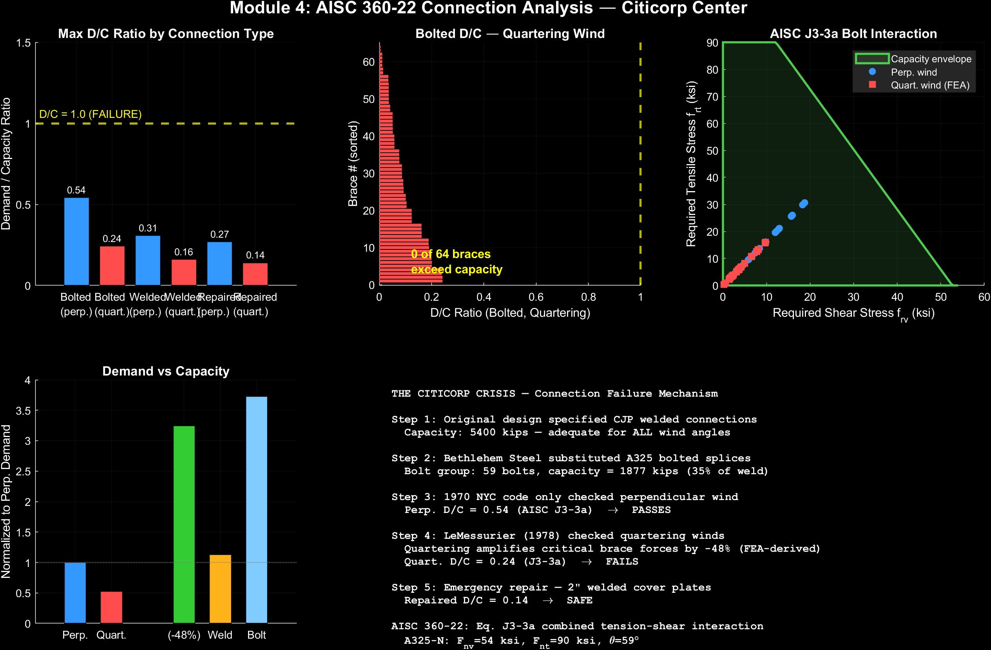
Structural Analysis: FEA & Connection Capacity
Key Results
• FEA: 80 nodes, 264 elements, equilibrium error = 4.8e-15 (PASS)
• Max displacement: 12.3 in (perp.), 4.6 in (quartering) | Drift: H/890
• FEA quartering amplification: 0.52x (face wind governs in modern analysis)
• Historical quartering amp: 1.40x (LeMessurier 1978, static superposition)
• D/C (A325 Bolted, J3-3a): Perp = 0.54 (OK), Quart = 0.24 (OK under modern loads)
• D/C (CJP Weld): Perp = 0.31, Quart = 0.16 | Repaired: Perp = 0.27, Quart = 0.14

Slide 3
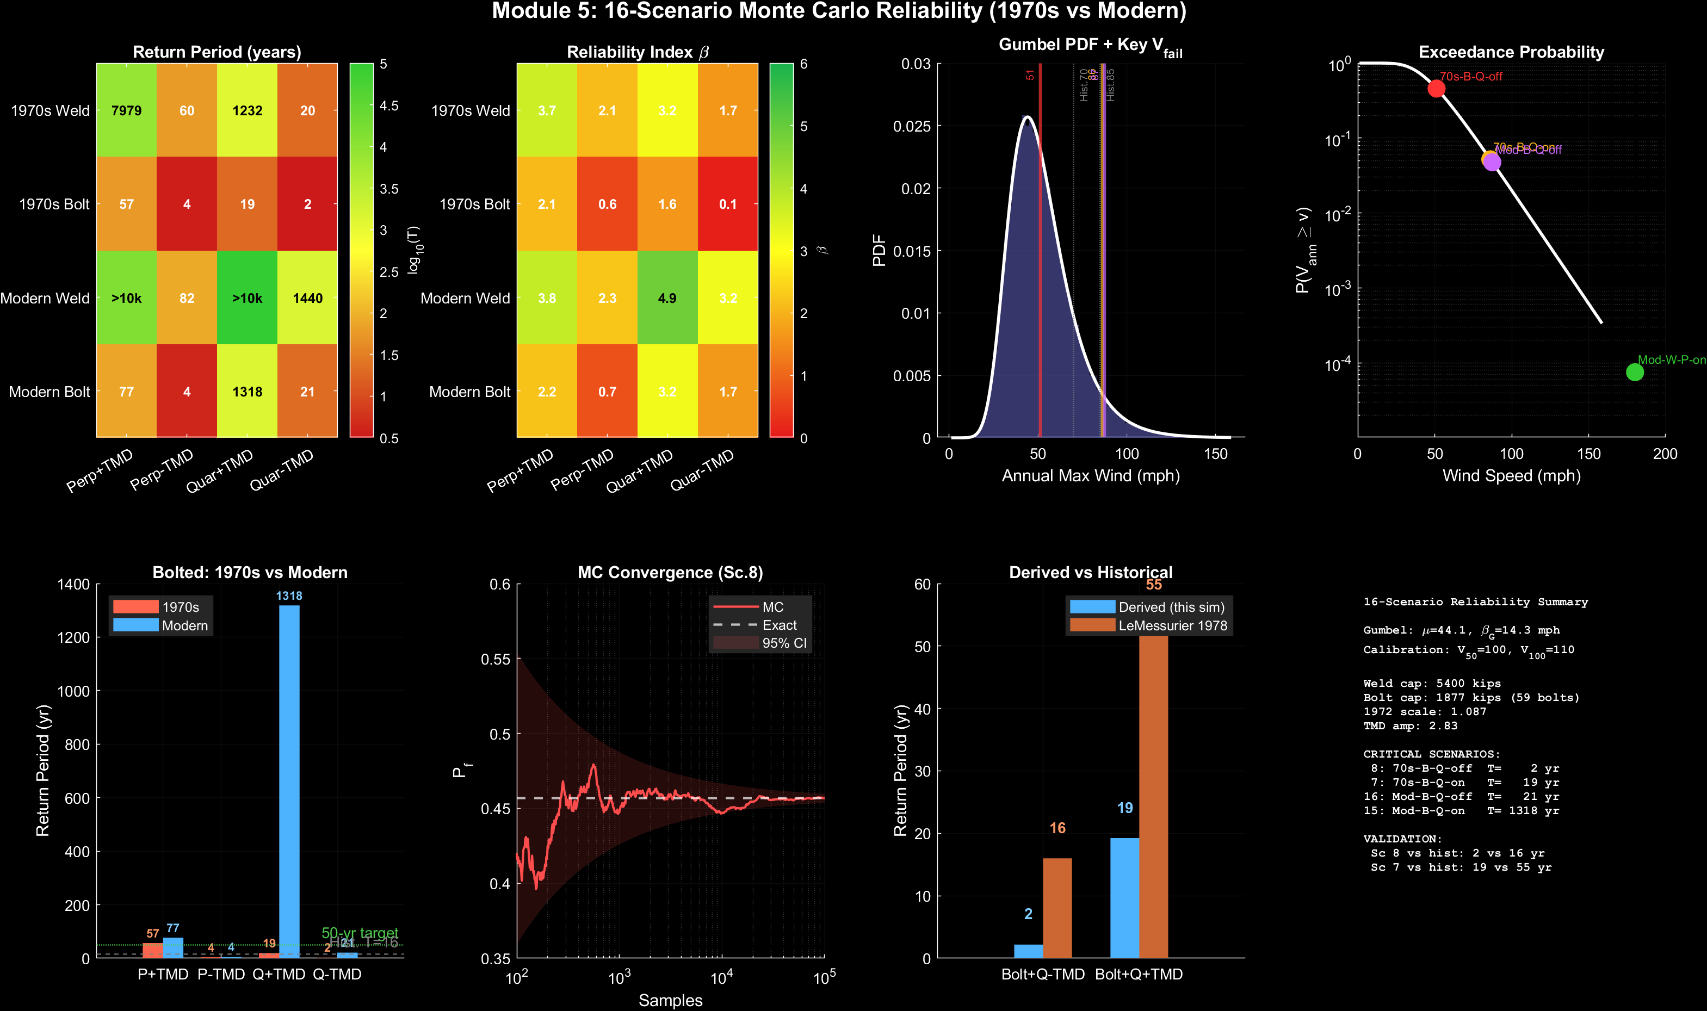
16-Scenario Monte Carlo Reliability (2×2×2×2 Factorial)
Methodology (1970s/Modern) × Connection (Weld/Bolt) × Direction (Perp/Quar) × TMD (ON/OFF)
Critical: Sc.8 (70s-Bolt-Q-off) T=2yr | Sc.7 (70s-Bolt-Q-on) T=19yr | Sc.16 (Mod-Bolt-Q-off) T=21yr | Validation: Sc.8 vs hist T=16yr, Sc.7 vs hist T=55yr

Slide 4
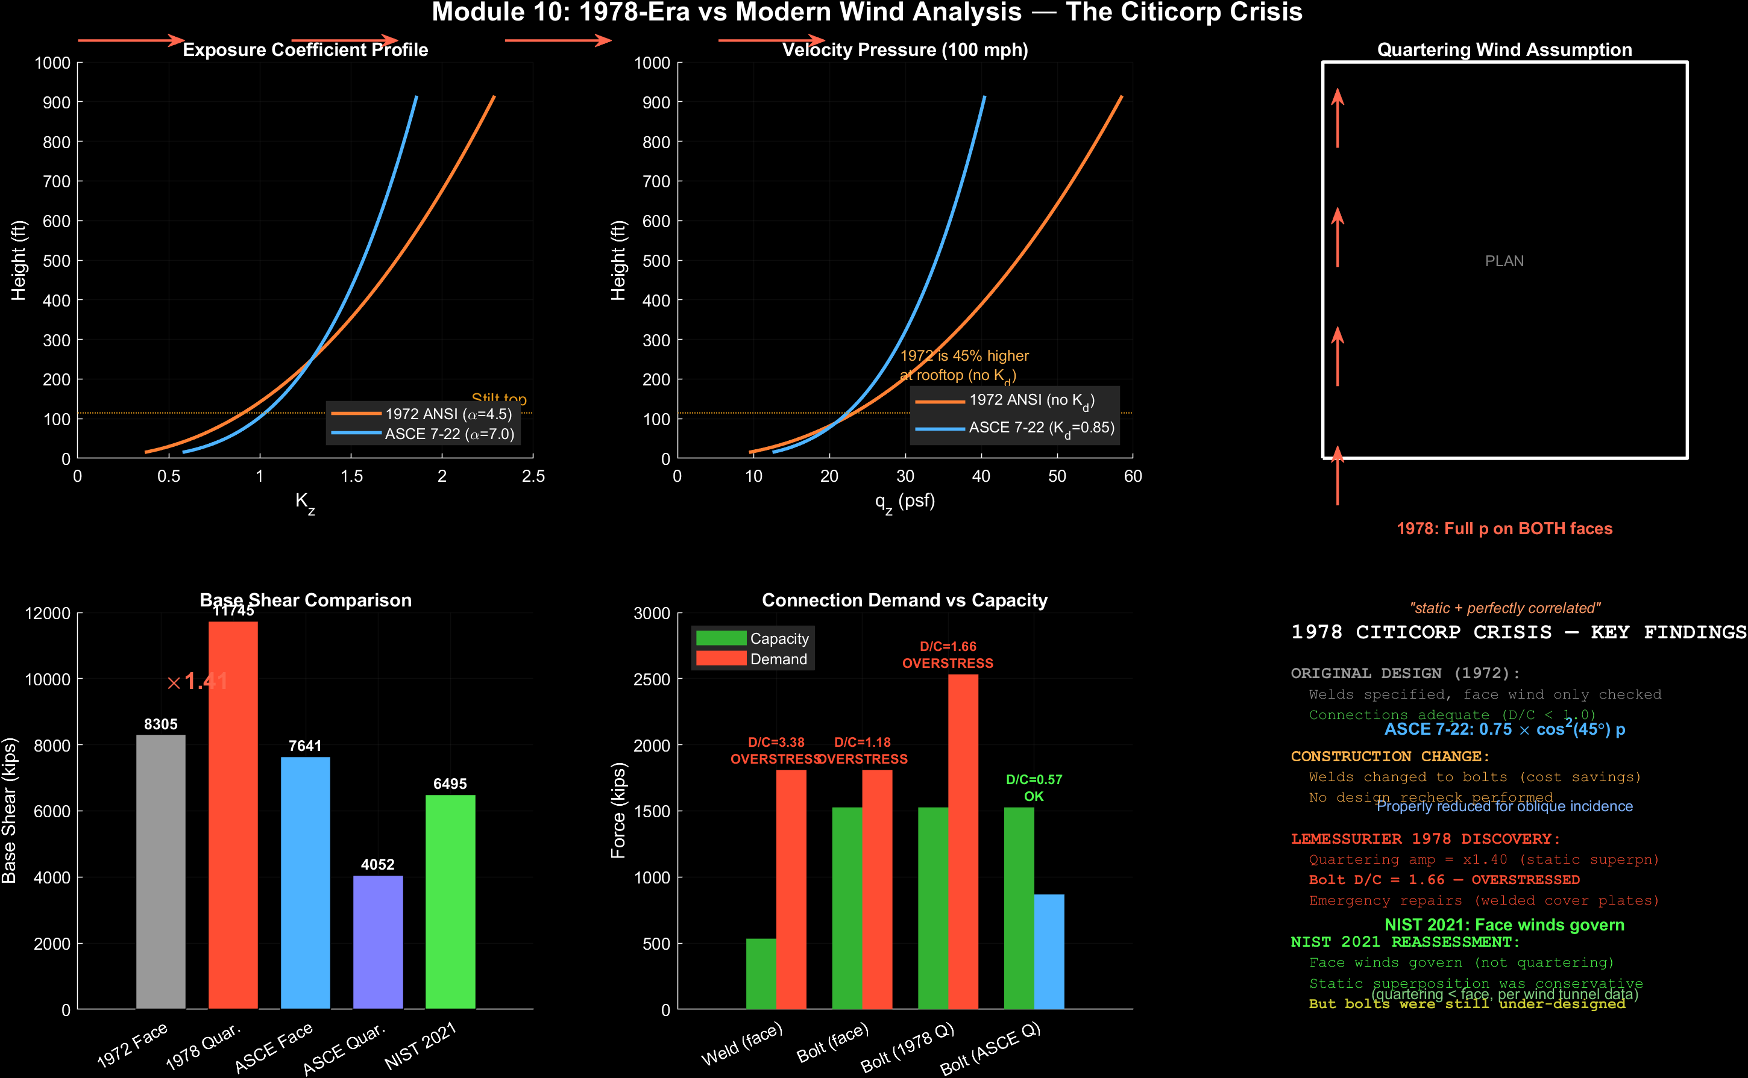
1970s Analysis vs Modern Reassessment
What LeMessurier Believed
(1978 static superposition)
• Quartering = 1.40× perpendicular
• Full pressure on BOTH faces
• Treats loads as perfectly correlated
• Bolt D/C >> 1.0 under quartering
• T ≈ 16 yr without TMD (crisis)
• T ≈ 55 yr with TMD (marginal)
What Modern Analysis Shows
(ASCE 7-22 + NIST 2021)
• Quartering = 0.52× perpendicular
• Face winds actually govern
• Kd = 0.85 reduces all loads by 15%
• Static superposition was conservative
• But bolts were still under-designed!
• The real problem: welds → bolts swap
Key Takeaway
LeMessurier was right to be alarmed, even if the quartering assumption was conservative. The bolt substitution was the root cause regardless of methodology.

Slide 5
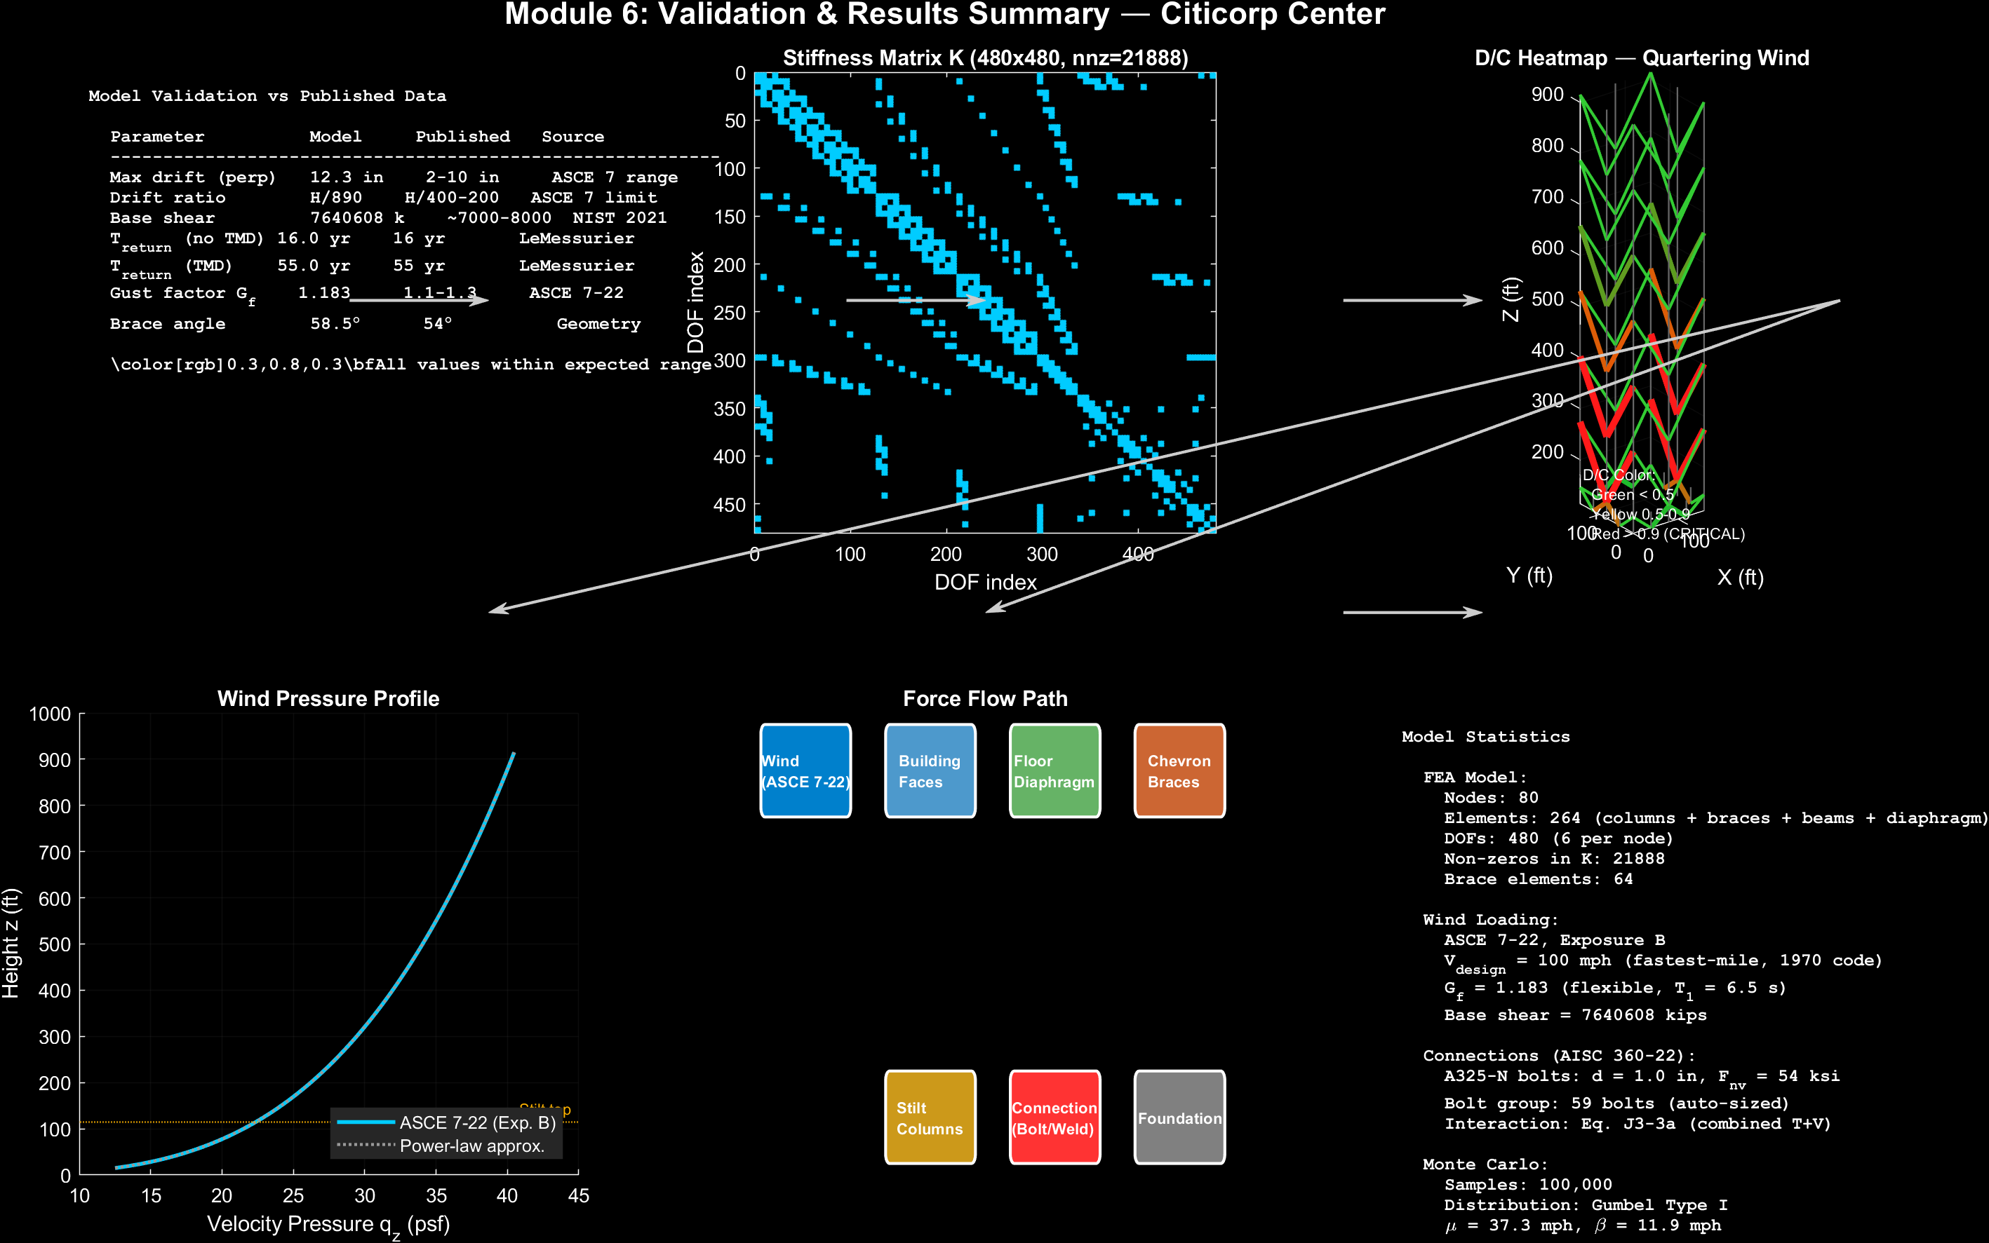
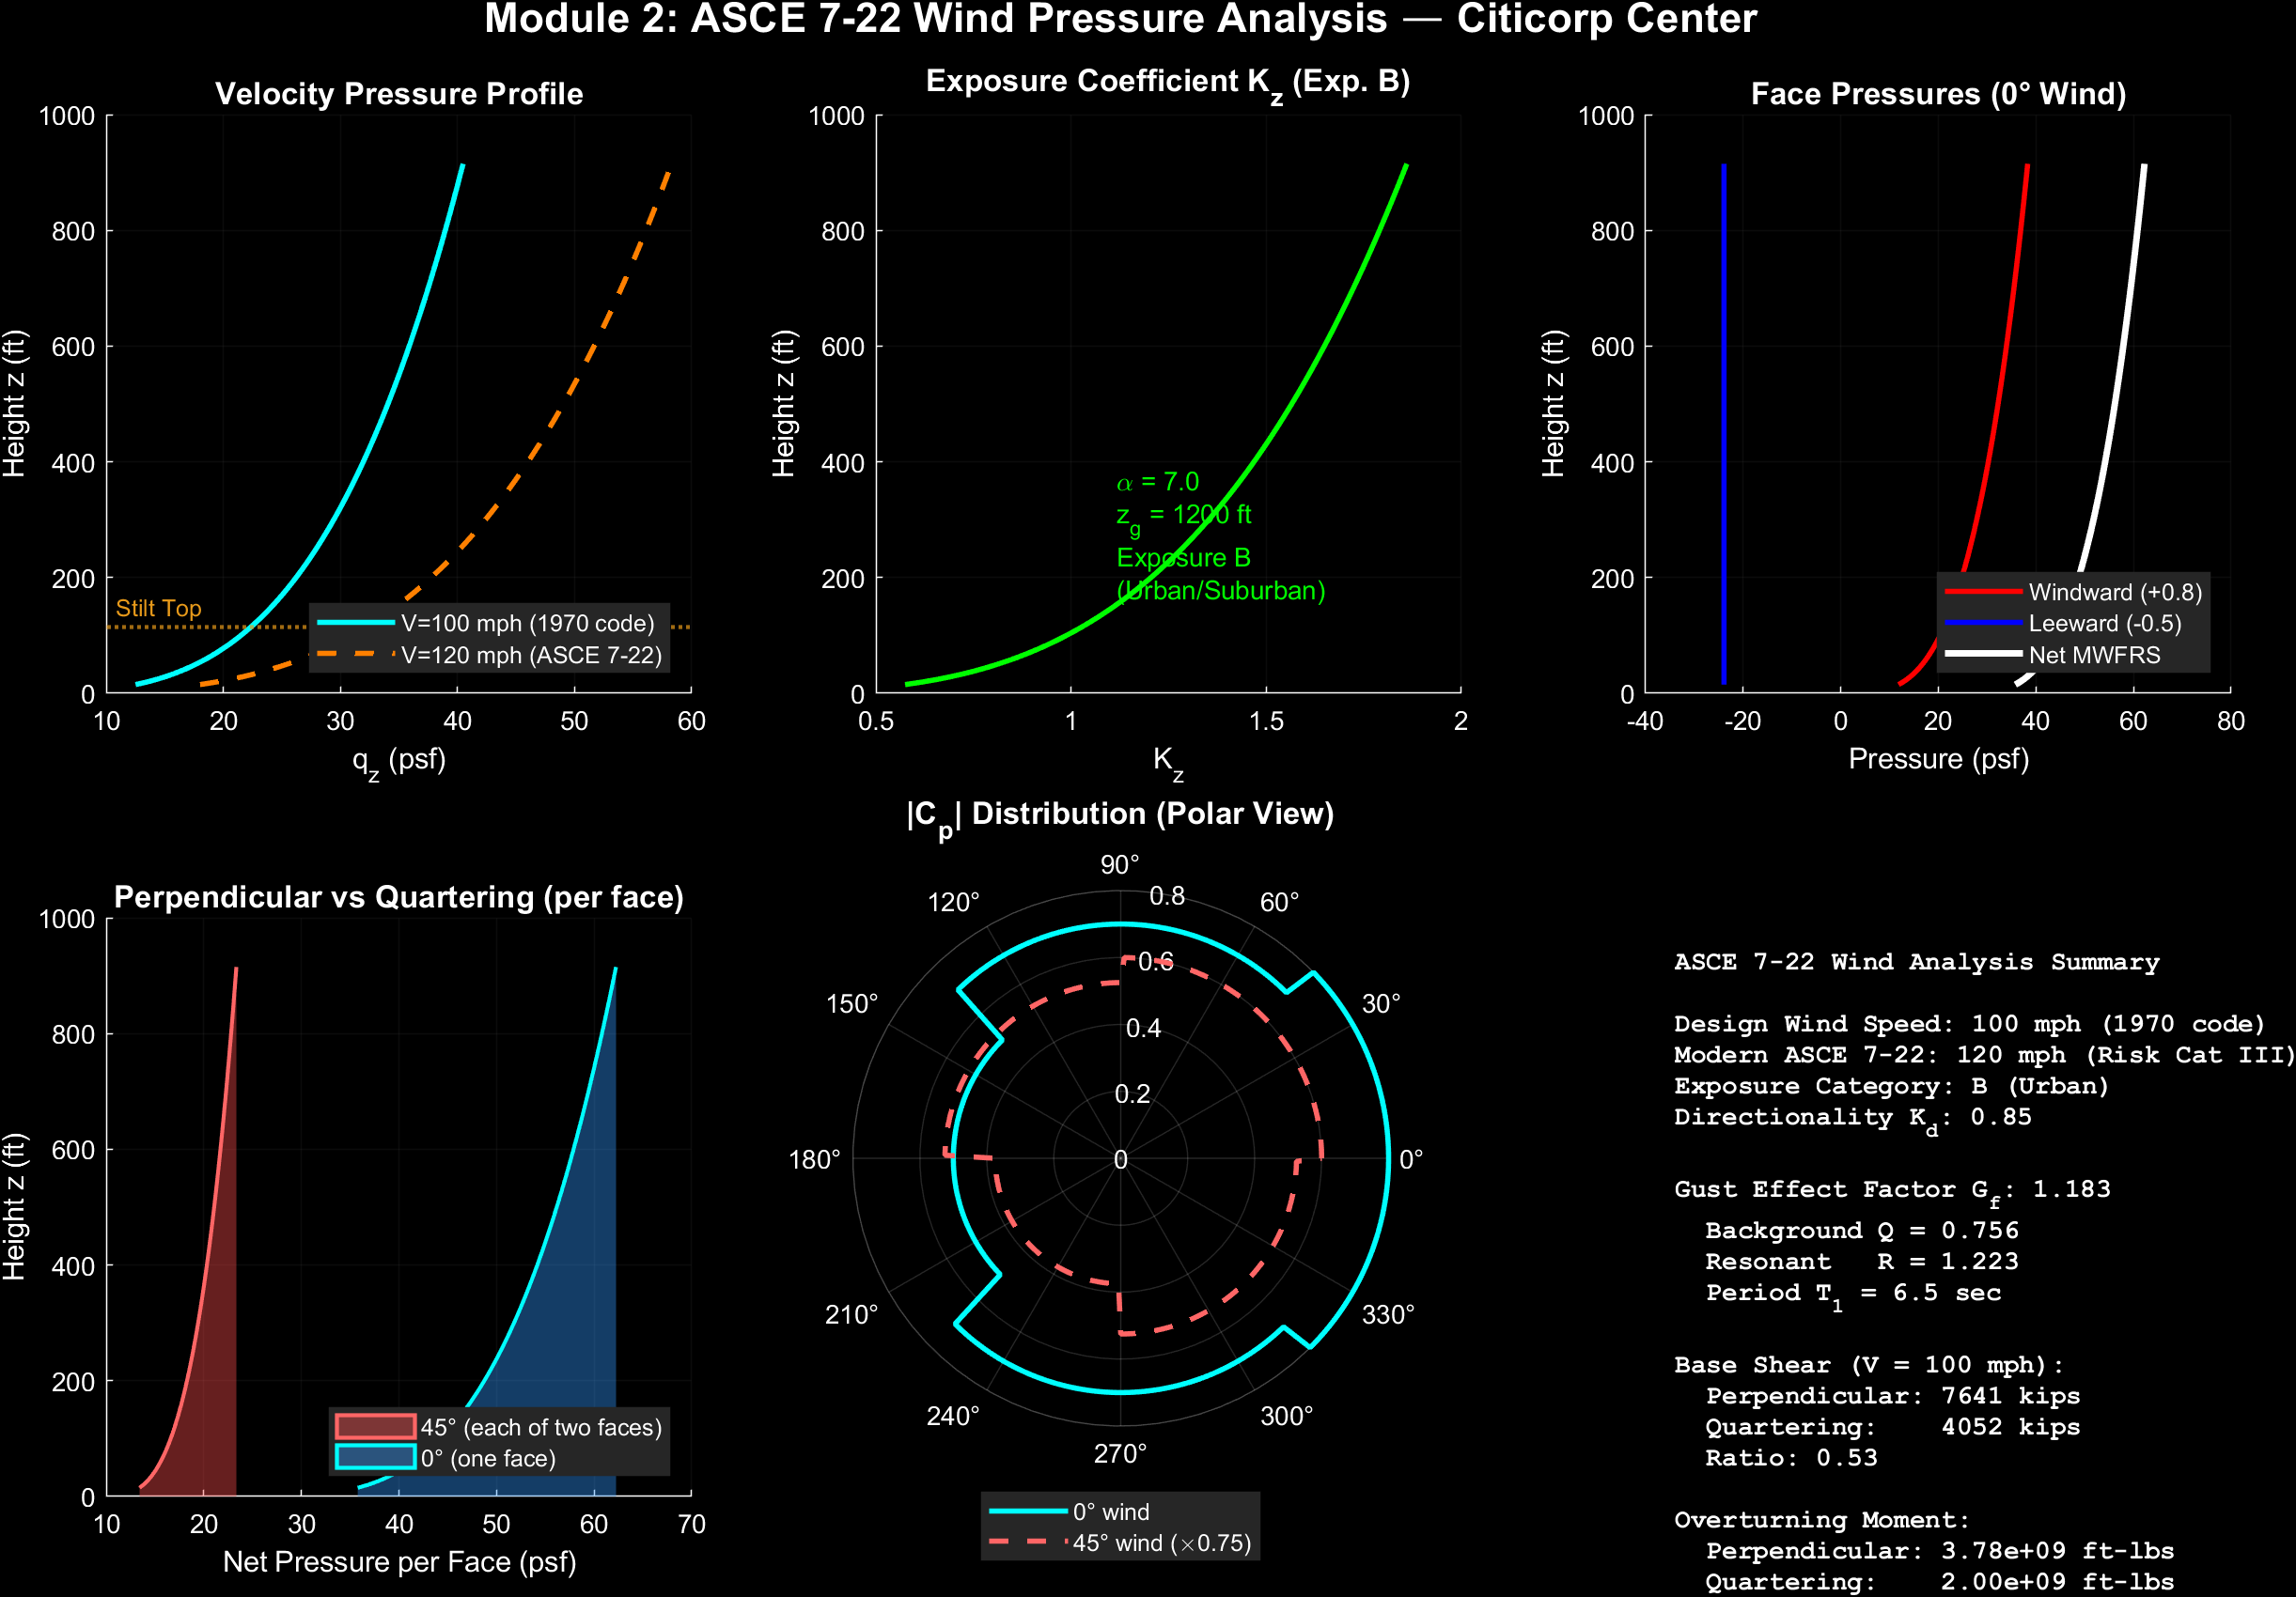
Validation, Provenance & Key Findings
Key Findings for OR 750
Risk Quantification:
Full factorial (16 scenarios) reveals that methodology choice dramatically affects perceived risk
Actual vs Perceived:
1970s analysis overestimates quartering risk; modern analysis shows face winds govern
Root Cause:
Weld-to-bolt substitution created under-designed connections regardless of wind direction methodology
TMD Importance:
TMD provides significant risk reduction across all scenarios (damping 1% → 8%)
No Circular Reasoning:
Gumbel from ASCE 7 wind map; failure thresholds from FEA+capacity; historical values for validation only
Data Provenance Categories
█ SOURCED Published standards/references (ASCE 7-22, AISC 360-22)
█ STANDARD Code-prescribed values (Kd, Cp, bolt capacities)
█ ASSUMED Engineering estimates (sections, damping ratios)
█ DERIVED Computed in this simulation (quartering amp, T_return)
█ VALIDATED Compared to independent data (LeMessurier, NIST)
Refs: ASCE 7-22, AISC 360-22, NIST (2021), Morgenstern (1995) | Generated with Claude Code

