Slide 1
UN Headquarters Area CityGML Hybrid Mesh Extraction
CityGML LoD2 (primary) + Socrata API (fallback)
Center for Computational Fluid Dynamics George Mason University

Slide 2
Extraction Parameters
Location & Domain
Results
Center: 40.7489° N, 73.9680° W
(UN Secretariat Building centroid)
Domain radius: 300 m (600 m × 600 m square)
EPSG:2263 (NY State Plane): X=[991798, 993767], Y=[211358, 213327]
Ground elevation: 5.51 ft MSL (1.7 m)
Tallest building: 169 m (BIN 1090642, built 2018)
UN Secretariat: 156 m (BIN 1083875)
One UN Plaza: 154 m (BIN 1038758)
CityGML (primary): 123 buildings (93%)
Socrata fallback: 8 buildings (6%)
Total: 131 buildings
Total triangles: 23,575
Surface breakdown:
GroundSurface: 125
RoofSurface: 1,048
WallSurface: 6,211
Bounding box: 732 m × 731 m × 170 m
Output
File: un_hq_surroundings.stl (binary STL, 23,575 triangles)
Coordinate system: local meters centered at UN Secretariat, Z=0 at ground
Solver-agnostic: compatible with FEFLO, OpenFOAM, Fluent, or any STL-reading CFD code

Slide 3
Methodology: Hybrid CityGML + Socrata Pipeline
STEP 1: CITYGML EXTRACTION (primary source — 2014 aerial photogrammetry)
1a. Convert domain corners from WGS84 to EPSG:2263 (NY State Plane feet)
1b. Identify overlapping DA district files (DA12 covers Midtown + Turtle Bay)
1c. Stream through GML files line-by-line (764 MB for DA12, no full-file load)
1d. For each <bldg:Building>: check if any coordinate falls in domain bbox
1e. Parse WallSurface, RoofSurface, GroundSurface → fan triangulate
1f. Convert EPSG:2263 feet → local meters (centered at target building)
1g. Auto-detect ground elevation from GroundSurface Z values
STEP 2: SOCRATA API FALLBACK (for post-2014 construction)
2a. Query NYC Building Footprints API (GeoJSON) within domain bbox
2b. Deduplicate: skip if BIN matches CityGML set (71 caught)
2c. Deduplicate: skip if centroid within 15m of any CityGML centroid
2d. Extrude remaining footprint polygons to height_roof (LoD1, flat-topped)
2e. Result: 8 genuinely new buildings added
STEP 3: OUTPUT
3a. Merge all triangles → un_hq_surroundings.stl (binary STL)
3b. Print provenance report with building counts + triangle counts

Slide 4
Data Sources
NYC 3D Building Model (CityGML)
Socrata Building Footprints API
2014 aerial photogrammetry survey
~1 million buildings across 5 boroughs
LoD2: actual wall, roof, ground surfaces
12 DA district files (~6 GB total)
EPSG:2263 coordinate system (US Survey Feet)
Source: georocket/new-york-city-model-enhanced
GitHub release: 20v5 (enhanced version)
Continuously updated (includes 2015+ construction)
2D footprint polygon + height_roof attribute
BIN (Building Identification Number) for matching
GeoJSON format, WGS84 coordinates
Extruded to flat-topped LoD1 boxes
API endpoint: data.cityofnewyork.us/resource/5zhs-2jue
Deduplication Strategy
Step 1: BIN matching — if Socrata BIN exists in CityGML set, skip (caught 71)
Step 2: Spatial proximity — if Socrata centroid within 15m of CityGML centroid, skip
Step 3: Remainder kept as fallback — genuinely new post-2014 buildings (8 added)

Slide 5
How to Reproduce
PREREQUISITES
Python 3.8+, requests library (pip install requests)
CityGML data: _citygml/DA12.gml.zip (52 MB, auto-downloaded from GitHub)
GENERATE STL (single command):
python generate_stl_hybrid.py \
--center-lat 40.7489 --center-lon -73.9680 \
--name un_hq --radius 300 --no-target
Output: constant/triSurface/un_hq_surroundings.stl
Runtime: ~2 minutes (DA12 scan: 20s, Socrata API: 2s)
OPTIONAL FLAGS:
--offline Skip Socrata API (CityGML only)
--year 1978 Historical filter (buildings built by year)
--ascii Also write ASCII STL for inspection
--data-dir PATH Custom CityGML data directory
--output-dir PATH Custom STL output directory
VISUALIZE:
pvpython _paraview_un_hq.py (generates 5 PNG views)
Open building_browser.html → click 'UN Headquarters' preset

Slide 6
Pipeline Architecture
STREAMING PARSER
Line-by-line scan of GML files (764 MB+)
O(1) memory: only current building in RAM
Bounding box check on first coordinate → skip early
Pattern: <bldg:Building> ... </bldg:Building>
COORDINATE TRANSFORMS
CityGML: EPSG:2263 (US Survey Feet)
→ subtract center → multiply by 1200/3937
Socrata: WGS84 (degrees)
→ same scale factors for alignment
Ground: auto-detected from GroundSurface Z
TRIANGULATION
CityGML polygons: fan triangulation from v0
Socrata footprints: ear-clipping + extrusion
LOCATION-AGNOSTIC DESIGN
--center-lat/--center-lon for any NYC building
--radius for domain size
--no-target for surroundings-only mode
--exclude-bins to remove target building
DA DISTRICT AUTO-DETECTION
20 pre-computed EPSG:2263 envelopes
Domain → overlapping districts → scan only those
Auto-downloads missing districts from GitHub
OUTPUT
Binary STL (watertight, outward normals)
Compatible with any CFD solver
FEFLO, OpenFOAM, Fluent, Star-CCM+
Optional ASCII STL for inspection

Slide 7
Notable Buildings in Domain
Building
Address
Height
Source
Turkish Consulate (2018)
821 1 Avenue
169 m
Socrata
50 UN Plaza (2016)
50 United Nations Plaza
163 m
Socrata
UN Secretariat
752 1 Avenue
156 m
CityGML
One UN Plaza
787 1 Avenue
154 m
CityGML
UN Dev. Program
323 E 44 Street
147 m
CityGML
685 First Ave (2018)
685 First Avenue
140 m
Socrata
US Mission to UN
799 1 Avenue
117 m
CityGML
Woodstock Tower
312 E 42 Street
111 m
CityGML
Nigerian Mission
828 2 Avenue
94 m
CityGML
Windsor Tower
1 Tudor City Place
89 m
CityGML
Ford Foundation
320 E 43 Street
47 m
CityGML
131 total buildings | 123 from CityGML LoD2 (actual surfaces) | 8 from Socrata (flat-topped)
CityGML buildings have roof shapes, wall setbacks from 2014 aerial photogrammetry
Socrata buildings are post-2014 construction extruded to flat tops (LoD1)

Slide 8
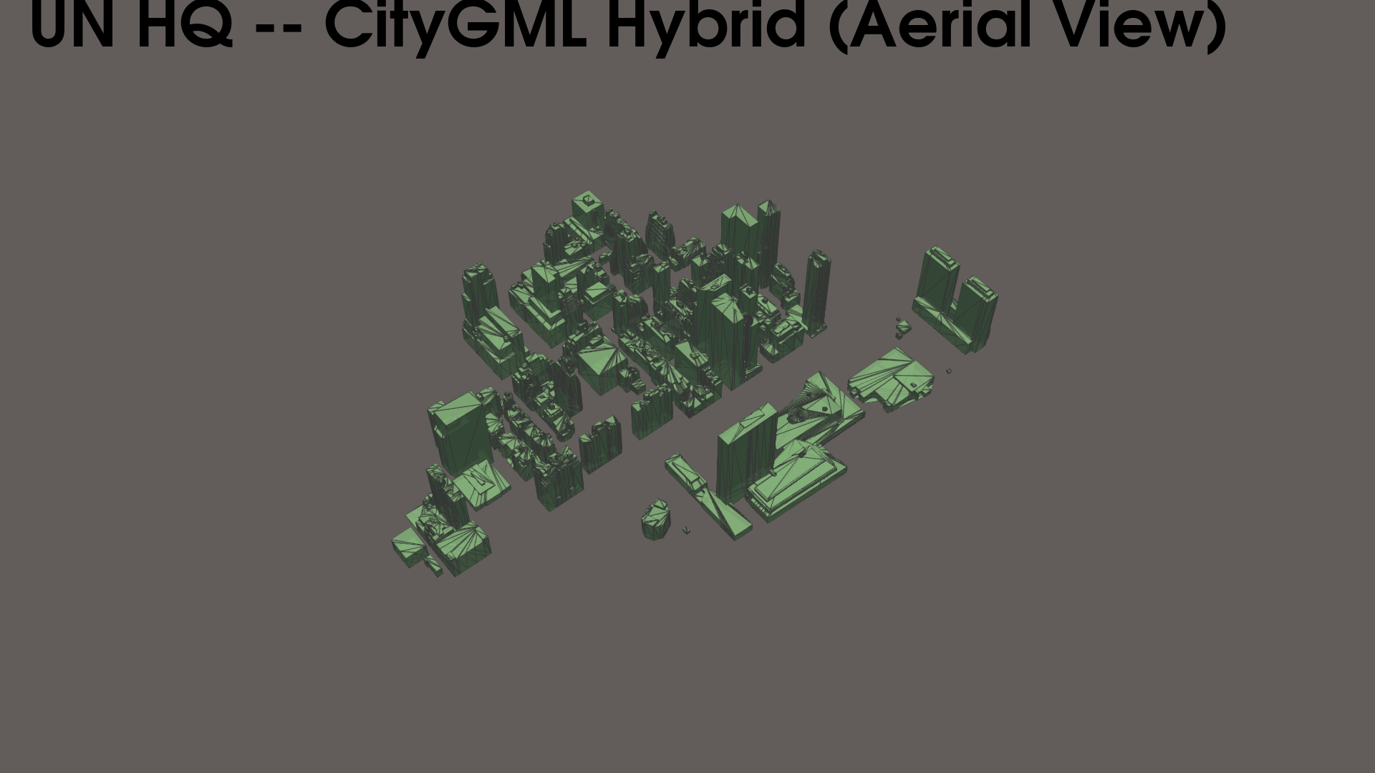
UN HQ — Aerial View

Slide 9
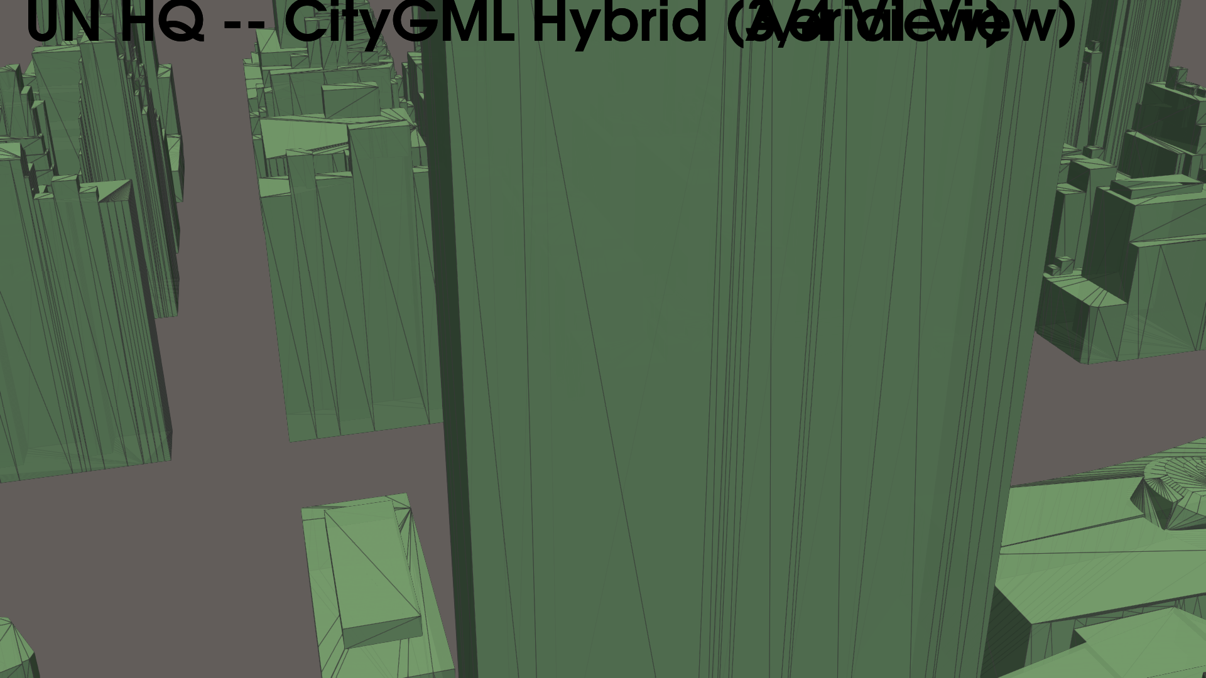
UN HQ — 3/4 View

Slide 10
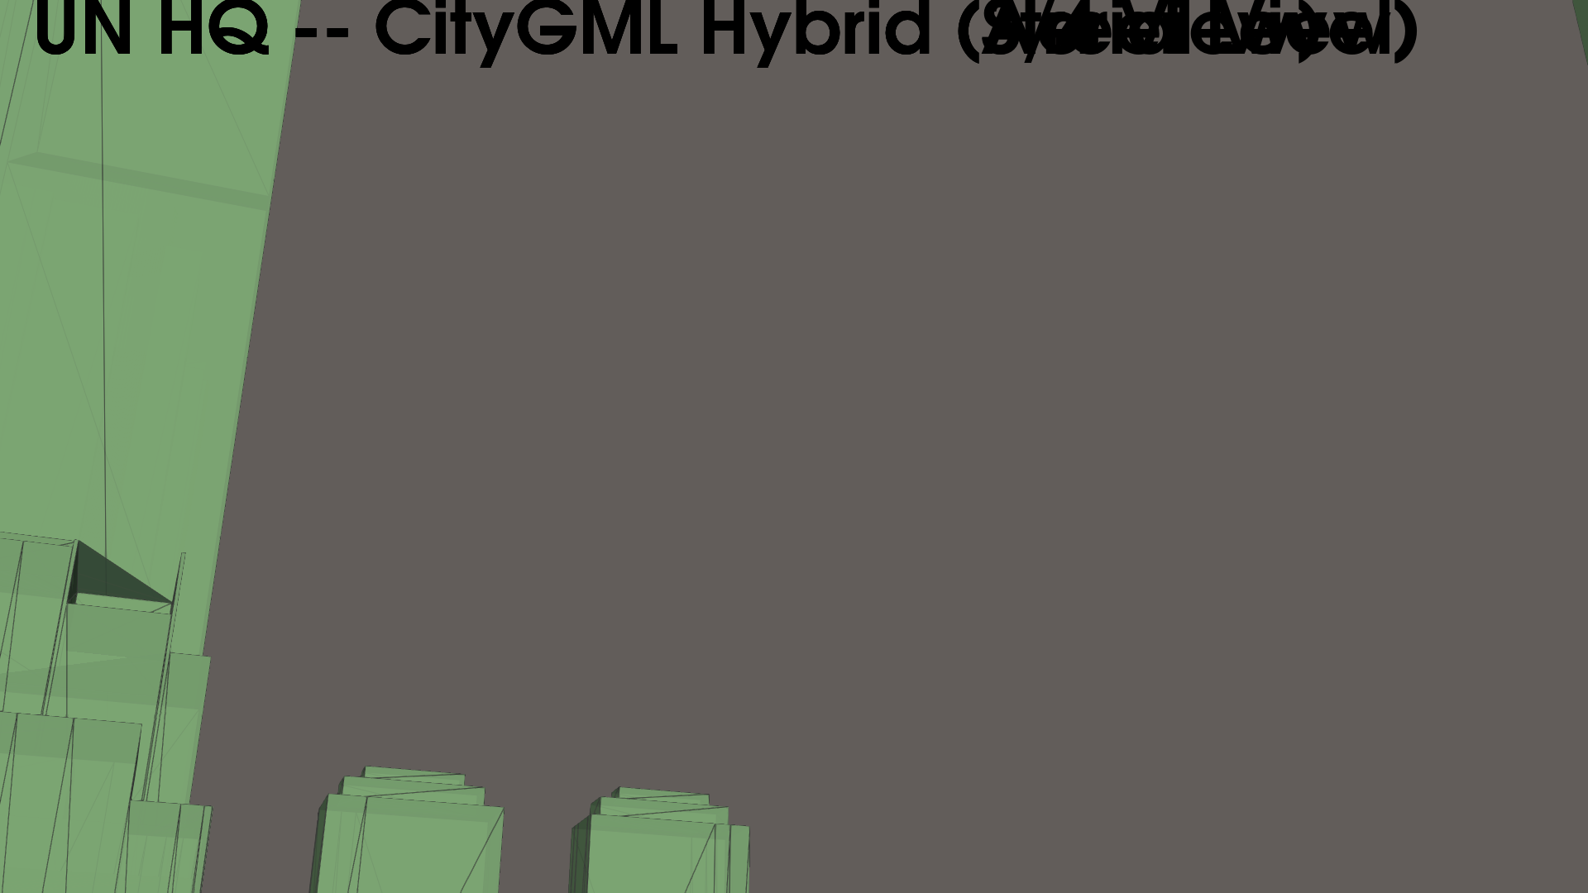
UN HQ — Street Level

Slide 11
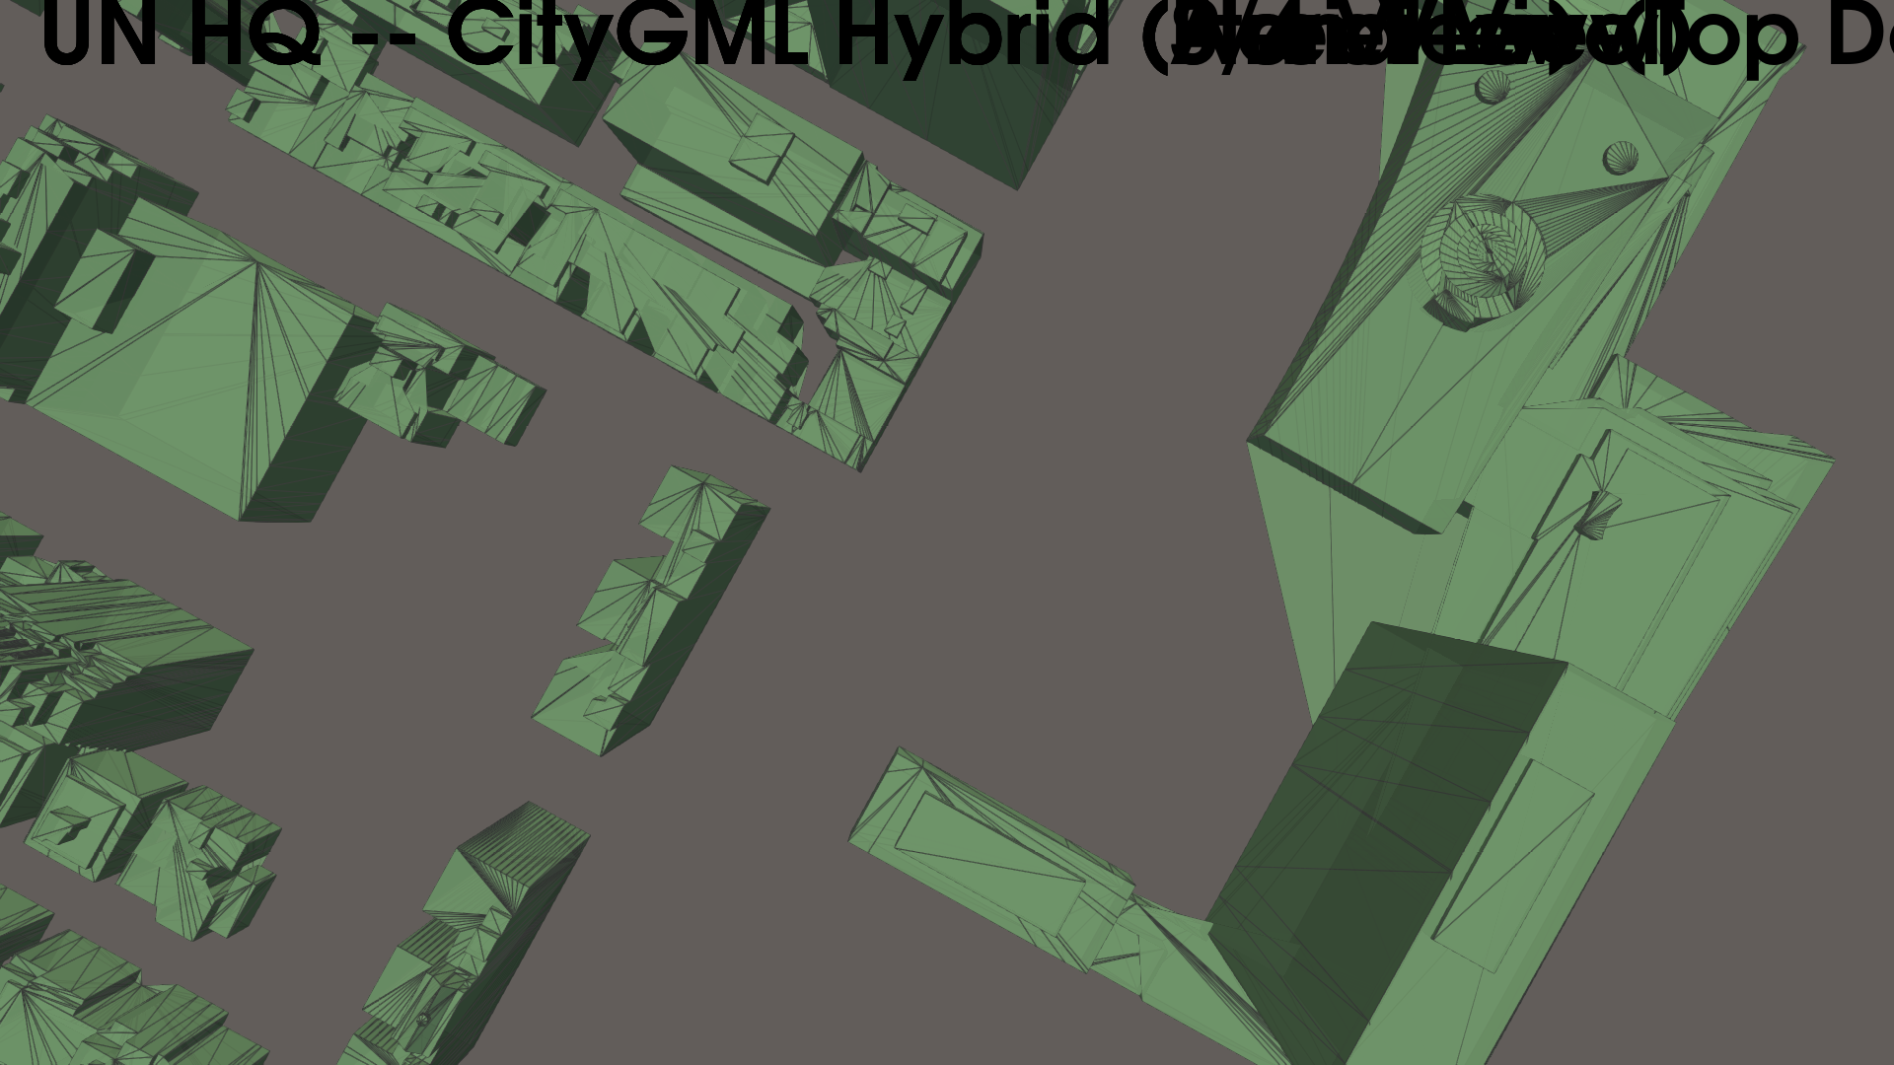
UN HQ — Plan View (Top Down)

Slide 12
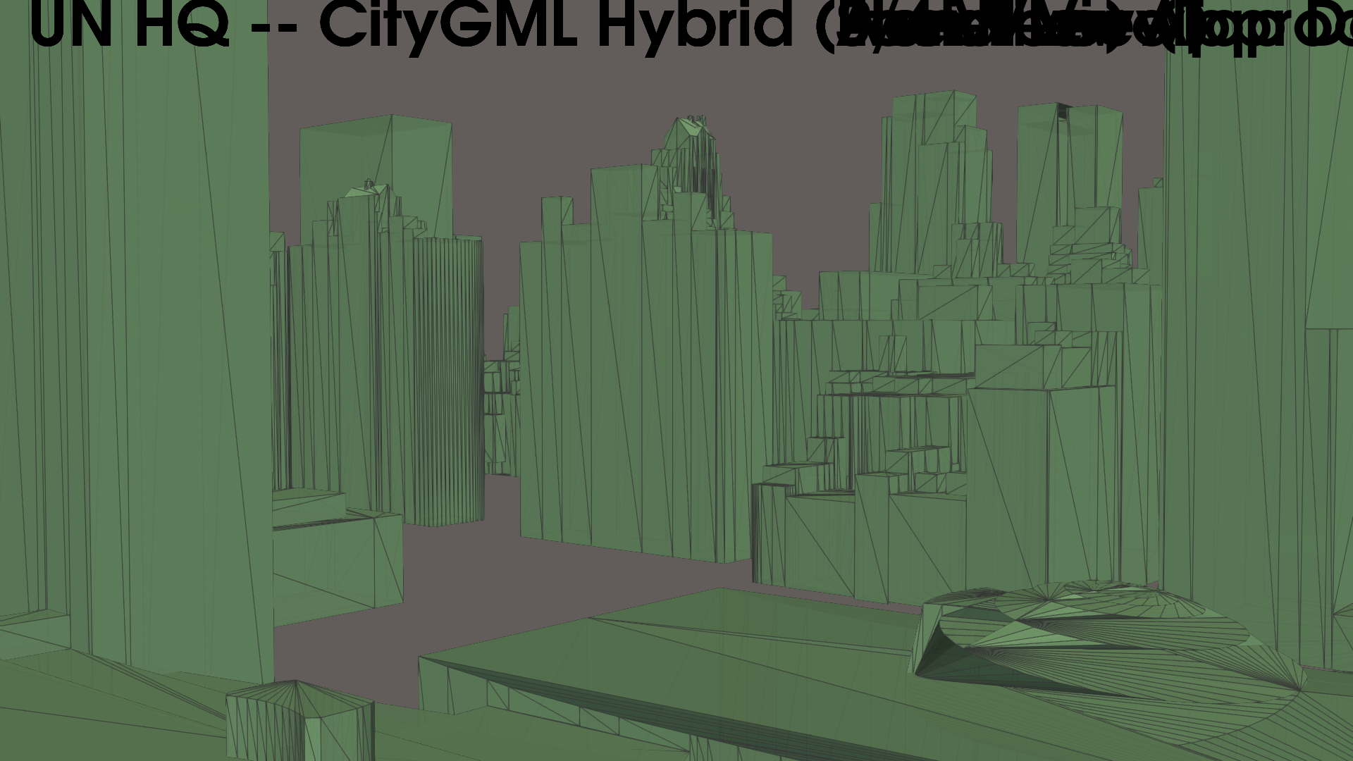
UN HQ — East River Approach

Slide 13
UN HQ Area — Ready for CFD
131 buildings extracted (CityGML LoD2 + Socrata fallback)
23,575 triangles with actual roof shapes and wall setbacks
Single command: python generate_stl_hybrid.py --center-lat 40.7489 ...
Pipeline works for any NYC location (Manhattan, Brooklyn, etc.)
Building browser (HTML) for visual QA against satellite imagery

