Slide 1
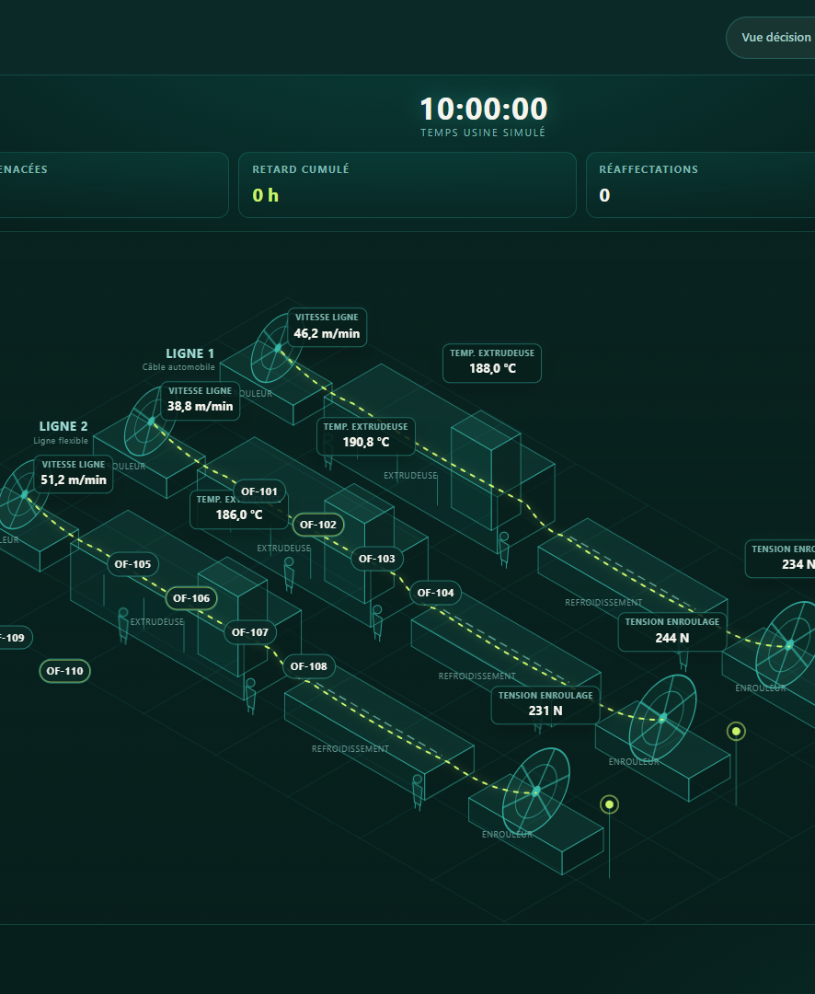

AUTOMATE OR DIE 2026 · INDUSTRY · ROOM 206
58-minute power loss.
24 km of customer commitment.
One governed recovery.
Six constraints. Three recovery branches. One accountable human decision.
17:42 → 18:40
8 × 3 km
LOCAL OUTAGE WINDOW
SYNTHETIC ORDER · 8 DRUMS
Oussama Akir · SUPCOM
akir.oussama@gmail.com
Notes:
0:00–0:20 — Good afternoon. In our synthetic Tunisian cable-factory scenario, grid power disappears for 58 minutes while a medium-voltage cable order is in production. Electricity returns; certainty does not. CableTwin compares recovery options before the plant commits equipment, quality resources, people and the customer schedule.

Slide 2
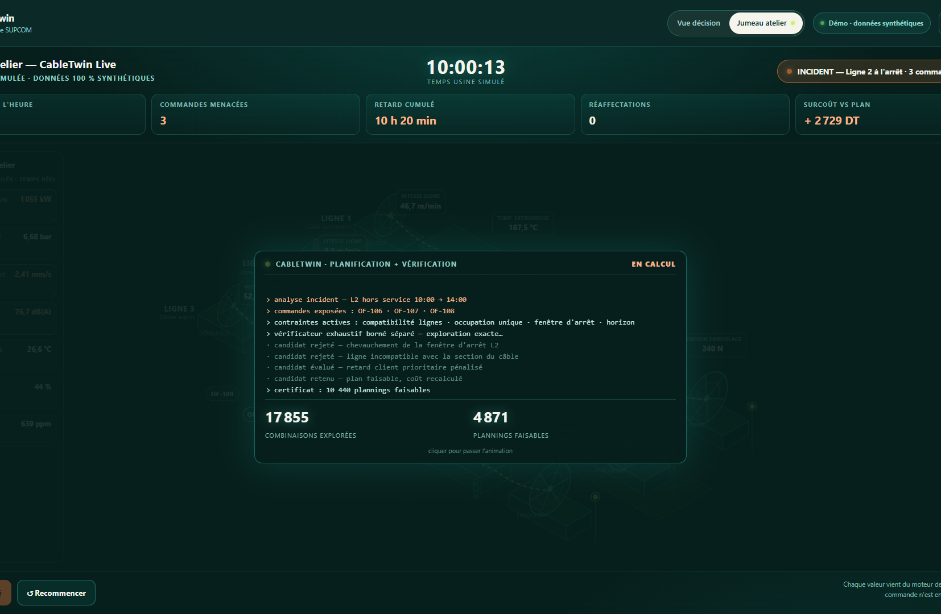
PROBLEM / OPPORTUNITY
02
The grid returns. Decision uncertainty does not.
17:42
58 min
LOCAL OUTAGE START
OPERATOR-ENTERED WINDOW
T7 HOLD
T8 NOT STARTED · REPLANNED
Restart too fast and Quality loses evidence. Wait blindly and the customer schedule loses time.
T7 IN CCV · T1–T6 OUTSIDE INCIDENT · T8 REPLANNED
Factory, order and constraints are synthetic. CableTwin does not predict the outage.
CableTwin · SUPCOM · Fully synthetic factory scenario
Context: TAP / La Presse · 17–18 July 2026
Notes:
0:20–0:50 — The line sees the stop. Energy sees a restart envelope. Quality sees incomplete process history. Logistics sees a truck at 06:30. One 24-kilometre order now has three truths: drums one to six remain outside the incident, drum seven is entirely on hold, and drum eight is not started and must be replanned. Restarting the line is not the same as recovering the operation.

Slide 3
VALUE PROPOSITION
03
ML retrieves. The twin tests. Humans authorize.
One decision layer across energy, process, quality, people, material and delivery.
01 · INCIDENT
02 · RETRIEVE
03 · SIMULATE
04 · AUTHORITY
Synthetic plant state
Local case retrieval
Bounded digital twin
Humans + laboratory
→
→
→
58-min outage
T7 HOLD · T8 replanned
Comparable cases
Distance · differences · OOD
Tests restart futures
Hard rules reject impossible
Energy · Quality · Logistics
approve, hold or stop
Operator-entered event
Advisory ML only
Deterministic what-if
No machine command
01
02
03
04
05
06
LOCAL · OFFLINE · READ-ONLY
energy
process
quality
people
logistics
material
hard constraints · human authority
CableTwin · SUPCOM · Oussama Akir · Fully synthetic demonstration
Synthetic scenario · no conformity, savings or plant-performance claim
Notes:
0:50–1:20 — CableTwin is a local, read-only decision layer. Explainable ML retrieves comparable synthetic cases and shows distance, differences and out-of-distribution warning. The deterministic twin tests recovery futures across energy, process, material, people, quality and delivery. Hard rules reject impossible sequences. CableTwin never commands a PLC and never releases cable: Quality, the laboratory and accountable humans keep authority.

Slide 4
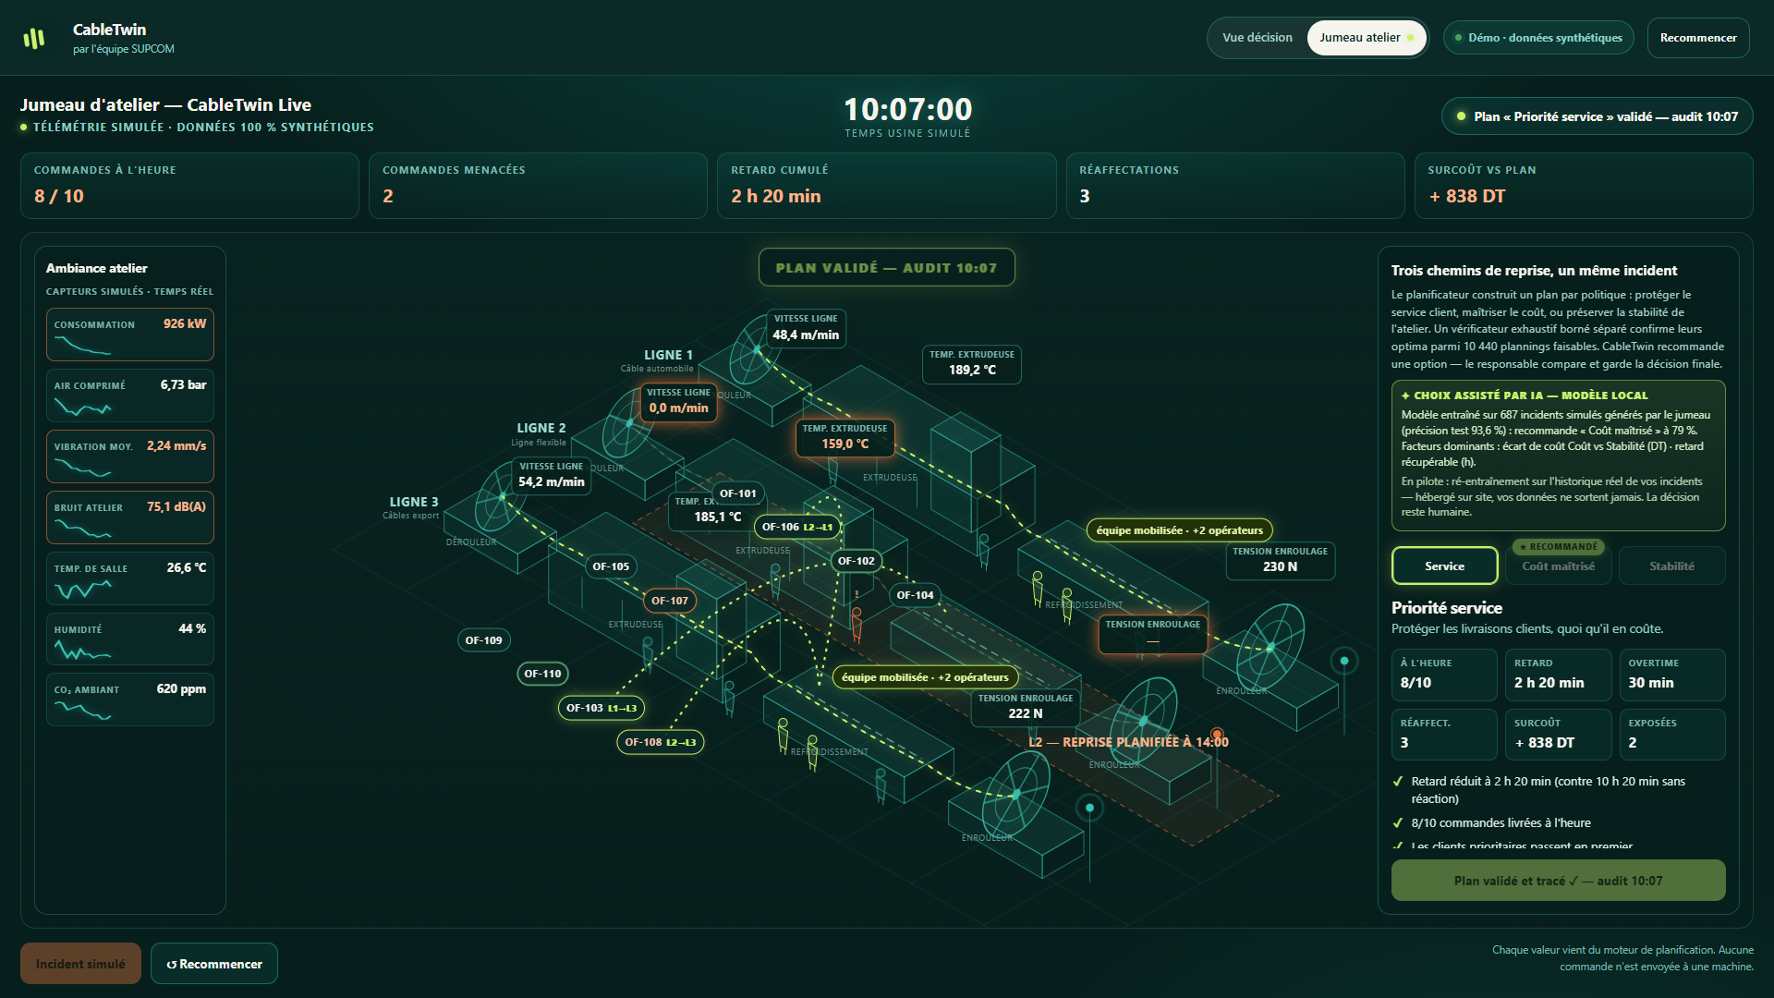
SECRET SAUCE / WORKING DEMO
04
Change one energy limit. Every feasible plan must update.
30-SECOND STORYBOARD
1
Inject 58-min outage
2
T7 HOLD + retrieve analogs
3
Reject restart-all & emergency
4
Drop power → no feasible plan
5
Restore Plan C · lab gate stays closed
30 s
5 beats
JURY MODE
ACCEPTANCE CONTRACT
CableTwin · SUPCOM · Oussama Akir · Fully synthetic demonstration
Public decision twin · flagship factory case synthetic
Notes:
1:20–1:50 — LIVE ONLY AFTER ACCEPT: Here is the same scenario in Jury mode. I inject the 58-minute outage: drum seven stays on hold and the system retrieves comparable cases. I reduce available restart power: no plan is feasible. I restore the operator-entered limit: staged Plan C returns under visible assumptions. The laboratory gate remains closed. Same engine, same rules, faster replay—not a scripted shortcut. PRE-ACCEPT FALLBACK: describe this as the acceptance contract, not a live capability.

Slide 5
BUSINESS MODEL
05
Revenue follows measured evidence—not a demo.
USER
BUYER
BEACHHEAD
Production · Quality · Reliability
Plant or operations director
Tunisian cable plants · one line first
01
02
03
04
Paid diagnostic
Read-only shadow pilot
Per-line or site license
Scale after proof
Map data, rules, roles and evidence gaps
Replay incidents + synthetic stress cases
Configuration, calibration and support
Only after measured pilot evidence
Pricing and ROI are pilot questions. No customer, revenue, savings or saved-distance claim today.
CableTwin · SUPCOM · Oussama Akir · Fully synthetic demonstration
Notes:
1:50–2:15 — We enter commercially in four disciplined steps: a paid data-and-decision diagnostic, a read-only shadow pilot, a license per line or site with configuration and support, then replication only after measured pilot evidence. Pricing and ROI are pilot questions. We sell decision speed, constraint visibility and traceability—not guaranteed savings.

Slide 6
GO-TO-MARKET
06
Start read-only on one cable line; earn every integration.
4–6 WEEKS
One read-only shadow pilot
WEEK 0
WEEKS 1-2
WEEKS 3-4
WEEKS 5-6
Map
Replay
Shadow
Decide
Data contract · roles · hard constraints
Historical incidents + synthetic stress cases
Compare options with actual plant decisions
Go · revise · stop on measured evidence
Pilot gates to agree
evaluation time · violations caught before action · stability · usability · traceability
Pilot targets to agree—not achieved claims
CableTwin · SUPCOM · Oussama Akir · Fully synthetic demonstration
Notes:
2:15–2:40 — The first pilot is one cable line for four to six weeks. We map the data contract and hard rules, replay historical incidents plus synthetic stress cases, compare CableTwin options with actual plant decisions, then go, revise or stop. Success measures are evaluation time, violations caught before action, stability, usability and traceability.

Slide 7
COMPETITIVE ANALYSIS
07
MES executes. QMS releases. CableTwin compares recovery options.
Manual / spreadsheet
Flexible and immediate
Knowledge stays fragmented; comparison and audit depend on people
SCADA · MES · APS · QMS
Systems of control, record and planning
Essential foundations; incident what-if remains site-specific
CableTwin
Read-only decision layer
Incident state + alternatives + hard constraints + provenance + human gate
Differentiation = cross-domain recovery comparison before action, with explicit human authority
CableTwin · SUPCOM · Oussama Akir · Fully synthetic demonstration
Sources: NIST human-in-loop twins · Siemens APS · DELMIA Ortems
Notes:
2:40–3:05 — We complement existing systems; we replace none. SCADA and PLC control. MES executes and records. APS plans capacity. QMS and laboratories test and release product. CableTwin is the cross-domain, read-only decision layer that makes incident alternatives, hard constraints, provenance and human gates visible before the plant acts.

Slide 8
TEAM
08
One accountable builder shipped the loop—and kept its limits visible.
PHASE 1
DAY 2
DAY 3
NEXT
Focus
Build
Defend
Validate
Oussama Akir
One stoppage decision
Public twin + evidence
Flagship scenario + 4-minute pitch
Cable-plant design partner
SUPCOM · solo participant
Product · industrial scenario · constraints · ML retrieval · twin · QA · deployment · evidence
The next team extension is not a fictional org chart.
It is one real cable plant, its production planner and its Quality authority.
CableTwin · SUPCOM · Oussama Akir · Fully synthetic demonstration
Notes:
3:05–3:25 — I am Oussama Akir, a solo SUP'COM participant. During this hackathon I built the public CableTwin demonstrator, its bounded planner, local ML guidance, digital-twin views, verification and evidence package. I also kept the product's limits visible. The next team extension is not a fictional org chart; it is one real cable plant and its Quality authority.

Slide 9
FINANCIALS / KEY FIGURES
09
Commercial truth first: zero pilots, zero revenue, zero ROI claims.
0
0
0
Commercial honesty is part of the product.
Synthetic evidence is not customer evidence.
SIGNED PILOTS
REVENUE
ROI CLAIMS
PROVED NOW
EARNS REVENUE NEXT
Public working product
9/9 planner + 5/5 ML checks
Exact verifier · 17,856 → 10,440
Local · offline · read-only
One cable-plant design partner
One paid shadow-pilot hypothesis
Price and scale after measured value
Commercial discipline: prove value first; price second; scale third.
CableTwin · SUPCOM · Oussama Akir · Fully synthetic demonstration
Notes:
3:25–3:40 — Today the honest numbers are zero signed pilots, zero revenue and zero ROI claims. What is proven is a public working product, nine planner and workflow checks, five ML checks, and a local, offline, read-only posture. Synthetic evidence is not customer evidence.

Slide 10
CURRENT STATUS / ACTION
10
Built now. Validate next. Scale only after proof.
NOW
Working public prototype
Decision twin · local ML · hard rules · bounded verifier · human approval
NEXT
One 4–6-week shadow pilot
Read-only data · real incident replays · planner-validated constraints
THEN
Integrate only if KPIs pass
Configuration · site deployment · per-line or site license
Select CableTwin—and connect one Tunisian cable-plant design partner.
hackaton-automate-or-die.vercel.app/#twin
github.com/akiroussama/hackaton_automate_or_die
Notes:
3:40–4:00 — Our ask is precise: select CableTwin and connect one Tunisian cable-plant design partner for a read-only shadow pilot. A power interruption lasts 58 minutes; industrial uncertainty can last for hours. CableTwin retrieves the past, compares futures, blocks the impossible—and leaves authorization to humans and the laboratory.

