Slide 1

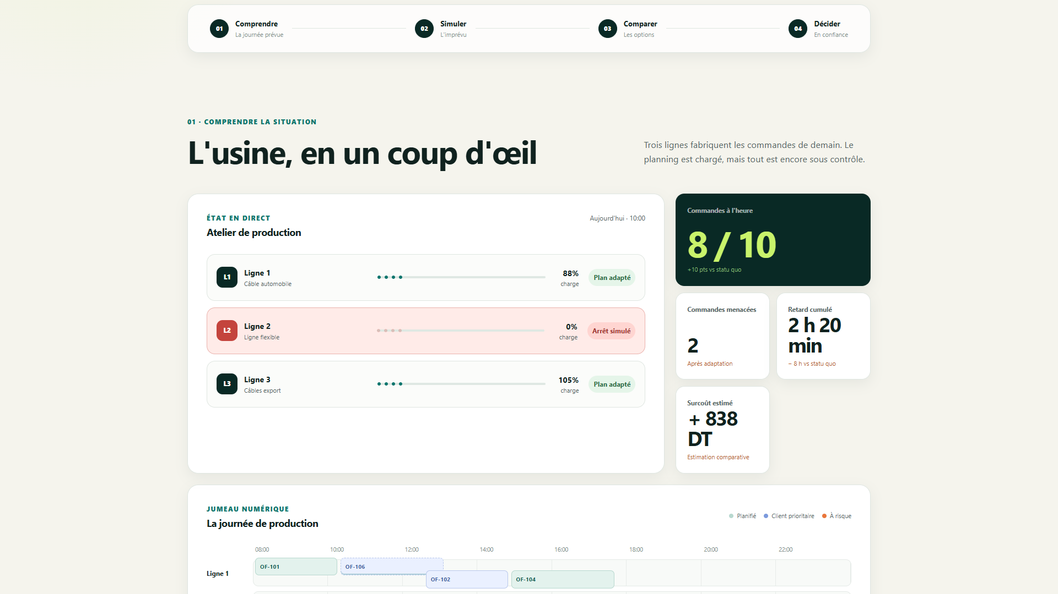
AUTOMATE OR DIE 2026 · INDUSTRY · THEME 3
CableTwin
When a line stops, see the consequences
before changing production.
The Waze of the cable factory
Working offline prototype · Fictional Tunisian factory · Fully synthetic data
CableTwin · SUPCOM · Oussama Akir · Fully synthetic data
Notes:
At 10:00, one production line stops. The schedule that looked correct one minute ago is now impossible. The production manager must decide which orders to move, delay or protect before every consequence is visible. CableTwin is the Waze of the cable factory: it shows what the disruption changes, compares feasible recovery routes and leaves the final decision to the manager. What you will see is a working offline prototype on a fully synthetic Tunisian cable factory.

Slide 2
THE PROBLEM
At 10:00, one stoppage exposes 3 orders and 620 minutes of delay
Which orders should be moved, delayed or protected —
and what will each choice do to service, throughput
and the workshop?
LINE 2 UNAVAILABLE
10:00 – 14:00
ORDERS EXPOSED
Eligible lines
Durations
Due times
3
No overlap
Planning horizon
ON TIME WITHOUT ADAPTATION
The active schedule becomes infeasible the moment the
line stops: two orders overlap the stop, one downstream
order is exposed, and every alternative must respect real
constraints. The decision owner is the production manager.
7 / 10
PROJECTED CUMULATIVE DELAY
620 min
The manager needs a feasible choice, not another dashboard.
CableTwin · SUPCOM · Oussama Akir · Fully synthetic data
Notes:
The process is incident-driven rescheduling. Once Line 2 is unavailable, two orders overlap the stop and one downstream order is exposed. Orders compete for the remaining eligible capacity. A valid answer must respect product-to-line compatibility, line-specific duration, downtime, non-overlap and the planning horizon. If every order stays on its original line, only seven of ten finish on time and cumulative delay reaches 620 minutes. The decision owner is the production manager; the process exists because the active schedule has become infeasible, while its local frequency and cost remain pilot questions.

Slide 3
THE PRODUCT
CableTwin turns one disruption into three feasible routes
1 Detect the stop
Like Waze after a road closes:
same destination, different routes and visible
trade-offs — the driver still decides.
2 Reveal exposed orders and KPI
3 Compare Service · Cost · Stability
One incident → three comparable recovery
schedules → one traceable human decision
4 Preview, approve and record
Read-only decision support · No failure prediction · No machine control
CableTwin · SUPCOM · Oussama Akir · Fully synthetic data
Notes:
CableTwin is a lightweight incident-time digital twin. It keeps the minimum calculable state needed for this decision: lines, orders, calendars, compatibilities and the current schedule. When a route closes, it measures the impact and generates three alternatives. Service protects priority-weighted delivery, Cost minimizes the illustrative comparison cost, and Stability avoids line changes. The value is not a 3D factory. It is the ability to test a production decision safely before changing the real workshop.

Slide 4
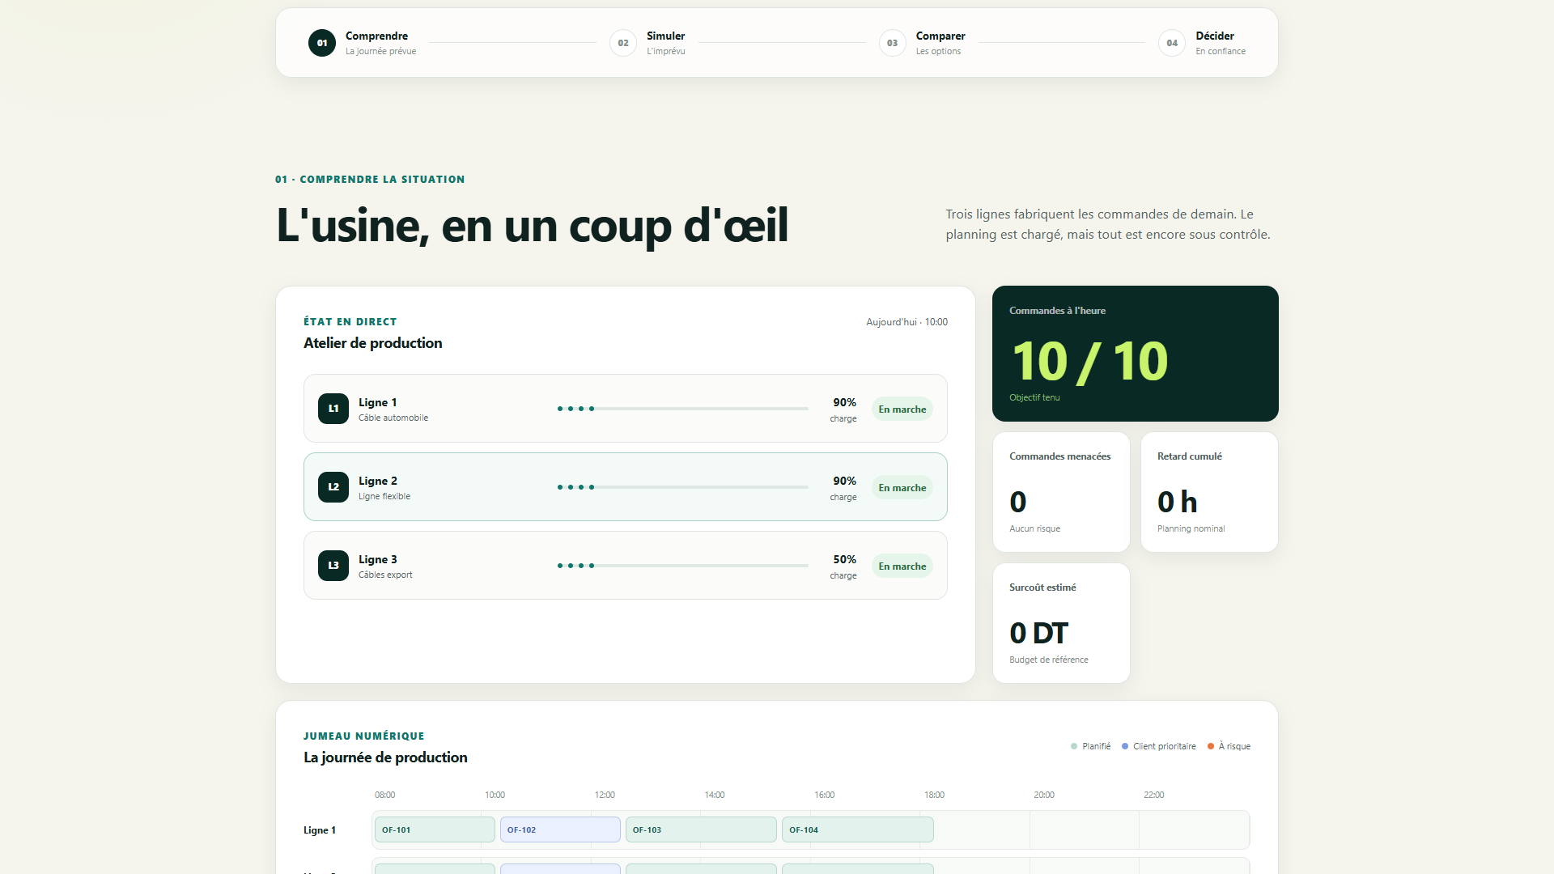

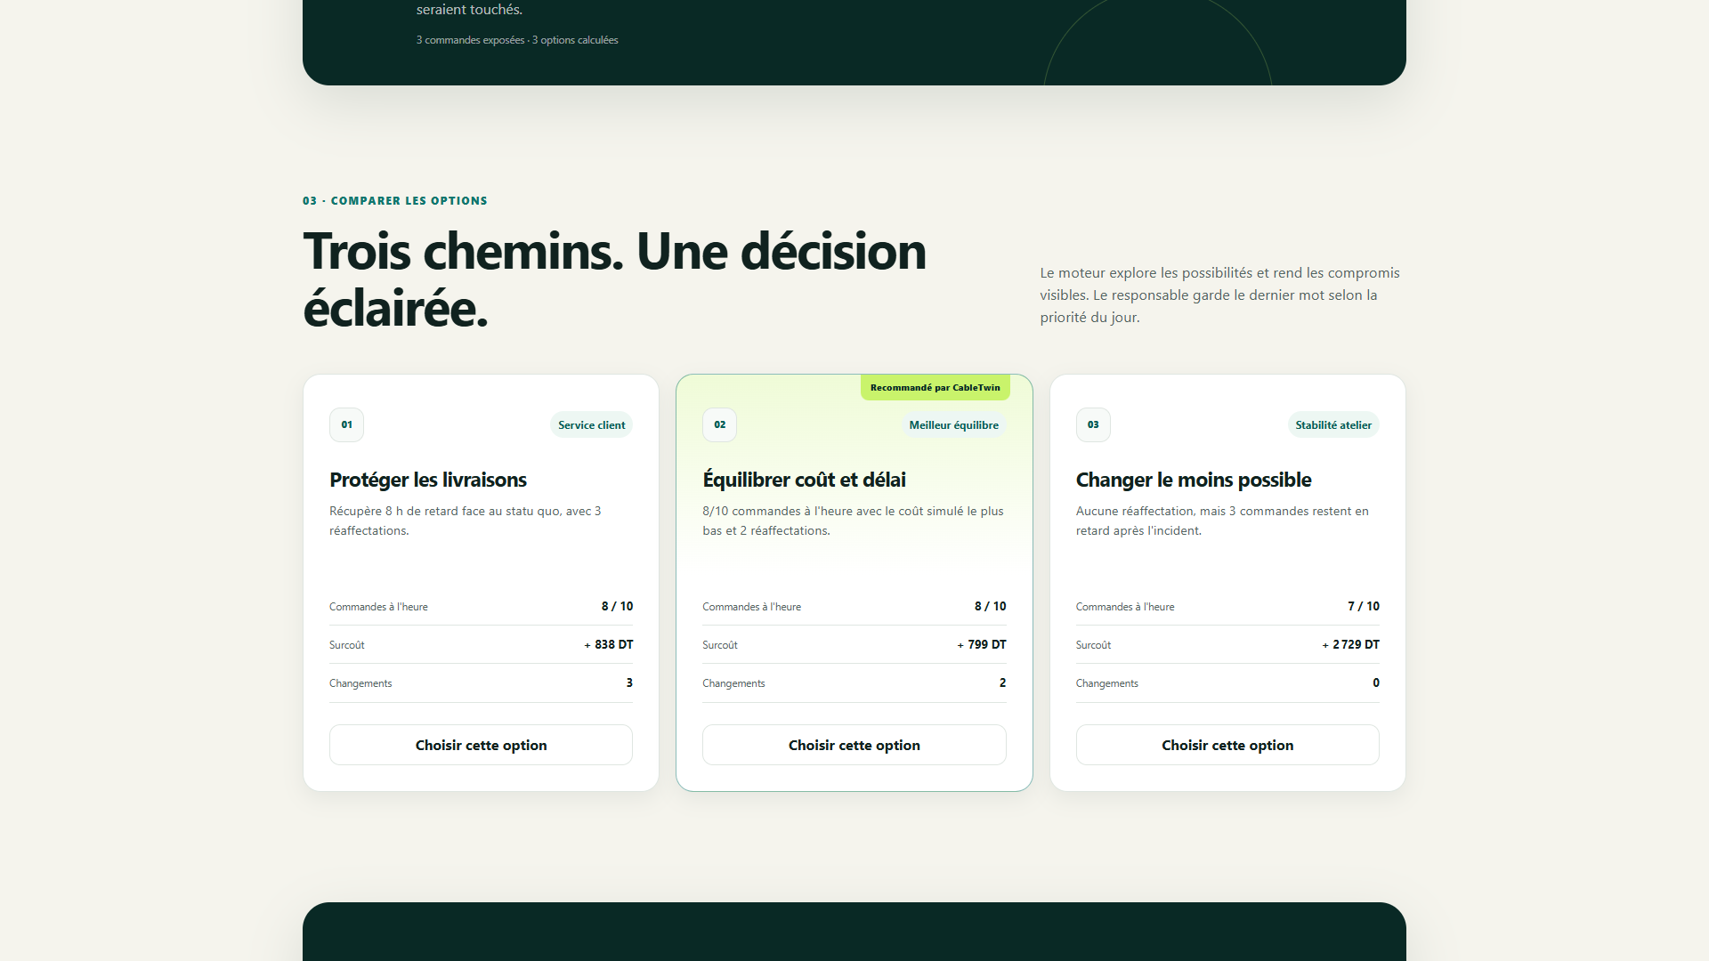
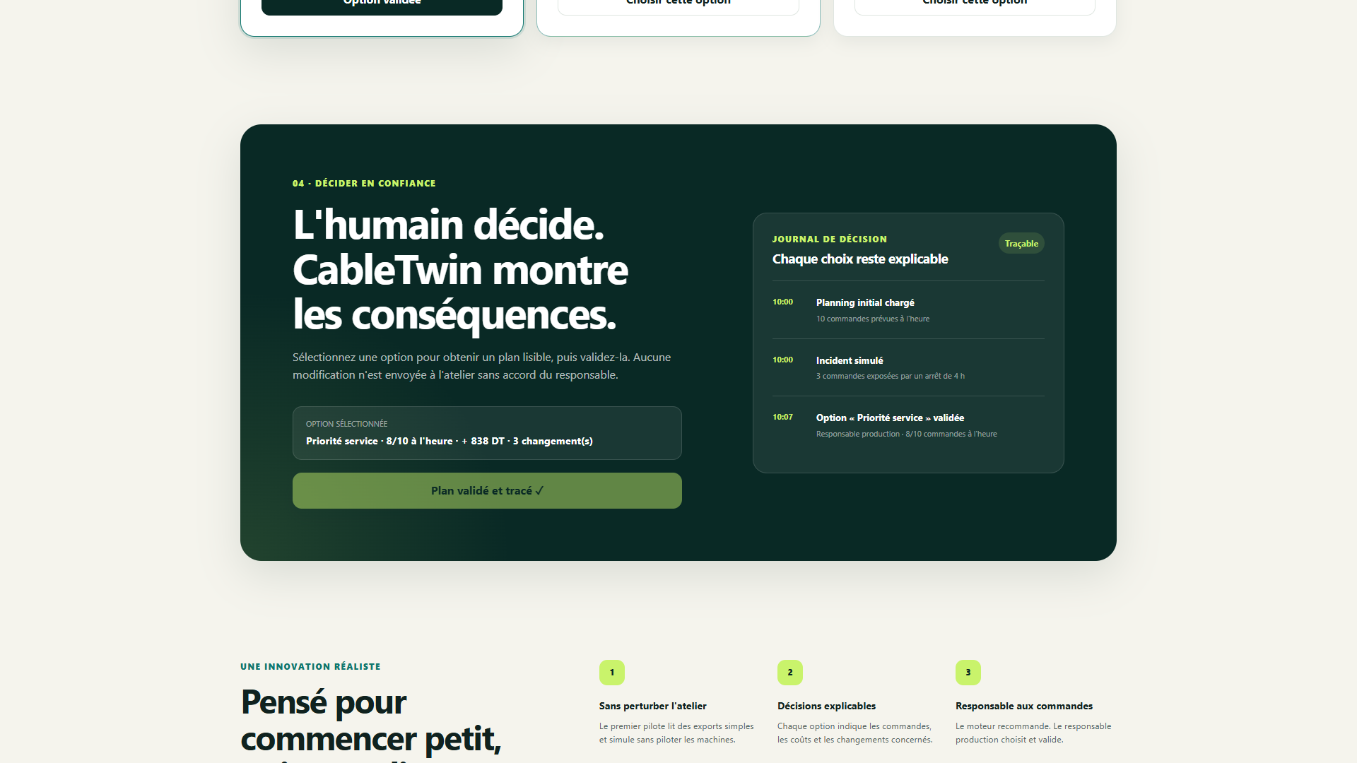
END-TO-END WORKFLOW
One end-to-end loop connects the incident to an auditable decision
01 — Understand
02 — Simulate
03 — Compare
04 — Decide
3 lines · 10/10 on time
Line 2 stops · 3 exposed
3 feasible routes · same KPI
Manager approves · audit at 10:07
The same executable path connects data, incident analysis, planning, Gantt preview, approval, audit and reset.
CableTwin · SUPCOM · Oussama Akir · Fully synthetic data
Notes:
This is the complete journey in the working build. We start from ten orders on time, trigger the four-hour stop, reveal the consequence, compare three plans, preview a revised Gantt and require the manager to approve. The final event records the choice at 10:07. Reset returns to the exact nominal state. These are post-freeze browser captures, not design mock-ups.

Slide 5
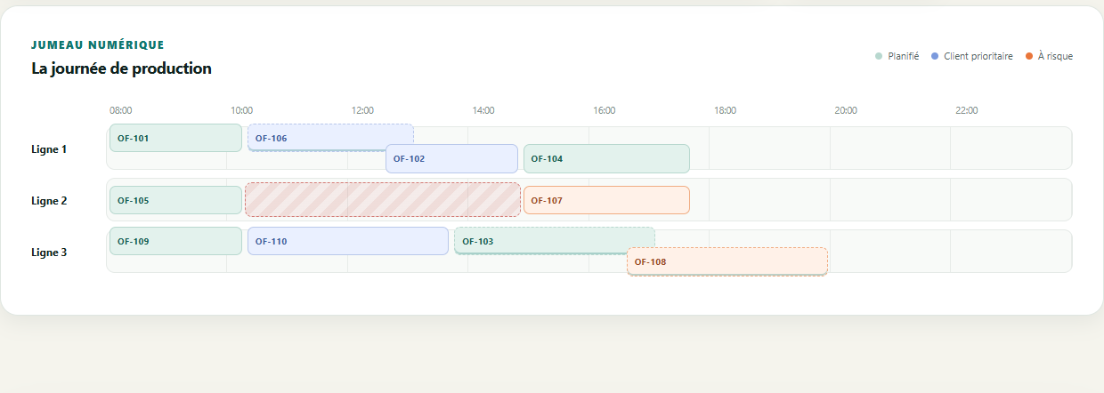
WORKING PROTOTYPE · MEASURED CONSEQUENCE
Service cuts projected delay from 620 to 140 minutes
620 → 140 min
188 → 216 km
180 → 30 min
7/10 → 8/10
projected cumulative delay
completed by 18:00 · +14.9%
overtime · −83.3%
orders on time · 3 line moves
Stability
620 min · 188 km · 0 moves
Service
140 min · 216 km · 3 moves
Cost
170 min · 216 km · 2 moves
Fixed synthetic scenario · calculated by the working prototype · not factory ROI
CableTwin · SUPCOM · Oussama Akir · Fully synthetic data
Notes:
Here is the live journey. The nominal schedule starts at ten of ten. I trigger the stop on Line 2. Without adaptation, three orders are exposed, delay reaches 620 minutes, overtime reaches 180 minutes and only 188 kilometres finish by 18:00. CableTwin calculates three routes from the same incident. Service reduces delay to 140 minutes and overtime to 30, while output reaches 216 kilometres. It accepts three line moves to protect priority-weighted delivery. Cost uses two moves and reaches 170 minutes of delay. Stability makes no move and keeps the full 620 minutes. I preview Service, inspect the revised Gantt and approve. The audit event appears; no order is sent to a machine. [Phase 3: run the live 90-second journey here; if the environment fails, narrate these frozen captures.]

Slide 6
CORE AI
The AI is the planning decision, not the dashboard
LIVE SYMBOLIC PLANNER
Decision variables
line assignment · sequence · start / end
Hard constraints
eligibility · duration · downtime · no overlap · horizon
Business policies
Service · Cost · Stability (lexicographic objectives)
INDEPENDENT BOUNDED ORACLE
17,856 candidate schedules evaluated
10,440 feasible complete schedules
3/3 displayed routes = unique policy optimum
9/9 automated checks pass
A 9/10 route exists, but creates 230 min of total delay; Service chooses 8/10 with only 140 min
because priority-weighted lateness matters. Exact for the encoded bounded demo — not factory-scale optimization.
CableTwin · SUPCOM · Oussama Akir · Fully synthetic data
Notes:
The intelligence is symbolic planning under constraints. For seven orders not complete at incident time, the engine chooses eligible lines, sequences and times. A route is rejected if it breaks compatibility, duration, downtime, non-overlap or the horizon. Service, Cost and Stability then express explicit lexicographic objectives. The browser uses a fast deterministic constructive planner. Separately, an exhaustive oracle enumerates 17,856 assignment and sequence candidates, finds 10,440 feasible schedules and confirms that all three displayed plans are the unique optima of their declared policies in this bounded scenario. That separation gives us both a usable product and an honest certificate.

Slide 7
FROM SIMULATION TO INDUSTRIAL PROOF
Simulation proves the mechanism; a shadow pilot will prove value
PROVED IN DEMO
Same incident
Same KPI definitions
Reproducible before/after
calculations
5–10 historical stoppages
Same information cutoff as the real decision
Planner-validated constraints
CableTwin vs actual historical baseline
Time, delay, output, overtime, moves, usability
PROPOSED SUCCESS GATES — targets to agree, not achieved claims
30% faster assessment · 20% lower delay · 0 hard-constraint violations · ≥70% planner usability · 100% traceability
Ends in Go · Revise · Stop
CableTwin · SUPCOM · Oussama Akir · Fully synthetic data
Notes:
I do not convert synthetic results into a factory ROI. Phase 2 proves that the workflow calculates meaningful, reproducible trade-offs. A real proof starts with five to ten past stoppages. We freeze the information available at the decision time, keep the actual decision as baseline, validate the rules with the planner and compare identical KPI definitions. Proposed gates are 30 percent faster assessment, 20 percent less delay, zero hard-constraint violations, at least 70 percent planner usability and complete traceability. The sponsor decides go, revise or stop.

Slide 8
BUSINESS VIABILITY
Start read-only in one workshop; scale only after measured proof
User: Production manager / planner Buyer: Plant or operations director Pilot: 4–6 weeks · read-only
Validate process
Map read-only data
Encode workshop constraints
Replay and shadow
Measured go / revise / stop
Manual / spreadsheet
familiar but hard to compare and trace
ERP · MES · APS
system of record / broad planning
High-fidelity twin
rich but integration-heavy
CableTwin
focused incident layer · 3 explainable routes · human approval
No prediction · no autonomous control · no write-back · no price or ROI claim
CableTwin · SUPCOM · Oussama Akir · Fully synthetic data
Notes:
The primary user is the production manager; the likely sponsor is the plant or operations director. The first engagement is deliberately small: one workshop, four to six weeks, read-only exports and five to ten historical incidents. It requires no sensors, GPU, cloud migration or machine access. CableTwin complements the systems already present. A spreadsheet remains flexible, an ERP or MES remains the system of record, an APS may already solve broad planning, and a high-fidelity twin models much more. CableTwin earns its place only where incident response is still manual, difficult to compare or weakly traced. If constraints, data or KPI value fail the gate, the pilot stops.

Slide 9
READY FOR PHASE 3
CableTwin is ready for Phase 3
25% · Business process & impact
One incident-rescheduling loop · delay, overtime and output measured
20% · Core AI
Constraint planning · 17,856-candidate independent bounded certificate
20% · Working prototype
Offline incident → routes → Gantt → approval → audit → reset · 9/9 checks
20% · Business viability
Named user and buyer · 4–6-week read-only pilot · go/no-go gates
15% · Pitch & clarity
One Waze metaphor · three routes · one human decision
Select CableTwin for the final pitch and see the complete live decision in 90 seconds.
CableTwin · SUPCOM · Oussama Akir · Fully synthetic data
Notes:
CableTwin is one coherent proof across the official grid. The process is a specific line-stoppage rescheduling decision. Impact is calculated with explicit definitions. The core AI builds constrained alternatives and is independently verified. The prototype runs end to end, offline, with nine automated checks. The business path begins with a read-only pilot and stops if evidence is not there. And the story remains simple: when a production route closes, show three feasible routes before the manager decides. Select CableTwin for Phase 3, and I will demonstrate that complete decision live in 90 seconds.

