Slide 1
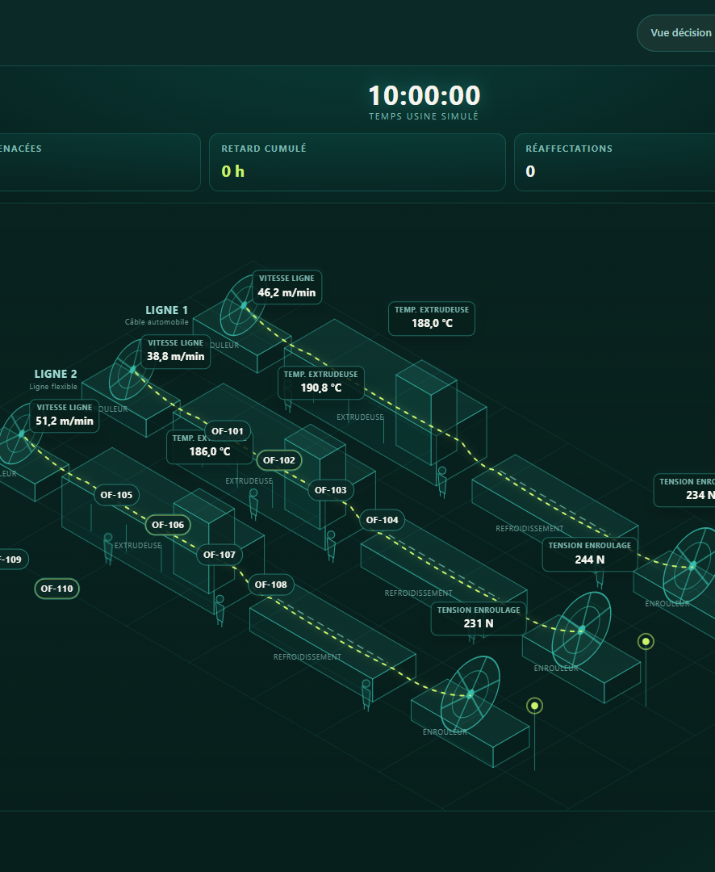
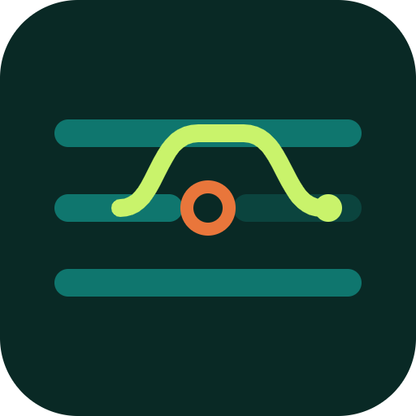
AUTOMATE OR DIE 2026 · INDUSTRY · ROOM 206
When one line stops,
CableTwin shows the recovery routes
before production changes.
One disruption. Three verified routes. One accountable human decision.
9 / 9
17,856 → 10,440
PLANNER & WORKFLOW CHECKS
CANDIDATES → FEASIBLE
Oussama Akir · SUPCOM
akir.oussama@gmail.com
Notes:
At 10:00, one production line stops. A schedule that was valid one minute ago is now impossible. CableTwin shows three verified recovery routes before production changes, while the production manager keeps the final decision.

Slide 2
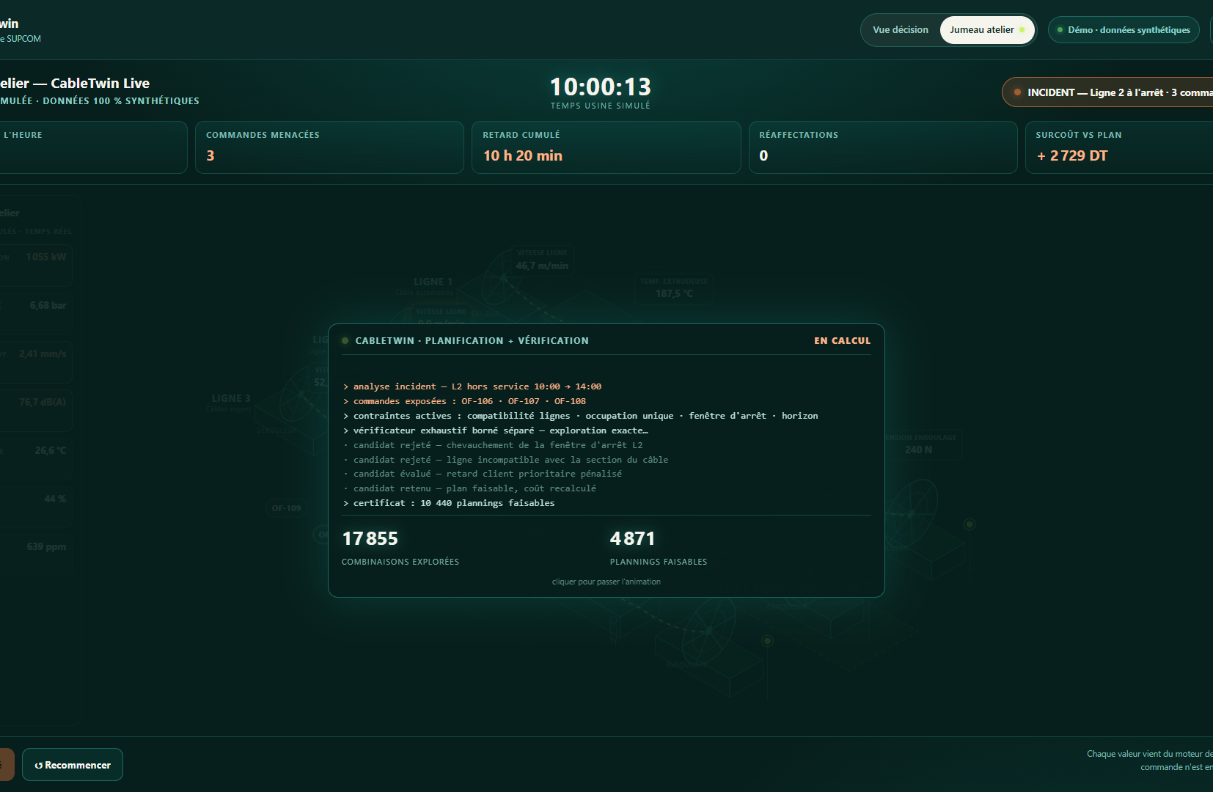
PROBLEM / OPPORTUNITY
02
A line stoppage threatens an export-driven industrial day.
115
107
TUNISIAN WIRE, CABLE & HARNESS FIRMS
TOTALLY EXPORTING
72,281
JOBS IN THE SEGMENT
A stoppage does not stop only one machine; it invalidates today's delivery commitments.
10:00 · 3 orders exposed · 620 min projected delay
The pain is real as a process; frequency and loss remain plant-specific pilot questions.
CableTwin · SUPCOM · Oussama Akir · Fully synthetic demonstration
Source: APII, June 2026 · tunisieindustrie.nat.tn
Notes:
Tunisia's cable, wire and harness segment counts 115 firms of ten employees or more; 107 are fully exporting, supporting 72,281 jobs. In this fully synthetic scenario, Line 2 stops for four hours, exposing three orders. Without adaptation, projected delay reaches 620 minutes. The process risk is real; plant frequency and loss are pilot questions, not claims.

Slide 3
VALUE PROPOSITION
03
One line stops. Three verified routes. One human decides.
The learned advisor ranks existing routes; it never creates or edits one.
01 · INCIDENT
02 · PLAN
03 · VERIFY + ADVISE
04 · AUTHORITY
Simulated twin
Constraint planner
Separate evidence
Production manager
→
→
→
Line 2 stops
10:00–14:00
Builds Service, Cost
and Stability routes
Verifier cross-checks
ML ranks the 3 routes
Preview · compare
approve or reject
Synthetic telemetry
Deterministic · non-learning
Bounded + advisory
No machine command
17,856
10,440
3
687
93.6%
LOCAL · OFFLINE · READ-ONLY
candidates
feasible
policy optima
twin-simulated incidents
held-out synthetic grid
9/9 planner checks · 5/5 ML checks · explicit human authority
CableTwin · SUPCOM · Oussama Akir · Fully synthetic demonstration
Fully synthetic demonstration · no plant-performance claim
Notes:
CableTwin builds Service, Cost and Stability routes with a deterministic, non-learning planner. A separate local model only ranks those existing routes. A separate bounded verifier cross-checks the encoded scenario. The manager previews the trade-offs, approves or rejects, and leaves an audit trace. The innovation is this evidence architecture, not the phrase digital twin.

Slide 4
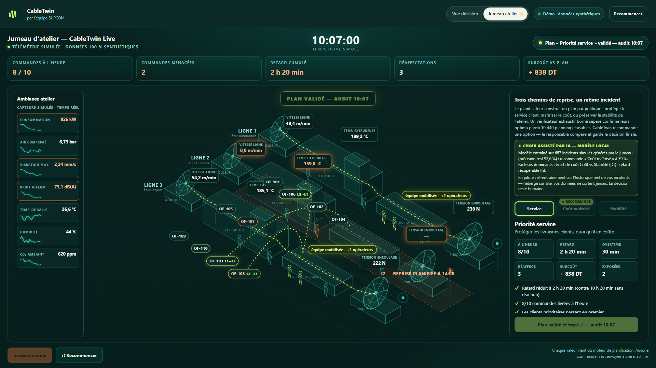
SECRET SAUCE / WORKING DEMO
04
In 30 seconds, the twin reaches an auditable choice.
LIVE DEMO
1
Trigger Line 2 stop
2
See three routes + local ML suggestion
3
Manager overrides to Service
4
Approve · audit 10:07
17,856
10,440
candidates
feasible
CableTwin · SUPCOM · Oussama Akir · Fully synthetic demonstration
Public live product · fully synthetic data
Notes:
LIVE DEMO - maximum 30 seconds. Line 2 stops. Three orders are exposed; delay rises to ten hours twenty. The local model suggests Cost, but cannot change a schedule. I choose Service to protect priority deliveries: projected delay falls to two hours twenty. I approve. The decision is audited at 10:07, and nothing is sent to a machine. If the network fails, narrate the approved screenshot with the same four beats.

Slide 5
BUSINESS MODEL
05
Monetization follows evidence, not promises.
USER
BUYER
BEACHHEAD
Production manager / planner
Plant or operations director
Tunisian cable & electrical plants
01
02
03
04
Design partner
Paid shadow pilot
Configuration + integration
Per-site subscription
Validate the decision and data contract
Read-only, 4-6 weeks, agreed KPIs
Only after measured pilot value
Commercial hypothesis to validate
Pricing, conversion and ROI are pilot questions. No customer, revenue or savings are claimed today.
CableTwin · SUPCOM · Oussama Akir · Fully synthetic demonstration
Notes:
The user is the production planner; the buyer is the plant or operations director. We start with a design partner, then a paid read-only shadow pilot. Configuration, integration and a per-site subscription follow only after measured value. Price and ROI remain hypotheses.

Slide 6
GO-TO-MARKET
06
Start read-only in one workshop; earn the right to integrate.
4-6 WEEKS
One bounded shadow pilot
WEEK 0
WEEKS 1-2
WEEKS 3-4
WEEKS 5-6
Map
Replay
Shadow
Decide
Data contract + planner-validated constraints
5-10 historical incidents at the same information cutoff
Compare CableTwin options with actual decisions
Go · revise · stop
Pilot gates to agree
faster assessment · lower delay · 0 constraint violations · planner usability · 100% traceability
Targets to agree - not achieved claims
CableTwin · SUPCOM · Oussama Akir · Fully synthetic demonstration
Notes:
The pilot lasts four to six weeks. We map constraints, replay five to ten historical incidents at the same information cutoff, then compare CableTwin's options with actual decisions in shadow mode. Agreed KPIs decide: go, revise, or stop. This is how integration is earned.

Slide 7
COMPETITIVE ANALYSIS
07
Enterprise APS proves the category; CableTwin lowers the first step.
Manual / spreadsheet
Immediate and familiar
Hard to compare constraints, alternatives and audit consistently
ERP · MES · APS · virtual twin
Broad, mature and integration-ready
A larger deployment and data foundation than our first adoption wedge
CableTwin
One disruption · three verified routes
Local read-only shadow mode; integrate where useful - step aside where existing APS already solves it
Differentiation = deterministic planner + advisory ML + separate bounded verifier + explicit human authority
CableTwin · SUPCOM · Oussama Akir · Fully synthetic demonstration
Sources: Siemens Opcenter APS · Dassault Systèmes DELMIA Ortems
Notes:
This is not a no-competitor story. Siemens and DELMIA prove the category. They are broader and more mature. CableTwin lowers the first step: one disruption, transparent alternatives, a limited data contract and no write access. If an existing APS already solves it, CableTwin integrates - or steps aside.

Slide 8
TEAM
08
One accountable builder delivered the full loop.
PHASE 1
DAY 2
DAY 3
NEXT
Focus
Build
Defend
Validate
Oussama Akir
One stoppage decision
Public twin + evidence
4-minute selection pitch
Plant design partner
SUPCOM · solo participant
Product · industrial workflow · constraint engine · ML · verification · isometric twin · deployment · evidence
The next team extension is not a fictional org chart.
It is one real plant design partner and its production planner.
CableTwin · SUPCOM · Oussama Akir · Fully synthetic demonstration
Notes:
I built the full loop as a solo participant: workflow, planner, learned advisor, verifier, interface, public deployment and evidence. That proves execution, not solo scale. The next team extension is one real plant design partner and its production planner.

Slide 9
FINANCIALS / KEY FIGURES
09
No fantasy forecast: the first commercial numbers must be earned.
0
0
0
This is a strength, not a gap we hide.
Synthetic product evidence is not customer evidence.
SIGNED PILOTS
REVENUE
ROI CLAIMS
PROVED NOW
EARNS REVENUE NEXT
Public working product
9/9 planner + 5/5 ML checks
17,856-candidate bounded verification
One design partner
One paid-pilot hypothesis
Price and scale validated after measured value
Commercial discipline: prove value first; price second; scale third.
CableTwin · SUPCOM · Oussama Akir · Fully synthetic demonstration
Notes:
Today: zero signed pilots, zero revenue, zero ROI claims. Synthetic evidence is not customer evidence. What is proved is a public product, nine of nine planner checks, five of five ML checks, and bounded verification. Commercial numbers must be earned.

Slide 10
CURRENT STATUS / ACTION
10
Built now. Validate next. Scale only after proof.
NOW
Working public prototype
Decision twin · local ML guidance · bounded verifier · human approval
NEXT
One 4-6-week shadow pilot
Read-only data · 5-10 incidents · planner-validated constraints
THEN
Integrate only if KPIs pass
Configuration · site deployment · subscription hypothesis
Select CableTwin for the Grand Finale - and connect one Tunisian plant design partner.
hackaton-automate-or-die.vercel.app/#twin
github.com/akiroussama/hackaton_automate_or_die
Notes:
CableTwin is built and public. Next is one read-only Tunisian shadow pilot. If agreed KPIs pass, we integrate and scale. My ask: select CableTwin for the Grand Finale, and connect one cable or electrical plant design partner who will challenge the constraints with real history.

