Slide 1
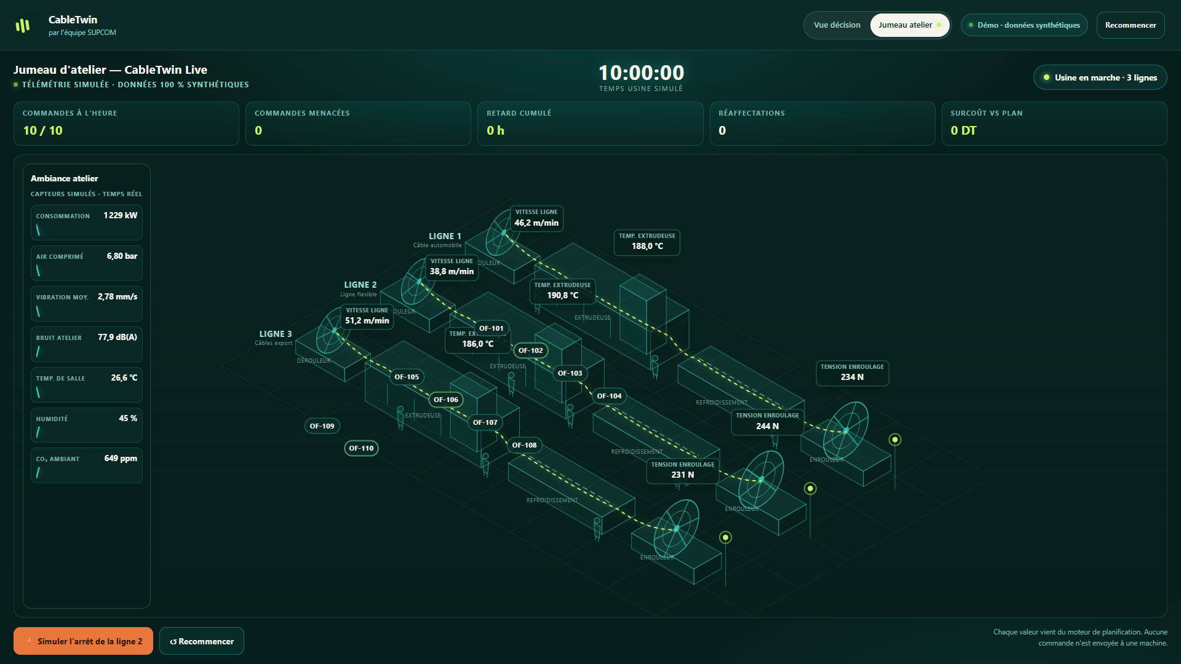
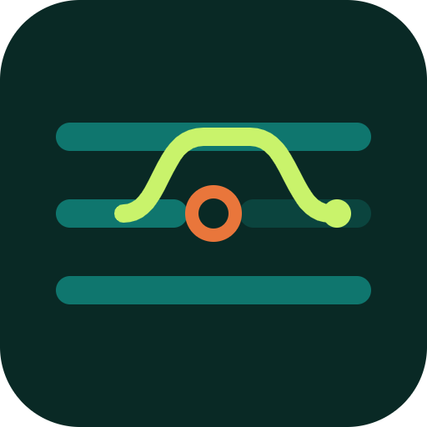
CABLETWIN · SUPCOM
AUTOMATE OR DIE · DAY 2
LIVE WORKSHOP TWIN
One line stops.
CableTwin shows three
verified recovery routes.
Deterministic planning · local learned guidance · human authority
17,856
10,440
≈79%
CANDIDATES EVALUATED
FEASIBLE SCHEDULES
COST SUGGESTED
Synthetic factory · read-only · no machine control
Notes:
Open with the decision, not the interface: one line stops and the manager needs defensible recovery options now.
CableTwin combines a living synthetic workshop twin, deterministic planning, a separate local learned recommender and a separate bounded verifier.
The human production manager always decides.

Slide 2
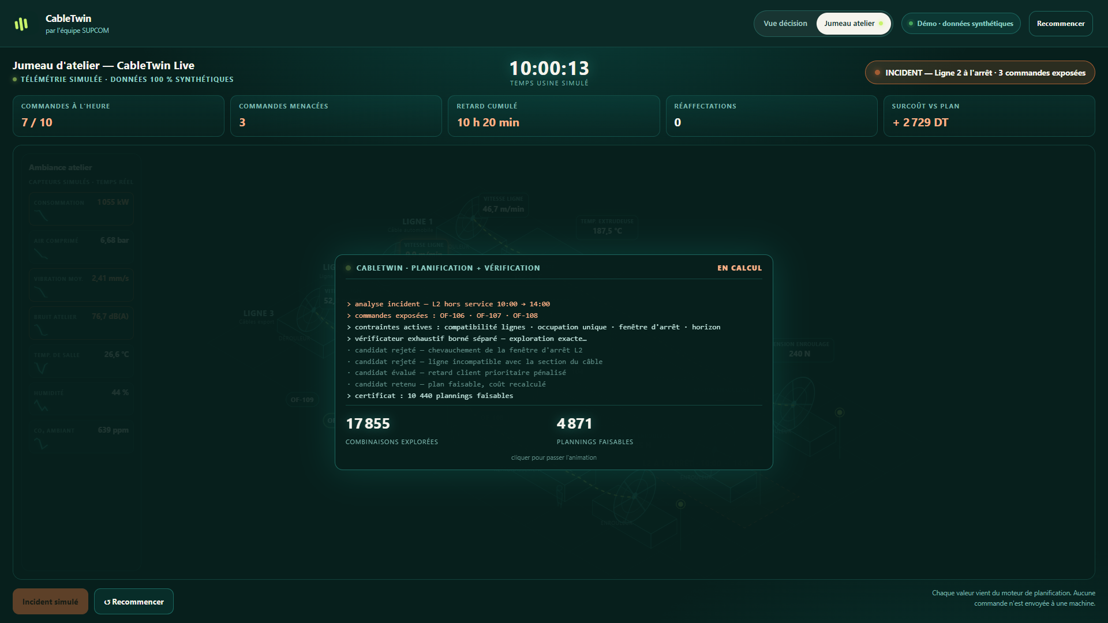
CT
CABLETWIN
02
INCIDENT
At 10:00, Line 2 stops for four hours.
Without action, the factory accumulates 620 minutes of delay.
SIMULATED INCIDENT
10 h 20
TOTAL DELAY
3
7 / 10
ORDERS EXPOSED
ON TIME
The twin does not guess.
It replays constraints, evaluates schedules and exposes the trade-off before any decision.
Notes:
The workshop twin receives a fully synthetic Line 2 stoppage from 10:00 to 14:00.
The immediate impact is 620 minutes of delay, three exposed orders and only seven of ten orders on time.
The system is decision support: no command is sent to a machine.

Slide 3
CT
CABLETWIN
03
LIVING TWIN
A living decision twin—not a decorative 3D model.
Telemetry, orders, constraints and consequences stay in one operational picture.
01
AMBIENT SIGNALS
Power, vibration, pressure and temperature make the event legible.
02
PRODUCTION CONTEXT
Three lines and ten synthetic orders remain visible while the clock advances.
03
DECISION BOUNDARY
Every value comes from the planner; nothing is sent to a machine.
Notes:
This is the product leap in Day 2: the factory twin is live and time-based.
It keeps physical context, production context and the safety boundary visible in the same frame.
All telemetry, operators, orders and incidents shown here are synthetic.

Slide 4
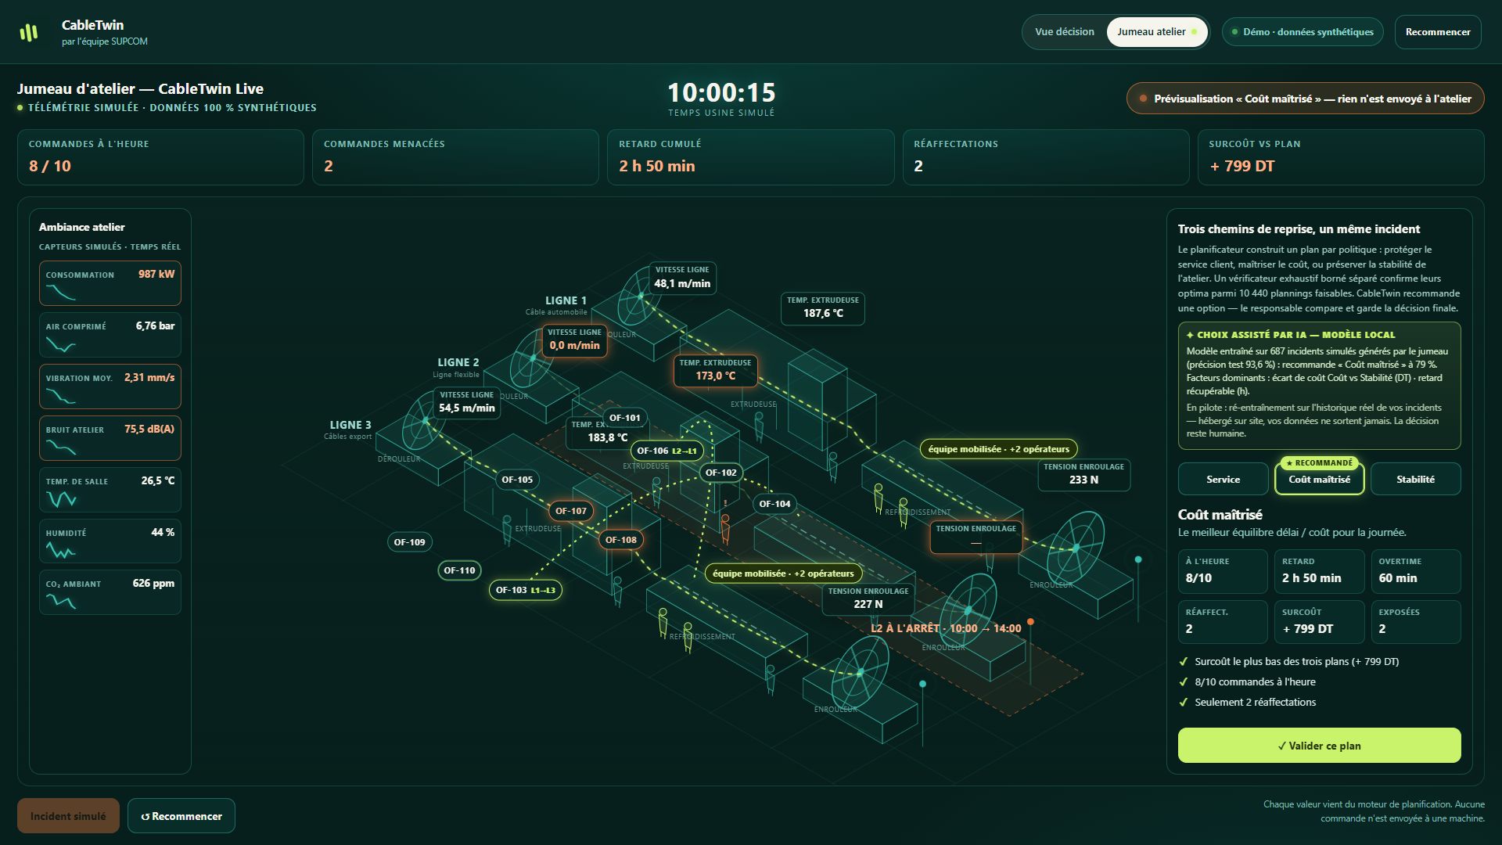
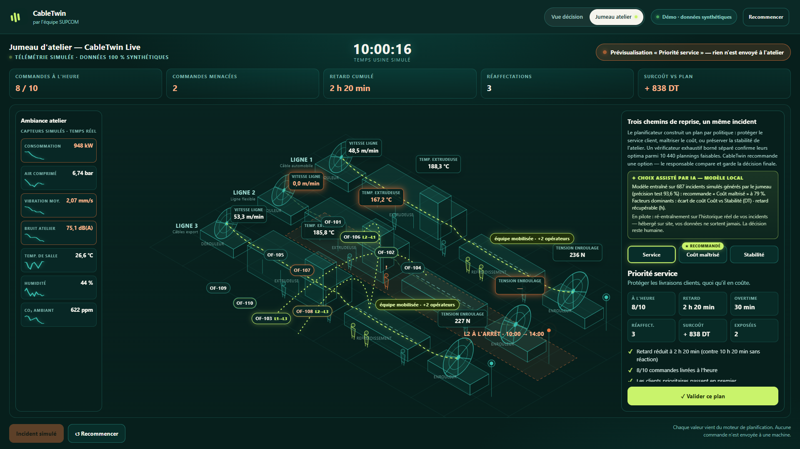
CT
CABLETWIN
04
HUMAN-CENTRED AI
The model suggests. The manager decides.
CableTwin separates recommendation from authority—and preserves both traces.
MODEL SUGGESTS
HUMAN CHOOSES
COST · ≈79% CONFIDENCE
SERVICE · MANAGER OVERRIDE
687 synthetic incidents generated by the twin itself · 16 explainable features · 93.6% held-out synthetic test accuracy
Notes:
The local learned recommender is separate from the deterministic planner. It never creates or changes schedules.
For the canonical incident, it suggests Cost at approximately 79 percent confidence.
The manager can still choose Service. The interface keeps both facts visible: what the model suggested and what the human selected.

Slide 5
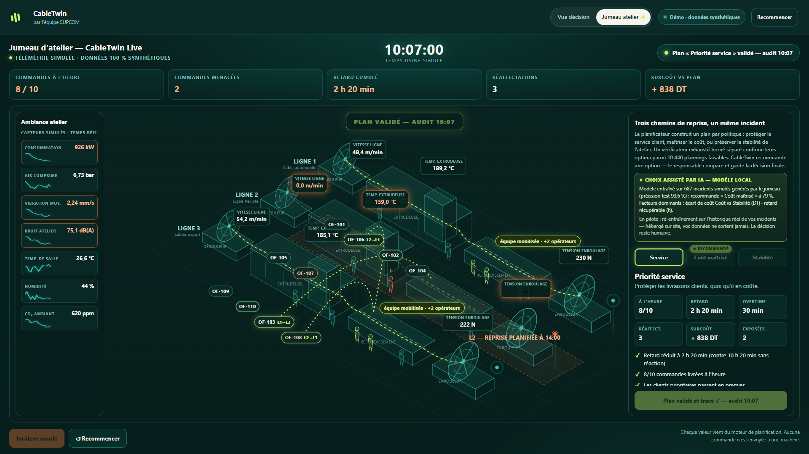
CT
CABLETWIN
05
TRACEABILITY
A human choice becomes an auditable recovery plan.
The selected route is approved once—and recorded without rewriting the recommendation.
APPROVED · 10:07
Human authority
The production manager confirms the selected strategy.
Decision trace
Model suggestion retained
Human selection retained
Approval time retained
No machine control
Read-only decision support.
Notes:
Approval writes an auditable decision record without modifying the proposed schedule.
The recommendation, the human selection and the approval time remain distinguishable.
CableTwin is read-only decision support; the product has no machine-control path.

Slide 6
CT
CABLETWIN
06
DECISION ARCHITECTURE
Three intelligence layers. One accountable decision.
Each layer has a bounded job—and the human remains the authority.
01
02
03
04
DETERMINISTIC
PLANNER
LOCAL LEARNED
RECOMMENDER
BOUNDED EXACT
VERIFIER
PRODUCTION
MANAGER
Builds Service, Cost and Stability schedules from explicit constraints.
Scores the three ready-made schedules. Never creates or changes a plan.
Enumerates the canonical space without reusing planner construction logic.
Compares routes, applies operational judgment and approves one.
9/9 product checks
687 incidents · 93.6%
17,856 → 10,440
Final authority
SHARED SAFETY SURFACE
Validation and KPI functions are shared; planner construction and bounded enumeration stay separate.
Notes:
Be precise about the architecture.
The planner is deterministic and non-learning. The recommender is a separate local softmax model that scores already-built routes.
The bounded exhaustive verifier does not reuse planner construction logic, but it does share validation and KPI functions. It is not presented as fully independent.
The fourth layer is the production manager, who owns the final decision.

Slide 7
CT
CABLETWIN
07
VERIFIED OPTIONS
There is no fake “best” plan—only an explicit trade-off.
All three displayed policies are unique optima for the fixed synthetic scenario.
SERVICE
COST
ML SUGGESTS · ≈79%
STABILITY
Protect deliveries
Minimize illustrative cost
Avoid reassignments
140 min
8/10
170 min
8/10
620 min
7/10
TOTAL DELAY
ON TIME
TOTAL DELAY
ON TIME
TOTAL DELAY
ON TIME
30 min
3
60 min
2
180 min
0
OVERTIME
REASSIGNMENTS
OVERTIME
REASSIGNMENTS
OVERTIME
REASSIGNMENTS
216 km output
1,971.15 DT
216 km output
1,931.45 DT
188 km output
3,862.20 DT
The demo manager selects SERVICE
Notes:
The three routes make the decision transparent instead of hiding it inside one optimization score.
Service minimizes priority-weighted lateness; Cost minimizes the illustrative synthetic cost; Stability minimizes reassignments.
The local model suggests Cost for this incident, while the demo manager selects Service.
DT values are synthetic comparison outputs, not quoted factory savings or commercial ROI.

Slide 8
CT
CABLETWIN
08
EVIDENCE & PILOT
Evidence first. A real-site learning loop only after permission.
The prototype is complete today; the pilot remains deliberately read-only.
WORKING EVIDENCE
4–6 WEEK SHADOW PILOT
9 / 9
5 / 5
01
READ-ONLY
Connect historical exports; no machine control.
PLANNER & WORKFLOW CHECKS
SEPARATE RECOMMENDER CHECKS
02
SITE-HOSTED
Data and inference remain on the plant site.
0
0
3
03
GATED LEARNING
Retrain only after sufficient real incident history.
EXTERNAL REQUESTS
CONSOLE ERRORS
UNIQUE OPTIMA
04
SEPARATE HOLDOUT
Promote only after an agreed validation threshold.
Reproduce in three commands
npm run check
npm run check:recommender
npm run benchmark:exact
Notes:
Keep the test claims separate: nine of nine checks cover the planner and workflow; five of five separately cover the recommender.
The browser evidence records zero external network requests and zero console errors.
A real-site pilot is read-only and hosted on site.
The model would be retrained only after sufficient incident history exists and would require a separate holdout gate before promotion.

Slide 9
CABLETWIN
by Team SUPCOM
LIVE NOW
THE ASK
See tomorrow
before deciding today.
Select CableTwin
for the final pitch.
A living factory twin that turns disruption into verified options—and keeps the human in command.
Then let us run a
read-only shadow pilot
with one planning team.
hackaton-automate-or-die.vercel.app/#twin
HUMAN-IN-COMMAND
90-second live decision journey
Automate or Die · Industry · Production Planning & Supply Chain Optimization
Notes:
Close on the product promise: see tomorrow before deciding today.
Invite the jury to open the live twin, trigger the incident, compare the routes and approve a decision.
The ask is simple: select CableTwin for the final pitch, then validate the workflow in a read-only shadow pilot with one planning team.

