Slide 1

Exploratory Data Analysis
G2M insight for Cab Investment firm
21-Jul-2022

Slide 2

Agenda
Executive Summary
Problem Statement
Approach
EDA
EDA Summary
Recommendations

Slide 3
Executive Summary
This presentation/report investigates which company, between Yellow Cab and Pink Cab, is better investment prospect for XYZ investment firm.
The results and final recommendation are backed by the extensive analysis of data regarding the two companies, their customers and their transactions.
The exploratory analysis focused on the companies’ profit and their customers’ profile after forming suitable hypotheses.
Upon the analysis, Yellow Cab has been deemed more appropriate and safer for investment as it is far more profitable and it has a large number of “regular/loyal” customers. Furthermore, the demand for its services is higher than Pink Cab’s at all times of the year and in most major cities. Lastly, Yellow Cab has a higher profit margin per ride than Pink Cab, which can be lowered, if needed, in order to further broaden the margin in customer reach.

Slide 4
Problem Statement
Background: Due to the rapid growth of the Cab industry in the US over the past few years, the private firm XYZ is interested in investing in one of its key players.
Objective: To provide an understanding of the market and to identify the right company to invest in, between the two candidates of Pink Cab and Yellow Cab.
The analysis makes use of four large datasets containing data gathered from 31/01/2016 to 31/12/2018 and document:
customer details of the 2 companies (Customer_ID.csv)
cab ride details of the 2 companies (Cab_Data.csv)
transactions details of the rides (Transaction_ID.csv)
demographic and cab usage information on USA cities (City.csv)

Slide 5
Approach
Structure the data in a better format and perform various checks about whether it is ready to use for the analysis (e.g. ensure duplicates are removed)
Understand the data and its key features by basic analysis.
Form hypotheses about the market and the companies’ profitability and customer base.
Test the hypotheses by further analysing the data.
Form conclusions about the market and the two companies at task
Provide recommendations to XYZ supported by the analysis

Slide 6
EDA (Data & Assumptions)
Data includes a total of 13 features (3 of them derived) providing detailed information on 359392 cab rides (date & city of travel, cost, price , length as well as some customer data). The analysis also uses demographic and cab usage data on the 19 cities the cab rides take place.
The data corresponds to the time period from 2016-01-31 to 2018-12-31.
We have assumed that the profit of a ride is calculated by subtracting its cost from the price charged to the customer. (We have no information as to how “cost” is calculated”).
The outliers in “Price charged” (vast majority account for rides with profit margin between 1.57 and 3.2) have not been removed as we assume that such a profit margin can occur in various scenarios in the city, such as taxis being stuck in a big traffic jam and charging the customer based on the time of the ride, rather than the distance travelled. We also assume that few instances of losses from short rides may occur for various reasons (e.g. promotions or deals & partnerships with other companies).
In order to gain insight into the companies’ customer bases, we have assumed a customer as “regular/loyal” to a company, if they have chosen to use its services at least 3 times, and if they prefer it over the other company at least 80% of the time.

Slide 7
EDA (Hypotheses & Areas of investigation)
Which company has maximum cab users at any particular time period?
Is there any seasonality in the demand for cab services?
Is the profit margin positively correlated to the number of customers?
Which company has the most "loyal"/“regular" customer base?
Which features are and which aren't correlated to the preference of a company?
Which company is more profitable and more worth investing on?

Slide 8
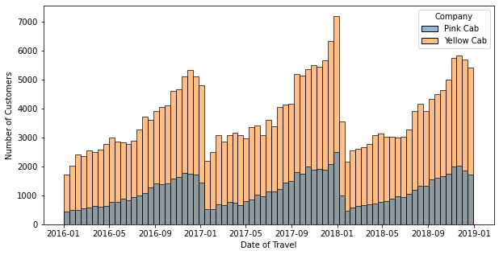
EDA (Customer Profile Analysis)
The analysis shows that Yellow Cab has operated more routes than Pink Cab every month inside the 3-year period (2016-2018) and that overall demand for the services of both companies peaks at the end of each year, then dropping suddenly right after. (Possibly due to winter holidays taking place in December)

Slide 9
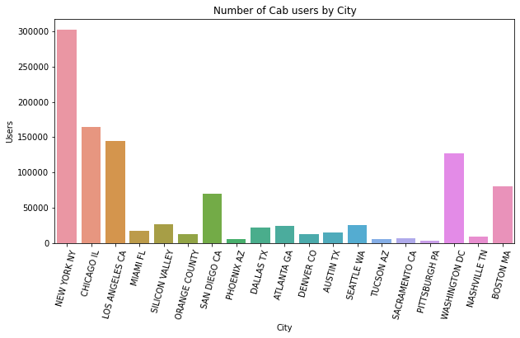
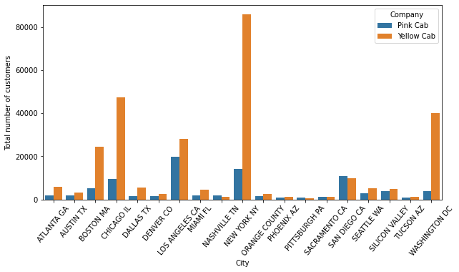
EDA (Customer Profile Analysis)
The cities with sizeable market share (between all Cab companies) are New York, Chicago, Los Angeles, Washington, Boston and San Diego. Yellow Cab are a more popular customer option in all of them, except for San Diego.

Slide 10
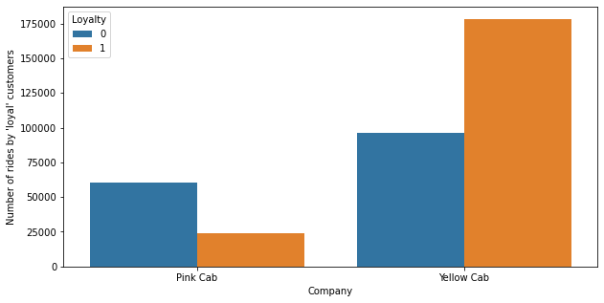
EDA (Customer Profile Analysis)
The graph below illustrates the number of cab rides taken by regular customers for each company (0 denotes a cab ride taken by a “non-regular” customer and 1 denotes a ride taken by a regular).
The numbers strongly suggest that Yellow Cab has a larger customer base than Pink Cab. This is of importance because “regular/loyal" customers use taxis at least somewhat often and are unlikely to switch their preferred Cab company. Because of that, the number of rides taken by “regular” customers (orange in graph), is not expected to change dramatically over the near future so it provides a good indication of a company’s services’ demand in the future.

Slide 11
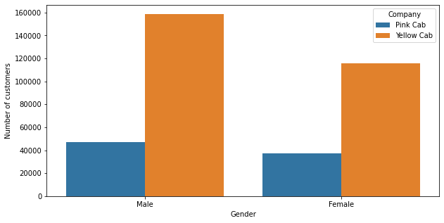
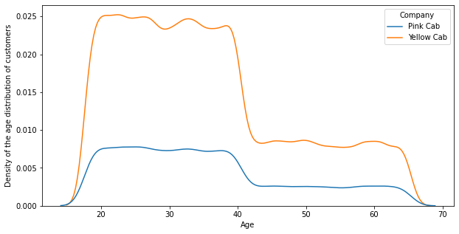
EDA (Customer Profile Analysis)
The first figure distinguishes the cab rides based on the gender of the customer (bottom left) and the second one presents the density of the age of the customers (bottom right). The numbers of the companies observed in the first figure are proportional to their overall customer numbers and the age density graphs follow a similar pattern. This suggests that there is no significant connection between the gender age of a customer and their choice of company.

Slide 12
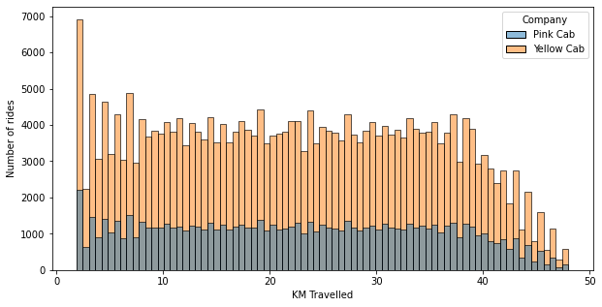
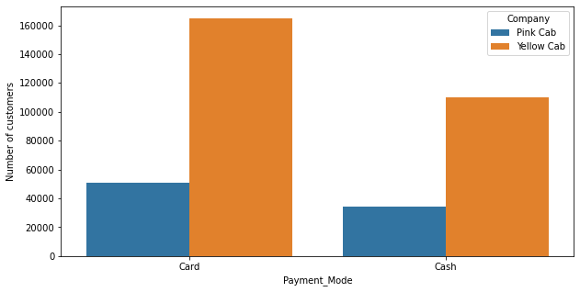
EDA (Customer Profile Analysis)
Likewise, the data suggest that the distance travelled on a ride or the preferred payment method of a customer do not appear to affect their preferred company.

Slide 13
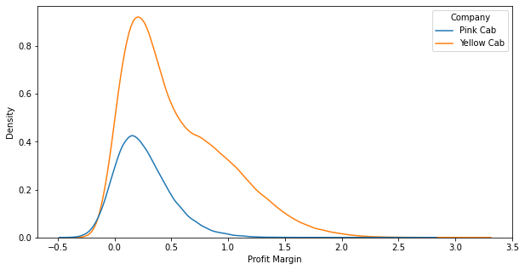
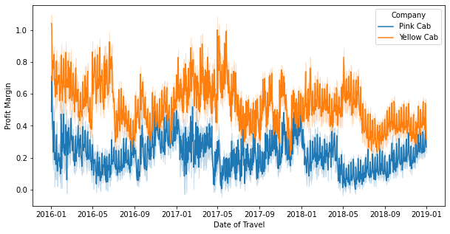
EDA (Profit Analysis)
Overall, Yellow Cab enjoys a slightly higher profit margin on it's rides. According to the second plot, the difference in profit margin of the two companies spikes during the summer but gets smaller towards the end of the year. This is particularly interesting as the end of the year is when customer numbers peak for both companies. The analysis shows that Yellow Cab’s profit margin does not increase when their customer numbers do. However the hypothesis is true for Pink Cab.

Slide 14
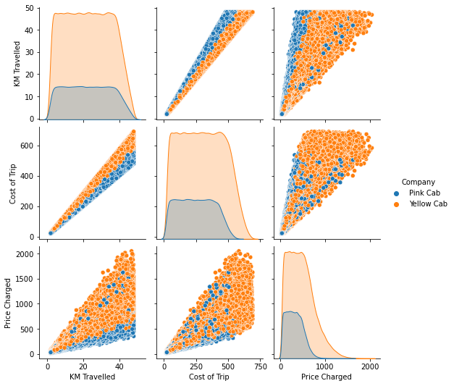
EDA (Profit Analysis)
Investigating the underlying reasons for Yellow Cab’s higher profit margin, we observe that for the same distance travelled, the cost of the trip is almost the same for both companies. Hence, it is the higher prices Yellow cab charges that explain the differences in profit margin. The fact that Yellow Cab charges higher prices and still has more customers may indicate a high quality of service from their part.

Slide 15
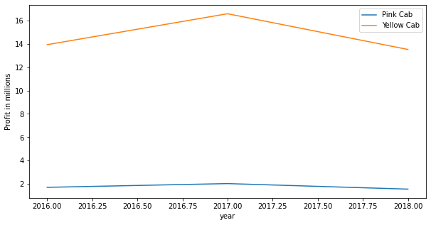
EDA (Profit Analysis)
The plot shows the yearly profit of the companies (in millions). Yellow Cab's revenue is about 7 times higher than Pink Cab's but that it has decreased over the year of 2018.

Slide 16
EDA Summary
The data collected was generally clean and of high quality, hence trustworthy. Analysing the data showed that:
Yellow Cab has had a higher number of customers compared to Pink Cab in any given month during the time period 2016-2018.
With the exception of San Diego, Yellow Cab dominates the market (compared to Pink Cab) in all major cities-markets.
Factors such as age, gender, preferred payment method or length of route don’t influence the customer’s choice of cab company to use.
Yellow Cab has a larger customer base with most of it’s rides taken by “regular” customers.
Yellow Cab is almost seven times more profitable than Pink Cab based on both total profit. This difference is attributed both in Yellow cab’s higher number of customers but also in Yellow Cab’s higher profit margin per ride.

Slide 17
Recommendations
Based on the EDA and the reasons below, Yellow Cab is recommended for investment.
Most of its rides are taken by “regular” customers who are likely to continue to use Yellow Cab regularly (so investment is safer).
Yellow Cab retains its high customer numbers while charging high prices, an indication of high customer satisfaction/quality of services. This also means that Yellow Cab can more easily lower the prices charged, while still making profit, in order to increase customer reach or in case of customer dissatisfaction.

Slide 18
Thank You

