Slide 1
EMOTION CLASSIFICATION FROM VOICE NOTES
Deep Learning 6303
Akshat, Xiao, Adhithya

Slide 2
Overview
Project Goal
Description of Dataset/EDA
Models and Experimental Setup
Results
Performance Comparison and Final Analysis
References

Slide 3
Project Goal
RAVDESS Audio Dataset
Contains 24 actors: 12 males, 12 females producing 60 voice notes each in different tones.
Goal is to build and compare performance of different models to classify voice notes into different emotion classes.
Historically, CNN has performed optimally on such datasets due to pattern recognition capability.
We will try to achieve similar or better performance using LSTM or Elman RNN.

Slide 4
Description of Dataset
The RAVDESS audio dataset is a collection of audio files and their corresponding transcripts.
The audio files were recorded in a variety of environments and situations, including phone calls, interviews, and meetings.
The dataset was created to be used for automatic speech recognition (ASR) and natural language processing (NLP) research and development.
Labels are provided within the file name
Example: 03-01-08-01-01-01-15.wav
We have used the dataset to classify emotions into 8 target classes : Neutral, Calm, Happy, Sad, Angry, Fearful, Disgusted, Surprised.
Notes:
Modality (01 = full-AV, 02 = video-only, 03 = audio-only). - All files are 03.
Vocal channel (01 = speech, 02 = song). - All files are 01.
Emotion (01 = neutral, 02 = calm, 03 = happy, 04 = sad, 05 = angry, 06 = fearful, 07 = disgust, 08 = surprised).
Emotional intensity (01 = normal, 02 = strong).
Statement (01 = "Kids are talking by the door", 02 = "Dogs are sitting by the door").
Repetition (01 = 1st repetition, 02 = 2nd repetition).
Actor (Odd numbered actors are male, even numbered actors are female).

Slide 5
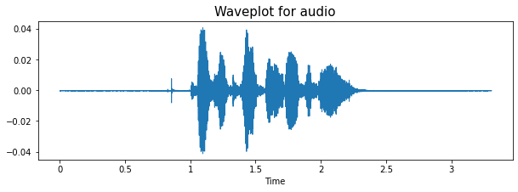
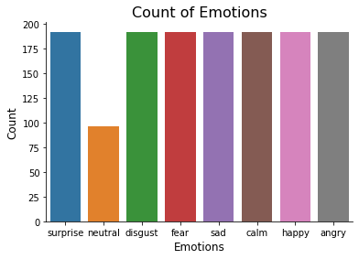
EDA of Dataset

Slide 6
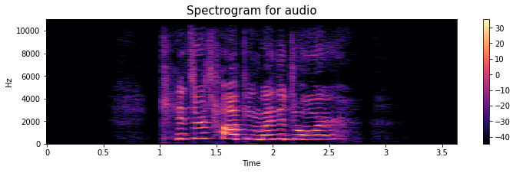
EDA of Dataset
Mel-Spectrogram Value Extraction

Slide 7
Data preprocessing
Using Python Package Librosa for Audio Pre Processing.
Feature Extraction :
Extract Mel Spectrogram values.
Helps in capturing frequency and pitch changes in voice notes.
Useful in cases of tone detection.
Data Augmentation :
Noise Injection
Stretch
Shift
Pitch
Padding
Normalization
One Hot Encoder for Target

Slide 8
Models
CNN
Performs decent at 45% test set accuracy on vanilla dataset.
Original dataset had 1440 audio files. 1224 in train, 216 in test (15% train/test split)
Data transformation using techniques like noise, pitch, stretch, shift etc. helps increase dataset size and give variation in original data.
Able to increase total accuracy to 85% on test set after audio data transformation.
Close to similar pre-trained CNN models like ResNet and TimNet (highest at 92%).

Slide 9
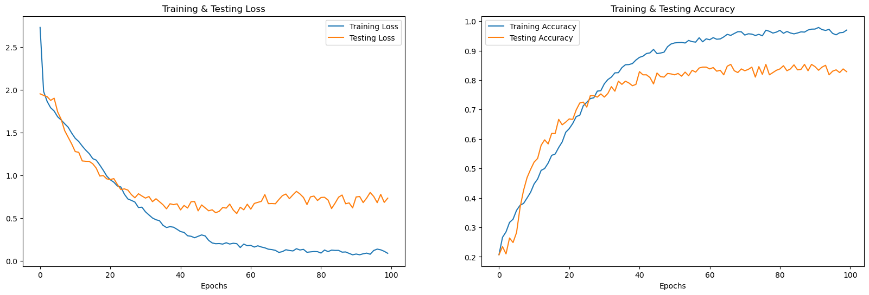
CNN Accuracy/Loss Plots on Train and Test Sets

Slide 10
Models
LSTM
Performs decent at 75% test set accuracy on augmented dataset.
Original dataset had 1440 audio files. 974 in train, 250 in test (20% train/test split)
Data transformation using techniques like noise, pitch, stretch, shift etc. helps increase dataset size and give variation in original data.
Close to similar pre-trained CNN models like ResNet and TimNet (highest at 92%).
We have the lstm model with 9 layers, which we tried building more complex but resulted in a less accuracy.

Slide 11
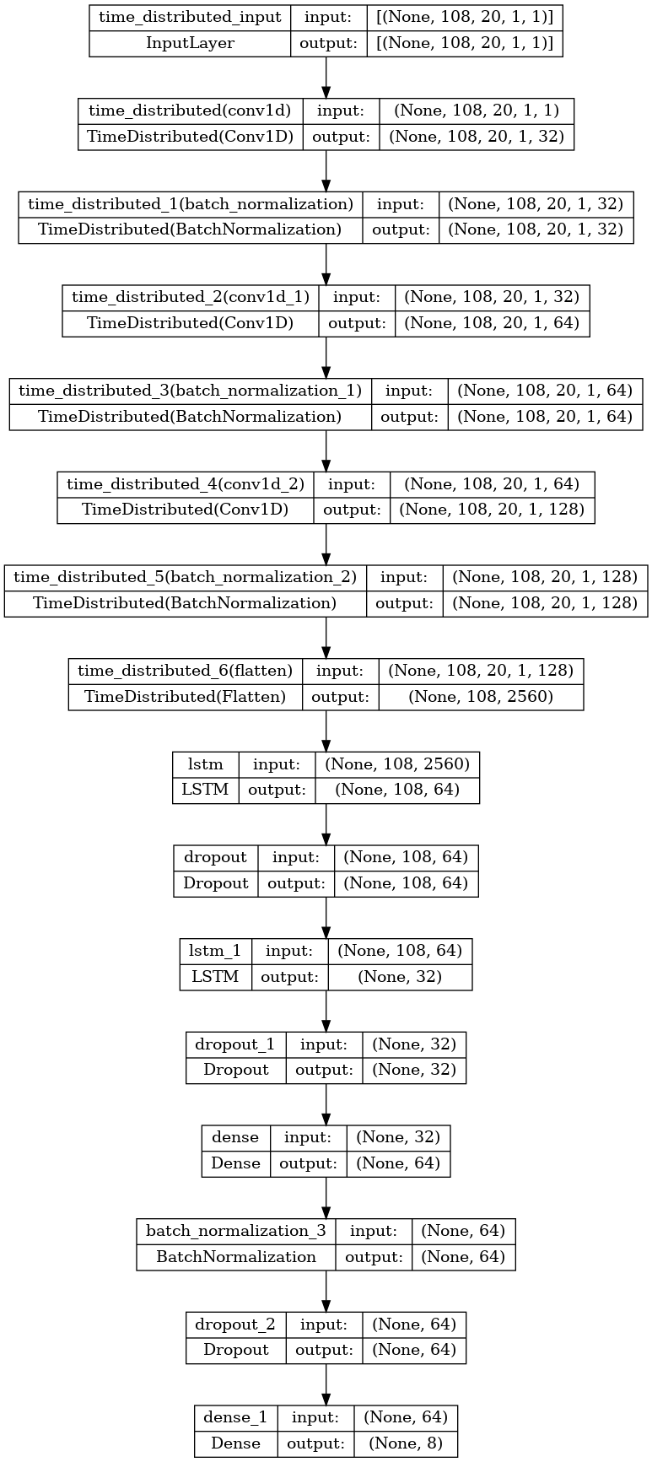
Architecture of the LSTM Model

Slide 12
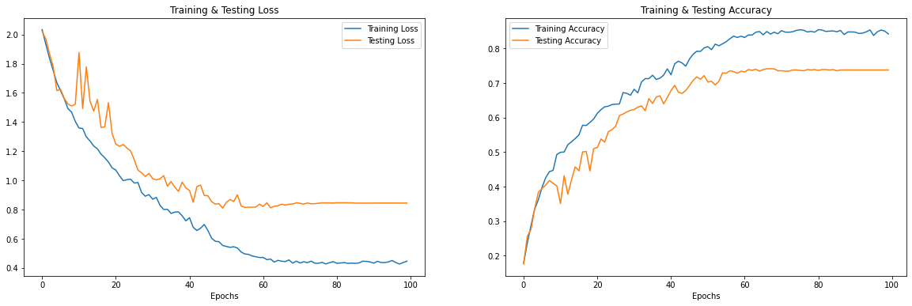
LSTM Loss Accuracy curves for Train Test

Slide 13
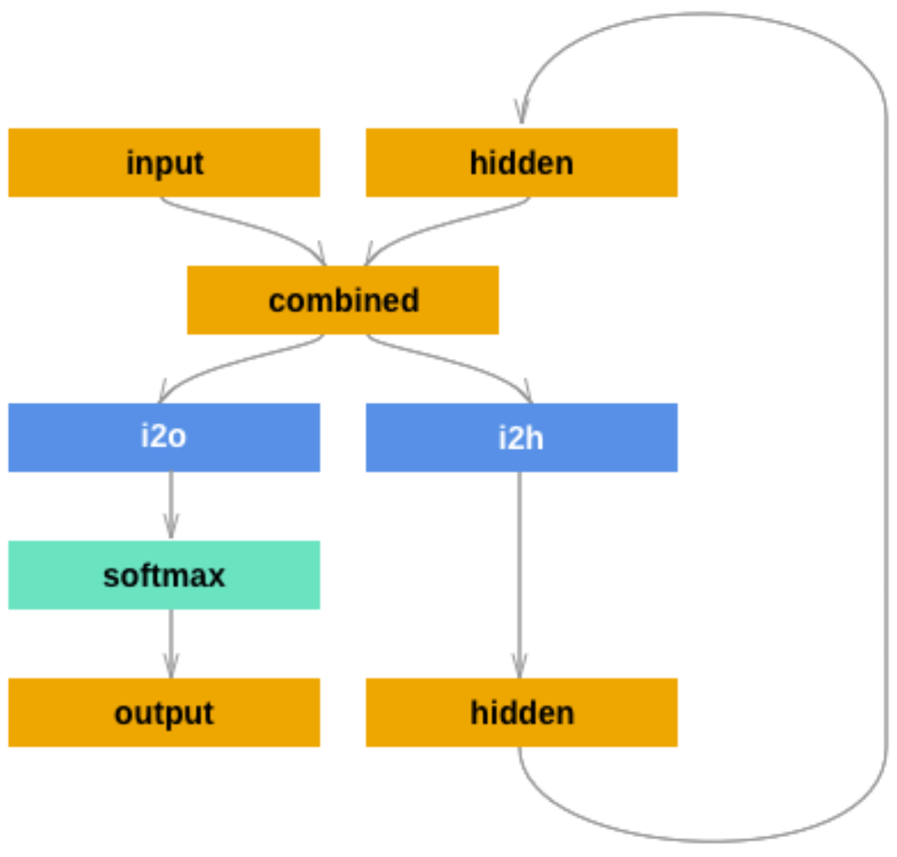
Models
Elman RNN
Notes:
We also used the traditional rnn model: elman to do the classification as well. Try to have a look the architecture difference effect to the model. So I built a elman model based on the pytorch. In the elman model, And the input size: 50, hidden size: 96.

Slide 14
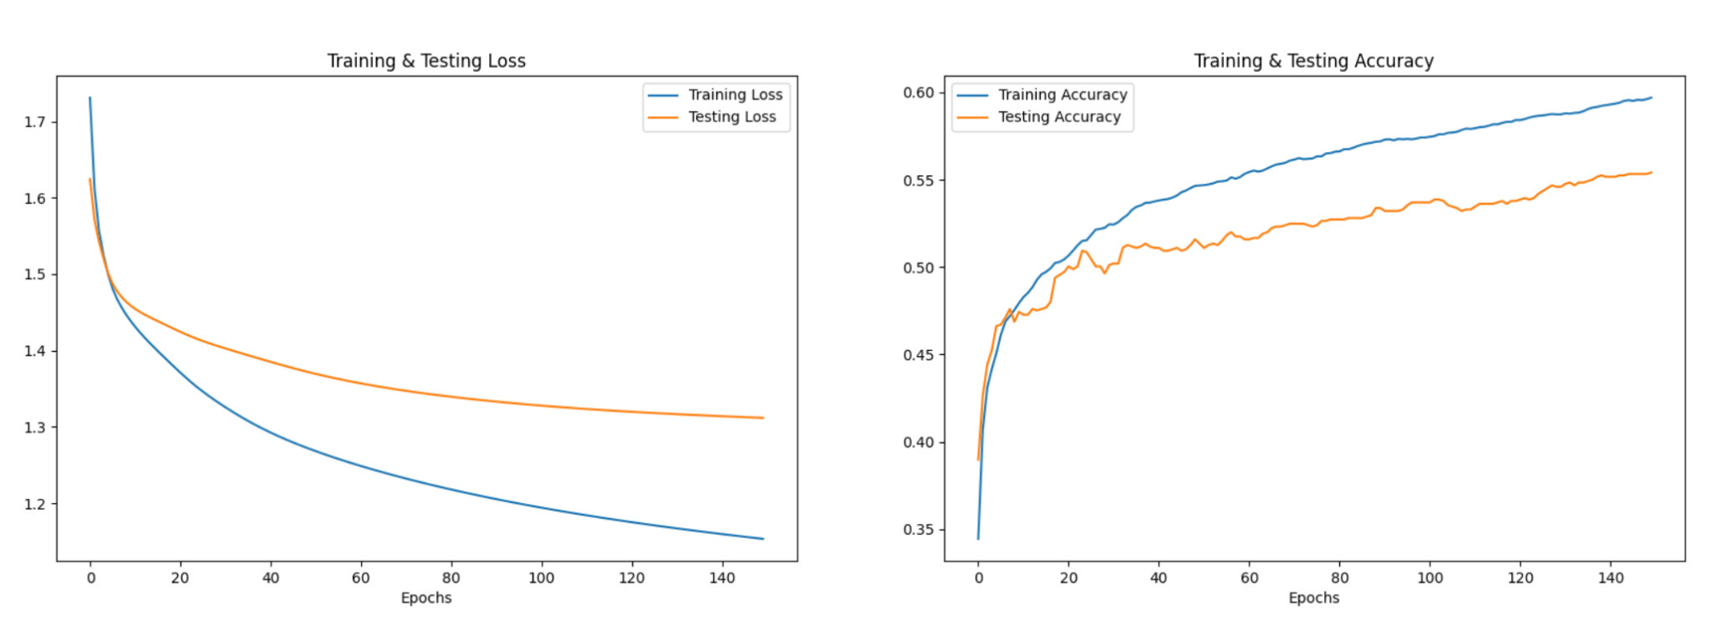
Models
Elman RNN
Performs decent at 39% test set accuracy on vanilla dataset.
After doing data augmentation, the test accuracy increases to 55%.
Notes:
We set the epoch as 150 to train the model. Also, I tried some other methods like reduce learning rate on plateau. For training process, we can find that the elman rnn’s accuracy is very low compared lstm and cnn. why?

Slide 15
Performance Comparison and Final Analysis
Compared with LSTM model, Elman RNN has a lower accuracy.
Compared between CNN model and RNN model, it seems that CNN model is more suitable for this task. It’s may because this is a classification problem and the sequences of the data is not as important as the patterns in classification.
 | CNN | Elman RNN | LSTM
Train accuracy | 0.91 | 0.60 | 0.80
Test accuracy | 0.85 | 0.55 | 0.75
Notes:
Compared with LSTM model, Elman RNN has a lower accuracy. This is because that LSTM has a more complex architecture that incorporates memory cells and gating mechanisms. However, the elman model has its advantages, it has faster training times and lower computational complexity. For our model, the training loop for elman is 2-3 seconds, but for the lstm model, it’s 20 seconds.
Compared between CNN model and RNN model, it seems that CNN model is more suitable for this task. It’s may because this is a classification problem, and the audio files has only 3 seconds length. So the sequences of the data is not as important as the patterns in classification.

Slide 16
References
https://journals.plos.org/plosone/article?id=10.1371/journal.pone.0196391
https://paperswithcode.com/dataset/ravdess
https://pytorch.org/tutorials/intermediate/char_rnn_classification_tutorial.html
https://github.com/gabrielloye/RNN-walkthrough/blob/master/main.ipynb
https://www.researchgate.net/publication/344308187_Speech_Emotion_Recognition_in_Neurological_Disorders_Using_Convolutional_Neural_Network
https://www.kaggle.com/code/blitzapurv/speech-emotion-recognition-using-lstm

Slide 17
THANK YOU.
ANY QUESTIONS ?

