Slide 1
Supermarket Kirana Store
Sales Analysis & Operations Report (Weekly)
Generated: 16 September 2026 | Data Since: 2026-09-09

Slide 2
PERFORMANCE ANALYTICS
Sales Performance Summary
TOTAL SALES
₹ 413.50
TOTAL BILLS
1
AVERAGE BILL VALUE
₹ 413.50

Slide 3
PERFORMANCE ANALYTICS
GST Tax Collections Breakdown
TOTAL GST COLLECTED
₹ 15.50
CGST TOTAL (CENTRAL)
₹ 7.75
SGST TOTAL (STATE)
₹ 7.75

Slide 4
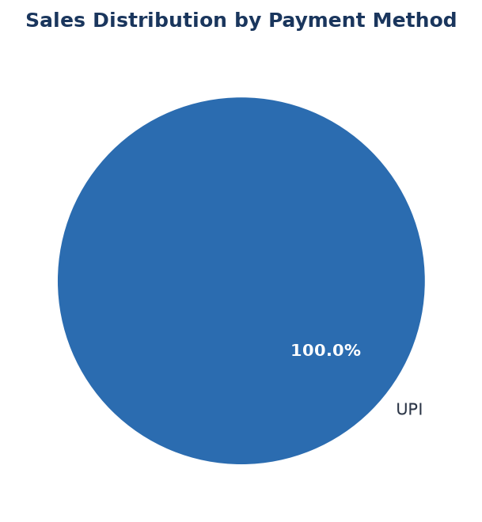
PERFORMANCE ANALYTICS
Payment Mode Breakdown
Summary Table
• UPI: ₹ 413.50 (1 bills)

Slide 5
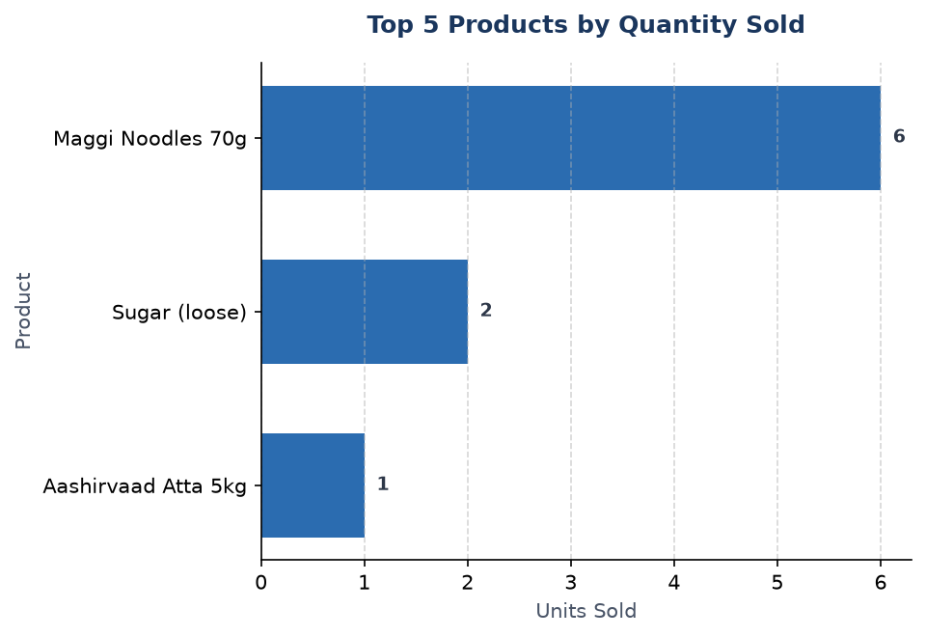
PERFORMANCE ANALYTICS
Top Selling Products

Slide 6
PERFORMANCE ANALYTICS
Stock Health & Inventory Alerts
⚠️ Low Stock Alert (4 products require reordering):
• Rice Sona Masoori (loose) (SKU: LOOS-RICE-KG): Stock = 15.0 kg (Reorder Level = 25, Shortfall = 10.0)
• Aashirvaad Atta 5kg (SKU: AASH-ATTA-5KG): Stock = 7.0 bag (Reorder Level = 10, Shortfall = 3.0)
• Surf Excel Washing Powder 1kg (SKU: SURF-EXCE-1KG): Stock = 5.0 pkt (Reorder Level = 8, Shortfall = 3.0)
• Tata Salt 1kg (SKU: TATA-SALT-1KG): Stock = 20.0 pkt (Reorder Level = 20, Shortfall = 0.0)

Slide 7
PERFORMANCE ANALYTICS
Automated Business Insights
Key Operational Takeaways:
• Highest demand product: 'Maggi Noodles 70g' leads total volume sales.
• Preferred payment method: 'UPI' is the most frequently used payment channel.
• Reorder priority: 4 products have hit inventory reorder thresholds.
• Revenue per ticket: Average customer transaction value is ₹ 413.50.

