Slide 1
Computer Networks IPv4 & TCP – Conceptual Teaching Demo
Presented By :Akhilesh Bhoria

Slide 2
Lecture Roadmap
IPv4 Addressing Basics
Classful Addressing
Types of Communication
IPv4 Header Overview
TCP Working(Handshake, Flow Control)

Slide 3
IPv4 Addressing
Ipv4 address is 32 bit
Initially in 1980’s IP address was divided into two fixed parts that is
Network ID
Host ID
8 Bit 24 bit
Network Id
Host Id
2^8 Networks
2^24 Networks
There are 256 Networks and to buy one network aswell even a small organization much buy 16M (2^24) computers , which is very big number ,
So, the Solution is Classfull Addressing

Slide 4
Classfull Addressing
This 32 bit IP Address is divided into 5 classes in the Classfull Adressing
Class A
Class B
Class C
Class D
Class E
No. of IP present in Class A = 2^31 (fixed bit = 0)
No. of IP present in Class B = 2^30 (fixed bits = 10)
No. of IP present in Class C = 2^29 (fixed bits = 110)
No. of IP present in Class D = 2^28 (fixed bits = 1110)
No. of IP present in Class E = 2^28 (fixed bits =1111)
Class B
2^30
Class A
2^31
Class C
Class D
Class E

Slide 5
Class A
8 bit
8 bit
8 bit
8 bit
Network ID
Host ID
Class A -> 0 to 2^31 (1 to 126)

Slide 6
Class B
8 bit 8 bit 8 bit 8 bit
Network ID 2^14
Host ID 2^16-2

Slide 7
Class C
8 bit 8 bit 8 bit 8 bit
Network ID
Host ID

Slide 8
Identification Problem
To send a Packet from Source to Destination we need 4 identification Steps
1.Identify the Network
2. Identify the Host within the network
3.Identify the Subnet within the Network
4. Identify the process within the Host.
IP address is also called as Logical Address
MACC address is also called as Physical address.
ARP is used to find MACC address
ARP request is broadcasting.
ARP reply is Unicasting

Slide 9
Identify the Process
Identify the Host
Identify the Subnet
Identify the Network

Slide 10
Types of Communication
There are 3 Types of Communication
Unicast Communication(1:1)
Broadcast Communication (1:all)
Multicast Communication (1:many)
Unicast Communication
Transmitting the data from one computer to another computer is called unicast Communication.
It is one to one transmission.
DATA 10.19.32.75 119.35.91.31
Source IP
Destination IP
In Unicast communication both Source and Destination can be present in same as well as different Network

Slide 11
Broadcast Communication
Limited Broadcasting
Direct Broadcasting
1.Sending a Message from one Computer to all Other Computer in the same Network.
2. 255.255.255.255 is reserved for Broadcasting.
Sending a Message from one Computer to all Other Computer in Other Network.
X.255.255.255 is reserved for Direct Broadcasting.
X.0.0.0.0 fixed for NID of Entire Network
127.X.Y.Z fixed for Loop back testing or inter process Communication
Limited Broadcast is always be used as Destination IP
Direct Broadcasting is always be used as Destination IP

Slide 12
Transport Layer is responsible for Process to Process Delivery of Segment
Network Layer is responsible for Source to Destination
Macc layer is responsible for Host to Host

Slide 13
Application Layer
Message
Transport Layer
H1
Segment
Network Layer
H2
Datagram
T1
Data Link Layer
H3
Frame
Physical layer
Steam of bits

Slide 14
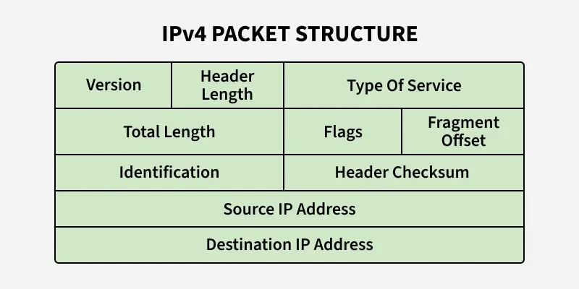
IPV4 Header(H2)

Slide 15
Header Length(4bit)
This field tells what is the exact header Size.
Hl is 4 Bit
We need header length because Header size is not fixed , it can vary between 20B to 40B
20 Bytes are fixed
From 4 bit max value can be 15 but the Size of Header is 60 byte.
So, we use the scaling factor
Header Length = 60/4=15 [Scaling factor]
Header Length =20/4 = 5 [Scaling factor]
If header size is not divisible by 4 , then we add the dummy bits from Option field which is Padding(5 bit)
So,
Header Length field Min value is 5
Header Length field Max value is 15

Slide 16
Services
It is 8 bit field
First 3 bits are Priority Bits
Next 4 bits are type of Services bits
Last is Not used
P P P D T R C not used
Priority Bits
Services Bits
Types of Services Bits
Delay – it should be minimum Delay
Throughput – Max throughput
Reliability – High Reliability
Cost – Cost should be minimum

Slide 17
Total Length
Total Length is 16 bit
Total Length = Data or payload + Header
Max Number possible = 2^16 -1 =65535
20 Bytes
65,515 H2
65,535

Slide 18
Identification Number (16 bit)
Every datagram is associated with a number which is called Datagram number or identification number.
300 Bytes
ID no = 100
MTU = 100 B
A
*
B
100 B
100 B
ID no = 100B
100 B
ID no = 100B
Id no =100B

Slide 19
Flags(3bit)
Not used DF(Dot Fragment) MF(More Fragment)
If DF = 1 means , Don’t Fragment the data Packet
If DF = 0 means , Datagram can be Fragmented
Connection Less = Not waiting for ACK
Connection Oriented = After sending a Pkt , Waiting for ACK
Network Layer is Connection Less
Transport Layer is Connection Oriented
If MF=1, this means more Fragment are available after this fragment , this is not the last Fragment
MF = 0 , this means it is the Last fragment or only fragment

Slide 20
Fragment Offset
This Field is 13 bit
Fragment offset indicate no of data byte ahead of this fragment
Max number possible =2^13-1= 8191
This Fragment offset tells us , regarding which is 1st fragment , which is 2nd fragment and which is 3rd Fragment.
IP is a Packet Stream Protocol , that every Packet is Associated with one Sequence no. called as Identification number

Slide 21
TTL(8bit)
TTL is used to avoid the infinite Lopping
Router 1
*
*
Router 2
*
Router 3
TTL field is used to control the maximum number of hopes visited by datagram
If TTL value become 0 at the destination the ,Packet will be accepted , But if TTL value become 0 at Router then packet will be Discarded.
Min TTL value in IPV4 is 1

Slide 22
Protocol(8bit)
This 8 bit fields tell us which protocol is encapsulated in the IP Packet
ICMP
1st Priority for Descarding
IGMP
2nd Priority for Descarding
UDP
3rd Prority for Descarding
TCP
Last Priority

Slide 23
Transport Layer
Here two Protocol works UDP , TCP
For large Segments we use TCP
For small Segments we use UDP
Segmentation & reassembly always done at transport layer.

Slide 24
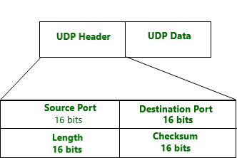
UDP frame formet

Slide 25
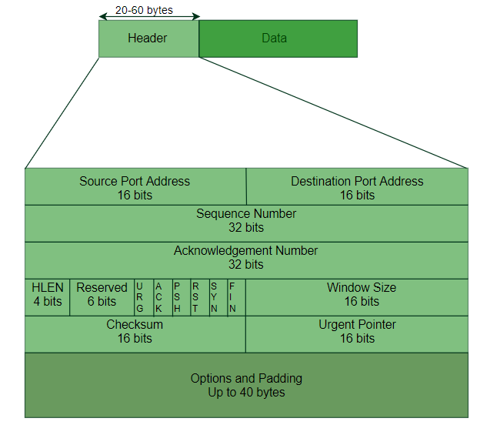
TCP

Slide 26
TCP is Connection Full Duplex .
TCP is Connection Oriented.
TCP is a byte Stream Protocol , that every byte associated with Sequence number.
TCP uses the combination of GBN and SR
TCP uses sliding window protocol for its flow Control.

Slide 27
TCP phases to send the data
TCP has three Phases –
Connection Establishment
Data transfer
Connection termination

Slide 28
TCP uses Sliding window Protocol for flow control
Each TCP connection has 4 windows
Sending Window at Sender
Sending Window at Receiver
Receiving window at Sender.
Receiving window at Receiver

Slide 29
In TCP we have 6 bit Flags
Urgent Flag(URG) –
Acknowledgement Flag(ACK) –It is used in Connection establishment phase
Push Flag(PSH) – it is used to push the urgent bits to upper layer or lower layer
Synchronization Flag(SYN)– It is used in Connection establishment Phase.
Finished Flag(FIN) – Fin is used for Connection Termination.
Reset Flag(RST) –
SYN and ACK flag are used in Connection establishment Phase.

Slide 30
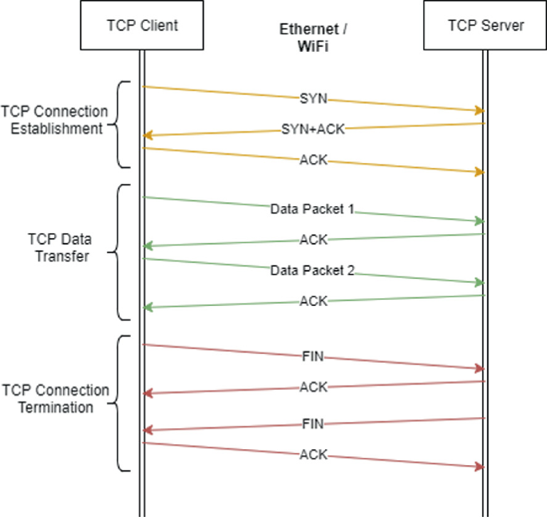

Slide 31
Connection Establishment
Connection establishment is Three Way Handshake
Connection Establishment Request(Sending Sequence number and SYN as 1)
SEQ+ACK
ACK
SYN =1(Server will Understand that it is request for connection Establishment )
SYN segment can't carry data, but it consume one Sequence no.
SYN +ACK segment can’t carry data, but it consumes one seq number.
ACK segment ,if carry no data ,then consume no seq number.

Slide 32
Server
Client
Seq No=1000 , SYN =1
Request
MSS=1460 , window size=14600B
Reply
Seq no=2000
SYN=1
Ack no=1001,MSS=500B,Ack=1,Window Size=10,000 Byte
Seq no=1001 , Ack =1
Ack no=2001

Slide 33
Data Transfer Phase
1100 to 1001
[100 Bytes]
Seq no=1001,Ack=1,Ack no=2001
2001 to 2100
[100 Bytes]
Seq no =2001,Ack=1, Ack no.=1001
Seq no=1101,Ack=1,Ack no=2101

Slide 34
Connection Termination Phase
FIN flag is used in the Connection Termination Phase.
Connection termination Request (FIN =1) [Sender]
Received ACK [sender]
Connection termination request(FIN =1) [Receiver to sender]
Received ACK[Receiver]

Slide 35
Request(FIN =1)
Client
Reply(ACK)
Server
Request(FIN=1
Reply(ACK)
CONNECTION TERMINATION

Slide 36
Push Flag = It says that u cannot store the data in buffer ,
Immediately u have to push the data to upper layer or lower layer .
Urgent flag = It is used to indicate that which some Bytes are Urgent in the Data.
Urgent Pointer = It defines , if the Urgent pointer is x then no of urgent Byte is x+1.
Last Urgent byte = Urgent pointer value + sequence no
TCP checksum is used for error Detection.
TCP checksum is computed for both header and data but in IP checksum only
computer at header part.

Slide 37
Window Size or Advertising window 16bit
It is Used for flow Control
TCP is full duplex connection ,Server can send data to client , Client can send data to Server.
First we have to establish the connection (three way handshaking)

Slide 38
A
B
REQUEST
REPLY
1000 Bytes
Adv window=1000
ACK
DATA = 400 Bytes
400 Bytes
Adv window=600
600 bytes
DATA = 500 Bytes
400 B 500 B
Adv window =100
100 B
DATA = 100 B
400 B 500 B 100 B
Adv window = 0B

Slide 39
A
B
Adv window = 400
500 B 100 B
400 B
After Some Time , 400 Bytes of data get processed by the B and 400 portion in B’s buffer become Free.
B sends a message to A and says my Advertising window is 400 B , but assumed this message got Lost
A wait for B’s Adv window size
B waits for A’s data
Therefore ,Deadlock Arise
This deadlock problem can be solved by Persistent Timer
When ever Sender Receives adv window =0 , then Sender starts a Persistent Timer and sends the data
If the new Adv window size arrived by B within the persistent timer then no issue unless A will send the probe Segment , which is reminder to B that I haven't received the new Avd window Size , probe consumes 1 seq no
Probe Segment 1B
Persistent Timer

Slide 40
Thankyou

