Slide 1
Shopping History Tracker
By Sitong Lu
Notes:
Hi, this is Sitong presenting the final presentation for the final project.

Slide 2
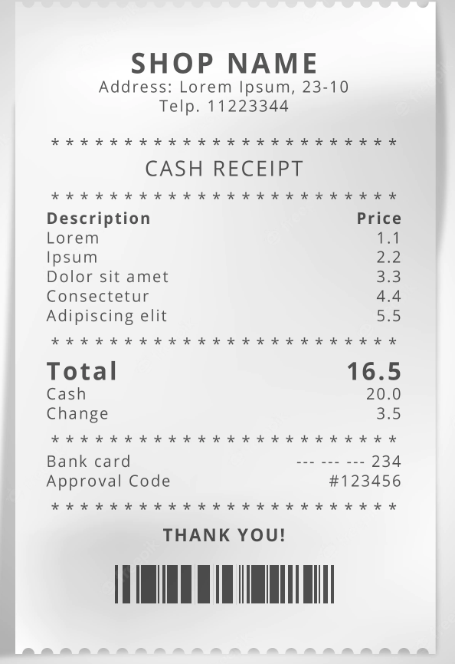
Shopping Receipt
Product name
Product price
Customer name
Shopping date
…
Notes:
So first at all lets start from something that might just be in your pocket right now – the shopping receipt. There are lots of type of information in it and I think we can sort them out in a more efficient and easy-to-review style.

Slide 3
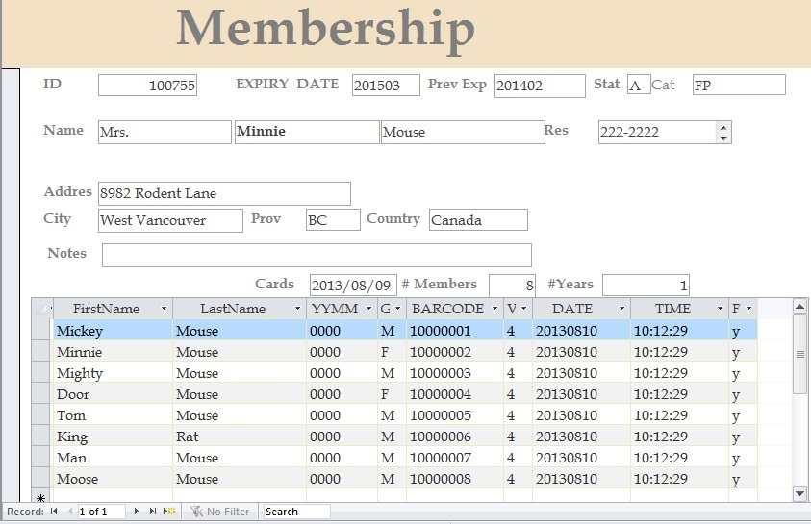
A Shopping History Tracking System
Database
Insertion & deletion
DataFrame
Summarization
User
Product
Time
…
Notes:
And that’s why I started this shopping history tracking system project. Since it is a history tracking system, we definitely need to have a database that support insertion and deletion for operating those data. We also want to introduce dataframe into this system so that data represented in the form of diagram can be easily generated for user to check on. Based on that, all kinds of summarization can be formed, representing user data, product analysis, seasonal overview, etc. The total number of doable summery is just limited by the creator’s imagination.

Slide 4
Components
Kubernetes – deployment and scalability
Flask REST server/client - user interaction
REDIS – message queue host
MySQL – database
Pandas – dataframe/diagram generator
Notes:
As for the components, I re-constructed most of them based on the structure built for lab7, including Kubernetes cluster for hosting this remote and individual space for the project, rest services, for user interaction, REDIS, as usual, for storing the temporally data generated by rest server and worker node, but also for acting as a host of the message queue this time. I replaced MinIO with mysql database, for better list type data modification, and used Pandas in the worker node for allowing the creation of dataframe and its corresponding diagrams.

Slide 5
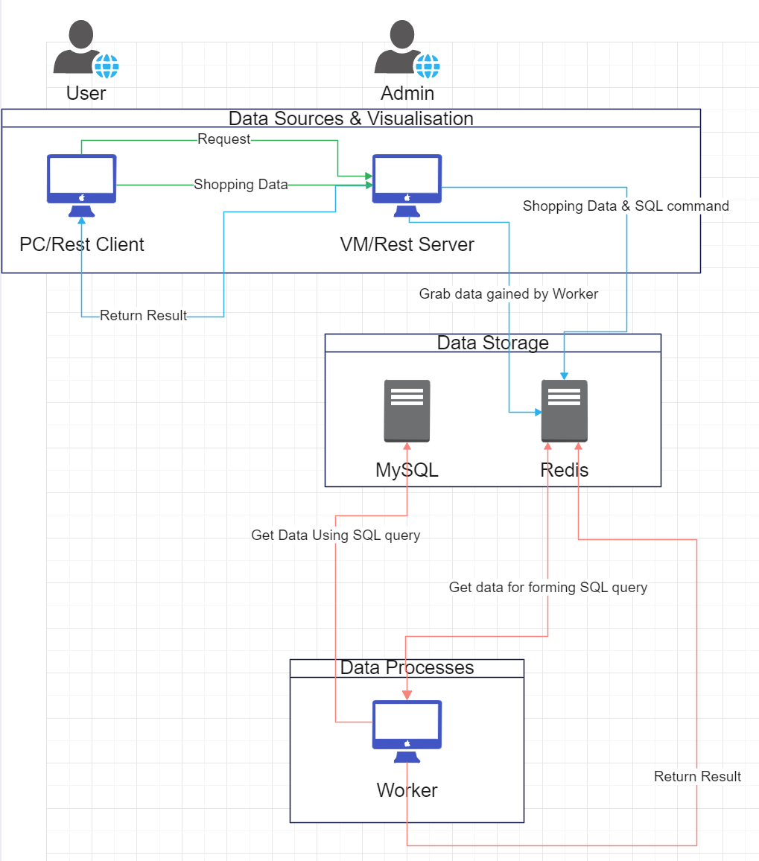
Architectural Diagram
Notes:
And here’s the diagram showing the architecture of the project. Now I will explain it in detail how these components work together to finish the job.

Slide 6
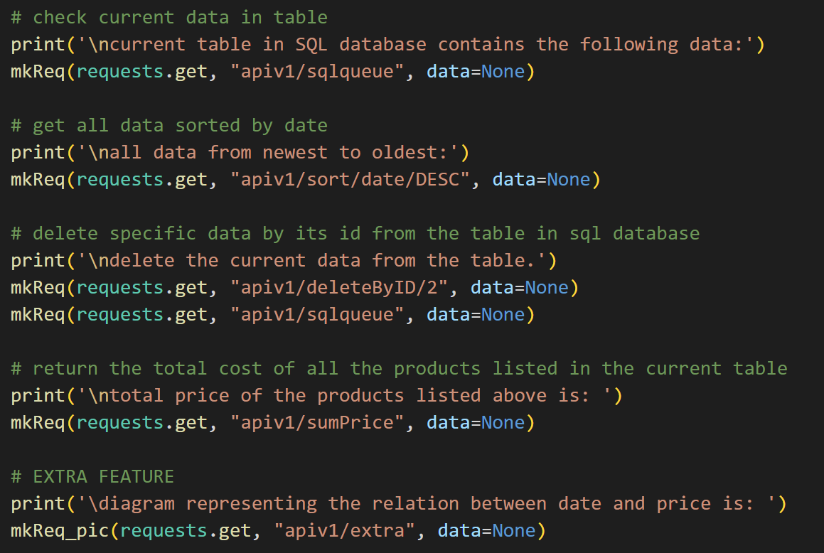
REST Client
Act as a user
Send data/requests & get responses
Notes:
We first let user send request to the server together with their raw json type shopping data through rest client.

Slide 7
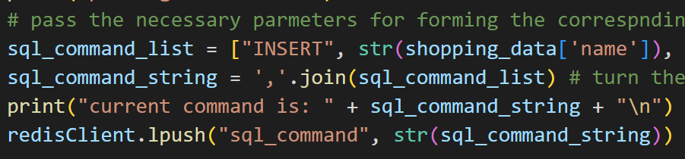
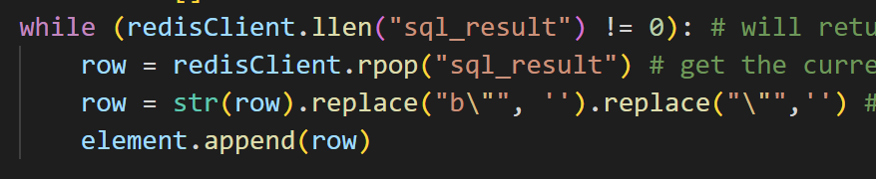
REST Server
SQL query generator
Take request -> grab parameter -> push to REDIS
-> pop result from REDIS -> return to client
Notes:
The server side receives the data, identifies the type of command the user is requesting, generates a raw SQL query list for worker node to process,

Slide 8
REDIS
Temporary result storage
Message queue host (lpush, rpop)
Notes:
and pushes this list to redis with tag “sql_command”.

Slide 9
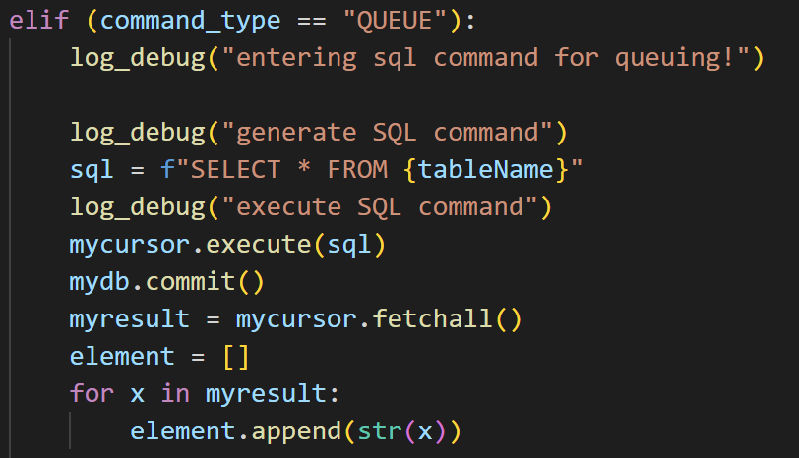
Worker
Actual SQL query generator and processor
Notes:
Meanwhile, worker node just keeps running in a while loop and tries to detect if the redis storage with tag sql_command contains anything. Once it detects content in it, grab the content but do not pop it out from redis yet, reform the list to a proper sql command,

Slide 10
MySQL
SQL Database
Notes:
and execute it with the connected sql database. After that, the worker node grabs the returned result – I mean, if there is a returned result from sql database,

Slide 11

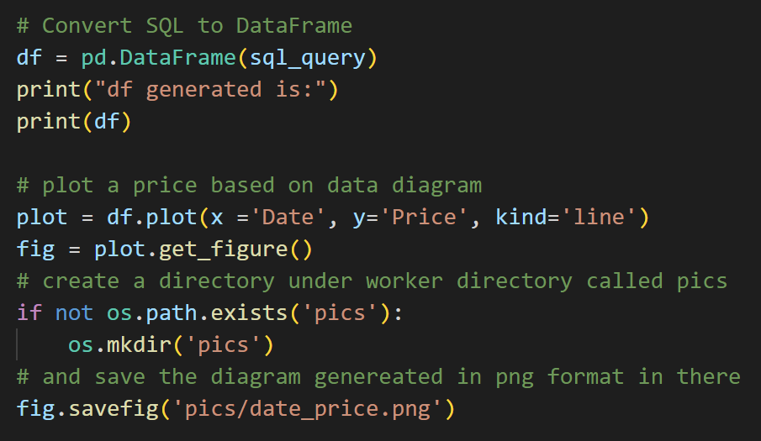
Worker
Generate diagrams and summaries using Pandas
Notes:
push it into redis with another tag called sql_result, and pop out the original one from sql_command at this stage. If the user want, worker can also let pandas kicks in at this stage, generate the corresponding diagram and add it to redis together with all the other return values.
Now rest server knows that the result is back, it grabs the data and send it back to client, finishes this one loop of the whole program.

Slide 12
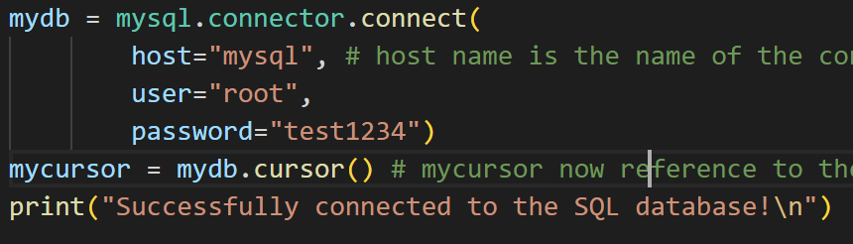
Debugging
Checking with log reports –
Integration testing & functional testing
And of course,
Local testing matters!
Notes:
For debugging the project, I of course used the log reports that can be seen from log’s pod after setting log_debug command into the corresponding potential bug areas. I also applied integration and functional testing into debugging, cause it is extremely hard to really just test the reliability of simple function method in such a complexed project that all are somehow related to really run something or return some value for you to check. For example, I have to finish setting all the parameters in this connecting method and some other places just to make sure that the mysql server has been hosted and can be connected properly. I actually spent at least 2 days until I figured out that I need to change the host name to the container name I set in mysql’s deployment method instead of just localhost when testing everything on the pods.

Slide 13
Learnings
Relearned MySQL’s transaction isolation
What happens if database is been accessed/edited by multiple programs at the same time?
How to let REST server know that worker node has finished processing the current SQL query?
Notes:
So what I have I learnt from this project? Well, I learnt that the existence of MySQL database’s default transaction isolation system, cause it will block you from accessing and editing it from multiple programs at the same time. Of course there must be a way to edit this setting but since we are playing the Database with a bunch of python programs, letting only the worker node to communicate with the database without causing any isolation trouble is the best and easiest way to do.

Slide 14
Source References
Pic used in slide 2:
Store receipt Images | Free Vectors, Stock Photos & PSD (freepik.com)
Pic used in slide 3 & 10:
Chapter 2 Fundamental Concepts – Database Design – 2nd Edition (opentextbc.ca)

Slide 15
Demo
Notes:
So now I am going to show you the demo of my project

Slide 16
Thank You!
And congregations to myself on passing JLPT N2 on 12/4!

