Slide 1
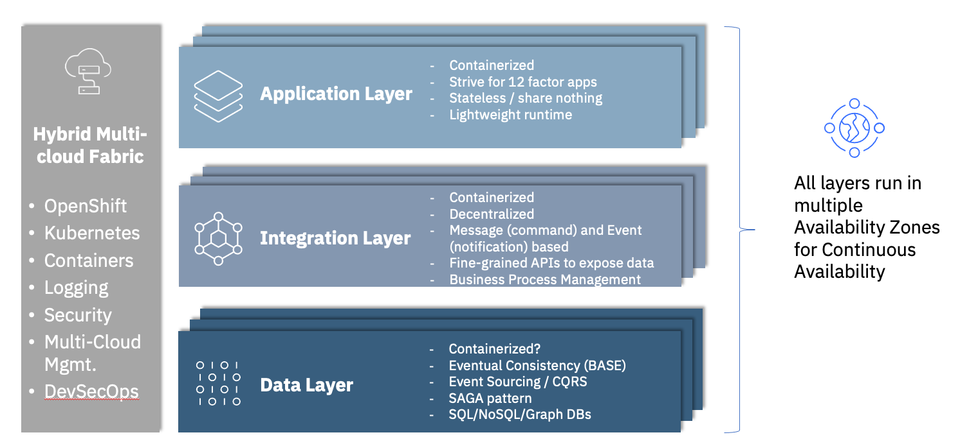
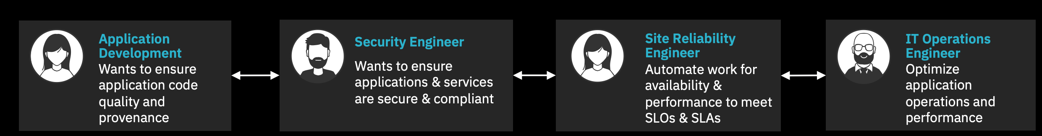
Application Modernization Defined across Application, Integration, Data Layers and Z
Evolving the application architecture, deployment topology and devops approaches for an existing estate of applications so that new functionality can be delivered incrementally and with high velocity
2. Customer Driven
Customer centricity
Data / insights
Self service
Enabling trust in data processing
1. Business Driven
Business priorities
Revenue drivers
Balance cost savings vs innovation
3. Technology Driven
Process automation
Process re-imagination with optimization techniques
Optimize Modernization Patterns
Application
Migration & Modernization
+
Replace, Retain, Retire

Slide 2
DevOps Quick Wins
Infrastructure as Code
GitOps
DevSecOps
DevOps
High-performing organizations deploy 30x more frequently with 200x shorter lead times; they have 60x fewer failures and recover 168x faster.
Coding
Testing
Source Code
Learning
Configuring
Releasing & Deploying
Continuous Innovation
Monitoring / Operations
Security
Building
CI/CD
AI for IT
Operations
AIOps

Slide 3
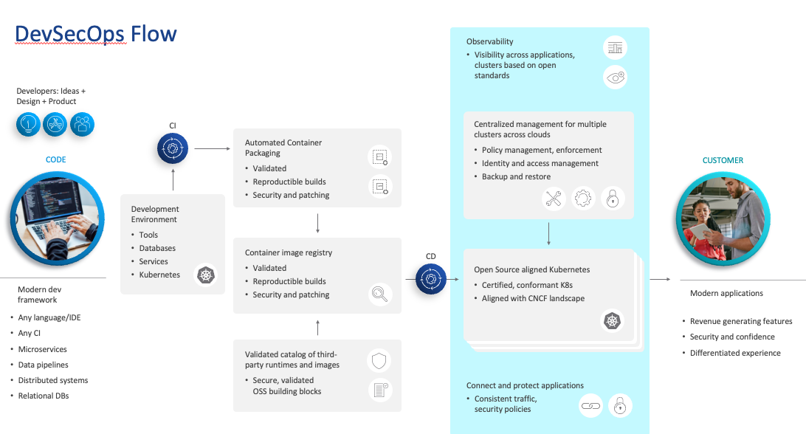

Slide 4
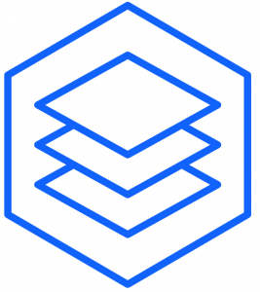
Options for runtimes across application modernization
Key:
Reuse
App
Change
Workload
migration
Runtime/ Frameworks
Red Hat OpenShift Virtualization
Rehost
Virtualization/ Management
App
Repackage
Runtime modernization
Runtime/ Frameworks
Liberty / JBoss EAP/ JBoss Web Server for OpenShift / Quarkus
App
Virtualization/ Management
Runtime/ Frameworks
Virtualization/ Management
Replatform
App
Operational modernization
Runtime/ Frameworks
Red Hat OpenShift Container Platform, Liberty & Quarkus
Retain
Virtualization/ Management
Refactor
App
App
App
Architectural modernization
Runtime/ Frameworks
Runtime/ Frameworks
Runtime/ Frameworks
Modernization Tools, Liberty & Quarkus
Virtualization/Management
App
App
App
Rewrite
New
cloud-native development
Runtime/ Frameworks
Runtime/ Frameworks
Runtime/ Frameworks
Developer Frameworks, Liberty & Quarkus
Virtualization/Management
Write New

Slide 5

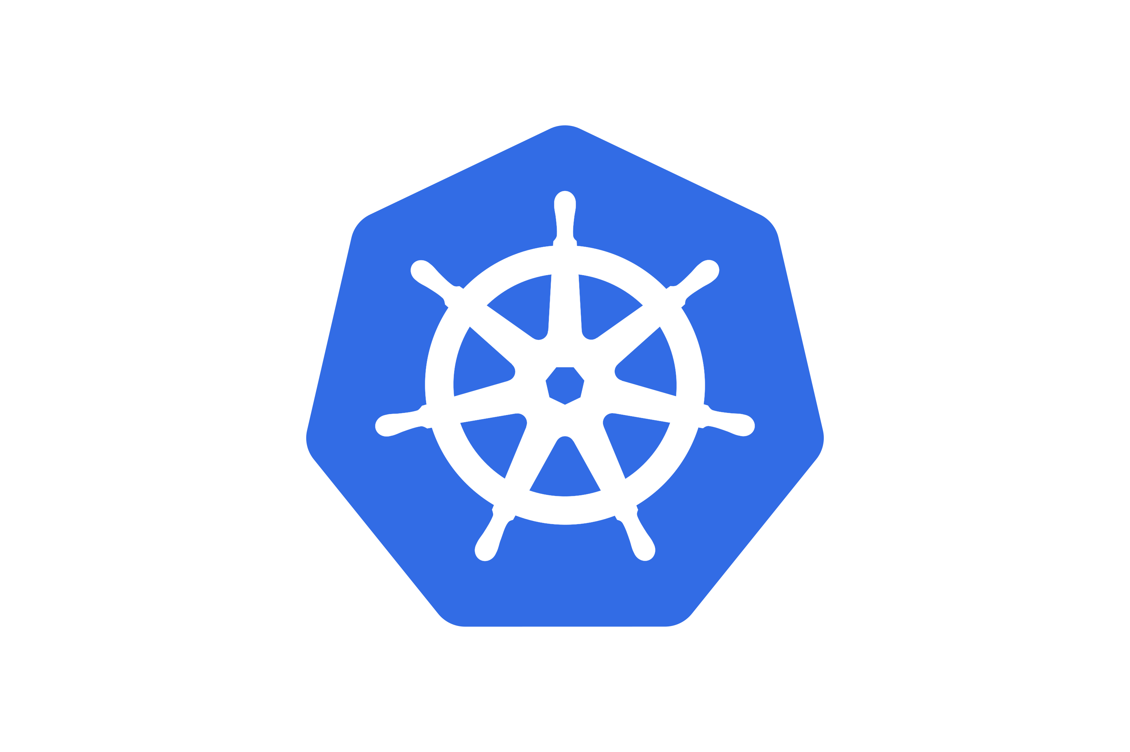

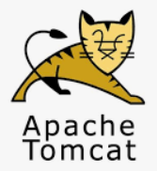
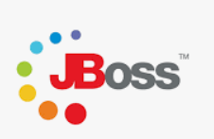
Java - Industry Evolution
Monolith to Composable Services/Microservices…
Traditional App Servers
OpenShift
Cloud-native
FaaS
Virtual Machines
Kubernetes
CRIU
Containers
Runtime-centric clustering
Microservices
Native Compilation
WebSphere
App Server
Monoliths
2012
WebSphere
Liberty
Open Liberty
Serverless
Open Source
Methodology
Waterfall
Agile
Infrastructure
Constrained
Utility
1998
Present
Notes:
When WebSphere Application Server (WAS) and other traditional Application Servers were first released in the late 1990s, the technology world was a very different place. The hardware on which WebSphere ran had modest compute power by today’s standards, networks were much slower, and memory and disk capacities were limited. Software delivery was also dominated by Waterfall and associated engineering practices. This naturally led to runtime and application designs that favored monolithic deployments. In the early 2000s, Virtual Machines (VMs) emerged as an approach to simplifying server deployments but clustering was done in a way specific to each runtime type deployed (e.g. WebSphere Network Deployment (ND) Cells).
Over the years, infrastructure and methodologies evolved. In 2012 IBM released WebSphere Liberty, which was a response to increasing for lighter weight, agile runtimes to help developers and operations more rapidly and efficiently deliver and deploy applications. These applications were still primarily monolithic but were evolved using more agile practices. Liberty started out with a modest API set but soon grew to support the full Java Enterprise Edition (EE) 7 capabilities as well the Network Deployment (ND) operational capabilities demanded by Enterprises. From the beginning, Liberty allowed you to subset the APIs and features so you only need to develop and deploy based on application and operational requirements.
Over the years, Open Source became an increasingly important aspect of software adoption. In support of this shift, IBM choses to move to an open source-first development model by open sourcing WebSphere Liberty as Open Liberty under the Eclipse Public License v1. Around the same time, Microservices were rapidly growing in popularity, and in collaboration with a number of other vendors, IBM added support for MicroProfile 1.1 – the first MicroProfile release to add new APIs designed specifically for Microservices. IBM has continued to drive and adopt the latest MicroProfile standards ever since.
With the growth of Microservices came rapid innovation in deployment technologies. Containers soon gave rise to container orchestration through Kubernetes and then platforms, epitomized by Red Hat’s OpenShift platform. Container orchestration platforms help greatly simplify enterprise operations by helping remove the need for runtime-centric clustering, such as ND Cells and Liberty Collectives.
Beyond Microservices, IBM has seen the emergence of Functions as an architecture type, typically deployed to Functions as a Service environment. There is also a shift in the industry away from a drive to towards larger numbers of smaller deployments to a more balanced and informed architecture selection and we’ll talk about this more in a couple of slides.
To help clients modernize their traditional application server workloads, IBM has two quite different approaches to traditional WebSphere and Liberty:
Traditional WebSphere’s focus is on stability. To enable this, IBM announced support for Java 8 on traditional WebSphere Application Server (tWAS) until at least 2030, with extended support till 2033. IBM continues to updates security capabilities, database support and operating system support to ensure applications continue to work and remain secure with minimal investment.
For Liberty, the focus is on first-class support for new cloud-native applications, as well as making it easy to modernize existing applications from traditional application server. This means strong Kubernetes integration, APIs for microservice development and deployment, and improved configuration and API fidelity with tWAS.

Slide 6
