Slide 1
Regression and Correlation methods

Slide 2
Learning Objectives
Describe the Linear Regression Model
State the Regression Modeling Steps
Explain Ordinary Least Squares
Compute Regression Coefficients
Understand and check model assumptions
Predict Response Variable
Comments of SAS Output
Notes:
As a result of this class, you will be able to...

Slide 3
Learning Objectives…
Correlation Models
Link between a correlation model and a regression model
Test of coefficient of Correlation

Slide 4
Models
Notes:
3

Slide 5

What is a Model?
Representation of
Some Phenomenon
Non-Math/Stats Model
Representation of
Some Phenomenon
Non-Math/Stats Model
Notes:
.

Slide 6
What is a Math/Stats Model?
Often Describe Relationship between Variables
Types
    Deterministic Models (no randomness)
    Probabilistic Models (with randomness)
Notes:
.

Slide 7
Deterministic Models
Hypothesize Exact Relationships
Suitable When Prediction Error is Negligible
Example: Body mass index (BMI) is measure of body fat based
  Metric Formula: BMI = Weight in Kilograms
  (Height in Meters)²
  Non-metric Formula: BMI = Weight (pounds)x703
  (Height in inches)²

Slide 8
Probabilistic Models
Hypothesize 2 Components
    Deterministic
    Random Error
Example: Systolic blood pressure of newborns Is 6 Times the Age in days + Random Error
    SBP = 6xage(d) + ε
    Random Error May Be Due to Factors Other Than age in days (e.g. Birthweight)

Slide 9
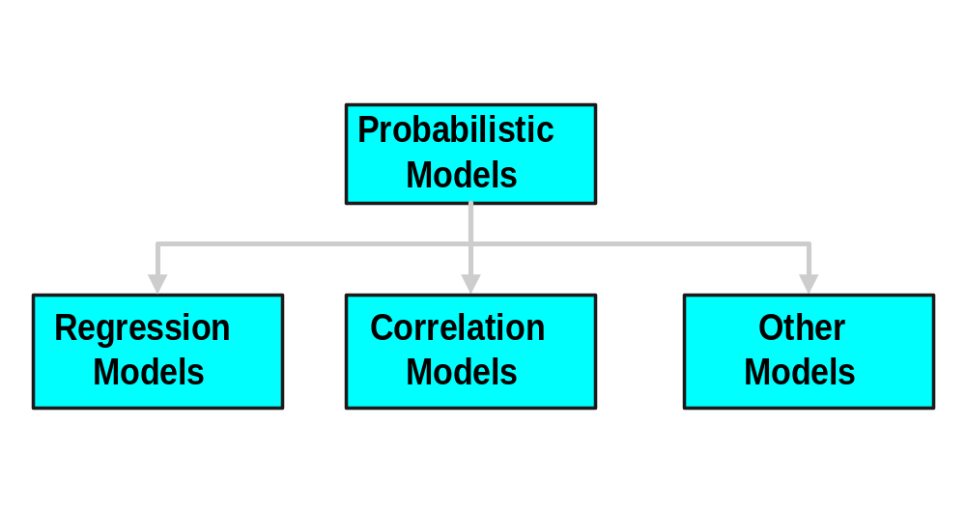
Types of
Probabilistic Models
Notes:
7

Slide 10
Regression Models
Notes:
13

Slide 11
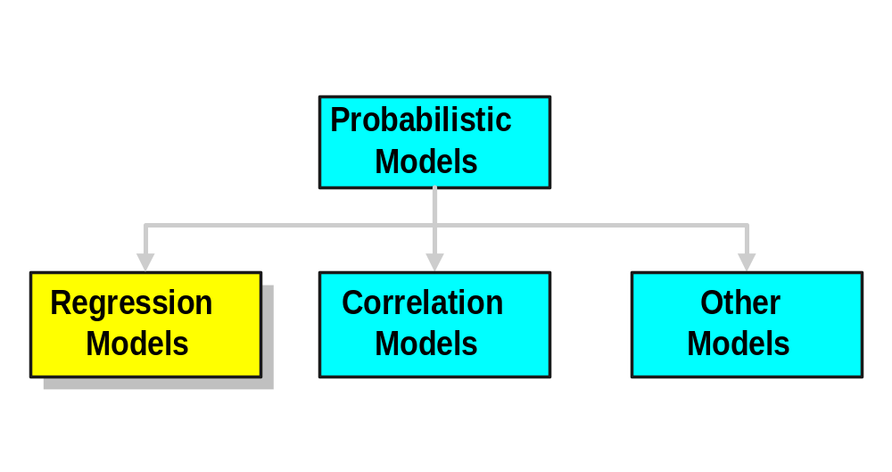
Types of
Probabilistic Models
Notes:
7

Slide 12
Regression Models
Relationship between one dependent variable and explanatory variable(s)
Use equation to set up relationship
    Numerical Dependent (Response) Variable
    1 or More Numerical or Categorical Independent (Explanatory) Variables
Used Mainly for Prediction & Estimation

Slide 13
Regression Modeling Steps
1. Hypothesize Deterministic Component
    Estimate Unknown Parameters
2. Specify Probability Distribution of Random Error Term
    Estimate Standard Deviation of Error
3. Evaluate the fitted Model
4. Use Model for Prediction & Estimation

Slide 14
Model Specification
Notes:
13

Slide 15
Specifying the deterministic component
1. Define the dependent variable and independent variable
2. Hypothesize Nature of Relationship
  Expected Effects (i.e., Coefficients’ Signs)
  Functional Form (Linear or Non-Linear)
  Interactions

Slide 16

Model Specification
Is Based on Theory
1. Theory of Field (e.g., Epidemiology)
2. Mathematical Theory
3. Previous Research
4. ‘Common Sense’

Slide 17
Thinking Challenge:
Which Is More Logical?
CD+ counts
CD+ counts
Years since seroconversion
Years since seroconversion
CD+ counts
CD+ counts
Years since seroconversion
Years since seroconversion
EPI 809/Spring 2008
Notes:
17
With positive linear relationship, sales increases infinitely.
Discuss concept of ‘relevant range’.

Slide 18
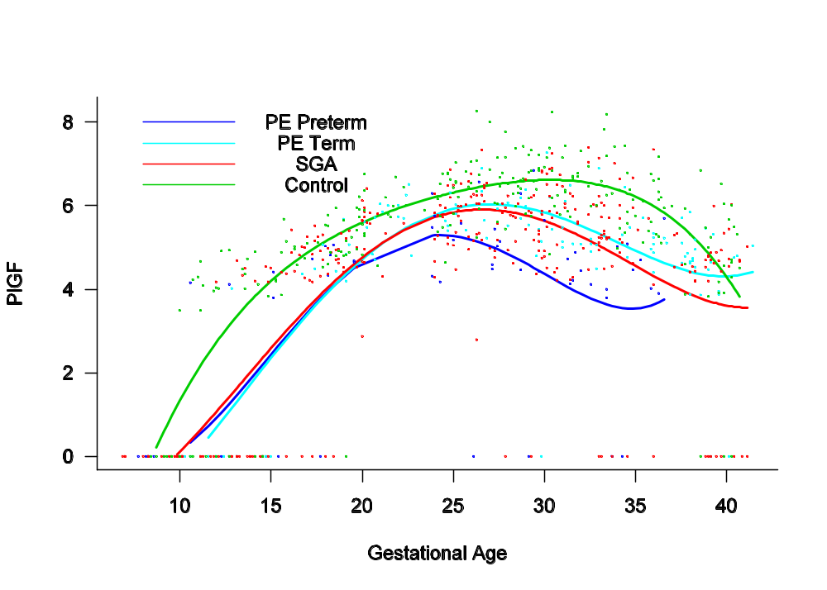
OB/GYN Study
EPI 809/Spring 2008

Slide 19
Types of
Regression Models
EPI 809/Spring 2008
Notes:
18
This teleology is based on the number of explanatory variables & nature of relationship between X & Y.

Slide 20
Types of
Regression Models
Regression
Models
EPI 809/Spring 2008
Notes:
19
This teleology is based on the number of explanatory variables & nature of relationship between X & Y.

Slide 21
Types of
Regression Models
1 Explanatory
Regression
Variable
Models
Simple
EPI 809/Spring 2008
Notes:
20
This teleology is based on the number of explanatory variables & nature of relationship between X & Y.

Slide 22
Types of
Regression Models
1 Explanatory
Regression
2+ Explanatory
Variable
Models
Variables
Simple
Multiple
EPI 809/Spring 2008
Notes:
21
This teleology is based on the number of explanatory variables & nature of relationship between X & Y.

Slide 23
Types of
Regression Models
1 Explanatory
Regression
2+ Explanatory
Variable
Models
Variables
Simple
Multiple
Linear
EPI 809/Spring 2008
Notes:
22
This teleology is based on the number of explanatory variables & nature of relationship between X & Y.

Slide 24
Types of
Regression Models
1 Explanatory
Regression
2+ Explanatory
Variable
Models
Variables
Simple
Multiple
Non-
Linear
Linear
EPI 809/Spring 2008
Notes:
23
This teleology is based on the number of explanatory variables & nature of relationship between X & Y.

Slide 25
Types of
Regression Models
1 Explanatory
Regression
2+ Explanatory
Variable
Models
Variables
Simple
Multiple
Non-
Linear
Linear
Linear
EPI 809/Spring 2008
Notes:
24
This teleology is based on the number of explanatory variables & nature of relationship between X & Y.

Slide 26
Types of
Regression Models
1 Explanatory
Regression
2+ Explanatory
Variable
Models
Variables
Simple
Multiple
Non-
Non-
Linear
Linear
Linear
Linear
EPI 809/Spring 2008
Notes:
24
This teleology is based on the number of explanatory variables & nature of relationship between X & Y.

Slide 27
Linear Regression Model
EPI 809/Spring 2008
Notes:
26

Slide 28
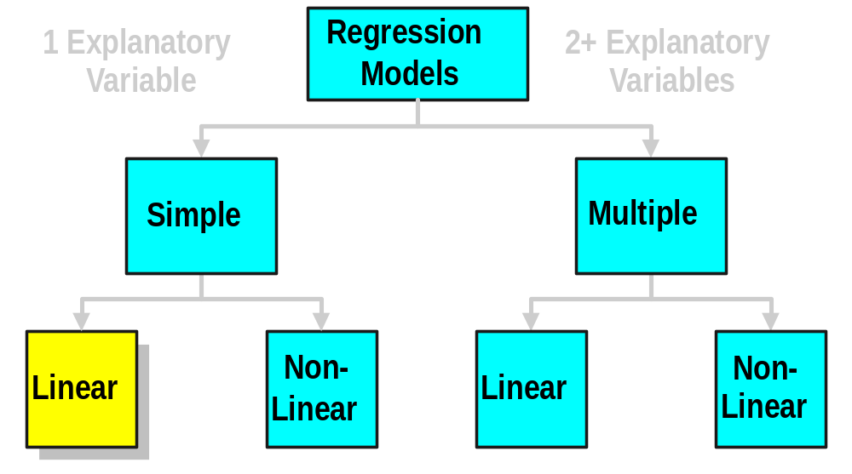
Types of
Regression Models
EPI 809/Spring 2008
Notes:
27
This teleology is based on the number of explanatory variables & nature of relationship between X & Y.

Slide 29
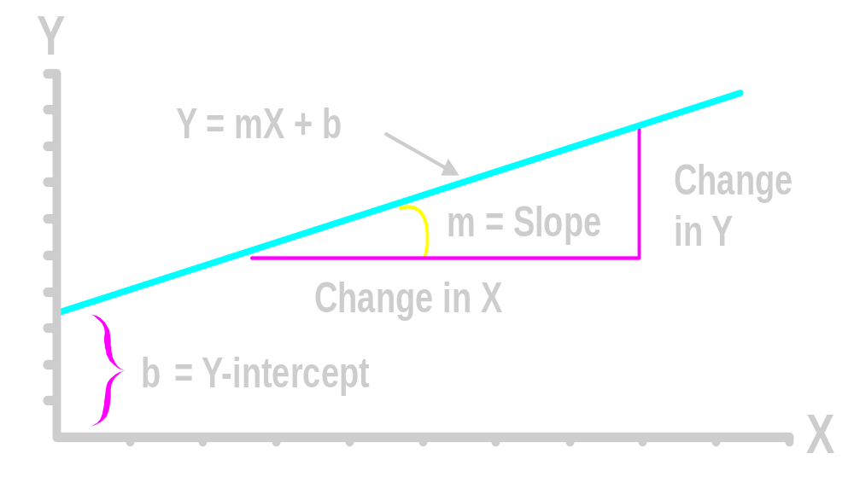

Linear Equations
EPI 809/Spring 2008
© 1984-1994 T/Maker Co.
Notes:
28

Slide 30
Linear Regression Model
1. Relationship Between Variables Is a Linear Function
Population
Y-Intercept
Population Slope
Random Error
Y
=
β
+
β
X
+
ε
i
0
1
i
i
Dependent (Response) Variable
(e.g., CD+ c.)
Independent (Explanatory) Variable
(e.g., Years s. serocon.)

Slide 31
Population & Sample Regression Models
EPI 809/Spring 2008
Notes:
30

Slide 32
Population & Sample Regression Models
Population
☺
☺
☺
☺
☺
EPI 809/Spring 2008
Notes:
31

Slide 33

Population & Sample Regression Models
Population
Unknown Relationship
☺
☺
☺
☺
☺
EPI 809/Spring 2008
Notes:
32

Slide 34
Population & Sample Regression Models
Population
Random Sample
Unknown Relationship
☺
☺
☺
☺
☺
☺
☺
EPI 809/Spring 2008
Notes:
33

Slide 35
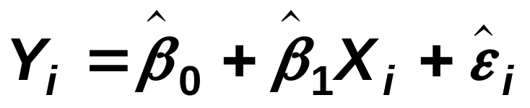
Population & Sample Regression Models
Population
Random Sample
Unknown Relationship
☺
☺
☺
☺
☺
☺
☺
EPI 809/Spring 2008
Notes:
34

Slide 36
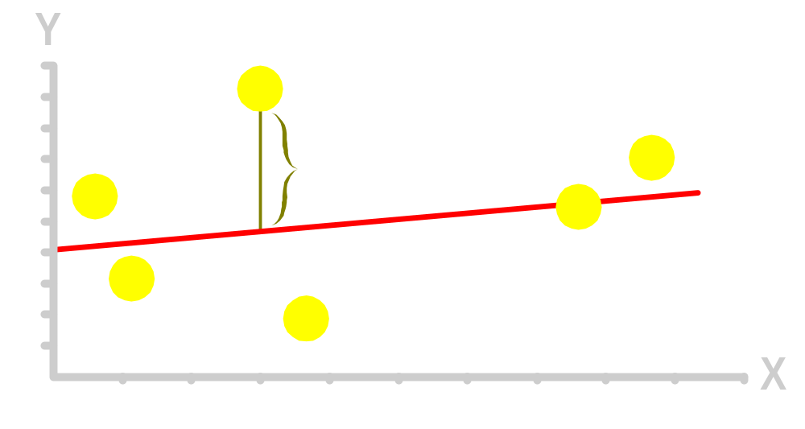
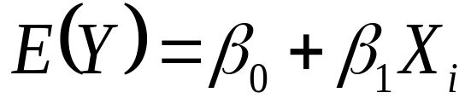
Population Linear Regression Model
Observedvalue
ε_{i} = Random error
Observed value
EPI 809/Spring 2008
Notes:
35

Slide 37
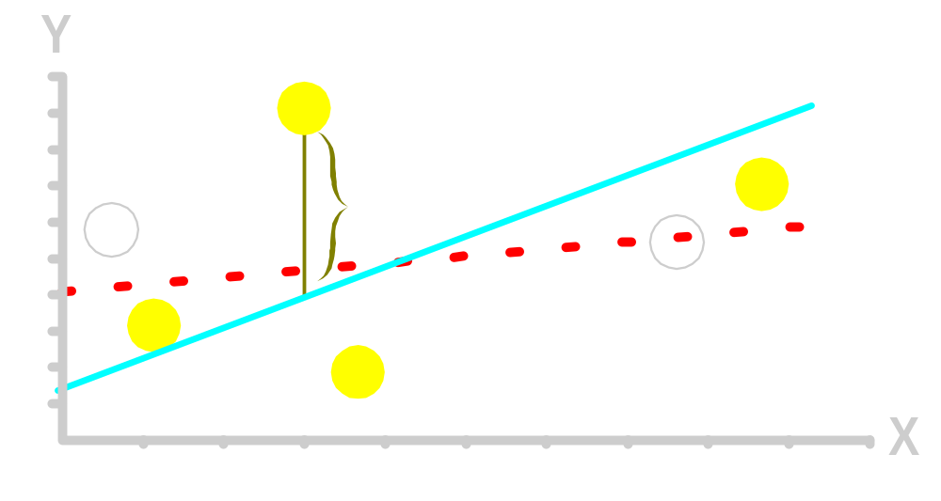
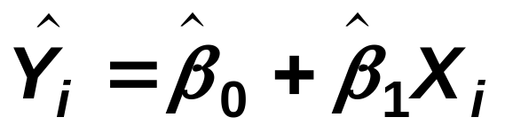
Sample Linear Regression Model
ε_{i} = Random error
^
Unsampled observation
Observed value
EPI 809/Spring 2008
Notes:
36

Slide 38
Estimating Parameters:
Least Squares Method
EPI 809/Spring 2008
Notes:
40

Slide 39
Scatter plot
1. Plot of All (X_{i}, Y_{i}) Pairs
2. Suggests How Well Model Will Fit
Y
60
40
20
0
X
0
20
40
60
EPI 809/Spring 2008

Slide 40
Thinking Challenge
How would you draw a line through the points? How do you determine which line ‘fits best’?
Y
60
40
20
0
X
0
20
40
60
EPI 809/Spring 2008
Notes:
42

Slide 41
Thinking Challenge
How would you draw a line through the points? How do you determine which line ‘fits best’?
Slope changed
Y
60
40
20
0
X
0
20
40
60
Intercept unchanged
EPI 809/Spring 2008
Notes:
43

Slide 42
Thinking Challenge
How would you draw a line through the points? How do you determine which line ‘fits best’?
Slope unchanged
Y
60
40
20
0
X
0
20
40
60
Intercept changed
EPI 809/Spring 2008
Notes:
44

Slide 43
Thinking Challenge
How would you draw a line through the points? How do you determine which line ‘fits best’?
Slope changed
Y
60
40
20
0
X
0
20
40
60
Intercept changed
EPI 809/Spring 2008
Notes:
45

Slide 44
Least Squares
1. ‘Best Fit’ Means Difference Between Actual Y Values & Predicted Y Values Are a Minimum. But Positive Differences Off-Set Negative ones
EPI 809/Spring 2008
Notes:
49

Slide 45
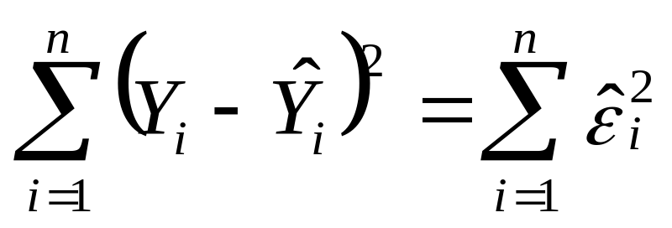
Least Squares
1. ‘Best Fit’ Means Difference Between Actual Y Values & Predicted Y Values is a Minimum. But Positive Differences Off-Set Negative ones. So square errors!
EPI 809/Spring 2008
Notes:
50

Slide 46

Least Squares
1. ‘Best Fit’ Means Difference Between Actual Y Values & Predicted Y Values Are a Minimum. But Positive Differences Off-Set Negative. So square errors!
2. LS Minimizes the Sum of the Squared Differences (errors) (SSE)
EPI 809/Spring 2008
Notes:
51

Slide 47
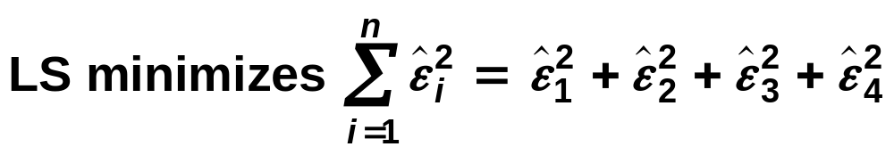
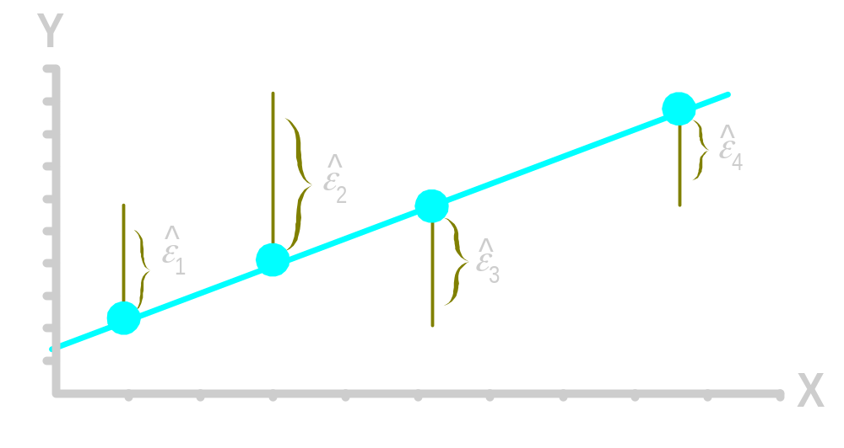
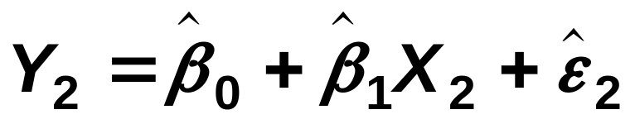
Least Squares Graphically
EPI 809/Spring 2008
Notes:
52

Slide 48
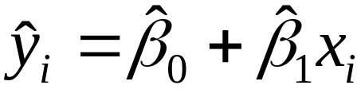
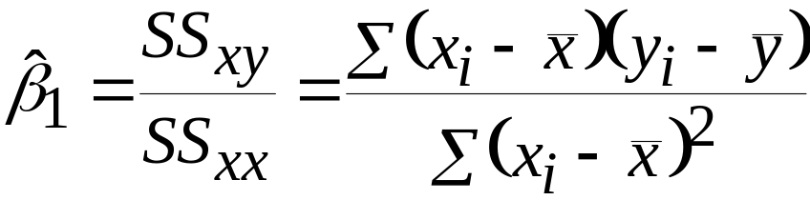
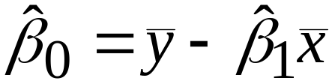
Coefficient Equations
Prediction equation
Sample slope
Sample Y - intercept
EPI 809/Spring 2008

Slide 49
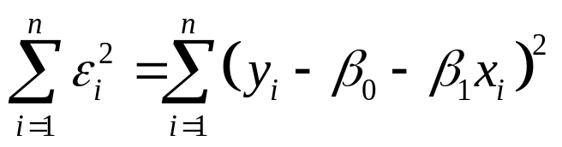
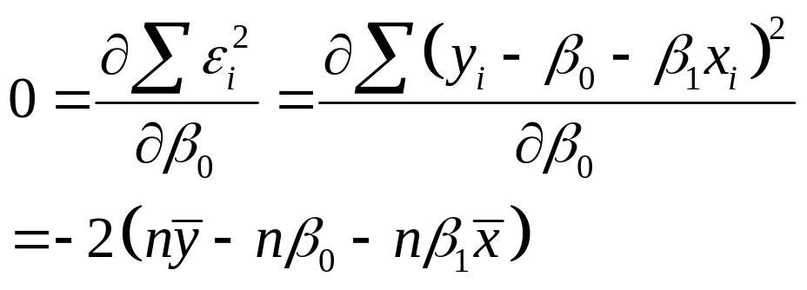
Derivation of Parameters (1)
Least Squares (L-S):
Minimize squared error
EPI 809/Spring 2008

Slide 50
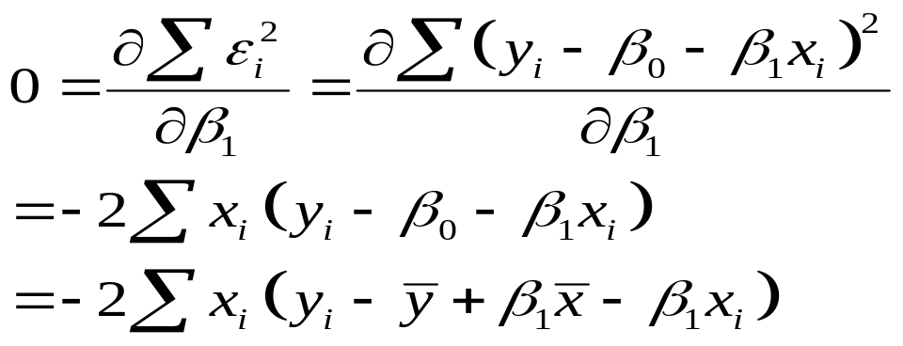
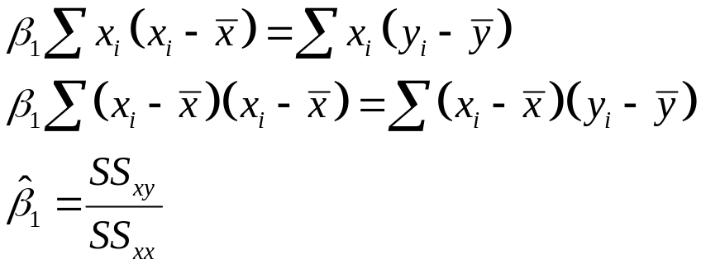
Derivation of Parameters (1)
Least Squares (L-S):
Minimize squared error
EPI 809/Spring 2008

Slide 51
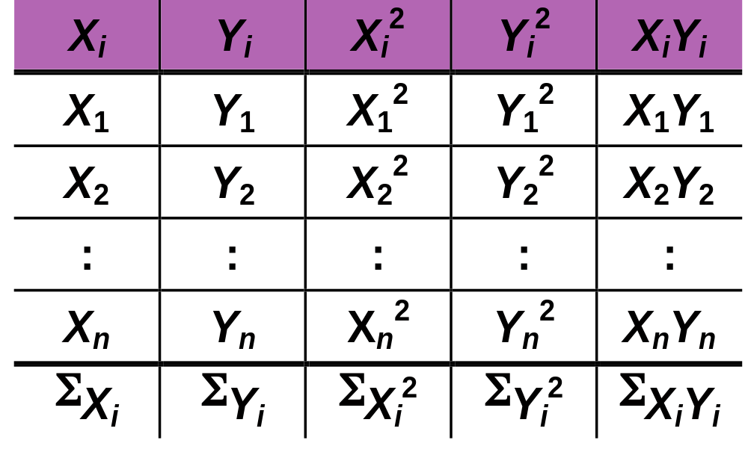
Computation Table
EPI 809/Spring 2008
Notes:
54

Slide 52
Interpretation of Coefficients
EPI 809/Spring 2008

Slide 53
Interpretation of Coefficients
^
1. Slope (β₁)
  Estimated Y Changes by β₁ for Each 1 Unit Increase in X
    If β₁ = 2, then Y Is Expected to Increase by 2 for Each 1 Unit Increase in X
^
^
EPI 809/Spring 2008

Slide 54
Interpretation of Coefficients
^
1. Slope (β₁)
  Estimated Y Changes by β₁ for Each 1 Unit Increase in X
    If β₁ = 2, then Y Is Expected to Increase by 2 for Each 1 Unit Increase in X
2. Y-Intercept (β₀)
  Average Value of Y When X = 0
    If β₀ = 4, then Average Y Is Expected to Be 4 When X Is 0
^
^
^
^
EPI 809/Spring 2008

Slide 55
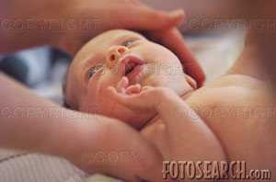
Parameter Estimation Example
Obstetrics: What is the relationship between
Mother’s Estriol level & Birthweight using the following data?
Estriol Birthweight
(mg/24h) (g/1000)
1 1
2 1
3 2
4 2
5 4
EPI 809/Spring 2008

Slide 56

Scatterplot
Birthweight vs. Estriol level
Birthweight
Estriol level
EPI 809/Spring 2008
Notes:
57

Slide 57
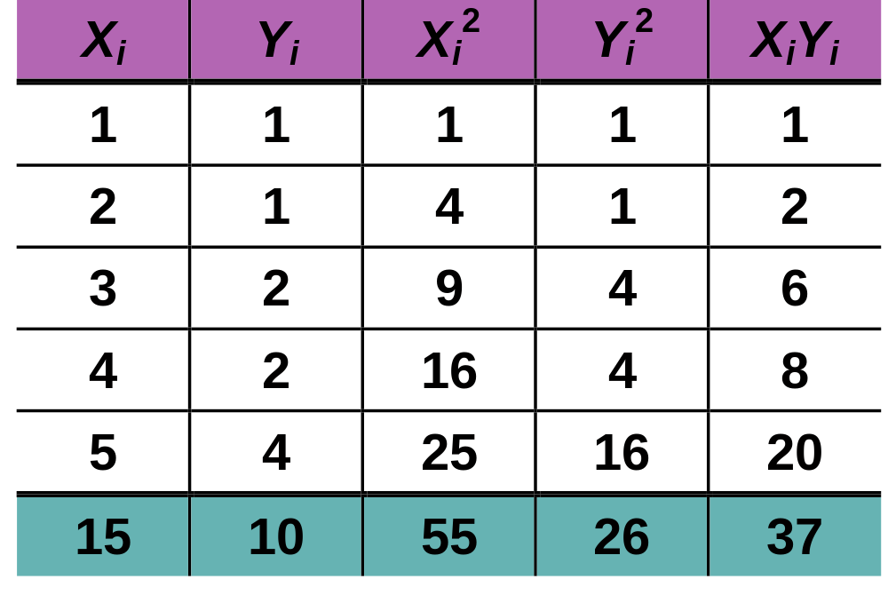
Parameter Estimation Solution Table
EPI 809/Spring 2008
Notes:
58

Slide 58
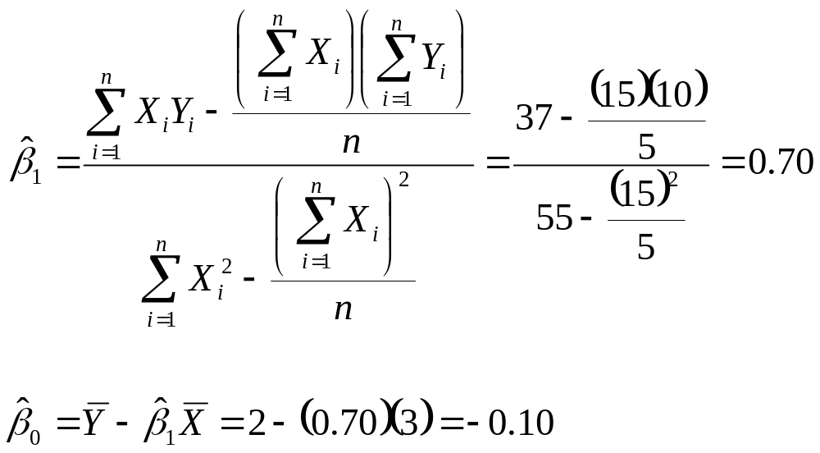
Parameter Estimation Solution
EPI 809/Spring 2008
Notes:
59

Slide 59
Coefficient Interpretation Solution
EPI 809/Spring 2008

Slide 60
Coefficient Interpretation Solution
^
1. Slope (β₁)
  Birthweight (Y) Is Expected to Increase by .7 Units for Each 1 unit Increase in Estriol (X)
EPI 809/Spring 2008

Slide 61
Coefficient Interpretation Solution
^
1. Slope (β₁)
  Birthweight (Y) Is Expected to Increase by .7 Units for Each 1 unit Increase in Estriol (X)
2. Intercept (β₀)
  Average Birthweight (Y) Is -.10 Units When Estriol level (X) Is 0
    Difficult to explain
    The birthweight should always be positive
^
EPI 809/Spring 2008

Slide 62
SAS codes for fitting a simple linear regression
Data BW; /*Reading data in SAS*/
input estriol birthw@@;
cards;
1 1 2 1 3 2
4 2 5 4
;
run;
PROC REG data=BW; /*Fitting linear regression models*/
model birthw=estriol;
run;
EPI 809/Spring 2008

Slide 63
Parameter Estimation
SAS Computer Output
Parameter Estimates
Parameter Standard
Variable DF Estimate Error t Value Pr > |t|
Intercept 1 -0.10000 0.63509 -0.16 0.8849
Estriol 1 0.70000 0.19149 3.66 0.0354
^
^
β₀
β₁
EPI 809/Spring 2008

Slide 64

Parameter Estimation Thinking Challenge
You’re a Vet epidemiologist for the county cooperative. You gather the following data:
Food (lb.) Milk yield (lb.)
4 3.0
6 5.5
10 6.5
12 9.0
What is the relationship
between cows’ food intake and milk yield?
© 1984-1994 T/Maker Co.
EPI 809/Spring 2008
Notes:
62

Slide 65

Scattergram
Milk Yield vs. Food intake*
M. Yield (lb.)
Food intake (lb.)
EPI 809/Spring 2008
Notes:
65

Slide 66
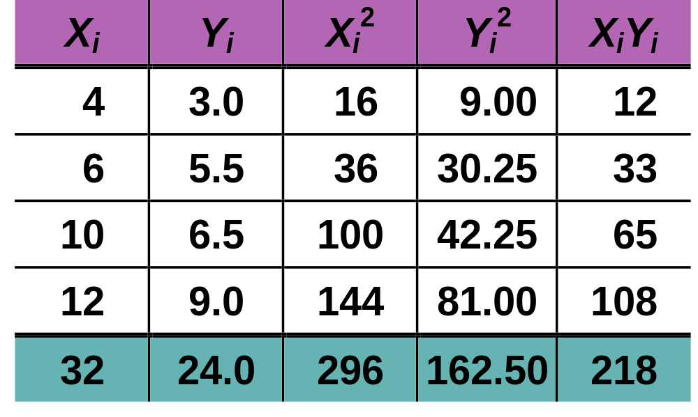
Parameter Estimation Solution Table*
EPI 809/Spring 2008
Notes:
66

Slide 67
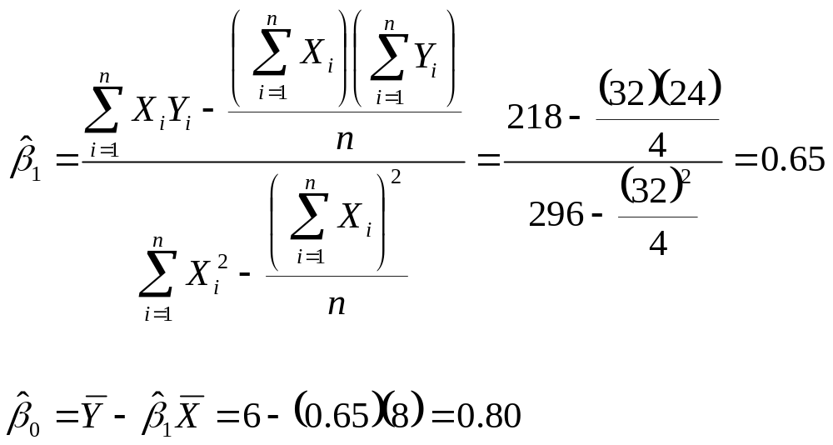
Parameter Estimation Solution*
EPI 809/Spring 2008
Notes:
67

Slide 68
Coefficient Interpretation Solution*
EPI 809/Spring 2008

Slide 69
Coefficient Interpretation Solution*
^
1. Slope (β₁)
  Milk Yield (Y) Is Expected to Increase by .65 lb. for Each 1 lb. Increase in Food intake (X)
EPI 809/Spring 2008

Slide 70
Coefficient Interpretation Solution*
^
1. Slope (β₁)
  Milk Yield (Y) Is Expected to Increase by .65 lb. for Each 1 lb. Increase in Food intake (X)
2. Y-Intercept (β₀)
  Average Milk yield (Y) Is Expected to Be 0.8 lb. When Food intake (X) Is 0
^
EPI 809/Spring 2008

