Slide 1
version control and git

Slide 2
why do we need version control?
Head to this link: bit.ly/2cgYzaF

Slide 3
why do we need version control?
Making changes

Slide 4
why do we need version control?
Making changes
Saving versions

Slide 5
why do we need version control?
Making changes
Saving versions
Recovering a specific version

Slide 6
why do we need version control?
Making changes
Saving versions
Recovering a specific version
Merging

Slide 7
what is version control
Where is my data?

Slide 8
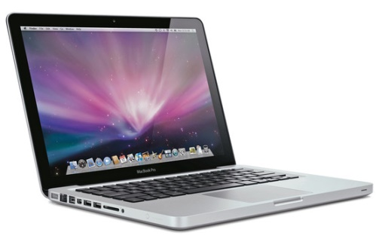
what is version control
Where is my data?
My Computer

Slide 9

what is version control
Where is my data?
The “cloud”
My Computer

Slide 10

what is version control
Where is my data?
The “cloud”
My Computer

Slide 11
what is version control
Where is my data?
The “cloud”
My Computer

Slide 12

what is version control
Where is my data?
The “cloud”
My Computer

Slide 13
what is version control
We use a program called git to do our version control

Slide 14
what is version control
We use a program called git to do our version control
git has a set of tools that let you:
Make changes
Save versions
Recover a specific version
Merge

Slide 15
what is version control
We use a program called git to do our version control
git has a set of tools that let you:
Make changes: “adding” a change
Save versions
Recover a specific version
Merge

Slide 16
what is version control
We use a program called git to do our version control
git has a set of tools that let you:
Make changes: “adding” a change
Save versions: “committing” a version
Recover a specific version
Merge

Slide 17
what is version control
We use a program called git to do our version control
git has a set of tools that let you:
Make changes: “adding” a change
Save versions: “committing” a version
Recover a specific version: “pulling” from the cloud
Merge

Slide 18
what is version control
We use a program called git to do our version control
git has a set of tools that let you:
Make changes: “adding” a change
Save versions: “committing” a version
Recover a specific version: “pulling” from the cloud
Merge: “merge”

Slide 19
how will I use version control?
Use git through RStudio:
Simple
You will probably use RStudio anyways

Slide 20
how will I use version control?
Use git through RStudio:
Simple
You will probably use RStudio anyways
(2) Use the github app
Simple
Not tied to R/RStudio

Slide 21
how will I use version control?
Use git through RStudio:
Simple
You will probably use RStudio anyways
(2) Use the github app
Simple
Not tied to R/RStudio
(3) Use git through terminal
More powerful, not as simple

Slide 22
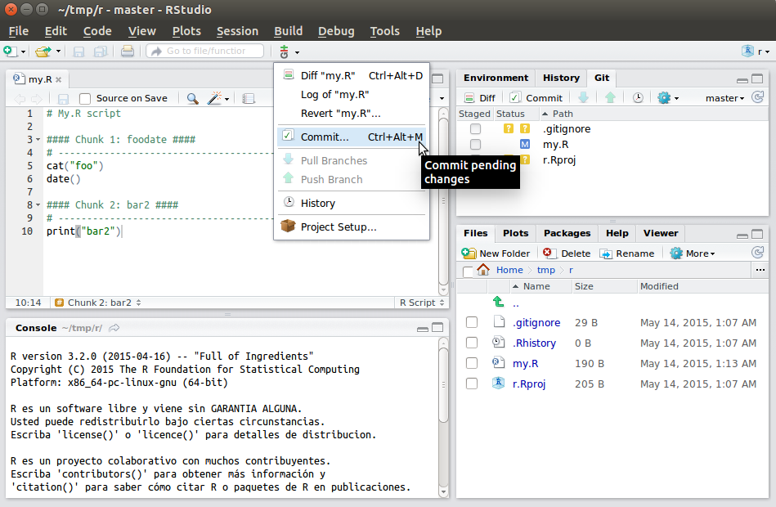
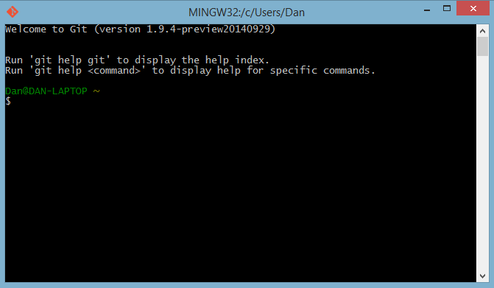
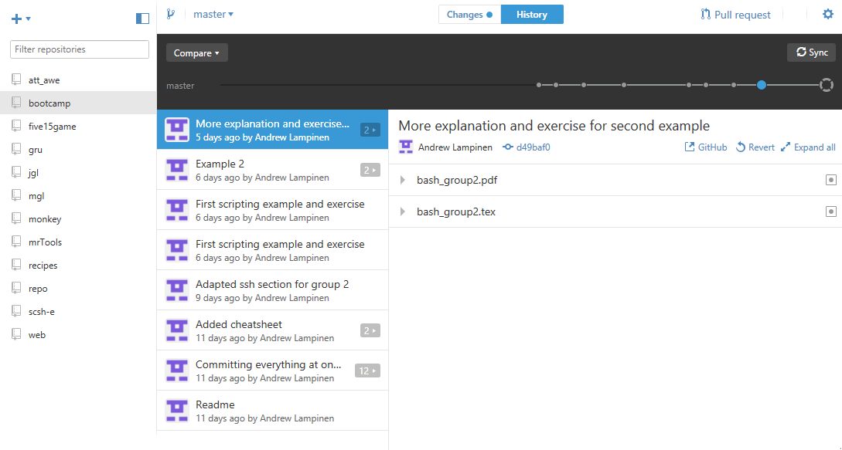
Rstudio:
Terminal/Bash:
Github App:

Slide 23
Rstudio:
Mac?
Windows?
Terminal/Bash:
Github App:

Slide 24
pull
The “cloud”
My Computer

Slide 25
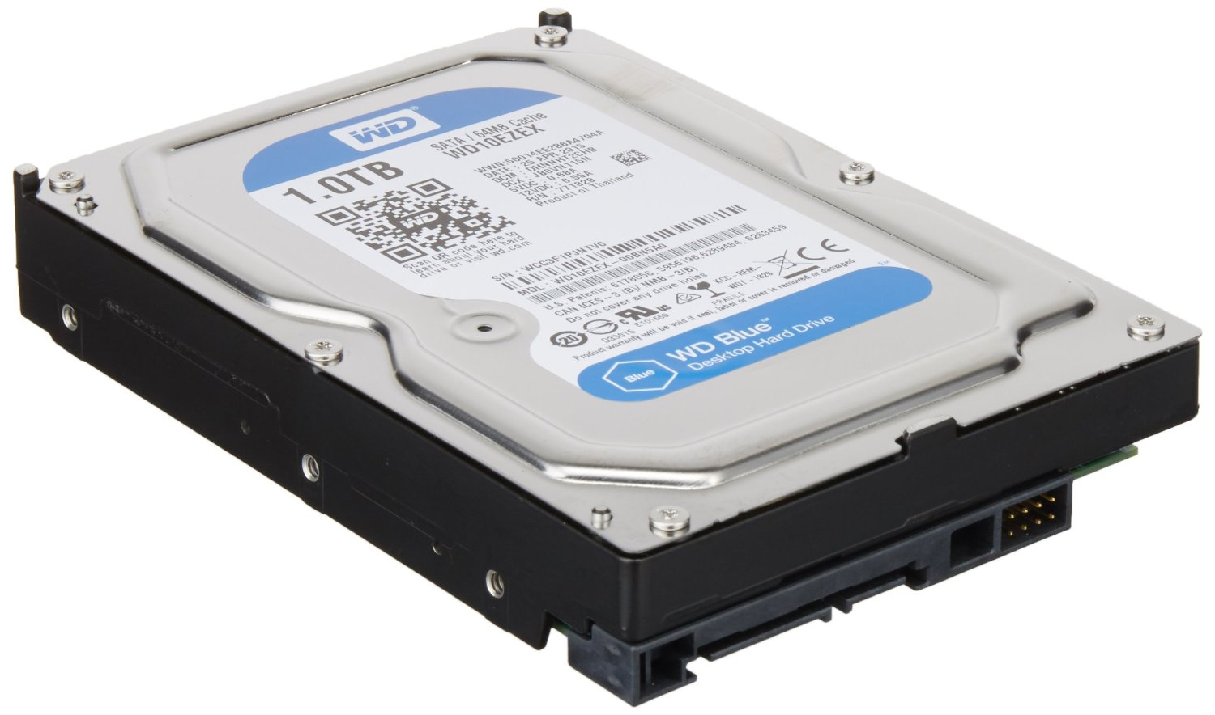
add
The “cloud”
My Computer
Files to keep track of

Slide 26
commit
The “cloud”
My Computer
Saved
Local Changes
Files to keep track of

Slide 27
push
The “cloud”
My Computer
Saved
Local Changes
Files to keep track of

Slide 28
merge
The “cloud”
Changed ‘a.txt’
My Computer
Also changed
‘a.txt’

Slide 29
philosophy
Why?
The “cloud”
My Computer

