Slide 1
Economic Inequality
Arshnoor Jandu
DS8007 Project Presentation
Winter, 2018

Slide 2
Agenda
Define Problem
Data Sources
Technology Used
Data Processing
Visualizations

Slide 3
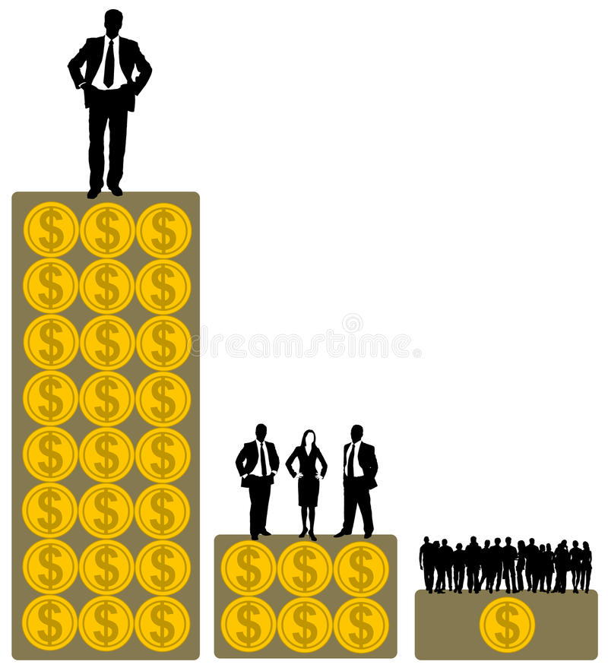
Problem: Rich is getting richer and poor poorer!

Slide 4


Data Sources
Analysis at world level
WID open data source (http://wid.world/)
Interactive interface to query data with required parameters
Download datasets as excel file
Analysis at Canada level
Government of Canada (https://open.canada.ca/en )
SFS (Survey of Financial Securities)
Download datasets in .csv format

Slide 5
Technology Used
Plotly Python Library
Jupyter Notebook
D3

Slide 6
Data Preprocessing
Raw Data
Structure Data
Explore Data
Data Ready for Viz

Slide 7
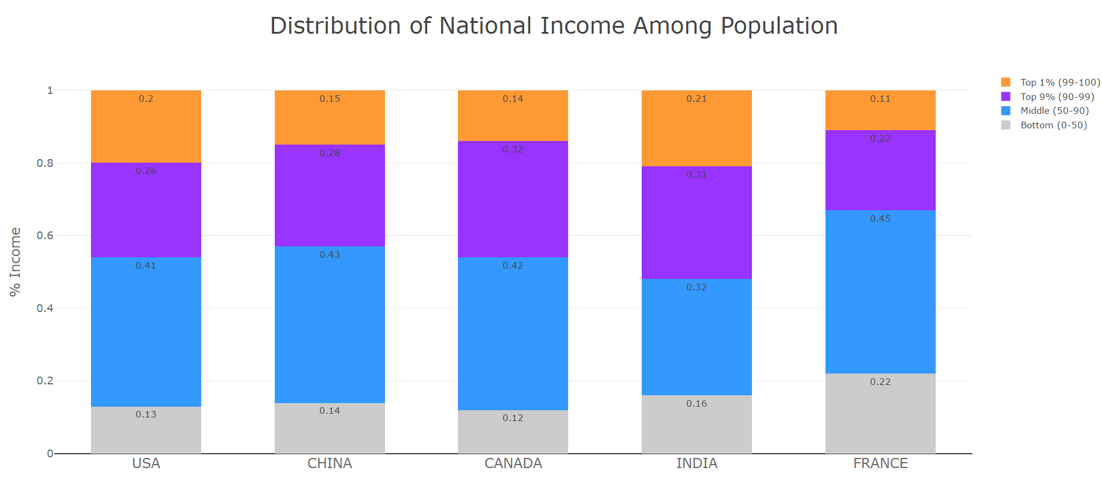
Economic Inequality 2015

Slide 8
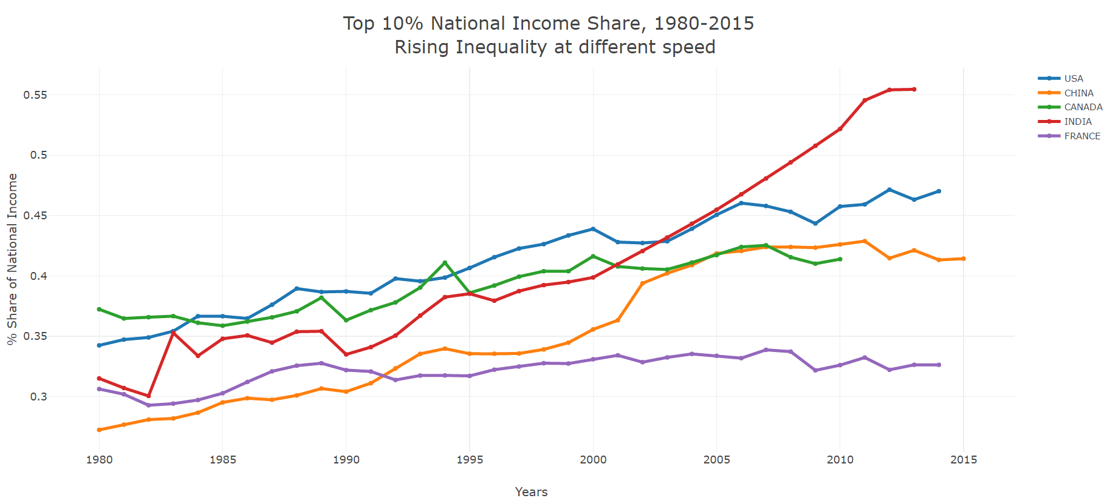
Rise in Top 10%

Slide 9
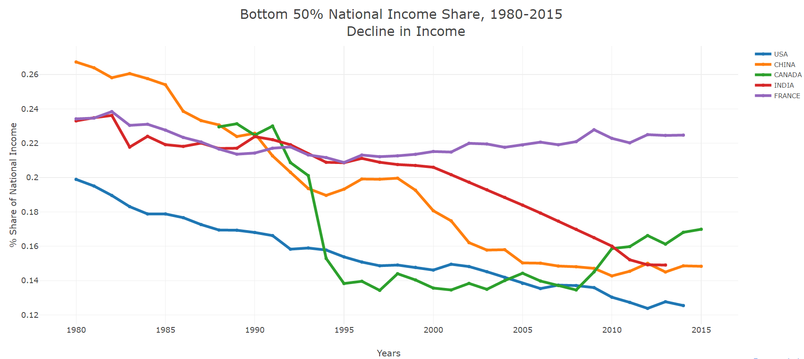
Decline in bottom 50%

Slide 10
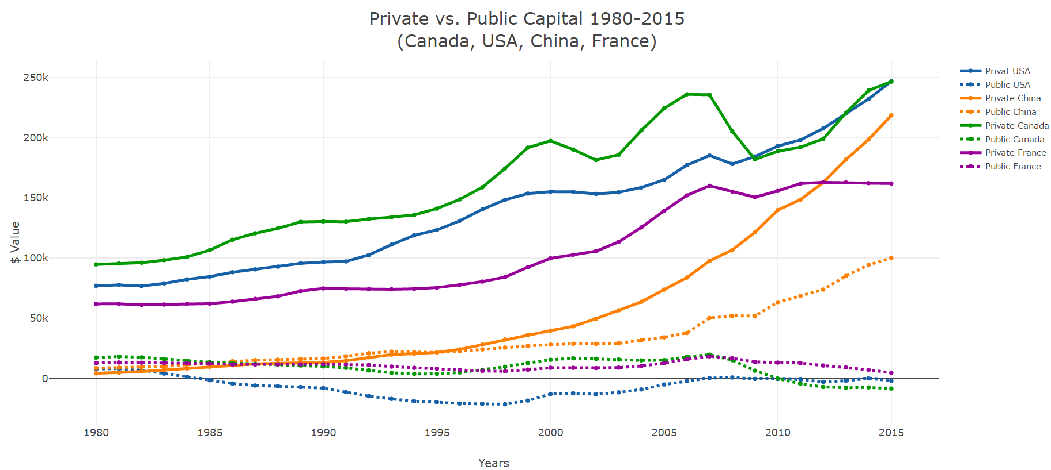
Private vs. Public Capital

Slide 11
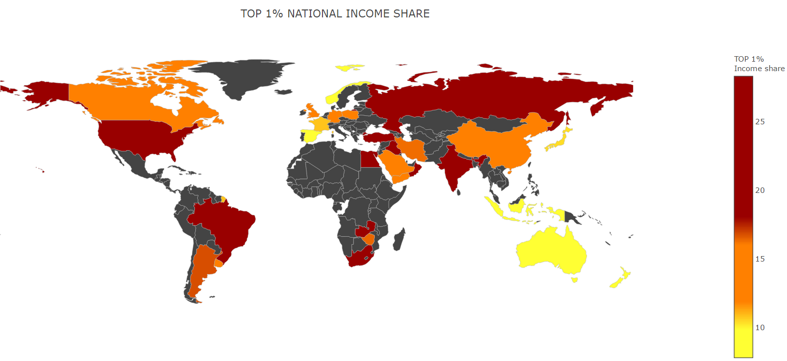
Income Inequality across World 2015

Slide 12
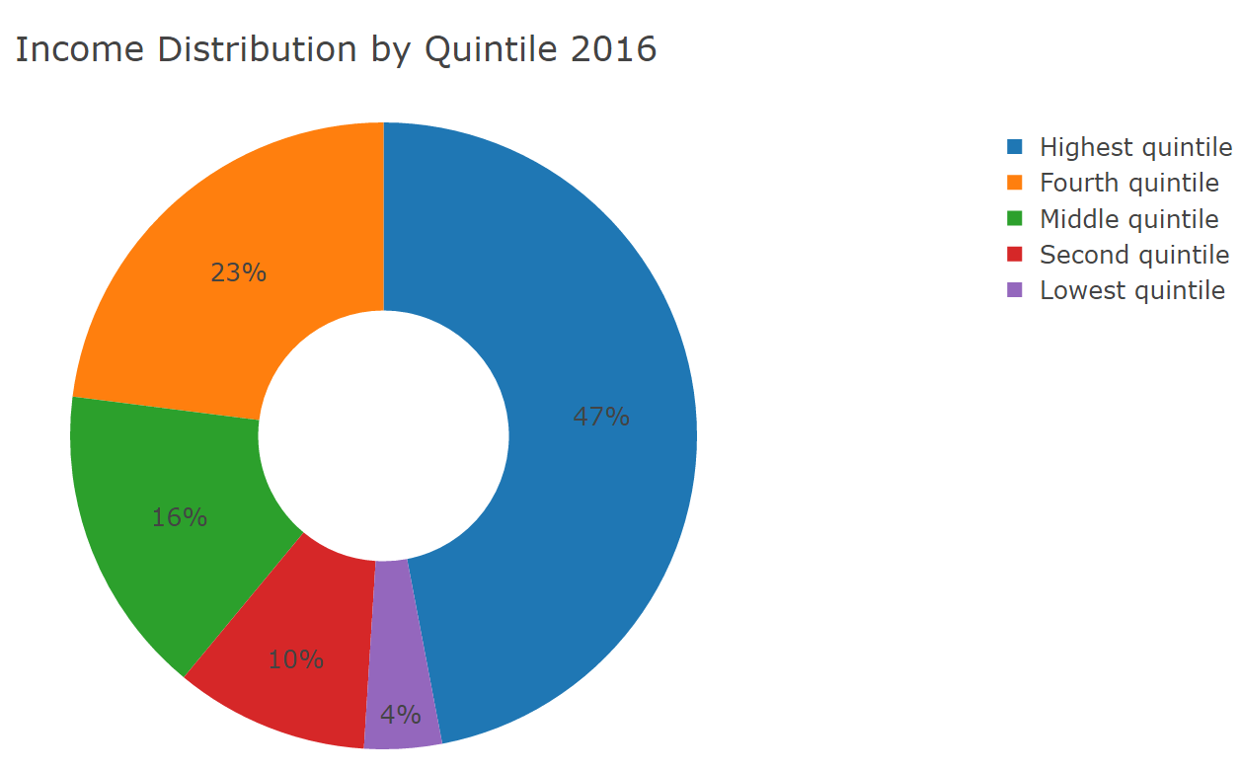
Economic Inequality in Canada 2016

Slide 13
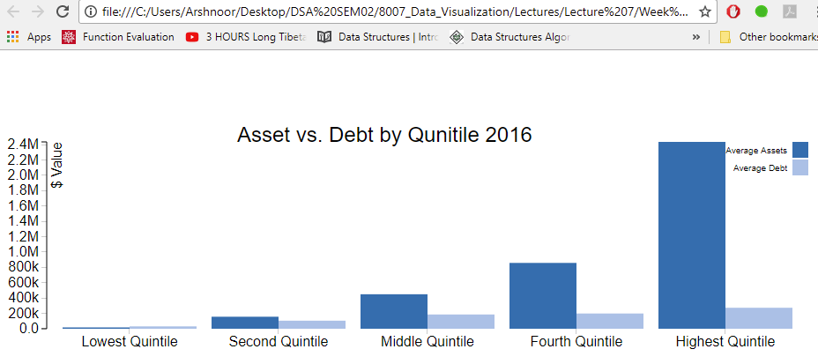
Assets vs. Debt By Quintile 2016

Slide 14
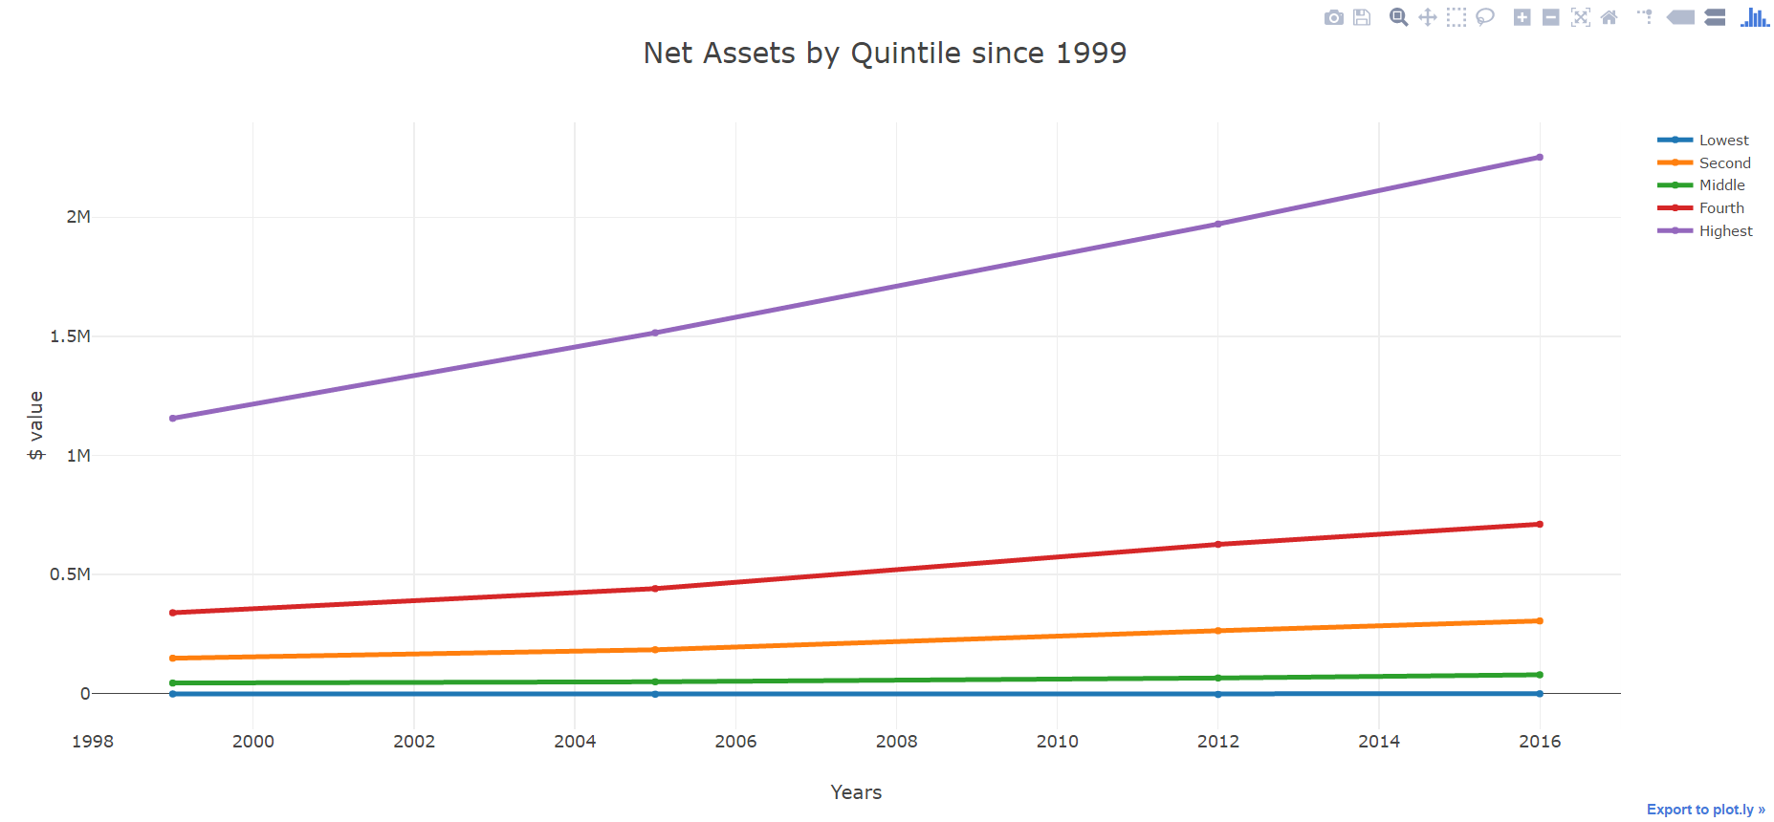
Rising Inequality since 1999

Slide 15
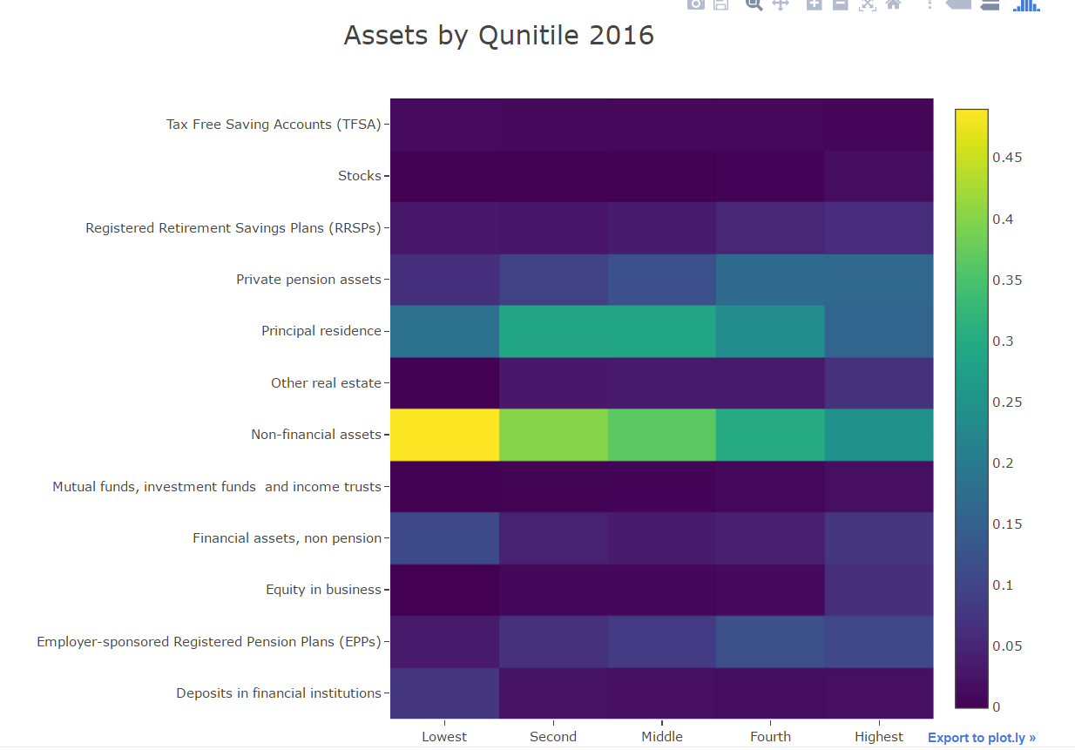
Assets by Quintile 2016

Slide 16
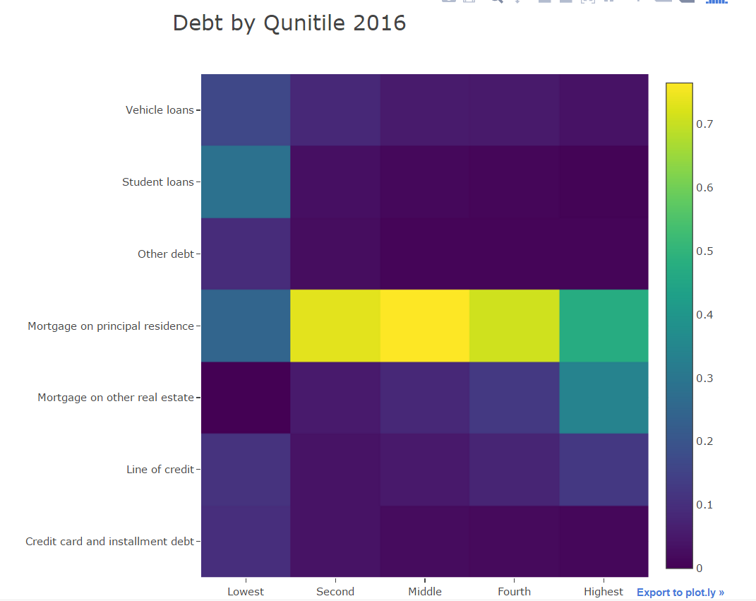
Debt by Quintile 2016

Slide 17
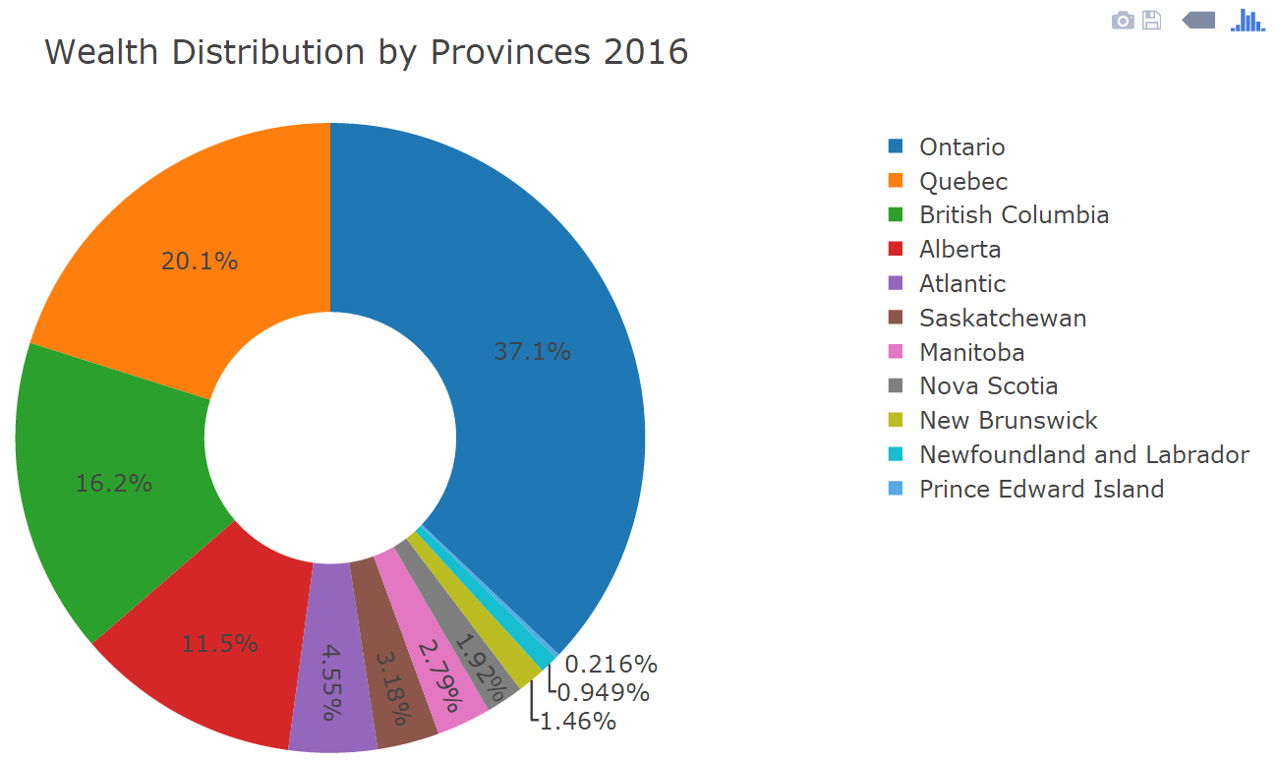
Wealth distribution by Provinces 2016

Slide 18
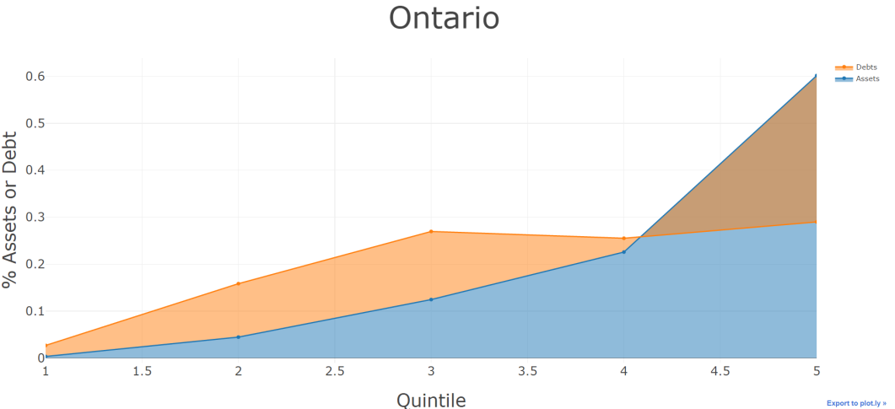
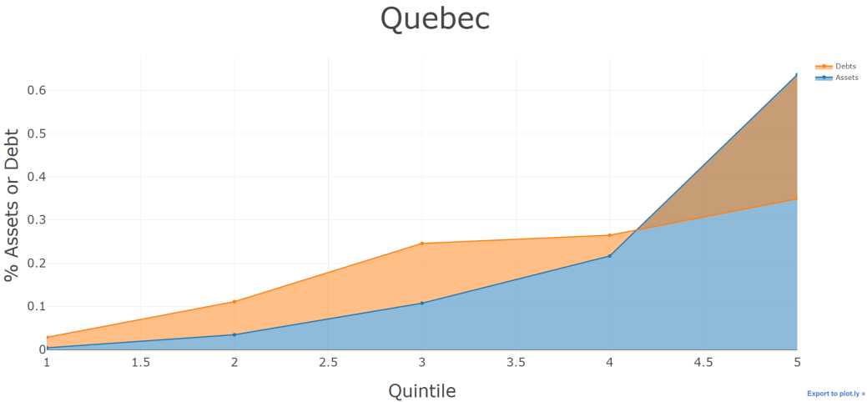
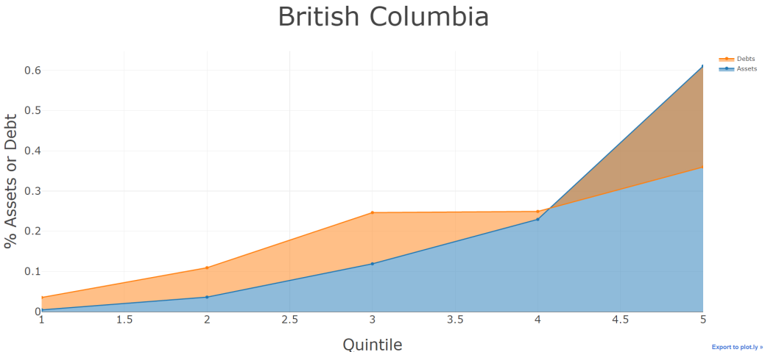
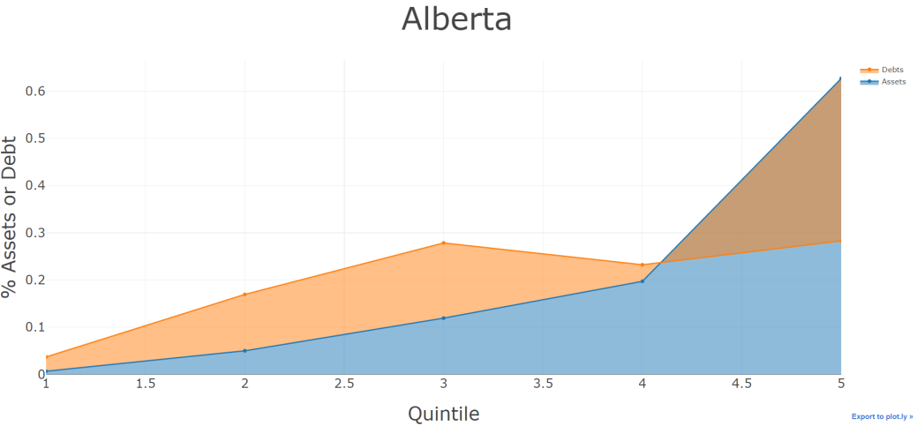
Distribution of Assets and Debt by Quintile in different provinces 2016

Slide 19
Conclusion
Economic inequality is a worldwide problem now
Increase in privatization is creating inequality
Top 10% business owners are making rising profits by cutting wages of bottom 50%
Canadian middle class families have same amount of debt as rich folks
Ontario is the richest province of Canada

Slide 20
Questions?

