Slide 1
Neural Architecture Search : Mid-Evaluation Presentation
Ashish Kumar Jayant (M.Tech Research, CSA)
Ankith Kumar (M.Tech, CSA)
Somyajit Guin (PhD, CSA)

Slide 2
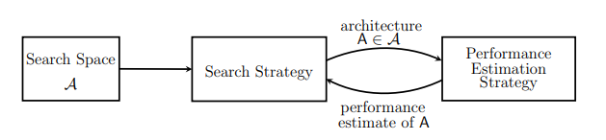
Neural Architecture Search (NAS) : Let’s Recall
Process of automating the architecture design part of Deep Learning neural networks.
Performance should be comparable to state of the art results.
Challenges : Search Space,Search strategy, Performance Estimation Strategy
Usability across datasets?

Slide 3
Neural Architecture Search with
Reinforcement learning (Zoph, B. and Le, Q. V. ,Google Brain,2016)
Formulation of NAS as Reinforcement Learning problem –
  State Space : set of possible architectures
    So as to bound the search space we have some predefined elements for e.g Image Classification datasets we will have Conv kernel, Pooling kernel,activation functions etc with limited no of layers and language models will have recurrent cells and activation functions.
    Note that search space do not include set of optimizers (sgd,adam,adagrad etc) here.
  Reward : Corresponding Performance metric ( for e.g Error rate for CiFAR,Perplexity for PennTreeBank dataset)
  Action: Generating/Choosing an architecture
  Policy : Stochastic Policy i.e, we will have probability of choosing an architecture not a determinsitic policy.
  Training mechanism : Policy Gradient
    Better convergence properties.
    Effectiveness in high-dimensional or continuous action spaces
    Ability to learn stochastic policies

Slide 4
Neural Architecture Search with
Reinforcement learning : Generation of network
Neural Networks can be represented as variable length string.
For e.g (as given in paper) a simple feedforward CNN can be represented as -
layer {
name = layer_1
type = conv
connect_to = input
filter_width = 2
filter_height = 2
stride_width = 4
stride_height = 5
num_filters = 8
}
layer {
name = layer_2
type = conv
connect_to = layer_1
filter_width = 7
filter_ height = 8
stride_width = 9
stride_height = 10
num_filters = 11
}
layer {
name = classifier
connect_to = layer_2
num_class = 10
}
Layer 1
Layer 2
“2, 2, 4, 5, 8, 7, 8,9,10,11”
Filter width
Filter height
Stride width
Stride height
Num filters
Filter width
Filter height
Stride width
Stride height
Num filters

Slide 5
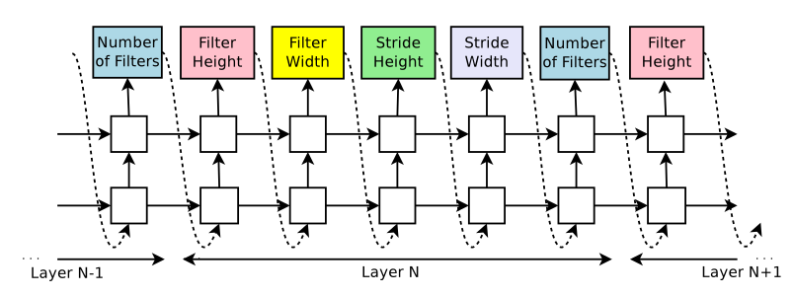
Neural Architecture Search with
Reinforcement learning : Generation of network contd
*Image Source - Zoph, B. and Le, Q. V. Neural architecture search with reinforcement learning, 2016

Slide 6
Neural Architecture Search with
Reinforcement learning : Flow
Using
Stochastic
policy
Samples a model m
with probability p
Controller (RNN)
With parameters k
Train m from scratch
To get reward r
Policy
Gradient
Use r to update
the controller parameters k

Slide 7
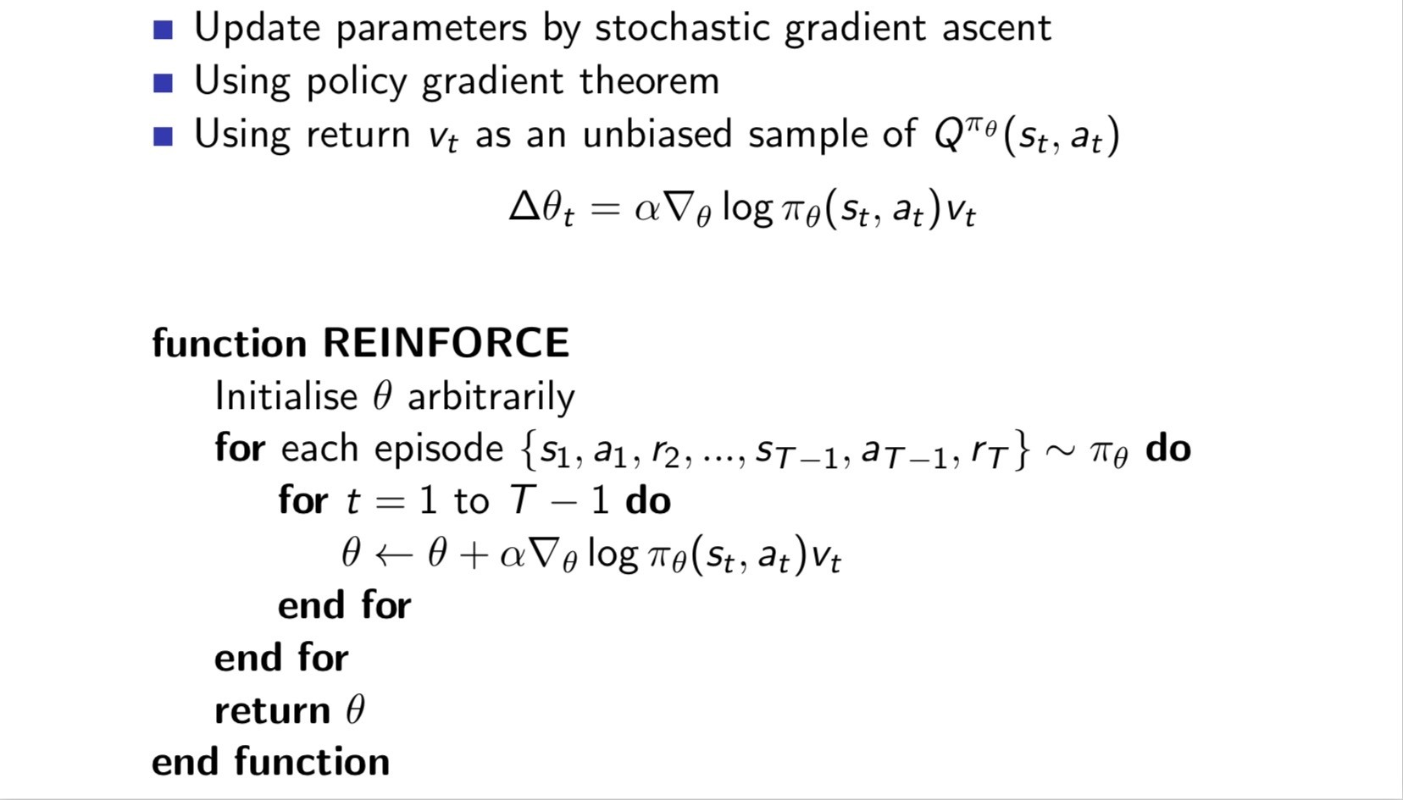
Neural Architecture Search with
Reinforcement learning : Training controller
*Source –
David Silver’s RL
lecture series

Slide 8
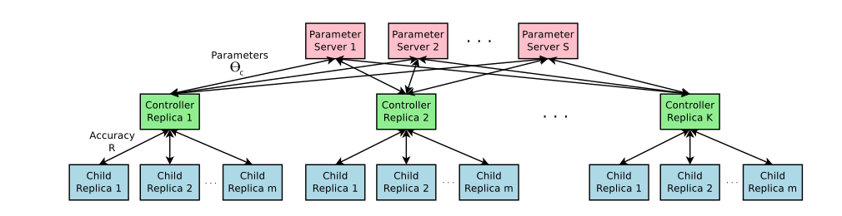
Neural Architecture Search with
Reinforcement learning : Training setup
S shards of shared contoller
parameters
K controllers
Each
Controllers
Training m
Different child
models
*Image Source - Zoph, B. and Le, Q. V. Neural architecture search with reinforcement learning, 2016

Slide 9
Neural Architecture Search with
Reinforcement learning : Pros & Cons
Achieves state of the art results on CiFAR and PenTreebank datasets
Can be used as baseline for other NAS models
Computationally expensive
  800 GPUs used for CiFAR,
  450 GPUs used for PenTreeBank
Complexity of implementation due to distributed training setup.
Suffers with disdavantages of policy gradient method.

Slide 10
Efficient Neural Architecture Search via Parameter Sharing
(Pham, H., Guan, M. Y., Zoph, B., Le, Q. V., and Dean. J,Google Brain-Stanford-CMU collab, 2018)
Search Strategy is still Reinforcement learning based, hence our framework will remain same.
Two important changes -
  Generation of Architecture
  Sharing of parameters of child models instead of re-training it again.

Slide 11
Efficient Neural Architecture Search via Parameter Sharing : Generation
Main idea is that we can represent search space of NAS as a single directed acyclic graph (DAG).
Choosing/sampling an architecture will mean choosing a sub-graph of this large DAG.
This design also allows parameters to be shared between child models.
1
4
2
5
3
Chosen subgraph : [1,2,4]
Resultant computation : op_node4(op2_node2(op_node1(input)))

Slide 12
Efficient Neural Architecture Search via Parameter Sharing : Generation of Recurrent cell (for text based problems) example
Assume node 1 to be input node, h_{t-1} and w_{x} are initialized by us and let list of activation functions we want to sample from be [tanh,relu,sigmoid].
W_{ij} are global and is shared among all sampled sub-graphs which enables parameter sharing.
Controller have two decision to make
  Which activation function?
  Which previous node to connect from or which weight matrix w_{ij} will be activated?
x_{t}
w_{x}
1
w₁₂
4
h_{t-1}
w₂₄
2
w₂₄
3
5

Slide 13
Efficient Neural Architecture Search via Parameter Sharing : Generation of Recurrent cell (for text based problems) example contd.
At node 1 controller samples activation function ‘tanh’,
h₁ = tanh(x_{t}.W_{x} + h_{t-1}.W_{h})
At node 2, controller sample ‘relu’ and prev node index ‘1’ which activates globally shared w₁₂
h₂ = relu(w₁₂.h₁)
At node 3, controller samples ‘relu’ and prev node index ‘1’.
h ₃ = relu( w₁₃.h₁)
At node 4, controller samples ‘sigmoid’ and prev node index ‘2’.
h₄ = sigmoid(w₂₄.h₂)
At node 5, controller samples ‘tanh’ and prev node index ‘2’
h₅ = tanh(w₂₅.h₂)
Final output : h_{t} = mean(h₄,h₅,h₃)
x_{t}
w_{x}
1
w₁₂
4
h_{t-1}
w_{h}
w₂₄
w₁₃
2
w₂₄
3
5
tanh
x_{t}
sigmoid
w₁₂
h_{t-1}
w_{h}
w₁₃
relu
w₂₄
w₂₄
h_{t}
tanh
relu
avg

Slide 14
Efficient Neural Architecture Search via Parameter Sharing : Training
There are two sets of learnable parameters: the parameters of the controller LSTM, denoted by θ, and the shared parameters of the child models, denoted by ω.
The training procedure of ENAS consists of two interleaving phases.
  Fix the controller policy and train child models using SGD on ω to minimize the expected loss function.
    Loss function is cross-entropy loss L(m;ω) computed on mini-batch of training data, model m sampled using parametrized stochastic policy π(m;θ) (*turns out any sampled model can be used to update the gradient) then perform SGD(batch_size, m)
  Fix the ω and update the policy paramters θ aiming to maximise expected reward using Monte Carlo Policy Gradient (REINFORCE) described in slide 7.

Slide 15
Efficient Neural Architecture Search via Parameter Sharing : Flow
Samples a model m
Use m to update
shared parameters
omega
1
4
Controller
2
3
5
Compute m’s reward
R (accuracy)
on validation set
Use R to
Update contoller
parameters
theta

Slide 16
Efficient Neural Architecture Search via Parameter Sharing : Pros & Cons
Achieves state of the art results on PenTreebank datasets and almost beats NAS on CiFAR.
Required Nvidia GTX 1080i for 16 hours for training PenTreeBank dataset.
Cannot search through optimizers in theory as it will require freezing of shared parameters.
Suffers with disdavantages of policy gradient method.

