Slide 1
Neural Architecture Search : Introduction Presentation
Ankith Kumar (M.Tech, CSA)
Ashish Kumar Jayant (M.Tech Research, CSA)
Somyajit Guin (PhD, CSA)

Slide 2
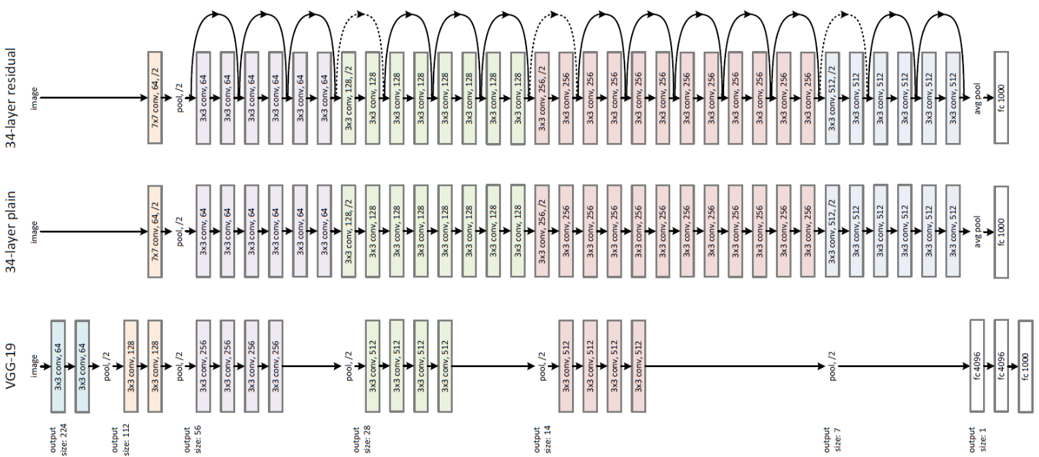
ResNet (Microsoft): Winner of ImageNet

Slide 3
Design of Deep Neural Network Architectures
State of the art deep neural network architectures are handcrafted by team of researchers and engineers.
These architecture are generally enormous and highly complex.
But they are dataset specific.
How can someone come up with this for any dataset they have, provided we can trade some compute and time?
Can we design a efficient search strategy to search through space of all neural network architectures?
Can we design a generalised approach that works across datasets?

Slide 4
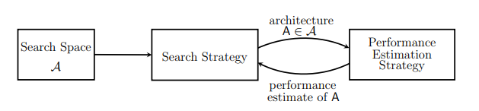
Neural Architecture Search
Process of automating the architecture design part.
Performance should be comparable to state of the art results.
Search strategy should be efficient.
Usability across datasets.

Slide 5
Search Spaces
  Set of architectures which our approach will search through.
  Prior knowledge of some components can reduce our search space, however it has some human bias.
  Common search spaces in recent work : Chain structured , Chain structures with skip connections etc. [1]

Slide 6
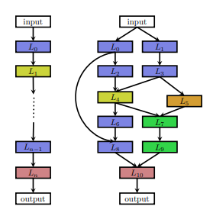
Search Spaces Approach 1 : Macro - Architectures [1]
Chain-structured Neural Network
  Sequence of n layers, where i-th layer receives input from i-1th layer
  Parameters :
    No of layers (n)
    Type of operation every layer execute (e.g – pooling,convolution etc)
    Hyperparameter associated with each operation (e.g – filter size,kernel size etc) *size of this depends on type of operations, hence this is a conditional space

Slide 7
Search Spaces Approach 1 : contd
Multi-branch networks (more general)
  Input of ith layer can be written as function of previous layer inputs i.e, input(L_{i}) = f(L_{i-1}^{out},L_{i-2}^{out},.....L₀^{out})
  Results in more degrees of freedom

Slide 8
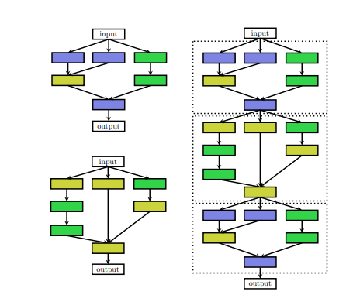
Search Space Approach 2 : Micro- Architectures
Search for cells rather than whole architectures.
Final architectures is stacking these cells in predefined manner.

Slide 9
Advantages of Approach 2
Size of search space is drastically reduced since cells usually consist of significantly less layers.
Architectures built from cells can be easily transferred to other datasets by simply varying no of cells & parameters within cell.
Zoph et al. (2018) transfer cells optimized on CIFAR-10 to ImageNet and achieved state of the art performance,

Slide 10
Approach 2 contd : Design choices
How many no of cells? - Unbounded search space
How they should be connected? - Arbitirary in principle
This leads to the fact if we just optimize cells, we may have to do manual engineering of final architecture part.
Idea – Jointly optimize macro and micro architectures.
  Hierarchical search space : Liu et al. (2018b)

Slide 11
Search Strategy
  Random Search
  Bayesian Optimization
  Evolutionary Methods
  Reinforcement Learning
  Gradient- based methods

Slide 12
Performance Estimation Strategy
Train-Validation Approach : Time consuming
Low fidelity Appproximations approaches
  Training on subset of data
  Training on lower dimensional data (e.g low resolution images)
  Less complicated models
Learning curve extrapolation
Weight Inheritance : warm start by inheriting weights from paraent models
One Shot models : one – shot model trained and weights shared to its all subgraph models

Slide 13
References
Neural Architecture Search: A Survey
https://arxiv.org/pdf/1808.05377.pdf

