Slide 1
National Taipei University of Technology Big Data Mining and Applications, Fall 2019 Final Project: Factors which influence students’ grades
105590051 / Jason King (陳福國) 106AEA002 / Mao Zhi Heng (毛智恒)
Presentation date: Wednesday, January 1, 2020

Slide 2
Dataset
Student Performance by Paulo Cortez, University of Minho, Portugal
Two CSV files representing two subjects (Mathematics, Portuguese – only the Portuguese file is used for this project)
33 attributes
Data of 649 students in two schools

Slide 3
Attributes
30 attributes related to students’ backgrounds
Home location, study habits, lifestyle, …
3 attributes containing the students’ grades from 0 to 20
First, second, third semester

Slide 4
Assumptions
Both schools use the same curriculum and teaching materials
Exams set at the same difficulty level
Students’ habits do not change throughout the year

Slide 5
Data Processing
Grades classified and scaled down from 0-20 to 0-3
Grade (g) classification
17 <= g High pass Scaled score: 3
13 <= g < 17 Medium pass Scaled score: 2
10 <= g < 13 Low pass Scaled score: 1
g <= 10 Failed Scaled score: 0

Slide 6
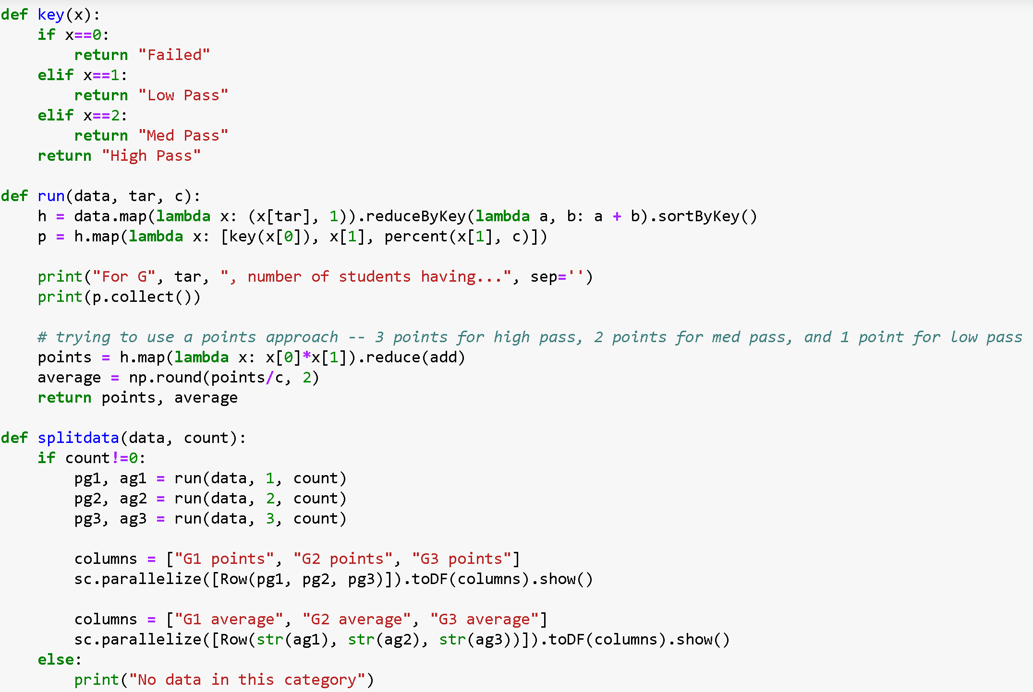

Slide 7
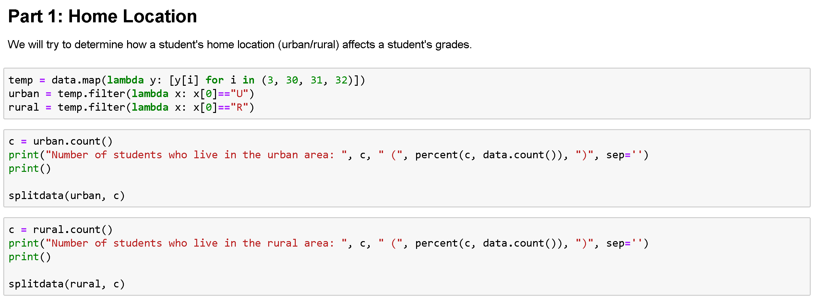
Depends on how the data is grouped

Slide 8
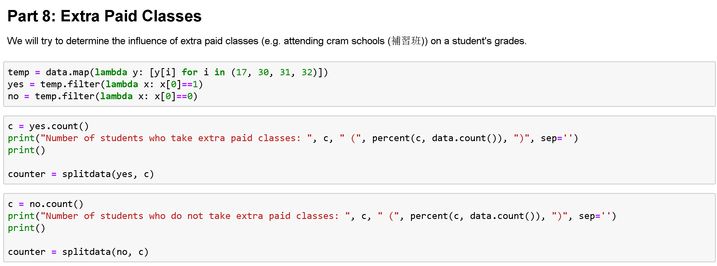
Some results: Boolean Values
“yes” or “no”, “A” or “B”, …

Slide 9
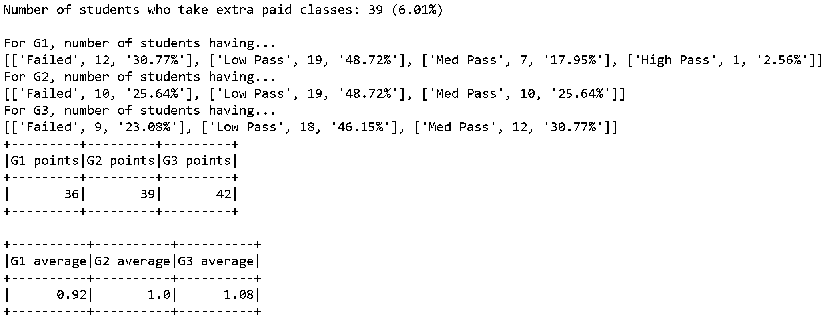
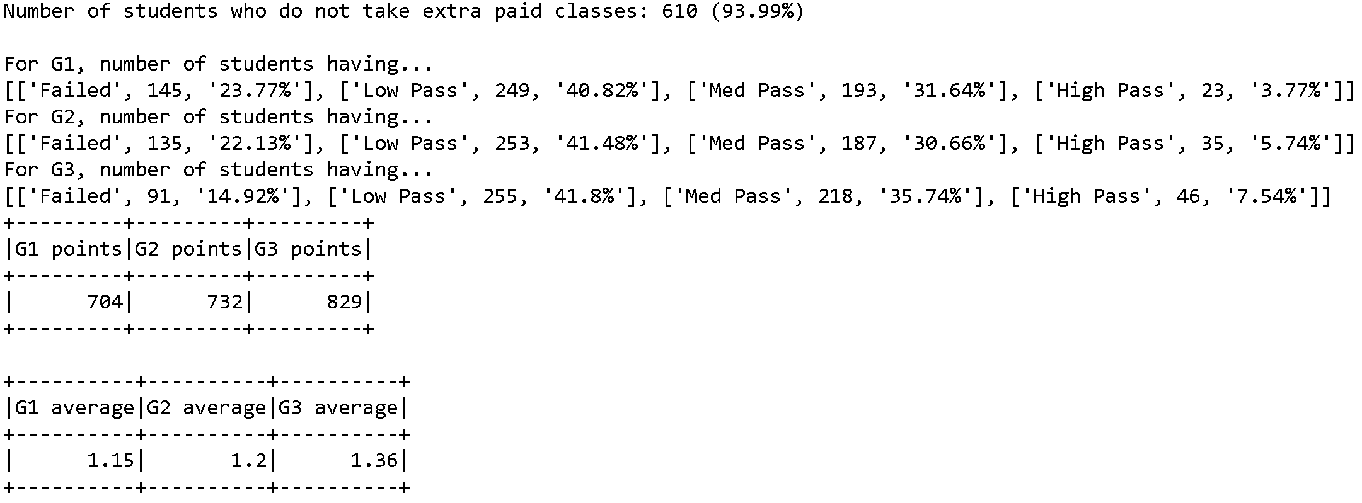

Slide 10
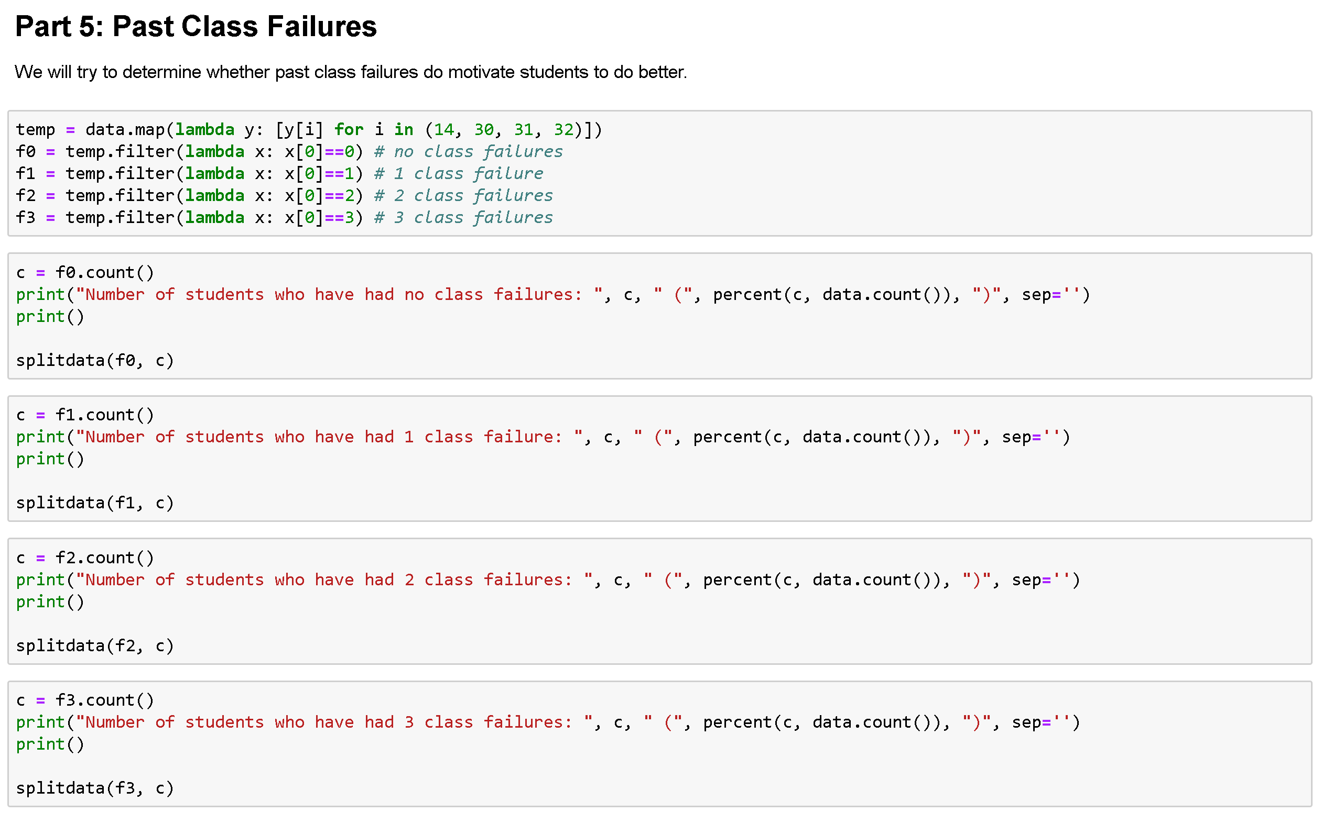
Some results: Numeric values

Slide 11
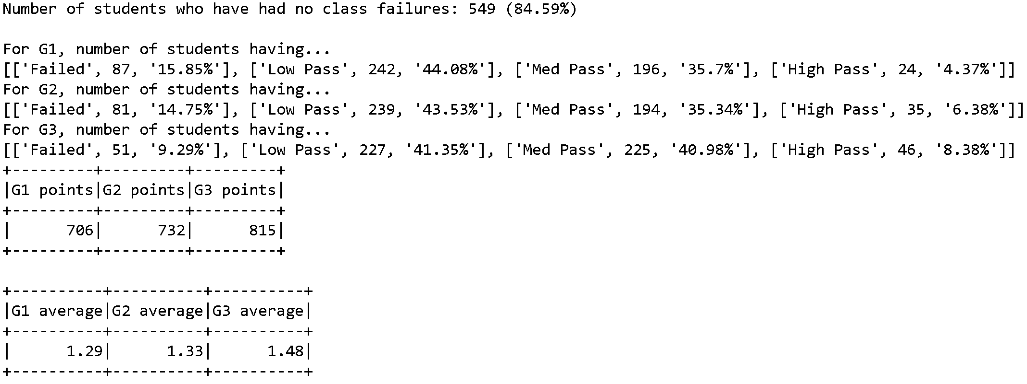
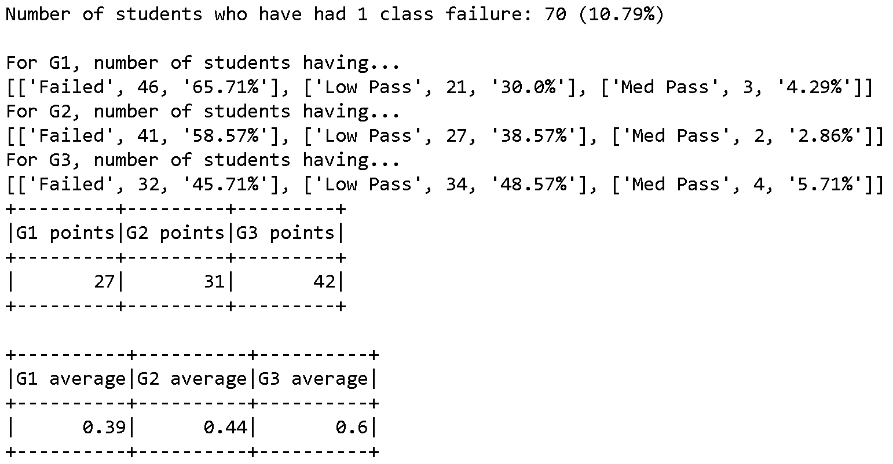
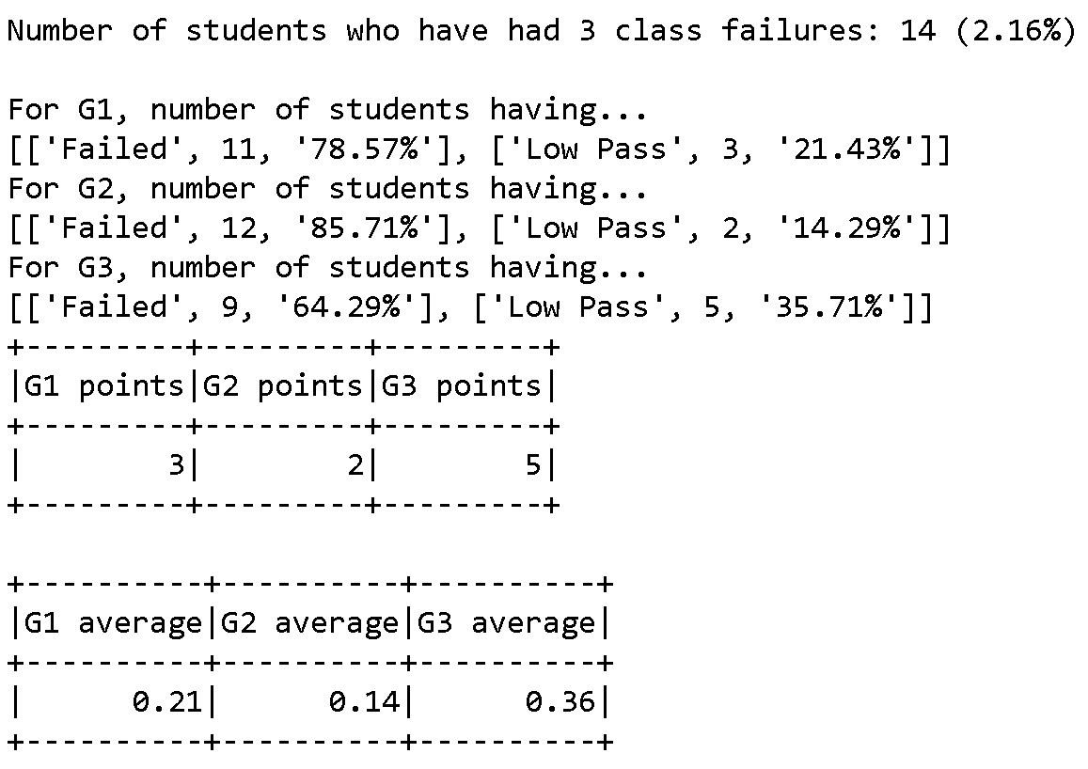
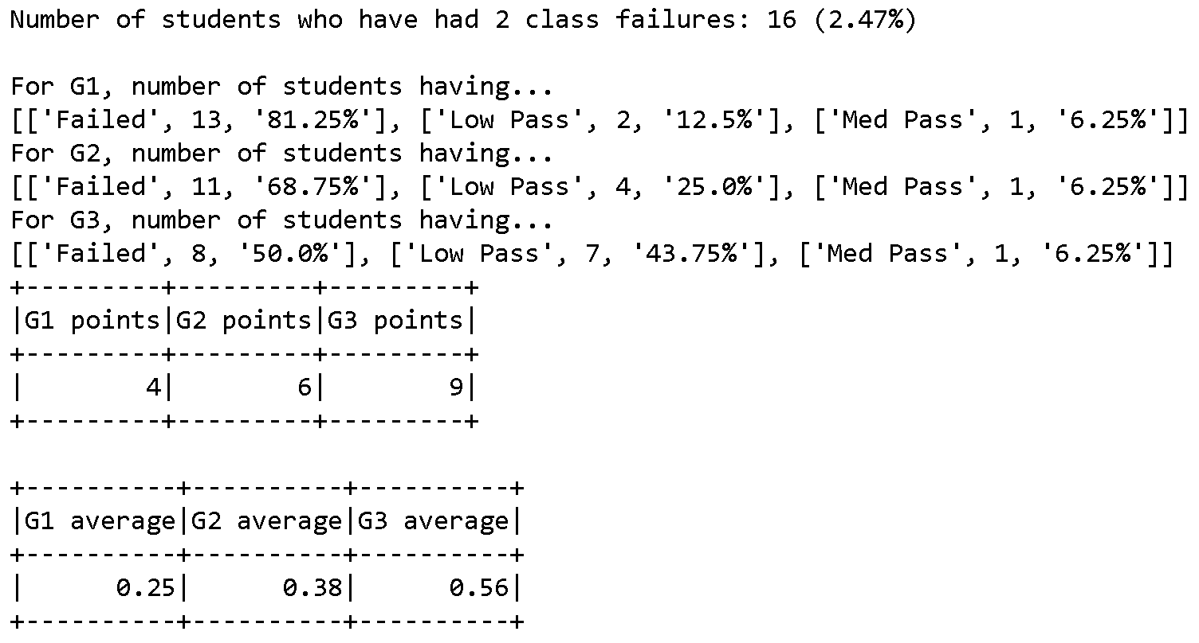

Slide 12
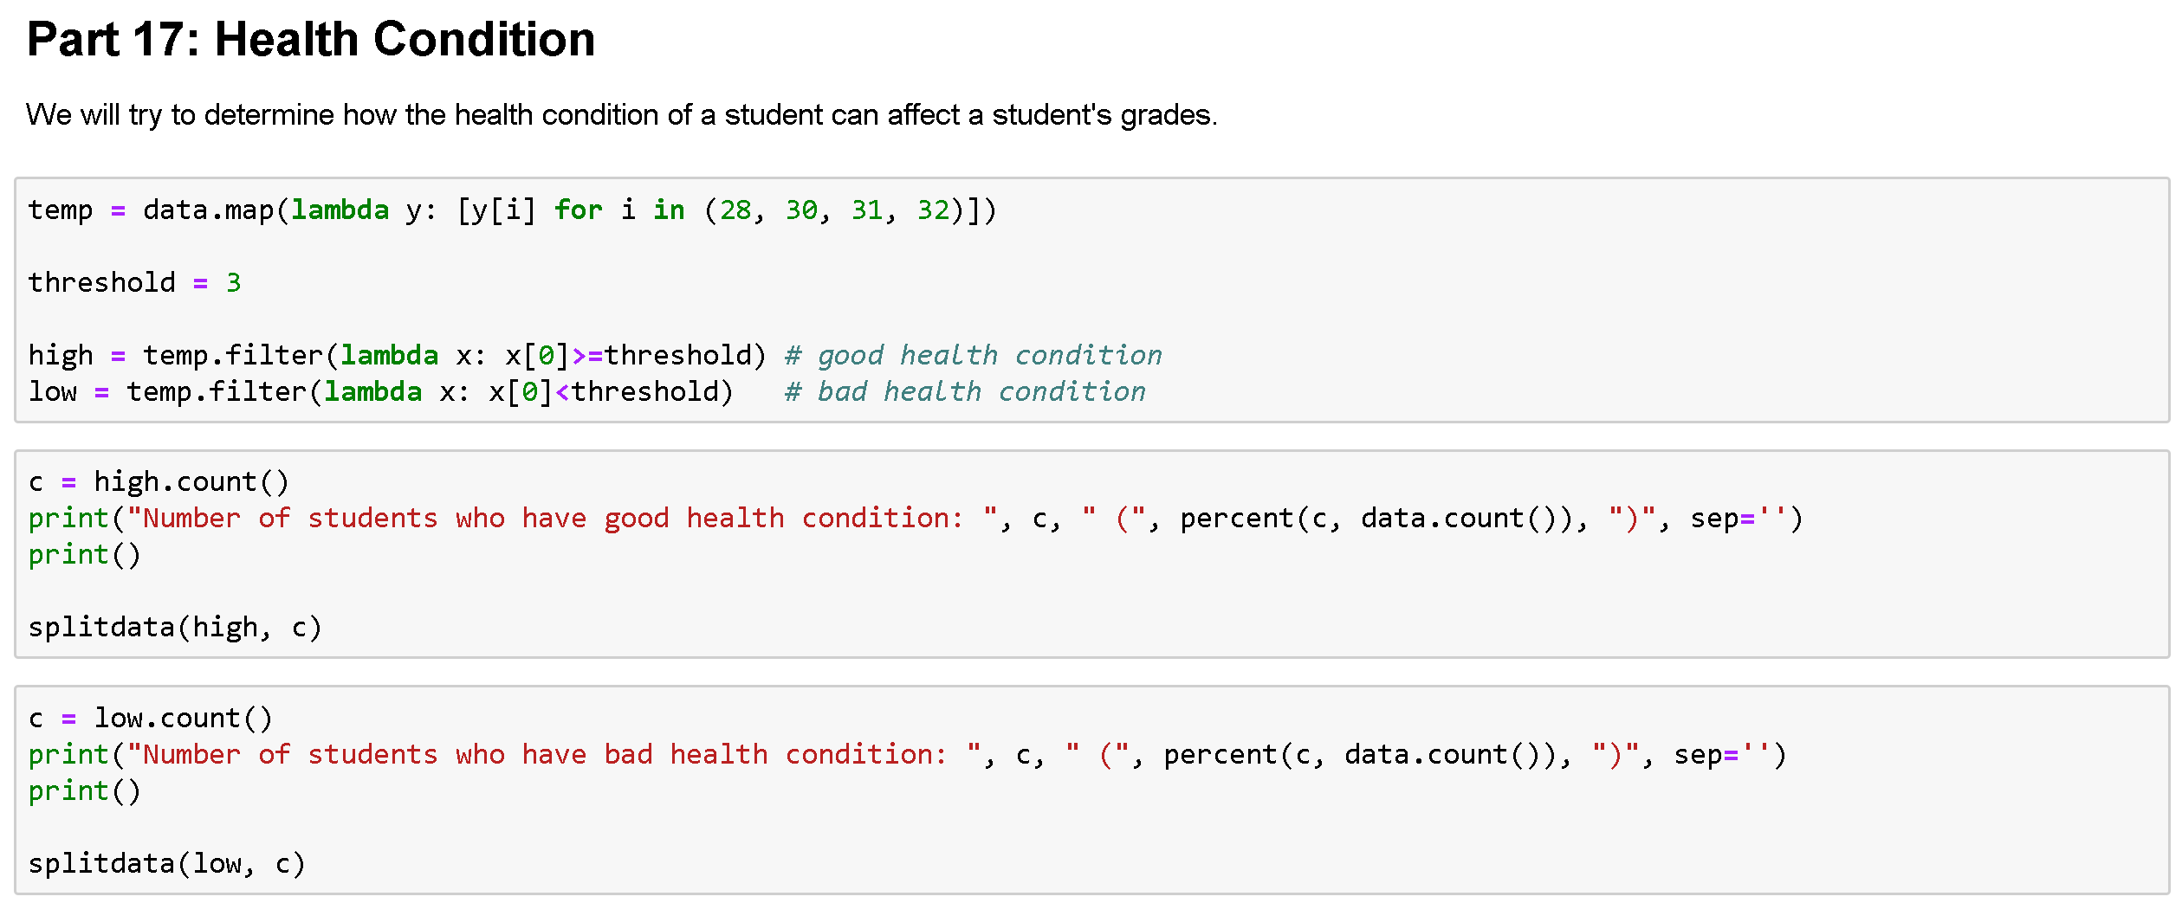
Some results: Using Threshold

Slide 13
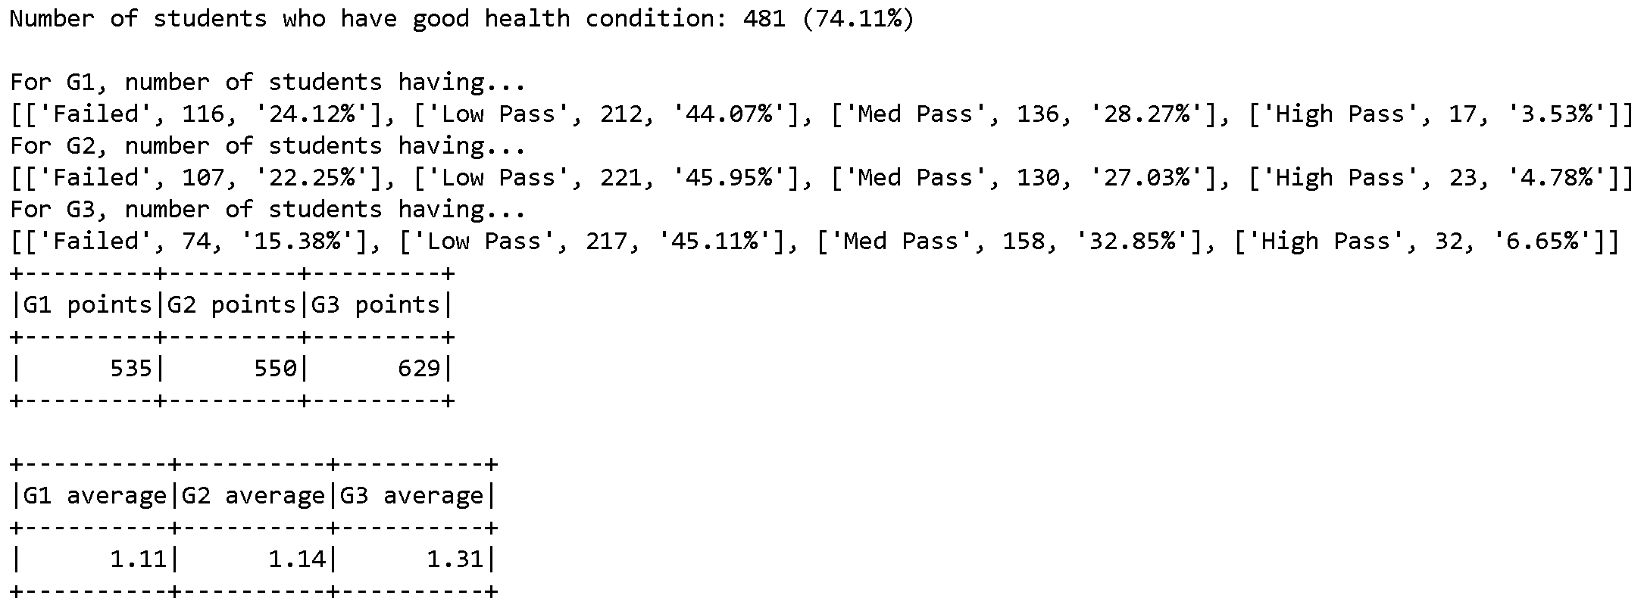
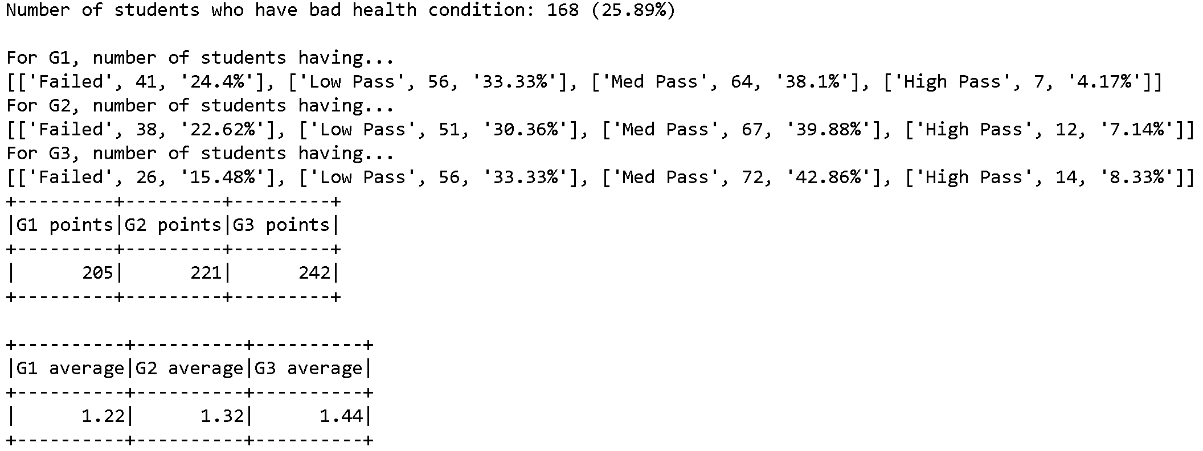

Slide 14
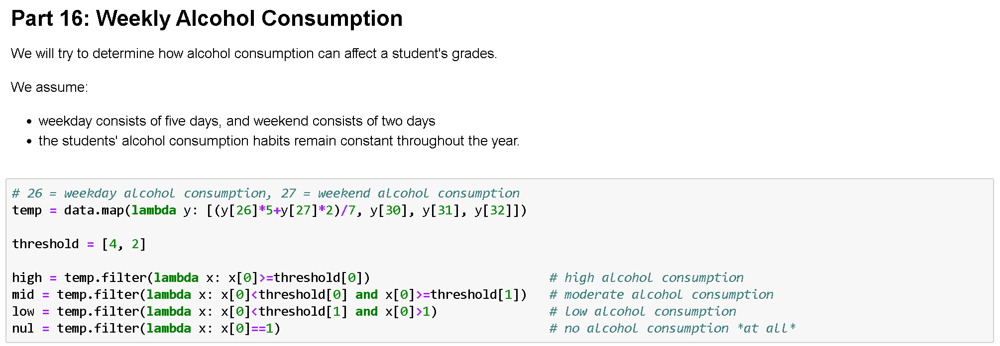
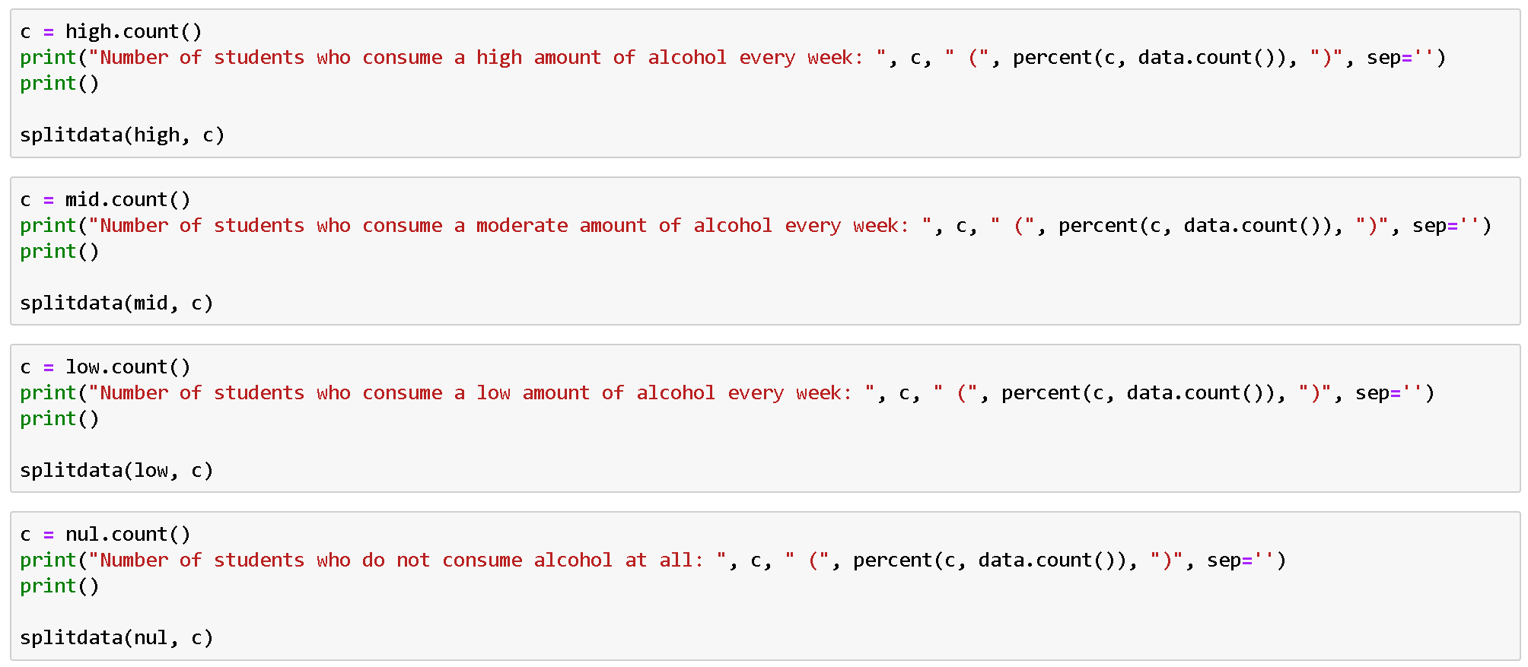
Some results: Multiple Threshold

Slide 15
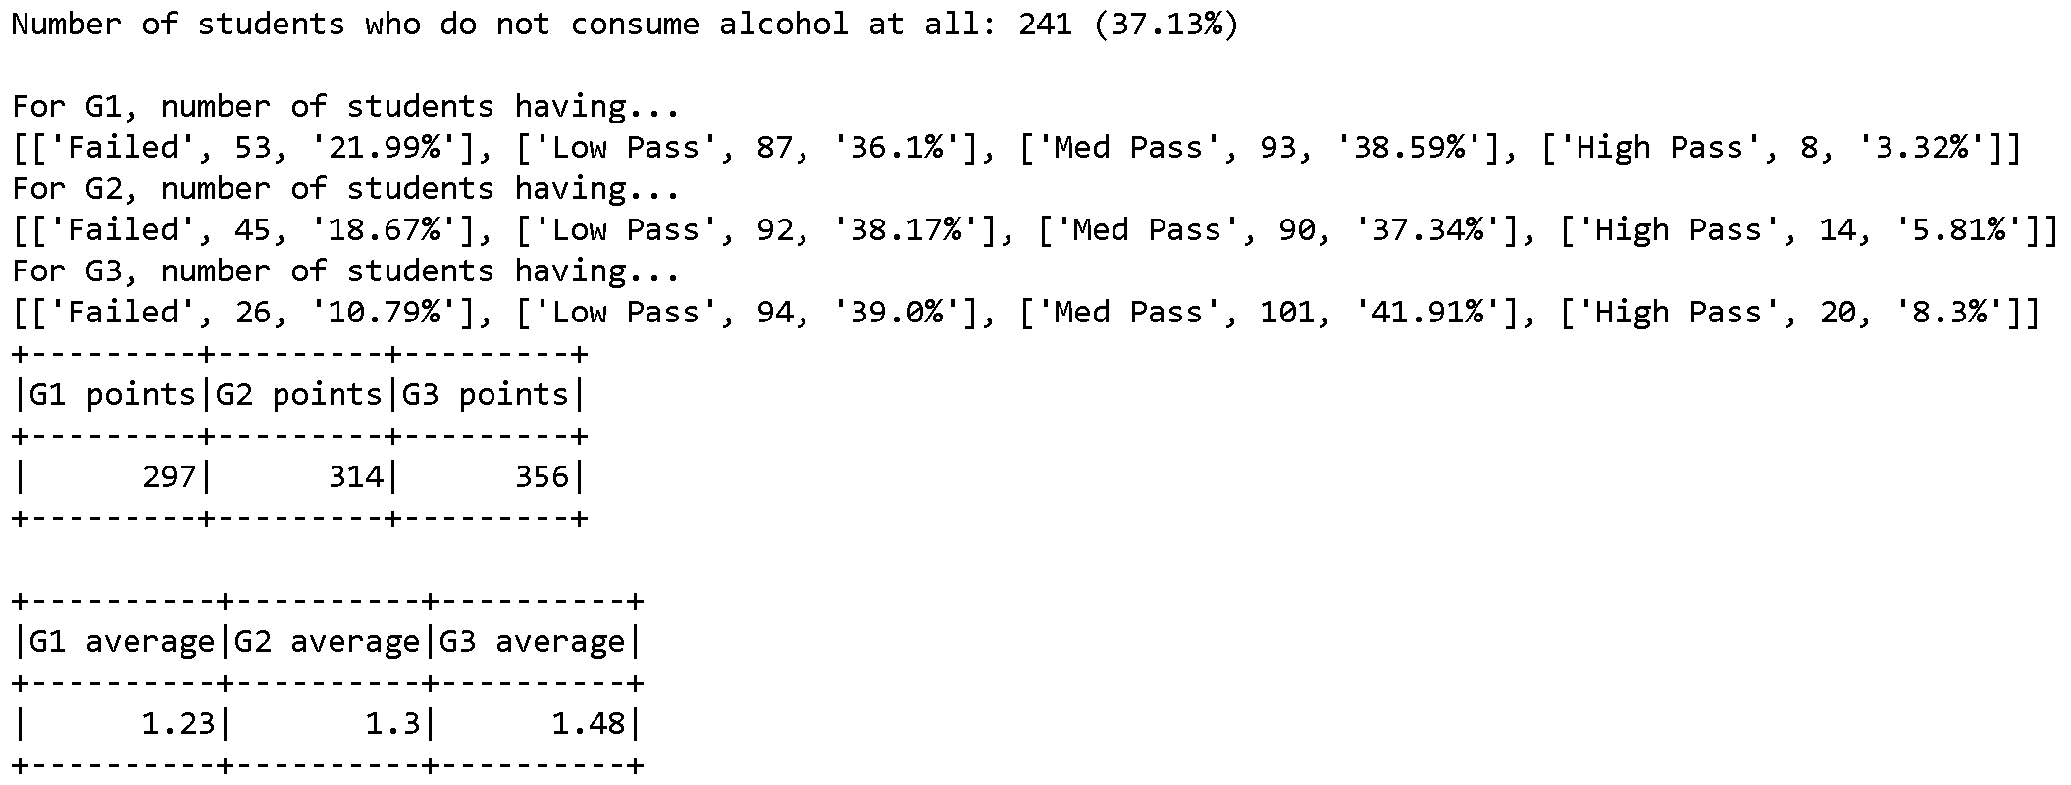
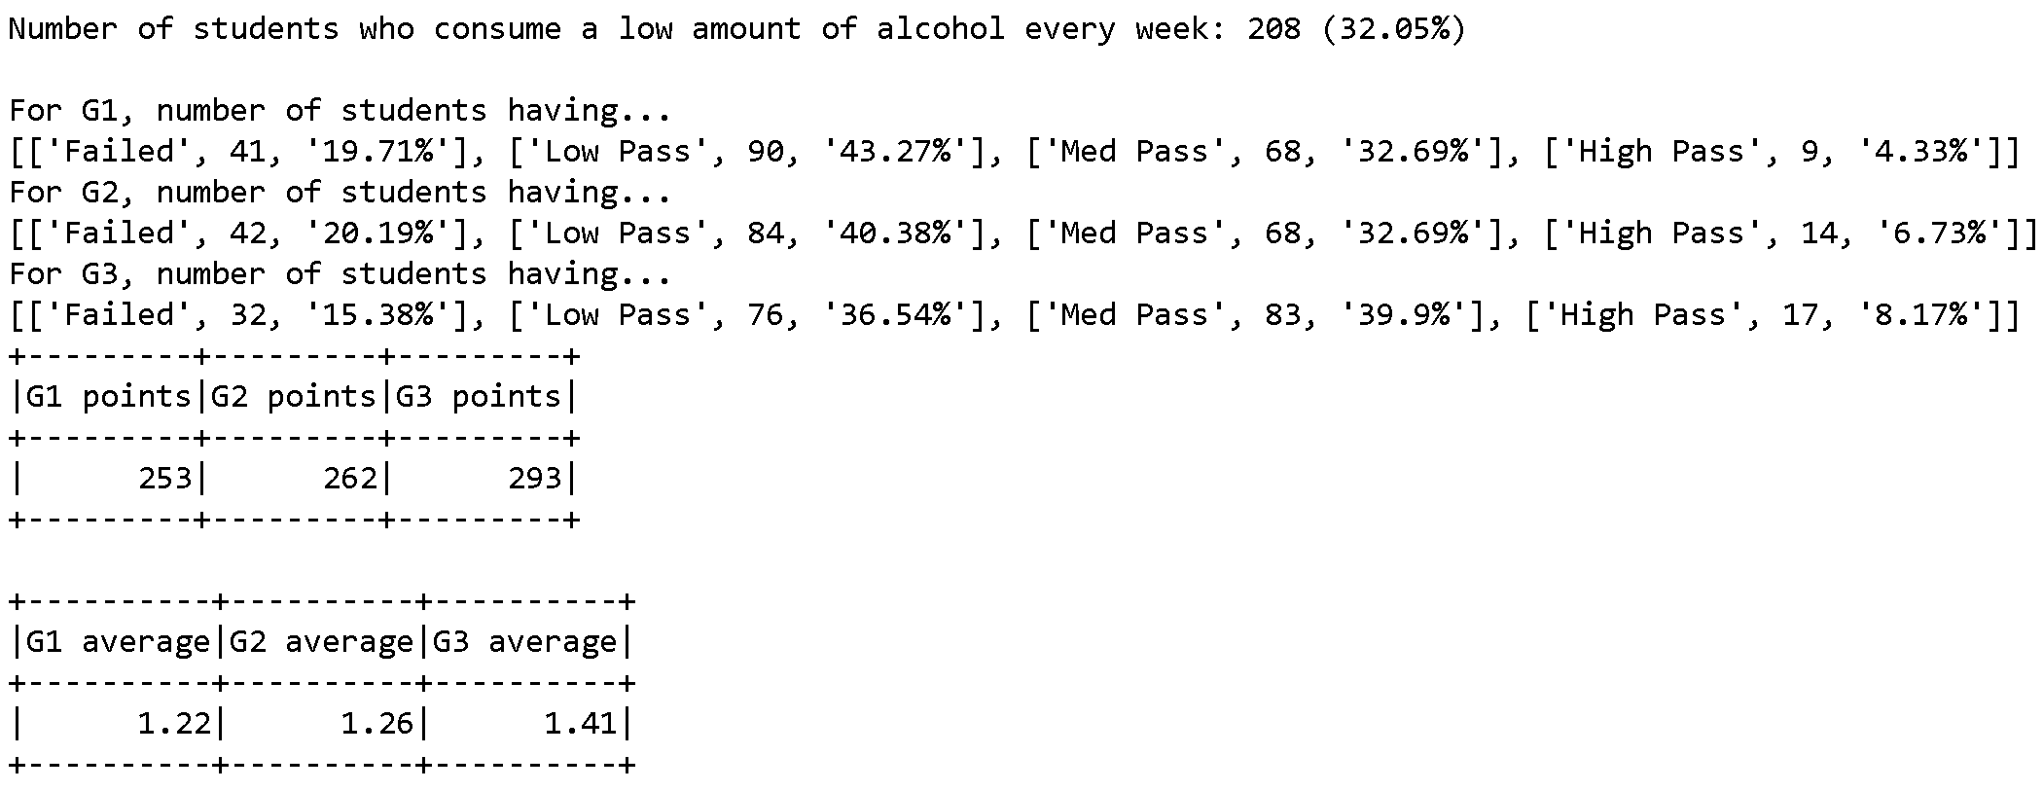
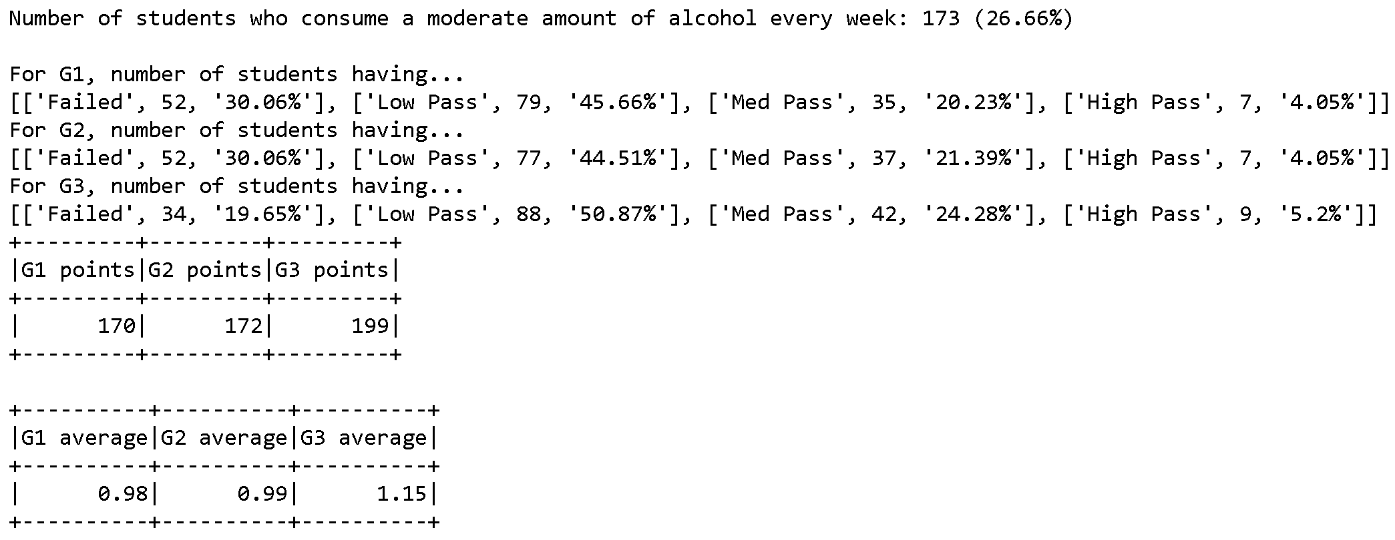
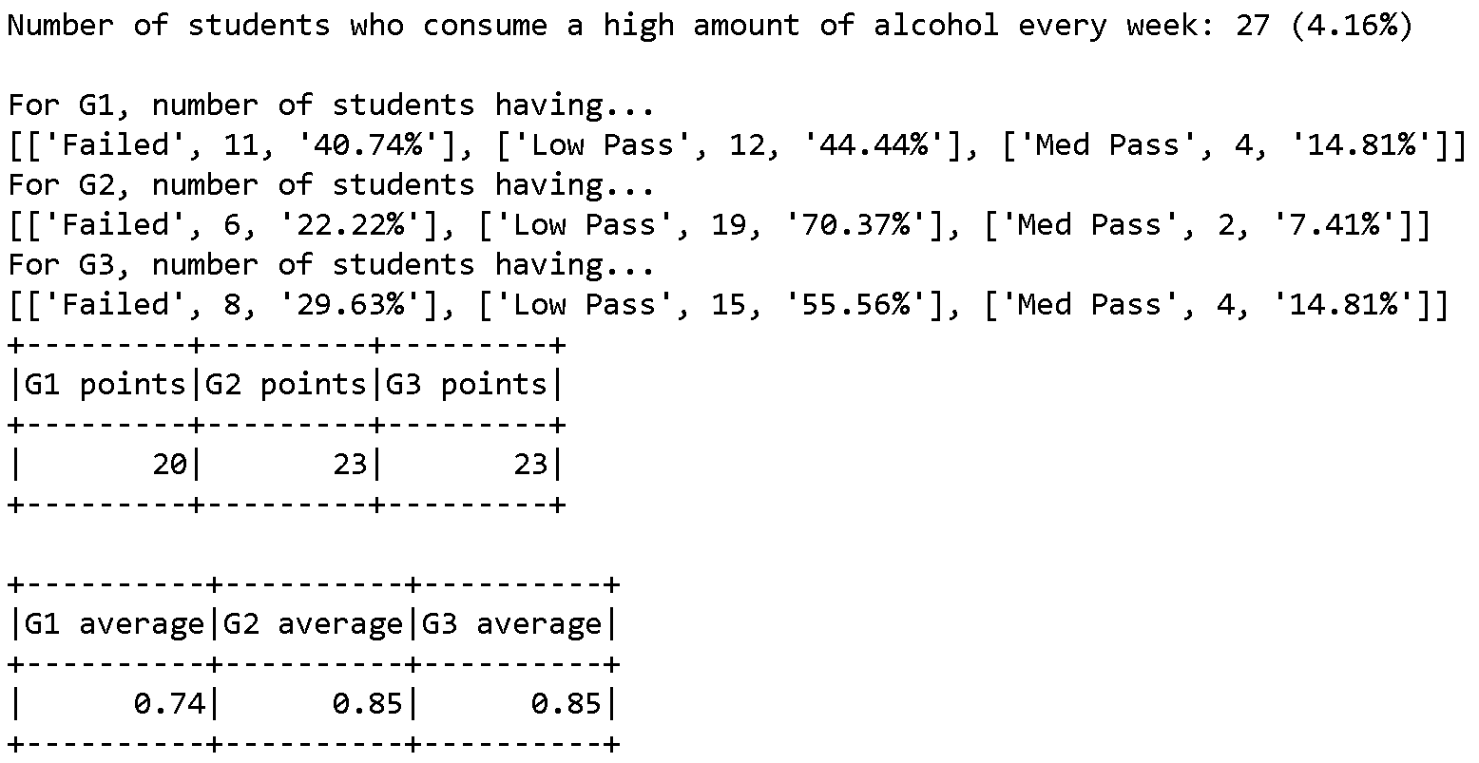

Slide 16
Conclusion and Possible Future Work
We may not be able to describe all 18 results in this presentation due to time constraints
There are many factors which influence a student’s grades
Top-notch condition
Program can be reused
Adaptation to Taiwan’s situation?

Slide 17

Thank you for your attention!
Reference:
Student Performance dataset, accessed from University of California Irvine Machine Learning Repository (https://archive.ics.uci.edu/ml/datasets/Student+Performance)
Full Program Code can be accessed here: https://nbviewer.jupyter.org/github/akjsn/1081_BDMFIN/blob/master/BDM_FINAL/FINAL.ipynb
Course Instructor: Dr. Jenq-Haur Wang (王正豪 老師)
2020

