Slide 1
Expense Tracker with Dashboard
Prepared Presentation
Expense Management Project

Slide 2
Introduction
Expense Tracker helps users record, monitor and analyze expenses.

Slide 3
Problem Statement
• Difficult to track daily spending
• Manual calculations take time
• Limited spending insights

Slide 4
Objectives
• Track income and expenses
• Categorize transactions
• Generate reports
• Dashboard analytics

Slide 5
System Features
• Add/Edit/Delete expenses
• Category management
• Dashboard visualization
• Monthly reports

Slide 6
Technologies Used
Frontend: HTML/CSS/JavaScript
Backend: Python/Node.js
Database: MySQL/MongoDB
Version Control: GitHub

Slide 7
System Architecture
User → Application → Database → Dashboard

Slide 8
Workflow
1. User enters transaction
2. Data stored in database
3. Data processed
4. Dashboard updates

Slide 9
Advantages
• Saves time
• Better planning
• Visual insights
• Easy tracking

Slide 10
Future Enhancements
• AI suggestions
• Budget alerts
• Mobile app
• Cloud synchronization

Slide 11
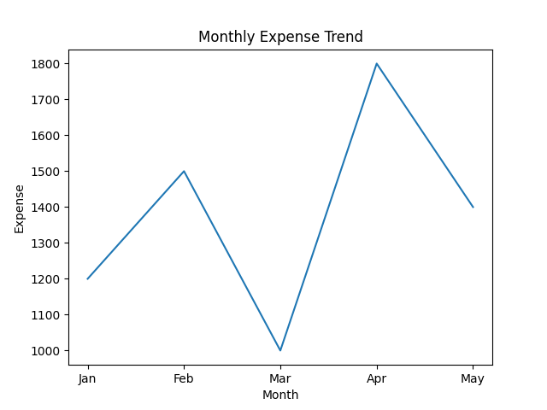
Dashboard Sample
Dashboard chart below

Slide 12
Thank You
Questions & Discussion

