Slide 1
SC
SwiftCourier
DBMS Project · Course 25TU03MJM0
LIVE TRACKING
CR202610010001
Courier Parcel Booking and Tracking Management System
Hyderabad → Chennai · Package
Booked
01 Oct, 08:50 · Hyderabad
Picked Up
01 Oct, 13:00 · Madhapur Hub
A PHP + MySQL web app: customers book parcels, admins update their status, and anyone can follow a parcel live by its tracking ID or by scanning its QR code.
In Transit
04 Oct, 07:30 · Chennai hub
Out for Delivery
05 Oct, 09:10 · Besant Nagar
A Srestadeep
25WU0101001
Abhigyan Gogoi
25WU0101004
Jogi Dhanush
25WU0101053
Delivered
pending
Guide: Dr. Kiran Mayee Adavala · B.Tech CSE, Section CSE Tigers · School of Technology, Woxsen University
Notes:
[Speaker: A Srestadeep · about 20 s]
Good morning. We are A Srestadeep, Abhigyan Gogoi and Jogi Dhanush, and our DBMS project is SwiftCourier, a Courier Parcel Booking and Tracking Management System, guided by Dr. Kiran Mayee Adavala.
The card on the right is a real parcel from our database, CR202610010001, now out for delivery in Chennai. Each line on it is a row in our tracking_history table.
Our talk follows the order we were asked for: problem, ER and schema, database and queries, the UI demo, then questions. The tracker at the top right of every slide shows where we are.

Slide 2




Courier counters still run on paper
Problem
ER & Schema
Database
UI Demo
Q&A
PROBLEM STATEMENT
Small and mid-sized courier operators still book parcels in paper registers and spreadsheets. No one can see a parcel's full journey, charges are worked out by hand, and a customer has to phone the branch to ask where the parcel is.
Paper registers
No visibility
Bookings live in books and spreadsheets, so the same parcel is recorded twice, differently.
A parcel's status lives in phone calls, not in a system a customer can check.
OUR ANSWER
One relational MySQL database behind a PHP web app. Customers book online, staff update status, every change is kept as tracking history, and a QR code on each parcel opens its live status.
Manual billing
No history
Charges are worked out by hand, with no link to the parcel's weight or type.
When a status is overwritten, the earlier steps of the journey are lost.
Notes:
[Speaker: A Srestadeep · about 35 s]
The problem: most small courier counters still run on paper registers or spreadsheets. A parcel's journey is not recorded anywhere a customer can see, charges are calculated by hand, and when a customer asks "where is my parcel?" someone has to phone around.
Four pains: duplicate records, no visibility of status, manual billing, and lost history, because overwriting a status erases the earlier steps.
Our answer is one relational database behind a simple PHP web app. Every booking, payment and status change is stored, and each parcel gets a QR code that opens its live status.

Slide 3








Objectives, scope and intended users
Problem
ER & Schema
Database
UI Demo
Q&A
Objectives
Scope
Intended users
Book a parcel online, with the charge calculated automatically
Give every parcel a unique tracking ID and a QR code
Store every status change as a new history row
Normalise the design to 3NF and enforce it with constraints
Show admins live statistics straight from SQL
IN SCOPE
Customer
registers, books and tracks parcels
Customer accounts and admin roles
Parcel booking and charges
Tracking history and public tracking
QR codes, simulated payments, dashboard
Admin / staff
updates status, location and remarks
Public visitor
tracks by ID or QR scan, no login
OUT OF SCOPE (FUTURE)
Real payment gateway
Live GPS location
SMS and email alerts
Receiver
scans the QR to see delivery status
Manager
reads the live dashboard statistics
Notes:
[Speaker: A Srestadeep · about 25 s]
Five objectives: online booking with an automatic charge, a unique tracking ID and QR code per parcel, a full history of every status change, a design normalised to 3NF, and a dashboard driven by live SQL.
In scope: accounts with customer and admin roles, booking, tracking history, public tracking, QR codes, simulated payments and the dashboard. A real payment gateway, GPS and SMS alerts are future work.
Users: the customer, the admin or staff member who updates the status, anyone tracking a parcel without logging in, the receiver who scans the QR, and the manager reading the dashboard.

Slide 4
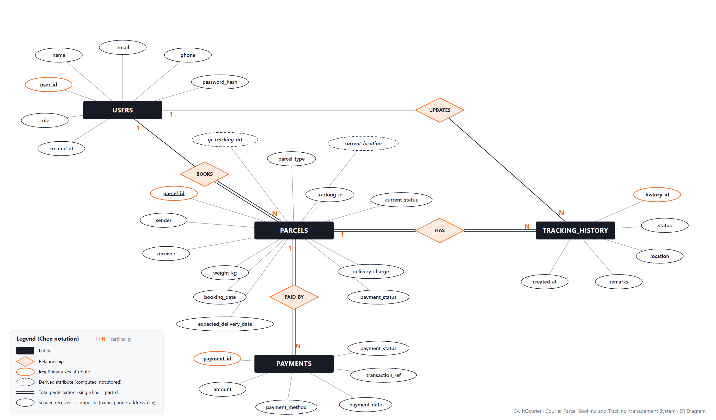
ER diagram: 4 entities, 4 relationships
Problem
ER & Schema
Database
UI Demo
Q&A
4 entities
PARCELS is the hub: users book it, history and payments belong to it
4 relationships
all one-to-many (1 : N)
2 derived attributes
current_location and the QR URL are computed, never stored
2 composite attributes
sender, receiver = name + phone + address + city
Notes:
[Speaker: A Srestadeep · about 50 s]
This is our ER diagram in Chen notation. Rectangles are entities, diamonds are relationships, ovals are attributes, and primary keys are underlined in orange.
PARCELS sits in the middle. A user BOOKS many parcels. Each parcel HAS many tracking-history events, and it is PAID_BY one or more payment records. USERS also UPDATES tracking history: that records which admin made each change.
Dashed ovals are derived attributes: the current location is read from the latest tracking event, and the QR code's URL is built from the tracking ID, so neither is stored. Sender and receiver are composite attributes made of name, phone, address and city.

Slide 5




Cardinality and participation rules
Problem
ER & Schema
Database
UI Demo
Q&A
Relationship | Entities | Cardinality | Participation
BOOKS | USERS – PARCELS | 1 : N | Parcel total
HAS | PARCELS – TRACKING_HISTORY | 1 : N | Both total
UPDATES | USERS – TRACKING_HISTORY | 1 : N | Partial (FK can be NULL)
PAID_BY | PARCELS – PAYMENTS | 1 : N | Both total
Total = NOT NULL foreign key
parcels.customer_id, tracking_history.parcel_id and payments.parcel_id are NOT NULL, so a child row cannot exist without its parent.
HAS is total on both sides
The booking transaction inserts each parcel together with its first 'Booked' history row, so no parcel is ever without history.
Why PAID_BY is 1 : N, not 1 : 1
Every booking creates exactly one payment row today, but the design also allows a retry or a refund row later without changing the schema.
Partial = nullable foreign key
tracking_history.updated_by can be NULL (ON DELETE SET NULL), so history survives if an admin account is removed.
Notes:
[Speaker: Abhigyan Gogoi · about 30 s]
Here are the four relationships. All four are one-to-many.
Total participation becomes a NOT NULL foreign key: a parcel must belong to a customer, and a history or payment row must belong to a parcel. HAS is total on both sides because the booking transaction always inserts the first 'Booked' event with the parcel.
UPDATES is partial: updated_by may be NULL, and if an admin account is deleted the history rows stay, with updated_by set to NULL.
PAID_BY is one-to-many on purpose, so a refund or retry could be recorded later.

Slide 6

Relational schema: 4 tables and 1 view
Problem
ER & Schema
Database
UI Demo
Q&A
users
parcels
tracking_history
payments
PK
user_id
PK
parcel_id
PK
history_id
PK
payment_id
email
tracking_id
parcel_id
→ parcels
parcel_id
UQ
UQ
FK
FK
→ parcels
name, phone, password_hash, role (ENUM), created_at
customer_id
→ users
updated_by
FK
FK
→ users
UQ
transaction_ref
sender_name, sender_phone, sender_address, sender_city
status, location, remarks, created_at
amount, payment_method, payment_status, payment_date
VIEW
receiver_name, receiver_phone, receiver_address, receiver_city
v_parcel_overview
parcels JOIN users, plus the latest location from a subquery
parcel_type, weight_kg, booking_date, expected_delivery_date, delivery_charge, payment_status, current_status, created_at
Surrogate keys + business keys: integer PKs keep joins small and stable; tracking_id, email and transaction_ref are the UNIQUE values people actually see. The QR code is never stored: it is generated from tracking_id.
Notes:
[Speaker: Abhigyan Gogoi · about 25 s]
Mapping the ER diagram gives four tables. Each has a single-column primary key in orange. FK chips show the foreign keys and the table they point to. UQ marks the unique columns: email, tracking_id and transaction_ref.
parcels holds the sender and receiver details because they belong to the parcel: the sender can be someone other than the logged-in customer.
We also created one view, v_parcel_overview, which joins parcels with users and picks the latest location with a subquery.

Slide 7
Normalised step by step to 3NF (and BCNF)
Problem
ER & Schema
Database
UI Demo
Q&A
STARTING POINT: THE PAPER REGISTER
BOOKING( tracking_id, customer_name, customer_email, sender…, receiver…, weight, charge, status_1, location_1, status_2, location_2 …, pay_mode, txn_ref )
1NF
Atomic values, no repeating groups
2NF
No partial dependencies
3NF
No transitive dependencies
status_1, location_1, status_2 … is a repeating group → one row per event in TRACKING_HISTORY.
Every column holds a single value.
Keyed by (tracking_id, event time), the sender, receiver and weight depend on tracking_id alone → they stay in PARCELS; events get their own key, history_id.
customer_id → name, email, phone ⇒ USERS.
transaction_ref → amount, method ⇒ PAYMENTS.
current_location and the QR URL are derived ⇒ computed, not stored.
Result: 4 tables in 3NF, and BCNF because every determinant is a key. current_status and payment_status are kept as summary copies for fast dashboards, updated in the same transaction so they never disagree.
Notes:
[Speaker: Abhigyan Gogoi · about 45 s]
We started from a paper register: one wide row per booking, with the customer's details and repeated status and location columns.
1NF: the status columns are a repeating group, so every movement becomes its own row in TRACKING_HISTORY.
2NF: if events were keyed by tracking ID plus time, the sender, receiver and weight would depend on only part of that key, so they stay in PARCELS and each event gets its own key.
3NF: the customer's name and email depend on the customer, not the parcel, so they move to USERS. Payment details depend on the transaction, so they move to PAYMENTS. The current location and QR URL are derived, so we compute them.
Every determinant is now a candidate key, so the schema is also in BCNF. The one deliberate exception is current_status and payment_status in parcels: summary copies kept for fast dashboard counts, always updated in the same transaction as the history or payment row.

Slide 8
Database creation with full constraints
Problem
ER & Schema
Database
UI Demo
Q&A
courier_management.sql
4
PRIMARY KEY
4
FOREIGN KEY
CREATE TABLE parcels (
parcel_id INT UNSIGNED AUTO_INCREMENT PRIMARY KEY,
tracking_id CHAR(14) NOT NULL,
customer_id INT UNSIGNED NOT NULL,
... -- sender + receiver columns
parcel_type ENUM('Document','Package','Electronics',
'Fragile','Other') NOT NULL,
weight_kg DECIMAL(6,2) NOT NULL,
current_status ENUM('Booked', ... ,'Returned')
NOT NULL DEFAULT 'Booked',
CONSTRAINT uq_parcels_tracking UNIQUE (tracking_id),
CONSTRAINT fk_parcels_customer FOREIGN KEY (customer_id)
REFERENCES users (user_id) ON DELETE RESTRICT,
CONSTRAINT chk_parcels_weight
CHECK (weight_kg > 0 AND weight_kg <= 50)
);
3
CHECK
3
UNIQUE
7
ENUM DOMAINS
1
VIEW
Referential actions
CASCADE: deleting a parcel removes its history and payments.
RESTRICT: a customer who still has parcels cannot be deleted.
SET NULL: removing an admin keeps the history rows.
Notes:
[Speaker: Abhigyan Gogoi · about 30 s, then switch to phpMyAdmin]
LIVE: open http://localhost/phpmyadmin, click Import and import database/courier_management.sql. Then open the courier_management database and show the Structure tab of parcels.
While it runs: this is the parcels table. tracking_id is UNIQUE, customer_id is a foreign key to users, parcel_type and current_status are ENUMs so only valid values are allowed, and a CHECK keeps the weight between 0 and 50 kg.
Across the database we have 4 primary keys, 4 foreign keys, 3 CHECK constraints, 3 UNIQUE constraints, 7 ENUM domains and a view. Deleting a parcel cascades to its history and payments, a customer with parcels cannot be deleted, and deleting an admin sets updated_by to NULL.

Slide 9

Sample data and integrity checks
Problem
ER & Schema
Database
UI Demo
Q&A
RUN LIVE: EACH OF THESE MUST FAIL
Rows inserted per table
Minimum required: 5 per table
ERROR 4025
CHECK
Book a 75 kg parcel (limit is 50 kg)
ERROR 1452
FOREIGN KEY
Book a parcel for customer_id 99, who does not exist
ERROR 1062
UNIQUE
Register customer@courier.com a second time
ERROR 1451
RESTRICT
Delete a customer who still has parcels
ERROR 1265
ENUM (strict mode)
Set a parcel's status to 'Lost'
XAMPP's MariaDB reports a failed CHECK as 4025; MySQL 8 reports the same rule as 3819.
Notes:
[Speaker: Abhigyan Gogoi · about 30 s, live]
LIVE: in phpMyAdmin, run the first queries of database/demo_queries.sql to show the row counts. users has 6 rows, parcels 12, tracking_history 44 and payments 12, so every table has more than 5.
Then run the failing statements one at a time. Each must be rejected with the error shown: 4025 for the weight CHECK, 1452 for the missing customer, 1062 for the duplicate email, 1451 for deleting a customer who still has parcels, and 1265 when a status is not in the ENUM list. The app turns on strict mode for its connection, so invalid ENUM values are refused rather than silently changed.
(If time is short, run just two: the 75 kg parcel and the duplicate email.)

Slide 10
Tracking a parcel is a 3-table join
Problem
ER & Schema
Database
UI Demo
Q&A
RESULT · 5 ROWS
Q9 · TRACK A PARCEL
SELECT th.created_at, th.status, th.location,
th.remarks, u.name AS updated_by
FROM tracking_history th
JOIN parcels p ON p.parcel_id = th.parcel_id
LEFT JOIN users u ON u.user_id = th.updated_by
WHERE p.tracking_id = 'CR202610010001'
ORDER BY th.created_at;
created_at | status | location | updated_by
01 Oct 08:50 | Booked | Hyderabad | Rahul Sharma
01 Oct 13:00 | Picked Up | Madhapur Hub | Admin User
02 Oct 06:00 | In Transit | Hyderabad Sorting | Admin User
04 Oct 07:30 | In Transit | Chennai Sorting | Ops Staff
05 Oct 09:10 | Out for Delivery | Besant Nagar | Ops Staff
Also in the app
The admin dashboard joins parcels with users for Recent bookings. The Customers page uses LEFT JOIN … GROUP BY, so customers with zero bookings still appear.
Hyderabad → Chennai: the same rows the tracking page and the QR scan draw as a timeline. Locations shortened to fit.
Notes:
[Speaker: Abhigyan Gogoi · about 20 s, live]
LIVE: run query 9 from demo_queries.sql.
Tracking a parcel needs three tables: parcels to find the parcel from its tracking ID, tracking_history for its events, and users to show who made each update. users is a LEFT JOIN because updated_by can be NULL.
This parcel was booked in Hyderabad, went through the Hyderabad and Chennai sorting centres, and is now out for delivery in Chennai. The tracking page in our app runs this same query.

Slide 11
Aggregates turn bookings into reports
Problem
ER & Schema
Database
UI Demo
Q&A
BOOKINGS PER CUSTOMER · LEFT JOIN + GROUP BY
Parcels by current status
COUNT(*) with GROUP BY current_status
Rahul Sharma
₹500
5
Priya Nair
₹200
3
Arjun Mehta
₹300
2
Sneha Reddy
₹204
2
THE CHART'S QUERY
SELECT current_status, COUNT(*)
FROM parcels
GROUP BY current_status;
Revenue SUM(amount) WHERE payment_status = 'Paid': ₹780.
HAVING COUNT(*) > 1 lists customers with repeat bookings.
Notes:
[Speaker: Abhigyan Gogoi · about 20 s, live]
LIVE: run queries 3 and 5, then open the admin dashboard's "SQL queries powering this dashboard" panel.
Aggregates turn rows into reports. The chart is a COUNT with GROUP BY on current_status: three delivered, two each booked, picked up and in transit, and one each out for delivery, failed and returned.
On the right, a LEFT JOIN from users to parcels with GROUP BY gives each customer's bookings and total charges. Rahul Sharma has booked five parcels. Revenue is a SUM over paid payments, 780 rupees, and HAVING filters customers with more than one booking.

Slide 12





A web UI wired straight to MySQL
Problem
ER & Schema
Database
UI Demo
Q&A
Browser
PHP 8 on Apache
MySQLi
MySQL / MariaDB
HTML, CSS, Bootstrap, JS
XAMPP · 14 pages
prepared statements, transactions
courier_management · 4 tables
Track (public)
VIEW
Register / Login
INSERT · VIEW
Book Parcel
INSERT × 3
timeline from tracking_history, no login
password_hash, sessions, roles
parcel + history + payment, one transaction
My Parcels
VIEW
Admin Dashboard
VIEW
Admin Parcel
UPDATE · DELETE
search and status filter (LIKE, WHERE)
COUNT, SUM, GROUP BY, JOIN
status change + new history row, cascade delete
Every number is live SQL: the admin dashboard has a panel that shows the exact queries behind its cards.
Notes:
[Speaker: Jogi Dhanush · about 25 s]
The UI is a PHP web app running on Apache in XAMPP. It talks to the courier_management database through MySQLi with prepared statements, so user input never becomes part of the SQL text, and it uses transactions wherever more than one table changes.
The main screens: public tracking, registration and login with hashed passwords, booking, the customer's parcel list, the admin dashboard and the admin parcel page.
Every number on the admin dashboard comes from a live query, and the dashboard shows those queries in a panel at the bottom.
LIVE: start Apache and MySQL in XAMPP and open http://localhost/courier/.

Slide 13
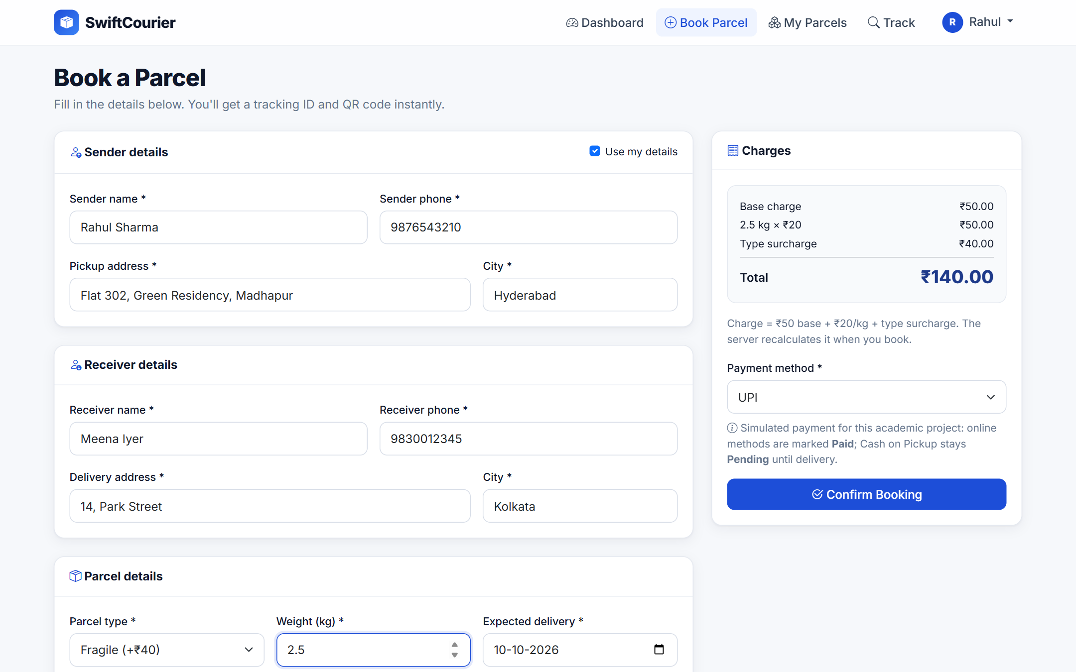
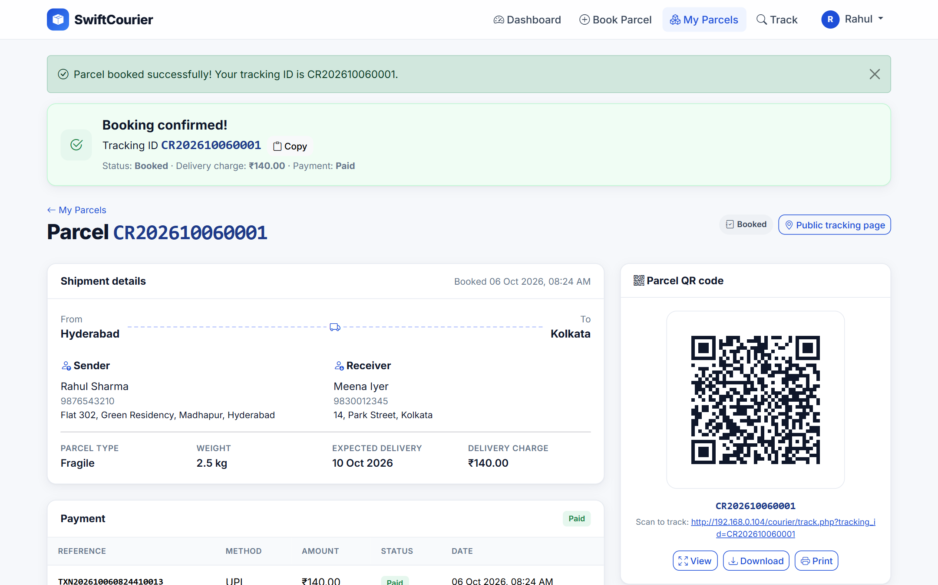
Insert: one booking writes 3 tables
Problem
ER & Schema
Database
UI Demo
Q&A
1 Customer fills the booking form
2 Booked: tracking ID, charge and QR
parcels
12 → 13
INSERT
tracking_history
44 → 45
'Booked' row, same transaction
payments
12 → 13
INSERT, same transaction
Notes:
[Speaker: Jogi Dhanush · about 60 s, live]
LIVE: log in as customer@courier.com / customer123 and open Book a Parcel. Tick "Use my details", enter a pickup address in Hyderabad, receiver Meena Iyer in Kolkata, Fragile, 2.5 kg, UPI, and click Confirm Booking.
The charge is 50 base plus 20 per kg times 2.5, plus 40 for Fragile: 140 rupees. The browser shows a preview, but the server recalculates it.
In one transaction the app inserts the parcel, its first 'Booked' tracking row and a payment row, and generates the tracking ID: CR, today's date and a 4-digit sequence. If any insert fails, all three are rolled back.
In phpMyAdmin, run SELECT COUNT(*) on the three tables: parcels 12 to 13, tracking_history 44 to 45, payments 12 to 13.

Slide 14
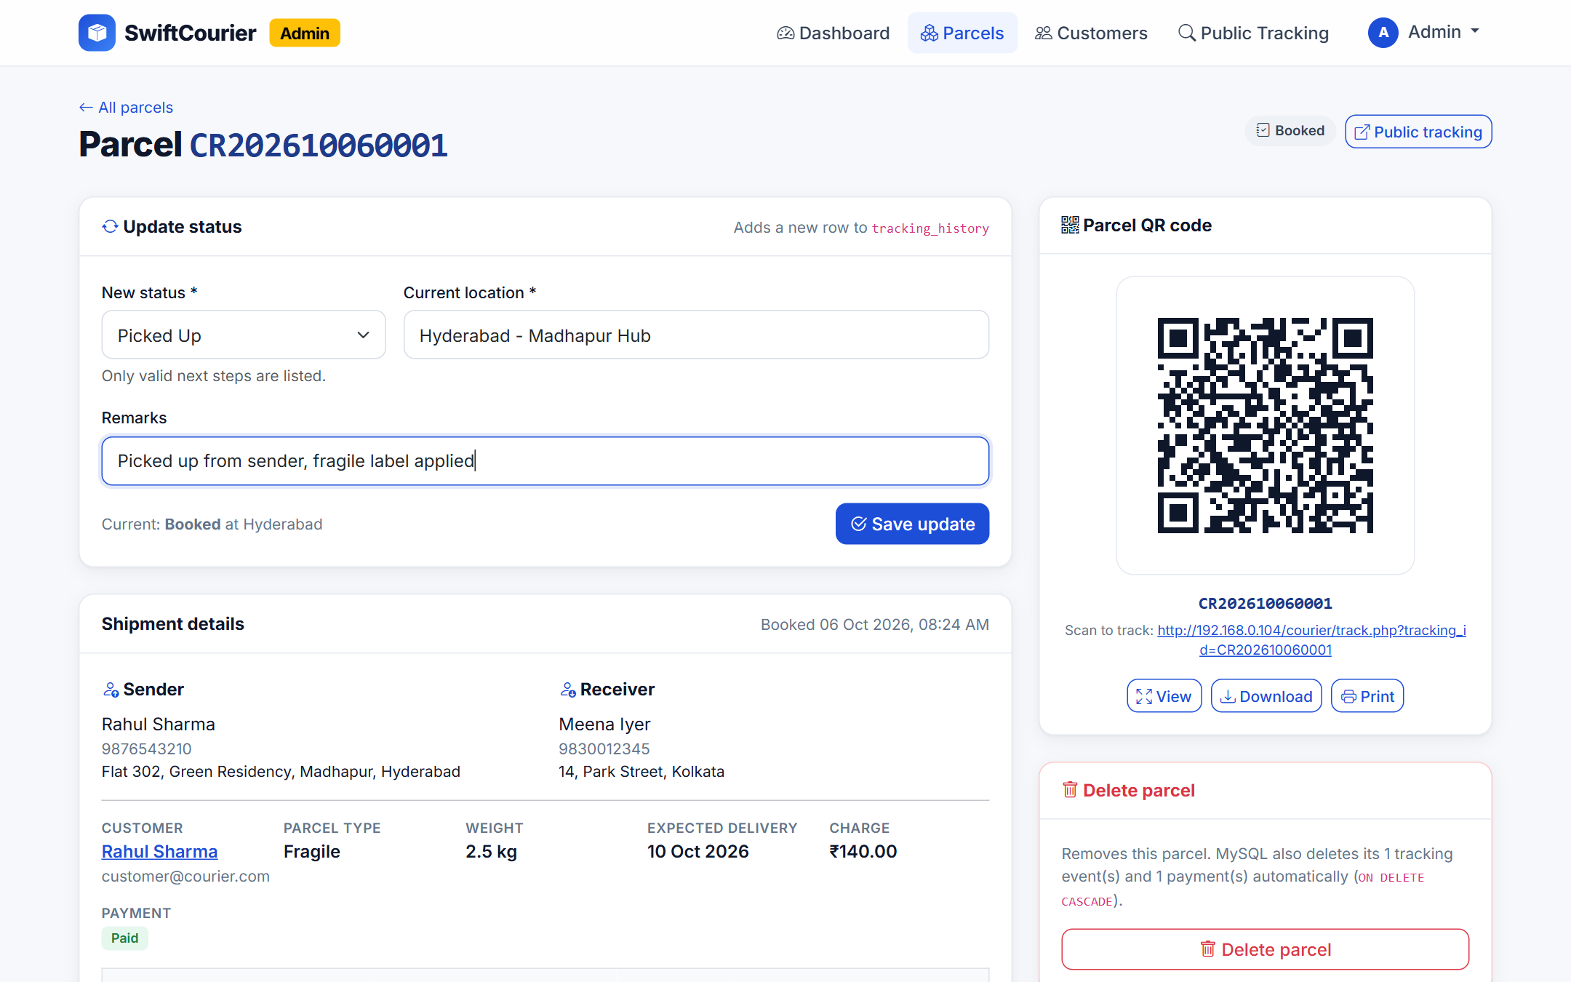
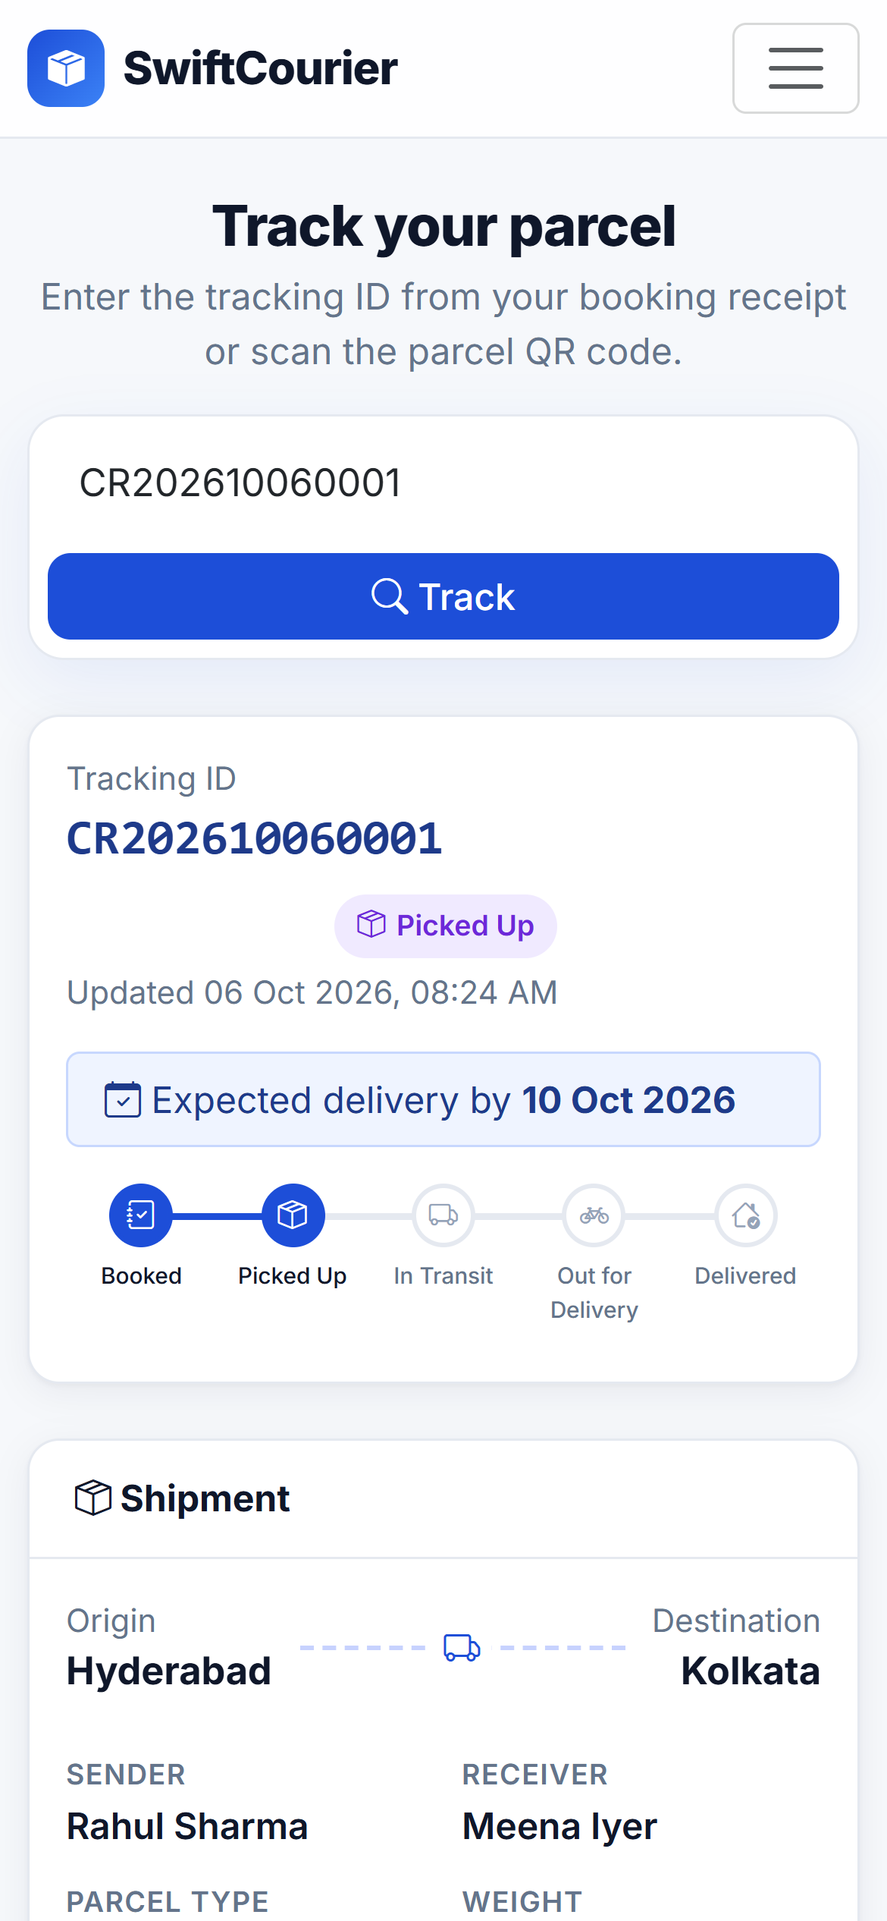
Update: every status change is a new row
Problem
ER & Schema
Database
UI Demo
Q&A
1 Admin sets Picked Up at Madhapur Hub
2 Phone scans the QR
ONE TRANSACTION
START TRANSACTION;
UPDATE parcels
SET current_status
= 'Picked Up';
INSERT INTO
tracking_history
VALUES (…);
COMMIT;
parcels
Booked → Picked Up
UPDATE current_status
tracking_history
45 → 46
INSERT, old rows kept
QR scan
live status
opens track.php on the phone
Notes:
[Speaker: Jogi Dhanush · about 60 s, live]
LIVE (1): log out, log in as admin@courier.com / admin123. The new parcel is at the top of Recent bookings. Click Manage, choose Picked Up, enter "Hyderabad - Madhapur Hub" and a remark, and click Save update.
In one transaction the app updates current_status in parcels and inserts a new row into tracking_history. The old rows are never overwritten, so the whole journey is kept. Only valid next steps are offered: a Booked parcel cannot jump straight to Delivered.
LIVE (2): scan the QR code on the parcel page with a phone on the same Wi-Fi. It opens track.php, which reads MySQL and shows Picked Up with the full timeline.
In phpMyAdmin, run query 9 (tracking history for one parcel) with the new tracking ID to show both rows.

Slide 15
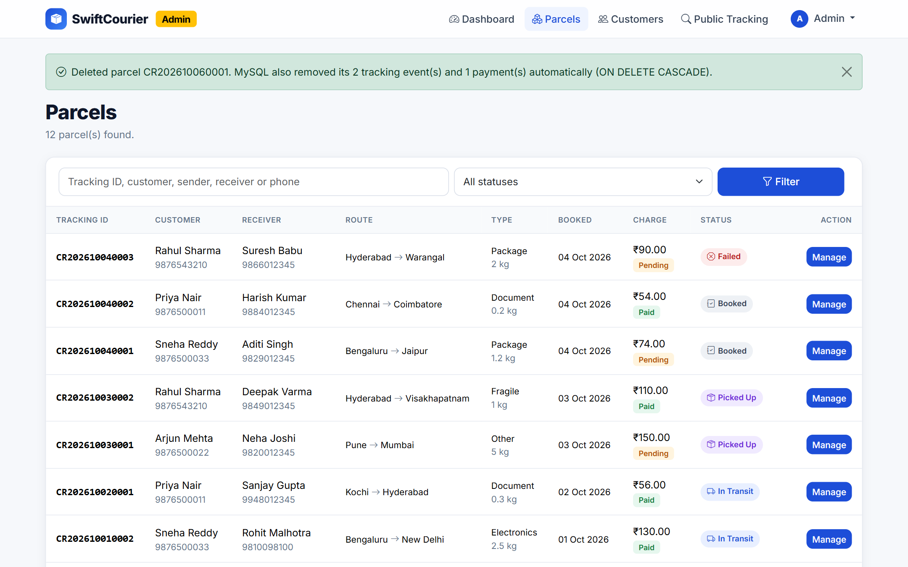
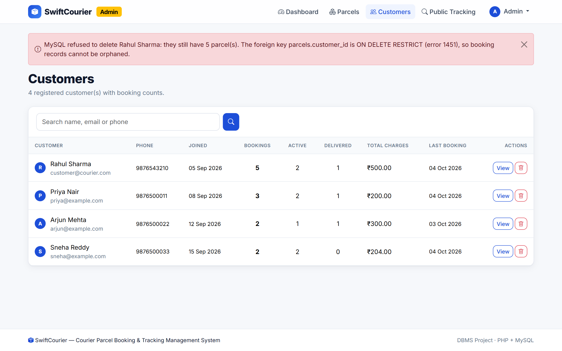


Delete: cascades or refuses, by design
Problem
ER & Schema
Database
UI Demo
Q&A
DELETE parcel CR202610060001
DELETE customer Rahul Sharma
CASCADE: its 2 tracking events and 1 payment go too. parcels 13 → 12, tracking_history 46 → 44
RESTRICT: MySQL error 1451, because this customer still has 5 parcels
Notes:
[Speaker: Jogi Dhanush · about 45 s, live]
LIVE (1): on the admin parcel page of the parcel we just booked, click Delete parcel and confirm. The app runs one statement, DELETE FROM parcels WHERE parcel_id = ?. Because tracking_history and payments reference parcels with ON DELETE CASCADE, MySQL removes the parcel's tracking events and payment by itself. The message shows how many rows went.
LIVE (2): on Customers, register a throwaway customer first and delete them: that works because they have no parcels. Then try to delete Rahul Sharma. MySQL refuses with error 1451 because parcels.customer_id is ON DELETE RESTRICT, so booking records can never be orphaned. The app explains the refusal instead of hiding it.
To finish, run SELECT COUNT(*) on parcels, tracking_history and payments in phpMyAdmin to show the counts dropped back.

Slide 16




Problem
ER & Schema
Database
UI Demo
Q&A
Delivered.
NEXT STOP: FUTURE SCOPE
Thank you. Questions?
SMS and email alerts
at every status change
4-table schema in 3NF and BCNF, with 4 FKs, 3 CHECKs and 7 ENUMs
Real payment gateway
UPI and cards instead of simulation
Transactions keep parcels, history and payments in step
Live GPS tracking
the delivery agent's location on a map
13 demo queries: JOIN, LEFT JOIN, GROUP BY, HAVING, a view
Working PHP app: insert, update, delete, view, and QR tracking on a phone
Proof of delivery
photo and OTP in an agent app
GitHub: github.com/akkalasrestadeepgoud333-code/DBMS-Course-Project
Notes:
[All members · about 2 min Q&A]
To sum up: a normalised 4-table database with real constraints, transactions that keep the tables consistent, tested queries, and a working PHP app with QR tracking.
Next steps would be SMS alerts, a real payment gateway, live GPS and proof of delivery.
Thank you. We're happy to take questions.
Likely questions and short answers:
• Which normal form? 3NF, and also BCNF: every determinant (user_id, email, parcel_id, tracking_id, history_id, payment_id, transaction_ref) is a candidate key.
• Isn't current_status redundant? Yes, on purpose. It equals the latest tracking_history row. We keep it for fast GROUP BY counts and update it in the same transaction as the history insert, so the two can never disagree.
• Why is the history never overwritten? Each status change is an INSERT, so the full journey is kept as an audit trail.
• How is the tracking ID unique? CR + date + a 4-digit sequence, generated inside the booking transaction with SELECT … FOR UPDATE; the UNIQUE constraint is the final guarantee.
• How do you stop SQL injection? Every query uses MySQLi prepared statements with bound parameters.
• How are passwords stored? As bcrypt hashes from password_hash(), checked with password_verify().
• How does the QR work? It encodes the URL track.php?tracking_id=…; scanning it opens the public page, which reads MySQL live.

